Slide 1
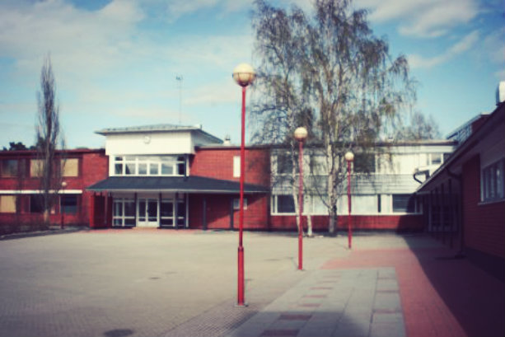
Alajärvi High school

Slide 2


Common
- Alajärvi Upper Secondary School is the biggest school in Järviseutu,the lake district.
-In the middle of the town by a lake.
Part of a larger student campus.
-Large selection of possibilities all under one roof
-Alajärvi Upper Secondary School is a general upper secondary.
school which offers the student an individual study route according to
his own wishes and needs.

Slide 3
- you can choose for example the mathematical route (physics, chemistry, biology geography)
- the language route (English, Swedish, German, Russian, French, Spanish)
- the route of visual arts, music and physical and health education
- the social studies route (religion, philosophy, psychology, history)
- the commercial subjects route
- the entrepreneur route
- the media route (mother tongue, computer science and visual arts)
- offers individual flexibility in regard to
o place of study
o time of study (winters, summers, days, nights, freetime)
o manner of studying (standard lessons, small groups, virtual studies)
o modern technology

Slide 4
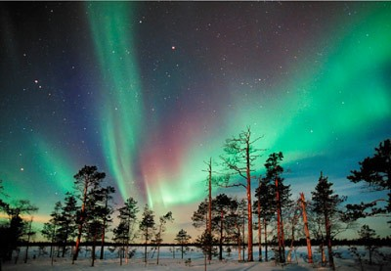
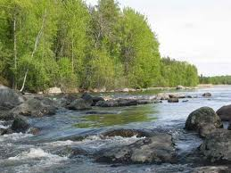
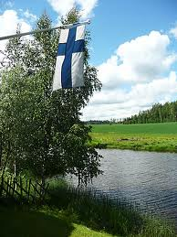

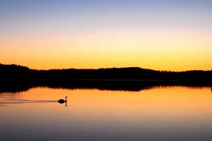
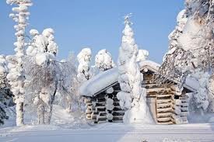
Thanks for watching ! ☺<3

