Slide 1
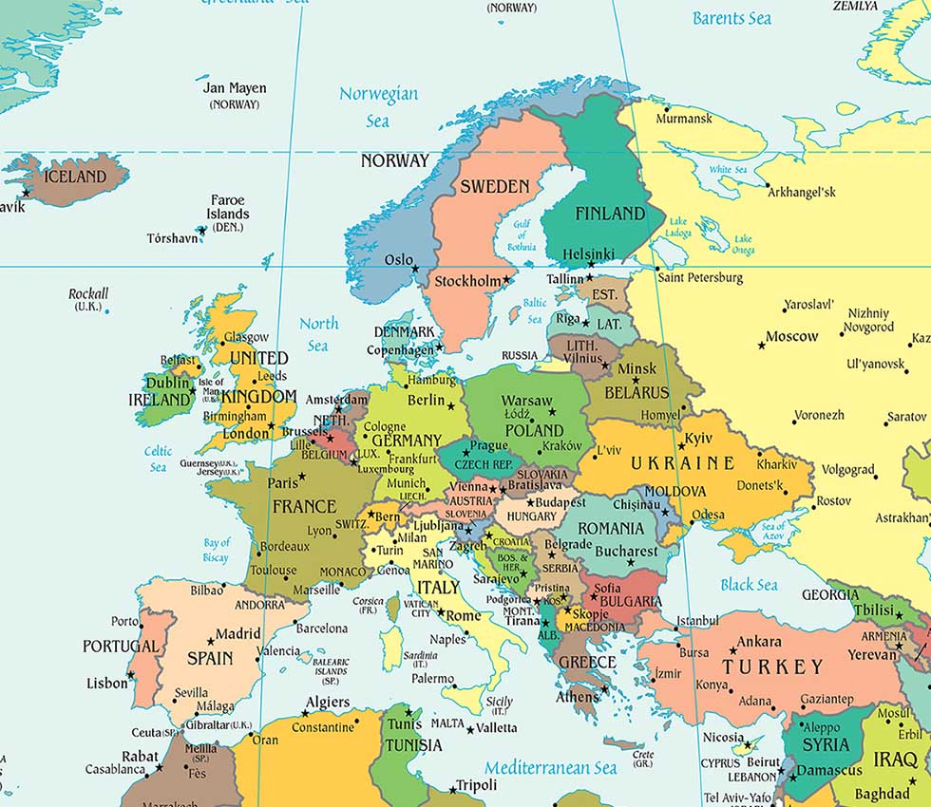
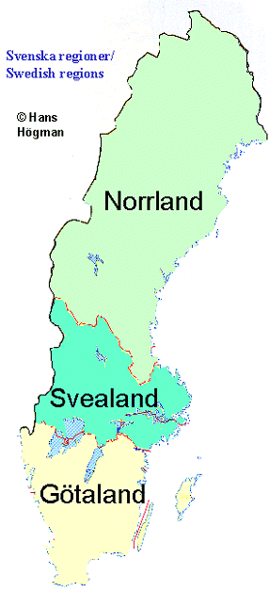
SWEDEN
QUICK FACTS
Official name | Konungariket Sverige (Kingdom of Sweden)
Form of government | Unitary Parliamentary Constitutional Mocharchy
King | Carl XVI Gustaf
Head of government | Prime Minister: Stefan Löfven
Capital city | Stockholm
Official language | Swedish
Monetary unit | Swedish Krona (SKE)
Population | (2016 est) 9.858.794
Surface | 450.295 km2

Slide 2
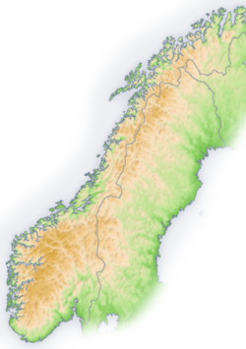
Sweden is, in its majority, a plain country, with the exception of the Scandinavian Alps, the highest point in Sweden is located in mountain of Kebnekaise , with 2.111 meters above the sea level.

Slide 3
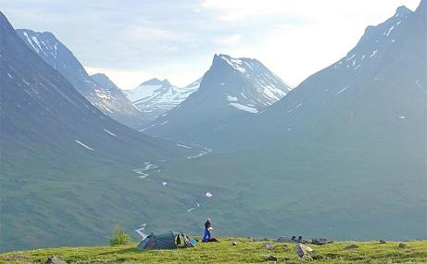
To the west of Sweden there is the Scandinavian mountain chain, Skanderna, which separates Sweden from Norway.
Its border with Norway (1,619 km long) is the longest uninterrupted border within Europe.

Slide 4
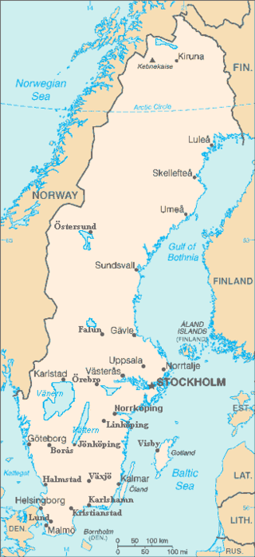
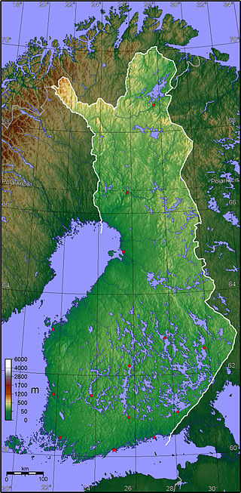
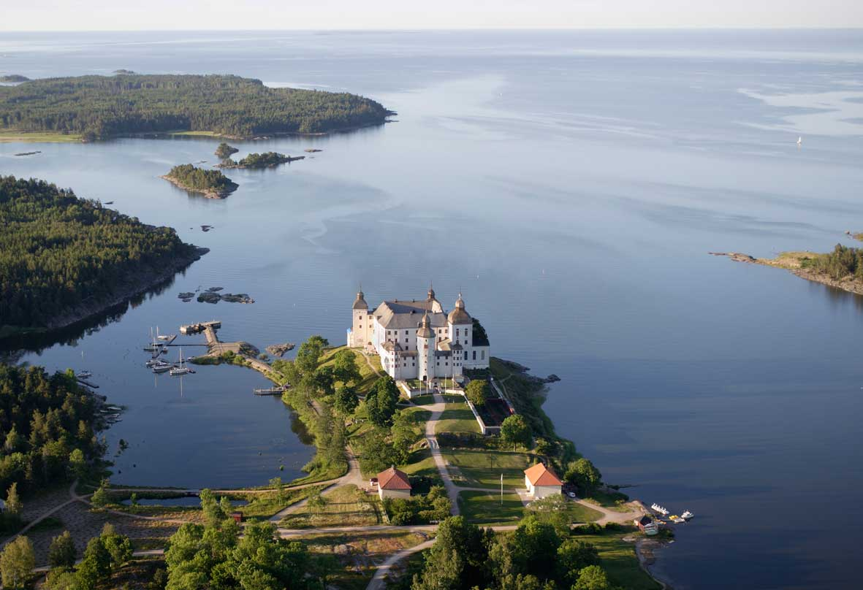
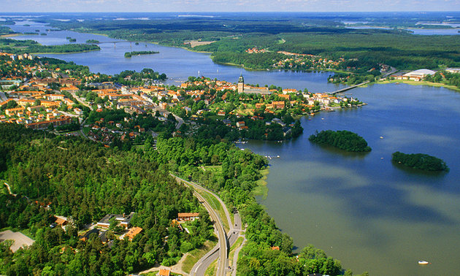
Due to this is the amount of lakes that Sweden has 95.700 lakes, which is equivalent to the 9% of Sweden total area. In Finland there are 187.888 lakes
Vänern
5.648 km²
Vättern
(1.893 km²)
Mälaren
(1.140 km²)

Slide 5
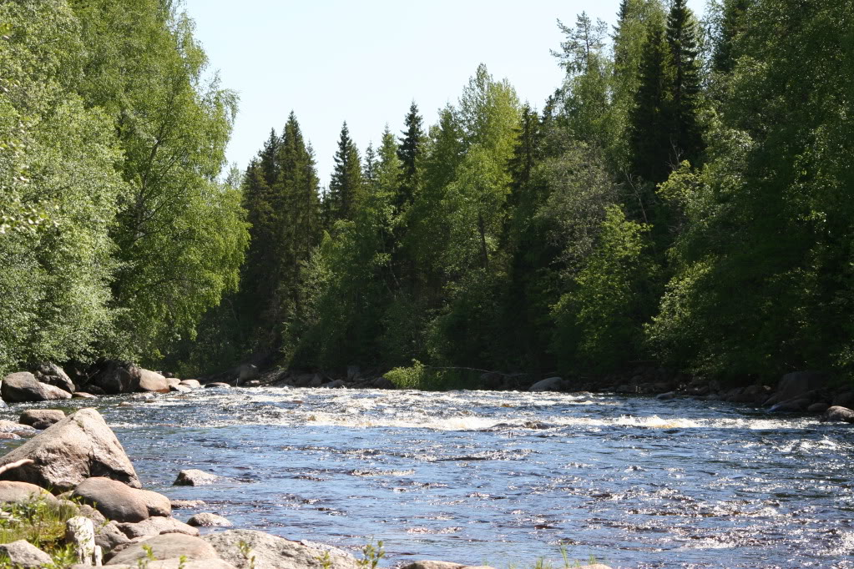
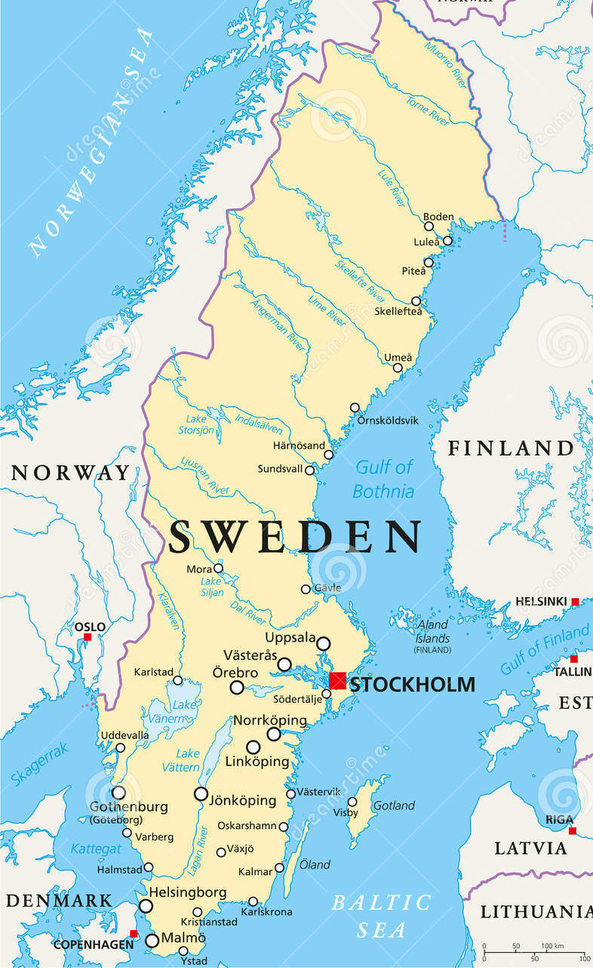
Rivers in Sweden are mostly fast and with numerous falls.
Rivers’ direction is mainly from the Northwest to the Southeast part of the country, and most of them flow into the Kattegat (sea situated in between Sweden and Denmark). A great amount of them are originated in lakes.
The most important rivers are Klara (660 km) and Torne (570km).
Kattegat

Slide 6
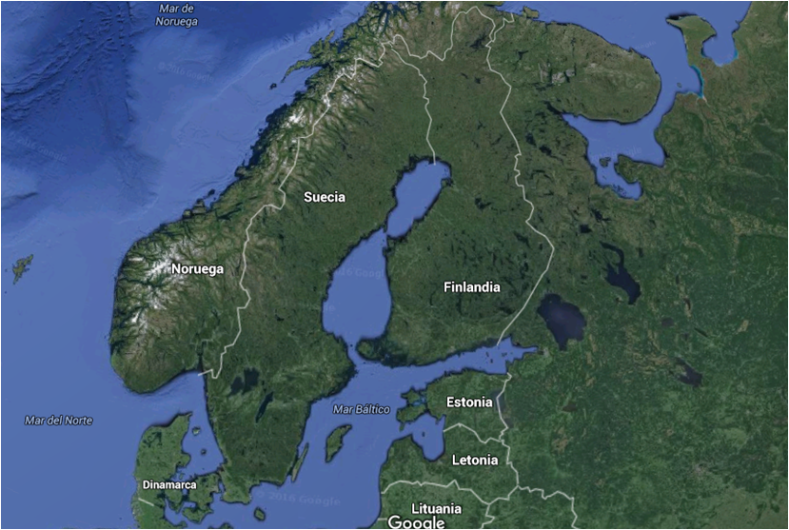
Around 65% of Sweden's total land area is covered with forests, a little bit less than Finland, with a 75%

Slide 7
Sweden has 221.800 isles, (179.584 in Finland) from which 1.085 have inhabitants living permanently.
Gotland
Öland
Orust

Slide 8
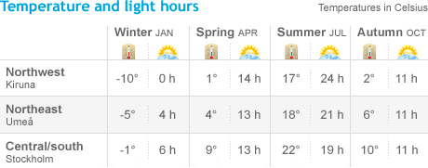
CLIMATE
Spring: March-April to May
Summer: June to August
Fall: September to October-November
Winter: November-December to March-February

Slide 9
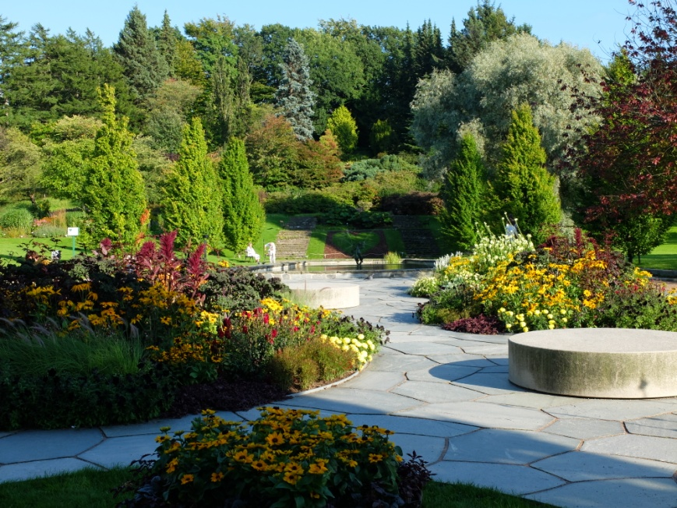
In Götaland winters are shorter and milder, while daytime summer temperatures normally range from 15 to 25 degrees.
The air is relatively humid here, making warm days feel warmer and cold days colder.
Even in winter, snow is rare near any southern coast.

Slide 10
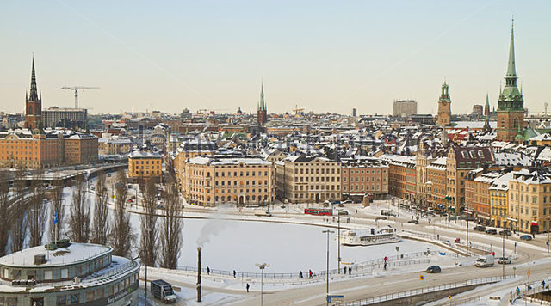
Svealand has a climate that is normally a few degrees cooler than that of Götaland.
Average temperatures are just below zero in January, and snowfall is more common, more in the northwest, where lots of popular ski resorts are located.

Slide 11
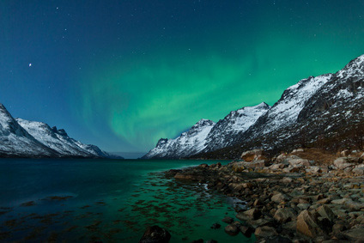
Although relatively few people live in Norrland, it has a climate that many people falsely associate with all of Sweden.
Winters here are long, cold and dry, with sub-zero temperatures lasting several months. There is also much more snow here.
Summers may be short, but temperatures are often a comfortable, with 15 degrees, with occasional peaks of up to 30 degrees.

