Slide 1
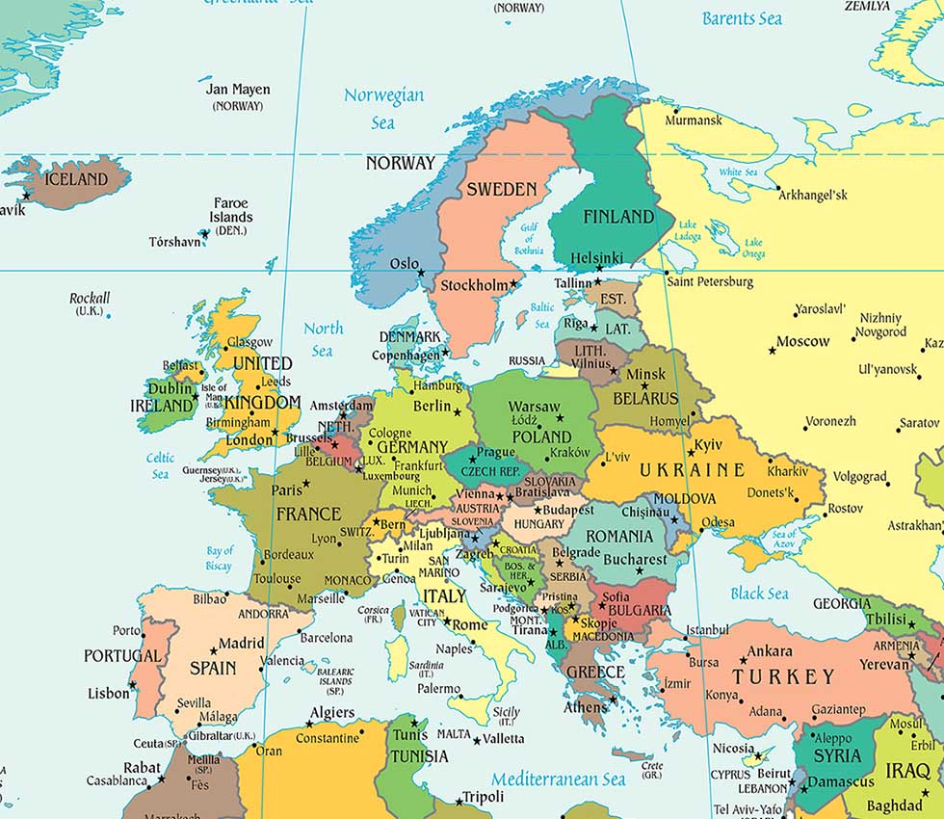
ICELAND
QUICK FACTS
Official name | Iceland or Republic of Iceland
Form of government | Unitary Parliamentary Republic
President | Ólafur Ragnar Grímsson
Prime minister | Sigmundur Davíð Gunnlaugsson
Capital city | Reykjavík
Official language | Icelandic
Monetary unit | Icelandic króna
Population | 330,171 (2016 estimation)
Surface | 102.775 km2

Slide 2

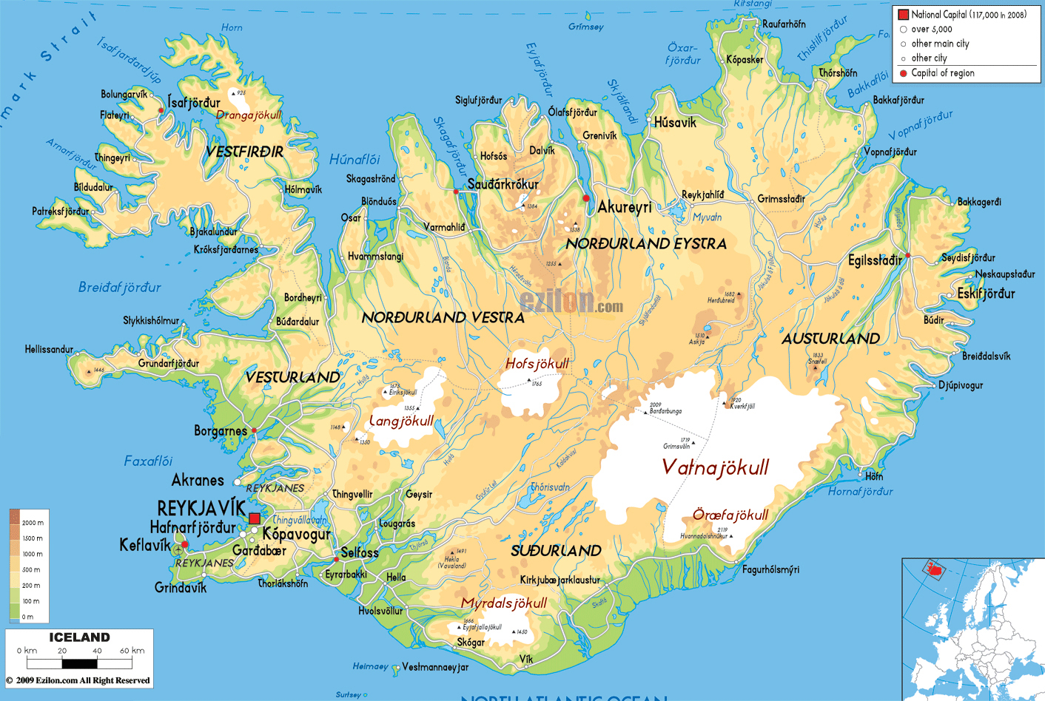
REYKJAVÍK

Slide 3
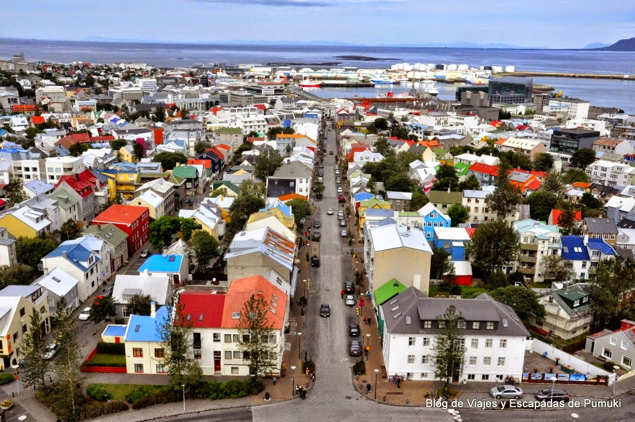
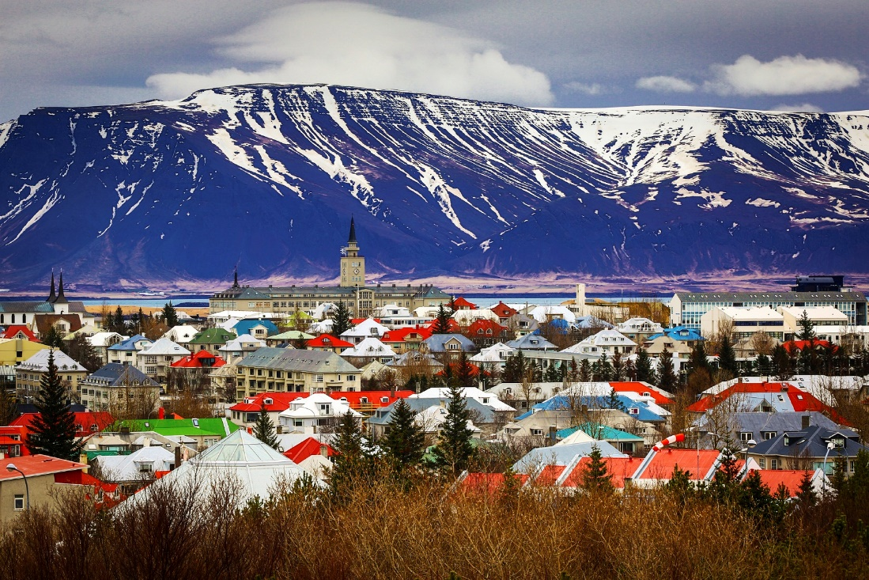
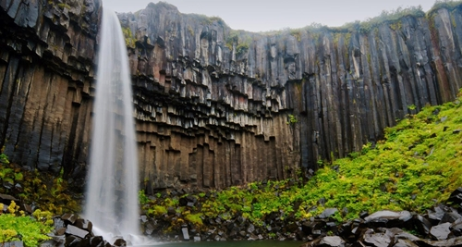
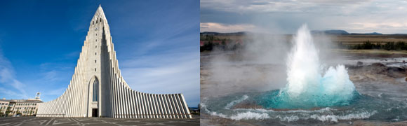
REYKJAVÍC
Is the capital city and the largest city in Iceland with a population of around 120,000 inhabitants.
It is the world´s nothermost capital of a sovereign state and a popular tourist destination.
Reykjavík is believed to be the location of the first permanent settlement in Iceland. Until the 18th century, there was no urban development. It was founded as an official trading town.
Volcanic activity provides Reykjavík with geotermal heating systems for both residential and industrial districts. In 2008, natural hot water was used to heat roughly 90% of all buildings in Iceland.

Slide 4
KÓPAVOGUR

Slide 5
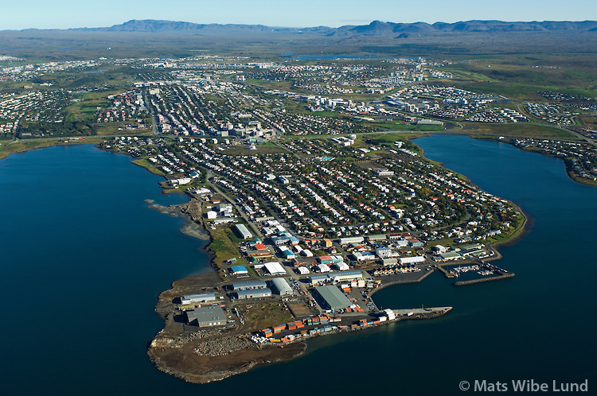
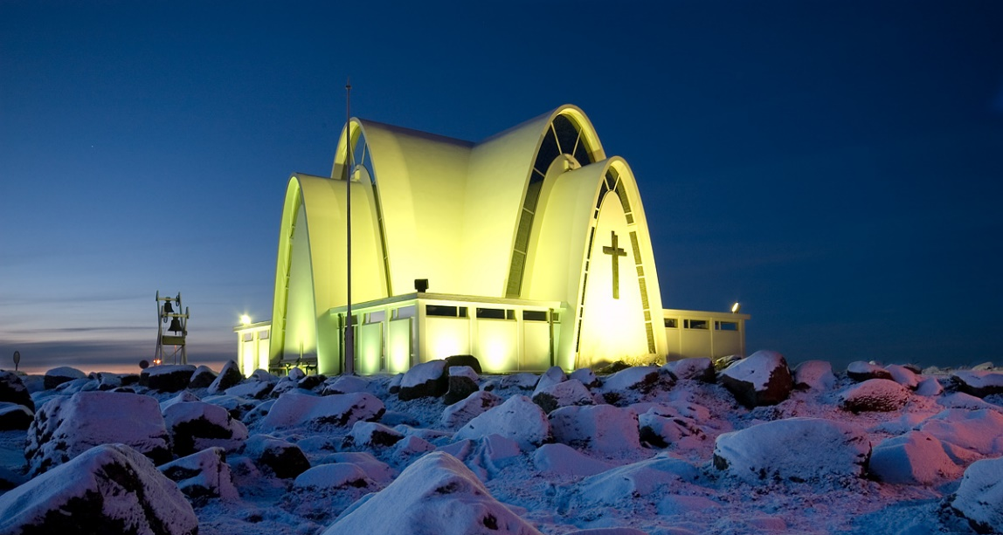
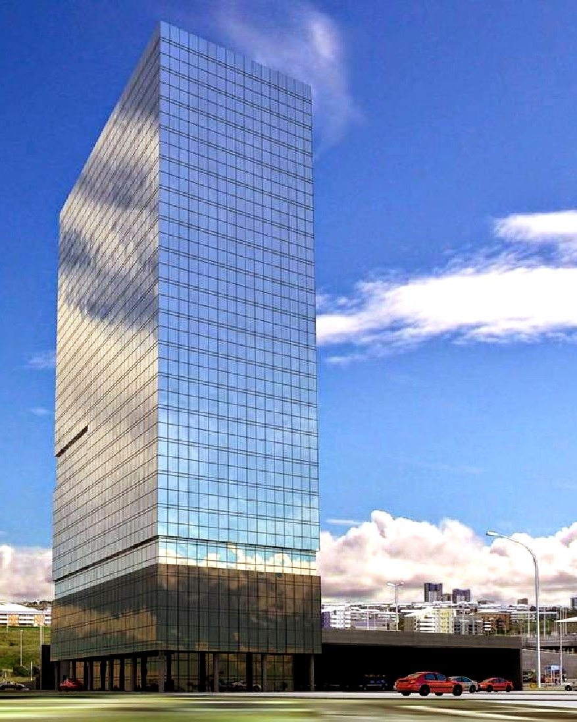
KÓPAVOGUR
Kópavogur is the second largest city in Iceland with 32,308 inhabitants according to the Statistics of Iceland.
It lies immediately south of Reykjavík and is part of the Capital Region.
The name literally means “seal pup bay”.
Kópavogur is largely made up of residential areas, but has commercial areas and much industrial activity as well.
The tallest building in Iceland, the Smáratorg tower, is located in central Kópavogur.

Slide 6
HAFNARFJÖRðUR

Slide 7
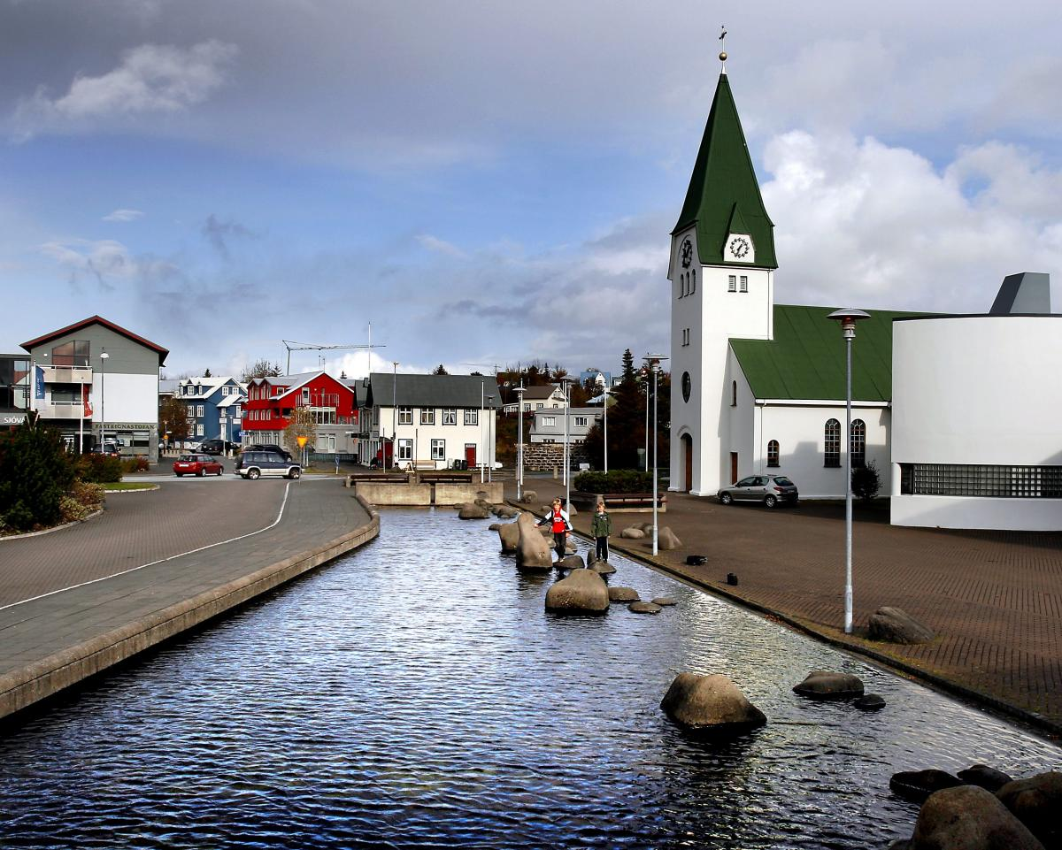
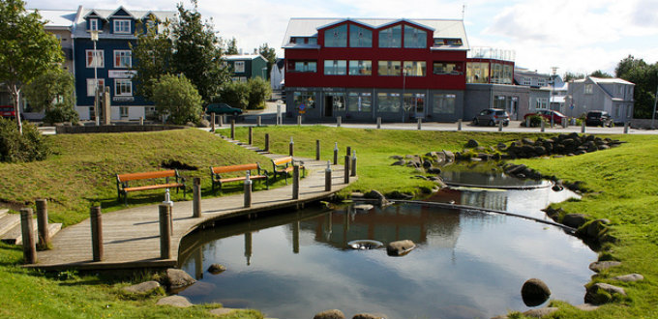
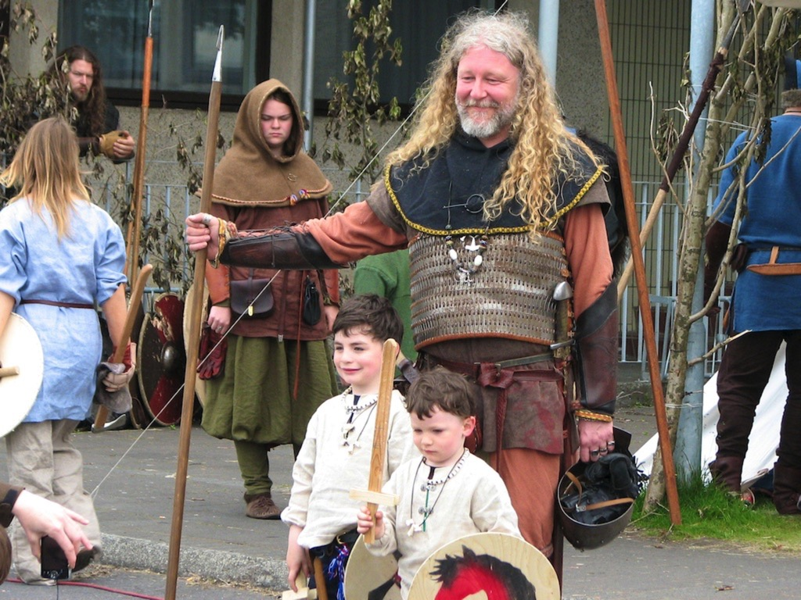
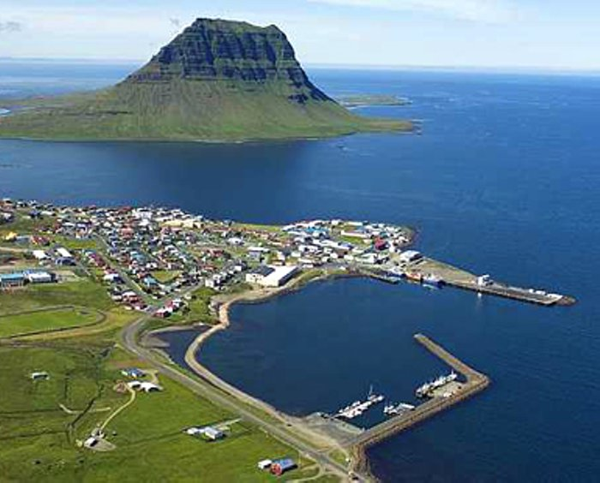
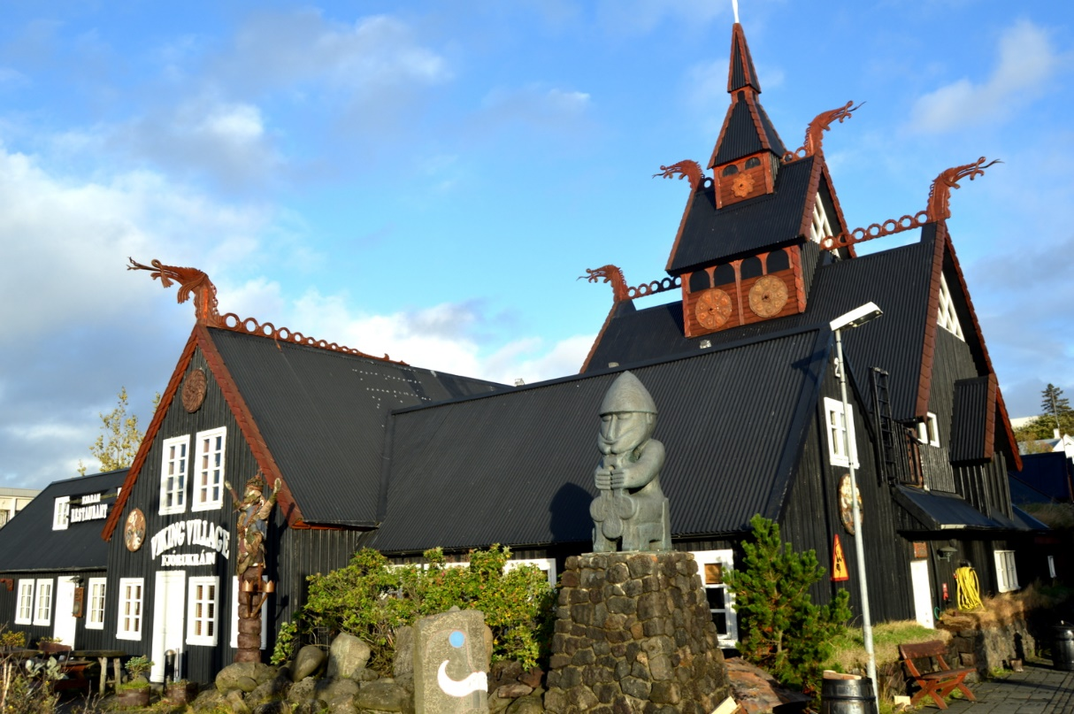
Hafnarfjörður is a port town and municipality located on the southwest coast of Iceland, about 10 km south of Reykjavík.
It is the third-most populous city in Iceland with a population of around 27,000 inhabitants.
The town is the site of an anual Viking festival, where Viking culture enthusiasts from around the world display reconstructions of Viking garb, handicraft, sword-fighting, etc.
Hafnarfjörður is now arguably considered to be the rock n' roll capital of Iceland
HAFNARFJÖRðUR

Slide 8
AKUREYRI

Slide 9
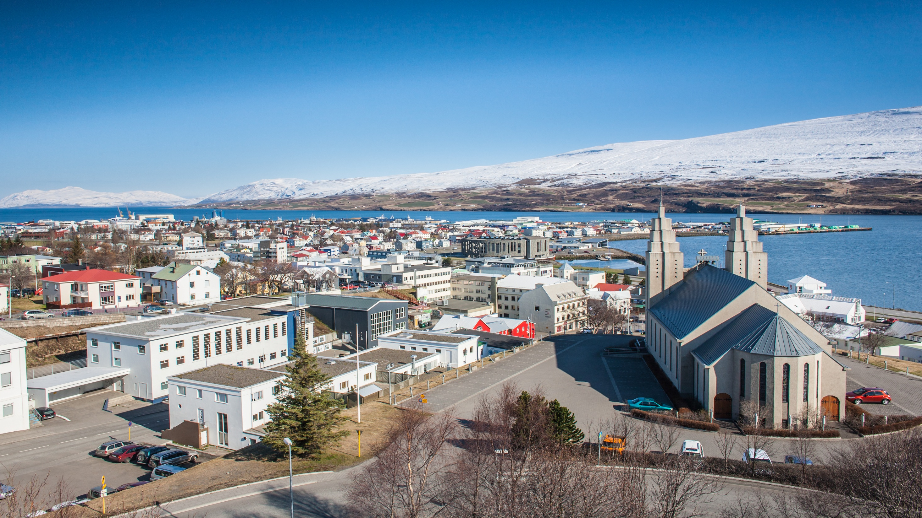
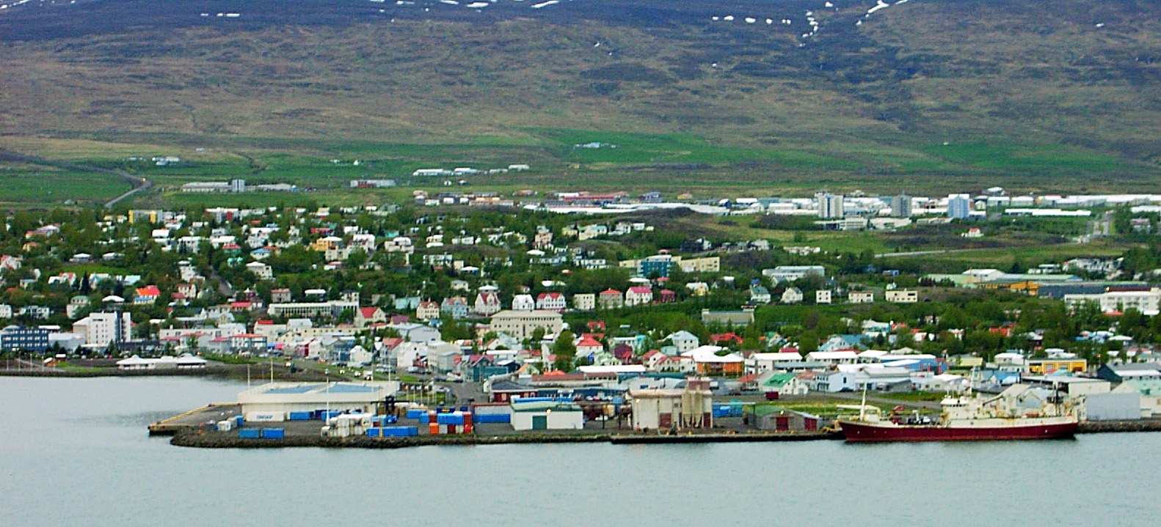
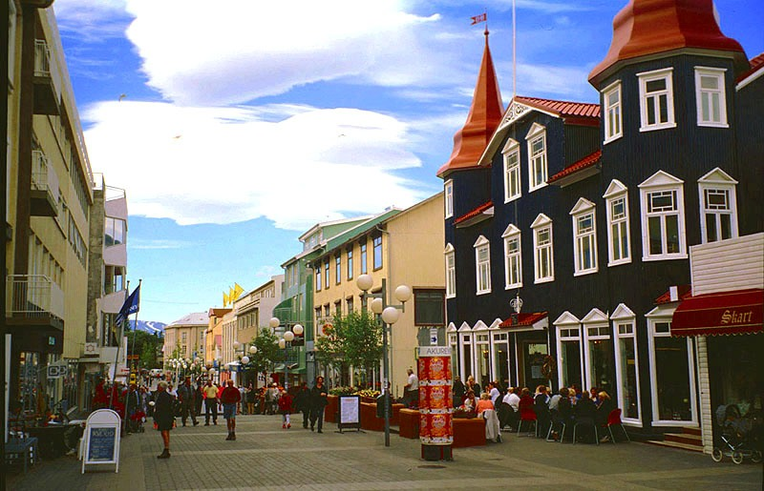
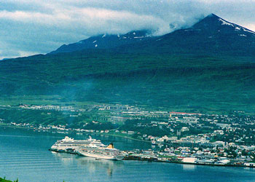
Akureyri is a small city in northern Iceland. It is the fourth largest urban center in the country, with a population of around 19,000 inhabitants.
It is nicknamed the “Capital of North Iceland”. Akureyri is an important port and fishing centre. The town was the site of Allied Units during the Worl War II.
Although it is placed in northern Iceland , near the Arctic Circle , the city has a relatively milder climate than the rest of the country and its corresponding geographical area , thanks to its location in a protected fjord.
And the town's ice-free harbour has played a significant role in its history.
AKUREYRI

Slide 11

Largest cities or towns in Iceland
Rank | Name | Region | Pop.
1 | Reykjavík | Capital Region | 121,230
2 | Kópavogur | Capital Region | 32,308
3 | Hafnarfjörður | Capital Region | 27,357
4 | Akureyri | Northeastern Region | 18,103
5 | Reykjanesbær | Southern Peninsula | 14,527
6 | Garðabær | Capital Region | 14,180
7 | Mosfellsbær | Capital Region | 9,075
8 | Árborg | Southern Region | 7,889
9 | Akranes | Western Region | 6,699
10 | Fjarðabyggð | Eastern Region | 4,675

Slide 12
POPULATION:
The total population of Iceland was estimated to be 330,171 on
January 2016
The average age is 36.3 years.
The Norwegian life expectancy rate is about 83 years old.

Slide 13
According to Norway Statistics around the 15,6 % inhabitants of Norway were of a foreign background.
Last year, immigrants represented 8.4 % of the population.
Almost 38 % percent of them come from Poland. The second largest group is from Lithuania, followed by immigrants from the Philippines.

Slide 14
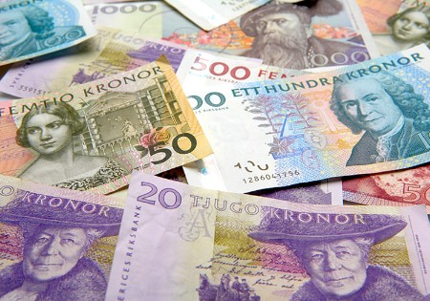
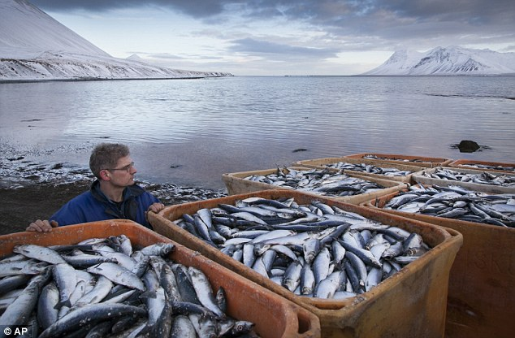
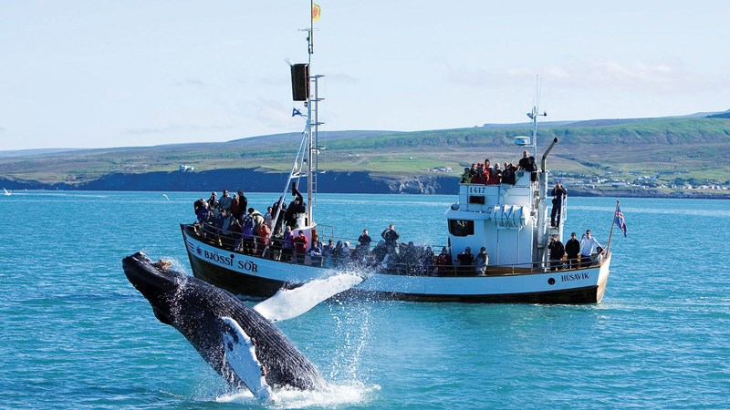
The basic sectors in the Icelandic economy are various services as tourism which has grown increasingly in the last few years (57%), manufacturing industries, construction and utilities (23.4%), and fisheries (6.3%).
Despite the decision to resume
commercial whale hunting in 2006, the
tourism sector is expanding, especially in ecotourism and whale-watching.
ECONOMY:

Slide 15
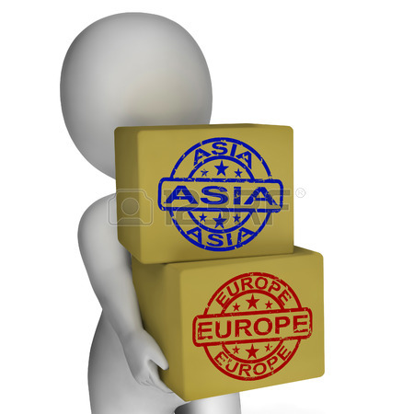
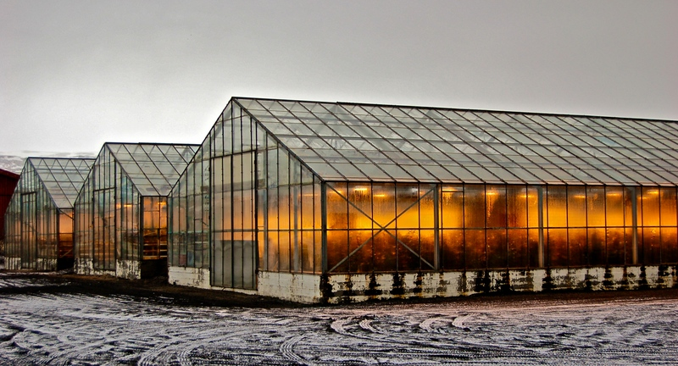
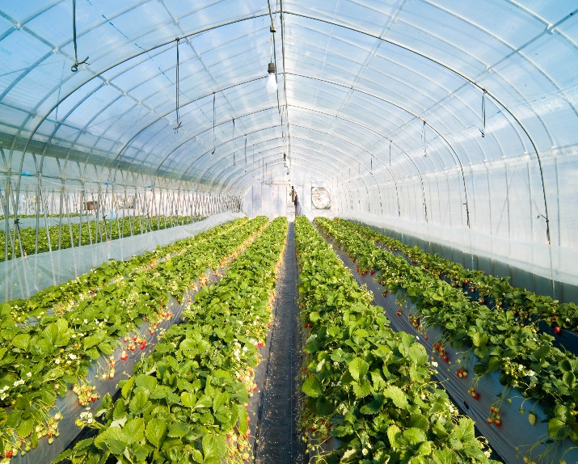
Iceland's agriculture and ranching industry, accounting for 5.4%, consists mainly on potatoes, green vegetables (in greenhouses), mutton (lambs products) and dairy products.
The export base is relatively narrow and largely based on natural resources, namely fisheries, energy intensive industries, and tourism and these industries are predominantly occupied by small and medium-sized businesses.

Slide 16
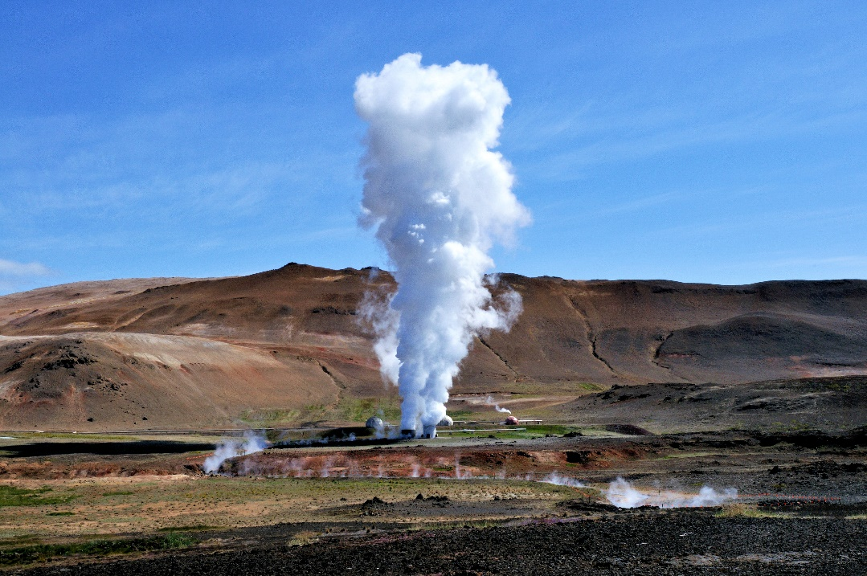
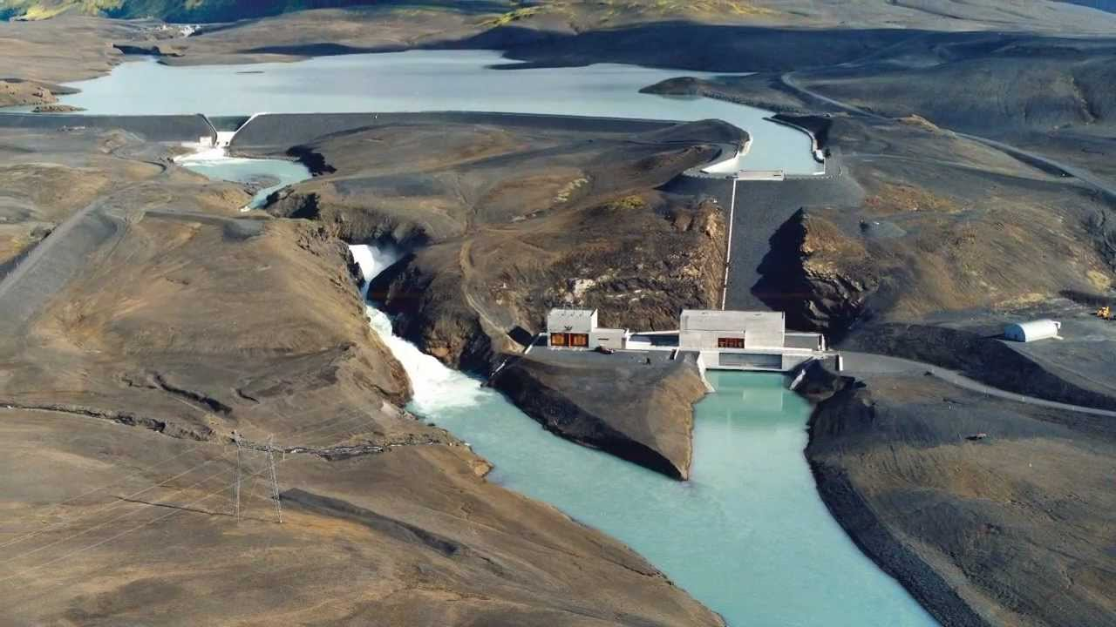
Renewable sources -geothermal and hydropower- provide effectively all of Iceland's electricity and around 85% of the nation's total primary energy consumption, with most of the remainder consisting of imported oil products used in transportation and in the fishing fleet.
Iceland expects to be energy-independent by 2050.

Slide 17
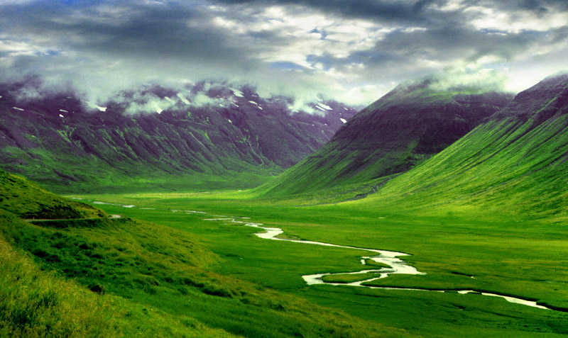
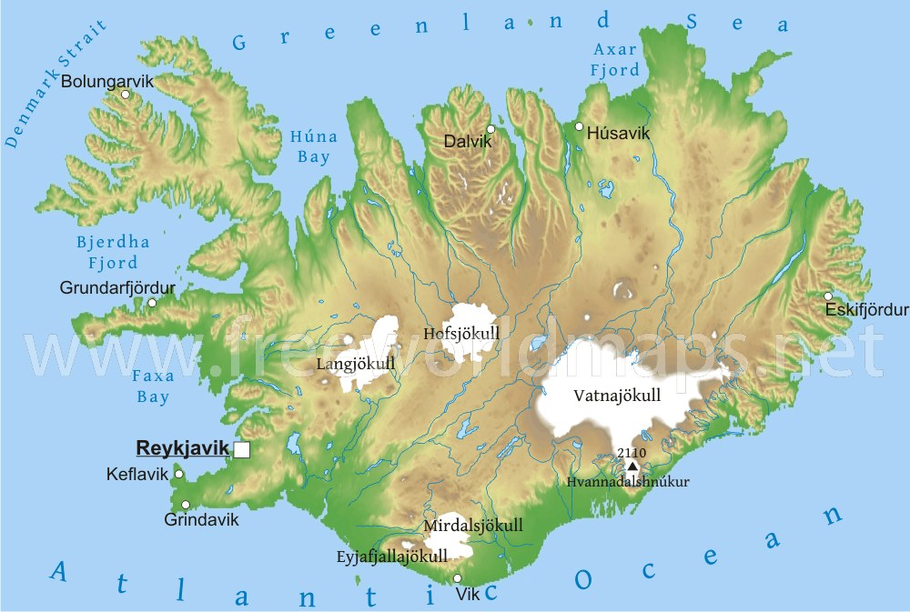
Nature and environment
From a geological standpoint, Iceland is a very young country, still in the midst of its own creation.
And although they are very accessible, they still remain virtually untouched by human civilization.
Despite the name, “ice” only covers
10% of the land, but still represents
the largest glaciers in Europe.
According to the Environmental
Performance Index, created by the
World Economic Forum in 2012,
Iceland is the world's greenest country.

Slide 18
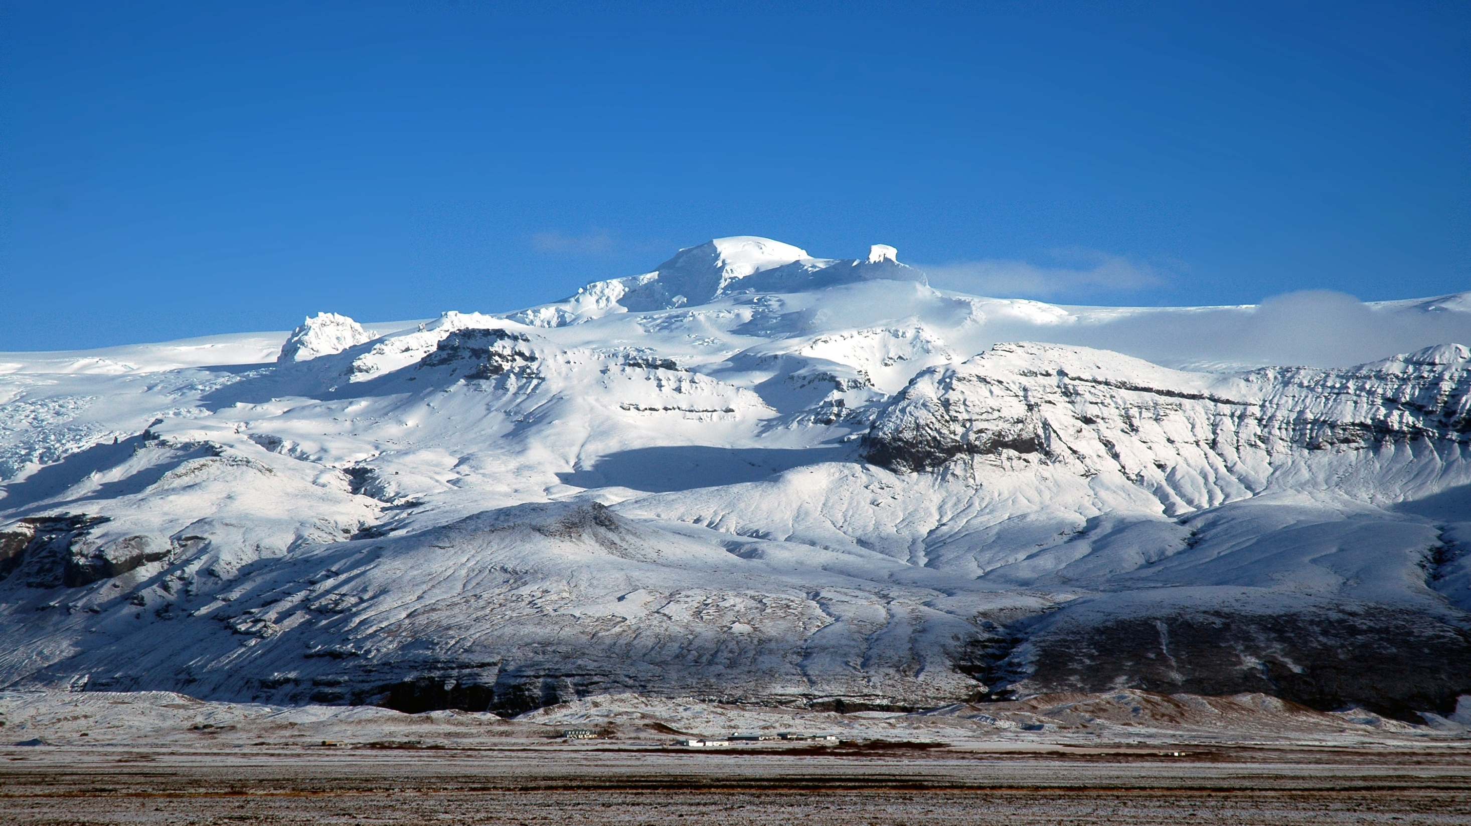
CLIMATE
Winter
The Icelandic winter is relatively mild for its latitude: the southerly lowlands of the island average around 0ºC in winter, while the Highlands of Iceland tend to average around −10 °C.
The lowest temperatures in the northern part of the island range from around −25 to −30°C. The lowest temperature on record is −39.7°C.
Summer
The average July temperature in the southern part of the island is 10–13°C. Warm summer days can reach 20–25°C. The highest temperature recorded was 30.5°C at the Eastern fjords in 1939.

Slide 19
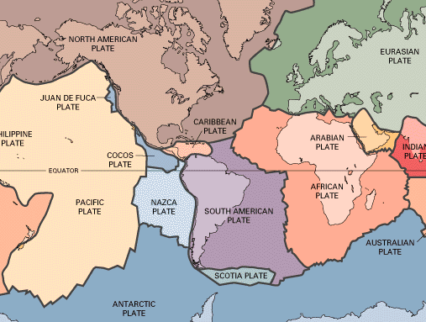
GEOGRAPHY
Located in the Atlantic Ocean, near
the Arctic Circle, between Greenland and Norway
Is the second largest island in Europe, following Great Britain, and the 18th largest island in the world
The coastline is 4,970 km, and Iceland maintains a 200 nautical-miles exclusive economic zone
It is home to some of the world’s most
active volcanoes, and it is where the
Eurasian and American tectonic plates
meet

Slide 20
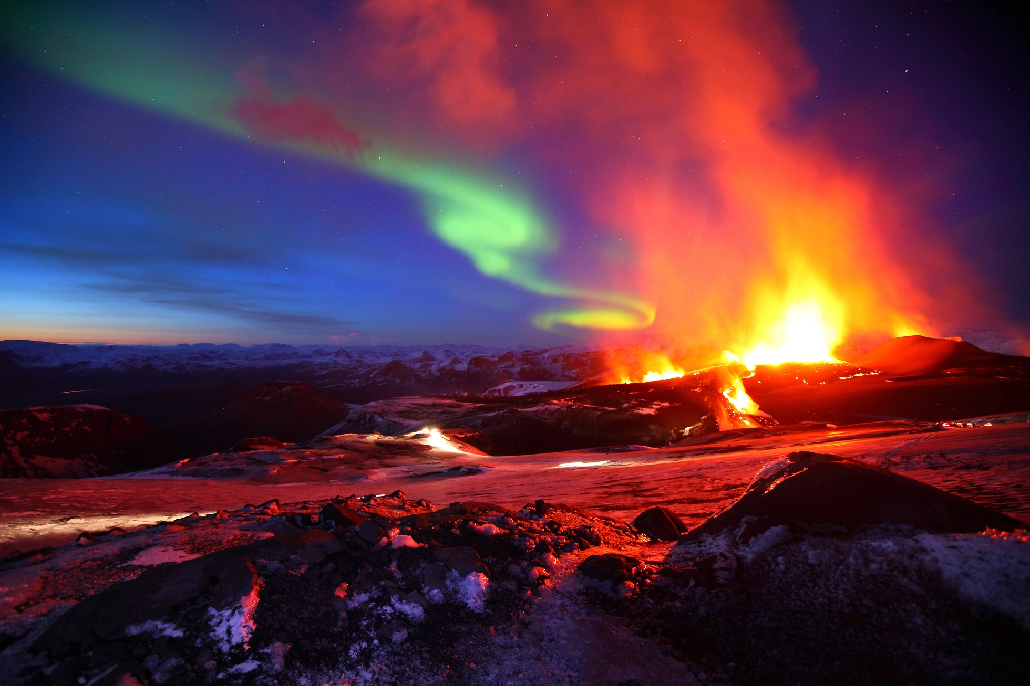
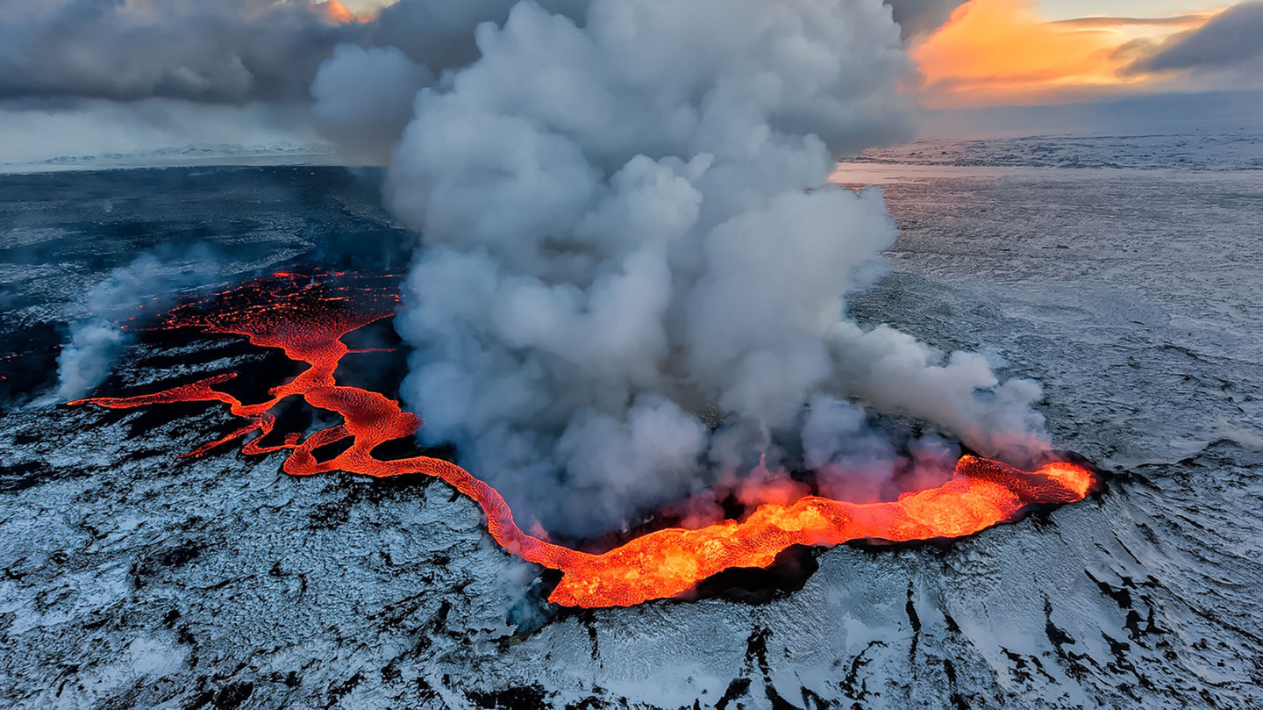
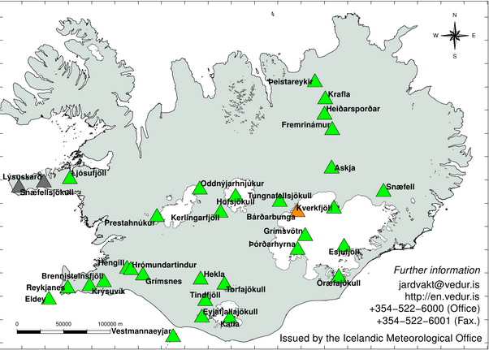
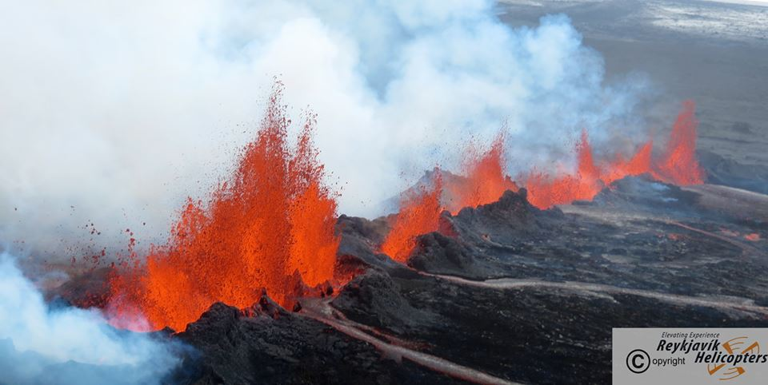
VOLCANOES
Iceland has 130 active and extinct volcanic mountains
The western part of Iceland belongs to the North American plate, and the eastern part to the Eurasian plate. Sometimes, they only move away from each other, releasing pressure and exposing the lava sea between them. This allows the lava stream to the surface, cooling down and forming new land, and this is what is happening in Iceland
                The latest volcanic eruption was in Holuhraun from August 2014 to February 2015. The eruption produced a lava field of more than 85 km2 and 1.4 km3, the largest in Iceland since 1783

Slide 21
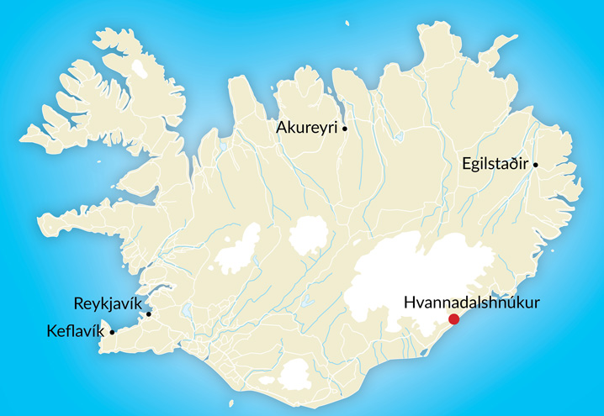
Iceland’s highest peak is Hvannadalshnjúkur, standing 2.119 metres (6852 ft) over sea level. and over 11 percent of the country is covered by glaciers, including Vatnajökull, the largest in Europe. Its land mass comprises glaciers (12,000 km²), lava (11,000 km²), sand (4,000 km²), water (3,000 km²) and pasture (1,000 km²).

Slide 22
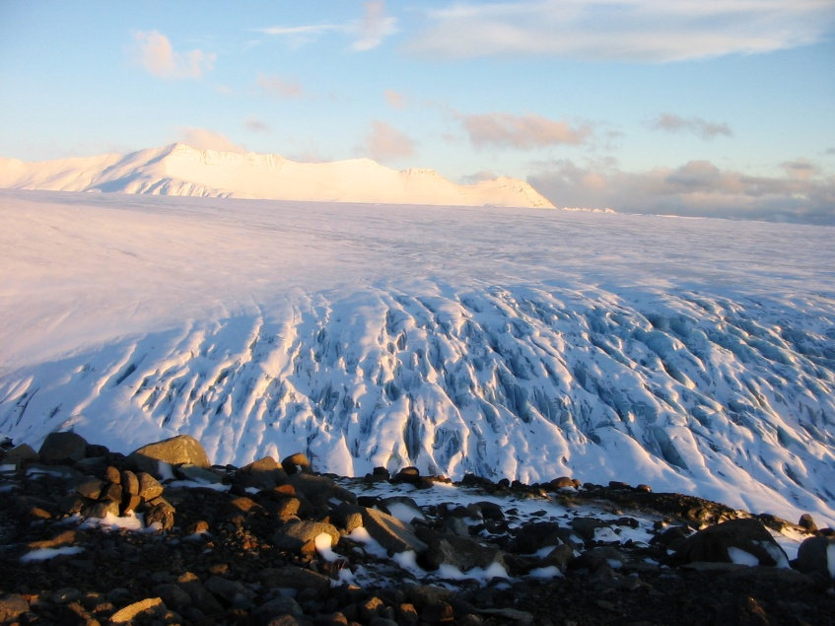
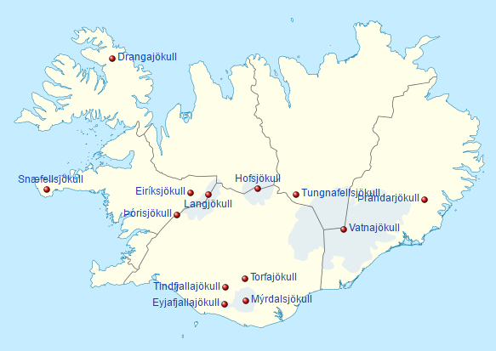
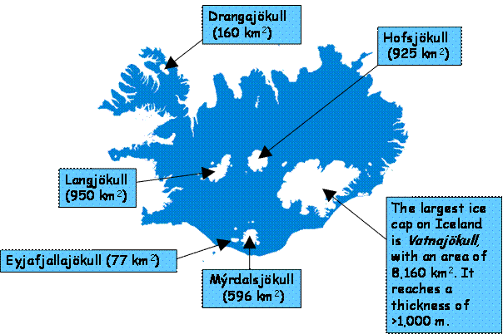
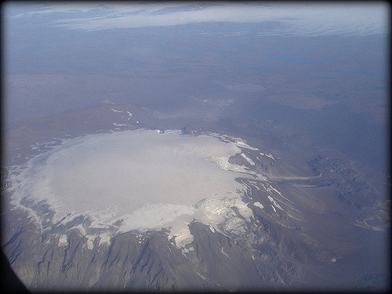
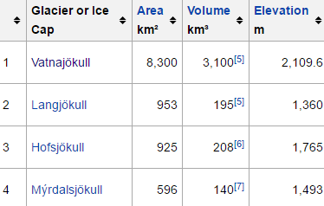
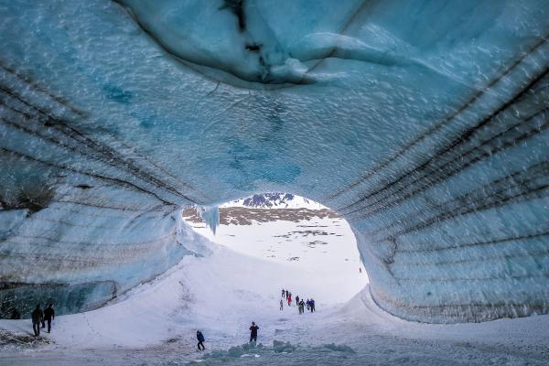
The glaciers and ice caps of Iceland cover 11.1% of the land area of the country (about 11,400 km² out of the total area of 103,125 km²). An ice cap is a mass of glacial ice that covers less than 50,000 km² of land area covering a highland area and they feed outlet glaciers.
Vatnajökull, largest and most voluminous ice cap in Iceland, and one of the largest in area in Europe.
Hofsjökull
Langjökull

Slide 23
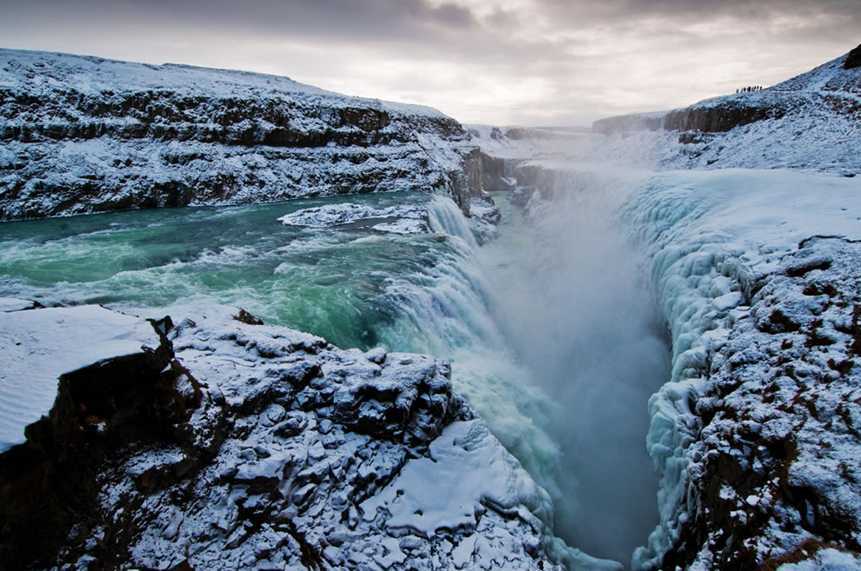
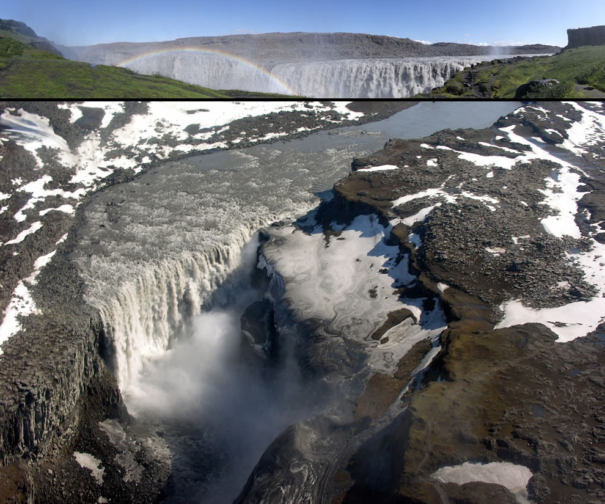
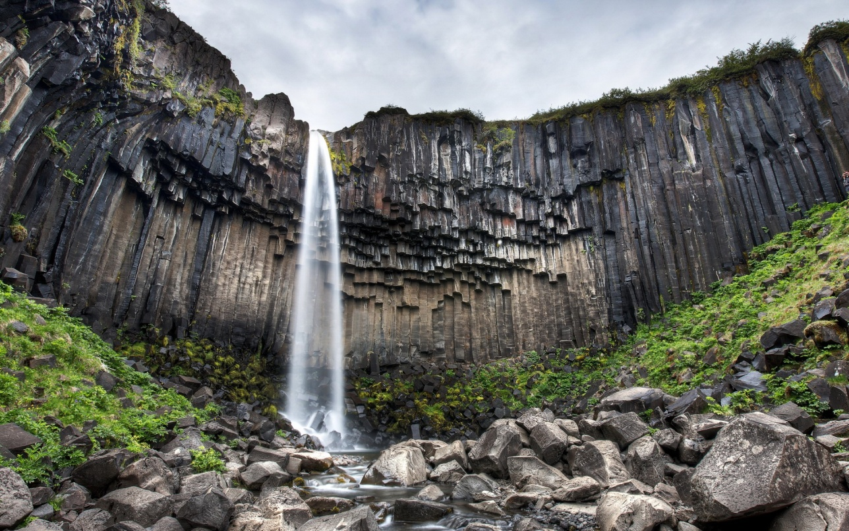
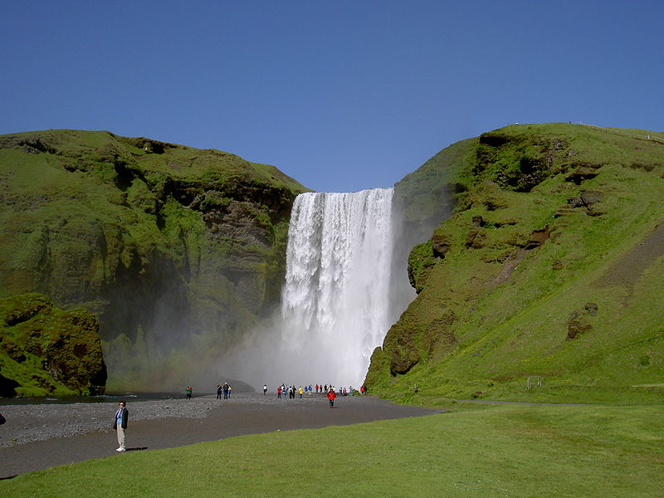
Iceland is unusually suited for waterfalls. This small island country has a north Atlantic climate that produces frequent rain and snow, and a near arctic location that produces large glaciers, which melt in summer, feeding many rivers. As a result, it is home to a number of large and powerful waterfalls.
Dettifoss, most powerfull waterfall in Europe
100 meters wide and 45 down to the Vatnajökull glacier
Svartifoss is surrounded by dark lava columns
Skógafoss, with a width of 25m and a drop of 60m

Slide 24
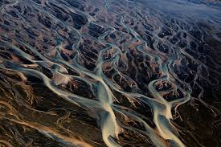
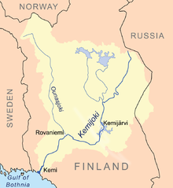
On an island like Iceland, no rivers are very long. None of the rivers are important as a means of navigation due to the impracticality of settlements in the Highlands of Iceland where they originate.
Þjórsá is the Iceland's longest river at 230 kilometers (about 143 miles), in the south of the island. Þjórsá is a glacier river and has its source on the glacier Hofsjökull.
Kemijoki, with 550 km length, is the longest river in Finland, runsning throughKemijärvi and Rovaniemi before reaching the Gulf of Bothnia at Kemi

Slide 25
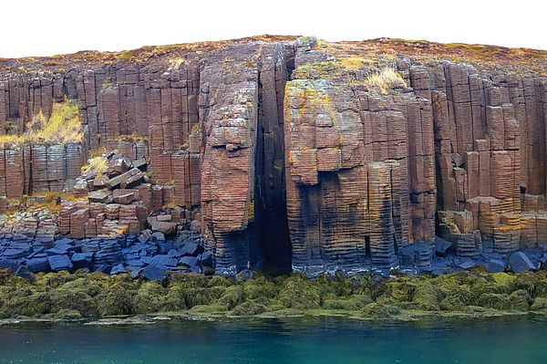
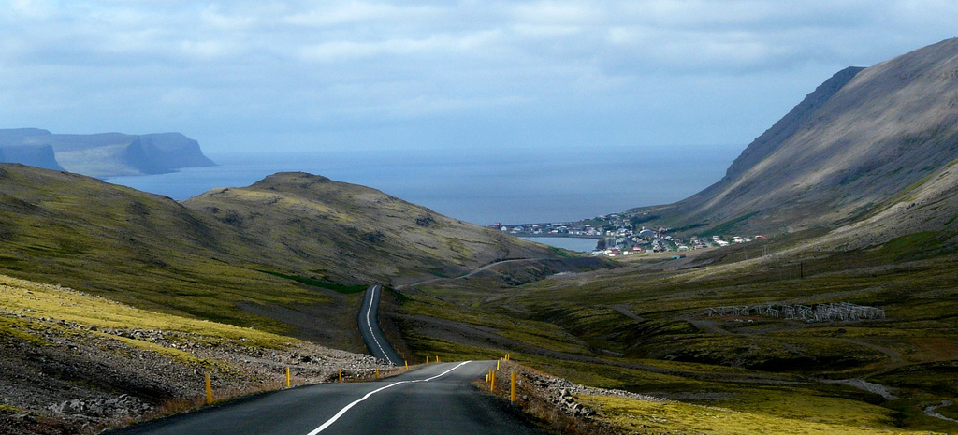
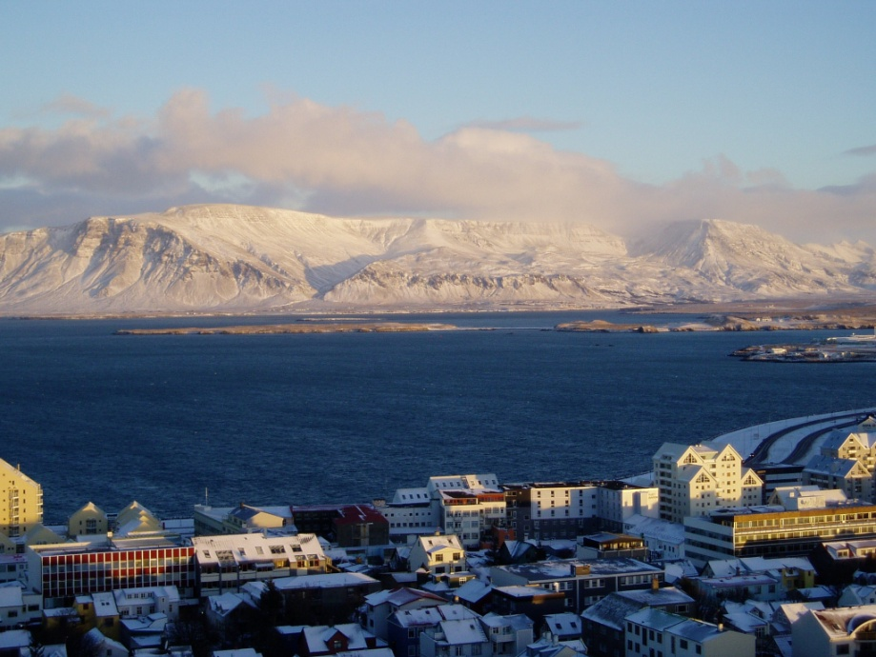

The fjords of Iceland round the island from the SW to the East. There are no important fjords along the south coast.
Breiðafjörður fjord
Patreksfjörður
Kollafjörður, in Faxaflói bay

Slide 26



A geyser is a spring characterized by intermittent discharge of water ejected turbulently and accompanied by steam. Generally all geyser field sites are located near active volcanic areas, and the geyser effect is due to the proximity of magma.
The Geysir field is situated at the northern edge of the southern lowlands, at an altitude of 105-120 m above sea level. The area is called Haukadalur. The hot springs are located to the east of a little mountain called Laugafell.
The blue lagoon

Slide 27




Fata geyser
Strokkur geyser
The great geyser
Blesi geyser

