Slide 1

POPULATION:
In July 2015 the population of Denmark was 5.670.000 people.
The average age is 41.4 years.
The Danish life expectancy rate is about 78 years old.

Slide 2

The World Happiness Report frequently ranks Denmark's population as the happiest in the world. This has been attributed to the country's highly regarded education and
health care system, and its low level of
income inequality.

Slide 3
Denmark has a moderate immigrant population. The most common
countries of origin are Poland, Turkey, Germany, Iraq, Romania, Syria,
Somalia, Iran, Afghanistan and Yugoslavia and its successor states.

Slide 4
Largest cities in Denmark.
Rank | Core City | Region | Urban Population | Municipal Population
1 | Copenhagen | Capital Region of Denmark. | 1.263.698 | 580.184
2 | Aarhus | Central Denmark Region | 261.570 | 326.676
3 | Odense | Region of Southern Denmark | 72.060 | 196,090
4 | Aalborg | North Denmark Region. | 110.495 | 205.809
5 | Esbjerg | Region of Southern Denmark | 72.060 | 144.244
6 | Randers | Central Denmark Region | 61.664 | 96.559
7 | Kolding | Region of Southern Demark | 58.757 | 89.556
8 | Horsens | Central Denmark Region | 56.536 | 85.911
9 | Vejle | Region of Southern Denmark | 53.975 | 109.737
10 | Roskilde | Region Zealand | 49,297 | 80,687
Source: Statistics of Denmark (2015; Municipal Data:2014)

Slide 5
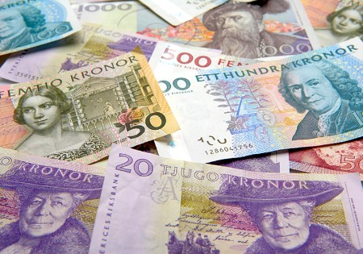

Denmark's economy has a high degree of dependence on foreign sector : Imports and Exports.
The main trading partner of Denmark is Germany, followed by Sweden and the United Kingdom. Outside the EU, the main trading partners are Norway, United States and Japan.
ECONOMY:

Slide 6



The 46.2 percent of the Danish production comes from the service sector, followed at some distance by the public sector and industry. Within these activities primarily they encompass trade, transport and financial activities.

Slide 7

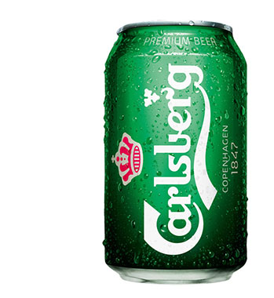
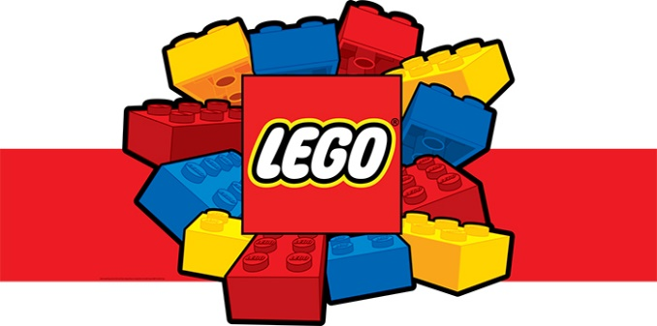
Within the industrial sector, it should be highlighted the metallurgical
industry, food and paper.
Danish industry is dominated by small and medium enterprises.
The main company in the country is Danish Crown, with about 19,000
workers in Denmark.
Among the best known worldwide products are the Carlsberg beer and
Lego toy.

Slide 8


Agriculture and ranching industry have lost weight in the Danish economy in the recent years. Most of the production in this sector comes from farm animals (dairy products and pork).
About the energy industry, Denmark extracts oil and natural gas from the 80s and has progressed to the self-supply in the 90s.

Slide 9
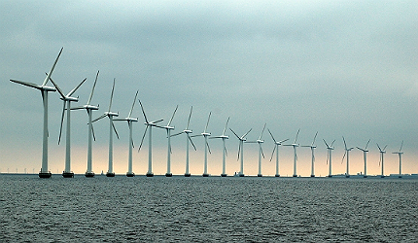
Today, more than 40 % of Denmark’s energy supply comes from wind power and the plan is to reach 50 per cent by 2020, as set out in the 2012 Energy Act.
In 2050, the plan is for Denmark to be 100 % free of fossil fuel and wind energy will make up a very large part of the energy mix by then.

