Slide 1
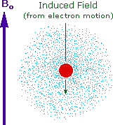
Nuclear Magnetic Resonance Spectroscopy
Spin creates a magnetic field
B_{o} represents an external magnetic field which causes two spin states to exist, the lower energy in line with the external field and the higher energy opposed.
GIFs and images courtesy of William Reusch (2013)

Slide 2
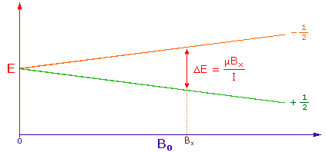
The x-axis here shows increasing strength of magnetic field, which causes an increasing difference between the two energies (although the differences remain rather small!)
The energy difference corresponds to frequencies found in radio waves, making NMR a very low energy means of ”observing” molecular structure.
Image courtesy of William Reusch (2013)

Slide 3
An nmr spectrum is acquired by manipulating or sweeping the magnetic field over a small range and simultaneously observing the rf signal from the sample. An alternative technique is to vary the frequency of the rf radiation while holding the external field constant.

Slide 4
Although H atoms are the same, the resonace signals given off depend upon the environment of the H atom
Incredibly precise instruments measure the resonance. Ppm is akin to measuring a difference of a meter on a thousand kilometer scale!

Slide 5
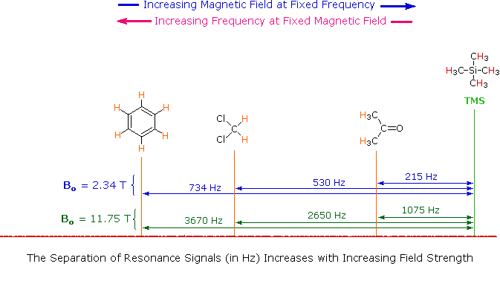
The location of nmr signals depends upon the strength of the magnetic field and the radio frequency energy

Slide 6
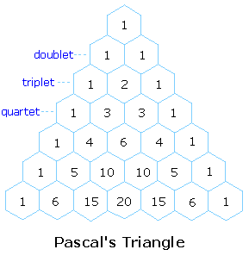
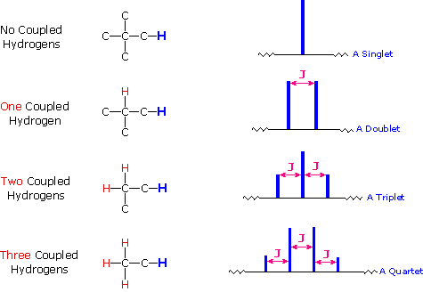
Note that J would be measured in units of Hz.

Slide 7
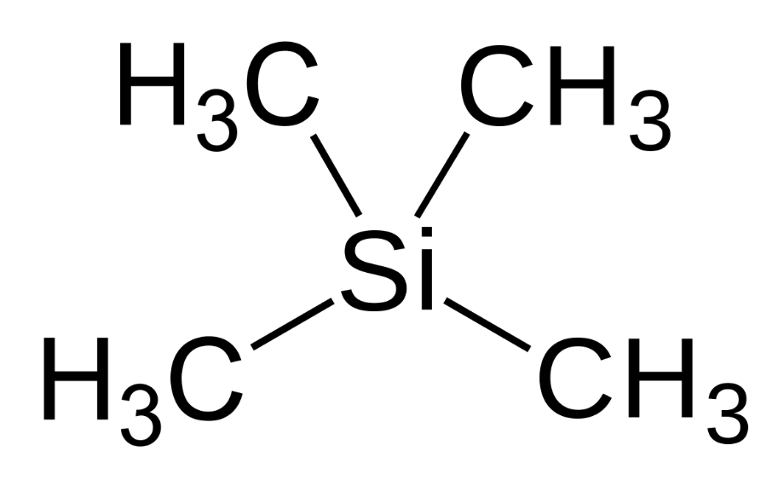
Why tetramethylsilane?
It provides one single strong peak (all H’s in the same environment)
Inert
It absorbs ”upfield”
Volatile (Low bp (27°C)

Slide 8
Single Crystal X-ray Crystallography
Can be used to identify the bond lengths and bond angles of crystalline compounds

