Slide 1
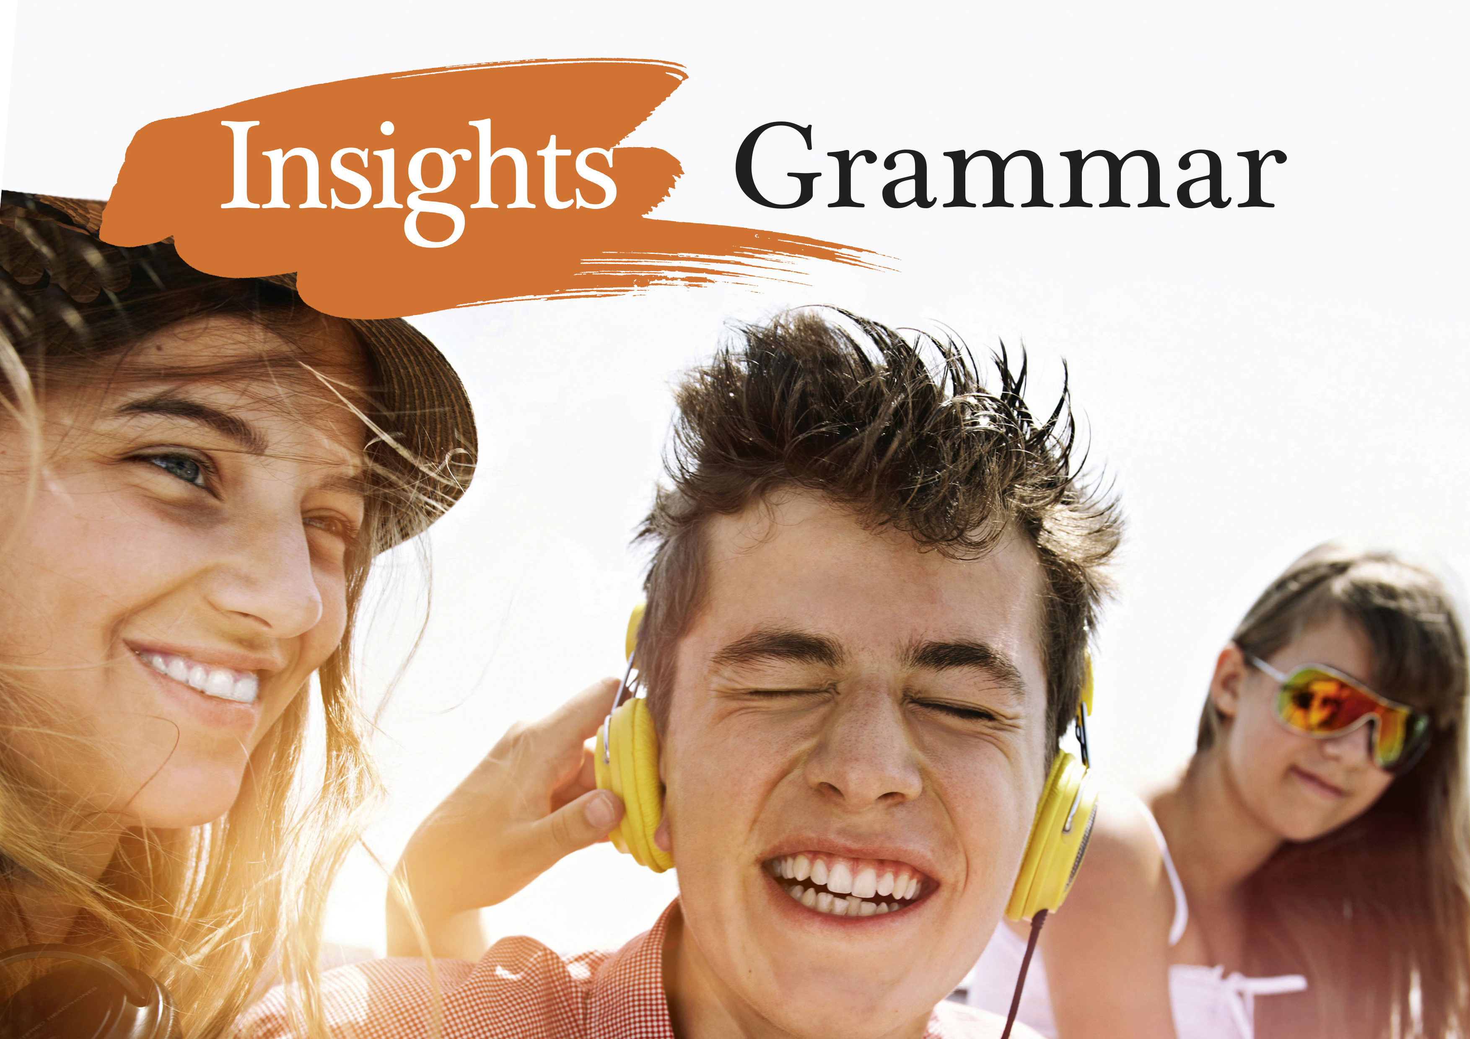
Notes:
<numero>

Slide 2
Relatiivipronominit
joka, mikä
Relatiivipronomini yhdistää kaksi lausetta.

Slide 3
Etsi seuraavista lauseista relatiivipronominit.
Pasta meals, which many of us enjoy, can be quick to make.
This is the film that everyone is raving about.
People who are always late are annoying.
This is the politician to whom I will give my vote.
I have a friend whose cat is adorable.
I didn’t take an umbrella, which was a huge mistake.
What I just saw was unbelievable.

Slide 4
Etsi seuraavista lauseista relatiivipronominit.
Pasta meals, which many of us enjoy, can be quick to make.
This is the film that everyone is raving about.
People who are always late are annoying.
This is the politician to whom I will give my vote.
I have a friend whose cat is adorable.
I didn’t take an umbrella, which was a huge mistake.
What I just saw was unbelievable.

Slide 5
Relatiivipronominit
Mikä seuraavassa virkkeessä on
relatiivipronomini?
korrelaatti eli sana, johon viitataan?
relatiivilause?
The guy who plays the trumpet lives upstairs from me.
Notes:
<numero>

Slide 6
The guy who plays the trumpet lives upstairs from me.
relatiivipronomini
korrelaatti eli sana, johon viitataan
relatiivilause
(Päälause: The guy … lives upstairs from me.)
Notes:
<numero>

Slide 7
Who, whom, whose
A person who snores is difficult to live with.
I hate women who wear too much perfume.
who viittaa ihmisiin
who on sekä yksikkö että monikko (a person/women who)
Notes:
<numero>

Slide 8
Who, whom, whose
Here is the man to whom you should speak.
Sue has four brothers, two of whom / of whom two live abroad.
Mikä muoto on whom?
whom on objektimuoto (sekä preposition jälkeen)
whom korvataan useimmiten nykyään muodolla ’who’
➢ joista kaksi = two of whom tai of whom two
Notes:
<numero>

Slide 9
Who, whom, whose
Parents whose kids get into trouble often feel helpless.
Ikea is a firm whose products are sold everywhere.
Entä mikä muoto on whose? Mihin se viittaa?
whose on omistusmuoto
se voi viitata sekä ihmisiin että asioihin
Notes:
<numero>

Slide 10
Which
Milloin relatiivipronomini on which?
This is the house which Jack bought. Tables which only have three legs fall over easily.
What is this music which you are playing now?
which viittaa esineisiin ja asioihin
käytetään sekä yksikössä että monikossa
Notes:
<numero>

Slide 11
Which
Mihin relatiivipronomini which viittaa seuraavissa lauseissa?
It started to rain, which was a shame.
I had my friend to keep me company, which was really nice.
Which –pronominia on käytettävä viitattaessa koko edeltävään lauseeseen.
Muista pilkku tällöin!
Notes:
<numero>

Slide 12
Which
The boat, the pieces of which we found, had sunk.
This city, the population of which is 10 million, is final destination.
➢ Huomaa sanajärjestys genetiivissä: pääsana + of which.
I got three messages, two of which / of which two were from Mum.
➢ joista kaksi = two of which tai of which two
Notes:
<numero>

Slide 13
That
● Mitä korrelaatteja that-sanalla on?
● Mitä huomaat pilkun käytöstä?
● Entä prepositioiden käytöstä?
Pick the picture that you like the best.
This is the man that I was talking about.
All that he said was true.
There is nothing that I want.
Tell us everything that happened.
She said something that I won’t forget.
Is this the worst that you can think of?
What was the first job that you ever had?
Notes:
<numero>

Slide 14
Pick the picture that you like the best.
This is the man that I was talking about.
that-pronominin
korrelaattina voi olla
esine tai asia
ihminen
All that he said was true.
➢ sekä erityisesti:
all, little, much, few
There is nothing that I want.
Tell us everything that happened.
She said something that I won’t forget.
thing-loppuinen pronomini
Is this the worst that you can think of?
What was the first job that you ever had?
superlatiivi, järjestysluku, only
Notes:
<numero>

Slide 15
Pick the picture that you like the best.
This is the man that I was talking about.
! ! !
Relatiivipronominin
that
edellä ei käytetä pilkkua eikä prepositiota.
(Mahdollinen prepositio lauseen loppuun.)
All that he said was true.
There is nothing that I want.
Tell us everything that happened.
She said something that I won’t forget.
Is this the worst that you can think of?
What was the first job that you ever had?
Notes:
<numero>

Slide 16
What
Missä on what-sanan korrelaatti?
What you need is more confidence.
I’ll do what I can.
I can’t believe what I just saw!
➢ What-sanalla ei ole korrelaattia - tai se on oikeastaan what-sanan sisällä (’se, mitä’).
➢ What esiintyy relatiivipronomineista vähiten, koska sen käyttö on niin rajoitettua.
Notes:
<numero>

Slide 17
Relatiivipronominin jättäminen pois
● Milloin relatiivipronominin voi jättää pois?
● Mikä lauseenjäsen se silloin on?
● Milloin sitä ei voi jättää pois?
That’s the girl who asked me out once. Who’s the boy (that) you were talking about? All (that) I need is a little bit of luck. I saw all that happened there.
Notes:
<numero>

Slide 18
Relatiivipronominin jättäminen pois
Subj Pred
That’s the girl who asked me out once.
Subj Pred
Who’s the boy (that) you were talking about?
Subj Pred
All (that) I need is a little bit of luck.
Subj Pred
I saw all that happened there.
Relatiivipronominin voi jättää pois, jos se ei ole relatiivilauseen subjekti.
Notes:
<numero>

Slide 19
Activate:
1. Näin miehen, joka kerjäsi ruokaa.
1. I saw a man who was begging for food.
2. Kukat, jotka lähetit minulle, olivat ihania.
2. The flowers which you sent me were lovely.
3. Paulin, jonka auto varastettiin, piti jäädä Lontooseen.
3. Paul, whose car was stolen, had to stay in London.
4. Hän tapasi joitain ihmisiä, joista kaksi oli suomalaisia.
4. He met some people, two of whom were Finns.
1. ‘who’ ihmisistä
2. ‘which’ esineistä ja asioista
3. ‘whose’ omistusmuoto ’jonka’ (who’s = who is/has)
4. ‘whom’ objektimuoto, ’joista joku/jotkut’
Notes:
<numero>

Slide 20
Activate:
1. Hän on unohtanut kaiken oppimansa.
1. She’s forgotten all (that) she learned.
2. Muistatko kaiken, mitä sanottiin?
2. Do you remember everything that was said?
3. Ensimmäinen ja ainoa asia, joka merkitsee, on luottamus.
3. The first and only thing that matters is trust.
4. Hän on paras yleisurheilija, josta olemme kuulleet.
4. She is the best athlete (that) we have heard about.
’that’ ihmisistä, esineistä ja asioista
Korrelaattina all (1), thing-loppuiset pronominit (2), järjestysluku (3), superlatiivi (4), last, only (3), much, little
Ei pilkkua, prepositio lauseen loppuun (4)
Notes:
<numero>

Slide 21
Activate:
1. Voitko toistaa, mitä opettaja sanoi?
1. Can you repeat what the teacher said?
2. Se, mitä he tekivät, oli väärin.
2. What they did was wrong.
what = ’se mikä’ Ei korrelaattia
Notes:
<numero>

Slide 22
Activate:
Voiko relatiivipronominin jättää pois?
1. Auto, jonka hän osti viime viikolla, näyttää upealta.
1. The car (that) he bought last week looks great.
2. Mies, joka myi sen hänelle, näytti luotettavalta.
2. The man that sold it to him looked reliable.
Relatiivipronominia ei voi jättää pois, jos se on relatiivilauseen subjekti.
Notes:
<numero>

