Slide 1
Find your journey

Slide 2
How do you spend your free time?
Watch TV
Netflix
Youtube
PC game
Instagram (phone)
Snapchat(phone)
Gym
Nap
Make
Journey Plan
+ gym

Slide 3
Why make a journey plan?

Slide 4
Because…
“…the highest spike in happiness came during the planning stage of a vacation as people enjoy
the sense of anticipation.”
“In the study, the effect of vacation anticipation boosted happiness for eight weeks.”
(Refers to a study in the journal Applied Research in Quality of Life that revealed. )
The NewYork Times WELL

Slide 5
1.What kind of journey do you want to do?
Festivals in the world?
Feel different culture?
Eat food
in the world?
World Heritage?
Great view
of the world?
Volunteering?

Slide 6
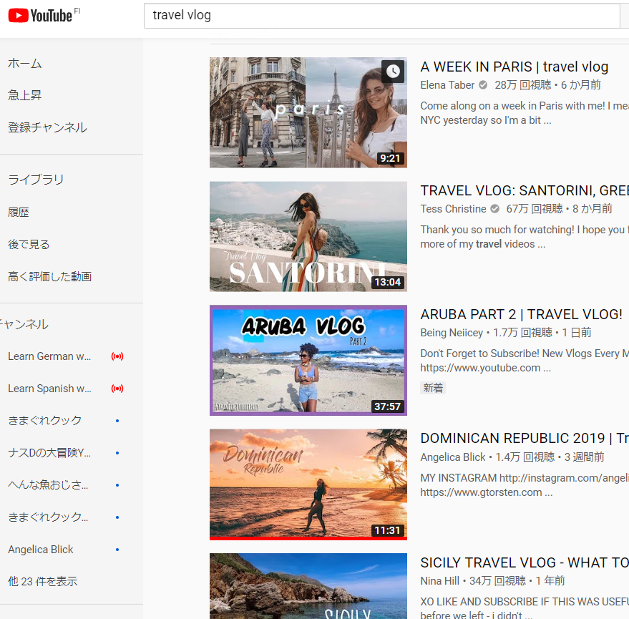
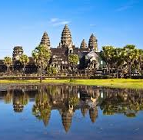
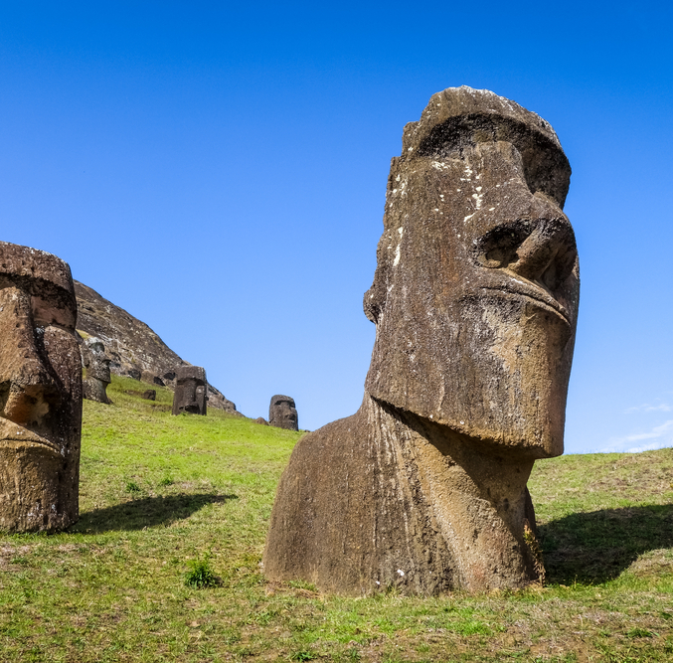


2. Watch video to get inspiration

Slide 7
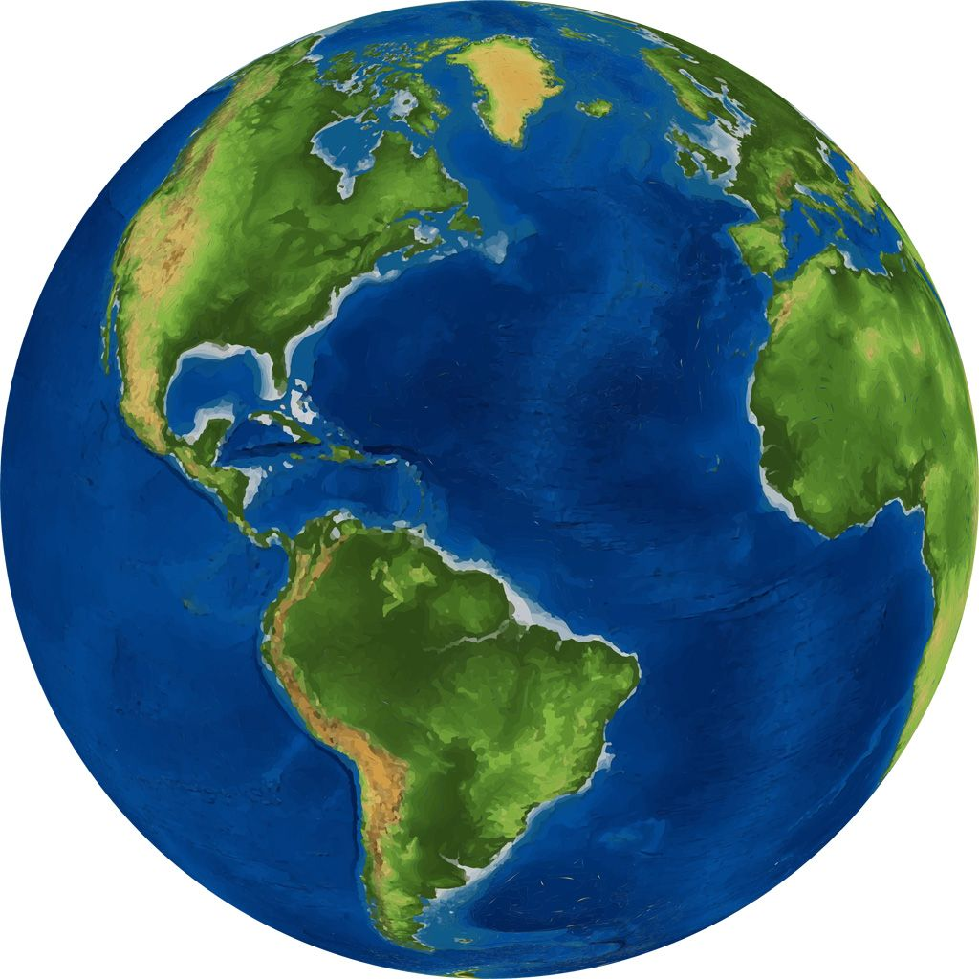

3. Pick up your countries that you want to go

Slide 8
4. Make the route
(reality plan)
When do you go?
How safe
it is?
How much money?
How long is this trip?
How do you transport?
Do you need a visa?

Slide 9
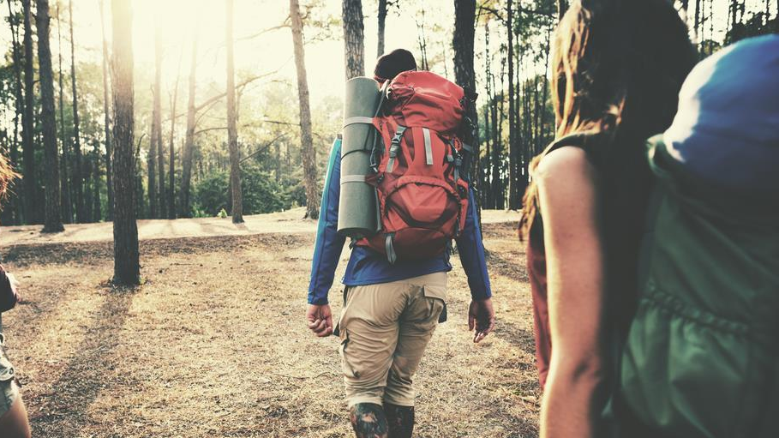
5. Prepare and start your journey!!

Slide 10

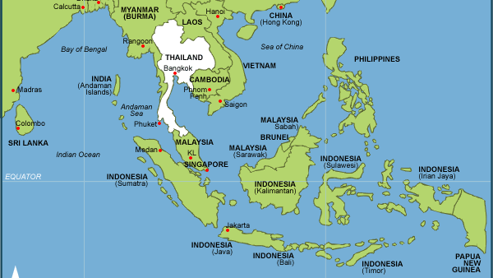
Southeast Asia
Concept:
It’s for people who are backpack beginners and if you don’t have so much time and money to travel. But you want to enjoy the journey and you want to experience different cultures and foods.

Slide 11
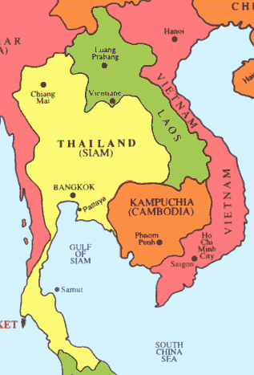
Model route
BANGKOK(Thailand)
SIEM REAP(Cambodia)
PHNOM PENH(Cambodia)
HOCHIMINH(Vietnam)
HANOI(Vietnam)
LUANG PRABANG(Laos)
VIENTIAN(Laos)
BANGKOK(Thailand)

Slide 12
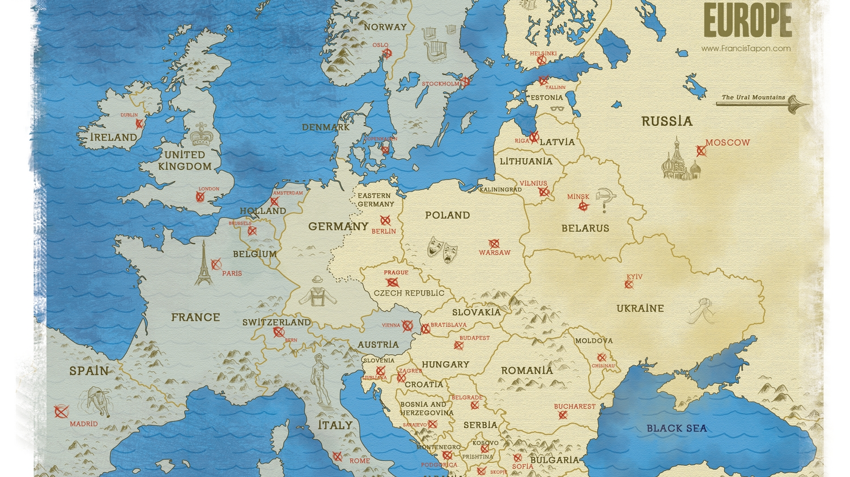
East europe
Concept:
It’s for people who want to go to Europe but the western Europe is too expensive to travel and you don’t have so much time. But you want to feel European culture and see beautiful European streets.

Slide 13
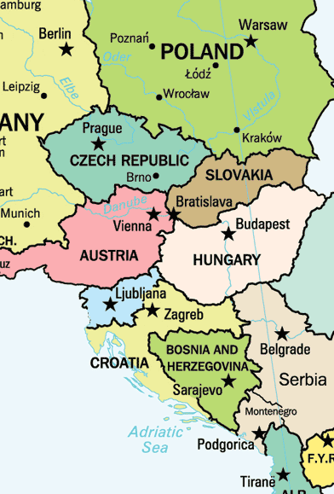
Model route
PRAGUE(Czech)
VIENNA(Austria)
BUDAPEST(Hungary)
HOLLOKO(Hungary)
BUDAPEST(Hungary)
ZAGREB(Croatia)
DOBROVNIK(Croatia)
ZAGREB(Croatia)

Slide 14
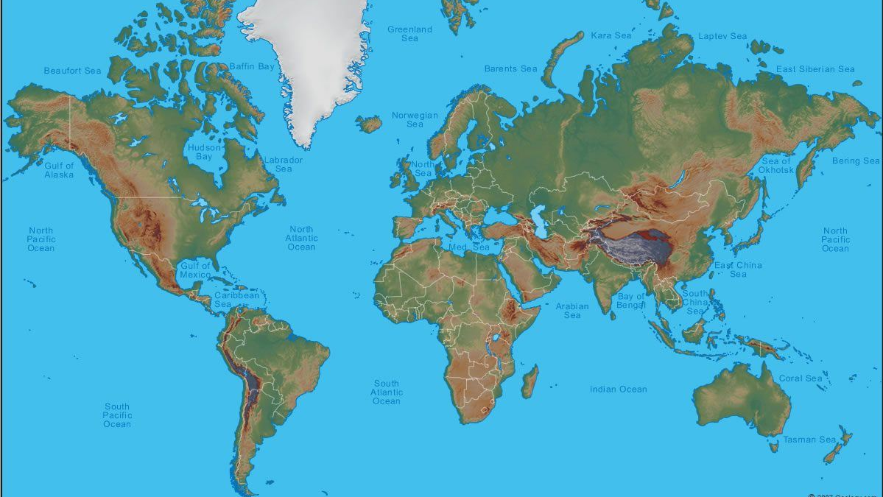
Around the world
Concept:
It’s for people who have a lot of time(like 1 year) to go to travel and who want to go and see places where people don’t normally go. In this route, you can see unforgettable views and get great experiences.

Slide 15
Where do you wanna go?
Oceania
Australia, New Zealand, New Caledonia
Asia
North America
China, India, Taiwan, Thailand, Cambodia, Singapore, Sri Lanka, Indonesia,
Canada, America, Mexico
South America
Europe
Brazil, Argentina, Bolivia, Chili, Peru, Ecuador,
UK, France, German, Italia, Greece, Ukraine, Spain, Finland, Norway, Sweden, Denmark, Netherland, Switzerland, Iceland, Russia
Africa
Egypt, Morocco, Zimbabwe, Namibia, South Africa

Slide 16
