Slide 1
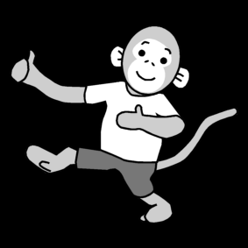

Five little monkeys
Five little monkeys jumping on the bed.
One fell off and bumped his head.
Mommy called the doctor and the doctor said:
No more monkeys jumping on the bed!
Four little monkeys jumping on the bed…
Three little monkeys jumping on the bed…
Two little monkeys jumping on the bed…
One little monkey jumping on the bed.
He fell off and bumped his head.
Mommy called the doctor and the doctor said:
No more monkeys jumping on the bed!
Kuva:

Slide 2


Teddy bear
Teddy bear, teddy bear turn around.
Teddy bear, teddy bear touch the ground.
Teddy bear, teddy bear touch your nose.
Teddy bear, teddy bear point your toes.
Teddy bear, teddy bear wear your shoes.
Teddy bear, teddy bear go to school.
Kuva:

Slide 3


Five little gingerbread men
Five little gingerbread men jumping on the bed.
One runs way, he is red.
Four little gingerbread men eating jello.
One runs away, he is yellow.
Three little gingerbread men acting mean.
One runs away, he is green.
Two little gingerbread men about to fall down.
One runs away, he is brown.
One little gingerbread man looking at you.
He runs away, he is blue.
Kuva:

Slide 4

What is a tree?
What is a tree?
A place to play, a wall to climb, a thing to swing.
What is a tree?
Adventures start when it can be anything.
- Gillian Graig -
Kuva:

Slide 5

What is a bed?
What is a bed?
A place to sleep, a land to dream, mind wandering.
What is a bed?
Adventures start when it can be anything.
- Gillian Graig -
Kuva:

Slide 6

What is a box?
What is a box?
A place to hide, a hat to wear, treasure glittering.
What is a box?
Adventures start when it can be anything.
- Gillian Graig -
Kuva:

Slide 7
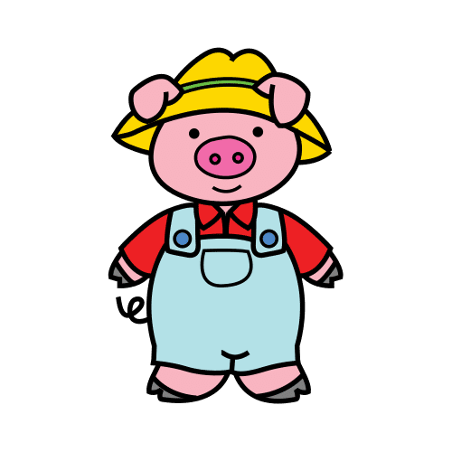
This Little Piggy
This little piggy went to market.
This little piggy stayed home.
This little piggy had roast beef.
This little piggy had none.
This little piggy cried, "Wee, wee, wee, wee."
All the way home.
Kuva:

