Slide 1
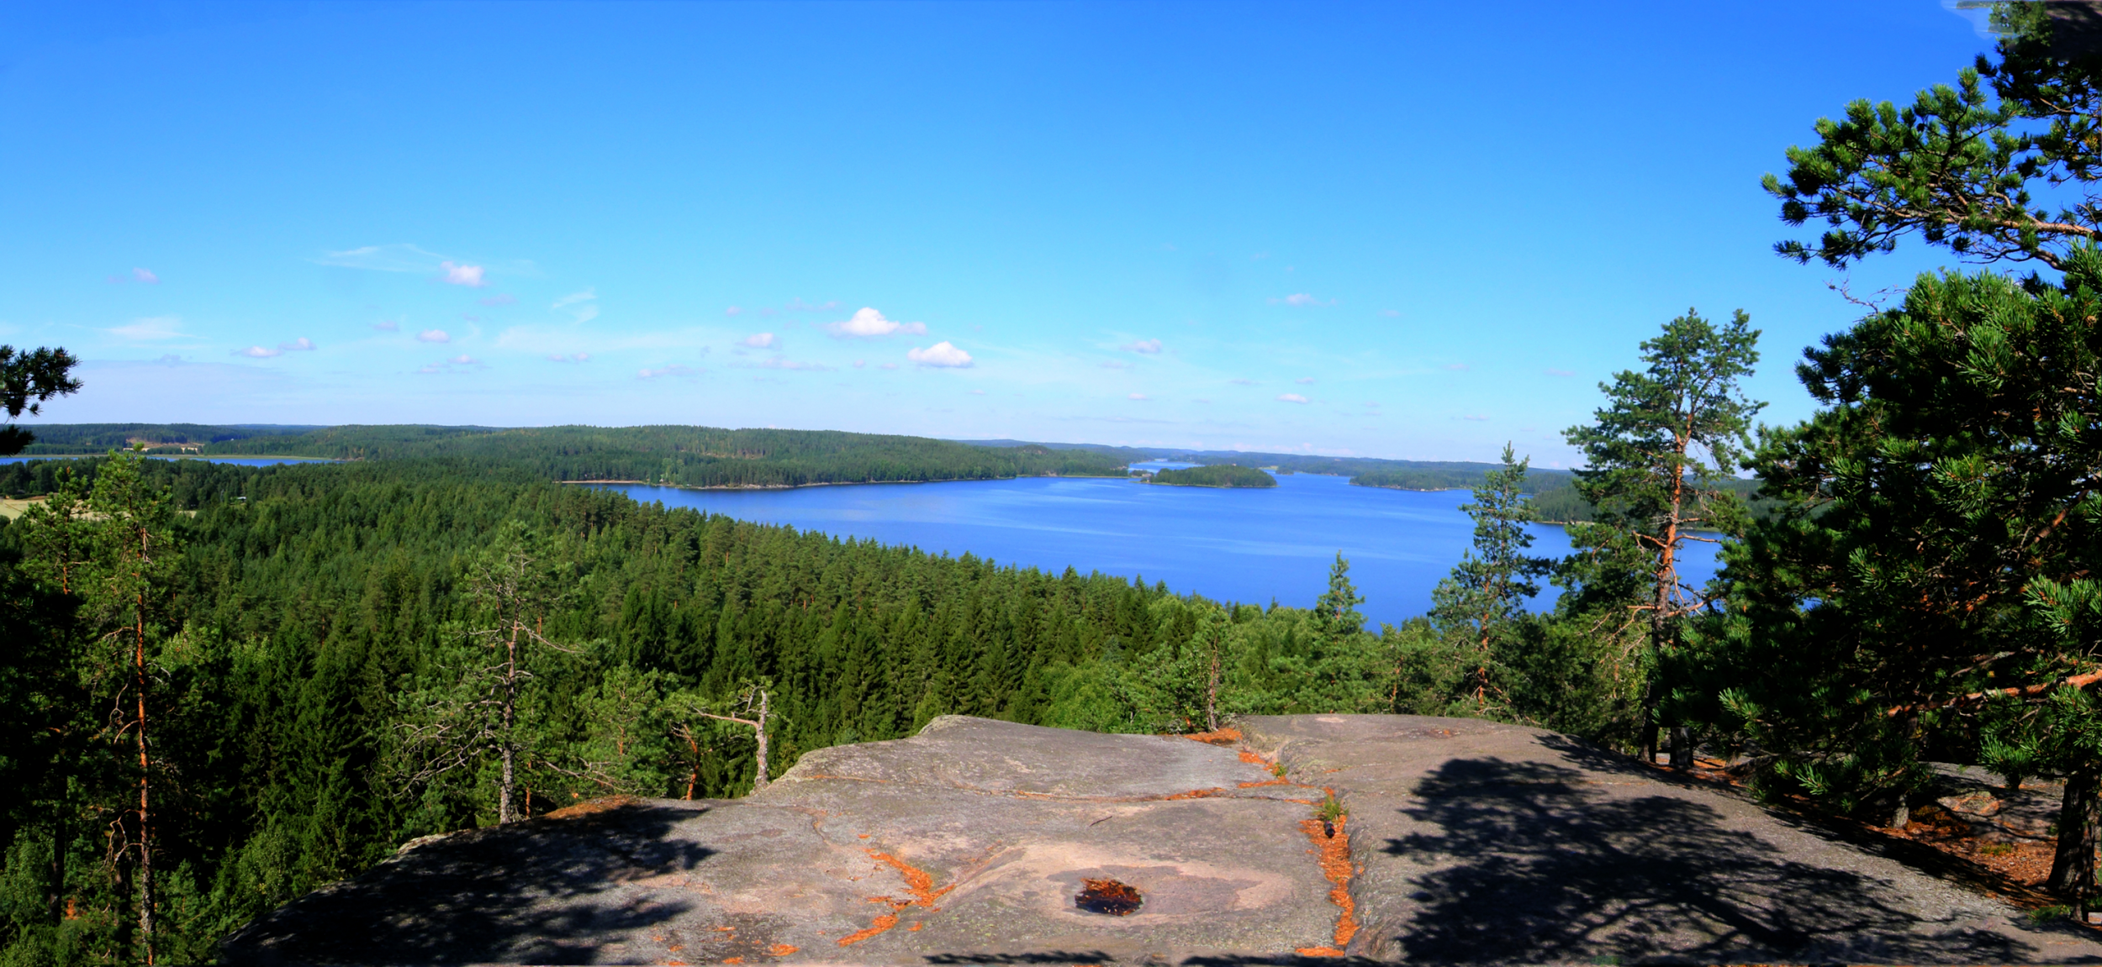

Iitti

Slide 2
Basic information
Population: 6900
Area: 687 km²
Region: Kymenlaakso
Location: Southern Finland
Founded: 1865

Slide 3
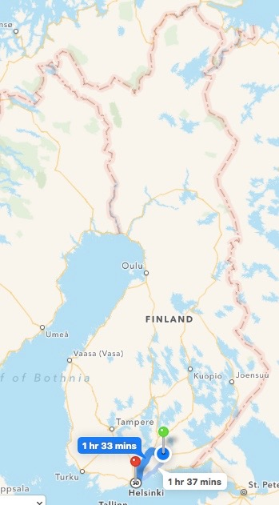
Kausala is about 130 km from Helsinki
It takes 1,5 h to drive to Helsinki
The nearest big city is Kouvola

Slide 4
Sights and activities
Hiidenvuori
Hiidenvuori Hill is located on a headland in Hiidensaari
It’s over 60m high
It is a regional attraction and venue for events in summertime, like night concerts
Iitin kirkonkylä (Iitti’s church village)
It was fourth in the prettiest village competition in 1991 (Europe)
There are lot of historical buildings in that area
Iitti’s church is located in church village
In Iitti’s church village are also located Iitti museum, where the permanent exhibition features peasant culture from the turn of the previous century

Slide 5
Sights and activities
Prehistoric Remains and Rock Paintings
In the Haukkaselkä area in northern Iitti, there are three rock paintings from the Stone Age.
Dwelling sites dating back to the same period have been found in the villages of Vuolenkoski and Lyöttilä.
Birdwatching Tower of Mukulanlahti
It’s one of the first birdwatching towers in Kymenlaakso
Beautiful nature
Kymijoki river
Forests
Iitti Golf
Hunting and fishing
Canoeing
Ice hockey
New ice rink located in Kausala

Slide 6
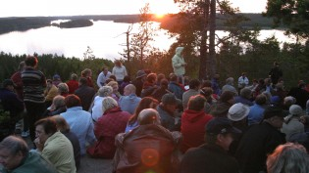
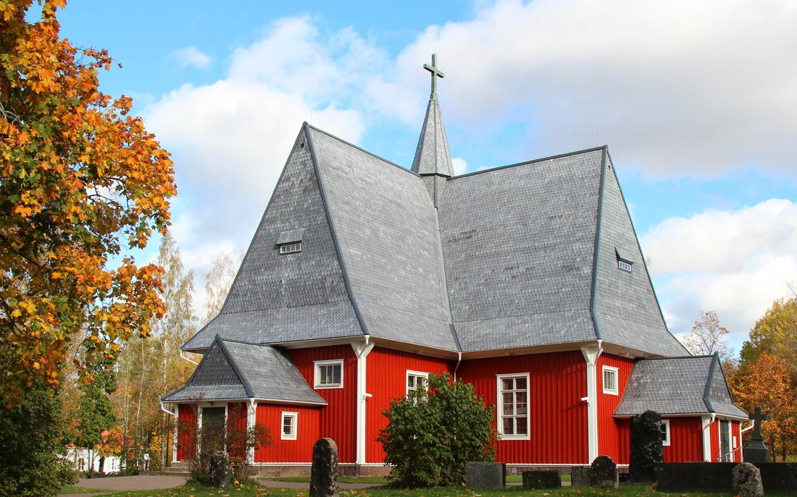
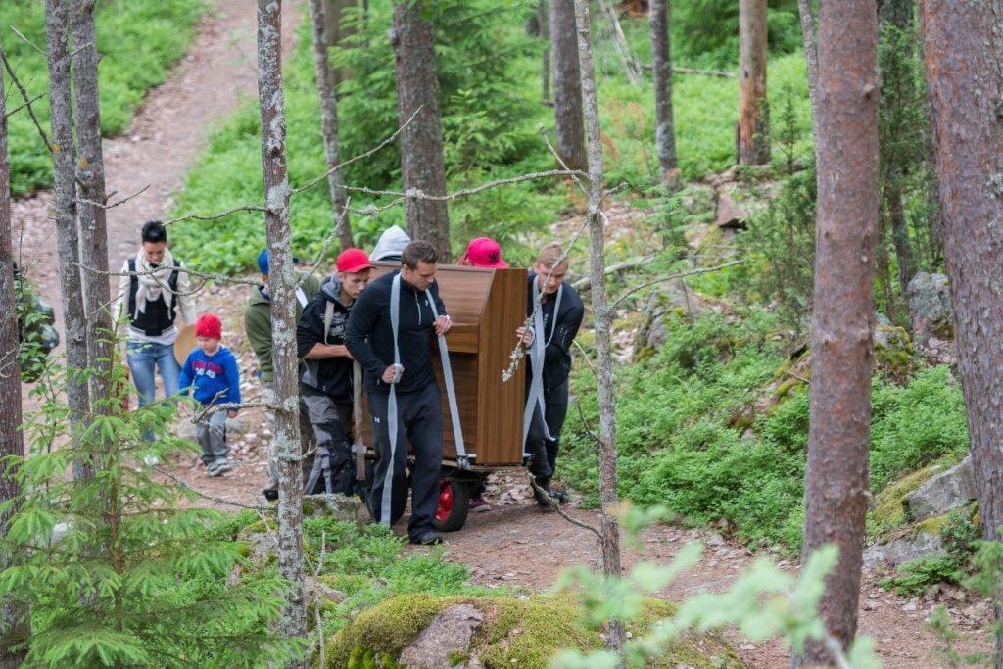
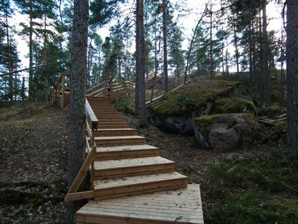

Slide 7
