Slide 1

Niittylahti School's Positive Pedagogy Action Model.

Slide 2
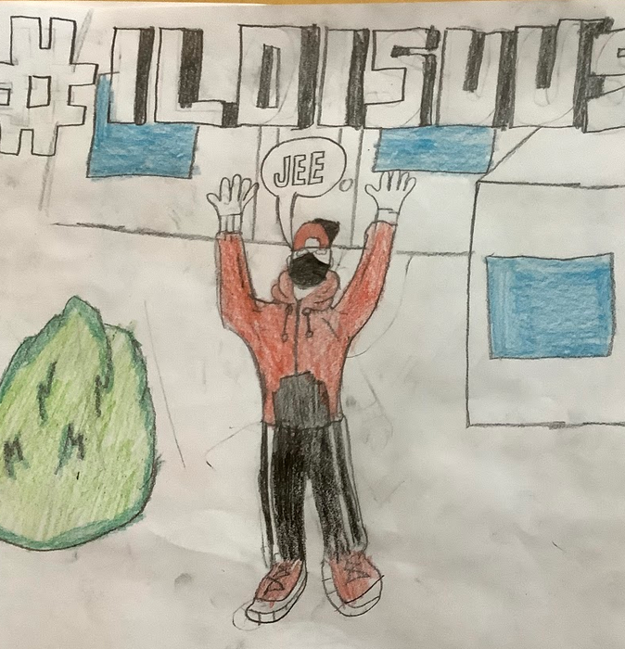
What is Positive Pedagogy?
Positive pedagogy is an educational approach based on positive psychology. In teaching and the overall school culture, it emphasizes respectful encounters with each student, assistance in challenges, and, above all, recognizing the good.
In a positive learning environment, the learner:
Can safely be their authentic self
Respects others and oneself
Experiences joy in their work
Behaves politely

Slide 3
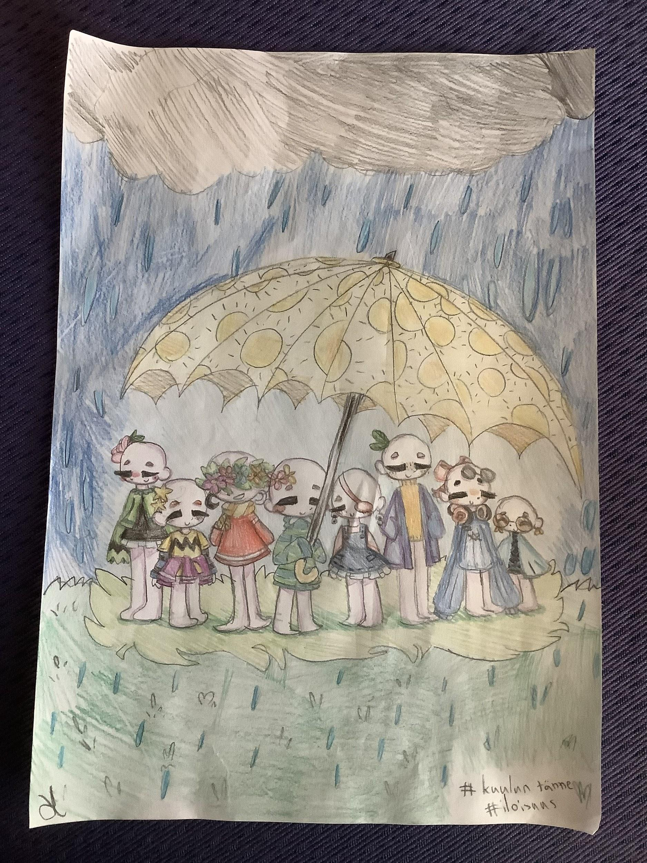
Positive pedagogy in Niittylahti School

Slide 4
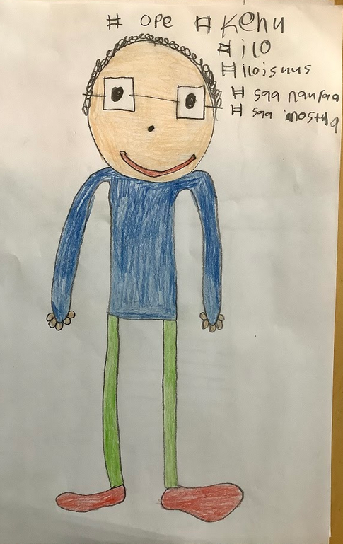
Positive pedagogy and positive psychology are evident in all activities at Niittylahti School.

Slide 5
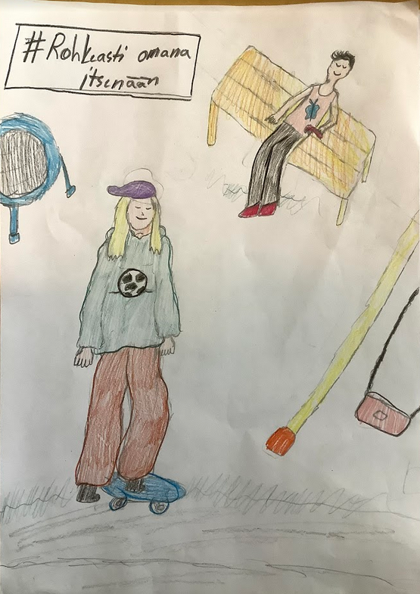
Niittylahti school
Noticing the positive aspects and expressing them aloud,
providing a safe and open learning environment,
cultivating a sense of feeling good, accepted, and valued,
avoiding haste to have time to hear and listen to children and adults,
accepting and safe space for differing opinions and discussions from various perspectives,
regularly practicing acknowledging the good in oneself and others,
regularly practicing skills in self-awareness, gratitude, forgiveness, and well-being

Slide 6
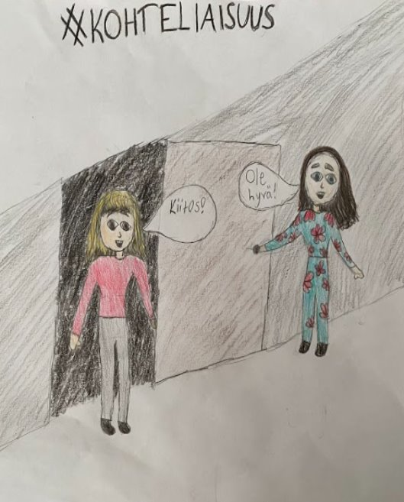
The positive work community of Niittylahti School.
The values and habits of adults are conveyed through example to children. Therefore, in the Niittylahti School's work community
We notice small strengths and good moments.
We are present when someone needs support and also when there is a need for a chat.
There is an accepting atmosphere where diversity is seen as a strength.
Joy can be experienced in work and being together.
It is pleasant to come to work.
In a good work community, there is laughter and compassion.
The school has a positive and cheerful atmosphere of collaboration, supporting and encouraging each other

Slide 7
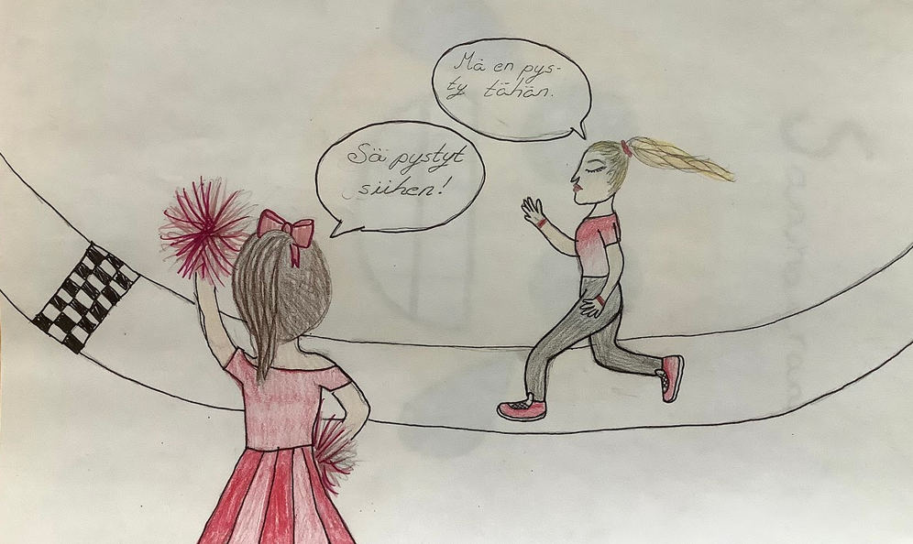
The positive collaboration between Niittylahti School and families
The foundation of collaboration is the realization that home and school sincerely pursue the same goal: the well-being and good life of the child. The shared objective supports and enables collaboration in an atmosphere of mutual consideration, attentive listening, and respect.

Slide 8
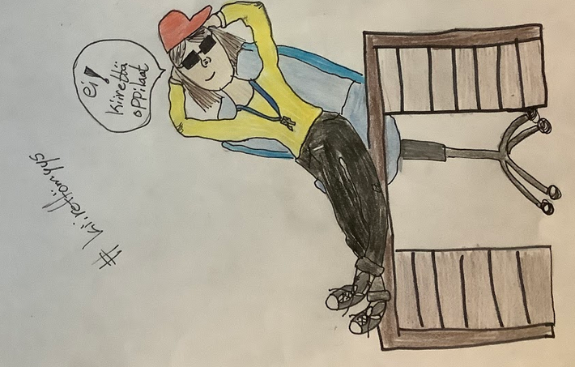
#Hashtags for Positive Pedagogy
#Joyfulness #Positivity #CarpeDiem
#Openness #FeelingSafe
#EmpathySkills #StudentAwereness
#BeBoldlyYourself #WellbeingSkills
#NoticeTheGoodInYourself #NoticeTheGoodInOthers
#NoHurry #PauseAndReflect
#MistakesAreGifts

Slide 9
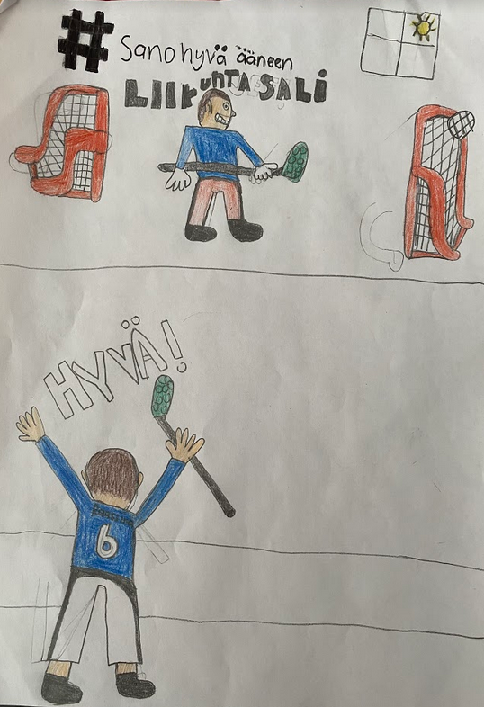
#Love #It'sOkayToDisagree #Hopefulness
#Gratitude #Smile #Politeness
#BelieveInYourself #Joy #Encourage #Praise
#ThankYou #Encounter #CanDoAttitude
#SpeakPositively #Safety
#Acceptance #BeInspired
#SmileBack #ListenHere

Slide 10
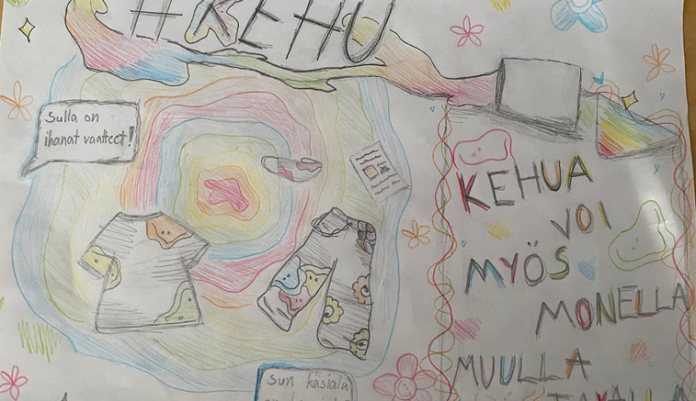
Concrete measures
The toolkit of Positive Pedagogy

Slide 11
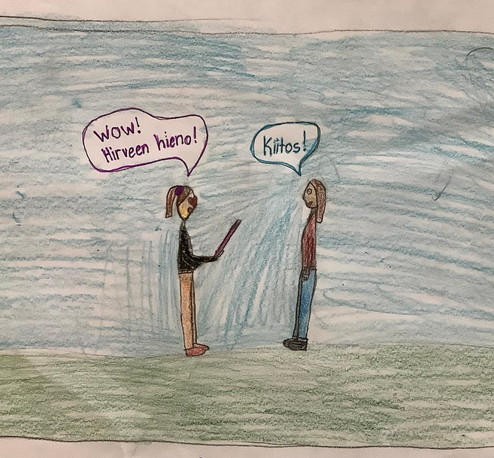
"What Went Well" board on the wall.
Smile boards.
Bead jar: students notice positive actions in each other.
Bead jar: a shared goal, and when achieved, a common reward is earned.
Strength cards and strength sessions.
Emotional/social skills session/moment regularly.
Positive CV (Curriculum Vitae)

Slide 12
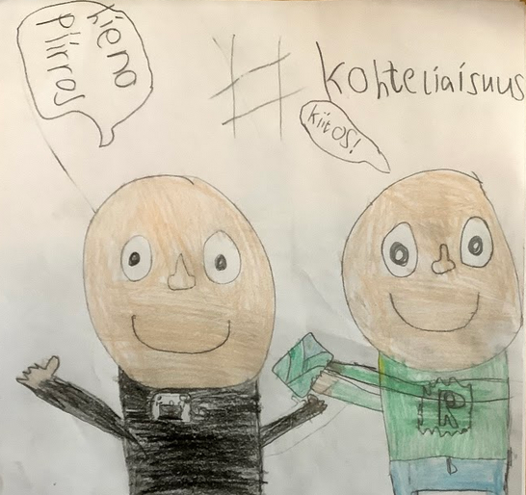
Star Student and Star Student Day (Week)
Compliment Bench in groups
Kiva School - emotional skills package
MOK (Mistake of the Week) Week
Each grade has its own annual calendar with one theme/month. Commitment to using the calendar on all grade levels.
Improve existing lesson plans from Rovaniemi's well-being calendar.
Feeling Journal: filled out weekly/daily/over a specific period, where the student records and reflects on what was enjoyable during that period at school and in which areas they have succeeded personally.

Slide 13
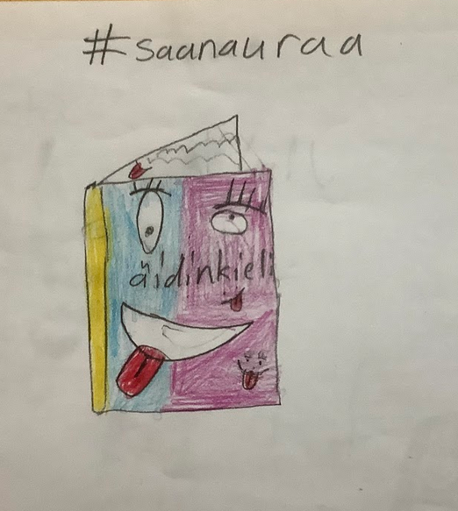
Strength Heart: each person draws/writes in the heart a strength they would like to share with other classmates.
Anonymous compliments, for example, written on a separate note.
Friendship Day Heart.
Making virtues visible.
Teacher praises and encourages a student out loud in the classroom or in front of others.
Theme week.
Laughing together at jokes/situational comedy.
Informing parents about successes with a Wilma notification or a phone call.

Slide 14
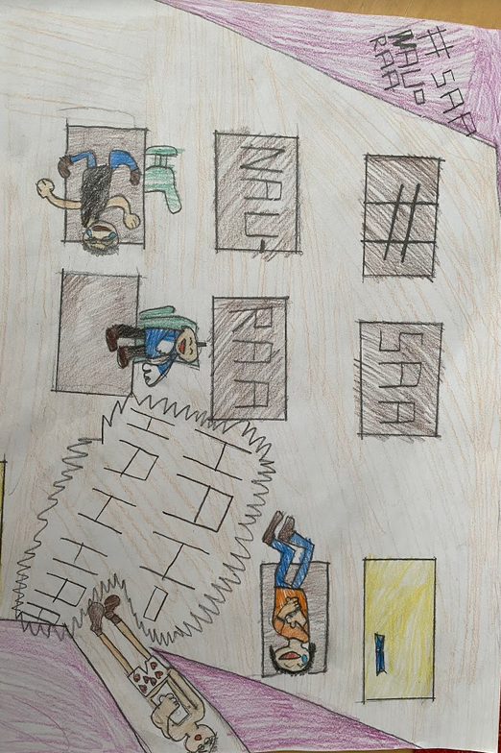
Grade-Specific Concrete Measures

Slide 15
Grade 1
Bead jar: a shared goal, and when it is achieved, a common reward is earned.
Star Student and Star Student Day (Star Student Week).
Acts of kindness, acknowledging the doer, for example, with a trophy.
Teacher praises and encourages a student out loud in the classroom or in front of others.
Acknowledging and sharing all kinds of emotions.
#NoHurry
#Joy
#MistakesAreGifts
#Praise

Slide 16
Grade 2
Anonymous compliments from classmates twice per semester before holidays (fall, Christmas, winter, and summer break). Each student gets a personalized note as a keepsake.
Bead jar: a shared goal, and when it is achieved, a common reward is earned.
Theme week: taking into account students' opinions, plan a positivity week 1-2 times per school year.
Enhance ready-made lesson plans from Rovaniemi's well-being calendar.
#NoHurry
#NoticeTheGoodInYourself
#NoticeTheGoodInOthers
#SmileBack

Slide 17
Grade 3
Compliment board: either the teacher or students notice a good deed, and the person's name is added to the compliment board for the day.
Together We're More: a shared goal, and when achieved, small treasures are placed in a jar, with the reward being a jointly agreed-upon enjoyable activity.
Regular positive Wilma notifications by the teacher.
Speak positively aloud: practice verbalizing good deeds.
#IListen
#IDiscuss
#IEncourage
#IPraise
#IThank

Slide 18
Grade 4
In the fourth grade, a yearly calendar is introduced, featuring three themes in the fall and three in the spring.
Fall themes: community, empathy, and social skills.
Spring themes: self-awareness, personal well-being, and relaxation.
Each theme's introductory session takes place in the fall semester in September, October, and November, and in the spring semester in January, February, and early March.
#CanDoAttitude
#Positivity
#Joy
#Encourage

Slide 19
Vuosiluokka 5
Generally, we avoid haste and practice acknowledging the good. In activities and discussions, there is an emphasis on the consistency of common goals for children and young people, with children at the center and adults providing support. Concrete measures include using a yearly calendar with five themes, reward jars, and strength sessions. The themes revolve around kindness, gratitude, self-control, perseverance, and a sense of belonging.
Students are rewarded for their achievements, and when a goal is reached, the accomplishment is celebrated together in a modest manner. Additionally, the teacher gives vocal praises in the classroom for good actions, sends a message home acknowledging the positive contribution of the student, highlighting details or positive developmental trends.
#EmpathySkills
#StudentAwareness
#NoHurry

Slide 20
Grade 6
In the sixth grade, a bead jar is introduced: a common goal is chosen, and when achieved, a shared reward is earned.
Additionally, a yearly calendar is implemented in the sixth grade: two themes in the fall and three themes in the spring. Fall themes include social skills, conflict resolution, and community. Spring themes include relaxation and calming, self-awareness, and empathy.
The introductory session for each theme is held in the fall semester in September and November, and in the spring semester in January, February, and early April.
#Politeness
#NoticeTheGoodInOthers
#SpeakPositivelyAloud

