Slide 1

A.R.T.I.S.A.N.S at school
Welcome to Iisalmi 8.4.2019
Welcoming address by Sara Niini
Photos Sara Niini

Slide 2
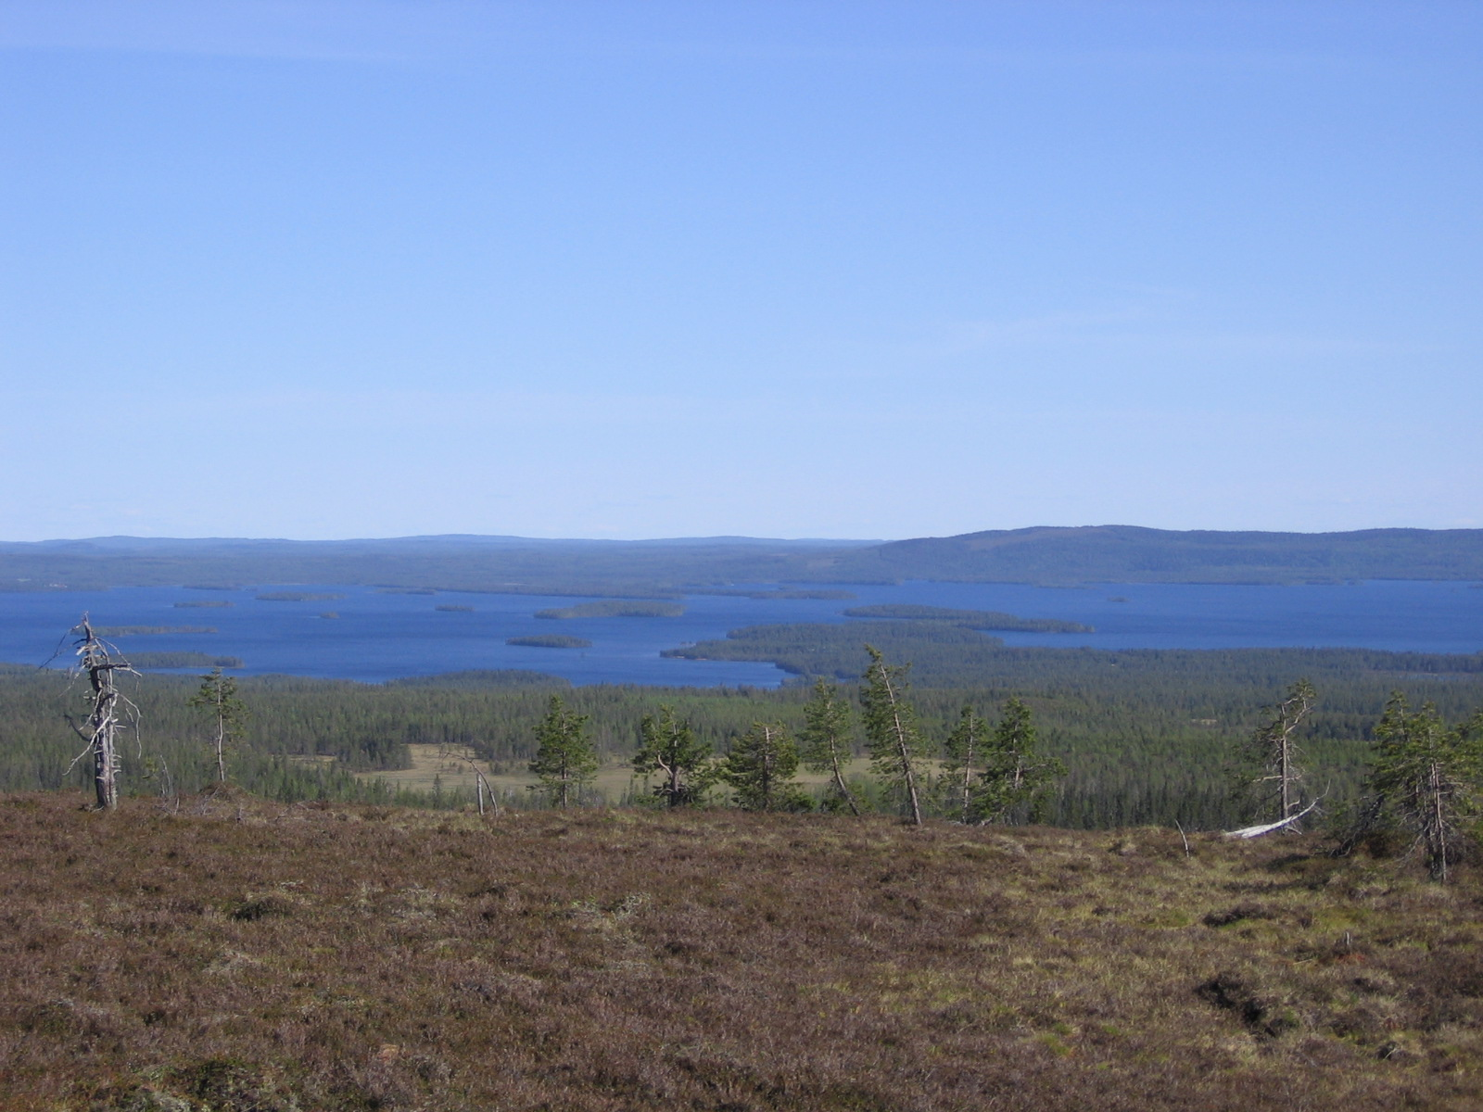
When our ancestors came to Finland some 10 000 years ago, at the time the last Ice Age was melting, there was only water from where barren earth started to emerge…

Slide 3
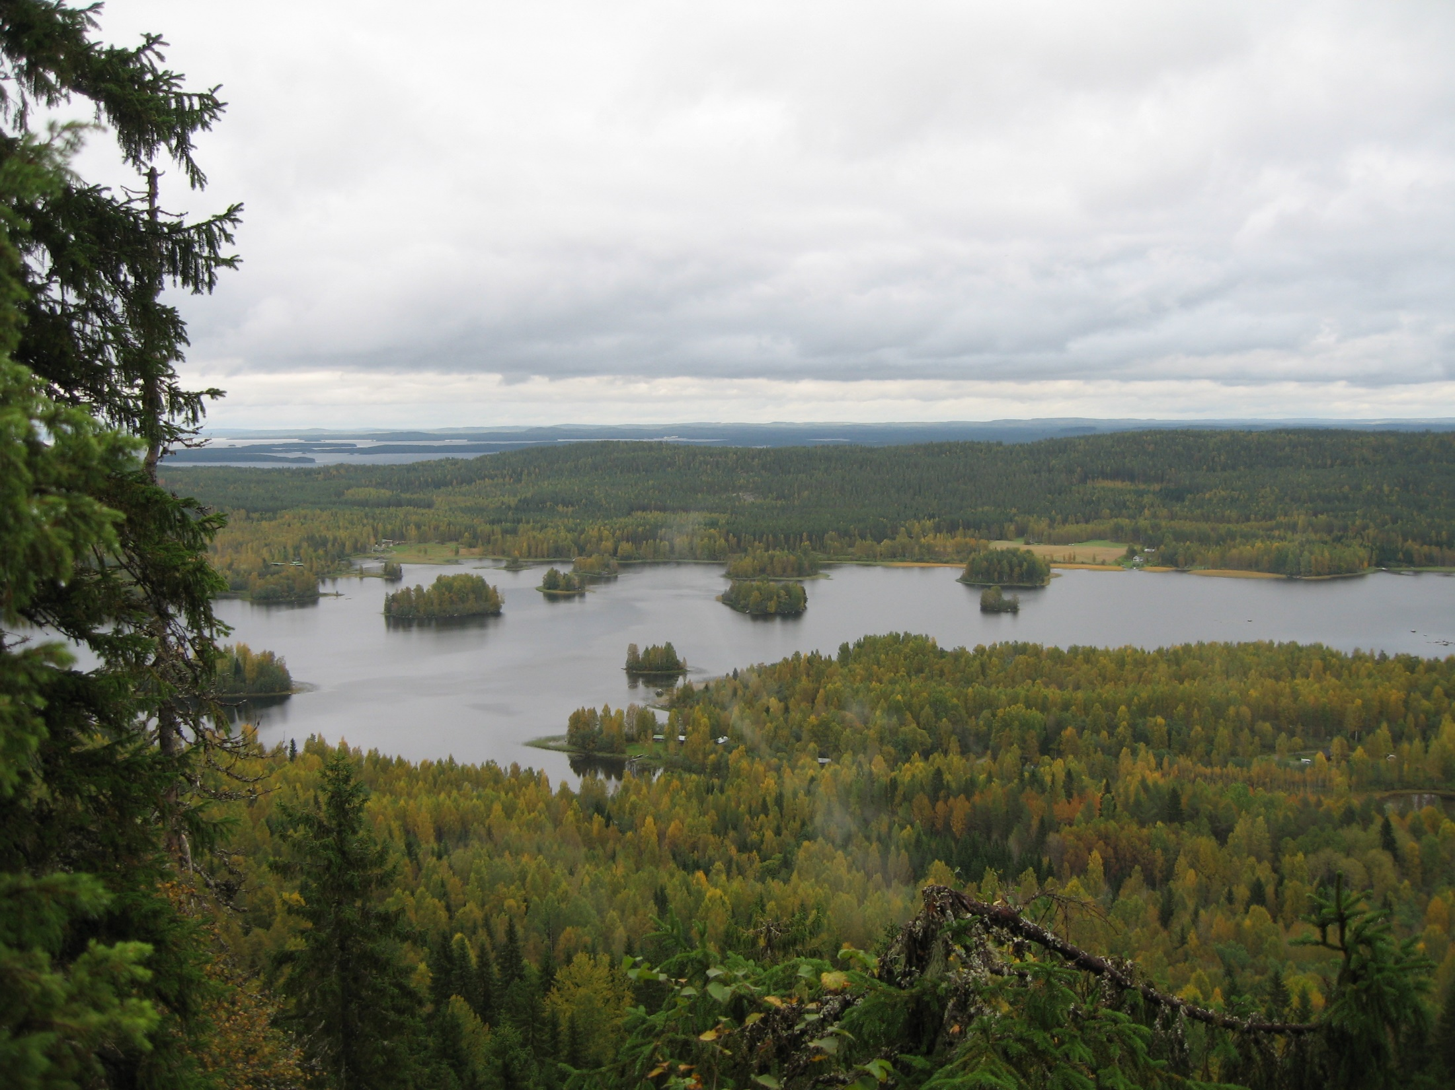
But soon forest started to grow everywhere, and our land was covered with either forest, swamps or lakes. The life was really tough, harsh and hard – cold and hunger were constant companions. The only way of survival was hunting, fishing and learning to use wood for everything.

Slide 4
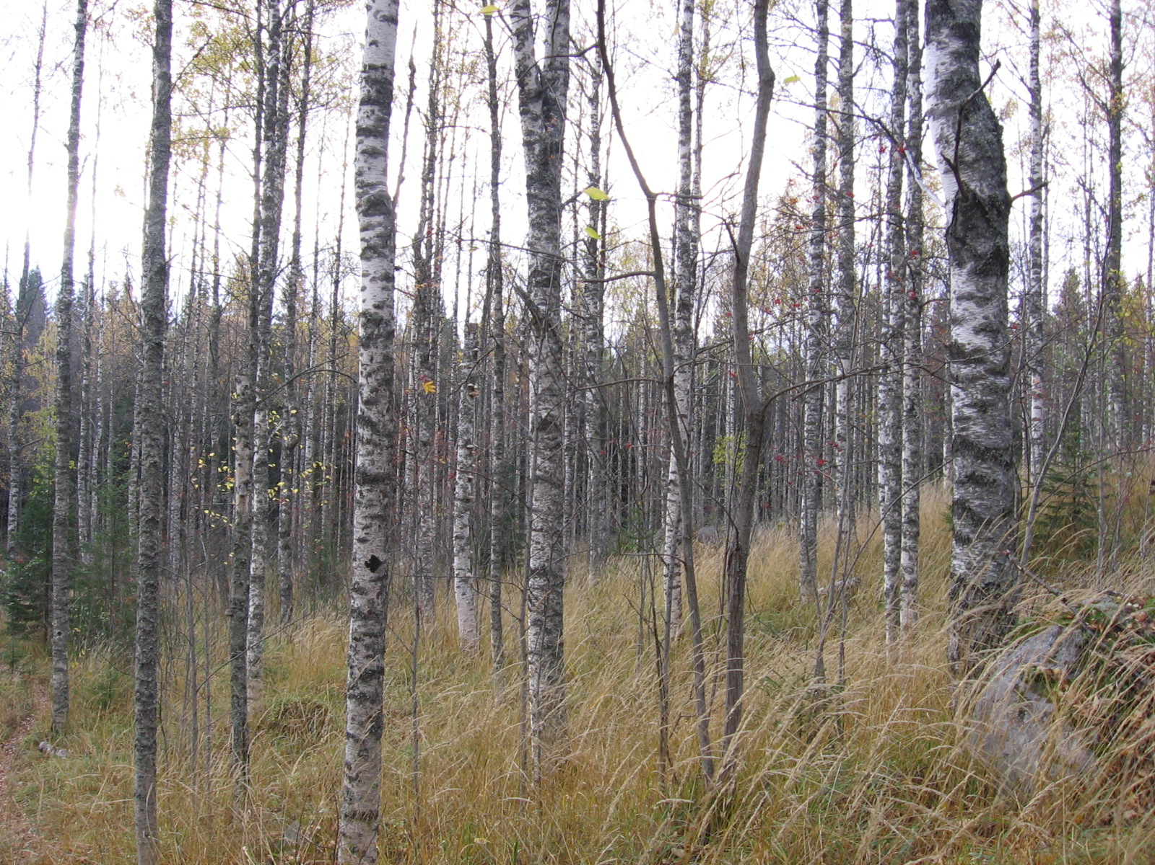
The Finnish became very good in wood-work; the fore-fathers knew exactly which tree species could be used for which purpose
Notes:
All the different treespecies had different uses. You can see the timber specimens over there in the table…

Slide 5
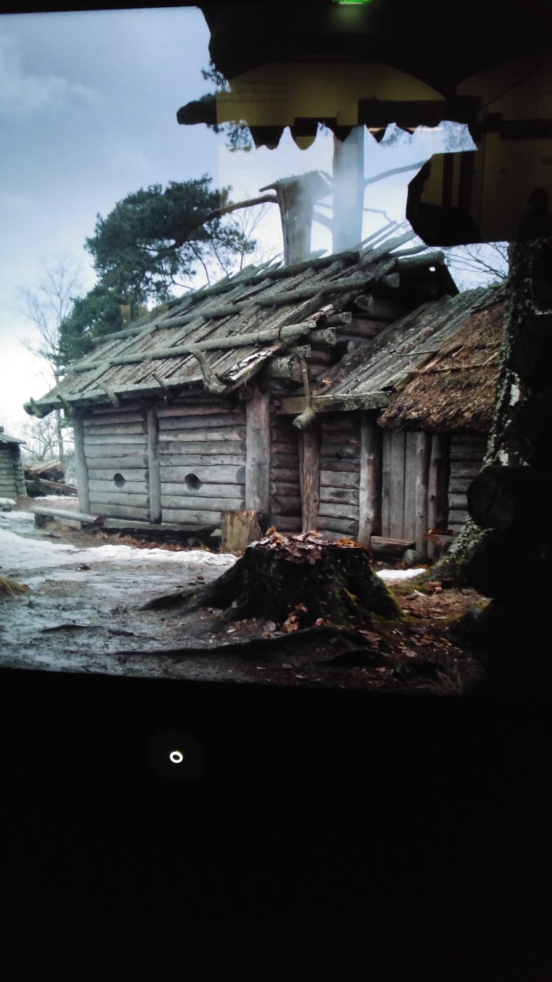
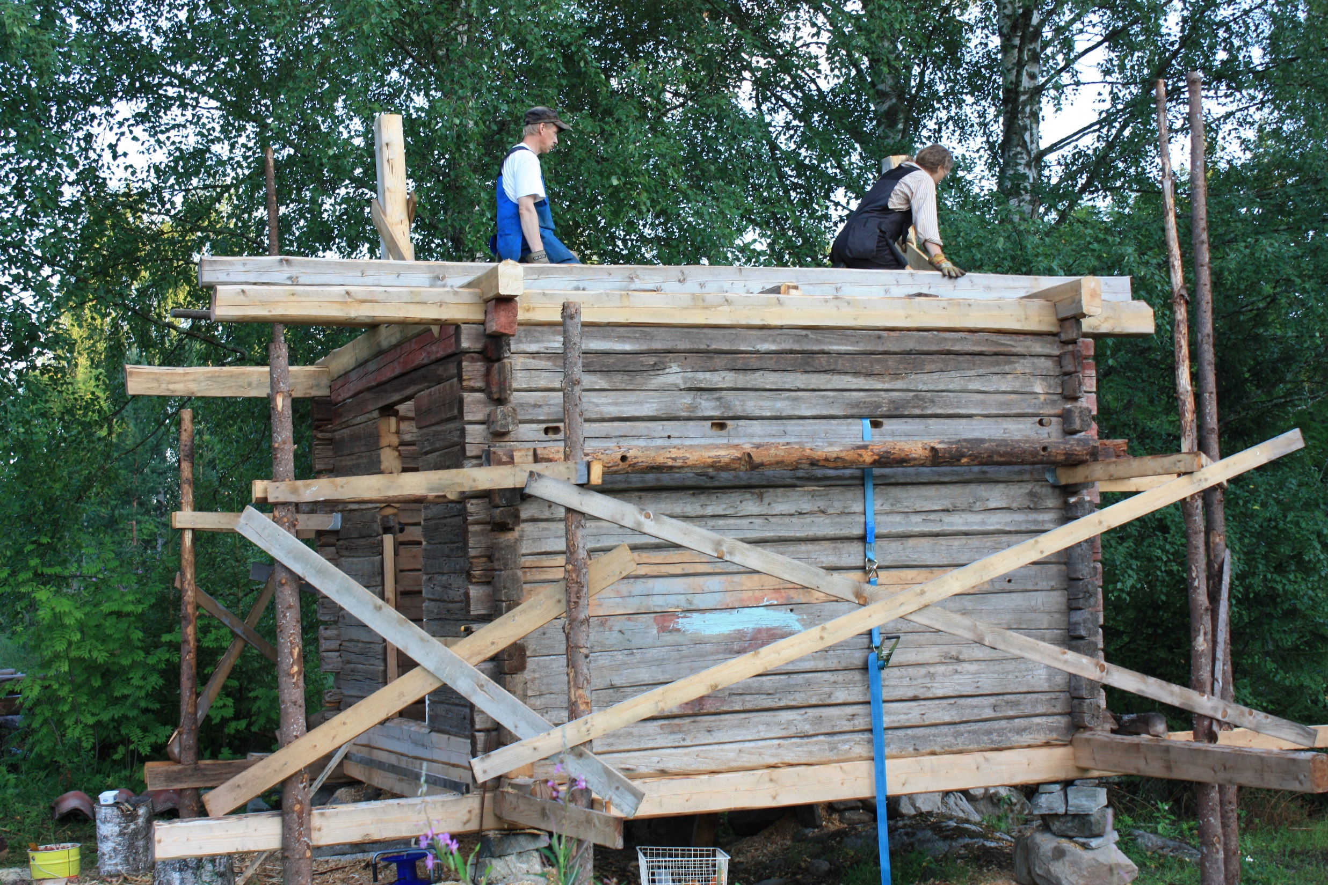
All they had, was an axe and a knife, of which you had to be a skillful user in order to survive. They had to know how to make a house, how to warm it and how to make all the utensils for everyday-life.

Slide 6
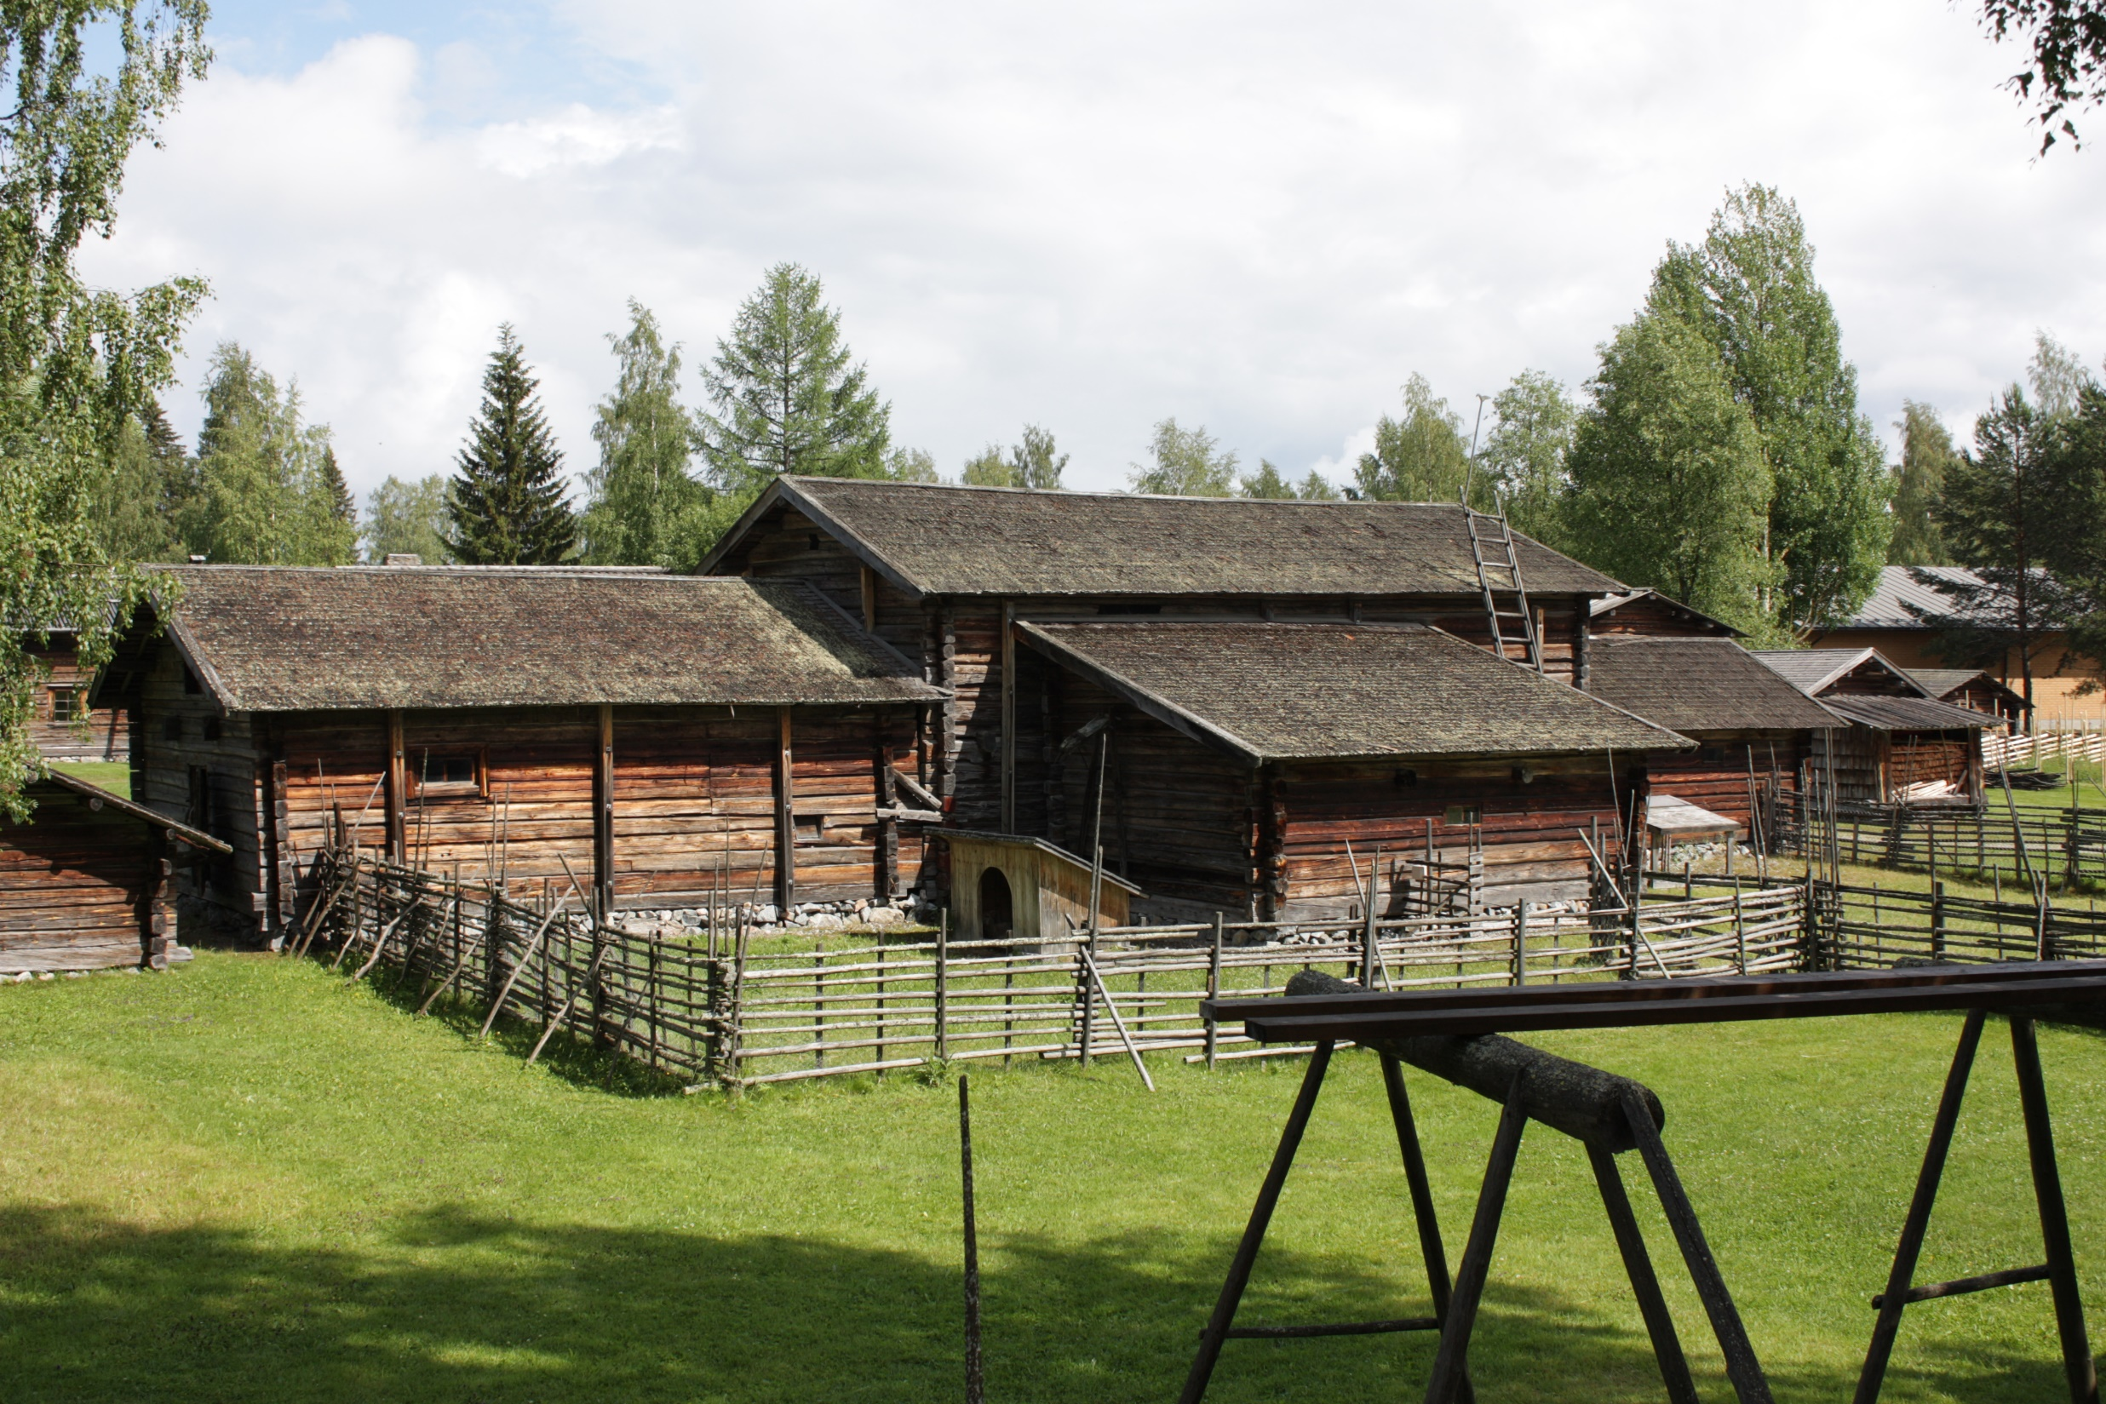
The skillful men could build log houses, barns, sheds and fences withour using any metal nails. They also knew how to repair them all the time, but compared to the Medeterranean region, we have very little history left, as the wooden houses decay eventually into the soil.

Slide 7
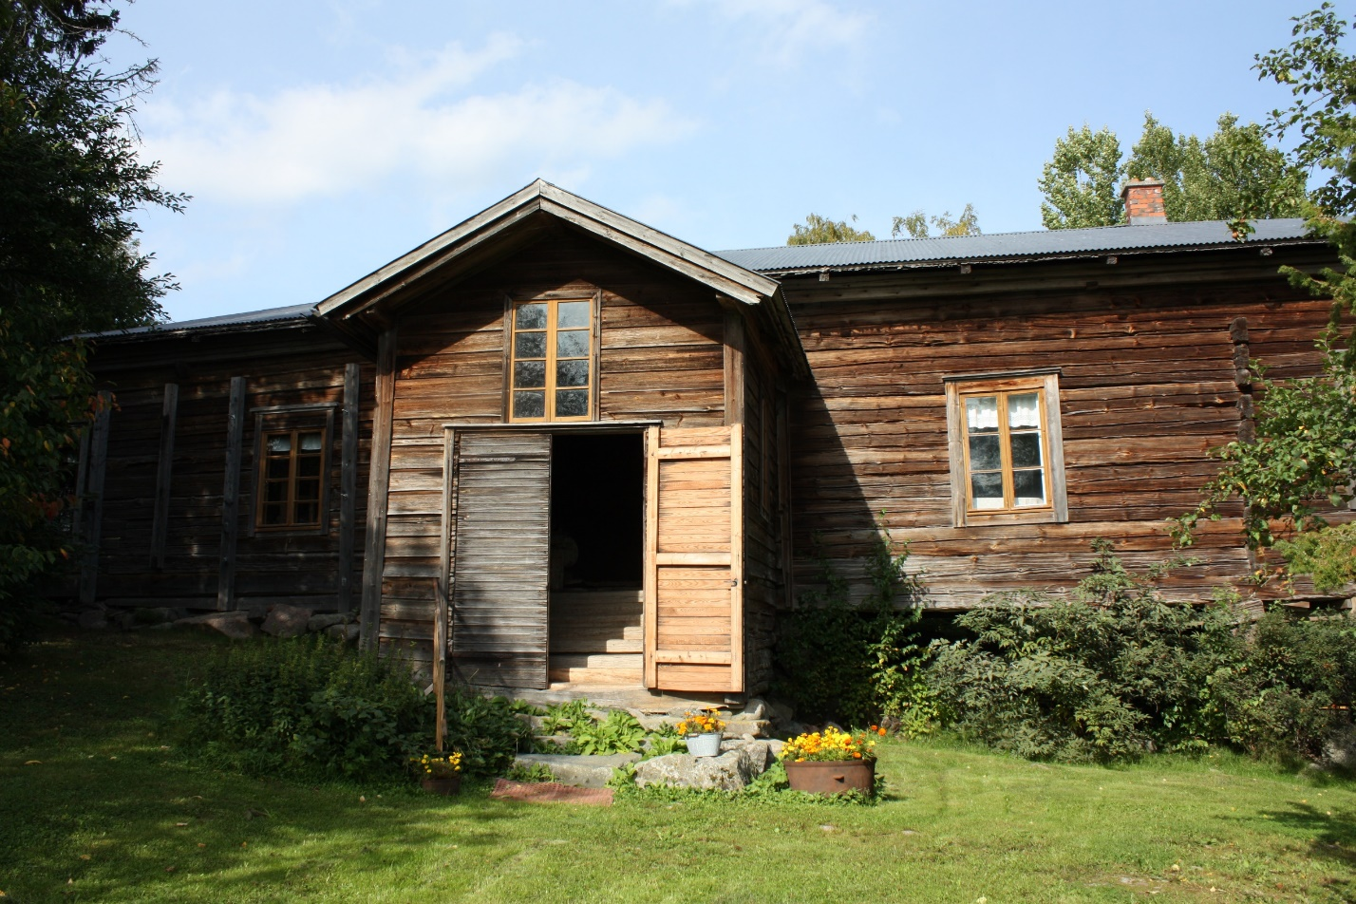
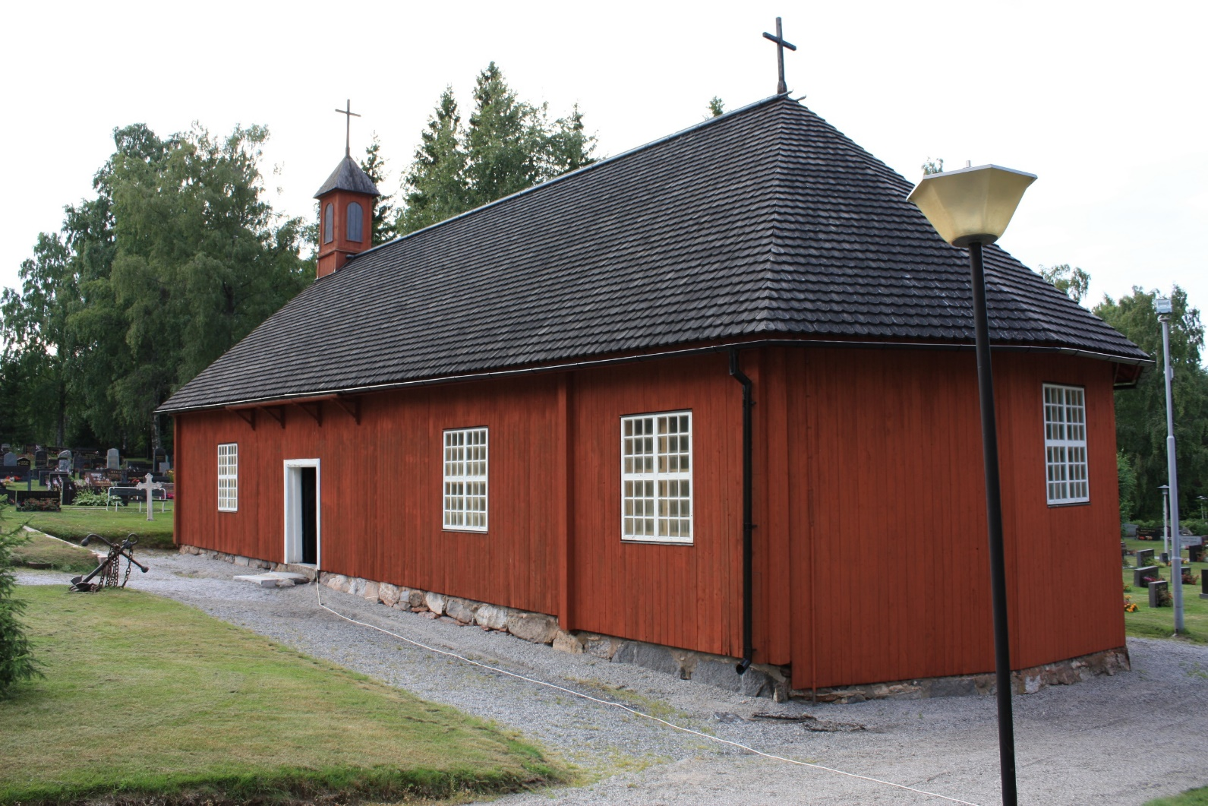
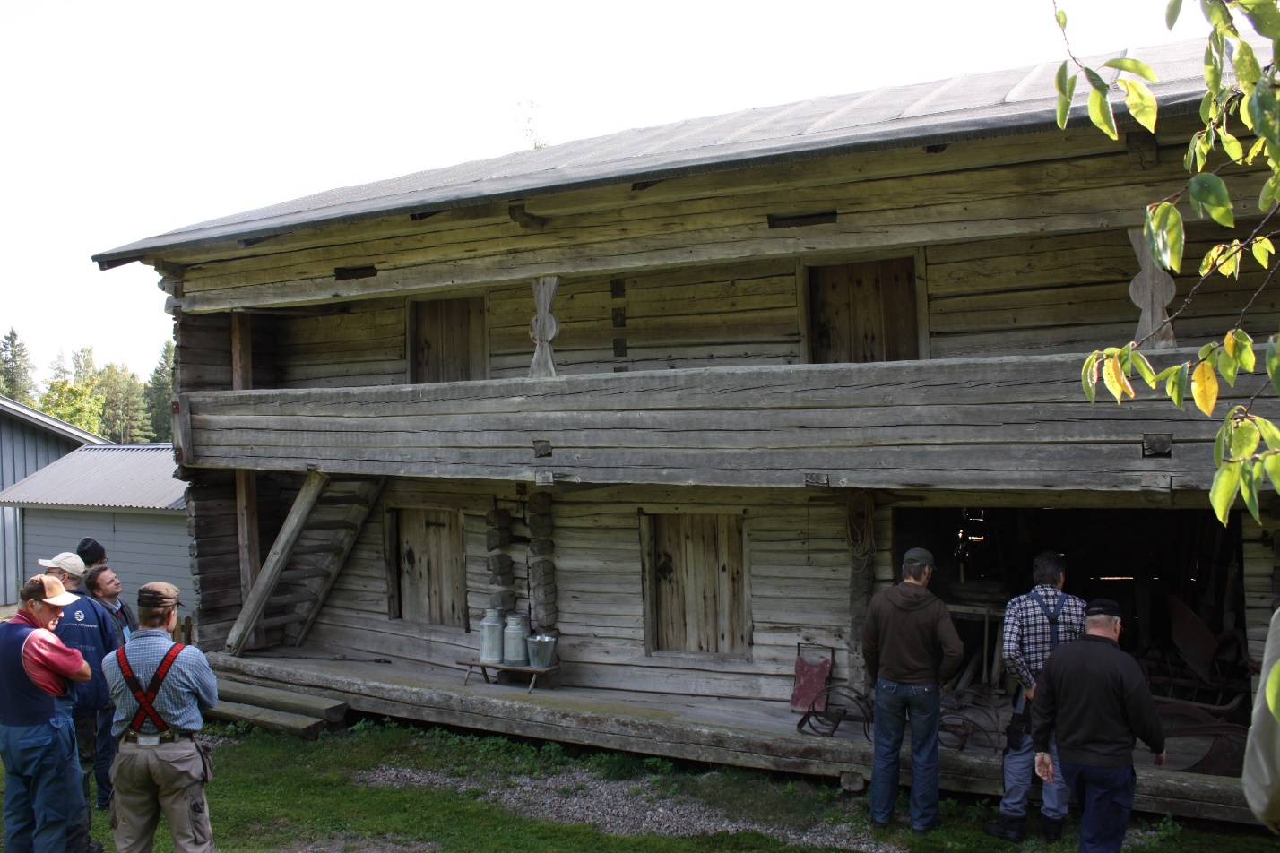
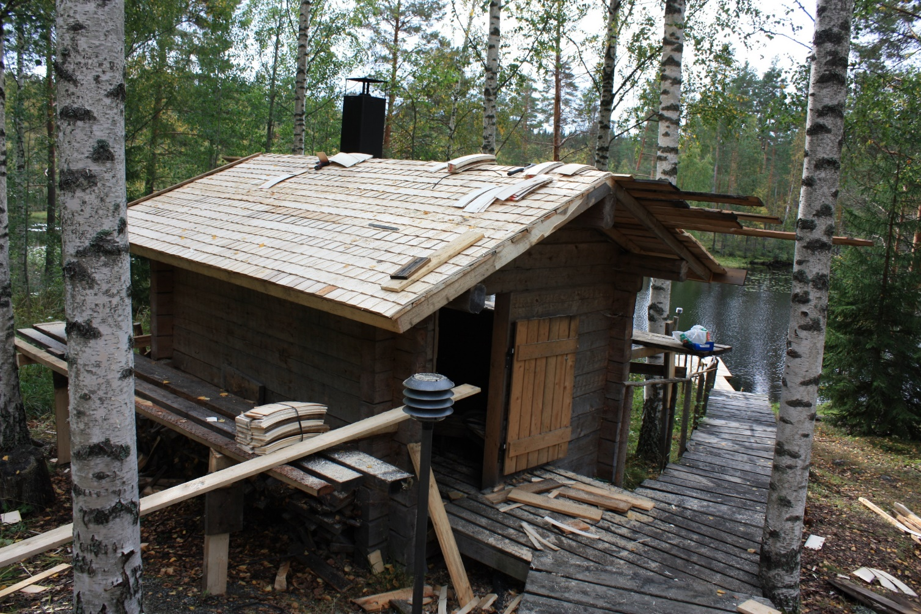
Even the churches were made of wood, not to mention ordinary houses and ware-houses. Many buildings burnt because of the heating, or they just got abandoned and rotted away.

Slide 8
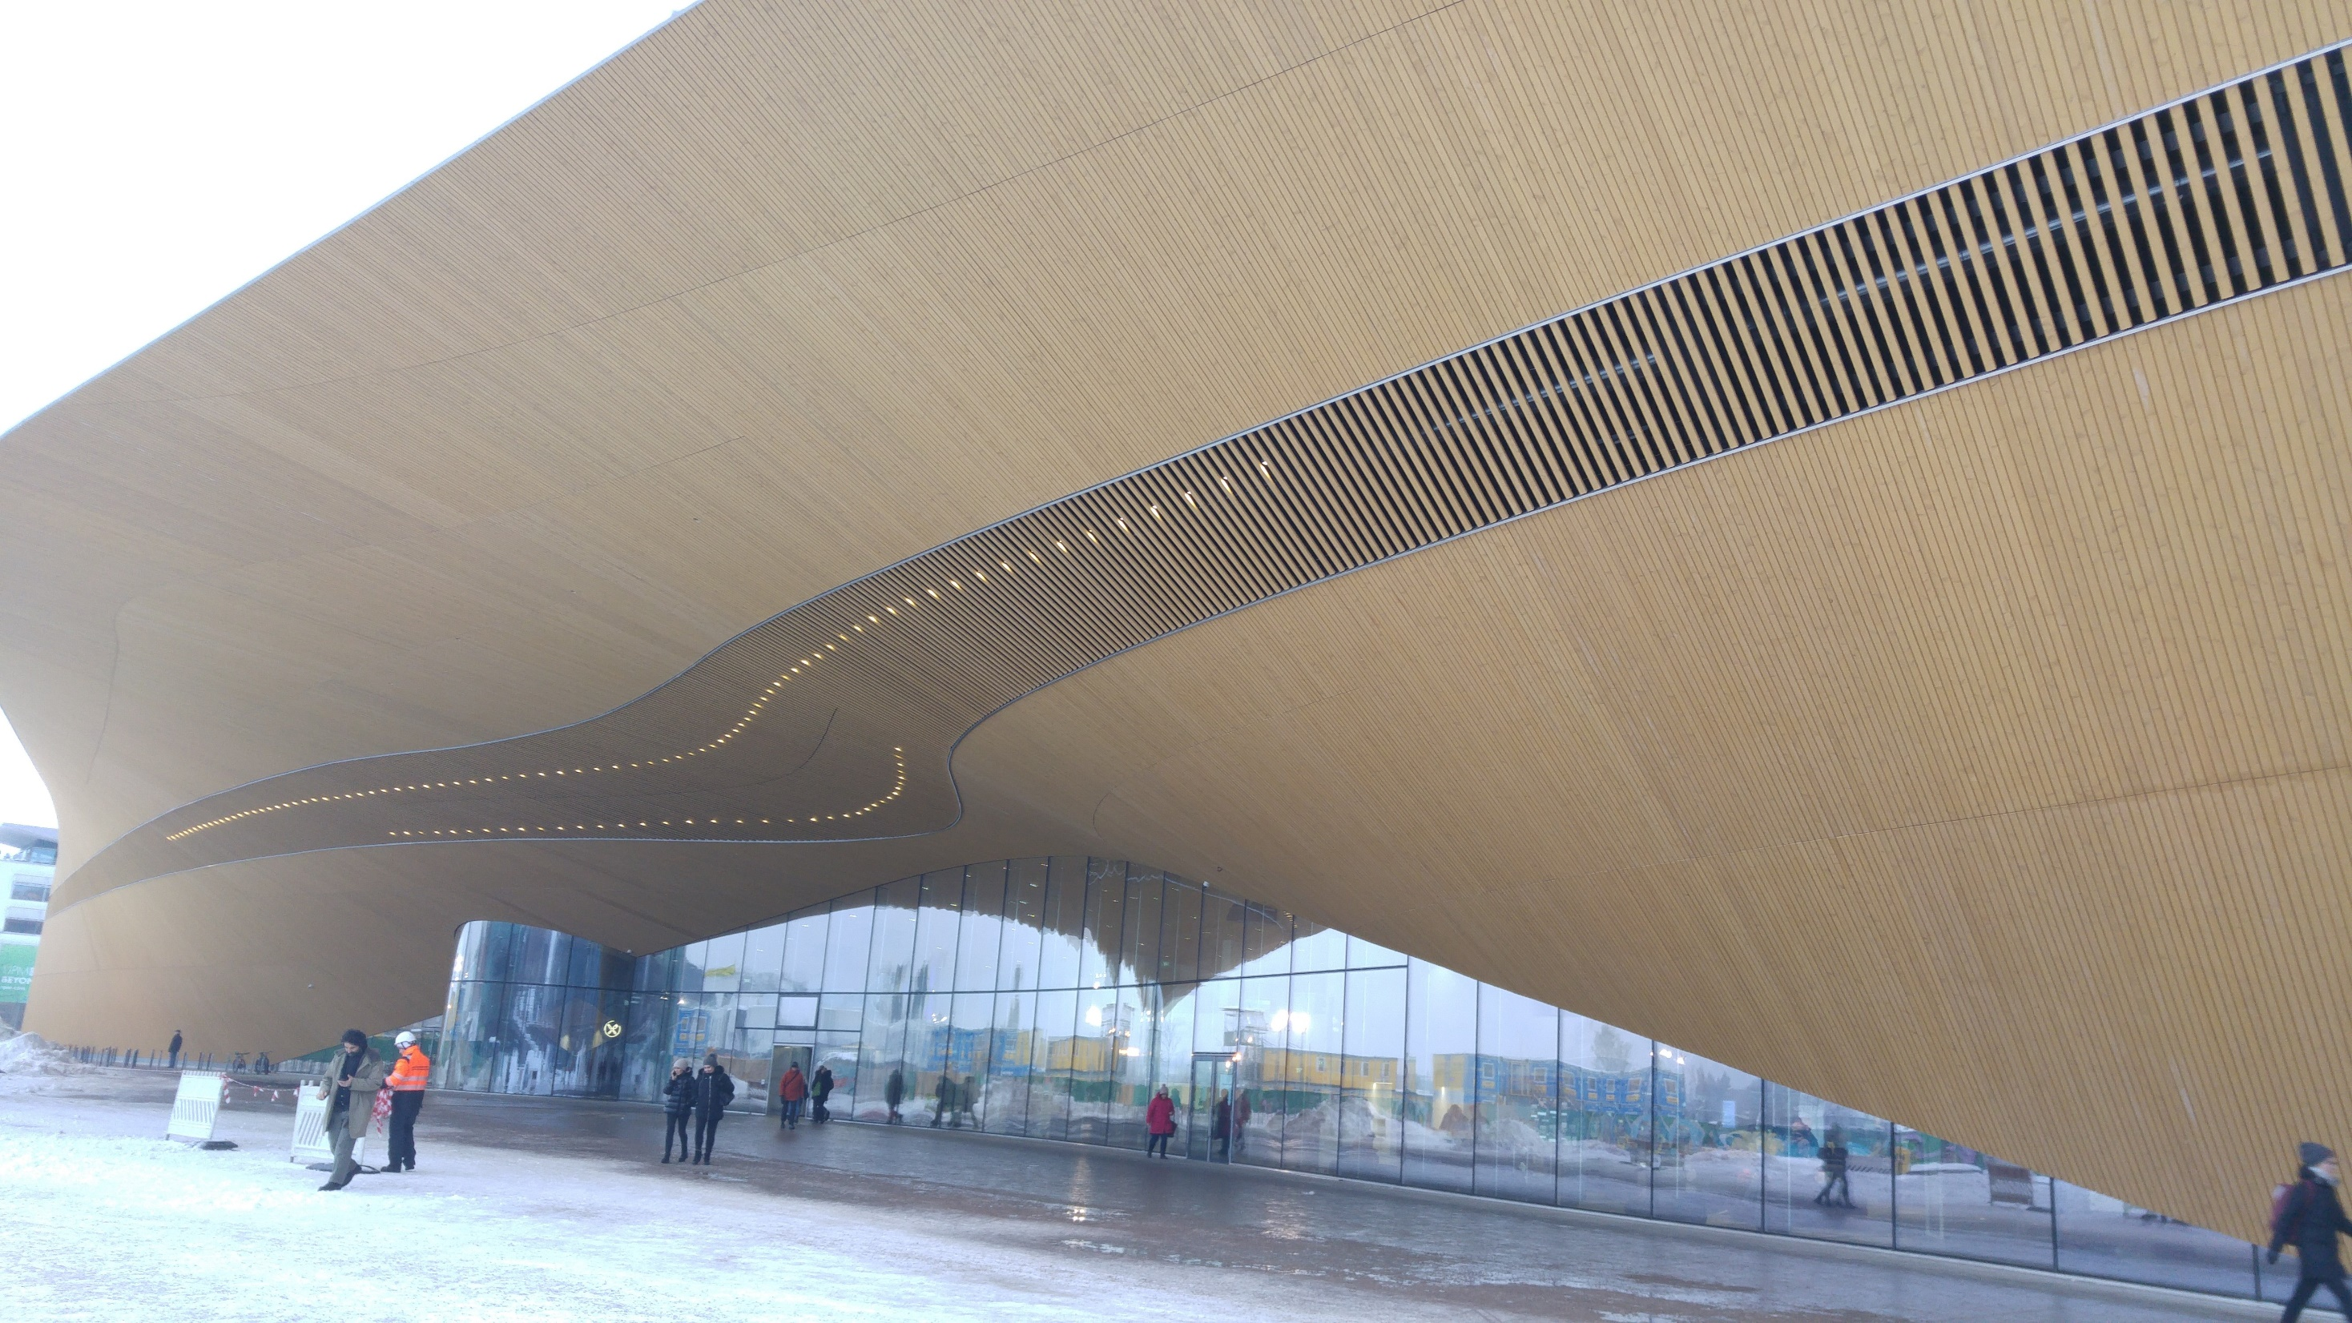
Contemporary buildings in Finland are also made of wood as this new library in Helsinki, Oodi, and are very important in the ready-made-house industry as the Oma-talo here close to Iisalmi.

Slide 9
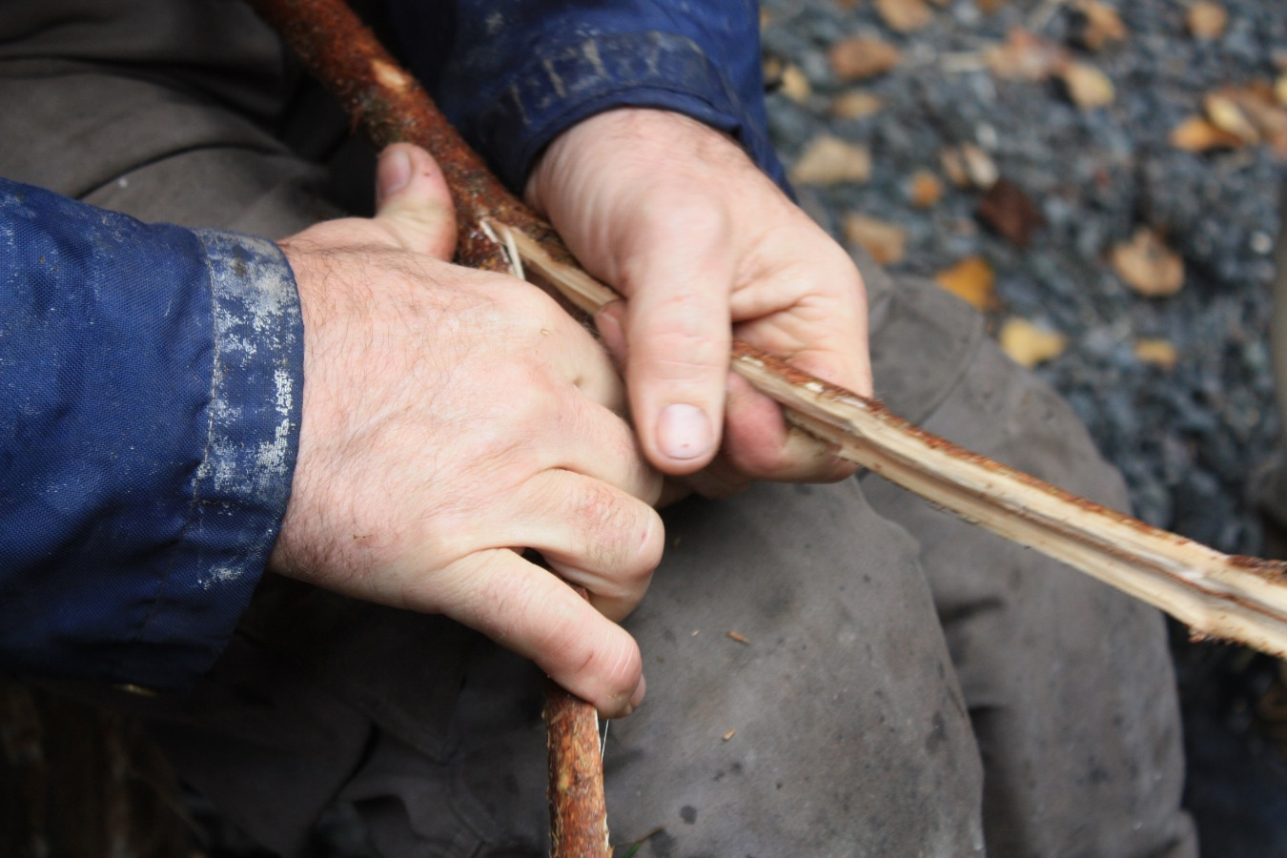
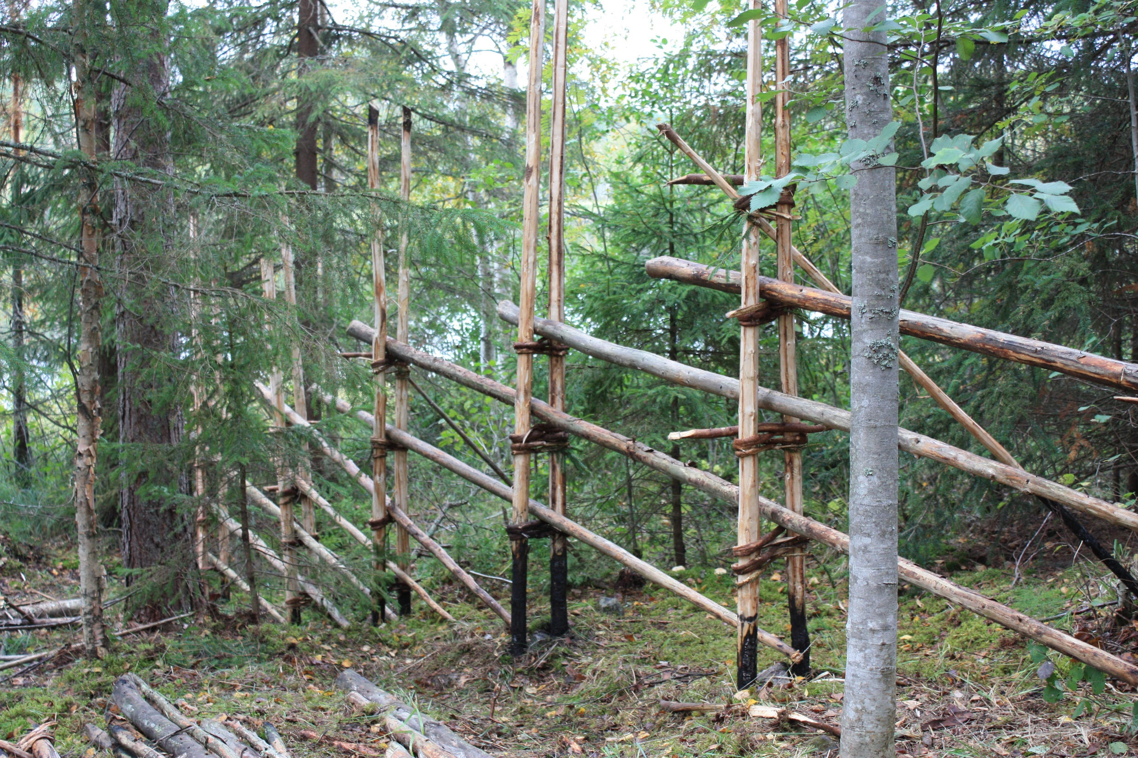
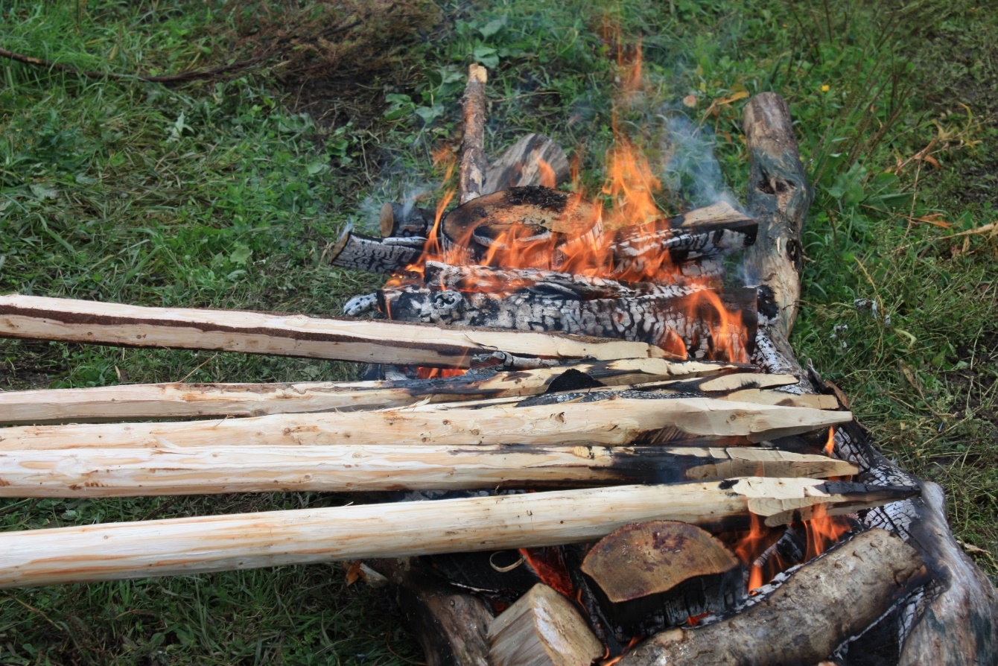
The fences needed to protect the fields from animals were made earlier using young spruce trees, and the poles were burnt in order to prevent them rotting too easily

Slide 10
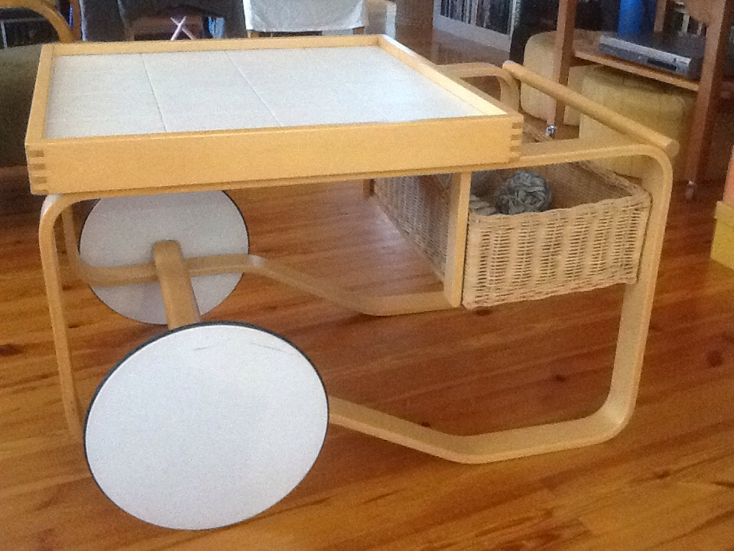
The heat has later been adapted by famous Alvar Aalto when designing his famous birch furniture in 1930’s, as well as the modern Lunawood Thermowood here in Iisalmi

Slide 11
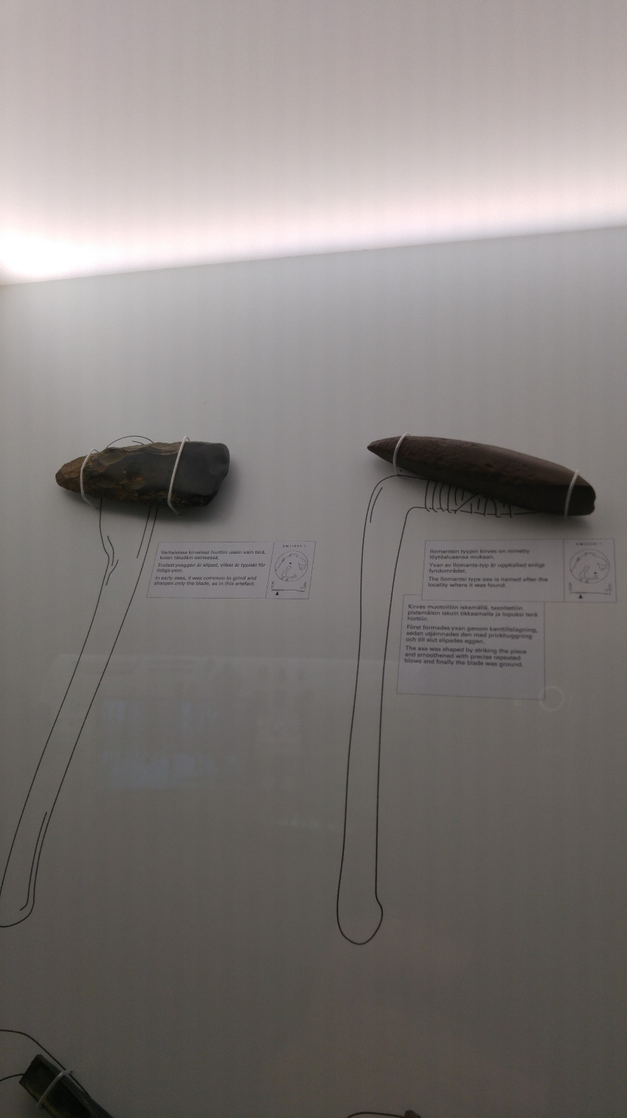
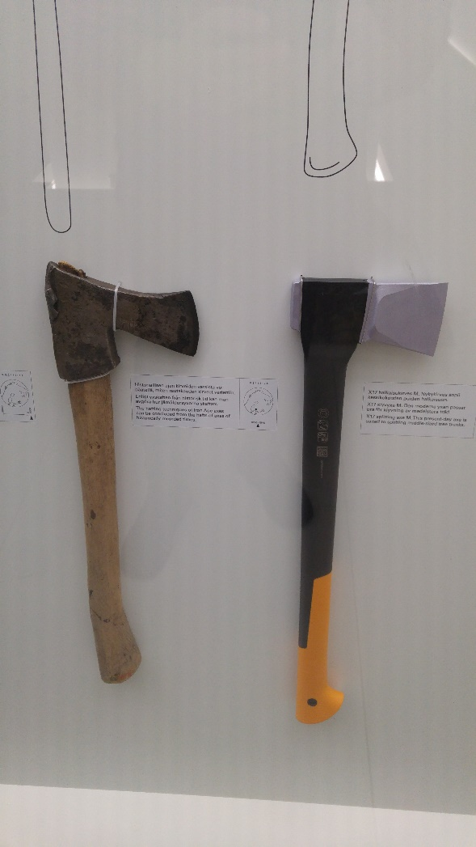
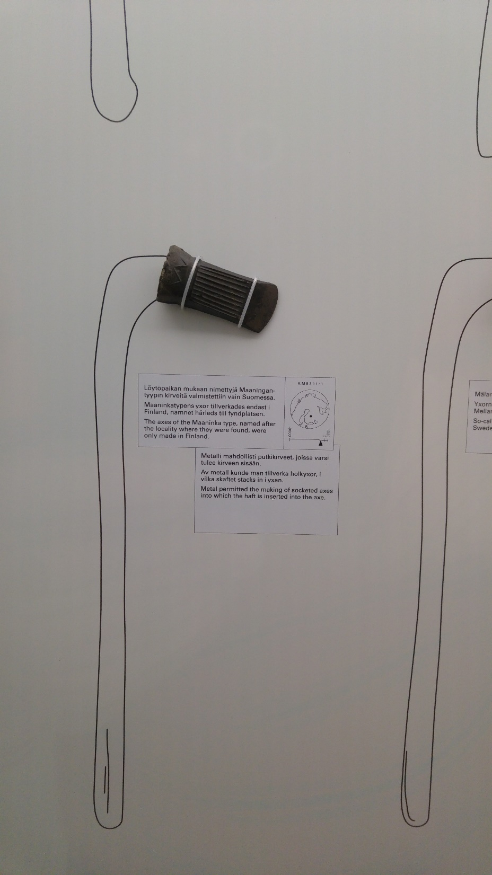
Here you can see the evolution of a Finnish axe, as depicted in exhibition of the the National History Museum. In 9000 years it has become the famous Fiskars axe, known world-wide. Here next to Iisalmi, we have the world’s number one maker of forest harvesters, Ponsse Inc.
Notes:
Evolution of a Finnish ax during the 9000 years

Slide 12
So we want to welcome you to the Artisans week in Iisalmi, Finland…
Please take pictures during your stay, as you will need them on Friday for your work
What will you see during this week?
Probably more snow… and ice…
First we will take you to skating, as our ancestors were living in a very harsh environment where they needed to ski and skate with wooden skis and skates

Slide 13
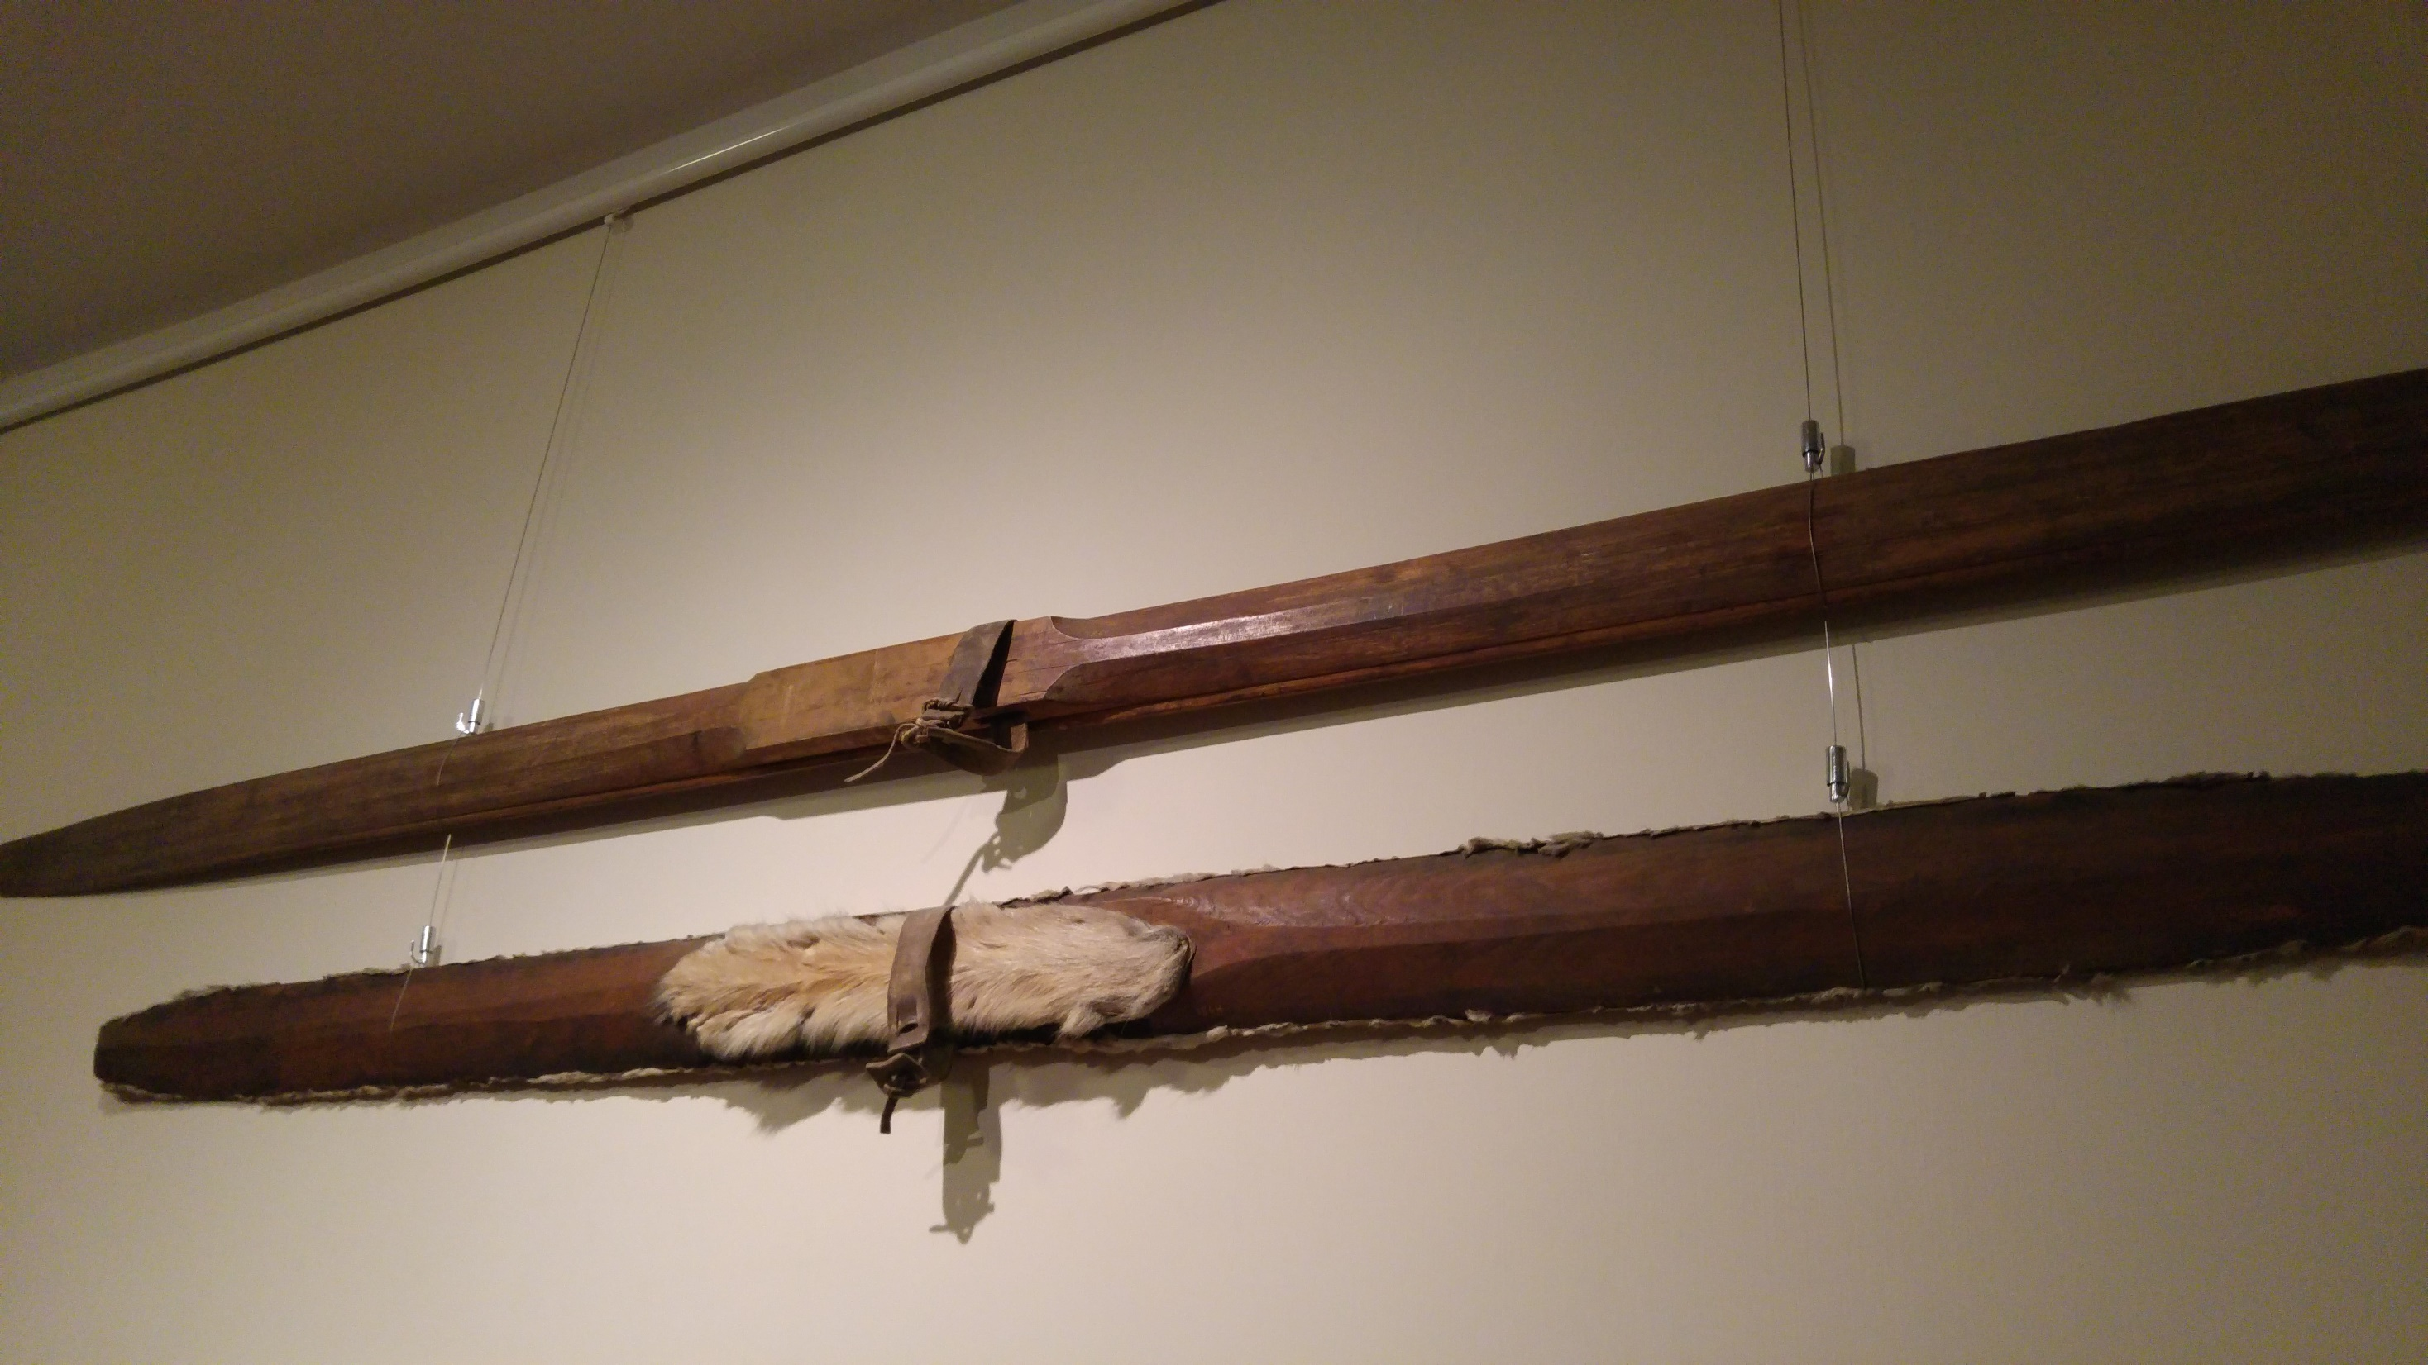
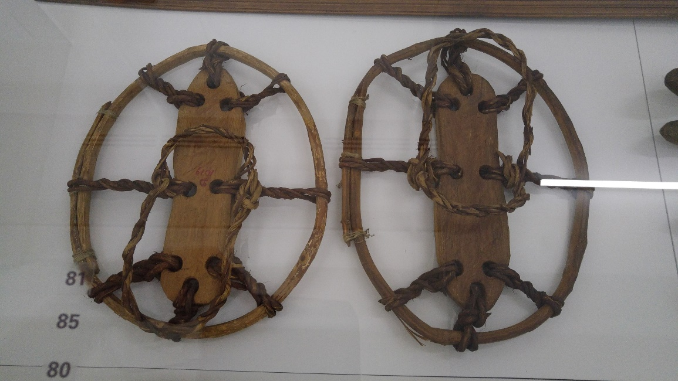
There has been a long way from these wooden skis of our ancestors to the ice-hockey profession of today…

Slide 14
There are tens of Finnish players in the NHL
Tuukka Rask in Boston makes 7 million euros a year
Pekka Rinne in Nashville 7
Aleksander Barkov in Florida 6,75
Mikko Koivu in Minnesota 6
Mikael Granlund in Minnesota 5,5
Rasmus Ristolainen in Buffalo 5,4
Jori Lehtelä in Philadelphia 5
Sami Vatanen in New Jersey 5
Olli Määttä in Pittsburgh 4,1 etc….

Slide 15
But of course, the wood industry is much more important for our economy:
Some examples in our area are:
In Iisalmi, Lunawood produces 150 000 m3 thermowood , and Ponsse is the world’s leading harvester factory with over 500 million yearly revenue, Oma-Talo makes popular wooden houses in Sonkajärvi
The big industry is the logging, pulp factories and paper factories – every year over 20 billion euros in Finland
In Iisalmi-area a sawmill IPOWOOD handles 50 million euros worth of timber, Keitele Forest over 260 million and in Kuopio the Powerflute makes pulp worth almost 200 million euros

Slide 16
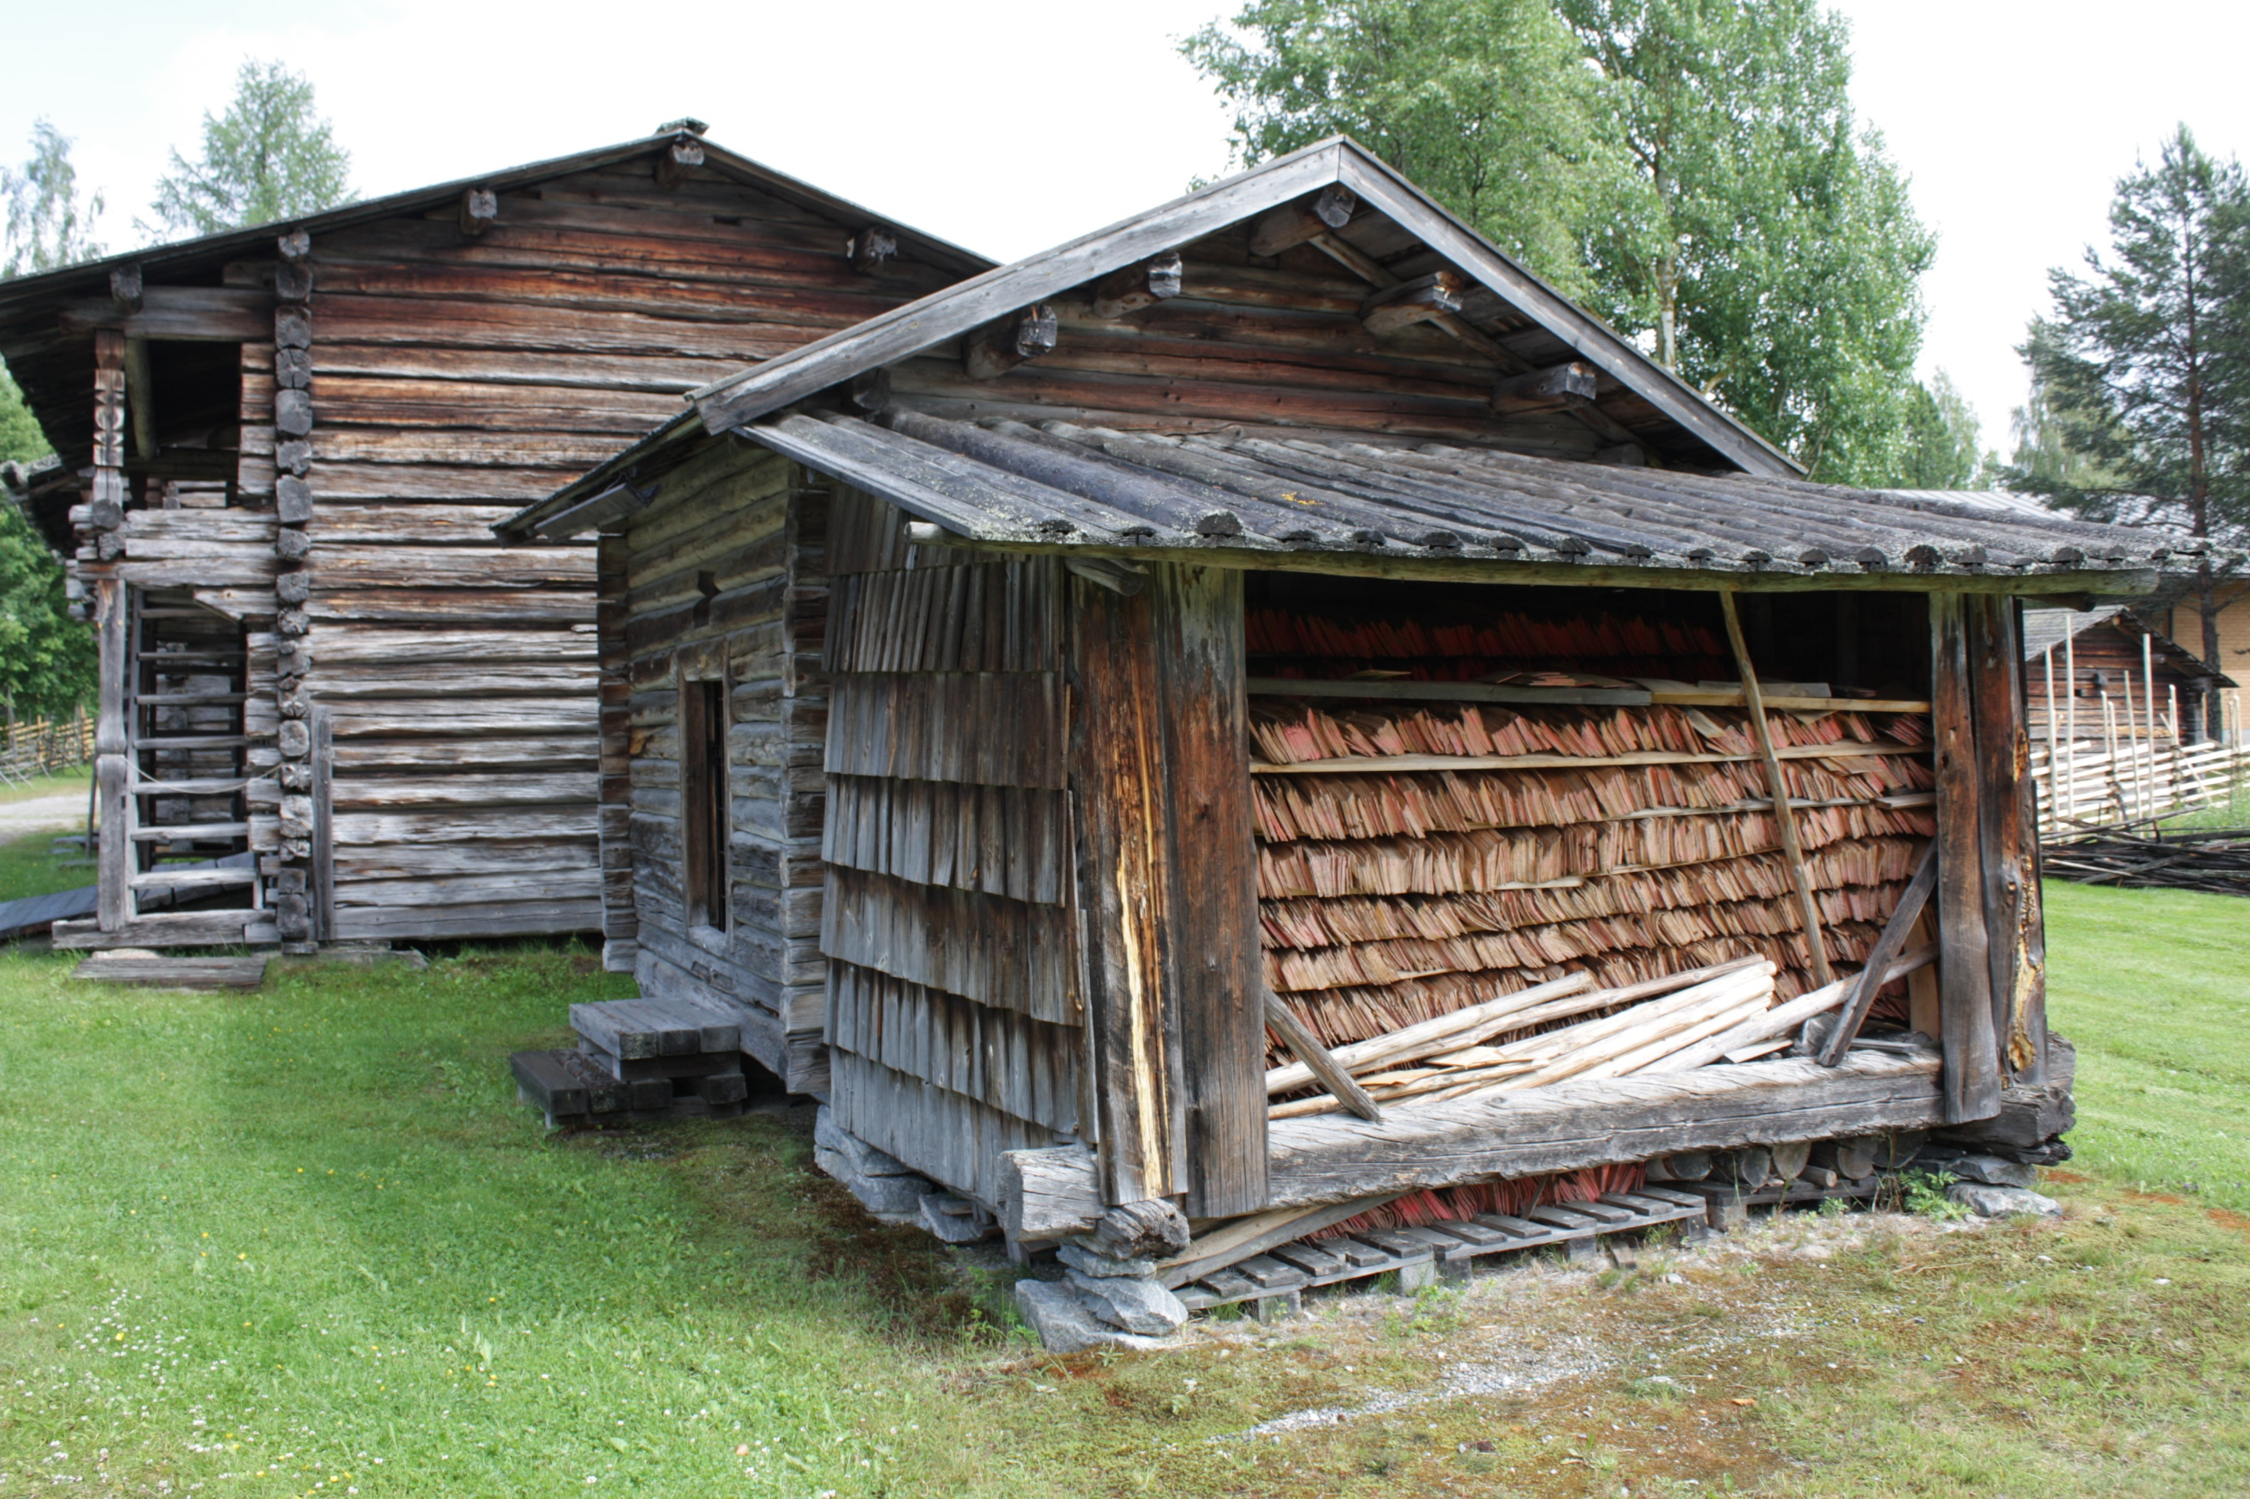
Never mind the big business….
Back to the crafts and artisanship of the poor people, we will see many small and humble objects full of everyday’s beauty

Slide 17
There will be a homestead museum full of old things made of wood and other material from the forests and an artisan workshop
A modern school for wood and textile design in Kuopio with a workshop
A museum of the Orthodox Church in Finland, full of most beautiful textiles and icons, also an artisan workshop there
A museum for the town life, in Kuopio where even the towns-people were still dependent on forests during the 19th century
An architectural learning center for children and adults that specializes on building with wood, an artisan workshop
A recently built wooden school in Iisalmi
Local handscraft organization: a workshop on Finnish wool
An insight into Finnish heritage food: workshop baking pasties from Karelia
A fashion show of all the countries on Thursday MADE BY YOU!

Slide 18
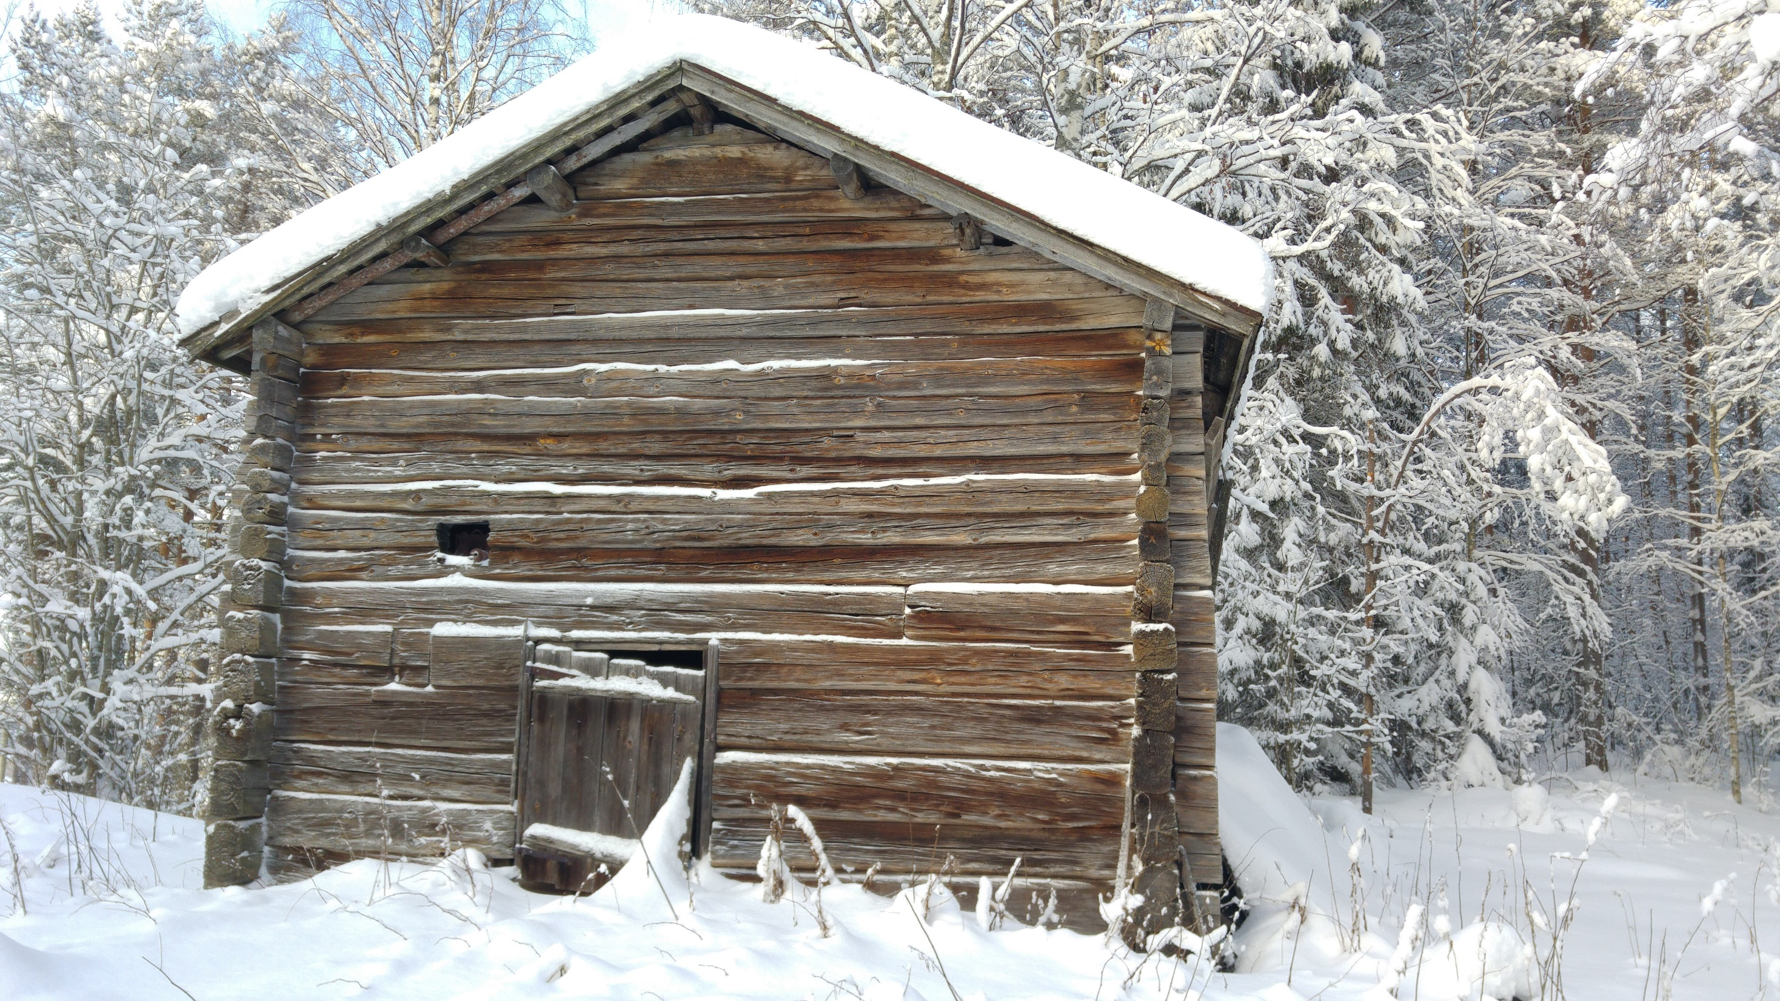
So please, welcome to Iisalmi and..
Now our students are going to tell you about the life and old and new things in Finland

