Slide 1
RATING the food markets in salo
IN OUR OPINION

Slide 2
WHAT ARE WE LOOKING FOR
  In this review we are looking for these things:
  Location
  Opening hours
  Selection
  Prices
  Parking lot
  Custome service
  Purpose

Slide 3

HOW WE GIVE POINTS
We review the stores that WE use the most in Salo/Halikko
For everything we give out maximum of 10 points
We have seven topics
So, the maximum points we can give is 70

Slide 4
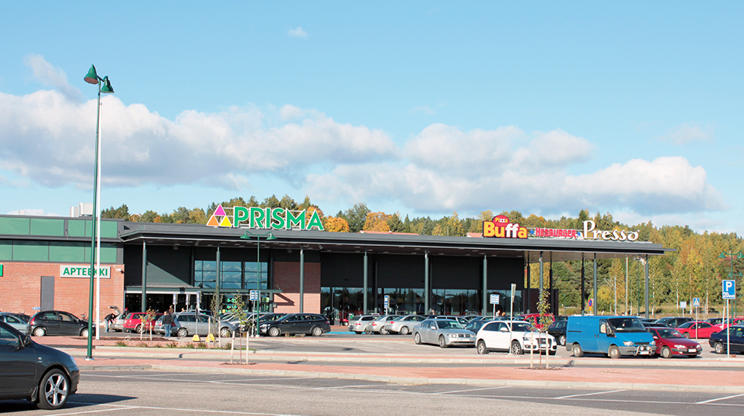
PRISMA
Prismantie 2, 24800 Halikko
Location is good for people who live in Halikko
Open: 24/7 so it is for example a good place to get late night snacks if needed
Parking: there is enough space because there is always free parking spaces but –1 because of the speeding bumps (there is too much of them)
  Location 9/10
  Opening hours 10/10
  Selection 8/10
  Prices 8/10
  Parking lot 9/10
  Custome service 8/10
  Purpose 10/10
TOTAL POINTS: 63/70

Slide 5
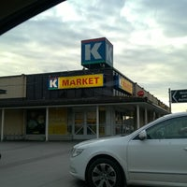
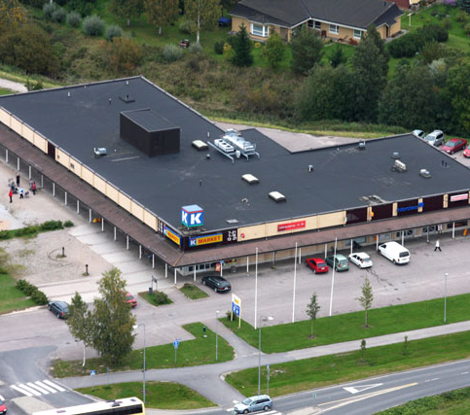
K- MARKET PIRKKATORI Halikontie 2, 24800 Halikko
Again the location is good for people who live in Halikko
Open from 7am to 22pm (10am to 22pm)
Good place to go if you need to quickly grab some snacks or some other basic stuff needed
Parking: even though there is not much space you can still always find a parking space somewhere in there
  Location 8/10
  Opening hours 7/10
  Selection 7/10
  Prices 7/10
  Parking lot 8/10
  Custome service 9,5/10
  Purpose 9/10
TOTAL POINTS: 55,5/70

Slide 6
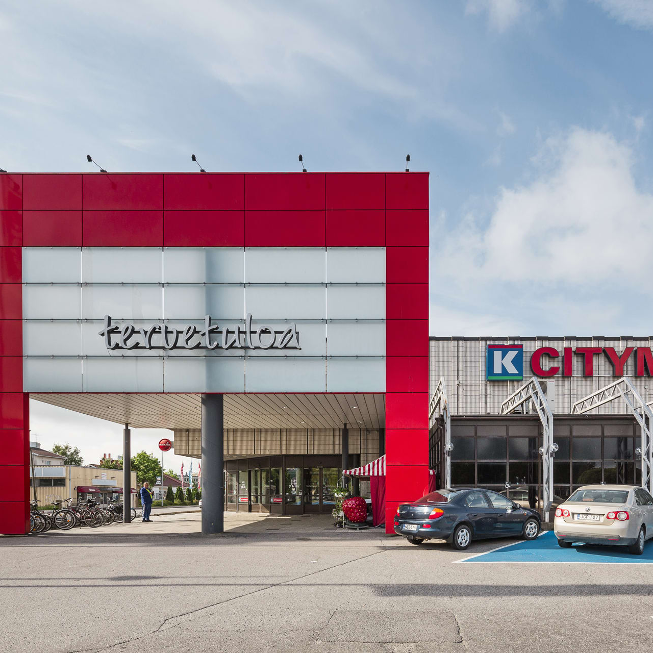
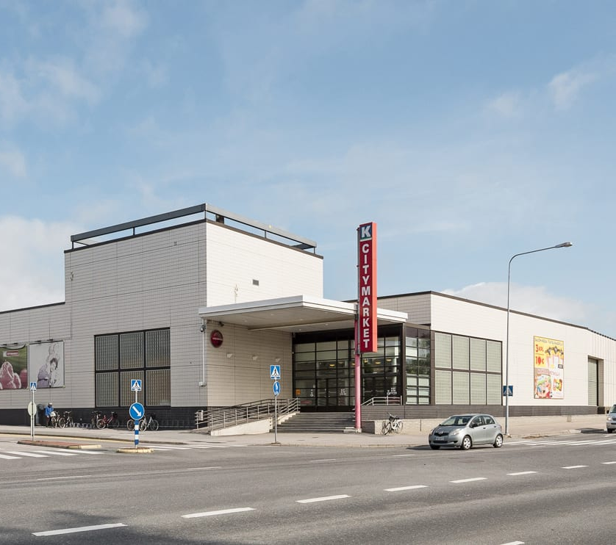
K-CITYMARKET Hämeentie 24-30, 24240 Salo
Great location if you live in the center of Salo
Open from 7am to 23pm (9am to 23pm)
Under renovation so it's messy right now but we are sure it will be great once the renovation is done
Purpose: Good place to get almost anything you need Custome service
Parking: Just renovated parking lot but sometimes it is still hard to find parking spot even though the parking lot is quite big
  Location 8/10
  Opening hours 9/10
  Selection 9/10
  Prices 8/10
  Parking lot 9/10
  Custome service 7/10
  Purpose 8/10
TOTAL:58 /70

Slide 7
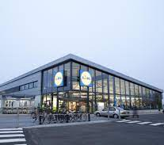
LIDL HALIKKO Halikontie 1, 24800 Salo
Location is once again great for people who live in Halikko
Open from 8am-21pm (8am-20pm/10am-20pm)
Prices: 10/10
Custome service: 5/10
Parking: 7/10
Purpose: The prices are low and the selection is good so it's a good place to buy daily day products AND the in-store bakery in Lidl is 10/10
  Location 8/10
  Opening hours 7/10
  Selection 9/10
  Prices 10/10
  Parking lot 8/10
  Custome service 8/10
  Purpose 9/10
TOTAL: 59/10

Slide 8
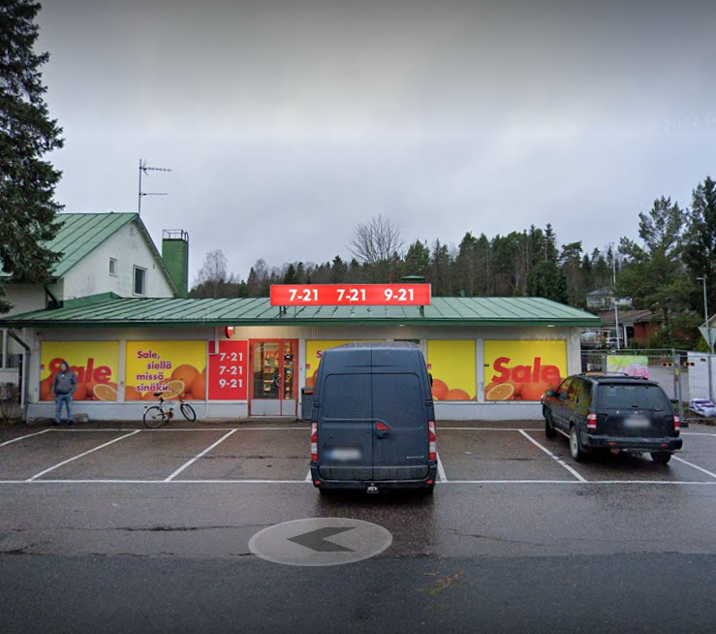
Sale Paukkula Salaistentie 6, 24240 Salo
  Location: Equally between Halikko and Salo
  Opening hours: 7am-21pm (9am-21pm)
  Selection: you can find some basic things but nothing more
  Purpose: Conveniently along the way from Halikko to Salo or from Salo to Halikko so great place to grab something basic you need quickly
  Location 7/10
  Opening hours 8/10
  Selection 5/10
  Prices 7/10
  Parking lot 5/10
  Custome service 10/10
  Purpose 7/10
  TOTAL:49/70

Slide 9



OUR TOTAL RESULTS
Prisma 63p
Lidl Halikko 59p
K-Citymarket 58p
K-market Pirkkatori 55,5p
Sale Paukkula 49p
After our research we were surprised that K-Market Pirkkatori was so low on points

Slide 10
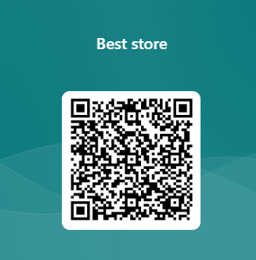
NOW WE WANT TO HEAR YOUR OPINION

Slide 11
SOURCES
Pictures: https://visuaalisianakemyksia.blogspot.com/2018/11/tyossaoppimassa-prismassa.html
https://foursquare.com/v/kmarket-pirkkatori/4bf3a3c898ac0f477a1263a8
https://www.pirkkatori.com/
https://eqhaku.fi/toimitilat/liike-ja-lahipalvelut/k-citymarket-salo-hameentie-24-30-salo/
https://news.cision.com/fi/lidl-suomi/r/lidlin-uusi-myymala-salon-halikossa-avasi-ovensa,c2101541
https://www.google.com/maps/uv?pb=!1s0x468c470388c734af%3A0x3148ead3d00f0620!3m1!7e115!4s%2Fmaps%2Fplace%2Fsale%2Bpaukkula%2Bsalo%2C%2Bsalaistentie%2C%2Bsalo%2F%4060.3967747%2C23.1035114%2C3a%2C75y%2C270.16h%2C90t%2Fdata%3D*213m4*211e1*213m2*211sfpZRTQBEPKZ2FllDVvv3Mg*212e0*214m2*213m1*211s0x468c470388c734af%3A0x3148ead3d00f0620%3Fsa%3DX%26ved%3D2ahUKEwjg3ovO-66CAxXECRAIHQRLBTUQpx96BAgxEAA!5ssale%20paukkula%20salo%2C%20salaistentie%2C%20salo%20-%20Google%20Search!15sCgIgAQ&imagekey=!1e2!2sfpZRTQBEPKZ2FllDVvv3Mg&hl=en&sa=X&sqi=2&ved=2ahUKEwjg3ovO-66CAxXECRAIHQRLBTUQpx96BAhIEAQ

