Slide 1
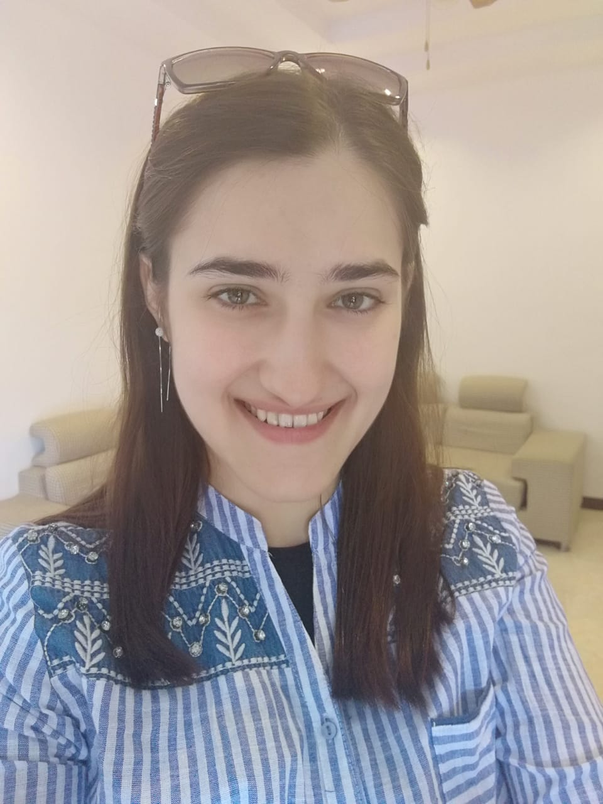
MOI KAIKKI

Slide 2
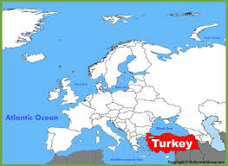
Minun nimi on MERYEM
Minun kotimaa on
Turkki.
Opiskelen Tampereen
yliopistossa.
Hauska Tavata

Slide 3
Here is Turkey.
Here is Turkish flag.

Slide 4
Renkler
Colors

Slide 5
sininen
mavi

Slide 6
keltainen
sarı

Slide 7
punainen
kırmızı

Slide 8
valkoinen
beyaz
The letter ”y” makes /y/ sound in Turkish like in English.

Slide 9
mavi
sarı
kırmızı
beyaz

Slide 10
Print and match the color words to the correct colors.
mavi
sarı
kırmızı
beyaz

Slide 11
Draw and color the Turkish and Finnish flags.

Slide 12
THANK YOU VERY MUCH
ÇOK TEŞEKKÜR EDERİM
KIITOS PALJON

