Slide 1




Thank you for downloading this free resource!
I believe English teaching resources should be free but keeping a website is very costly! PLEASE help me continue making my resources FREE and keep my blog running by clicking some GOOGLE ADS that appear in my website. Average revenue I get per click is only $0.01 (LOL, no kidding!) but it’s up to you how willing you are to support my advocacy.
Sharing is caring! Please share my blog posts to your friends and colleagues.
For more resources and updates, follow me on social media:
https://www.facebook.com/EnglishTeaching101/
https://twitter.com/ENteaching101
https://www.pinterest.com/ENteaching101/
http://englishteaching101.com/

Slide 2
Visual puzzles

Slide 3
Rules
Guess the mystery word.
The pictures are the clues to solve the puzzle.
First team to get the answer correctly gets the points for the round.

Slide 4



Slide 5

Answer: Iced Tea

Slide 6



Slide 7
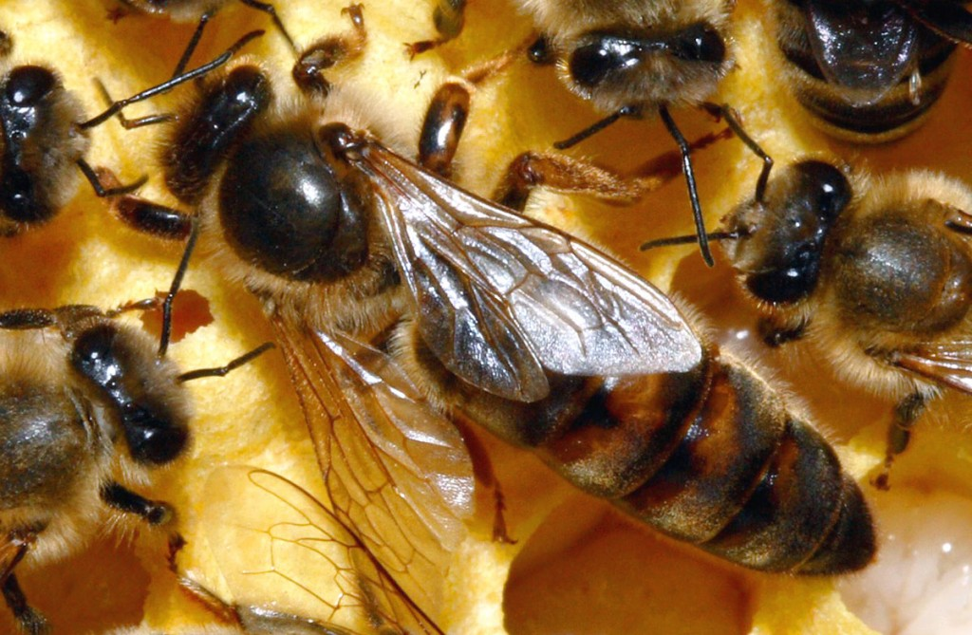
Answer: Queen Bee

Slide 8
ARE YOU READY?

Slide 9
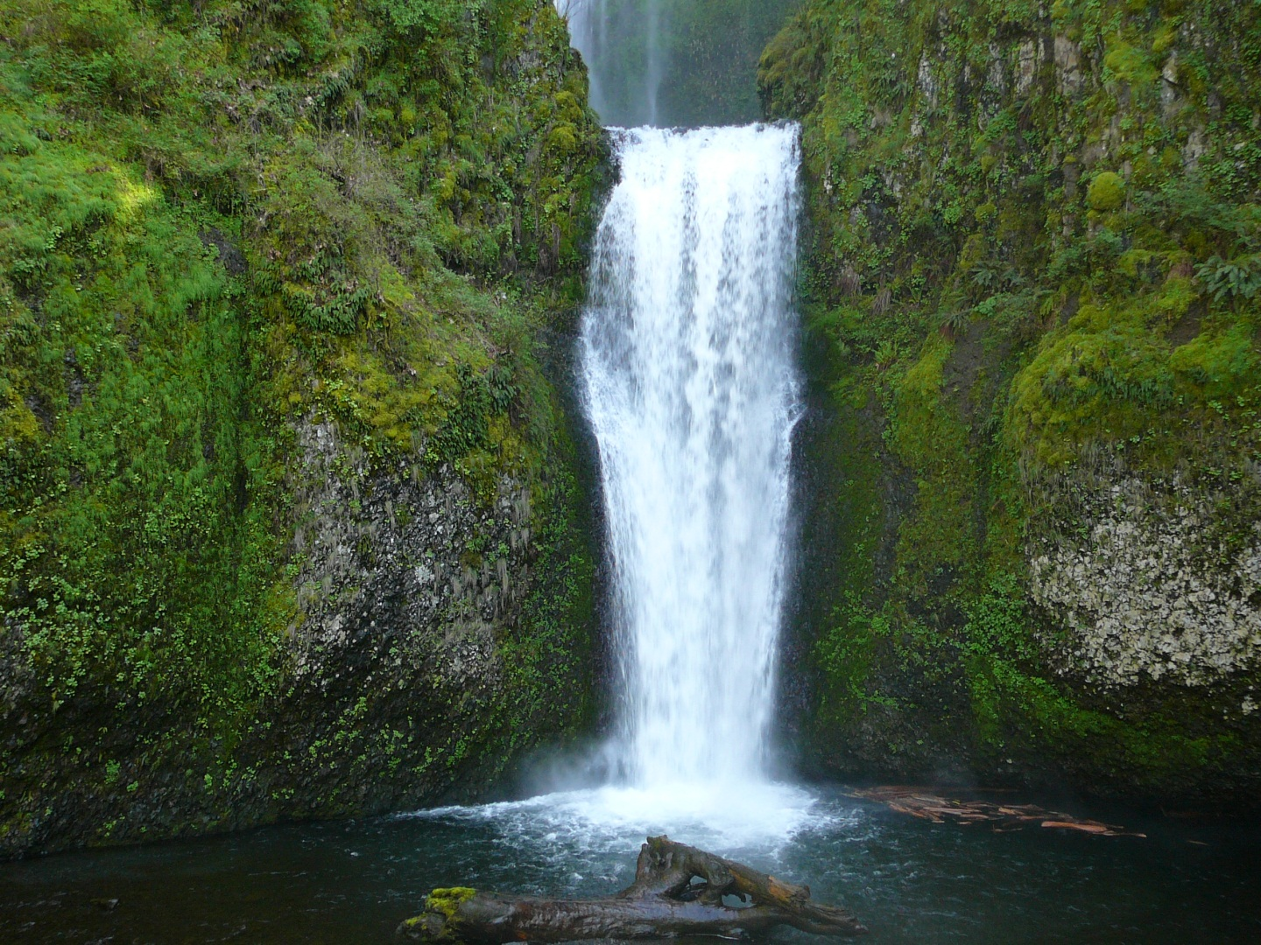


Waterfall

Slide 10
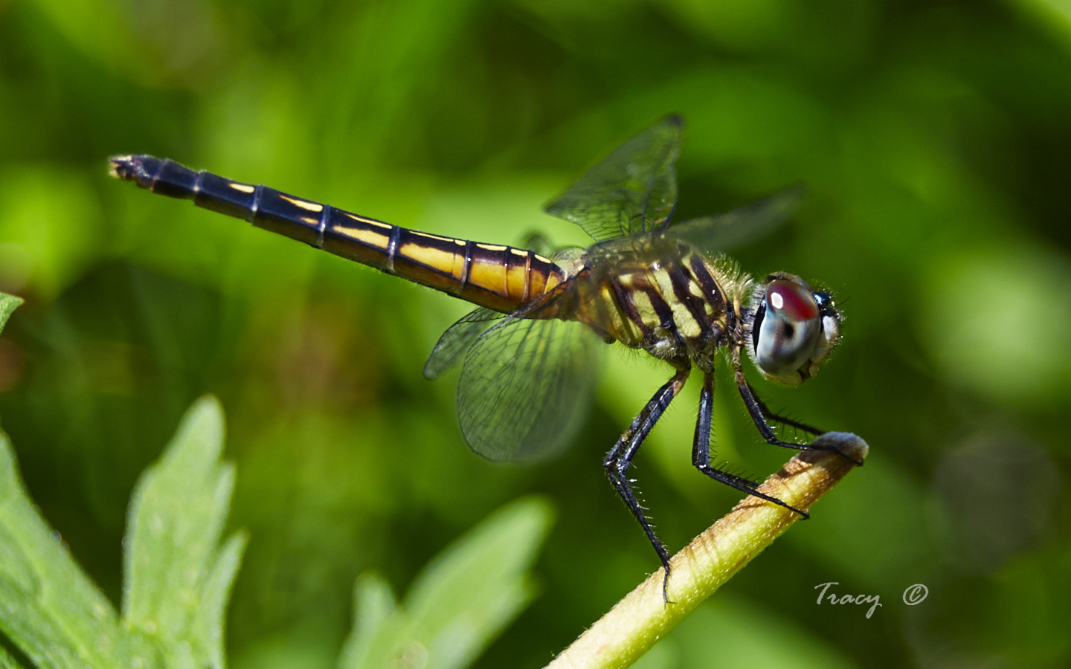


Dragonfly

Slide 11
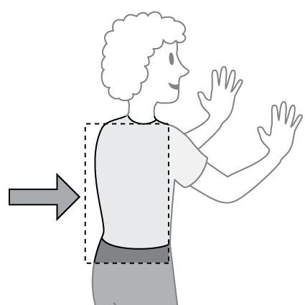

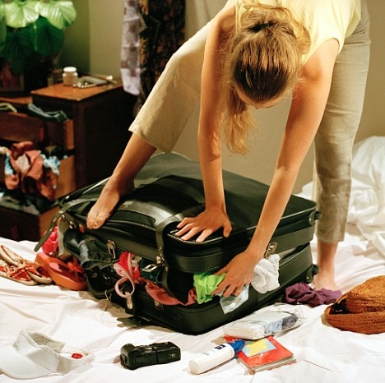
Backpack

Slide 12

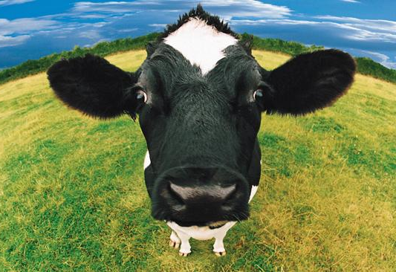

Cowboy

Slide 13


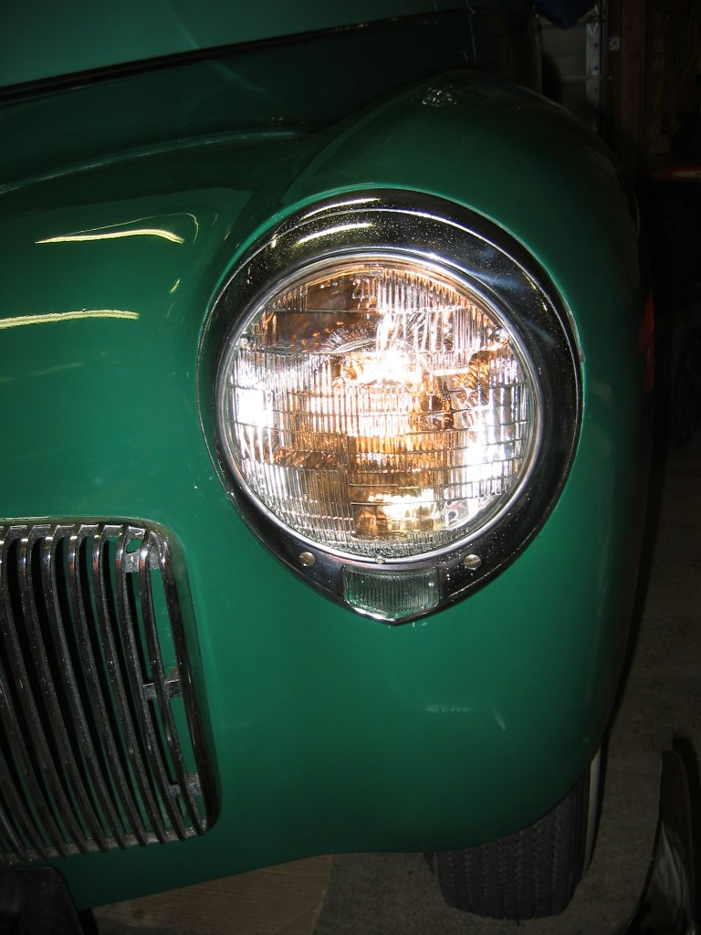
Headlight

Slide 14

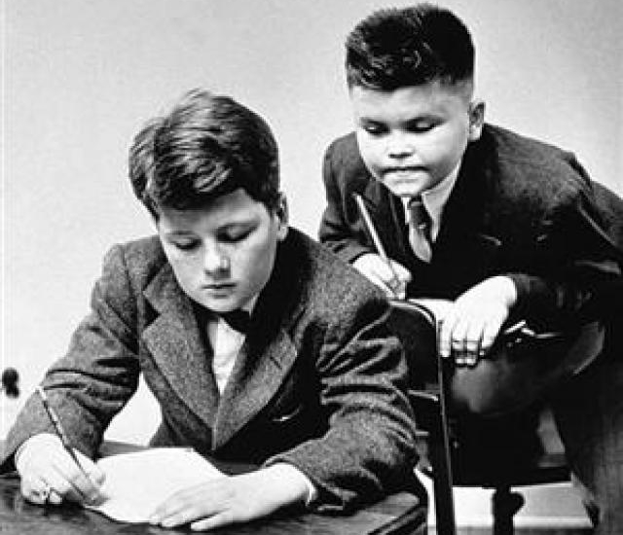
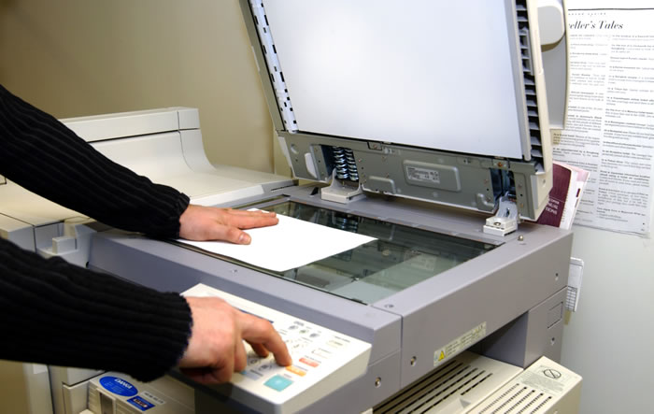
Photocopy

Slide 15


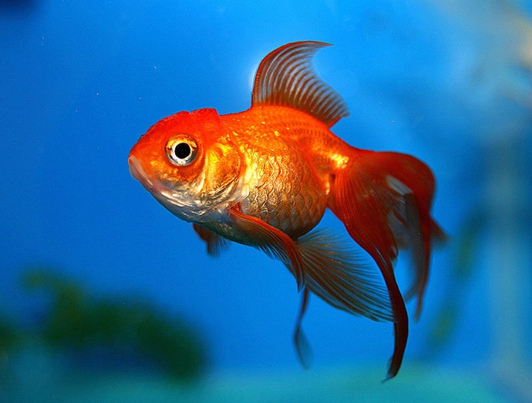
Starfish

Slide 16
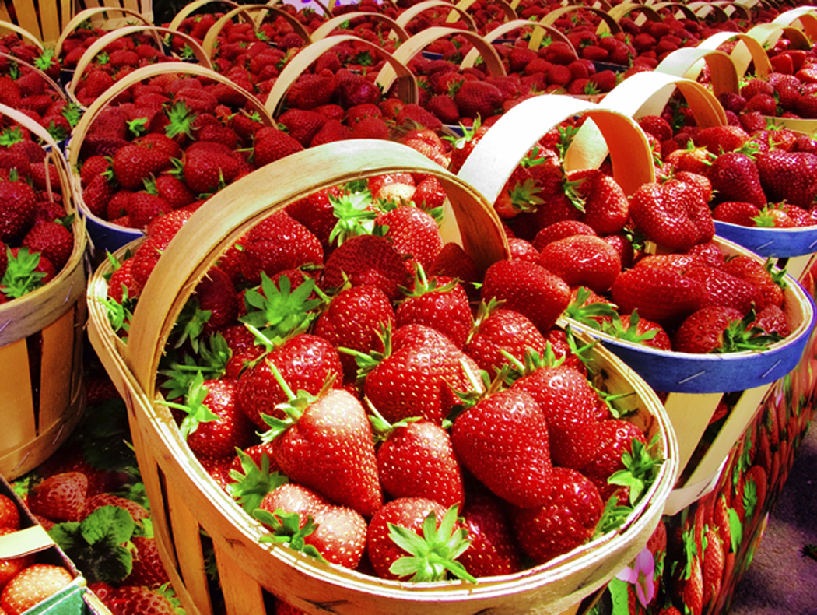



Strawberries

Slide 17




Sherlock
his/_ _ _

Slide 18


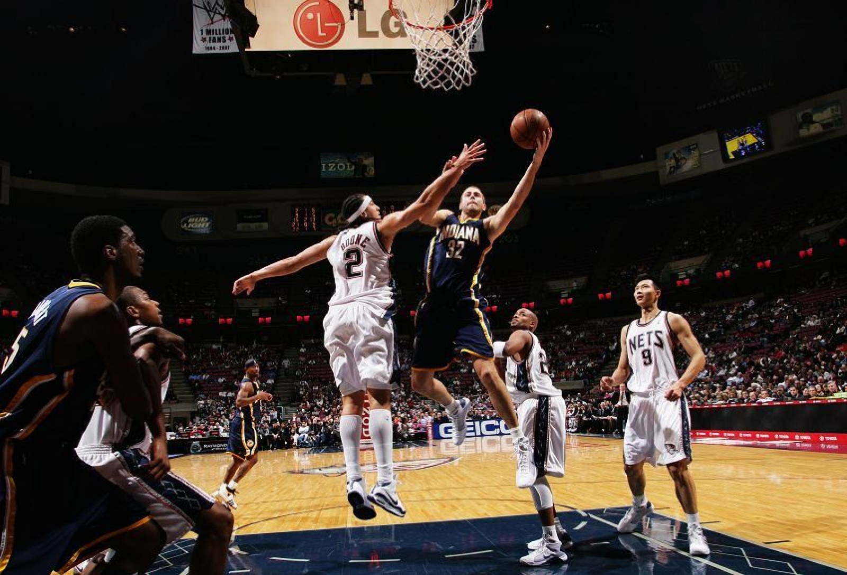
Basketball

Slide 19



Yellow

Slide 20
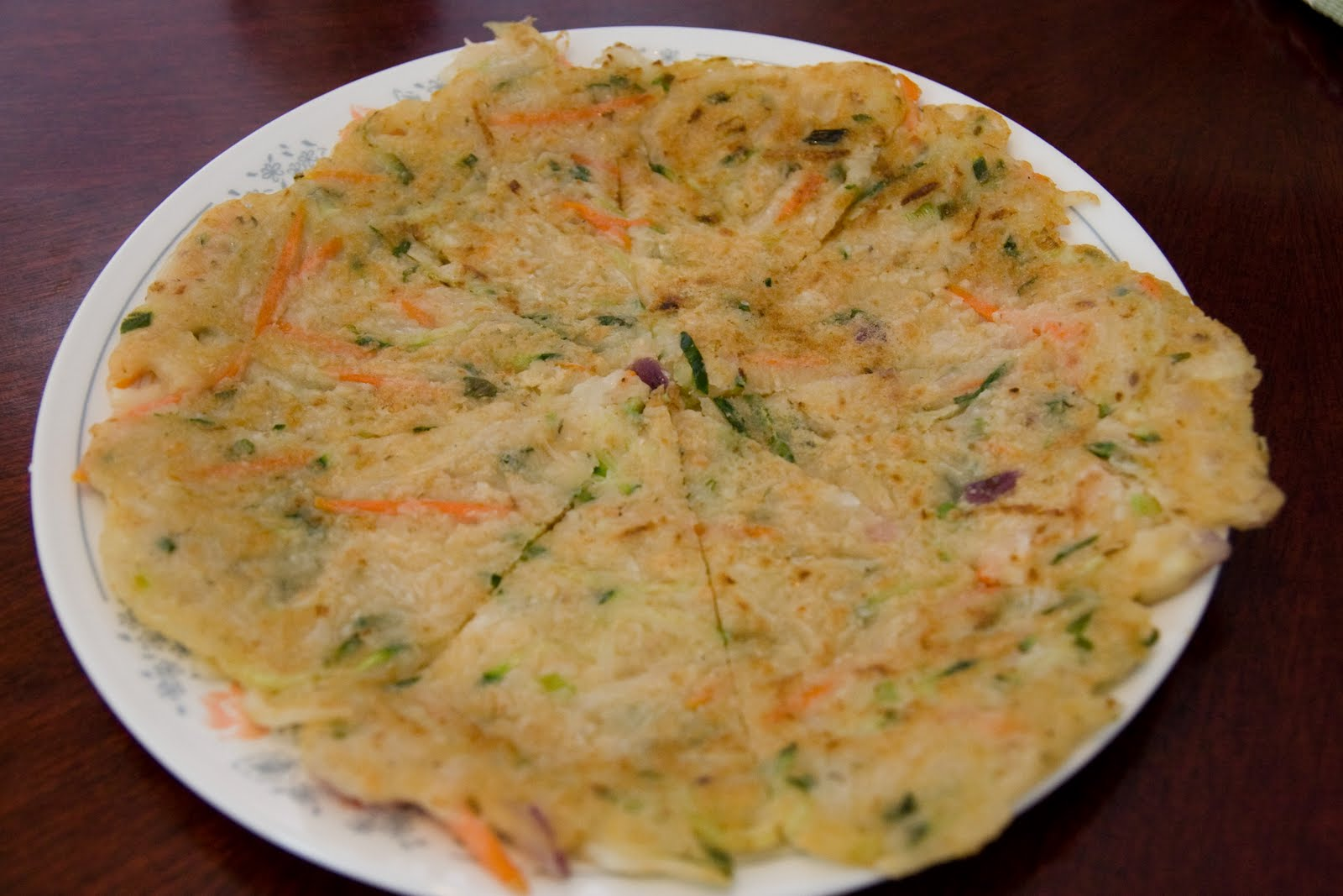
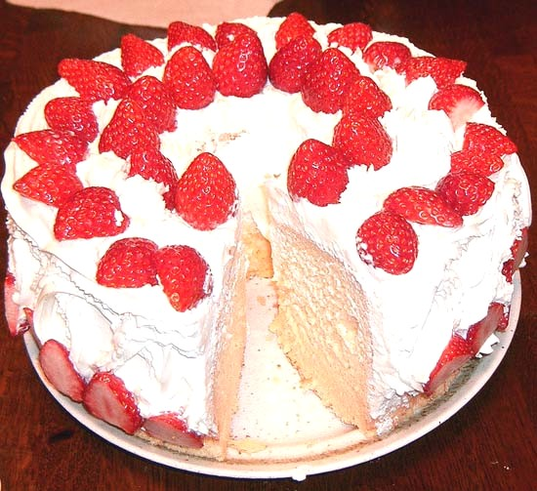

Pancake

Slide 21


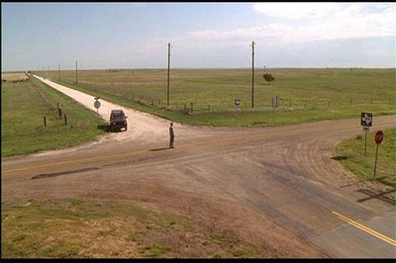
Crossroad

Slide 22


Twilight
T
_ _ _ _

Slide 23



Website

Slide 24

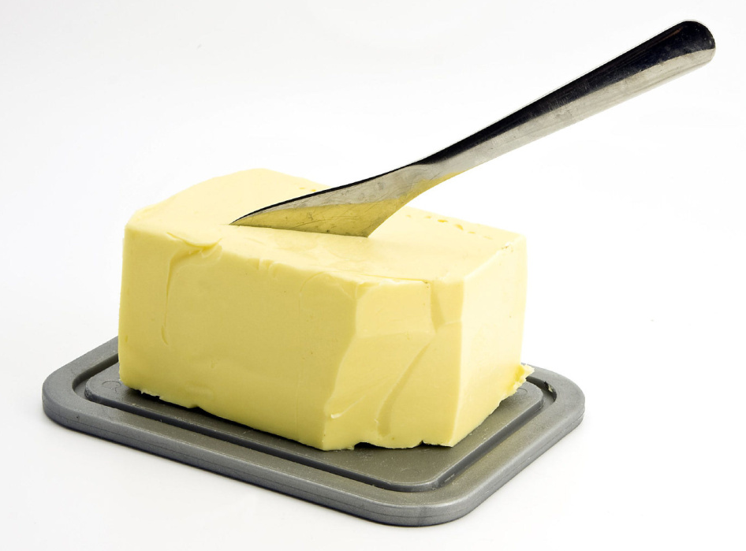
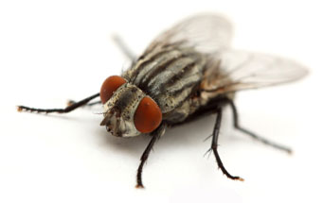
Butterfly

Slide 25
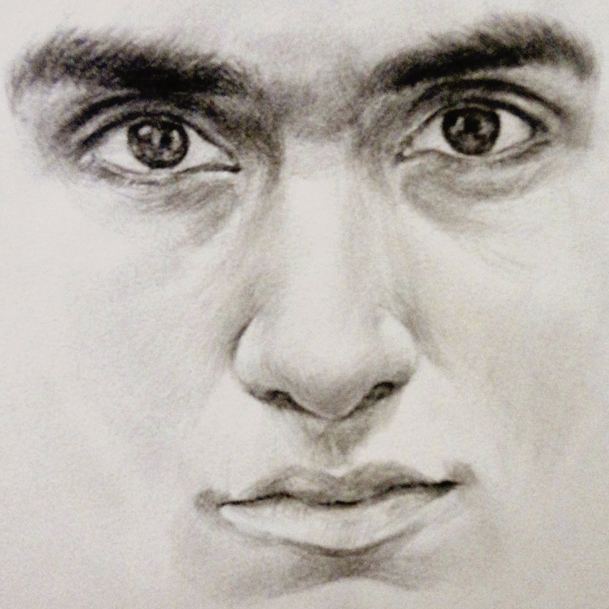


Facebook

Slide 26



Caps Lock (Caps)

Slide 27


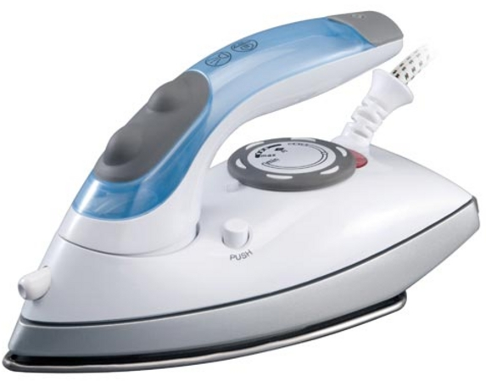
Iron Man

Slide 28



Mango

Slide 29

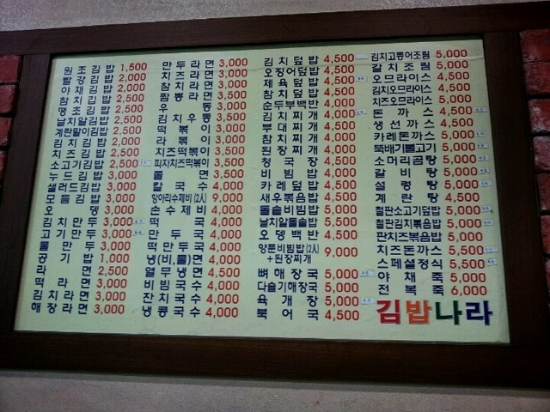

Menu

Slide 30
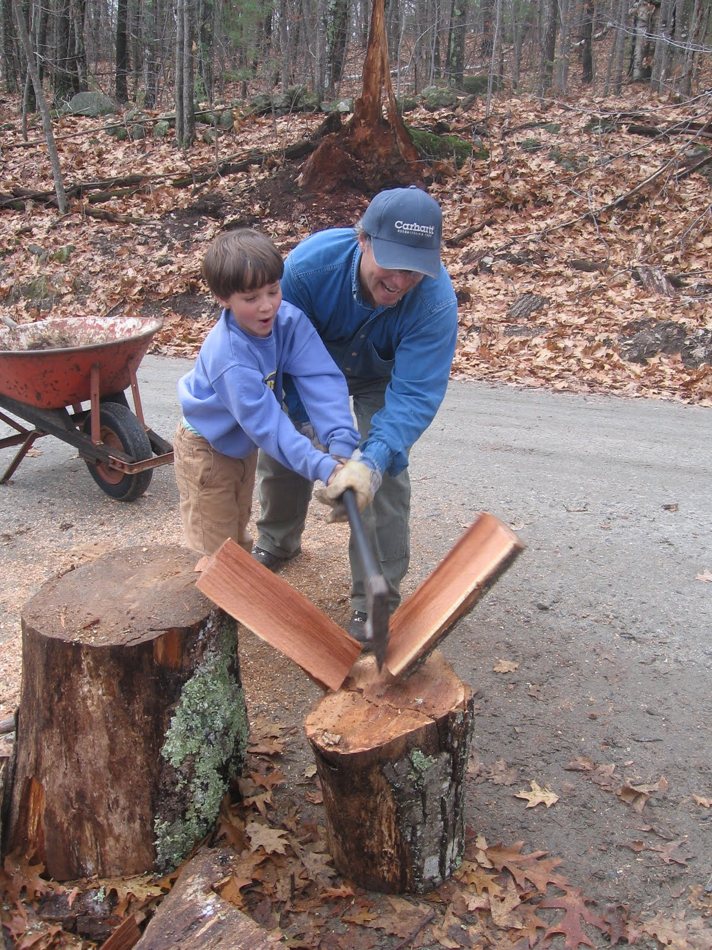
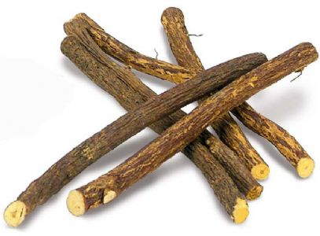
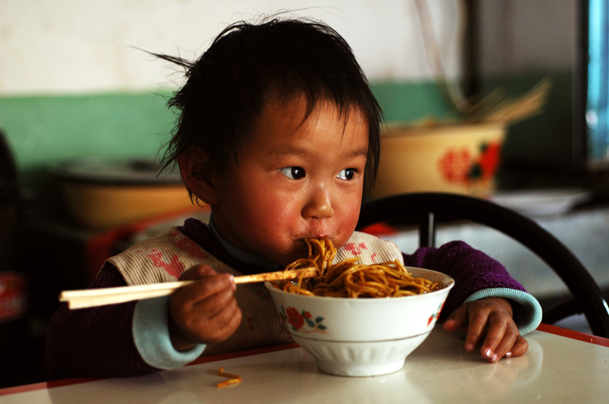
Chopsticks

Slide 31

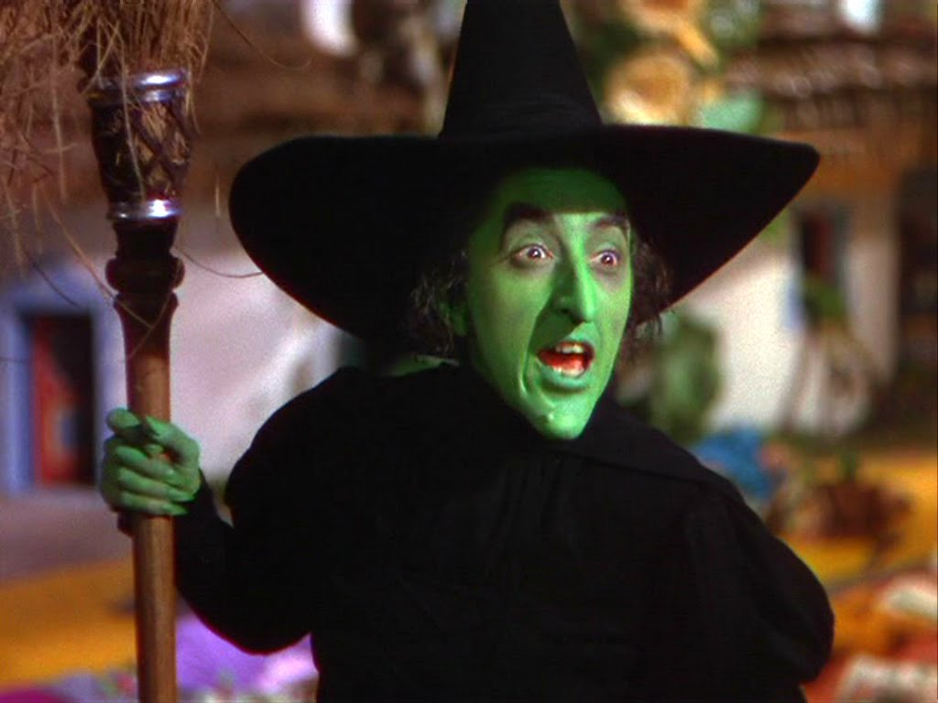
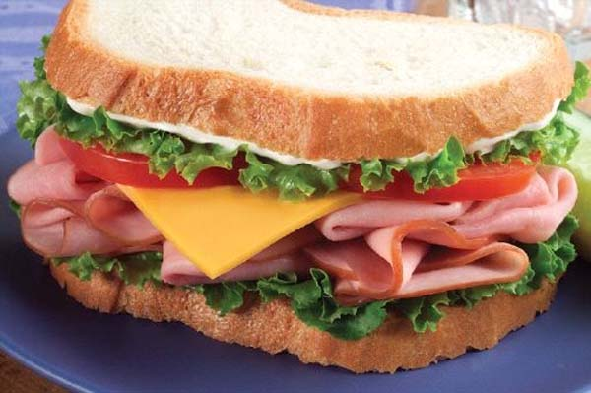
Sandwich

Slide 32
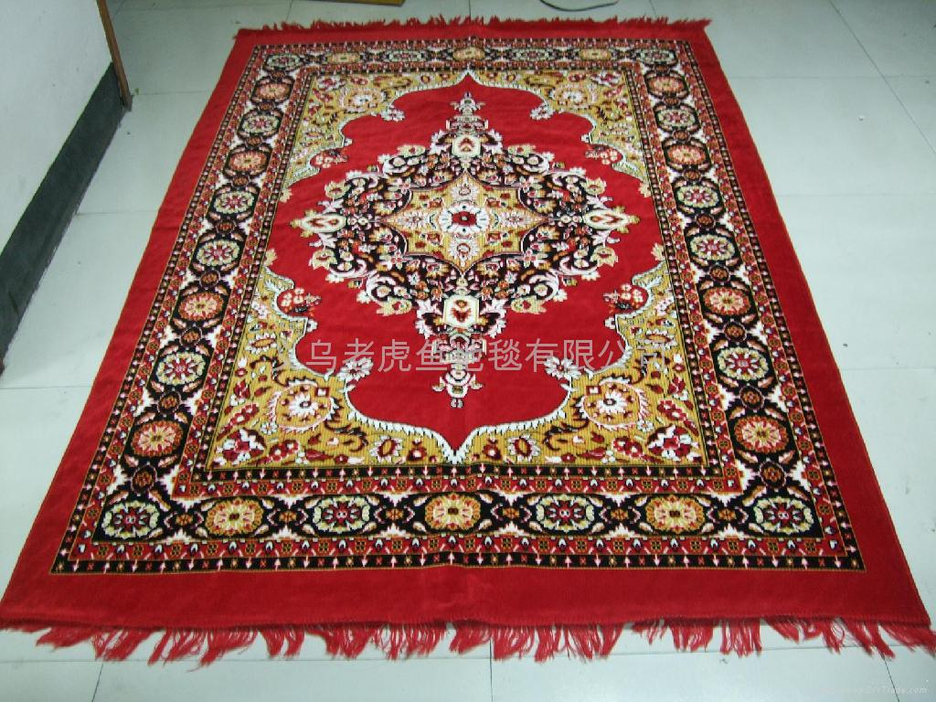
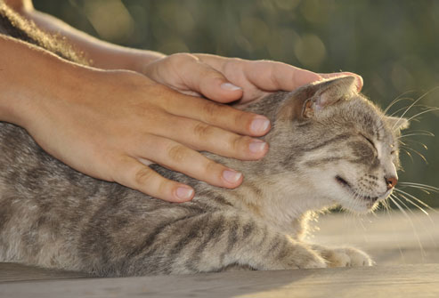

Carpet

Slide 33
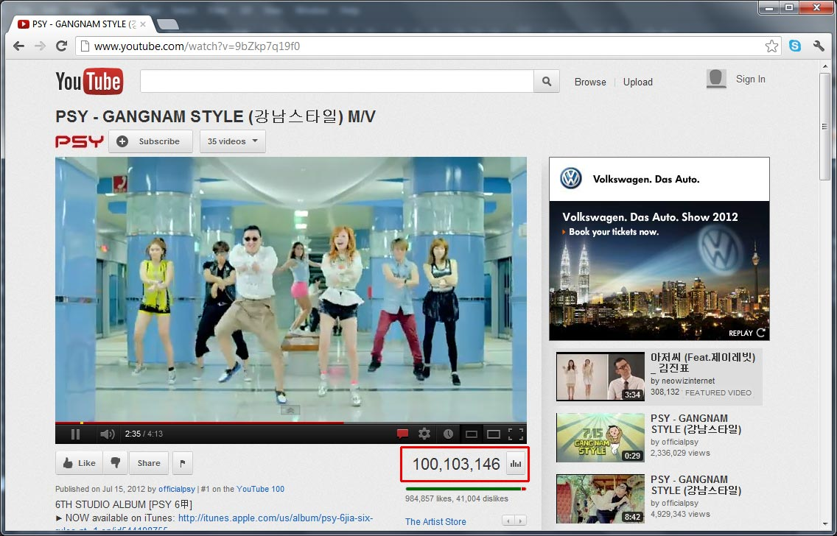


YouTube

Slide 34



Forest

Slide 35



Sunset

Slide 36


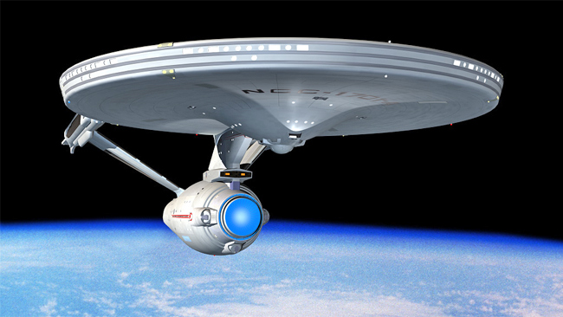
Spaceship

Slide 37



Lipstick

Slide 38
Thank you for downloading this free resource!
I believe English teaching resources should be free but keeping a website is very costly! PLEASE help me continue making my resources FREE and keep my blog running by clicking some GOOGLE ADS that appear in my website. Average revenue I get per click is only $0.01 (LOL, no kidding!) but it’s up to you how willing you are to support my advocacy.
Sharing is caring! Please share my blog posts to your friends and colleagues.
For more resources and updates, follow me on social media:
https://www.facebook.com/EnglishTeaching101/
https://twitter.com/ENteaching101
https://www.pinterest.com/ENteaching101/
http://englishteaching101.com/

