Slide 1

Erasmusplus project Better Teaching, Better Learning
Eija Kumpulainen

Slide 2
Keywords
Peda.net
Formative assessment
Flipped classroom
Peer to peer

Slide 3
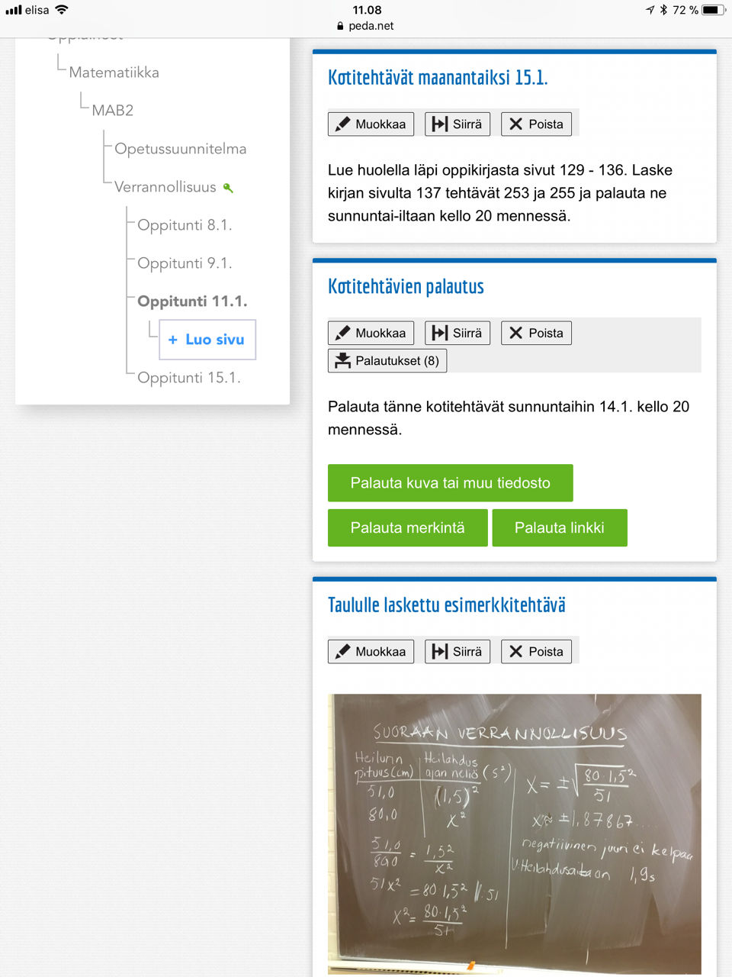
Using Peda.net
All the lessons had their own page in our Peda.net.
Each page contains at least homework and a file, in which the students sent their homework as a picture.
There might also be pictures of some examples from the lesson.

Slide 4
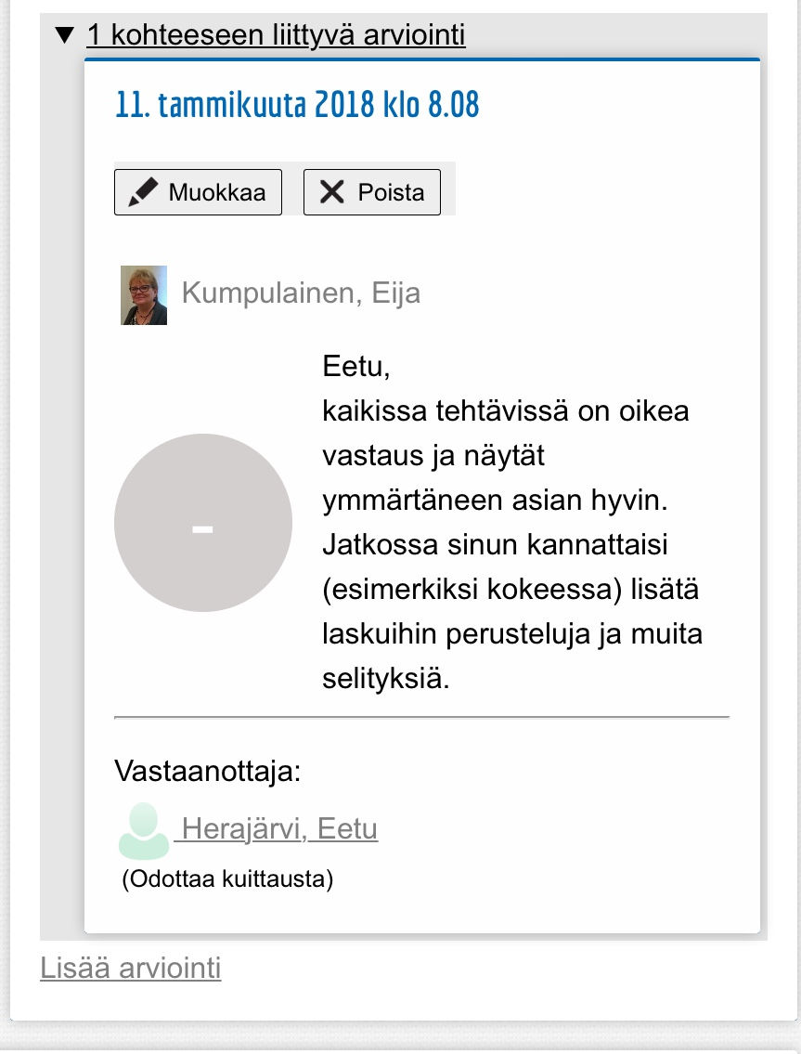
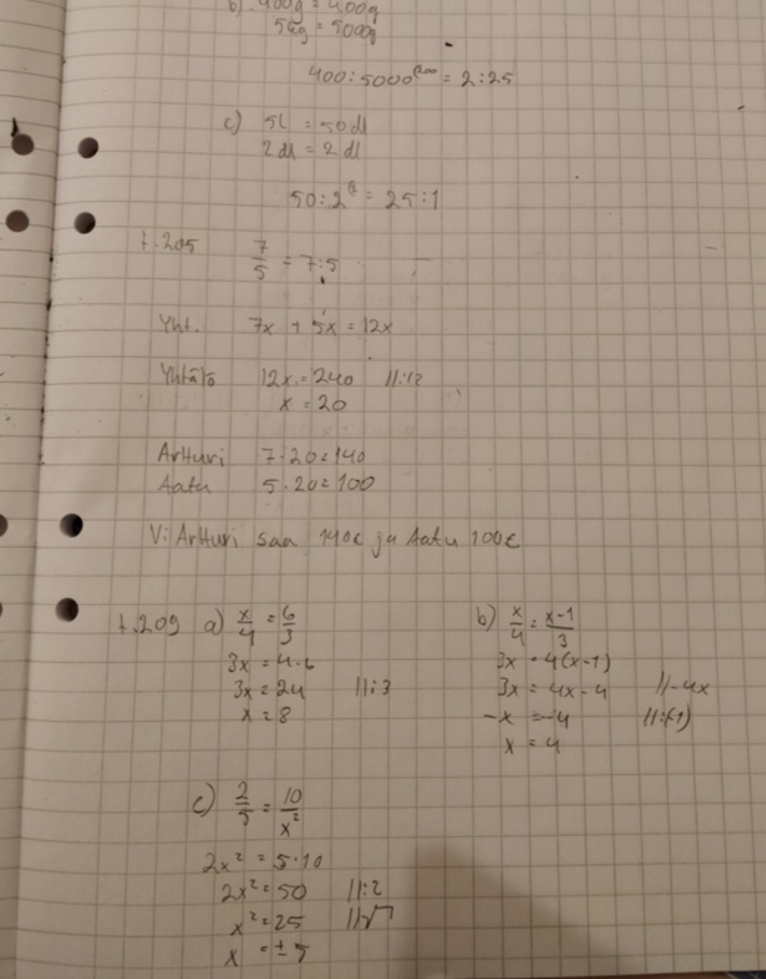
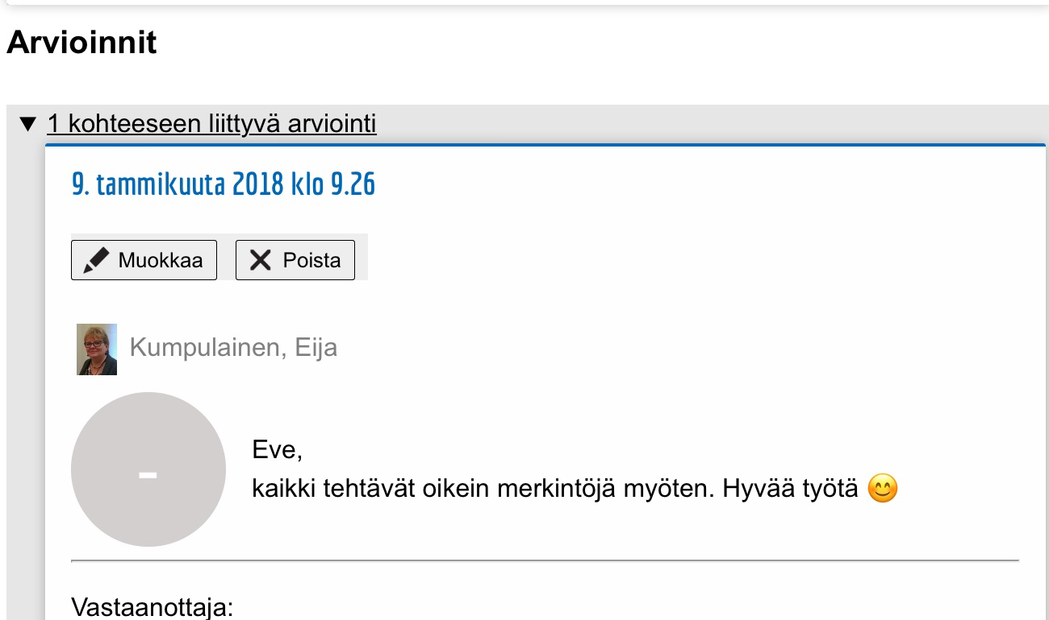
Formative assessment
The teacher wote a short note for each student.

Slide 5
Flipped classroom
Part of the students homework was to watch a video:
https://m.youtube.com/watch?v=uJmkqqFdpo0 https://m.youtube.com/watch?v=VObdN8Cb8qE

Slide 6
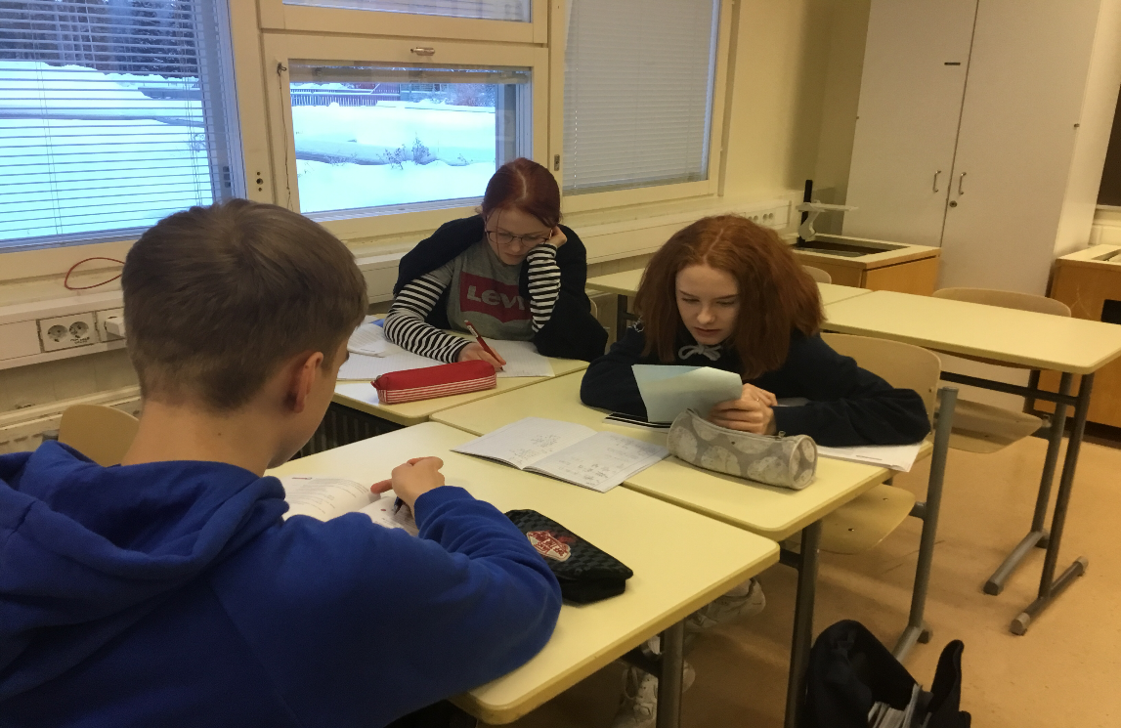
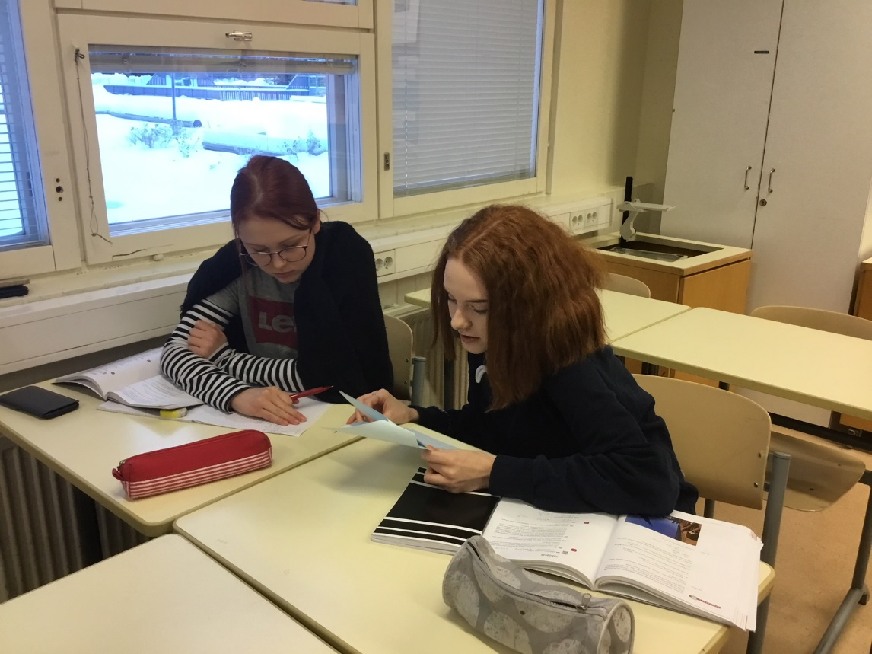
Peer to peer
Students worked in groups of three or four.
The teacher gave six problems to each group to solve.
One of the students had the solution, and she/he had to give advice to other members of the group, in other words work as a teacher.
Each member of the group works as a teacher in alternately.

