Slide 1
Our German Course

Slide 2
Basic Info
9 of us
Revisionary course
From 2 courses to 5 years
3 times per week
DIY-project for 2 weeks

Slide 3
Learning Techniques
Doing exercises
Reading texts
Rehearse vocabulary
Writing down and repeating harder words
Partner exercises
Group exercises
Speaking exercises
Listening exercises

Slide 4
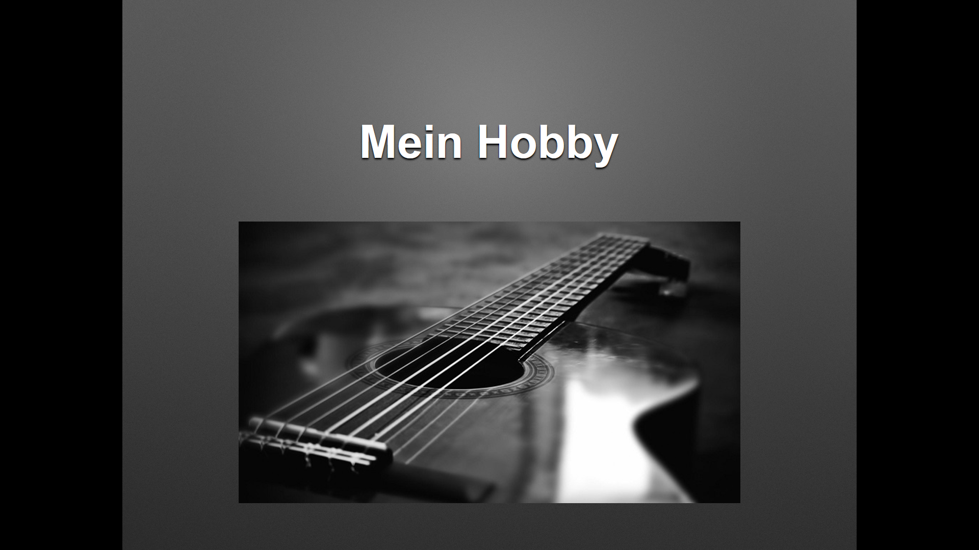
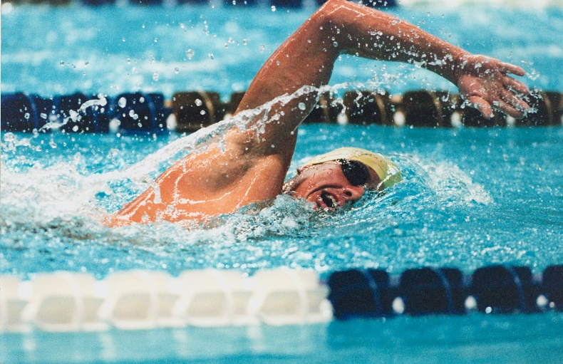
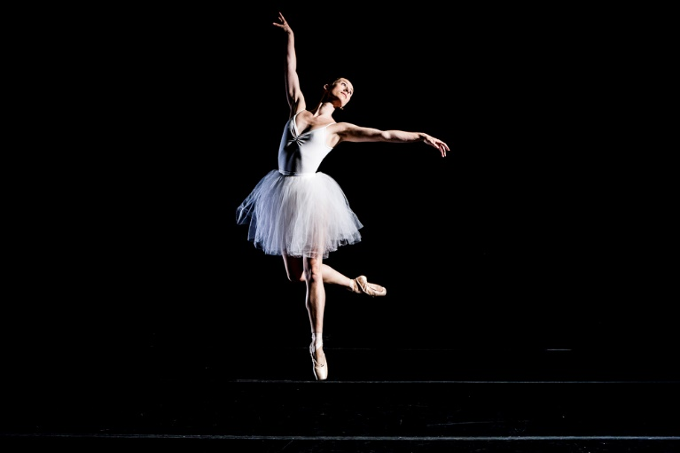
”Degree Work”
”Mein Hobby”
Informal task about hobbies/interests
Done in Powerpoint
Atleast 50 words

Slide 5
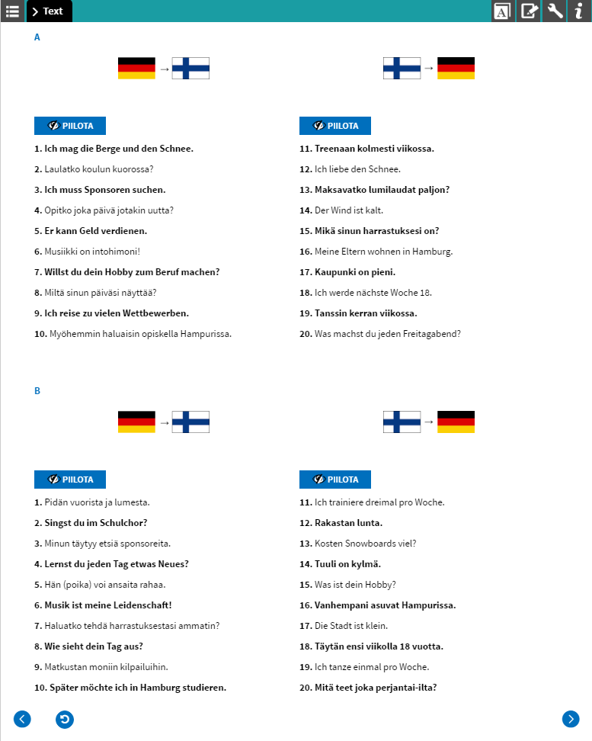
Examples of exercises

Slide 8
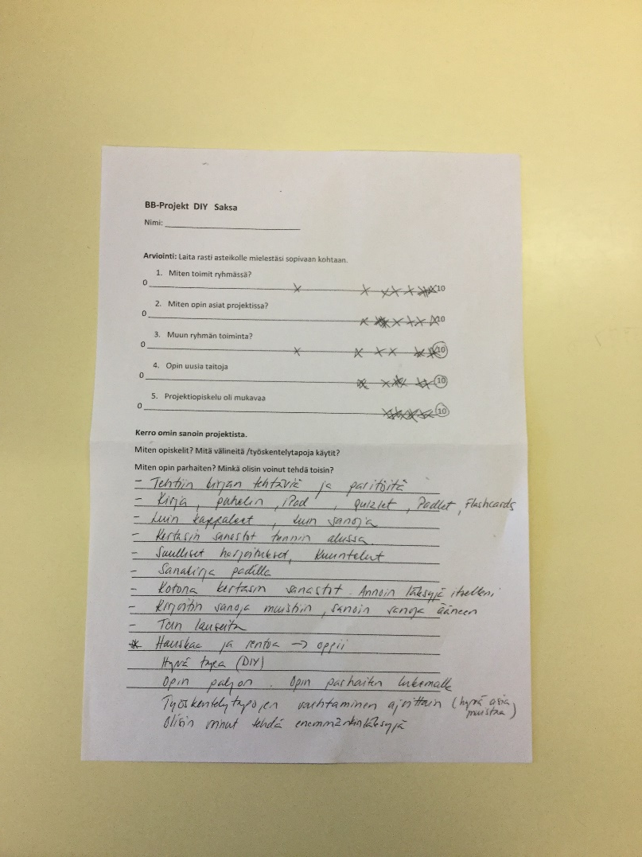
Self-Evaluation and opinions
Included multiple questions about the Diy-project
Done in the end of DIY-project
Overall opinion was positive
Some thought it was Boring at times…
But Mostly productive

Slide 9
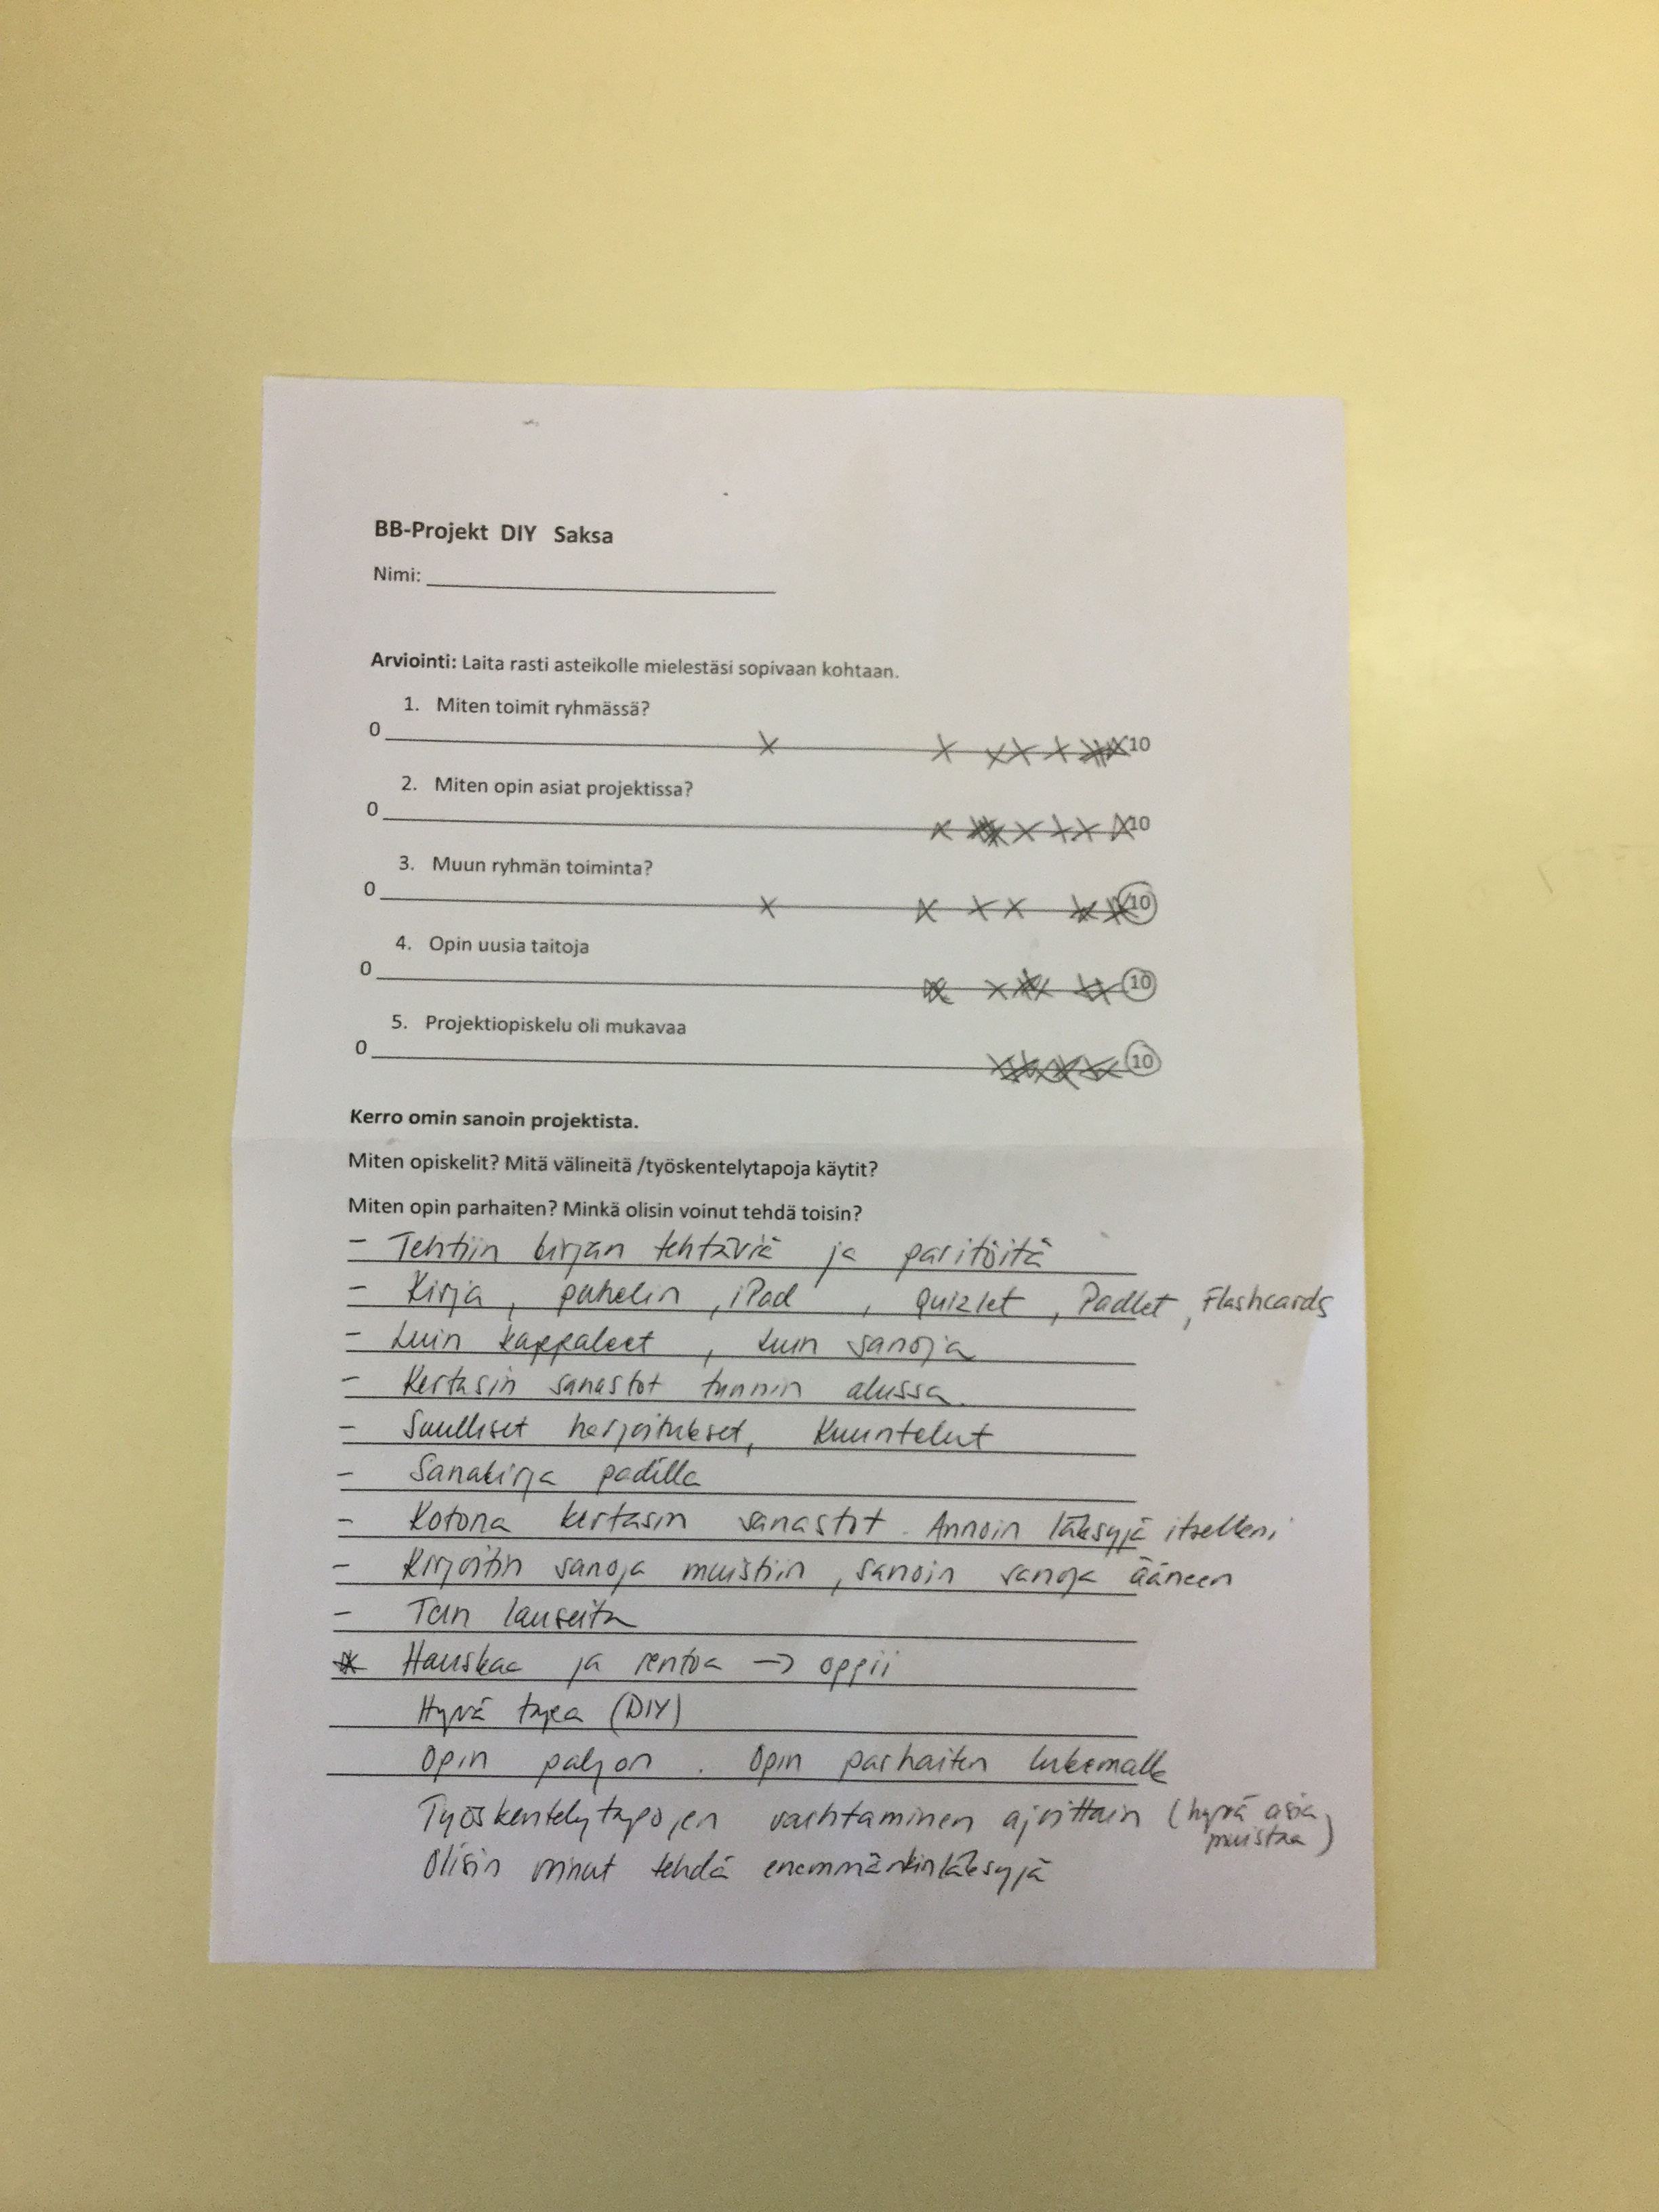

Slide 10
Teacher’s opinion
Fits revisionary course well
Different learning styles
Teacher is present but doesn’t need to do so much work
Offers help when needed

Slide 11
Example of degree work

Slide 13
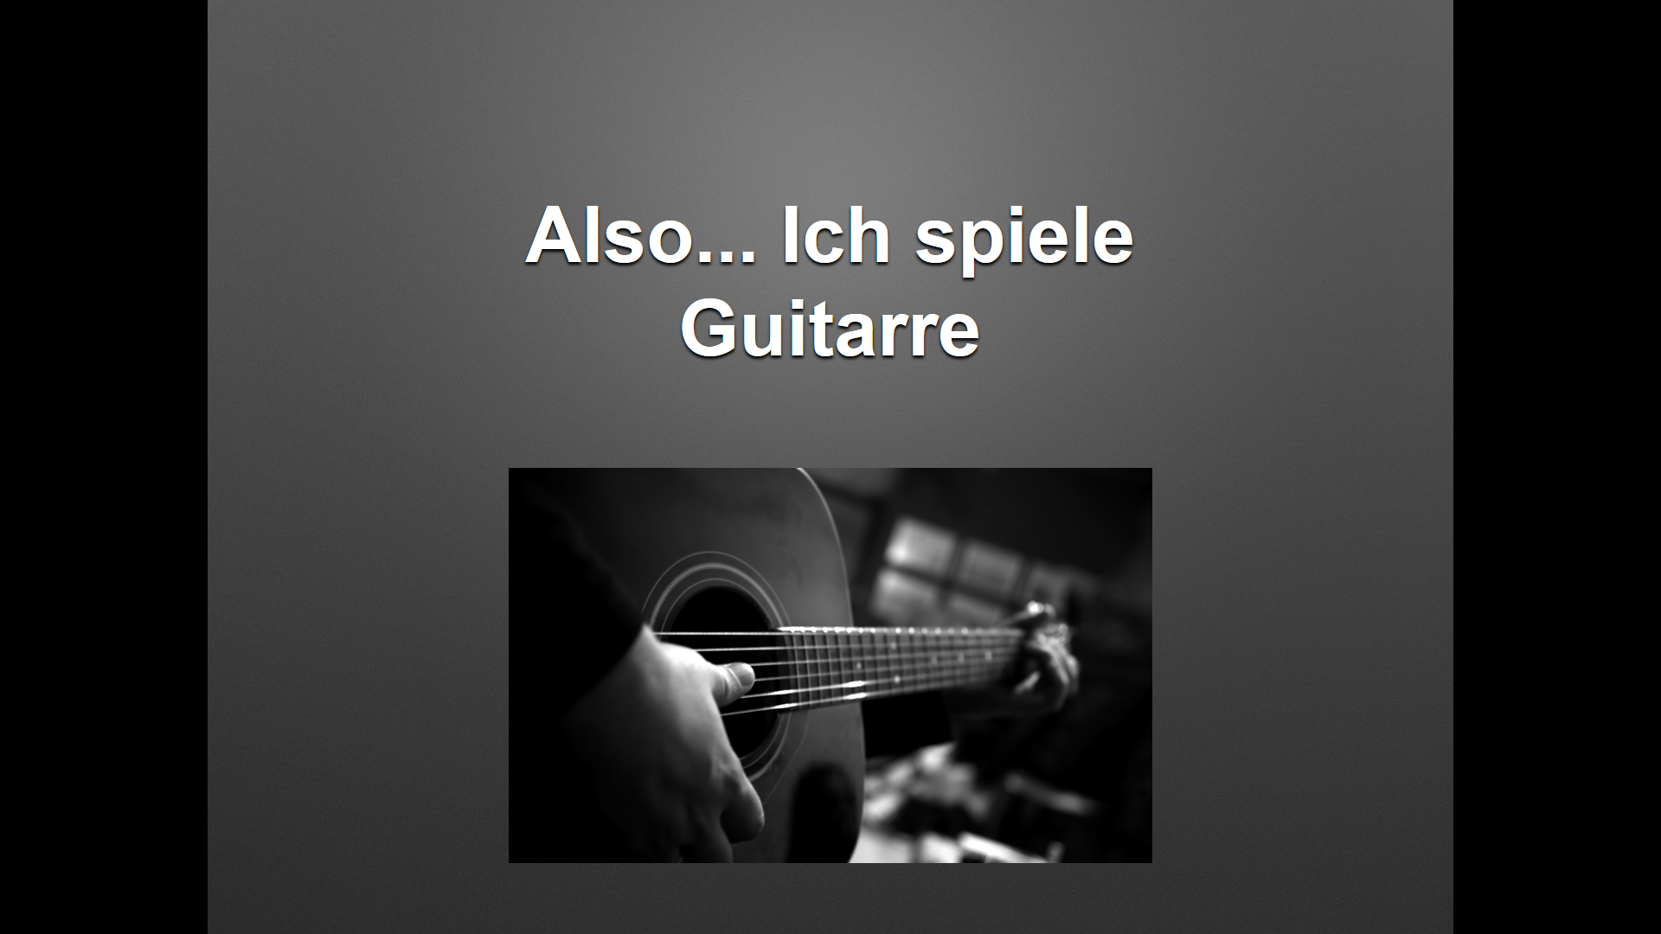

Slide 14
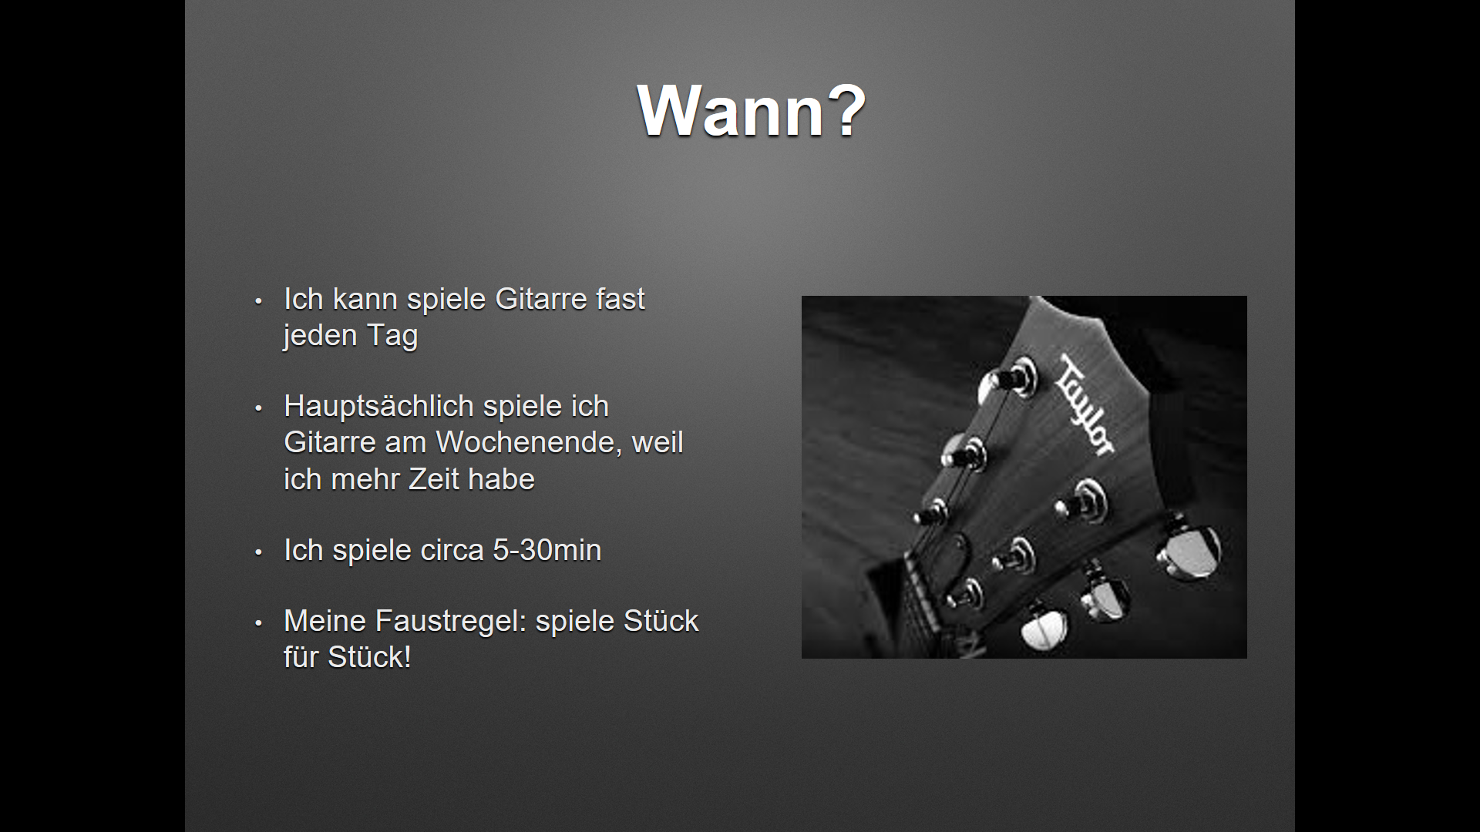

Slide 15
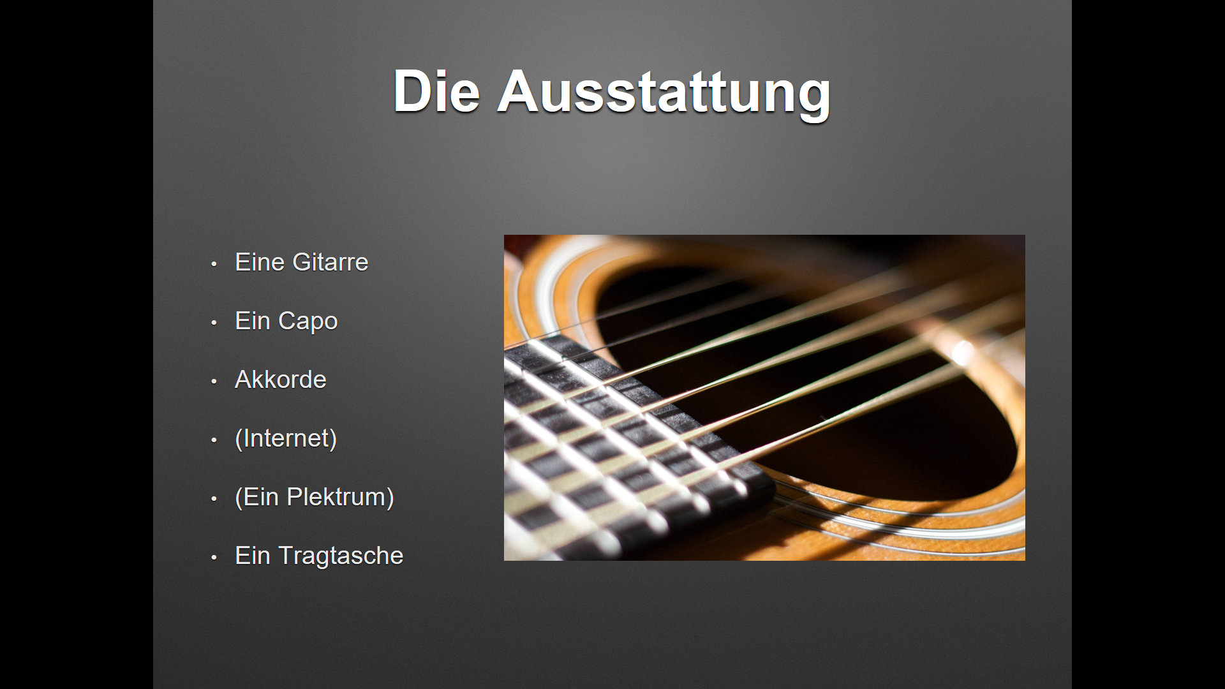

Slide 16
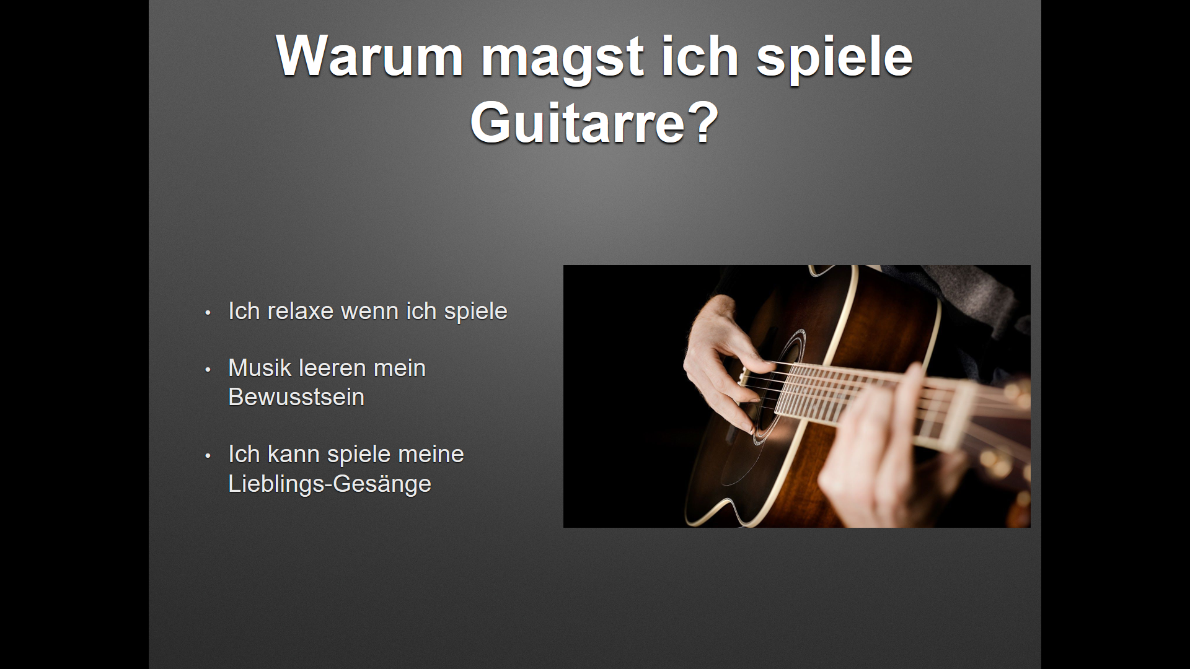

Slide 17
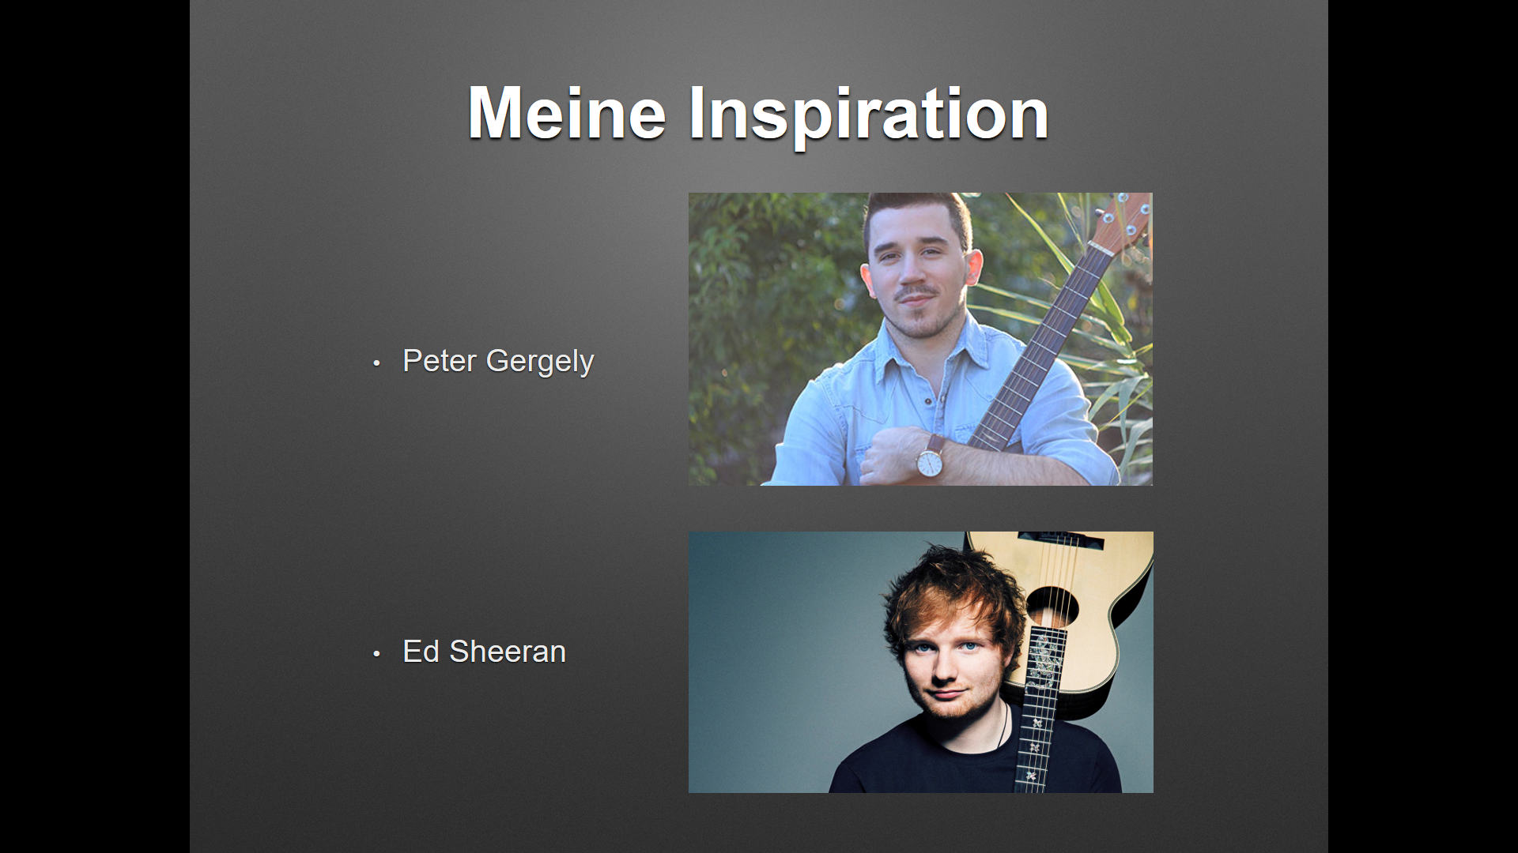

Slide 18

It was a fun project

