Slide 1
ITALIAN SCHOOL SYSTEM
Barbara Marino
Introduction to the Italian school system

Slide 2
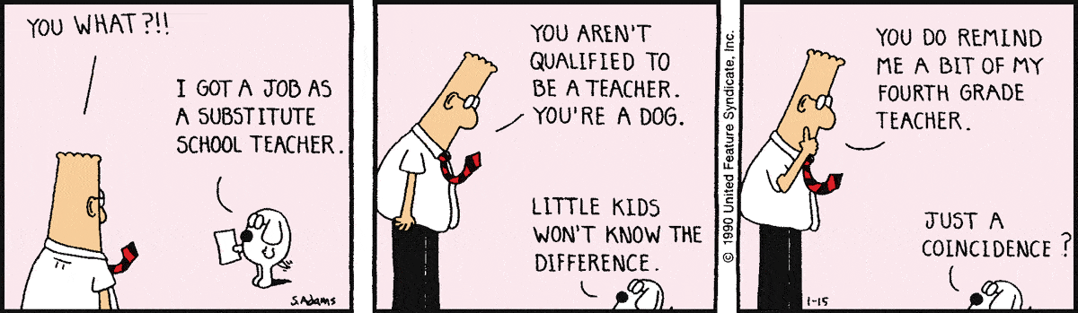
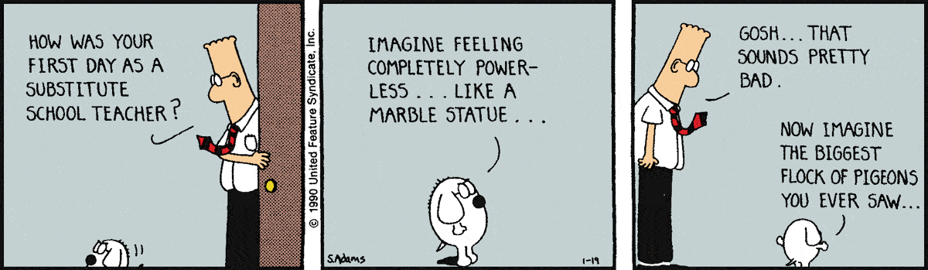
Just to break the ice……

Slide 3
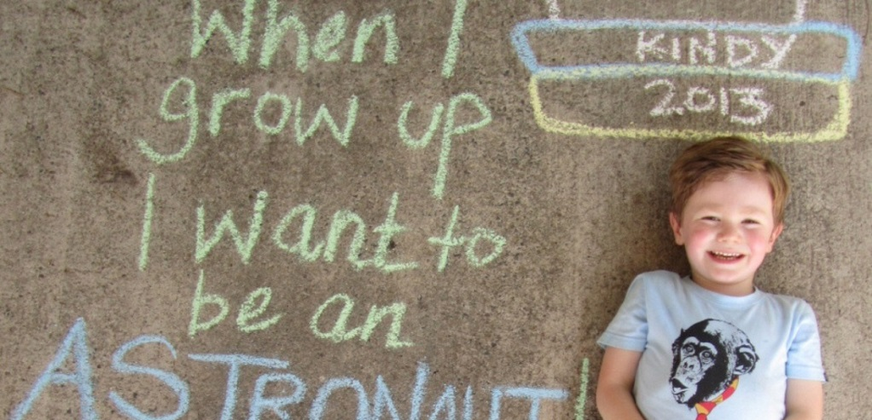
School Structure –do I really have to…?
Education in Italy is compulsory from 6 to 16 years of age, and is divided into three stages: elementary; middle; high school
There is also the possibility to attend kindergarten from 3 to 5.

Slide 4

Funny sentences on first day school
Paul 6 years first day school
“Ok mum I’ve understood, how to write letter A, but now stop it. I cannot learn how to write all letters, they are too many”
Kid- Very good.
Mum - Did you learn something new?
Kid – yes mummy,
Mum - so tomorrow we are going back to school?
Kid – Tomorrow? What tomorrow? Is not school over?
Mum – Oh dear how was it your first day?
“Mum mum, please don’t let me……………..ehm you need me at home for my bro”
Andrew 5 years and 8 months
Ann – 3 years old

Slide 5
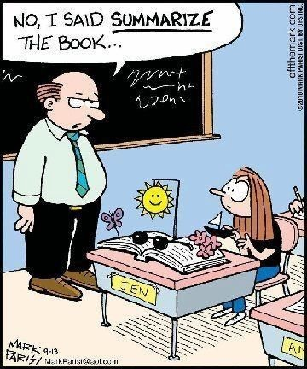
School Structure – Facts and Numbers 1
3 LEVELS
elementary school
middle school or lower secondary school
high school or upper secondary school

Slide 6
School Structure – Facts and Numbers 2
LEVELS
YEARS
1st – elementary school
2nd - middle school or lower secondary school
3rd - high school or upper secondary school
5 for elementary school
3 for middle school
5 for high schools; 3 for vocational schools

Slide 7
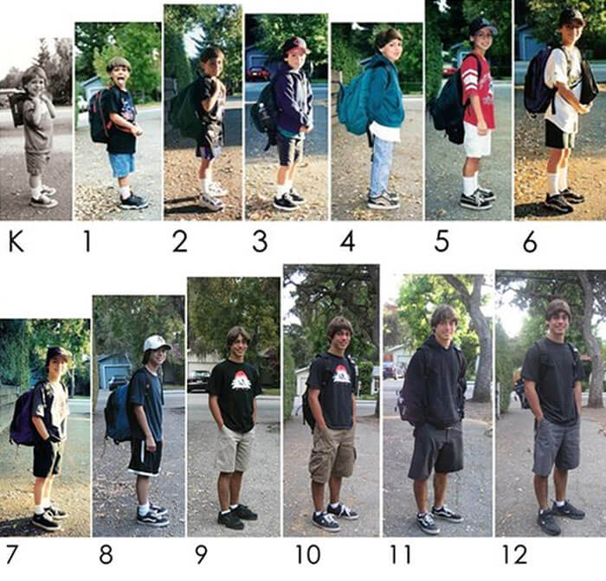
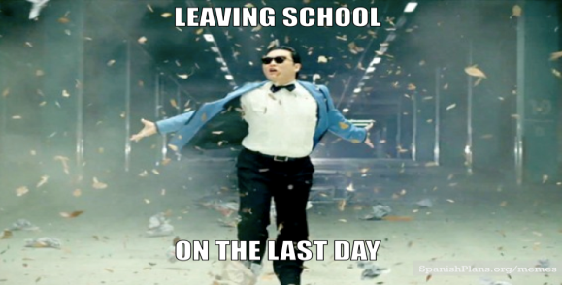
School Structure – Facts and Numbers 3
YEARS
elementary school from 6 to 11
middle school or lower secondary school from 11 to 14
high school or upper secondary school from 14 to 19

Slide 8
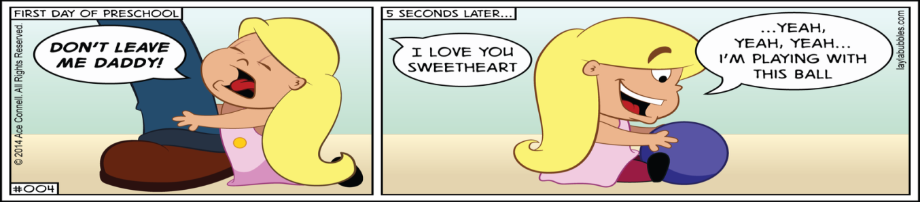
School Structure – Kindergarten
How it work?
Children are looked after by two teachers per class,
What do they do?
They play, start socialising and learn to recognize letters and numbers.

Slide 9
School Structure – Primary school
How it works?
There are 2 teachers for the main subjects Maths, Science, Italian, History and other specialists helping them in other subjects like Music, PE….etc
What do they do?
educational curriculum is the same for all students who are given a basic education in Italian, English, Mathematics, Natural sciences, History, Geography, Social studies, Physical education, Visual and Musical arts

Slide 10
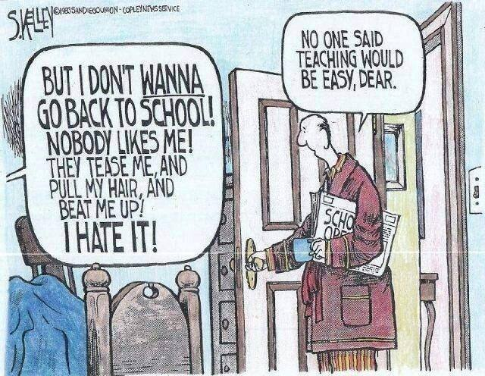
School Structure – Primary school

Slide 11

School Structure – Middle school
How it work?
There are 8 teachers, another European language is introduced (German, French, Spanish), students start to play an instrument
What do they do?
Educational curriculum is the same for all students who are given a further education in Italian, English, Mathematics, Natural sciences, History, Geography, Social studies, Physical education, Visual and Musical arts

Slide 12
School Structure – High school Intro
At the age of 14, students must make a choice as to the kind of upper secondary school ( scuola superiore, equivalent to a senior high school in the US) they want to attend, according to which subjects they would like to specialise in and what they would like to do when they leave school.
There are essentially two categories of upper secondary school:
a liceo (similar to a British grammar school), which provides a more academic training, and
an istituto, where more practical and technical disciplines are taught.

Slide 13
School Structure – High school Intro
How it works?
There are basically 3 possible choices
1st Lyceum
2nd Technical Institute
3rd Vocational School
Note: a part from the last one which lasts 3 years, all the rest are 5 years schools

Slide 14
School Structure – Lyceum
There are 8 main choices
1st Lyceum in Classical Studies (Latin and Ancient Greek are taught for 5 years
2nd Scientific Lyceum (with Latin)
3rd Scientific Lyceum for Applied Science ( without Latin)
4th Visual Art Lyceum
5th Linguistic Lyceum (with Latin)
6th Human Science Lyceum (with Latin)
7th Human science Lyceum for Economical and Marketing Studies (without Latin)
8th Dance and Music (Coreutico)

Slide 15
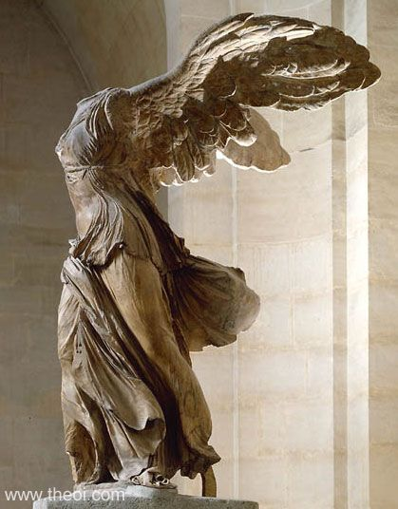
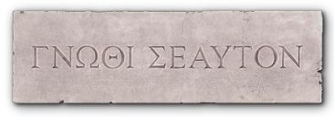
School Structure – Lyceum
What do they do?
The education received in a Lyceum is mostly theoretical, with a specialization in a field of studies, for example humanities, science, or art; less attention is devoted to technical-practical education.
Currently, most of the curricula have a similar structure and some subjects in common (such as Italian literature, History and Maths), while some subjects are peculiar to a particular type of course (for example ancient Greek in the Lyceum in Classical Studies , or scenography in Visual Art Lyceum)

Slide 16
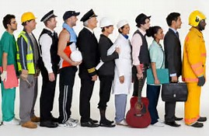
Tech School 1/2
What do they do?
By far the greatest number of upper secondary school students enrol in technical school, which prepares students to work in a technical or administrative capacity in agriculture, industry or commerce.
Technical schools have responded to Italy’s fast-growing economy by offering an ever-widening range of courses tailored to the needs of employers, courses in computer skills in particular seeing tremendous growth in recent years.

Slide 17
Tech Institutes 2/2
What do they do?
Technical schools follow the common curriculum for the first two years , with some practical training carried out in workshops and businesses. In the last three years, the number of hours of practical training increases.
Most of technical schools are agricultural, commercial (with specialisations in business administration, accountancy, commerce, foreign languages and computer programming), surveying, tourism, nautical, aeronautical and industrial (including many specialisations such as mining, electronics, engineering, industrial physics, computer science and food processing).

Slide 18
School Structure – Tech School
There is a wide range of schools, some are so peculiar that they exist only in one town in Italy… Here it is the main schools list
economics and management, offers a broad theoretical education oriented toward specific subjects, such as law, economy, politics, and accountancy;
administration, finance and marketing – which specialises in economy, law, accounting, political sciences, management and marketing
IT – which specialises in IT and Information Systems
Tourism – which specialises in tourism and related topics
Tech School – specialized in: technology, informatics, electronics, chemical industry, biotechnology, construction management, geotechnics, fashion; it comprises nine sub-types:
mechanics, mechatronics and energy
transport and logistics
electronics and electrical engineering
IT and telecommunications
graphics and communications
chemistry, materials and biotechnology
fashion system
agriculture, agro-food and agro-industry
building

Slide 19
Vocational Schools
What do they do?
Vocational school: are the least academic of upper secondary schools. They aim to train people in a variety of craft and industrial skills, such as cabinet-making, carpentry, mechanics and engineering, building and construction, food and catering, secretarial and office work.

Slide 20
Vocational Schools
Timetable?
In the third year, the number of hours of specialist practical training increases to between 21 and 24 hours per week. After three years, students gain a diploma in their specialist subject (qualification diploma), after which they may take a two-year course in order to earn their upper secondary school diploma, either at the vocational school or at a technical school.
The timetable varies between 35 and 40 hours per week, and for the first two years it includes 14 hours per week of practical training relevant to a pupil’s chosen area of specialisation.

Slide 21

University? Yes please!
All students can enter university, provided they complete a 5-year course at secondary school and acquire their upper secondary school diploma and it’s now common for students who have attended technical and vocational schools to go on to university.

Slide 22
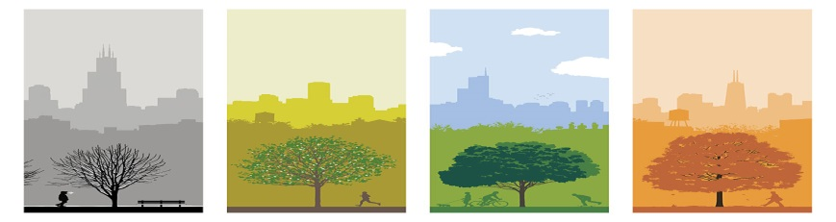
Where, When and How long
Lessons usually start around the second week of September and finish around the second week of June.
There are small regional differences, with the school term starting earlier in the Northern regions, and later in the South, but it is usually just a matter of days.
As more autonomy has been recently given to individual schools, it might also be the case that a school decides to make some minor changes to the yearly calendar.

Slide 23

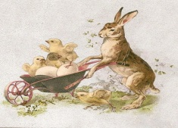
Where, When and How long
There are school breaks only for Christmas and Easter, with most holidays being concentrated in the summer, and schools are closed on national holidays.
The school year is divided into two terms, 'quadrimestri'.
The autumn term starts in September and runs until the middle of January.
Spring term begins in the middle of January and runs until the beginning of June.
At the end of each term, students receive a 'pagella', a report card with their grades which may vary from 10 (excellent) to 1 (impossible to assess), with passing being 6.
Today, report cards are frequently issued in automated form and may be mailed to parents/students or made accessible on a special section of the school website.

Slide 24

Where, When and How long
The majority of schools in Italy runs morning lessons starting at 8.00am/8.30 am which usually last 5/6 hours, from Monday to Saturday. This means most students come back home for lunch, therefore, there is no canteen in most Italian schools.
Kindergarten and schools with special afternoon projects and activities are an exception though, as they are usually open till 4.00/4.30pm and can provide lunch for students.

Slide 25

Where, When and How long
Enrollment in an Italian state school doesn’t depend on your living within its catchment area, as is the case, for example, in France and the UK. You can enroll your child in the school of your choice regardless of the area you live in. If a place is available, your child will be admitted; if places are limited, those who live in the local area will have priority.

Slide 26
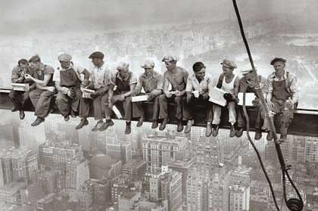
School and work - WLT
Recently Italian school System has introduced for high school a new approach to work.
WORK LINKED TRAINING (alternanza scuola lavoro)
WLT is mandatory for high school students who must attend a 200 hours work linked training activities for Lyceum and 400 hours one for Technical schools.

