Slide 1
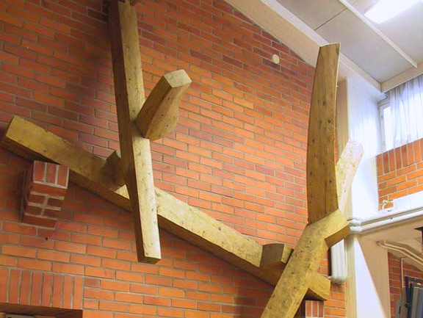
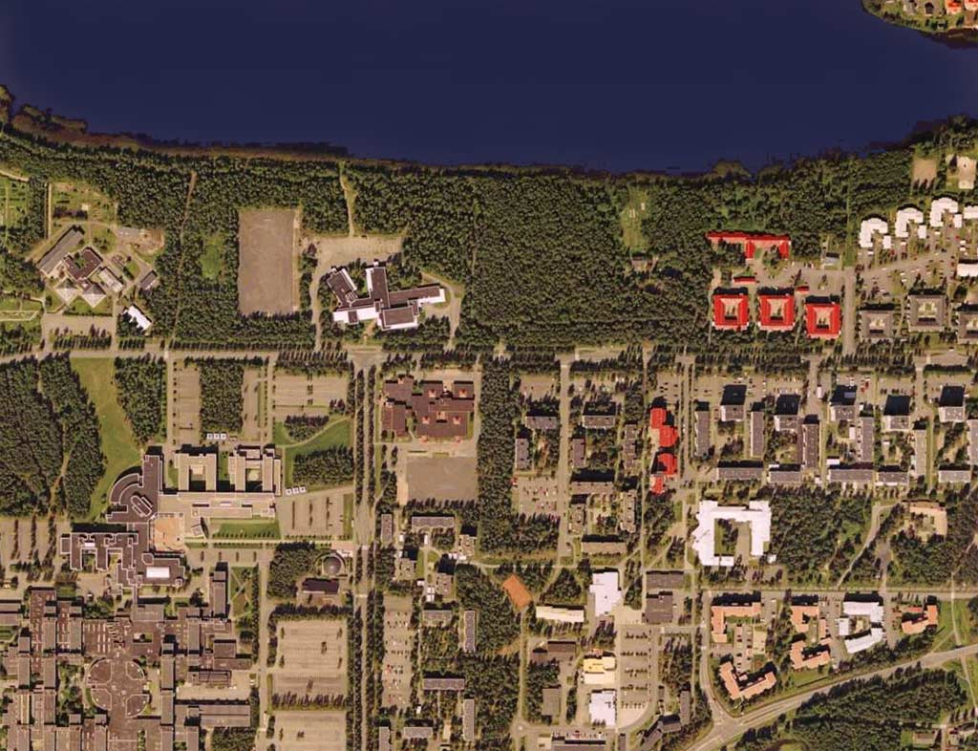
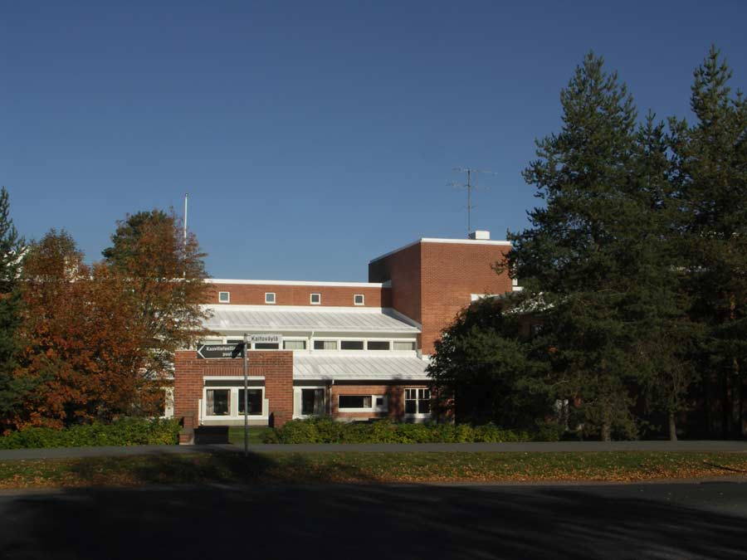
Oulu Teacher Training School
Upper Secondary School
Norssi
Principal Eija Kumpulainen
22.11.2016

Slide 2
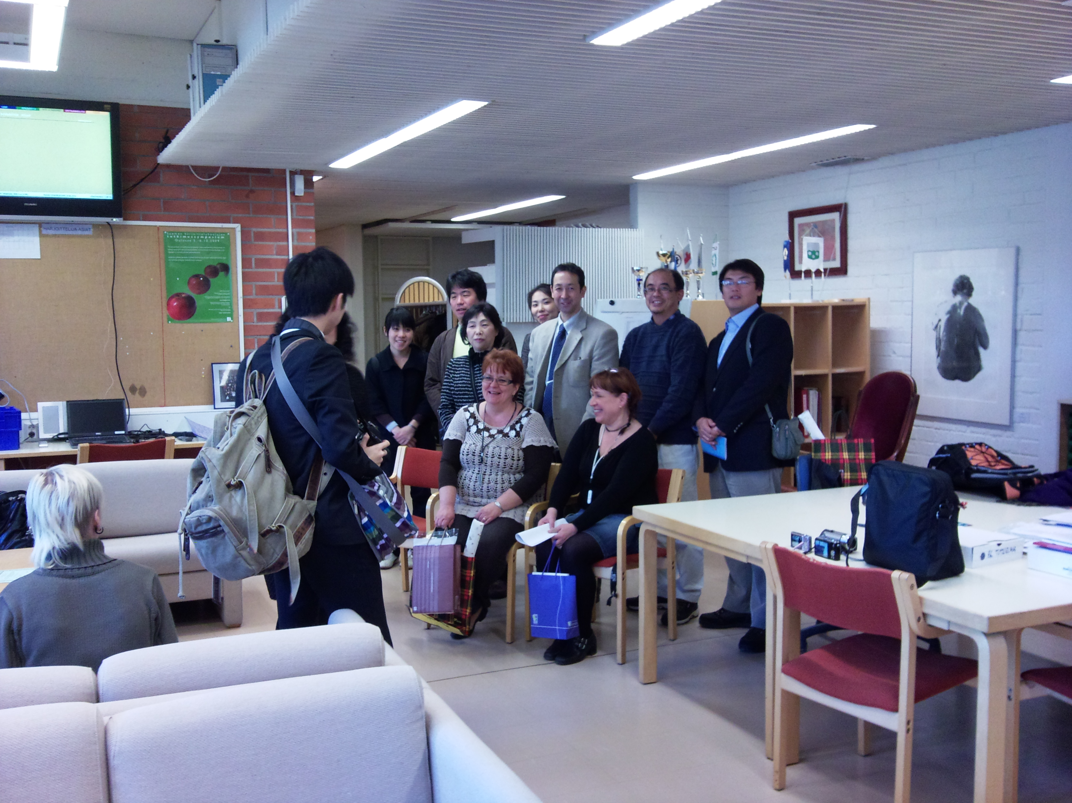
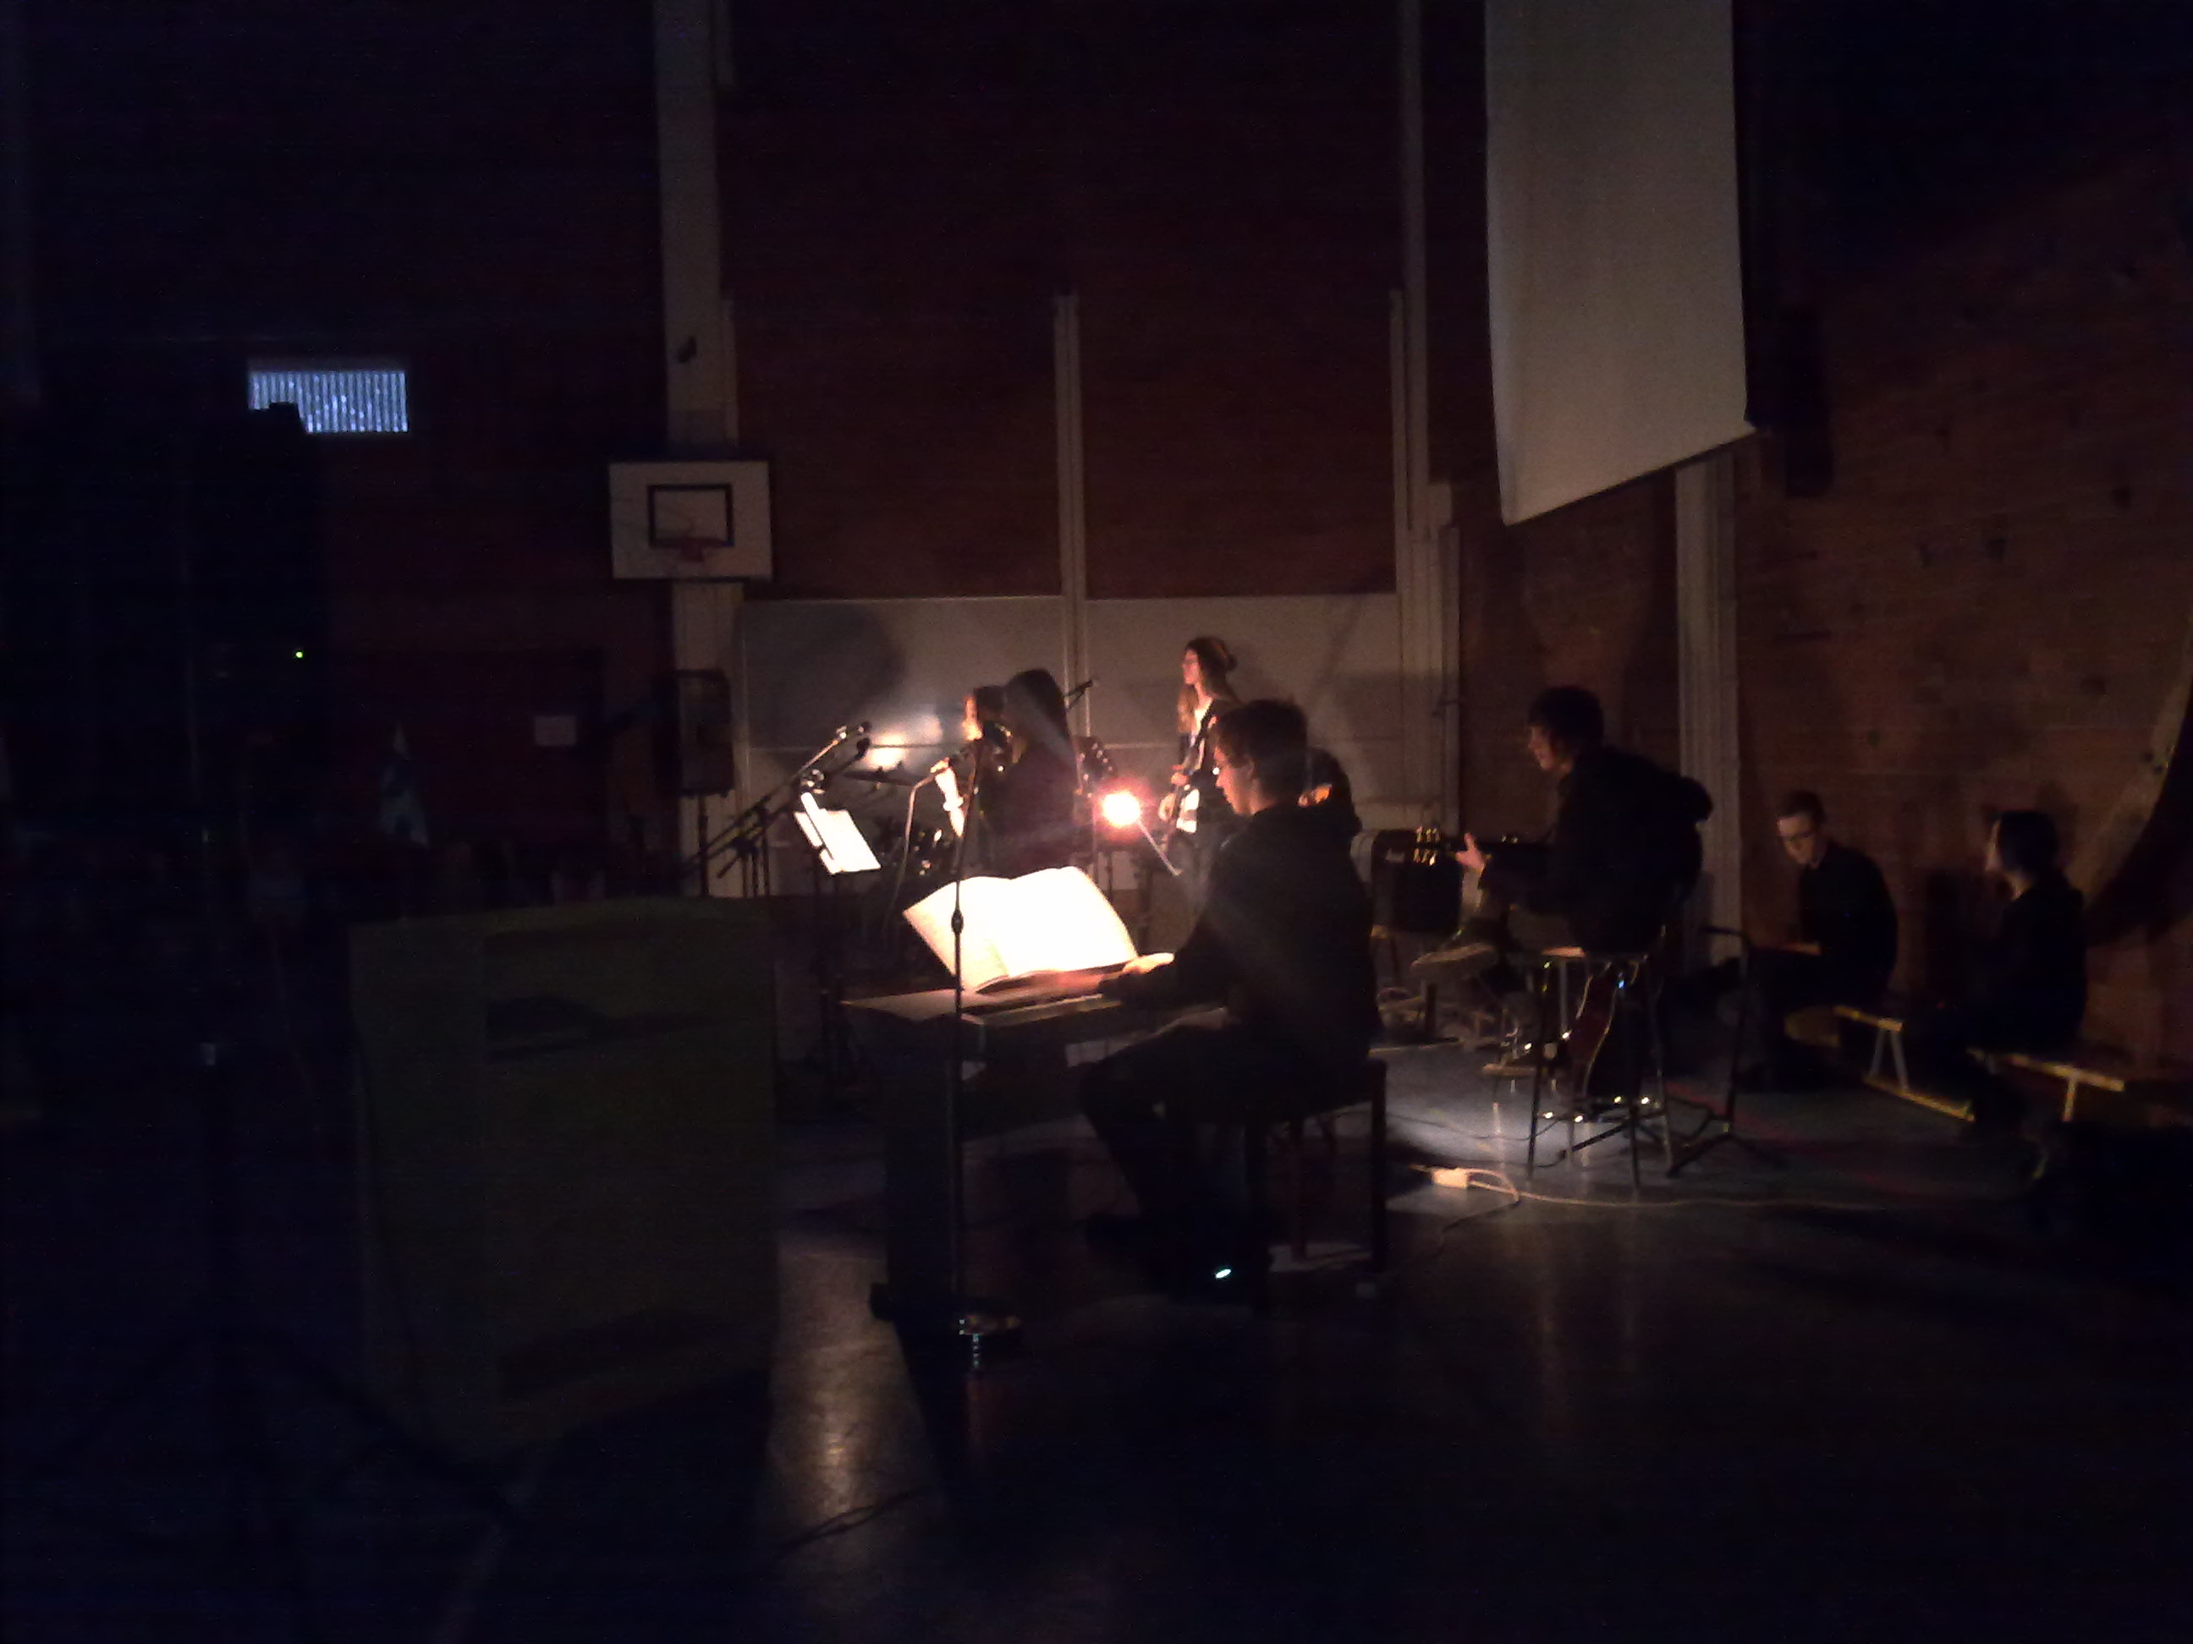
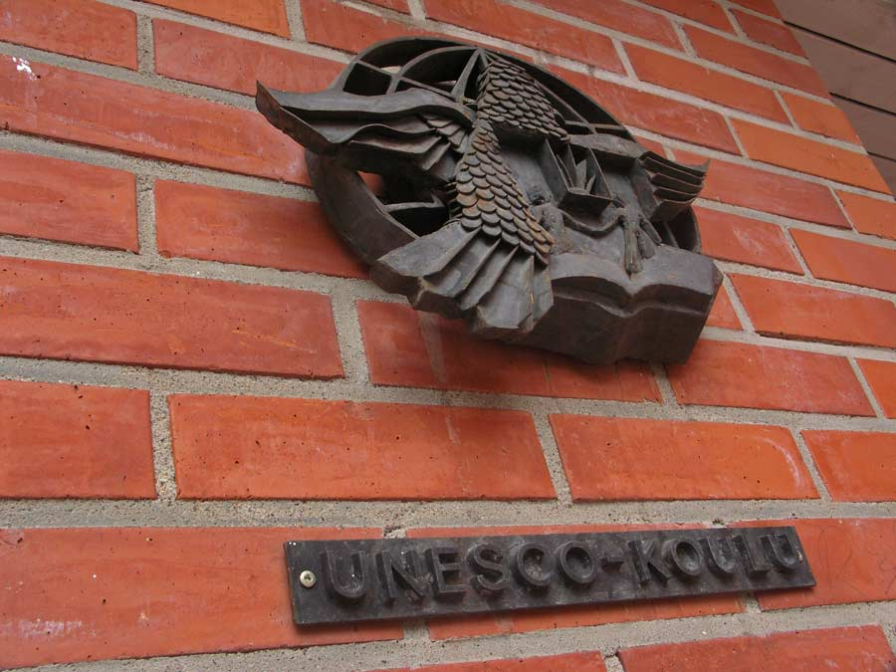
245 students
50 teachers
130 teacher trainees
Admission averages:
2010 | 2011 | 2012 | 2013 | 2014 | 2015 | 2016
8,06 | 8,33 | 7,75 | 8,06 | 8,00 | 8,50 | 8,30

Slide 3
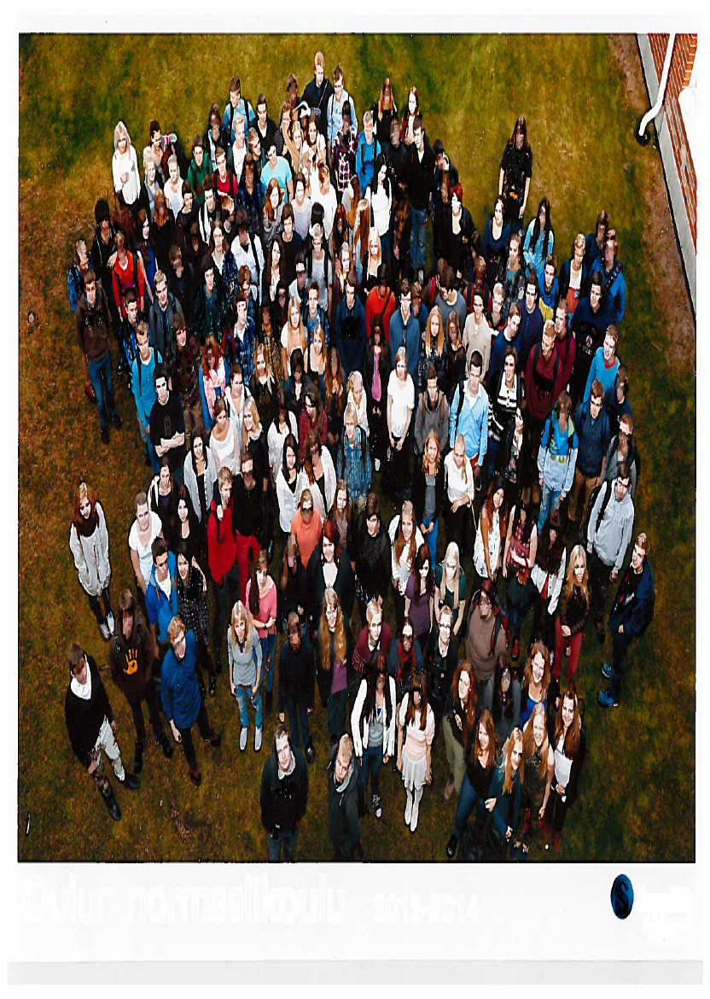
The size of the school is optimal
We all know each other
School nurse, social worker and psycologist have time to meet students
Student councellors have time to guide each student inividually
We can take good care of our students

Slide 4
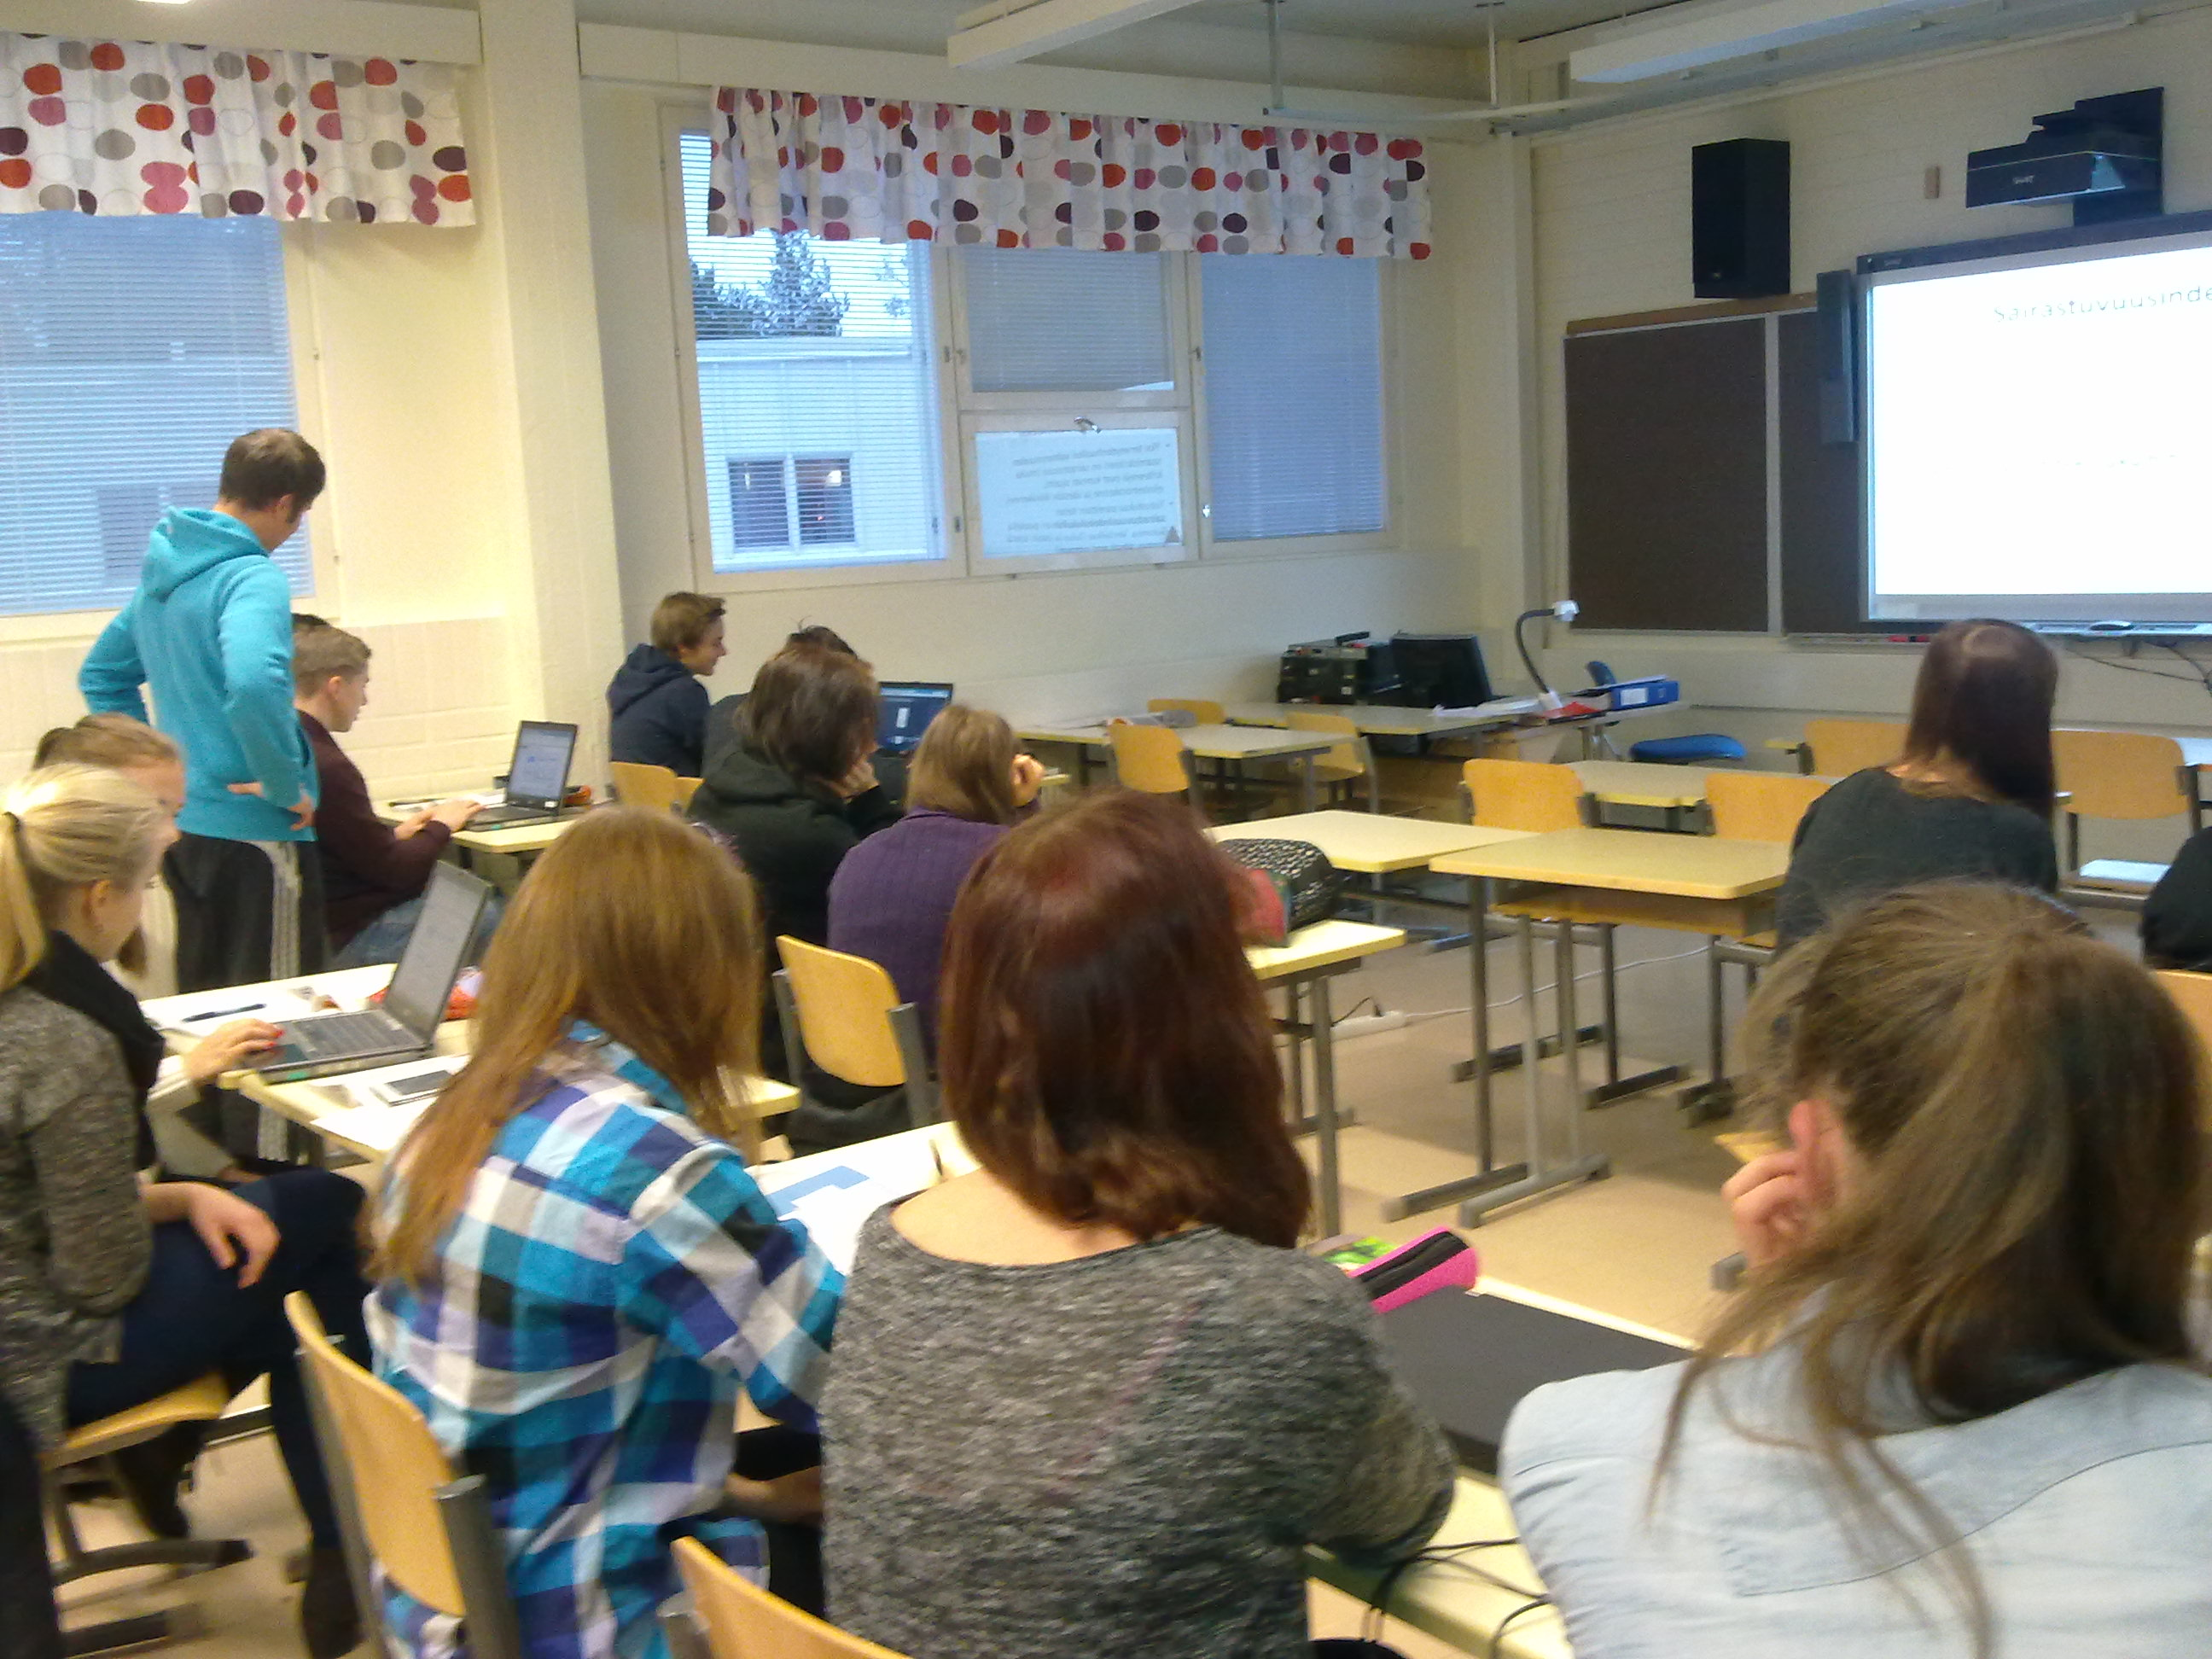
Modern tecnolology in teaching and learning
Apple iPads & other tablets
Windows-based PCs
Smart Boards
Interactive beemers
Document cameras

Slide 5
Subject | Compulsory courses* | Specialisation courses, national | Specialisation courses, school
Mother tongue and litteracy | 6 | 3 | 3
A-language, English | 6 | 2 | 5
B-language, Swedish | 5 | 2 | 5
Other language |  | 8 + 8
Mathematics, Common syllabus | 1 |  | 1
Mathematics, Basic syllabus | 5 | 2 | 3
Mathematics, Advanced syllabus | 9 | 3 | 6
*One course is 18 - 20 lessons, each 75 minutes

Slide 6
Subject | Compulsory courses | Specialisation courses, national | Specialisation courses, school
Biology | 2 | 3 | 3
Geography | 1 | 3 | 2
Physics | 1 | 6 | 1
Chemistry | 1 | 4 | 3
Religion or ethics | 2 | 4 | 1
Philosophy | 2 | 2 | 1
Psychology | 1 | 4 | 2
History | 3 | 3 | 3
Social studies | 3 | 1 | 3

Slide 7
Subject | Compulsory courses | Specialisation courses, national | Specialisation courses, school
Physical education | 2 | 3 | 3
Music | 1-2 | 2 | 3
Visual Arts | 1-2 | 2 | 3
Health education | 1 | 2 | 1
Educational and vocational guidance | 2
Theme courses |  | 3
Applied courses
Compulsory courses | 47-51
Minimum total number of courses | 75

Slide 8
Assessment
Period 1 10.8. – 30.9. 2016 |  | Period 2 3.10. – 29.11.2016 |  | Period 3 30.11.2016 – 8.2.2017 |  | Period 4 9.2. – 7.4.2017 |  | Period 5 10.4. – 3.6.2017
Exam week, five or six days
The students grade should be based on various types of assessment, for example
portfolios
presentations
essays
project work
smaller tests
group work
homework
self assessment
pier assessment

Slide 9
THE FINNISH MATRICULATION EXAMINATION
The purpose of the examination is to discover whether pupils have assimilated the knowledge and skills required by the curriculum for the upper secondary school and whether they have reached an adequate level of maturity in line with that school's goals.
Passing the Matriculation Examination entitles the candidate to continue his or her studies at university.
The Matriculation Examination Board is responsible for administering the examination, its arrangements and execution.
The Board ( about 40 members) issues guidelines on the contents, the arrangements and the assessment of the tests.
About 330 associate members assist the members in the work of preparing and assessing the tests.
The Matriculation Examination is twice a year, in spring and in autumn, in all Finnish upper secondary schools, at the same time.
A candidate must complete the examination during not more than three consecutive examination periods. The examination can also be completed in one examination period.

Slide 10
THE TESTS
The examination consists of at least four tests.
The test in the candidate´s mother tongue is compulsory for all candidates.
The candidate then chooses three other compulsory tests from among the following four tests: the test in the second national language, a foreign language test, the mathematics test, and one test in the general studies battery of tests (sciences and humanities).
As part of his or her examination, the candidate may additionally include one or more optional tests.
The headmaster of the upper secondary school will check to see whether the candidate fulfils the requirements laid down concerning participation in the examination and in the tests that are part of it.

Slide 11
THE LEVELS OF THE TESTS
Tests are arranged at two different levels of difficulty in mathematics, the second national language and foreign languages.
The levels in mathematics and foreign languages are the advanced course (level A) and the basic course (level B) , and in the second national language the advanced course and the intermediate course.
The candidate may choose which level of each of the above-mentioned subjects he or she takes, regardless of his or her studies at the upper secondary school.
The candidate must take a test based on the advanced course in at least one compulsory test.
The candidate may take only one test in the same subject on the examination.

Slide 12
DESCRIPTION OF THE TESTS
The mother tongue test have two parts: a textual skills section and an essay. In the textual skills test the candidate's analytical skills and linguistic expression are measured. The essay focuses on the candidate's general level of education, development of thinking, linguistic expression and coherency.
The second national language tests and the foreign language tests include sections for listening and reading comprehension and sections demonstrating the candidate's skill in written production in the language in question.
In the mathematics test the candidate must complete ten questions. The candidate is allowed to use calculators and books of tables that have been approved by the Board as aids.
The general studies battery includes tests in Evangelical Lutheran religion, Orthodox religion, ethics, philosophy, psychology, history, social studies, physics, chemistry, biology, geography and health education. Furthermore, the tests incorporate questions which cross the boundaries of these disciplines. Depending on the test in question, the candidate answers six or eight test items.

