Slide 1
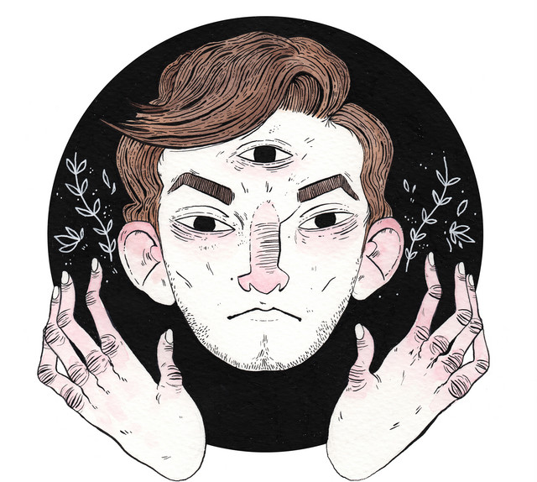
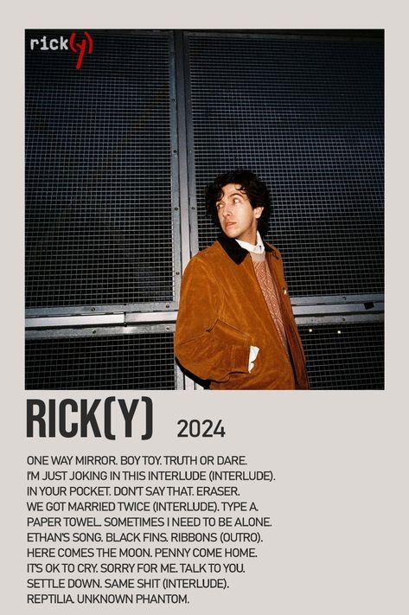

Slide 2

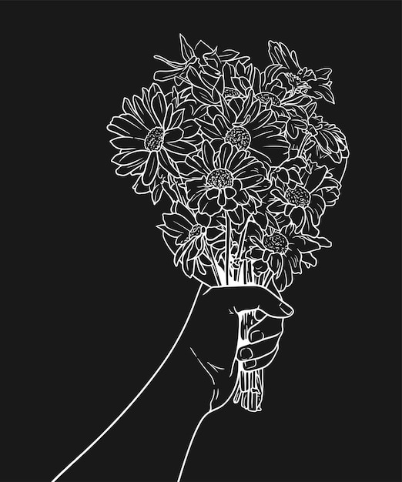
Your choice of topic
I chose to do a drawing of the song This December by Ricky Montgomery.
It's about seasonal depression wich is quite common among people.
December is in next month and the song has a cheerful christmast feeling to it.

Slide 3
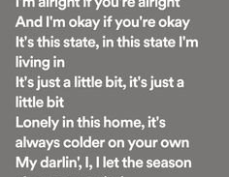
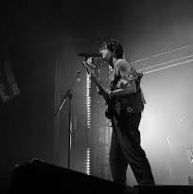

The different stages of work
Picking the song
Analyzing the song
Sketching
Drawing
Making the powerpoint
Picking out my favourite lyrics

Slide 4
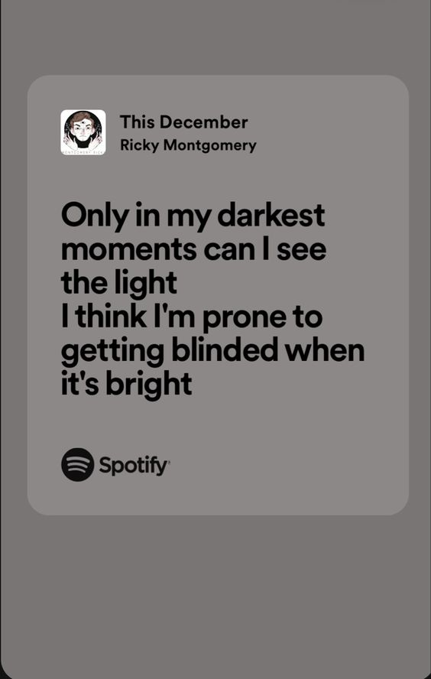
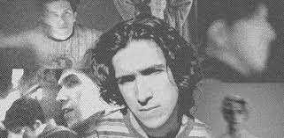

The easy/simple parts
Sketching the drawing
Thinking of the symbolisms
Making the Powerpoint

Slide 5
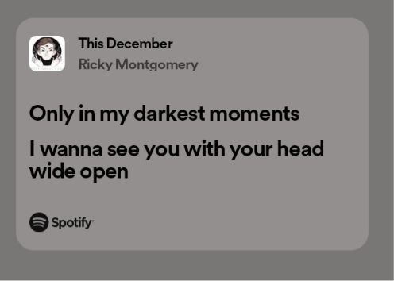
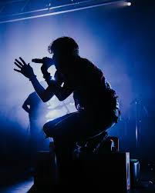

The difficulties/challenges
Deciding the song
Getting the colours right
The song is left hevily to the listeners own interpretition so it was a little bit difficut to determine the songs meaning at times.

Slide 6


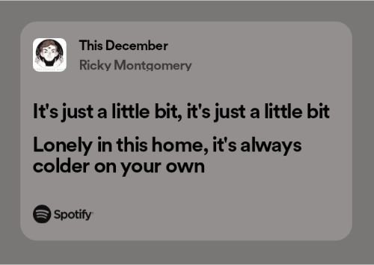
The facts/things you learned
I learned more about song analyzation
I learned to draw human anatomy better
I learned how to make more sense from song lyrics

Slide 7
Analysis of the song
“Only in my darkest moments, can I see the light” He’s saying that when he’s in the pits of depression, he can see how much better it is when he’s not depressed. He’s “blinded when it’s bright” because he tends to forget how bad it can get during the cooler seasons. But "this December I'll remember", meaning he’ll make more of an effort to remember what the “light” looks like and keep pushing forward.
I assume that he’s referring to a love interest when he says “want you to see it when I do”, meaning he wants to prove that he can do this. His line about “I wanna see you with your head wide open” most likely refers to intrusive thoughts, or it refers to him wanting to see his love interest’s thoughts, because he doesn’t know what they’re feeling.

Slide 8
Analysis of the song
“I’m alright if you’re alright, and I’m okay if you’re okay” He wants to feel good for the love interest, he knows that he is down but he doesn’t want that to effect the love intrest. It also could be a form of reassurance, or instead of a form of insecurity and unwillingness to be honest about his own feelings.
“It’s this state in this state I’m living in” likely refers to his depression. He’s fine, nothing has happened to him, it’s quite literally just his mind that’s depressing him. Him saying it’s “colder on your own” could refer to his love interest leaving him, but I think it’s him saying he’s mentally on his own. "I’ll let the season change my mind", wich connects it all for seasonal depression

Slide 9
