Slide 1


Opettajankoulutuslaitoksen kehittämispäivät 21.8.2018
Riitta-Leena Metsäpelto
Center for Research on Learning and Teaching
Jyväskylän yliopisto

Slide 2
Yhteishaku KK + KM, kaksivaiheinen opiskelijavalinta (LO, EP, LTO)
Sähköinen haku
Opintopolku
I VAKAVA-koe
II Soveltuvuuskoe
Lopullinen valinta
OKM-hankkeet opiskelijavalintojen kehittämiseksi
Yliopistojen opiskelija-valintojen uudistamishanke
OVET opettajankoulutuksen valinnat – ennakoivaa tulevaisuustyötä

Slide 3
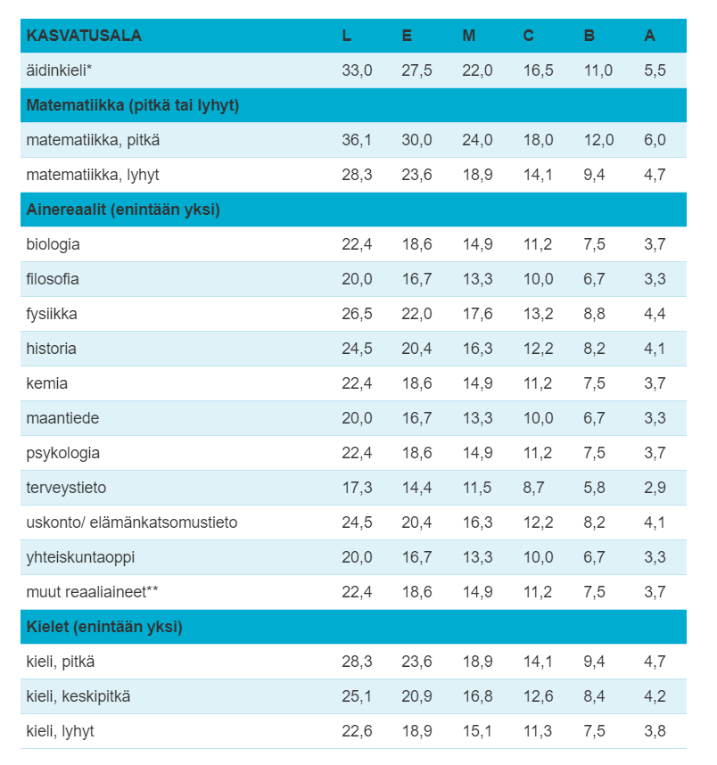
Ylioppilastutkinnon arvosanojen pistetaulukko: Kasvatusala
YO-todistuksella soveltuvuuskokeeseen valittavien osuus: 60%
VAKAVA (+Avoin väylä?): 40%

Slide 4
OVET – hanke
(2017-2020)
  Opettajankoulutuksen soveltuvuuskokeiden kehittäminen
  Hankkeessa mukana Turun (koordinaattori), Jyväskylän, Helsingin, Tampereen, Oulun, Itä-Suomen ja Lapin yliopistot
  Opettajankoulutuksen yhtenäiset tutkimusperustaiset valintamenettelyt 2020 lähtien
  Yhteishaussa yhteisvalinta

Slide 5
OVET-osahankkeet
OH1: Opettajan osaamisen mallin kehittäminen
OH2: Opiskelijavalintamallien kehittäminen ja kokeileminen (tavoitteena opettajankoulutuksen yhtenäinen opiskelijavalinta 2020)
OH3: Seurantamallin luominen ja vakiinnuttaminen

Slide 6
Kehittämistoimia
2017 JY/Pysäkkihaastat-telu (Luoko)
2018
JY/Pysäkkihaastat-telun kehittäminen
JY/Yhteinen soveltuvuuskoe (Luoko+Erkka)
UEF: yhteinen soveltuvuuskoe
2019
UEF ja HKI: Yhteinen soveltuvuuskoe (pysäkkihaastattelu) Yhteisvalinta
JY/Pysäkkihaastattelu (Aiko)
2020: Opettajankoulu-tuksen yhteiset valinnat

Slide 7

JY / Luokanopettajakoulutuksen ja erityispedagogiikan yhteiset soveltuvuuskokeet 2018
Työteliäs kevät pysäkkien suunnittelussa
Pysäkkihaastattelut sujuivat mainiosti
Keskustelutilaisuus myöhemmin syksyllä
https://commons.wikimedia.org/wiki/File:Kiitos!_(TIkkukirjaimin)_01.jpg

Slide 8
Alustavia havaintoja pysäkeistä
Haastattelijan merkitys hakijan pysäkkikohtaisissa pistemäärissä laski hieman
Pysäkkien välinen vaihtelu edelleen melko suurta
Kyselylomake haastattelijoille
  Jukka Utriainen (KLA)

Slide 9
Luokanopettaja- ja aineenopettajakoulutuksen opiskelijavalinnat 2019
Aikon soveltuvuuskokeet 5.2.2019
VAKAVA 25.4.2019
Luokon soveltuvuuskokeet 5.-10.6.2019
  KK + KM 5.-7.6.2019
  KM + VEP 10.6.2019
Yhteistyö erityispedagogiikan oppiaineen kanssa jatkuu
Työsuunnitelma, kalenteri
Kysyttävää?

Slide 10
OVET-osahankkeet
OH1: Opettajan osaamisen mallin kehittäminen
OH2: Opiskelijavalintamallien kehittäminen ja kokeileminen (tavoitteena opettajankoulutuksen yhtenäinen opiskelijavalinta 2020)
OH3: Seurantamallin luominen ja vakiinnuttaminen

Slide 11
Luokanopettaja
Lastentarhanopettaja
Erityisopettaja
Aineenopettaja
Ohjausala

Slide 12
Any attempt to describe the essential qualities of a good teacher should take into account that various levels are involved that fundamentally differ from each other
Korthagen, F. A. (2004). In search of the essence of a good teacher: Towards a more holistic approach in teacher education. Teaching and Teacher Education, 20(1), 77-97.

Slide 13

Source: https://hermentorcenter.com/

Slide 14
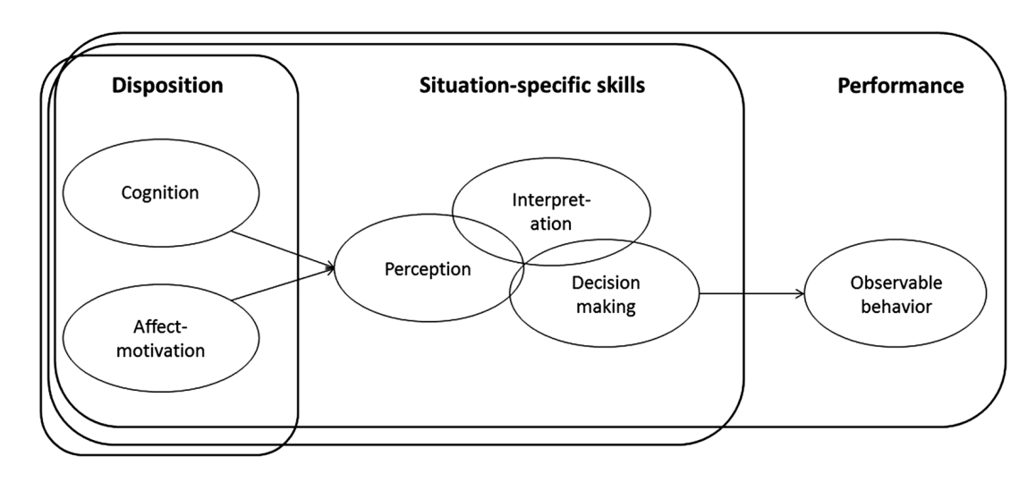
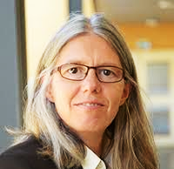
Teacher competence as a continuum
Blömeke, S., Gustafsson, J. E., & Shavelson, R. J. (2015). Beyond dichotomies: Competence viewed as a continuum. Zeitschrift für Psychologie, 223(1), 3-13.
Prof. Sigfrid Blömeke
University of Oslo, NO

Slide 15
Process model of teacher professional competences
Dimensions of
competences/dispositions
Observable professional practices
Situation-specific processing skills
Teacher
effectiveness
1 Cognitive and academic skills
Cognitive
Social-emotional
Individual / group level practices
Student outcomes – individual
and group level
2 Knowledge base of teaching
Interpretation
Organisation level practices
3 Social skills
Decision-making
Perception
4 Personal skills
Community / societal level practices
5 Professional ethics, values, and beliefs
Adapted from Blömeke, S., Gustafsson, J. E., & Shavelson, R. J. (2015). Beyond dichotomies: Competence viewed as a continuum. Zeitschrift für Psychologie, 223(1), 3-13.
Preliminary © OVET

Slide 16
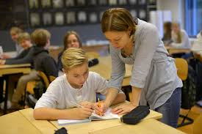
Observable professional practices: Everyday praxis of teaching
Teaching through interactions framework
Emotional support: teacher’s skills to maintain positive emotional tone in the classroom and avert negativity, to respond sensitively to student needs, and to take into account students’ perspective in instruction by emphasizing their interests and viewpoints.
Classroom organization: teacher’s abilities to maximize opportunities for learning by clearly expressing behavioral expectations and by using routines and effective methods to prevent and redirect misbehavior.
Hamre, B. K., Pianta, R. C., Downer, J. T., DeCoster, J., Mashburn, A. J., Jones, S. M., ... & Brackett, M. A. (2013). Teaching through interactions: Testing a developmental framework of teacher effectiveness in over 4,000 classrooms. The Elementary School Journal, 113(4), 461-487.
Instructional support: teacher knows how to promote students’ higher-order thinking, provides students feedback that is focused on expanding learning and understanding, and uses a variety of strategies to promote students’ thinking and understanding of material at a deeper and more complex level.

Slide 17
The Framework For Teaching
Danielson, 1996
Planning and Preparation
Classroom Environment
Professional responsibilities
Instruction
e.g., planning instruction, designing student assessments
e.g., communicate with parents, maintain information (e.g., digital records) on student progress, participate in the professional community, sustained efforts for continuous professional development
Danielson, C. (2011). Enhancing professional practice: A framework for teaching. (2nd ed). ASCD.

Slide 18
Process model of teacher professional competences
Dimensions of
competences/dispositions
Observable professional practices
Situation-specific processing skills
Teacher
effectiveness
1 Cognitive and academic skills
Cognitive
Social-emotional
Individual / group level practices
Student outcomes – individual
and group level
2 Knowledge base of teaching
Interpretation
Organisation level practices
3 Social skills
Decision-making
Perception
4 Personal skills
Community / societal level practices
5 Professional ethics, values, and beliefs
Adapted from Blömeke, S., Gustafsson, J. E., & Shavelson, R. J. (2015). Beyond dichotomies: Competence viewed as a continuum. Zeitschrift für Psychologie, 223(1), 3-13.
Preliminary © OVET

Slide 19

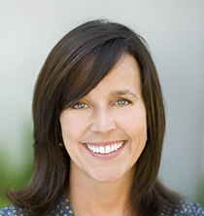
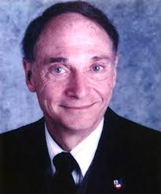
Situation-specific processing skills
Perception, noticing
Noticing
Becoming aware
Selectively attending
Niek van den Bogert
Fontys University of Applied Science, NL
Expert teachers process visual information faster and distribute their visual attention more evenly than novices
Elisabeth van Es
University of California, USA
Interpretation
Making sense
Professional vision is the ability to notice and interpret relevant features of classroom situations
Richard J. Shavelson
Stanford University, USA
Decision making
Instructional responding
Reflection-in-action
Any teaching act is the result of a decision - sometimes conscious but more often not - that the teacher makes after the complex cognitive processing of available information

Slide 20
Process model of teacher professional competences
Dimensions of
competences/dispositions
Observable professional practices
Situation-specific processing skills
Teacher
effectiveness
1 Cognitive and academic skills
Cognitive
Social-emotional
Individual / group level practices
Student outcomes – individual
and group level
2 Knowledge base of teaching
Interpretation
Organisation level practices
3 Social skills
Decision-making
Perception
4 Personal skills
Community / societal level practices
5 Professional ethics, values, and beliefs
Adapted from Blömeke, S., Gustafsson, J. E., & Shavelson, R. J. (2015). Beyond dichotomies: Competence viewed as a continuum. Zeitschrift für Psychologie, 223(1), 3-13.
Preliminary © OVET

Slide 21

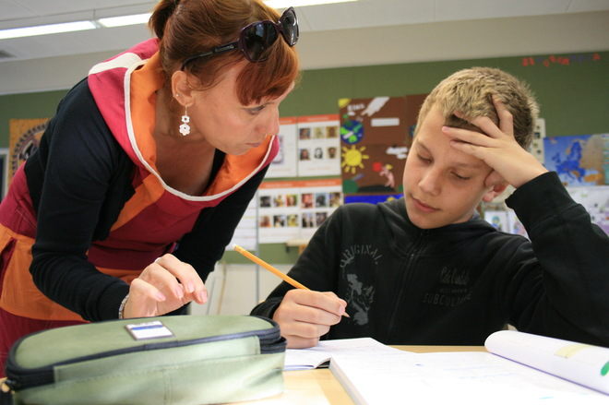
  Teacher competence = a combination of knowledge, skills, attitudes, values and personal characteristics, empowering the teacher to act professionally and effectively in situations involving, for instance, teaching and student learning (Koster, Dengerink, Korthagen & Lunenberg, 2008)

Slide 22
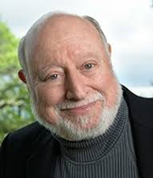
Dimensions of competences/dispositions
Knowledge base of teaching
Content knowledge
Pedagogical knowledge
Pedagogical content knowledge (incl. technological pedagogical content knowledge)
Contextual knowledge
Lee S. Shulman
Stanford University
USA
Teachers integrate knowledge of subject matter – content knowledge – with content-specific pedagogical strategies to produce successful teaching outcomes
Cognitive and academic skills
Information processing
Problem-solving
Metacognitive knowledge and regulation
Critical thinking and creativity
Argumentation and reasoning

Slide 23
Dimensions of competences/dispositions
Social skills (”how we manage relationships”)
Relational skills (e.g., teamwork skills, conflict management, negotiation)
Emotional competence skills (e.g., emotion regulation, expression of emotions)
Cultural competences (e.g., awareness of and attitudes towards diversity)
Personal skills (”how we manage ourselves”)
Motivation (e.g., teacher self-efficacy, attributions, goal orientation)
Personality
Adaptive coping and resilience (e.g., coping with stress)
Professional ethics, values, and beliefs

Slide 24
Implications for student selections
Dimensions of
competences/dispositions
Observable professional practices
Situation-specific processing skills
Teacher
effectiveness
1 Cognitive and academic skills
Cognitive
Social-emotional
Individual / group level practices
Student outcomes – individual
and group level
2 Knowledge base of teaching
Interpretation
Organisation level practices
3 Social skills
Decision-making
Perception
4 Personal skills
Community / societal level practices
5 Professional ethics, values, and beliefs
Targets of evaluation
Adapted from Blömeke, S., Gustafsson, J. E., & Shavelson, R. J. (2015). Beyond dichotomies: Competence viewed as a continuum. Zeitschrift für Psychologie, 223(1), 3-13.
Preliminary © OVET

Slide 25
Kysyttävää?
Kiitos.

