Slide 1
Introduction to Literary Studies
28 November 2020
karppinen.anne.m@gmail.com

Slide 2
Overview of the Course
5 lectures: 2 on poetry, 2 on prose + 1 on drama
Absences + compensation
Methods of study: lectures, readings and discussions
Home exam
Recommended reading:
- David Lodge: The Art of Fiction
https://www.slideshare.net/Annatess/david-lodge-the-art-of-fiction
- Internet sources
- all poetry, prose and criticism you can get your hands on
- lecture slides

Slide 3
The Art of Fiction vs. The Craft of Reading
Analysing poetry and prose fiction is often considered an ‘art form’ – something slightly mystical and difficult to master
-> gives the impression that literature has nothing to do with real life, and cannot simply be enjoyed
It’s more useful to consider textual analysis as a ‘craft’ – with some specific tools and techniques
One becomes a crafty reader by learning the craft of reading. I believe that it is in our interest as individuals to become crafty readers --. Art is high, craft is low. Art is unique; it can’t be taught. Craft is common; it can be learned.
Robert Scholes: Crafty Reader

Slide 4
Contemporary literary theory argues that the ‘message’ is made in and out of the text:
Meaning doesn’t exist before the text itself comes into existence: it is created by the text. Had the poet written other words into the text, the meaning of the poem would be different in essence, not merely in decoration.
-> the reader comes to share responsibility for meaning in the text, since it is her or his activity in reading that produces meaning.
David Buchbinder: Contemporary Literary Theory and the Reading of Poetry

Slide 5
-> when reading (poetry or prose), don’t try to look ‘between the lines’: most of the stuff should be IN the lines already
There is a lot of (sometimes complicated) terminology involved in literary study – this does not mean that laypersons cannot analyse literature
-> literary study CAN entail detailed analysis & terms, but it doesn’t NEED to

Slide 6
Texts can move you, amuse you, inspire you, anger you – or leave you cold. These effects should never be underestimated
-> However it’s always worthwhile to ask WHY
Therefore, when looking for reading material, go for the things you like – but don’t shy away from ‘difficult’ texts/authors either – you may be pleasantly surprised
Texts aren’t spoiled by close attention - rereading - quite the contrary: they often yield different angles with each new perusal

Slide 7
Theory! What is it good for?
Literature is generally meant to be read without the help / encumbrance of literary theory
Yet, theory helps us to get “at the life of literature”
Interpreting literature is a way of raising questions about it. The more questions raised, and the more difficult they are to answer, the more likely we are going to be tempted to want some kind of ‘toolkit’, and theory provides just the variety of tools that readers can employ to answer the questions that literature raises. -- The range of questions corresponds very closely to the range of our experiences in the world.
Gregory Castle: The Literary Theory Handbook

Slide 8
Critical Approaches to Literature
“Theory before theory”
Liberal humanism (late 19th to early 20th century)
Posits that people are free, and all of us have created ourselves on the basis of our individual experiences
How to examine ‘tastes and sympathies’ -> how to tell what is worthwhile literature and what isn’t?
Close reading: paying attention to the text itself, not to its context or writer
Good literature is of timeless significance; it somehow transcends the limitations and peculiarities of the age it was written in, and thereby speaks to the constant in human nature. Peter Barry: Beginning Theory

Slide 9
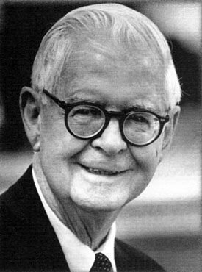
New Criticism (peaked in the 1940s and 1950s)
a school of reading which emphasised the form ->
‘the words on the page’ more important than subjective responses
The literary text as ‘autonomous’ - a coherent, aesthetic object made of words
‘The affective fallacy’ = the error of talking about a reader’s response (mainly feelings); also disregard of authors who ‘feel too much’
Main theorists: F.R. Leavis, Cleanth Brooks,
Monroe Beardsley

Slide 10
Contemporary critical theory rejects the universality of texts; therefore
1.) Identities (sexual, gender, ethnic, etc.), and world-views (including the way we regard literature) are socially constructed, dependent on social and political forces and on shifting ways of seeing and thinking.
2.) There is no ‘neutral’ way of looking at the world: everyone is touched by some ideology or another
3.) Language conditions, limits, and predetermines what we see -> all reality is constructed in and through language.
4.) The meanings within a literary work are never fixed and reliable, but always shifting, multi-faceted and ambiguous.
5.) Don’t trust generalisations: ‘great books’, ‘human nature’, ‘femininity’ etc. are all constructions

Slide 11
Key terms:
subjectivity: an idea of the cultural self (and interior life) that includes other people as well – either as objects of need, desire, and interest or as necessary sharers of common experience.
Other: the other end of the duality (as opposed to Self)
No group ever sets itself up as the One without at once setting up the Other over against itself.
Simone de Beauvoir
There has to be some ‘other’ – no master without slave, no economico-political power without exploitation, no dominant class without cattle under the yoke -- no Nazis without Jews, no property without exclusion - -. Héléne Cixous

Slide 12
intertextuality: Traditional literary theories tend to treat individual texts as separate, closed-off entities and to focus exclusively on internal structures.
-> However, texts are not independent beings: they overlap - both in the mind of the writer and that of the reader(s).
A text is... a multidimensional space in which a variety of writings, none of them original, blend and clash. The text is a tissue of quotations... The writer can only imitate a gesture that is always anterior, never original. His (sic) only power is to mix writings, to counter the ones with the others, in such a way as never to rest on any one of them. Roland Barthes

Slide 14
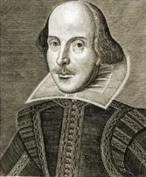
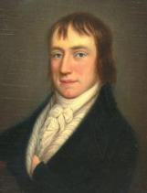
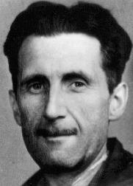
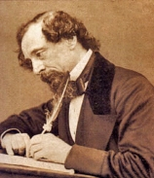
Canon: an established (but by no means monolithic) group of artists and works of art that are considered to form a ‘definitive’ representation of what is finest in their field
- in Anglo-American literature, the canon includes poets such as William Shakespeare, John Milton, and William Wordsworth, and novelists such as Charles Dickens, Jane Austen and George Orwell.
-> ‘White dead males’
-> Recent criticism has begun to widen the canon somewhat (to include women, racialised and openly homosexual/queer writers) but the notion of canon still remains.

Slide 15
Critical Theories of Reading
Poststructuralism
Born out of structuralism, which sees language as a phenomenon which not only records the world, but shapes it as well
focus on the reader (but not forgetting writer or text)
-> meaning is not stable – always “in process”
-> only a reader can bring temporary unity to a text (through the process of reading)
Subjectivities are socially produced, through language and the interaction of different discourses.
-> No meaning is always already there

Slide 16
There is not -- just one reality to be represented by a neutral innocent language; different discourses create different realities because of different, determining ideologies. This demands that attention be given not simply to the linguistic structures of language, but also discursive strategies of communication; to the context and setting; to social and institutional constraints; to power and status relations, to ideology and to change.
David Birch: The Language of Drama
To give a text an Author is to impose a limit on that text, to furnish it with a final signified, to close the writing.
Roland Barthes: “The Death of the Author”

Slide 17
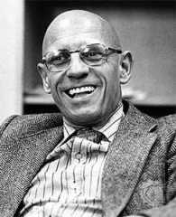
The main method of dealing with literary texts is deconstruction
Deconstruction is a theory aimed less at producing interpretations of particular texts -- than at examining how readers read these texts, and how the texts themselves apparently offer preferred readings. (Buchbinder)
-> “textual harassment” or oppositional reading; all texts contain points of rupture or gaps which, when examined, admit other, marginal or non-preferred readings
- Jacques Derrida, Michel Foucault

Slide 18
Postmodern theory
Based on the notions of modernism, which was dedicated to (artistic) experimentation and innovation (c. 1910-30)
Compared to modernism, which rued the fragmentation of culture, post- modernism delights in it
Distinctions between ‘high’ and ‘low’ cultural forms are diminishing -> intertextuality (parody, pastiche, allusion), sampling, hypertextuality, hyperreality
Identity is perceived as unstable and multiple
Less political than poststructuralism - and more ironic
In general terms it takes the form of self-conscious, self-contradictory, self-undermining statement. It is rather like saying something whilst at the same time putting inverted commas around what is being said. Hutcheon: Politics of Postmodernism
-> there is no absolute truth (in literature, or in life)

Slide 19
Feminist theory:
- Has its roots in the writings of 18th century philosophers (e.g. Mary Wollstonecraft and Olympe de Gouges)
1) critique of male canonical writings (1960s ->)
- focus on the representations of women and the mechanisms of patriarchy
2) the establishing and tracing a female literary tradition
- ‘gynocriticism’
3) calling into question gender difference in the work of both male and female authors (1980s ->)
- Challenging representations of women as ‘Other’, ‘lack’, ‘part of Nature’

Slide 20
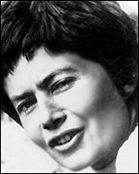
Unpicking binary categories (male/female; nature/culture; mind/body etc.) and the value judgements they include
- differences between and among women and men, different races, classes, ethnicities, sexualities etc.
Discussions on the nature of female experience: is there an essential difference between men and women?
-> écriture féminine ?
Luce Irigaray, Julia Kristeva and Judith Butler

Slide 21
Postcolonial theory
A salient field of study esp. in the Anglo-American context
Critique of the processes whereby other nations are characterised as Other – as negatively different to an implied Western norm (and denied subjectivity)
-> rejection of the Eurocentric viewpoint
-> the only subjectivity isn’t the white, heterosexual, Western (male) one
At the heart of postcolonial studies we find a trenchant critique of Eurocentrism and a strong focus on those who in one way or another have become the victims of Eurocentric thought (its utilitarian rationality), attitudes (racism), politics (military expansion), exploitation (economic or otherwise) and other unwarranted intrusions.
Hans Bertens: Literary Theory. The Basics.

Slide 22
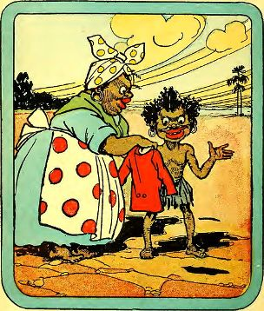
-> ‘empowering’ the reader, laying bare the mechanisms of power behind the production of texts, and revealing and deconstructing cultural stereotypes
The Western constitution of human identity itself as universal or unchanging may be recognised as a historical construct constituted by the exclusion, marginalisation, and oppression of racial others. (Bennet and Royle)
Edward Said, Gayatri Chakravorty Spivak
http://www.archive.org/details/storyoflittlebla1903bann

Slide 23
In everyday life, talking about imaginary people as though they were real is known as psychosis; in universities it is known as literary criticism.
Terry Eagleton: How to Read a Poem

Slide 24
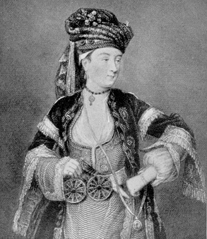
The Poetic Canon
The poetic tradition of English reaches back almost 1000 years and encompasses several cultures
-> some generalisations are needed
Everyone’s canon is slightly different: yet some (kinds of) works / authors are conspicuously absent
With the introduction of feminist, queer, and postcolonial
theories, some re-evaluation has happened
-> new canons have been formed
-> is there a need for a canon?

Slide 25
What is a Poem?
A poem is a fictional, verbally inventive moral statement in which it is the author, not the printer or word processor, who decides where the lines should end.
Poetry is language without contextual clues, and which therefore has to be reconstructed by the reader in the light of a context which will make sense of it.
Terry Eagleton: How to Read a Poem

Slide 26
Poetry breaks habitual collocation patterns (‘the black cat’, ‘an uninvited guest’)
-> words not usually seen together tend to pair up
In me she has drowned a young girl, and in me an old woman
Rises toward her day after day, like a terrible fish. Sylvia Plath
cold nights on the farm, a sock-shod
stove-warmed flatiron slid under
the covers Amy Clampitt
Poets divorce words from their usual partners and provide unlikely new partnerships between words which we would never have imagined getting together. Peter Barry

Slide 27
The Uncertainty of the Poet (Wendy Cope)
“The Tate Gallery yesterday announced that it had paid £1 million for a Giorgio de Chirico masterpiece, The Uncertainty of the Poet. It depicts a torso and a bunch of bananas. (Guardian, 2 April 1985)”
I am a poet. Fond of, “Am I bananas,
I am very fond of bananas. Am I ?” – a very poet.
I am bananas. Bananas of a poet!
I am very fond of a poet. Am I fond? Am I very?
I am a poet of bananas. Poet bananas! I am.
I am very fond, I am fond of a ‘very’.
A fond poet of “I am, I am” – I am of very fond bananas
Very bananas, Am I a poet?

Slide 29
How to Read a Poem?
Don’t panic
Read the poem through several times – and at least once aloud to yourself. Take your time.
Don’t try to look for things that aren’t there: first find out the prose meaning of the text (pay attention to punctuation)
-> look up any words you don’t understand
Take notes: mark down anything that seems striking, unusual, discordant. Write down any questions that arise. Pay special attention to the beginning and end.
Let your notes lead the way. What is it about the poem that makes you note those particular things?

Slide 30
What is your gut feeling about the poem? What is the poet trying to tell you; are you persuaded? Consider the emotions that are generated by the poem.
Consider what the form of the poem— the specific words, the figures of speech, the use of rhyme or rhythm, the relation of the sounds to the sense of the poem— has to do with the way you have received and evaluated the poem’s thoughts and feelings.
Use the tools and techniques you have to come to a conclusion about the poem’s meaning: in the final analysis, it’s important to show what the poem means to YOU.
Note that not all poems can be analysed at a great depth

Slide 31
Turning and turning in the widening gyre The falcon cannot hear the falconer; Things fall apart; the centre cannot hold; Mere anarchy is loosed upon the world, The blood-dimmed tide is loosed, and everywhere The ceremony of innocence is drowned; The best lack all conviction, while the worst Are full of passionate intensity.
--
William Butler Yeats, ‘The Second Coming’

Slide 32
Every day,
I think about dying.
About disease, starvation,
violence, terrorism, war,
the end of the world.
It helps
keep my mind off things.
- Roger McGough, ‘Survivor’

Slide 33
It is easy to be shy when confronting a poem. Poems can be the frightening older children at a party who make us want to cling to our mothers. But remember that poets are people and they have taken the courageous step of sharing their fears, loves, hopes and narratives with us in a rare and crafted form. They have chosen a mode of expression that is concentrated and often intense, they are offering us a music that has taken them a long time to create - many hours in the making, a lifetime in the preparation. They don’t mean to frighten us or to put us off, they long for us to read their works and to enjoy them.
Stephen Fry: The Ode Less Travelled

Slide 34
Tools for Analysis
A poem can be analysed by paying attention to the following aspects:
Content: How does the tone and the context of the work change your understanding of the poem?
Language: How does the language and rhythm contribute to the meaning, purpose or emotional force?
Imagery: How do metaphors construct the poem’s theme, tone, and purpose?
Form: How does the form of the poem (rhyme, metre, etc.) correspond to the theme and main idea of the work?
Syntax: How do the poet’s syntactical choices change or expand the ideas in the poem?

Slide 35
Content
Setting: Time and place
- Is the setting recognisable (=set in a physical world) or symbolic?
I wander’d lonely as a cloud
That floats on high o’er vales and hills,
When all at once I saw a crowd,
A host, of golden daffodils;
Beside the lake, beneath the trees, Fluttering and dancing in the breeze.
William Wordsworth, ‘The Daffodils’

Slide 36
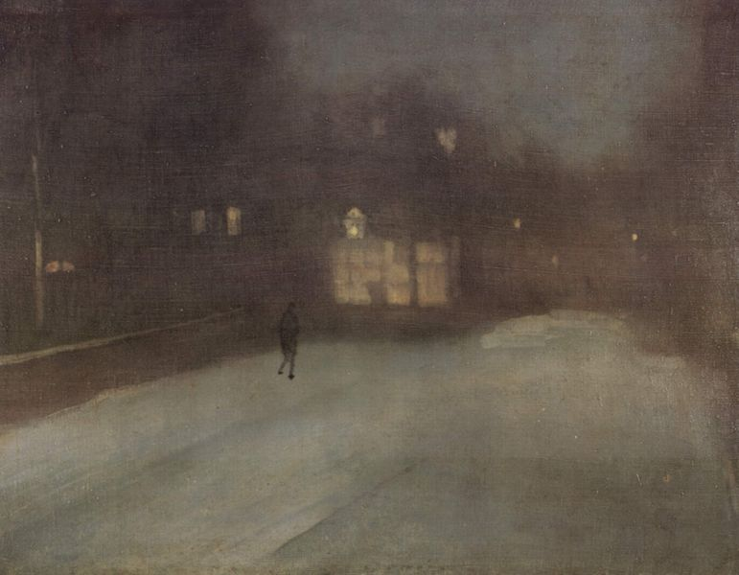
His soul stretched tight across the skies
That fade behind a city block,
Or trampled by insistent feet
At four and five and six o’clock;
And short square fingers stuffing pipes,
And evening newspapers, and eyes
Assured of certain certainties,
The conscience of a blackened street
Impatient to assume the world.
--
T. S. Eliot, ‘Preludes, IV’

Slide 37
Point of view & narration: Who sees / experiences? Who is speaking / telling?
Is the speaker an omniscient narrator or casual observer? Does the speaker refer to themselves in the 1st person?
Note that the ‘I’ in the poem ISN’T necessarily the poet – although there may be a strong resemblance
-> Whose thoughts and feelings do we have access to?

Slide 38
Dawn’s Rose
Is melting an old frost moon. Agony under agony, the quiet of dusk, And a crow talking to stony skylines. Desolate is the crow’s puckering cry As an old woman’s mouth When the eyelids have finished And the hills continue. A cry Wordless As the newborn baby’s grieving On the steely scales. As the dull gunshot and its after râle Amongst conifers, in rainy twilight. Or the suddenly dropped, heavily dropped Star of blood on the fat leaf. Ted Hughes

Slide 39
I Am Vertical (Sylvia Plath)
But I would rather be horizontal. I am not a tree with my root in the soil Sucking up minerals and motherly love So that each March I may gleam into leaf, Nor am I the beauty of a garden bed Attracting my share of Ahs and spectacularly painted, Unknowing I must soon unpetal. Compared with me, a tree is immortal And a flower-head not tall, but more startling, And I want the one’s longevity and the other’s daring.
Tonight, in the infinitesimal light of the stars, The trees and the flowers have been strewing their cool odours. I walk among them, but none of them are noticing. Sometimes I think that when I am sleeping I must most perfectly resemble them-- Thoughts gone dim. It is more natural to me, lying down. Then the sky and I are in open conversation, And I shall be useful when I lie down finally: Then the trees may touch me for once, and the flowers have time for me.

Slide 40
Tone: How is the tone of the poem developed through the imagery? How does diction (= choice of words) influence the understanding of the tone? Is the tone consistent at the beginning and ending of the poem?
In listening to a speaking voice we always pay attention to the tone in which the words are spoken, because the emotion is often more present in the tone of voice than in the words. To speak of tone in a written text is to use a metaphor to describe something that is not literally there. Tone, in writing, consists of verbal cues for the vocal tone to be used in saying the words aloud.
Scholes: Crafty Reader

Slide 41
When I am an old woman I shall wear purple
With a red hat which doesn’t go, and doesn’t suit me,
And I shall spend my pension on brandy and summer gloves
And satin sandals, and say we’ve no money for butter.
I shall sit down on the pavement when I’m tired
And gobble up samples in shops and press alarm bells
And run my stick along the public railings
And make up for the sobriety of my youth.
I shall go out in my slippers in the rain
And pick the flowers in other peoples’ gardens
And learn to spit.
-- Jenny Joseph: Warning. 1961

Slide 42
--
If in some smothering dreams you too could pace
Behind the wagon that we flung him in,
And watch the white eyes writhing in his face,
His hanging face, like a devil’s sick of sin;
If you could hear, at every jolt, the blood
Come gargling from the froth-corrupted lungs,
Obscene as cancer, bitter as the cud
Of vile, incurable sores on innocent tongues, -
My friend, you would not tell with such high zest
To children ardent for some desperate glory,
The old Lie: Dulce et decorum est
Pro patria mori.
Wilfred Owen: Dulce et decorum est, 1917

Slide 43
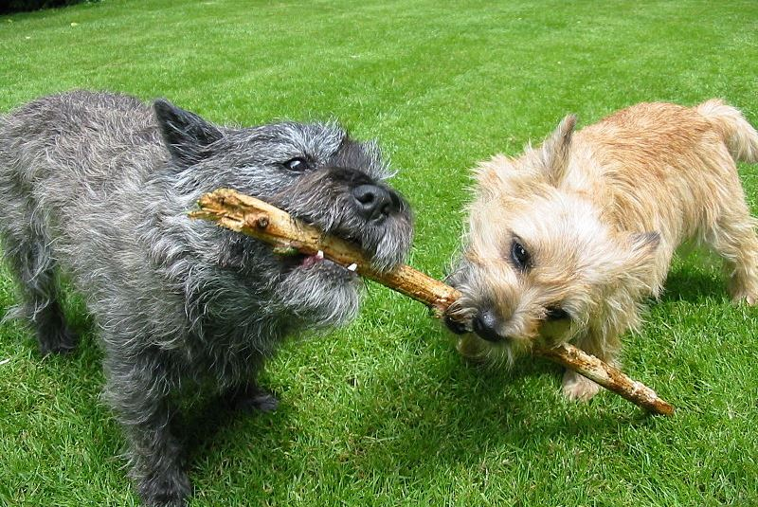
Tension: What is the conflict or point of tension in the poem? Is it physical, spiritual, moral, philosophical, etc.?
How is the tension in that conflict developed with poetic elements? Is it resolved?

Slide 44
Billy Collins: ‘Another Reason Why I Don’t Keep A Gun In The House’
The neighbors’ dog will not stop barking.
He is barking the same high, rhythmic bark
that he barks every time they leave the house.
They must switch him on on their way out.
The neighbors’ dog will not stop barking.
I close all the windows in the house
and put on a Beethoven symphony full blast
but I can still hear him muffled under the music,
barking, barking, barking
and now I can see him sitting in the orchestra,
his head raised confidently as if Beethoven
had included a part for barking dog.
When the record finally ends he is still barking,
sitting there in the oboe section barking,
his eyes fixed on the conductor who is entreating him with his baton
while the other musicians listen in respectful
silence to the famous barking dog solo,
that endless coda that first established
Beethoven as an innovative genius.

Slide 45
Context: When was the poem written? What were the historical, political, philosophical, and social issues of that time? Does that change your understanding of the poem’s theme? Did poets during that time period follow particular style? Is the poem consistent with the literary conventions of that era?
Also: who wrote the poem? What do we know of his/her life that may be relevant?

Slide 46
Language (*)
1) Word Choice: How would you characterise the poet’s word choice? Is it formal, conversational? Does the poet use a specific dialect for the speaker?
2) Meaning: What are the connotations and denotations (=the implied and explicit meanings) of particular words? Are certain words repeated? Are they abstract or concrete, literal or metaphorical?

Slide 47
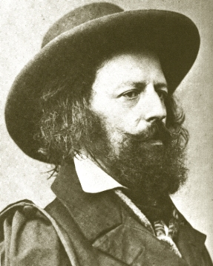
3) Rhythm: Does the poem have an identifiable rhythm? How many syllables are in each line? Does it follow a pattern? How does rhyme enhance the rhythm and musicality of the poem?
Half a league, half a league,
Half a league onward,
All in the valley of Death
Rode the six hundred.
‘Forward, the Light Brigade!
Charge for the guns!’ he said;
Into the valley of death
Rode the six hundred.
Alfred, Lord Tennyson:
‘The Charge of the Light Brigade’

Slide 48
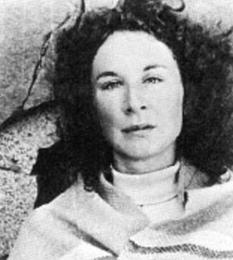
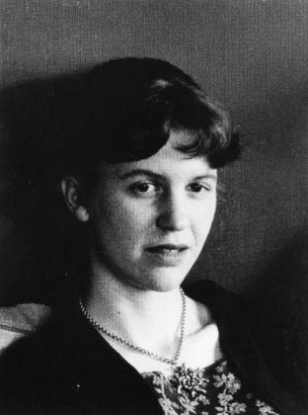
Activity: Content and Language
Read ‘Daddy’ and ‘Siren Song’ and discuss them in terms of content and language.
- which parts of the poems do you find striking / pleasing / jarring / unexpected / funny / ???
http://www.youtube.com/watch?v=6hHjctqSBwM
https://poetryarchive.org/poem/siren-song/

Slide 49
Bibliography
Barry, Peter. 2009. Beginning Theory. An Introduction to Literary and Cultural Theory. Manchester University Press.
Bennet, Andrew and Nicholas Royle. 1995. An Introduction to Literature, Criticism and Theory. Key Critical Concepts. London: Prentice Hall.
Bertens, Hans. 2008. Literary Theory. The Basics. Abingdon: Routledge.
Birkett, Julian. 1998. Word Power. A Guide to Creative Writing. London: A&C Black.
Birns, Nicholas. 2010. Theory After Theory. An Intellectual History of Literary Theory from 1950s to the Early 21st Century. Peterborough: Broadview Press.
Buchbinder, David. 1991. Contemporary Literary Theory and the Reading of Poetry. MacMillan Education Australia.
Castle, Gregory. 2013. The Literary Theory Handbook. Chichester: Wiley Blackwell.
Eagleton, Terry. 2007. How to Read a Poem.
Fry, Stephen. 2005. The Ode Less Travelled. Unlocking the Poet Within. London: Hutchinson.
Mills, Sara and Lynne Pearce.1996. Feminist Readings/Feminists Reading. Hemel Hempstead: Prentice Hall.
Scholes, Robert. 2001. Crafty Reader. Yale University Press.
http://www.uncg.edu/~htkirbys/meters.htm

