Slide 1
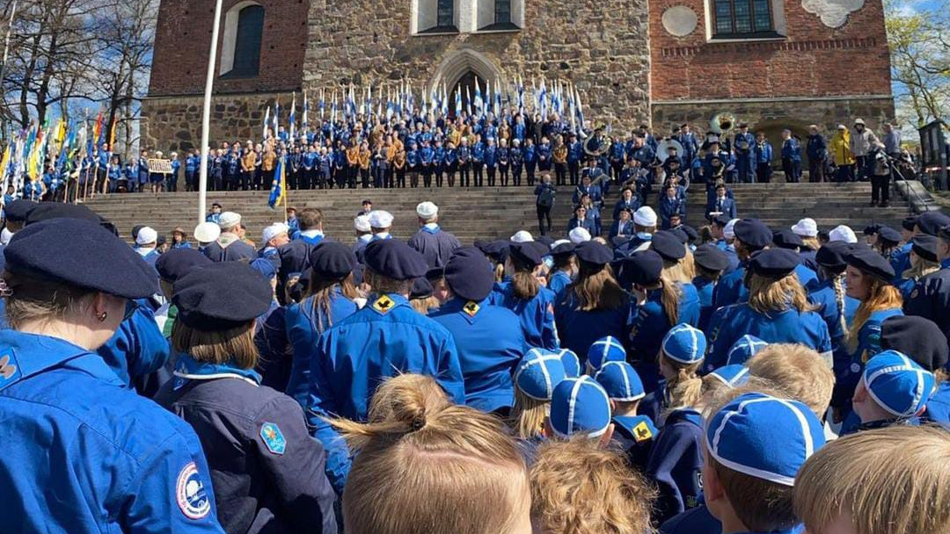
Scouting
”Be prepared!”

Slide 2
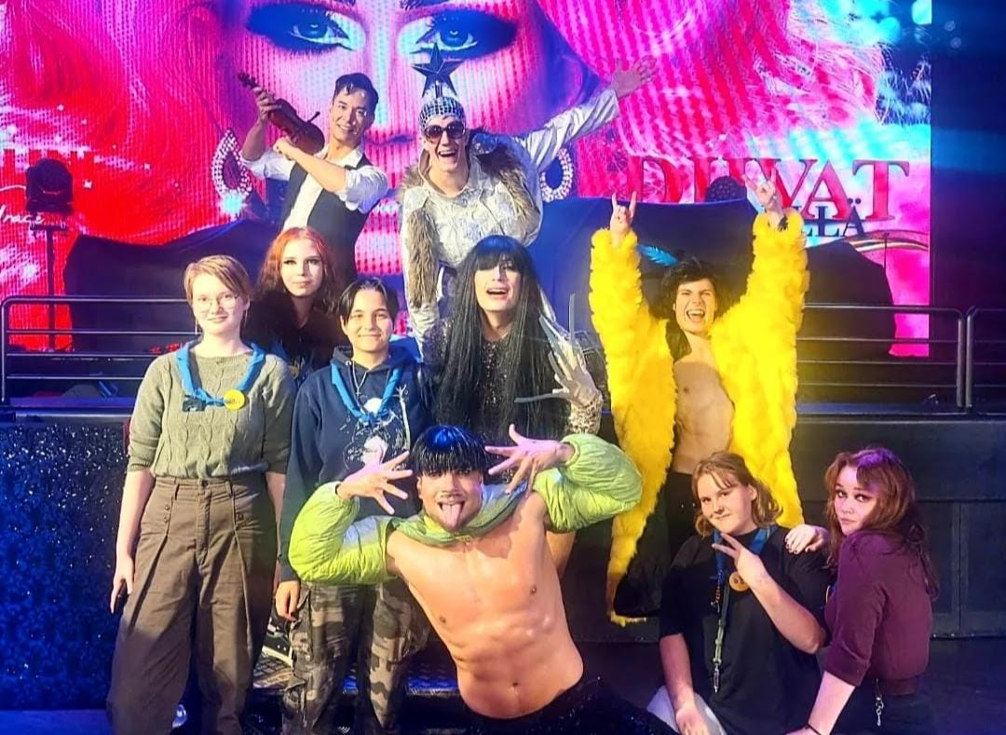
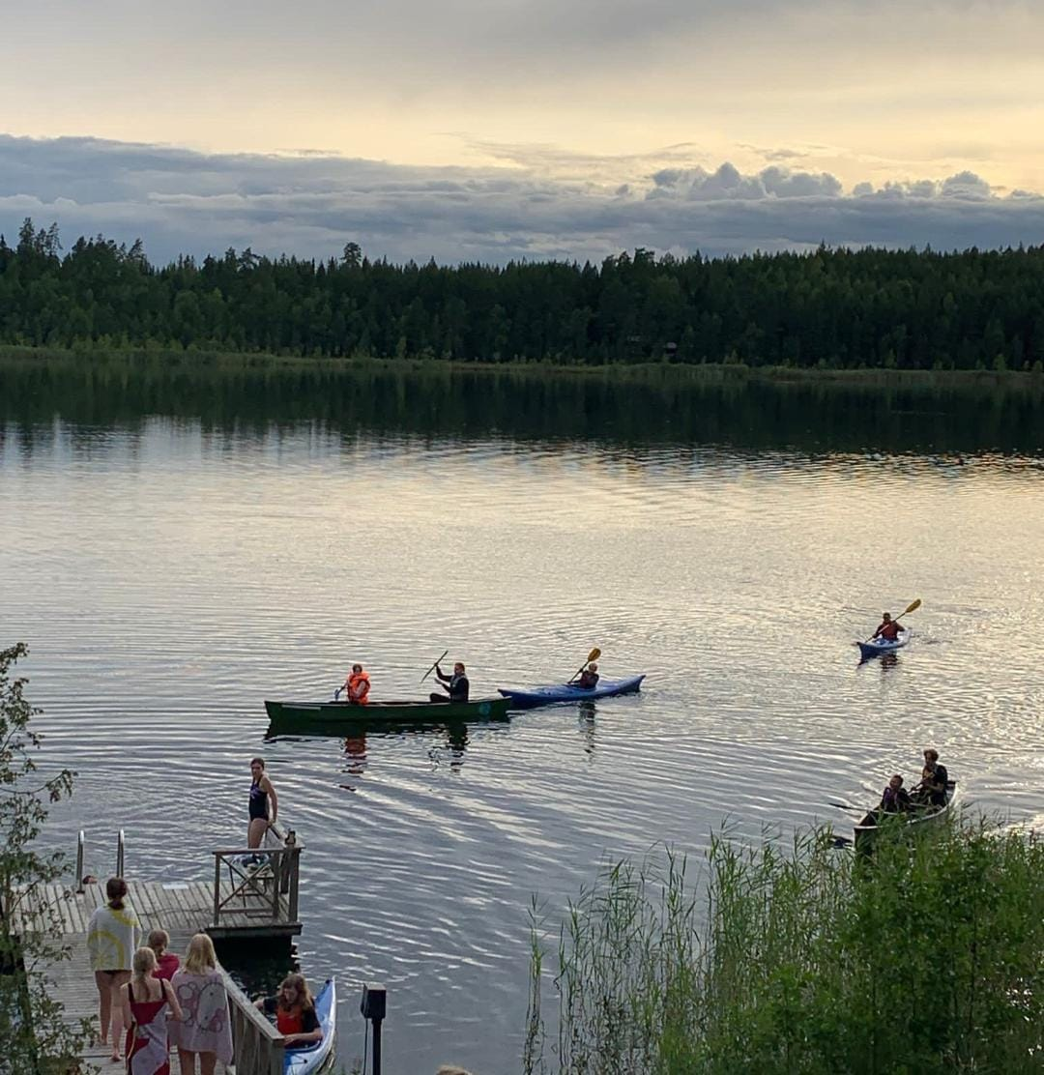

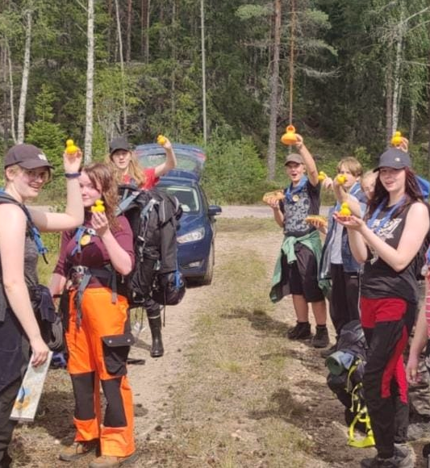

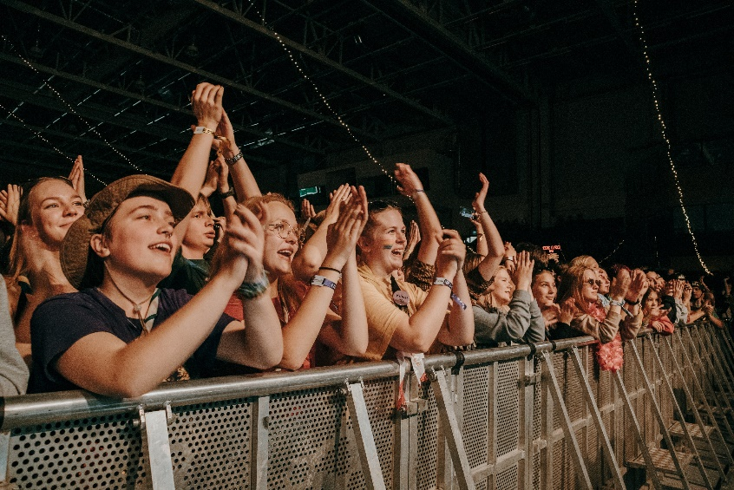
About scouting
Scouting is the world's leading educational youth movement with over 57 million Scouts in over 200 countries worldwide.
It’s a great hobby where kids and young people learn about nature and get to do fun things together outdoors.
Scouting is more than just marching around a forest and doing knots.

Slide 3
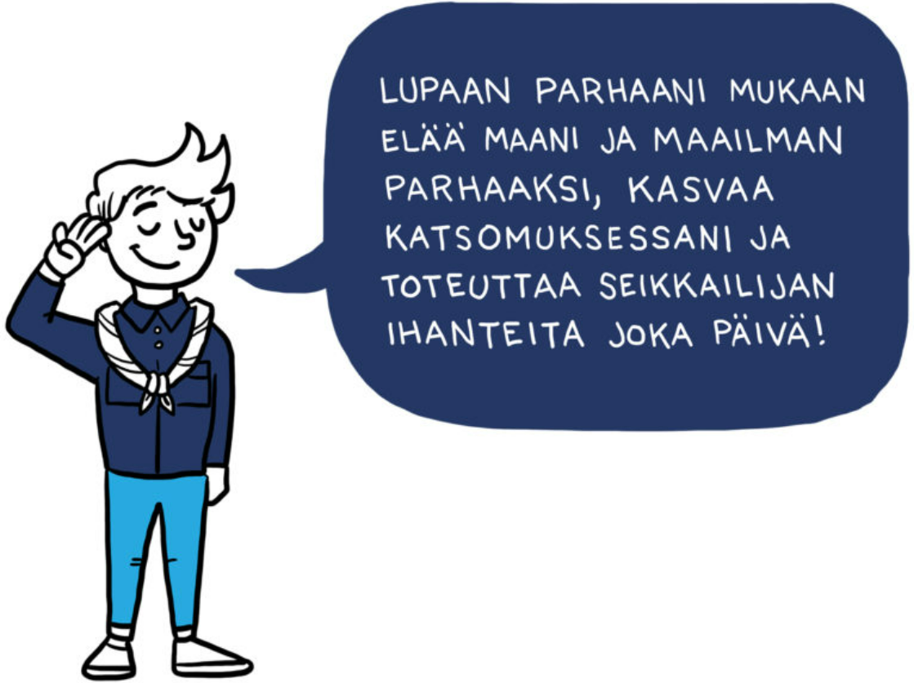
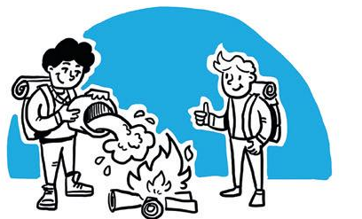
The Ideals of a Scout are
To respect others
To love and protect the environment
To be reliable
To build friendship across boundaries
To feel one’s responsibility and to take action
To develop oneself as a human being
To search for truth in life
They are based on Baden-Powell’s original Scout Law
Scout Promise
I promise to do my best
to live for the good of my country and the world,
to develop in my spiritual beliefs and worldview
and fulfil the ideals of the [age group] every day.

Slide 4
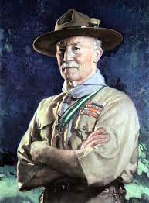
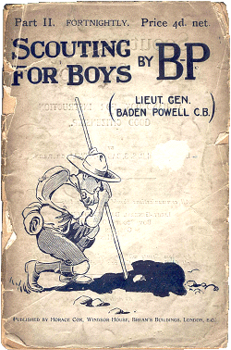
History of scouting
Robert Baden-Powell noticed that many boys showed interest in military scouting, so in 1908 he decided to write a book called “Scouting for Boys” which has sold over 100 million copies, and it was quickly translated in 5 different languages.
In 1910 B-P started Girl Guides with his sister Agnes

Slide 5
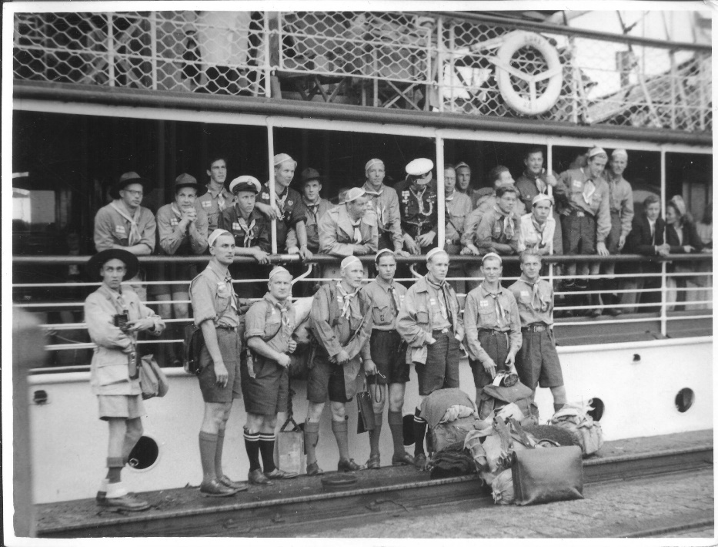
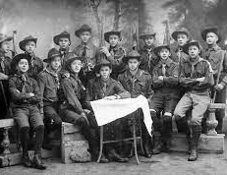
History of Scouting in Finland
Scouting came to Finland through Sweden in 1910 but it was soon prohibited by Russia, because they were worried that the finnish scouts wanted Finland to become independent. Some scout groups still continued their activities in secret.
Scouts helped in civil protection, air surveillance, hospital and other similar tasks during WWII
Some Finnish Scouts visited Germany in 1939 as invited guests of Hitler-Jugend
Finnish scouts started selling advent calendars in the 1940s
The first Finnjamboree, Karelia, was held in 1979

Slide 6


Cub scouts and Adventurers
The Cub Scouts:
7-10 years old
Groups of 8-12 scouts
They meet weekly: playing and learning
Mascot: wolf cub
Adventures:
10-12 years old
Groups of 10-15
Learn different skills: outdoor cooking, first aid, cooperation
Mascot: fox

Slide 7


Trackers and Explorers
Trackers:
12–15 years old
In groups of 4-12, girls and boys separately.
Weekly activities are led by Explorers, but the explorers can also seek help from adult scouts.
The themes of the Tracker program are camping, creativity, survival and society.
Mascot: wolverine
The Explorers:
15-17 years old
Organized in small teams.
Go hiking and participate in camps and other events.
Practice leadership by attending leadership training and leading a Tracker group.
Mascot: lynx

Slide 8

Rovers and adults
Rovers:
18-22 year olds
Groups of 3-5
Explore the home country and foreign cultures
Plan their own program
Mascot: bear
Adults:
Older than 22
Role: support the growth and development of the children

Slide 9


Family scouting and sisu scouting
Some local Scout groups also offer Family Scouting for children under seven and their parents
Children get familiar with scouting
Great hobby for the whole family
Mascot: squirrel
Sisu scouting is another type of activity that some local groups offer. It is a Scout group for people with special needs
It started in 1940s

Slide 10
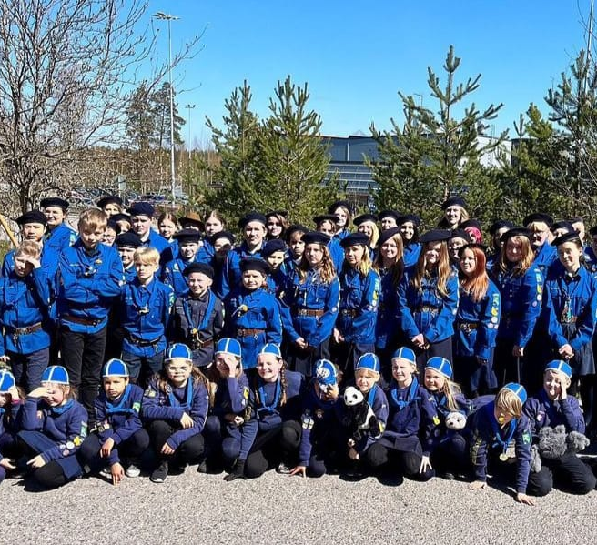
Uniform
The formal scout uniform consists of the Scout neckerchief, a Scout shirt, tidy trousers or a skirt, a scout belt, and sometimes headware.
The trousers, skirt and tights are usually dark blue but black is also okay
Used in festive scout events
The uniforms differs in every area, it's not necessarily blue

Slide 11
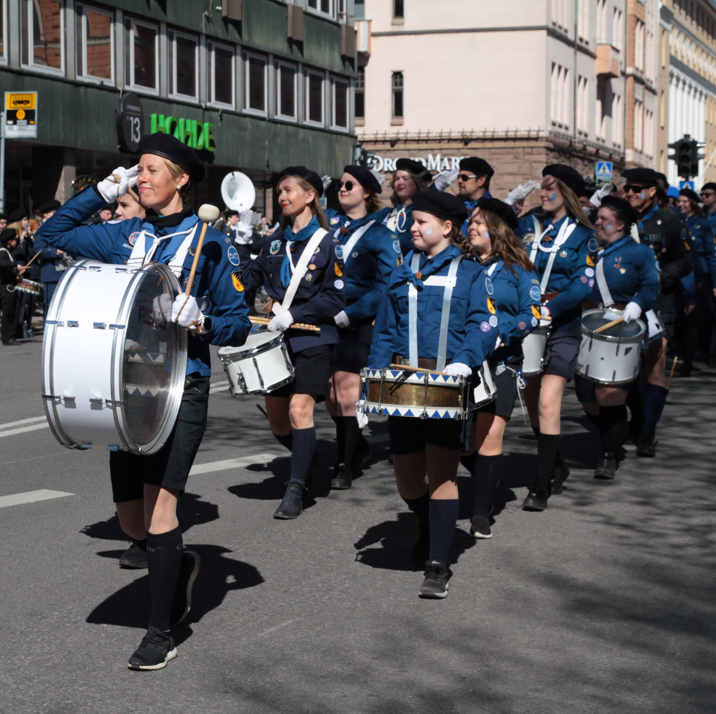
Parades
Every year in Finland there are parades in the bigger cities: Turku, Tampere
It is to raise the spirit, gather together and honor the ones that deserve the Mannerheim-buckle.
We wear an uniform, march a specific route and celebrate.

Slide 12
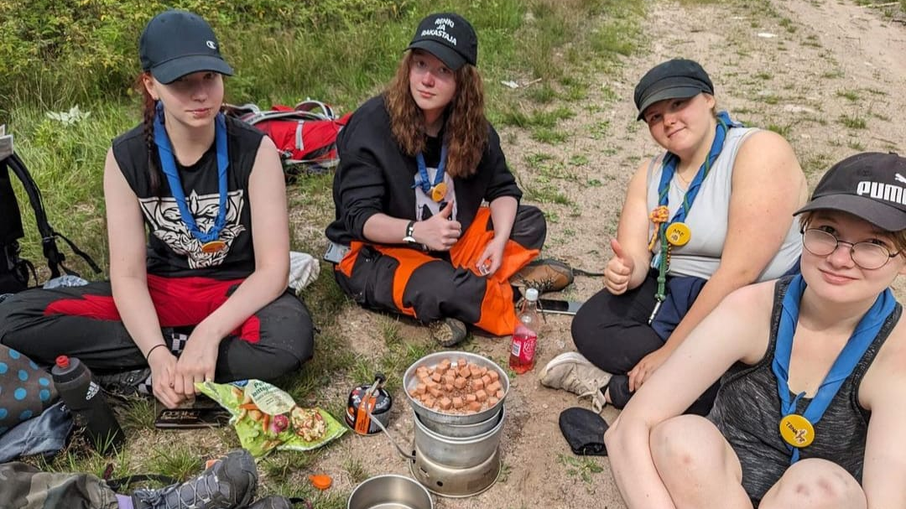
Our experience
We have gotten more friends
While camping/hiking, it's nicer when you're with friends
Sometimes it can be tiring and stressful
Scouting is fun and educational

Slide 13
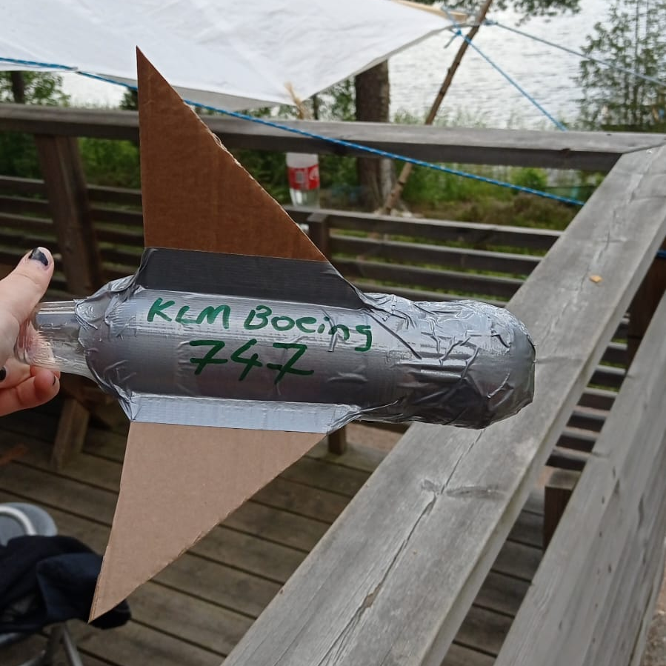
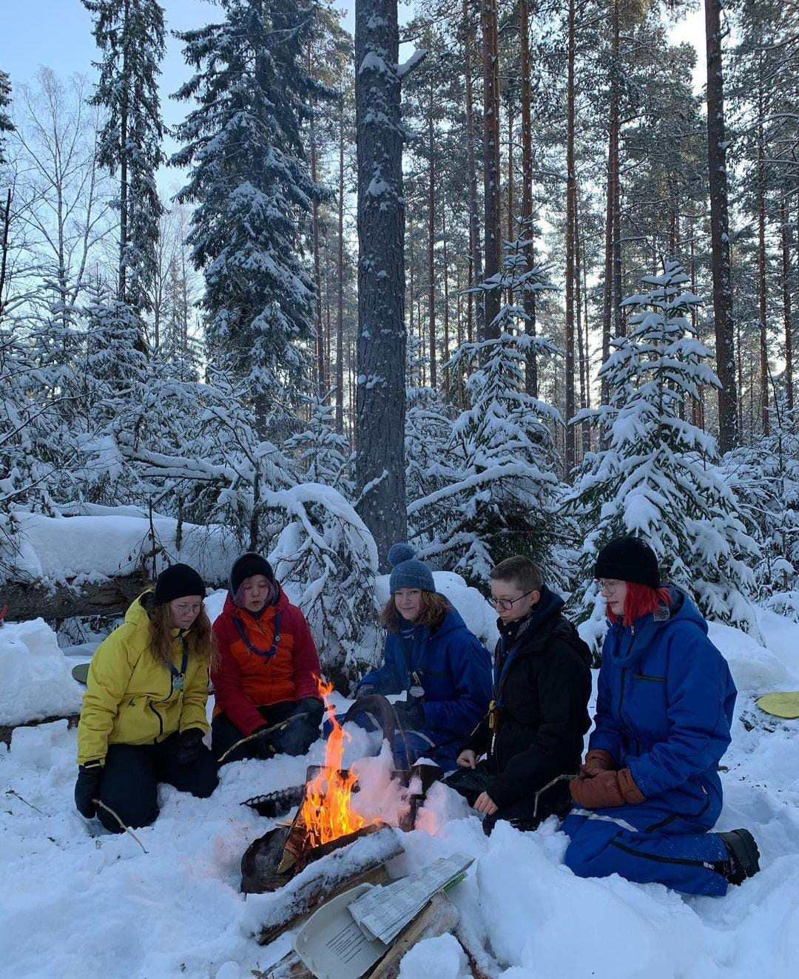
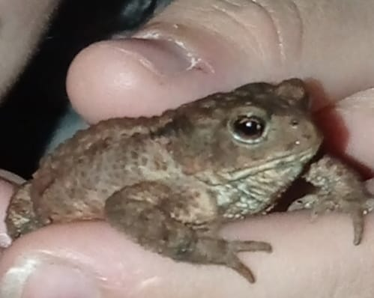
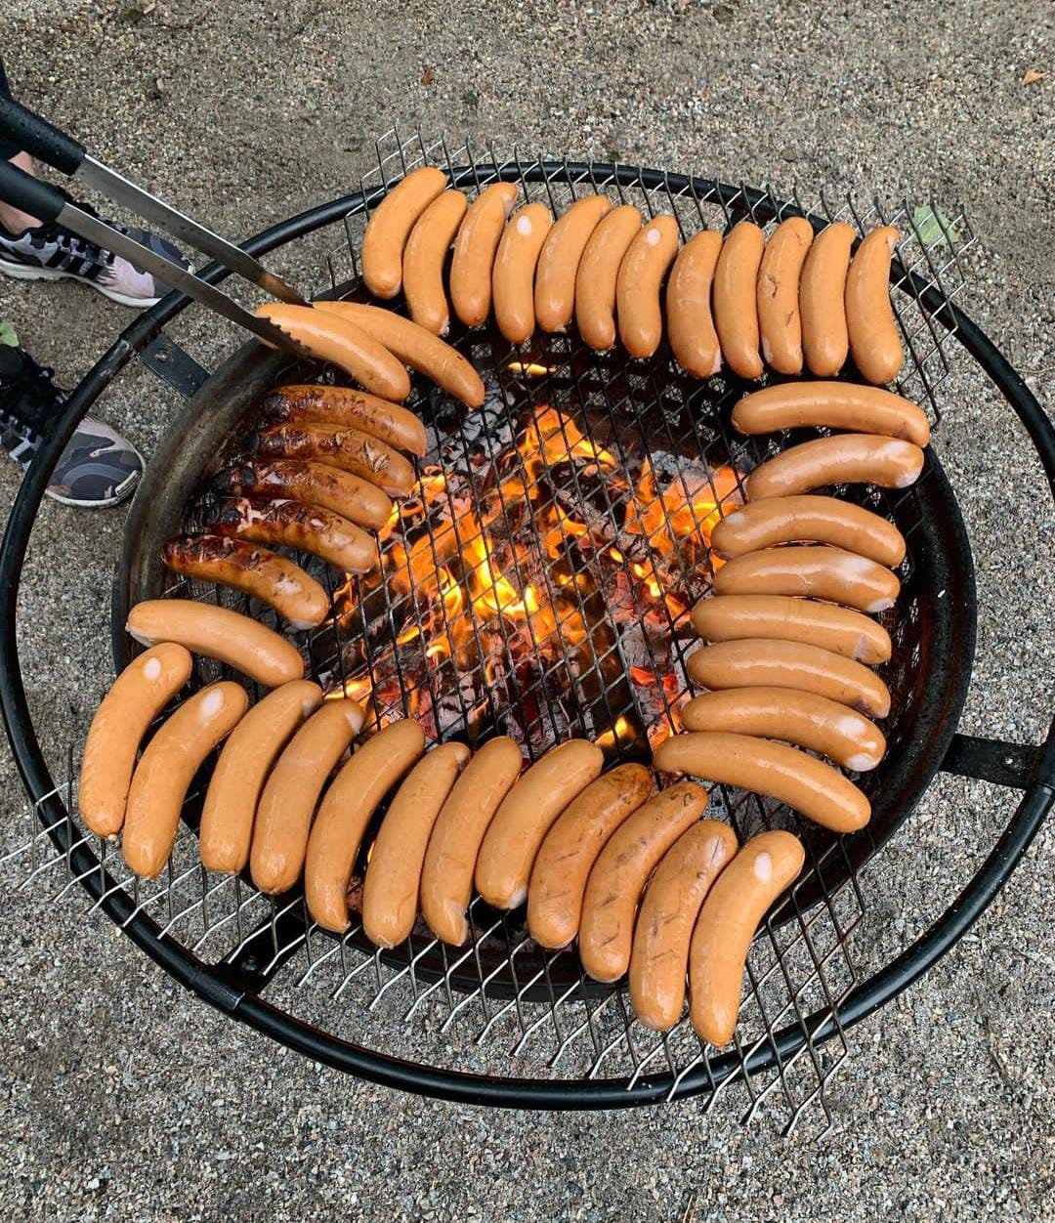
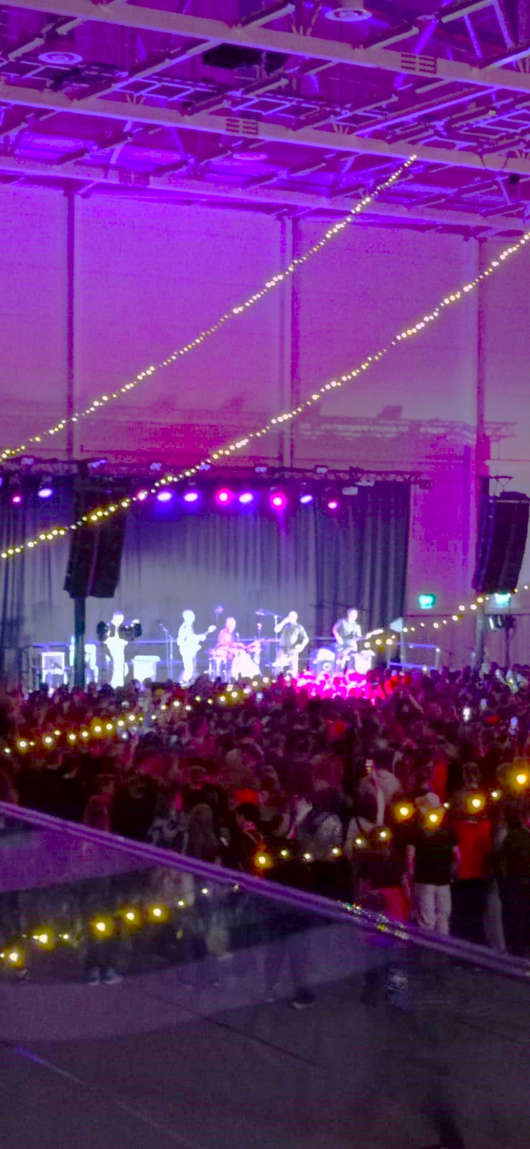
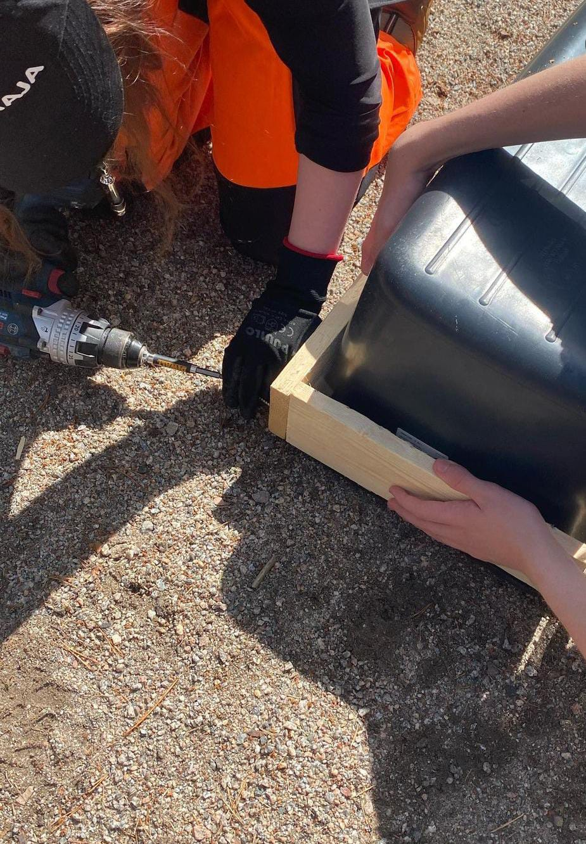
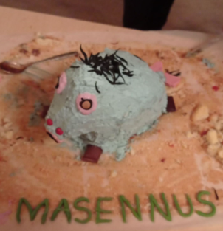
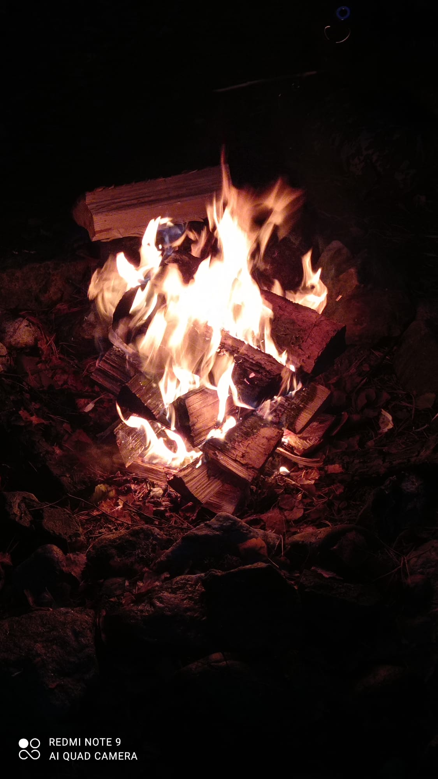

Slide 14
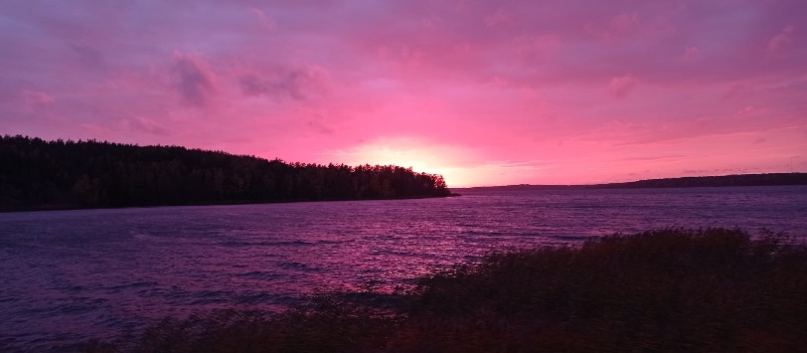
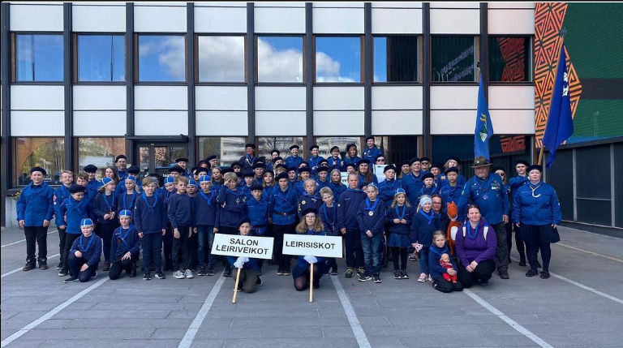
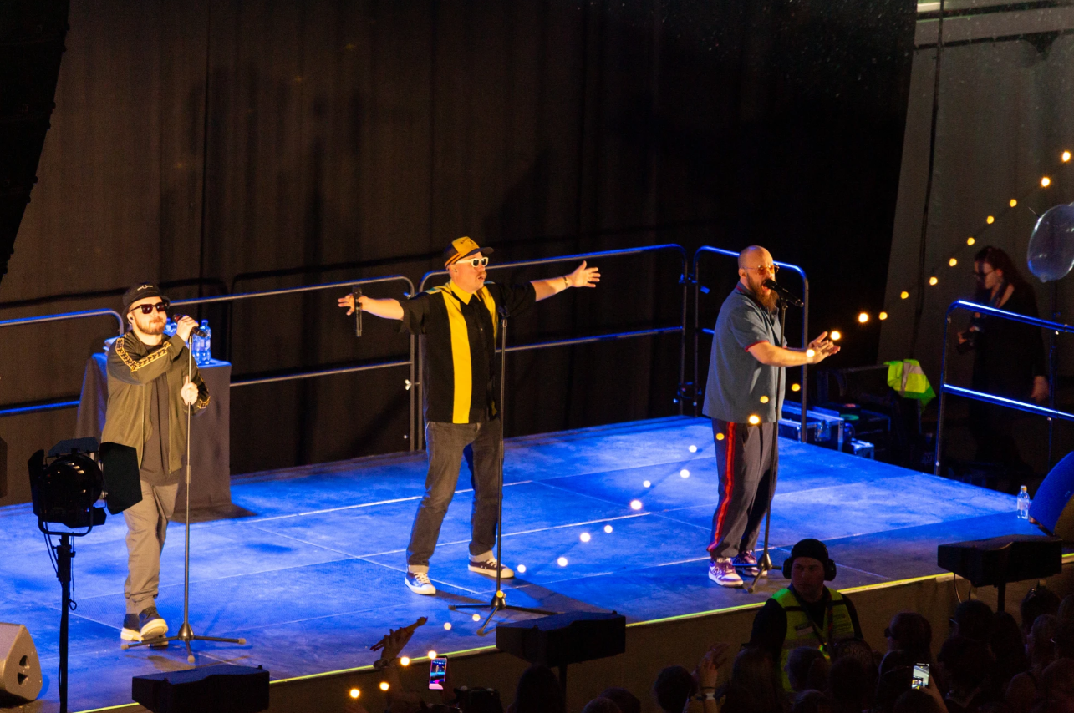
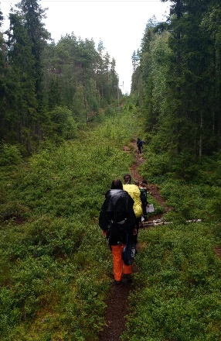
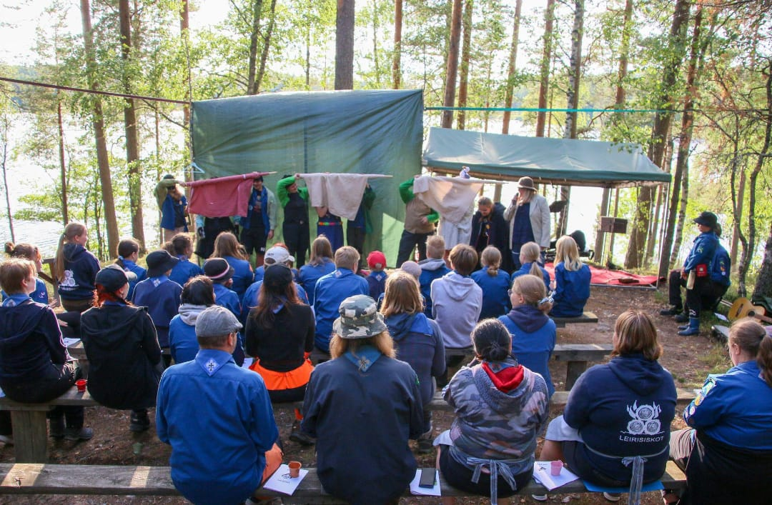
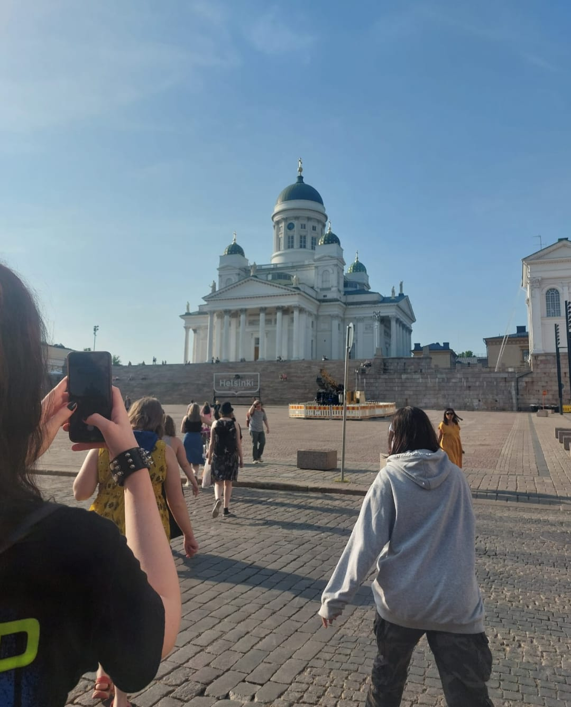
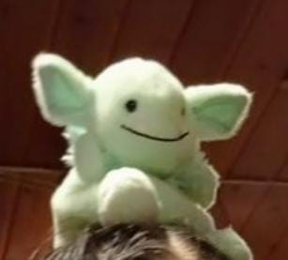
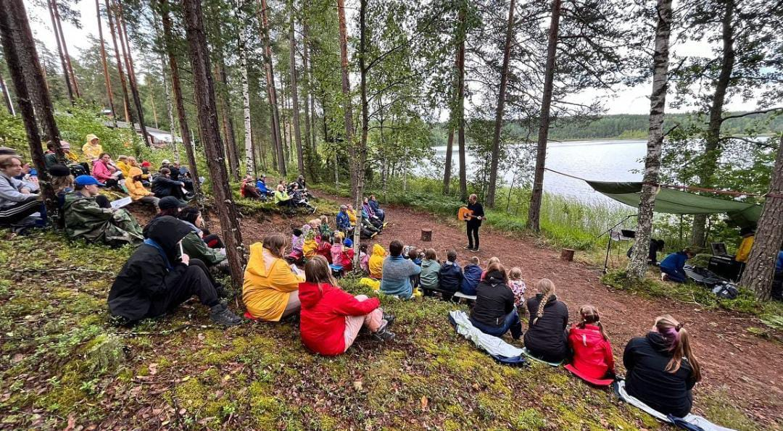

Slide 15
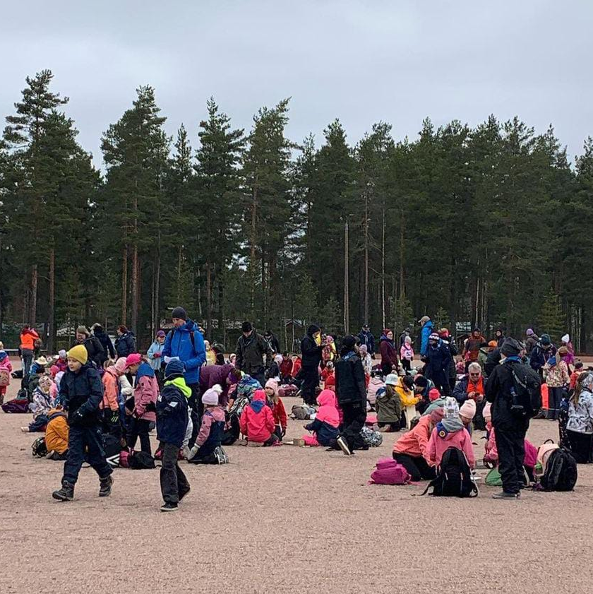
Competitions
They are organised by local groups.
The levels are district level and championships.
They take a day or a day and a night .
Competitions are a patrol where you walk or ski in the woods.
Along the way there are tasks you must complete.
In Finland the championships are organised three times: winter, spring and autumn.
There are different classes for groups.

Slide 16
Sources
https://www.scout.org/who-we-are/scout-movement/scoutings-history
https://en.wikipedia.org/wiki/Scouting
https://www.britannica.com/topic/Boy-Scouts
https://kuusenkavyt.com/partiotietoa/#pieni
Scouts.fi
https://www.partio.fi/partiomedia/provosoitumista-partiopuvusta-ja-tanssikielto-talta-naytti-1920-luvun-partio/
https://en.wikipedia.org/wiki/The_Guides_and_Scouts_of_Finland
Symboliikka | Partio-ohjelma
https://fi.scoutwiki.org/Suomen_partiohistoria
Picture sources
Most pictures are our own or from Leirisiskot/Leiriveikot instagram
https://partio.kuvat.fi/kuvat/TAPAHTUMAT/EXPLO/Explo+2023/Perjantai/20231020_EXPLO23_MinjaLallukka_003.jpeg
lspartiopiiri.kuvat.fi/kuvat/

