Slide 1

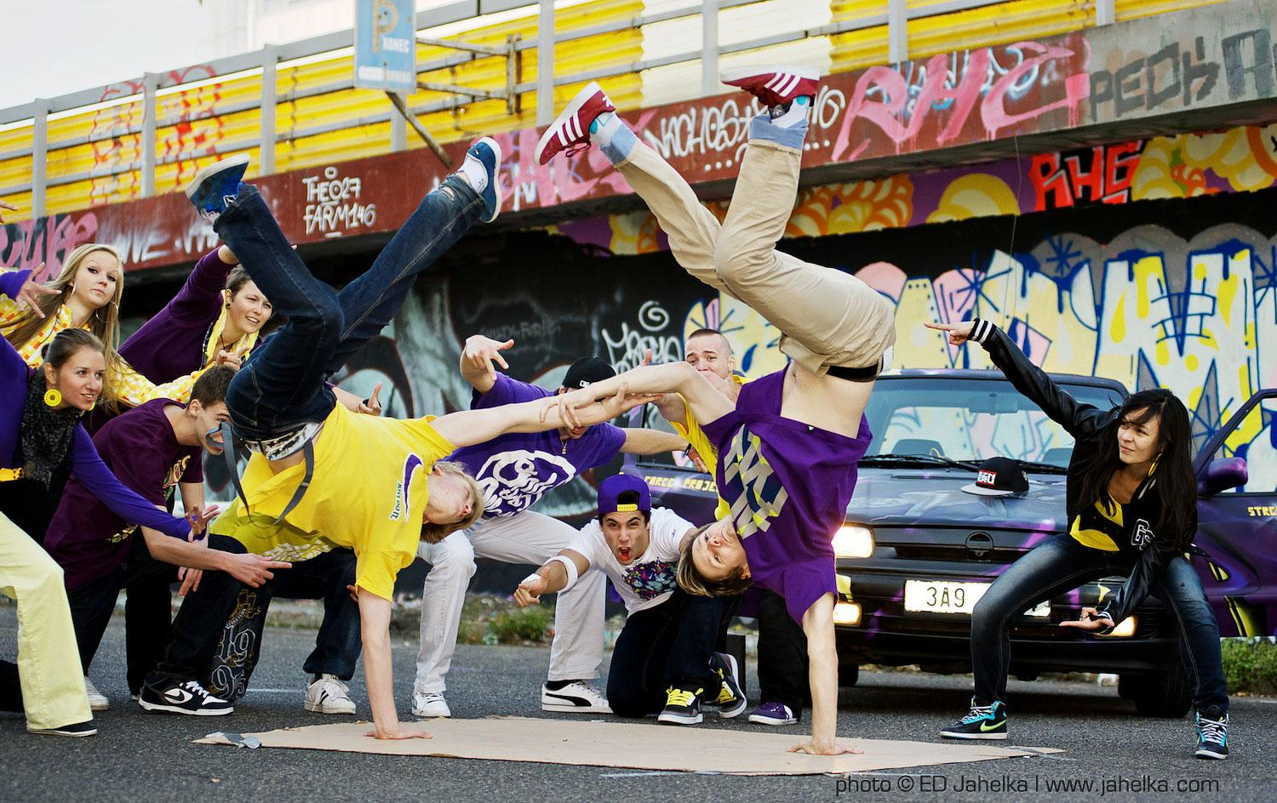
Konditionaali ja if-lause (Second conditional)
Suomen kielessä konditionaalin tunnus on isi (tulisin, menisin, tekisin…)
Englannin kielessä konditionaali ilmaistaan would-sanalla.
Esim. I would visit Australia.
Vierailisin Australiassa.
Muita isi-muotoja:
I could visit Australia (Voisin)
Should I go by bus? (Pitäisikö)
Would lyhennetään ‘d:
- I’d visit Australia.
Kielteinen muoto wouldn’t:
I wouldn’t visit Australia even if I had the money.

Slide 2
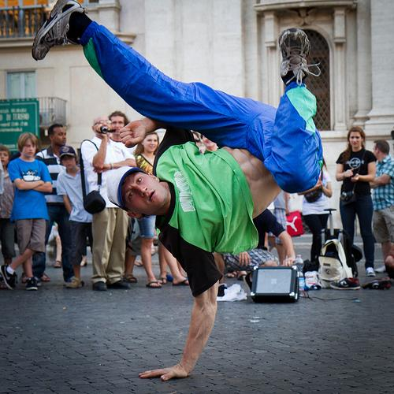
Konditionaali ja if-lause (Second conditional)
Konditionaaliin voi liittyä if-lause. Yhdessä ne kertovat, mitä tapahtuisi, jos if-lauseen ehto toteutuisi:
Konditionaalilause if-lause (päälause) (sivulause)
Would, should, could if +
+verbin perusmuoto verbin imperfektimuoto
Would you travel to Uluru if I travelled with you?
HUOM! If-lauseessa ei would-sanaa!
Pilkku mukaan vain jos if-lause aloittaa virkkeen!

Slide 3
Look at these sentences! Find the conditional.
Teen läksyt, jos minulla on aikaa.
Juoksisin nopeammin, jos olisin Usain Bolt.
If I went to the moon, I’d bring you back some cheese.
She is travelling to South Africa next year.
If I won the lottery, I would buy a fancy car. (but I won’t!)

Slide 4
LOOK AT THESE SENTENCES!
MUISTETTAVAA KONDITIONAALISTA:
WOULD - isi
COULD - voisi
SHOULD - pitäisi
If I win the lottery, I will buy a fancy car.
If I won the lottery, I would buy a fancy car.
Mitä eroa suomennoksessa?
Entä miten sanoisit:
Jos saan suukon, olen onnekas.
Jos saisin suukon, olisin onnekas.
If I get a kiss, I will be lucky.
If I got a kiss, I would be lucky..

Slide 5
Discuss with your partner:
What would you do…
…if you won the lottery?
…if you were President?
…if you passed all your exams with top grades?
…if you became a famous Hollywood film star?
BUT: How likely is it that any of these will happen?

Slide 6
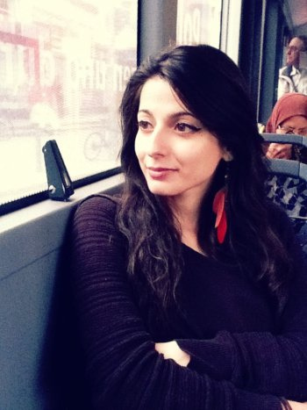
Futuuri + if-lause (first conditional)
Futuurilause (päälause) + if-lause (sivulause)
She'll be late + if the bus is delayed.
Will + perusmuoto if + preesensmuoto
I‘ll (I will) call you if I have time. (ei pilkkua!)
If I see her, I'll tell her. (Huom. pilkku!)

Slide 7
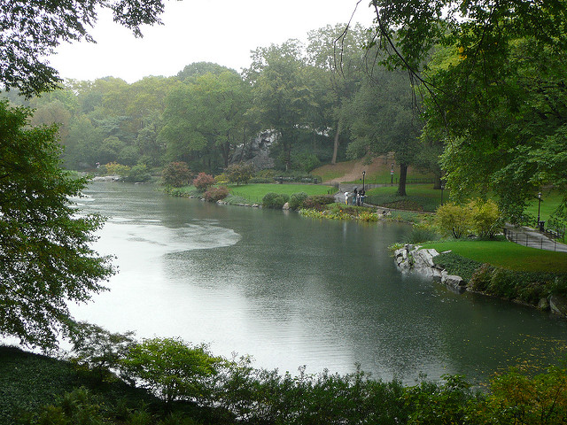
Futuuri + if-lause (first conditional)
If it rains, I won't go to the park.
If I study today, I'll pass the test tomorrow.
If I have enough money, I'll buy new shoes.
She'll miss the bus if she doesn't leave soon.
She won’t miss the bus if she leaves soon.

Slide 8
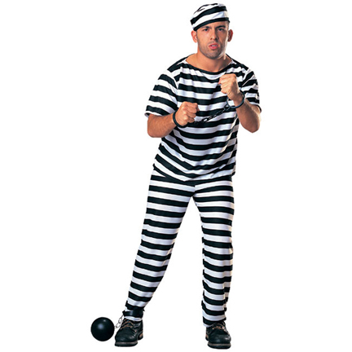
JOS OLISIN VAPAA, NOUSISIN PUOLILTAPÄIVIN!
JOS VARTIJA NUKAHTAISI...
JOS KARKAISIN, MENISIN...
If the guard fell asleep, I could get the key!
If I lived in Paris, I’d eat croissants every day!
If I escaped, I would go straight to France!
If I were a free man, I would get up at noon!

Slide 9
Rewriting history
Think of some historical situations that might have changed the world. Finish the sentences.
If electricity had never been invented…
If the dinosaurs hadn’t died out…
If Trump hadn’t been elected President…
If Columbus had never discovered America…
If 50 Cent hadn’t started rapping…
If Finland hadn’t won/lost the war with Russia…
If I had been Michael Jackson…
If I had been <INSERT PERSON>…

