Slide 1
14 Small decisions
14 Small decisions (video 6.30 min)
Small decisions (pdf)

Slide 2
Warm up questions
Why is being overweight more common now than it used to be?
Are there differences between individuals in how they relate to weight? Differences between girls and boys?
Is it possible to gain weight if you follow a weight loss plan?
Why is selling weight loss programs so profitable?

Slide 3
Small decisions
The weight range that enables the best health for you is called normal weight or healthy weight. The range is several kilograms.

Slide 4
Underweight causes fatigue and compromises your immune system
Excessive body weight strains your musculosceletal system and encumbers your cardiovascular system
Obesity/ overweight is associated with diseases such as Type 2 diabetes, cardiovascular diseases and cancers

Slide 5
People who follow strict weight-loss programs try to lose weight rapidly. The result is often the opposite when the diet is over.

Slide 6
A healthy way to manage your weight is to proceed step by step with simple and small changes in your eating and physical activity habits. After a while the good choices become a routine and lifestyle

Slide 7
Tasks
1. Compare a weight-loss program with managing your weight
a) What do they have in common?
b) What differences do they have?

Slide 8
Tasks
3. Why is being over-weight more and more common today?
4. List
a) physical
c) mental
c) social
disadvantages that may be caused by being overweight

Slide 9
Tasks
5. What kind of daily decisions can you make concerning
a) physical activity?
b) eating?

Slide 10
Tasks
6. Find a weight loss advertisement or commercial that advocates/tries to sell a weight loss product. What kind of ads are in your opinion convincing / good?

Slide 11
Morning routines Hand-out

Slide 12
Breakfast quiz

Slide 13
Breakfast quiz Answers

Slide 14
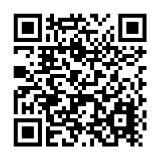
Tavat puntarissa kysely (Terve koululainen/ Maito ja terveys r.y.)

Slide 15
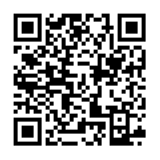
Staying at healthy weight (Kid's health audioarticle)

