Slide 1



What is biodiversity?
A variety of animal and plant life in a habitat or all around the world.
Can be considered at different levels:
Habitat diversity is a measure of different habitats in one particular area or region.
Genetic diversity is a measure of genetic characteristics between individual species, or between different species.
Species diversity is a measure of the number of different species and how many individuals of these species there are.

Slide 2
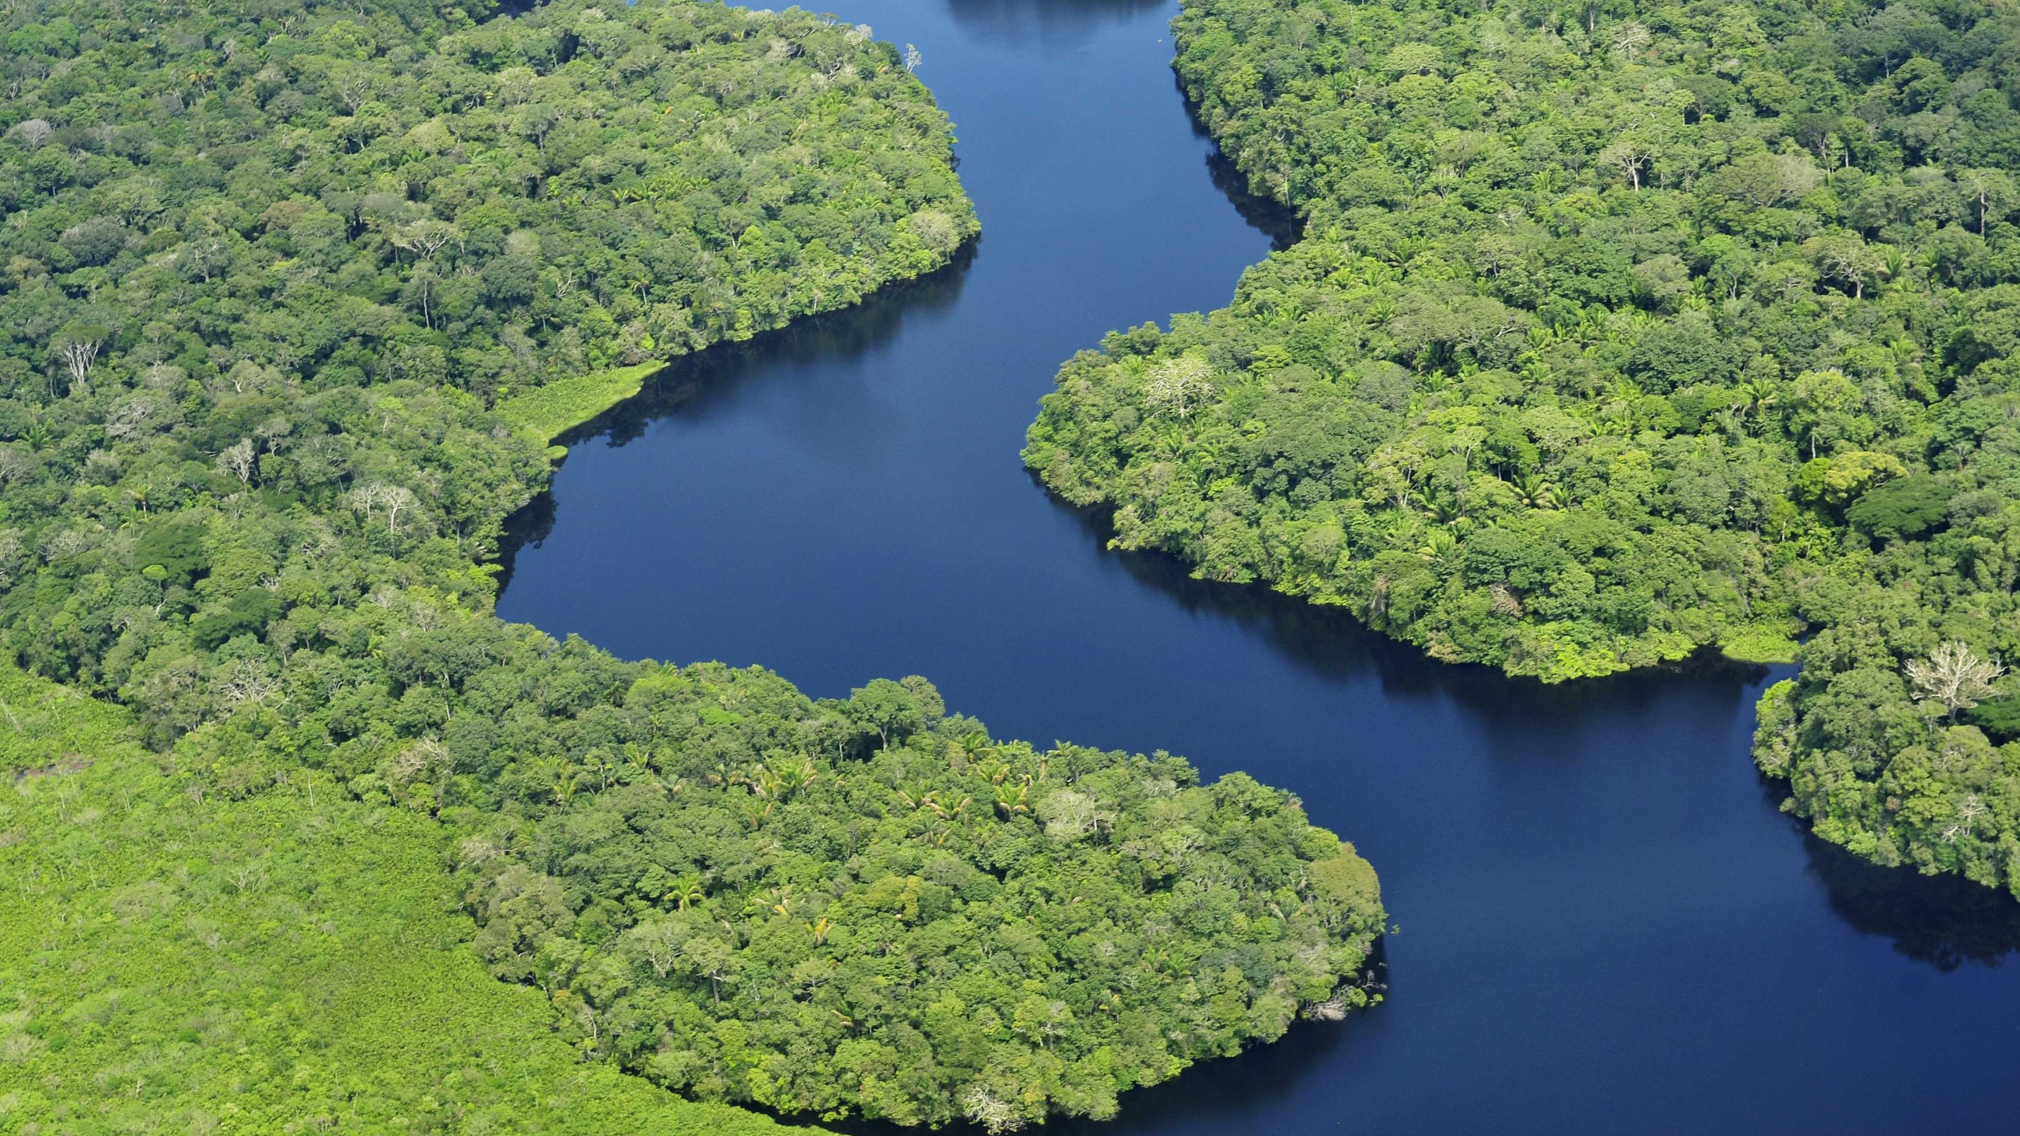
Why is biodiversity measured?
It provides sound information, that is used especially as environmental health indicators, to determine the status of our biological system.
For example, to identify whether there are changes in water quality over time in a certain lake.
However, biodiversity is also a complex concept that can be challenging to measure.
There are many different ways to quantify biodiversity.
This Photo by Unknown author is licensed under CC BY-SA-NC.

Slide 3
The importance of biodiversity
Low biodiversity isn't necessarily cause for concern – The Arctic and Antarctic contains habitats that naturally have low biodiversity compared to tropical rainforest.
The more important matter is the loss of biodiversity.
An ecosystem relies on the interpendence of organisms to maintain stability, and loss of species can cause serious, unpredictable and possibly irreversible changes.
Ecosystem distruption can have a significant impact on humans.

Slide 4
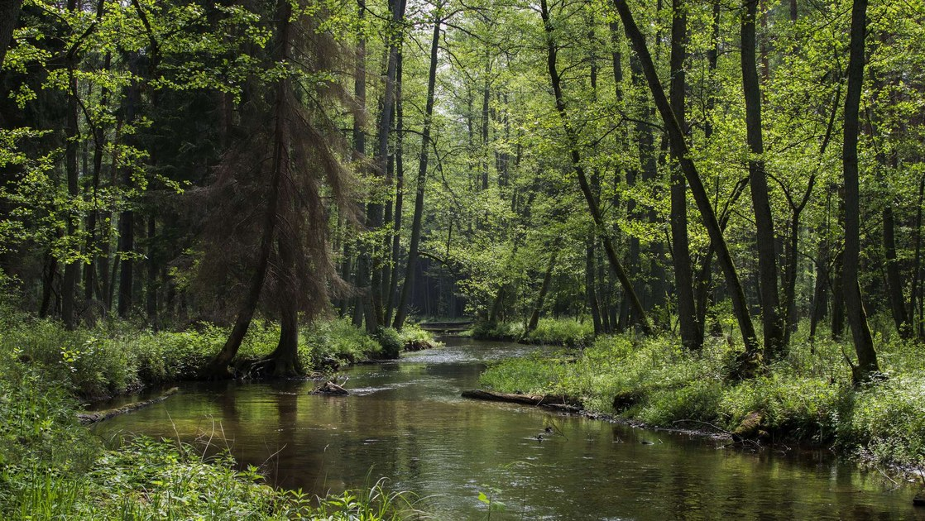
Biodiversity in UK
UK has a lot of information bout it's biodiversity, collected across a broad spread of species and habitats both by professionals and by expert volunteers.
For example, some habitats found in the UK are:
Dunes
Fens
Grassland
Heatland
Marsh
Rivers
Woodland
This Photo by Unknown author is licensed under CC BY.

Slide 5
FACTORS AFFECTING GLOBAL BIODIVERSITY
All the biggest threats to global biodiversity are caused by the rapidly increasing human population
They include:
Overexploitation
Areas are used solely for resources, and over their limits
Habitat change
Environmental changes that affect the survival of an organism
Nutrient loading and pollution
Nutrients are added to bodies of water, causing excessive growth of algae
Climate change
a change in global and regional climate patterns caused by the increase of atmospheric carbon dioxide that comes from fossil fuel use

Slide 6
Human population growth
Agriculture affects biodiversity; as synthetic nutrients have grown in use, biodiversity has been lost in bodies of water as algae spreads and supplants other organisms
The areas used for agriculture draw the natural nutrients from the soil causing plants that grow on the soil to become less diverse. This is known as monoculture
Monoculture is defined as being the cultivation of a single crop in a given area
Agriculture with animals usually leads to selective breeding, where certain alleles are favored, causing others to be lost. This causes a bottleneck effect where natural selection isn’t in effect, promoting negative effects that come with the alleles used for production efficiency
Selective breeding causes loss of genetic diversity by default

Slide 7
Species richness and evenness
There’s a clear difference between species evenness and richness; richness measures the variety of organisms in a given area, evenness compares how even species are in a given area
Species richness is defined as a measure of the number of species and how many individuals of these species there are in a given area
Species evenness is defined as a measure of how close in numbers each species in an environment is
Species richness can be lost when invasive species take control of a given area, or reproduce faster and more succesfully than other species in the given area.
evenness measures if diversity is at an acceptable level, where similar species are similar in numbers to each other

Slide 8
FACTORS AFFECTING GLOBAL BIODIVERSITY
All the biggest threats to global biodiversity are caused by the rapidly increasing human population
They include:
Overexploitation
Areas are used solely for resources, and over their limits
Habitat change
Environmental changes that affect the survival of an organism
Nutrient loading and pollution
Nutrients are added to bodies of water, causing excessive growth of algae
Climate change
a change in global and regional climate patterns caused by the increase of atmospheric carbon dioxide that comes from fossil fuel use

Slide 9
Human population growth
Agriculture affects biodiversity; as synthetic nutrients have grown in use, biodiversity has been lost in bodies of water as algae spreads and supplants other organisms
The areas used for agriculture draw the natural nutrients from the soil causing plants that grow on the soil to become less diverse. This is known as monoculture
Monoculture is defined as being the cultivation of a single crop in a given area
Agriculture with animals usually leads to selective breeding, where certain alleles are favored, causing others to be lost. This causes a bottleneck effect where natural selection isn’t in effect, promoting negative effects that come with the alleles used for production efficiency
Selective breeding causes loss of genetic diversity by default

Slide 10
Species richness and evenness
There’s a clear difference between species evenness and richness; richness measures the variety of organisms in a given area, evenness compares how even species are in a given area
Species richness is defined as a measure of the number of species and how many individuals of these species there are in a given area
Species evenness is defined as a measure of how close in numbers each species in an environment is
Species richness can be lost when invasive species take control of a given area, or reproduce faster and more succesfully than other species in the given area.
evenness measures if diversity is at an acceptable level, where similar species are similar in numbers to each other

Slide 11
CONSERVATION:
MINIMISING THE IMPACT OF HUMAN ACTIVITIES→
If we were in a position of power, in order to minimise the impact of human activities in the natural environment, WE COULD :
ISSUE NEWER AND MORE ENTICING GUNS ON THE CONDITION THAT HUNTERS ARE REGISTERED ON A FACIAL RECOGNITION DATA BASE THAT MEANS THEY ARE RECOGNISED AS CARRYING GUNS SO THEREFORE AREN’T ALLOWED ONTO CONSERVATION SITES.
Make an effort to retract all previously owned guns and replace them with government issued guns that have a special lens, this lens can detect endangered species; which will prompt the gun to disallow itself to fire bullets
Have a limiting feature on a gun that allows a certain amount of bullets to be fired per year before it disables; to correspond with a set quota.
THE BROKEN GUN CAN BE TAKEN BACK AND FIXED/REPLACED FOR A NEW ONE BUT ONLY BY THE BUREAU THAT OVERSEES IT.
ENFORCE A LAW WHICH SAYS THAT ONLY A CERTAIN AMOUNT OF LAND CAN BE USED TO DEVELOP TOWNS AND CITIES FOR EXAMPLE FOR BUILDING .

Slide 12
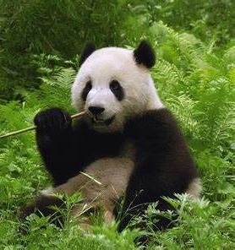
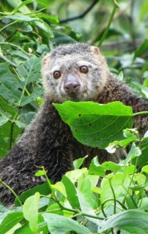
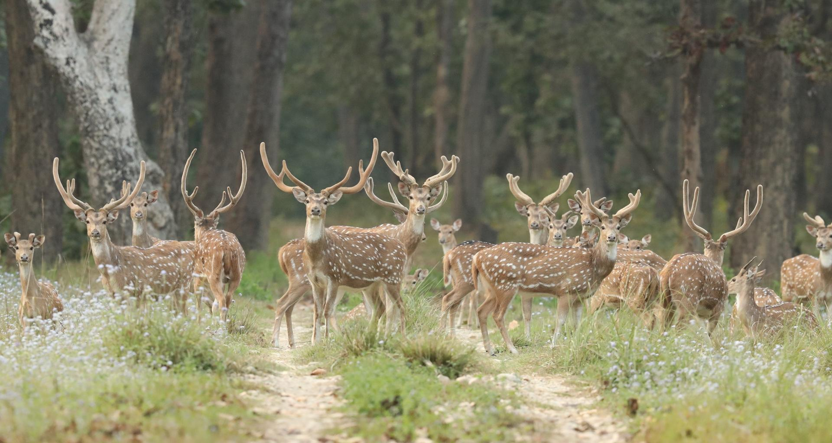
In situ conservation
=>the CONSERVATION OF ECOSYSTEMS AND NATURAL HABITATS AND THE MAINTENANCE AND RECOVERY OF VIABLE POPULATIONS OF SPECIES IN THEIR NATURAL SURROUNDINGS

Slide 13
ADVANTAGES & DISADVANTAGES
Endangered habitats may be fragmented so the area may not be large enough to ensure the survival of these species
Genetic diversity may have already been dramatically decreased
Conditions that threatened the organisms in the area may still be present, e.g. disease or interspecific competition
Plants & animals conserved in their natural environment
Biodiversity permanently protected
Representative examples of ecosystems also permanently protected

Slide 14
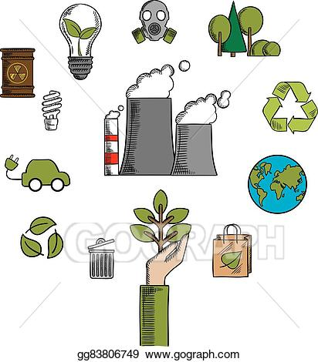
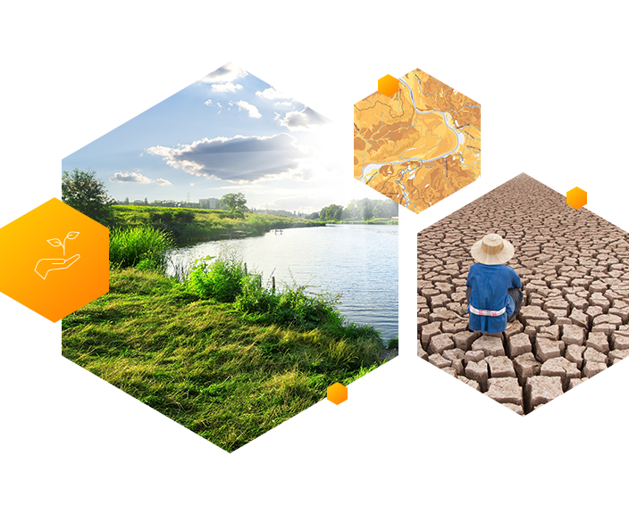
Conservation an ecological

Slide 15
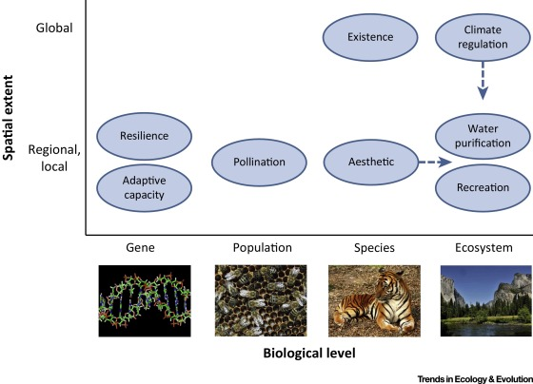
Conservation an ecological (reasons)
A framework is presented that can help unify diverse reasons for conserving nature.
Recognizing the utilitarian value of nature does not deny its intrinsic value.
Reconciling different viewpoints will result in better conservation practice.

Slide 16
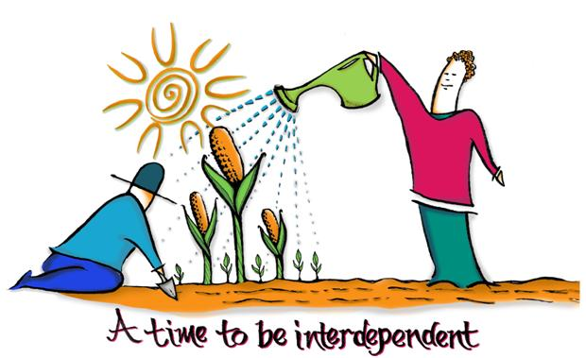

Interdependence is also the idea that everything in nature is connected to and depends on every other thing.

Slide 17
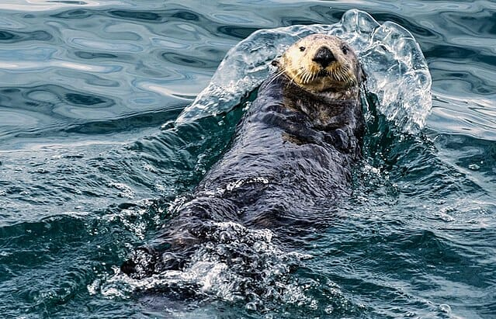
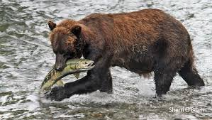
Keystone species are those which have an extremely high impact on a particular ecosystem relative to its population. Without keystone species, the ecosystem would be dramatically different or cease to exist altogether.

Slide 18
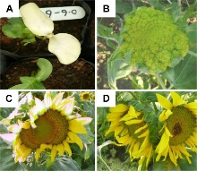
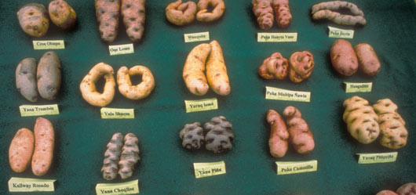
Genetic resources (GRs) refer to genetic material of actual or potential value. Genetic material is any material of plant, animal, microbial or other origin containing functional units of heredity.

Slide 19
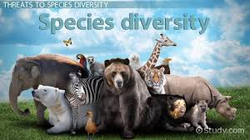
Species biodiversity
Species, in biology, classification comprising related organisms that share common characteristics and are capable of interbreeding.
Species diversity is defined as the number of species and abundance of each species that live in a particular location.

Slide 20
CITES
the Convention on International Trade in Endangered Species of Wild Fauna and Flora

Slide 21
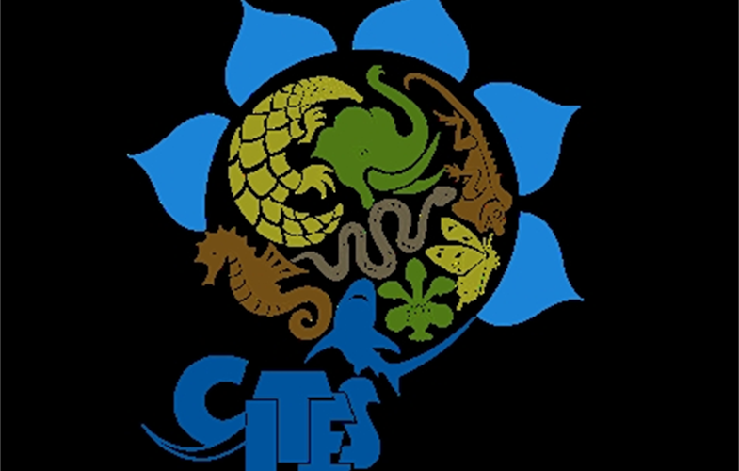
Their aims
Its an international agreement between governments
Its aim is to ensure that international trade in specimens of wild animals and plants does not threaten their survival.

Slide 22

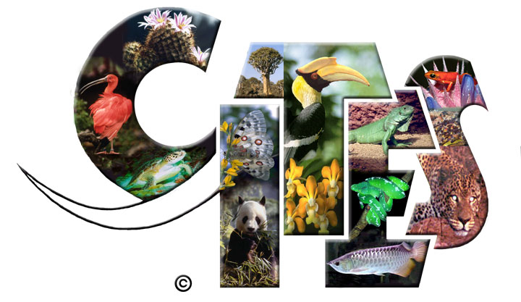
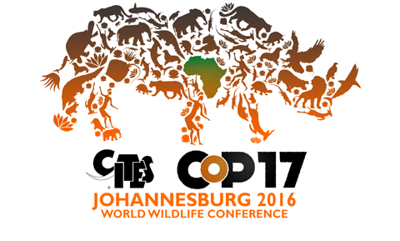

Slide 23
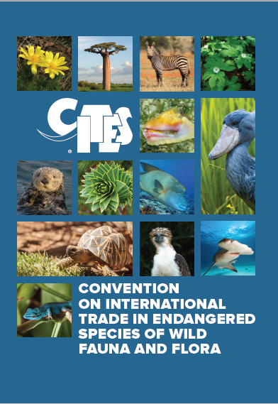
When were they created?
It was drafted as a result of a resolution adopted in 1963 at a meeting of members of the International Union for Conservation of Nature (IUCN). The convention was opened for signature in 1973 and CITES entered into force on 1 July 1975.

Slide 24

The aim of the Rio convention
The three Rio Conventions—on Biodiversity, Climate Change and Desertification—derive directly from the 1992 Earth Summit. Each instrument represents a way of contributing to the sustainable development goals of Agenda 21. The three conventions are intrinsically linked, operating in the same ecosystems and addressing interdependent issues.

