Slide 1
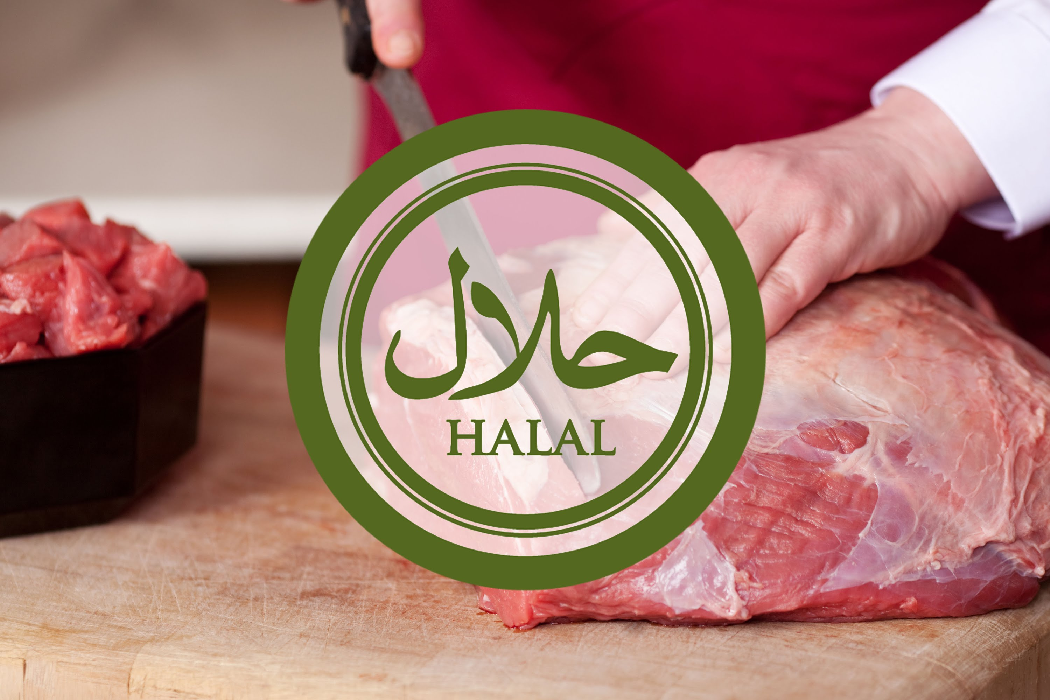

Slide 2
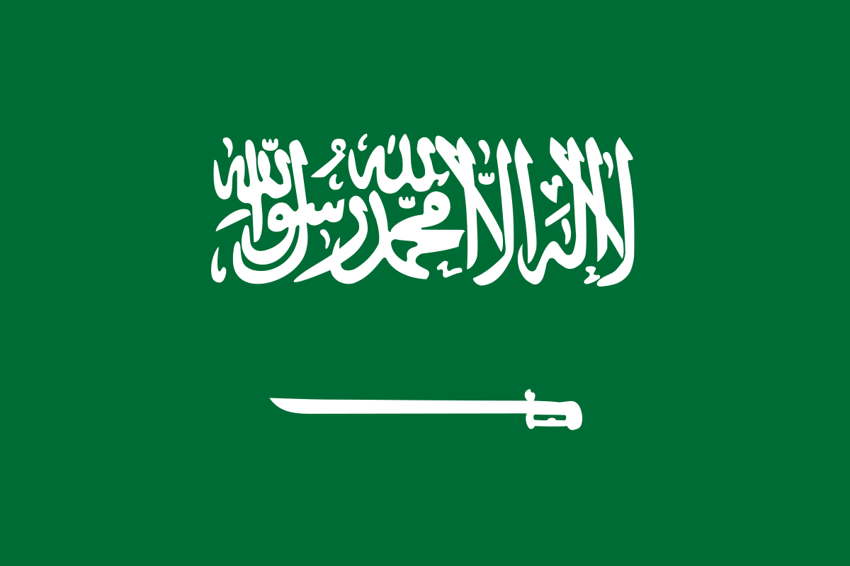

What is Halal?
Halal is designation of everything what is permissable in the light of Sharia.
ḥalāl
permissable
1/7

Slide 3

What is Haram?
Haram in turn, is designation of everything what is forbidden in the light of Sharia.
haram
forbidden
2/7

Slide 4
Halal as a diet
Halal is also a diet . It applies mainly to meat.
Prohibited food according to halal
Pork
Intoxicants
Blood
Animals other than pork, dedicated to other than God
3/7

Slide 5
Method of slaughter
What does it mean that the animal is „dedicated to God”?
To be „halal”, the animal must be slaughtered ritually (dhabīḥah):
The slaughter must be performed by a Muslim.
Animal must be conscious durin the ritual.
„In the name of God” (bismillah) sentence must be spoken by the butcher upon slaughter of each halal animal separately.
Animal’s blood must be integrally drained from the veins.
Carrion (carcasses of dead animals, such as animals who died in the wild) cannot be eaten. Additionally, an animal that has been strangled, beaten (to death), killed by a fall, gored (to death), savaged by a beast of prey (unless finished off by a human), or sacrificed on a stone altar cannot be eaten.
4/7
,

Slide 6
Why do people do Halal? – Spiritual meaning
To Muslims, halal meat is obligatory in their religion. But there are many people around the world doing halal, not being Muslims.
In contrast to other diets, halal is not only about taste or health. People doing halal believe that they’re spiritually clean thank to abstinence and „holy”, blood free meat to eat.
5/7

Slide 7

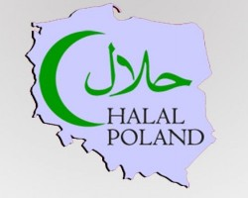
Halal in Poland
Killing an animal without depriving it of consciousness is prohibited by law in Poland.
By that, I think it’s safe to conclude that halal is partilly forbidden in our country.
6/7

Slide 8
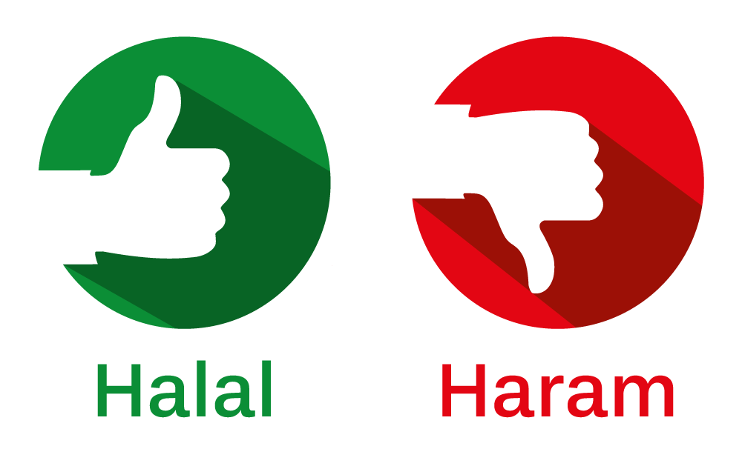
Summary
Ritually prepared meat
And everything what is not haram ☺
Alcohol (intoxicants in general)
Pork
Blood
7/7

Slide 9
Thanks for watching!
Nico Kisiel & Max Raczkowski

