Slide 1
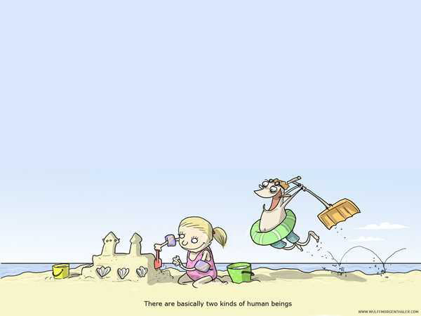
Drengene efter pigerne/DEP
Project background

Slide 2
Drengene efter pigerne - developing and testing new guidance methods. Gender stereotypical choices
Theoretical background:
Linda Gottfredson – where does interests come from?
Social Cognitive Career Theory - self-efficacy
Common assumptions:
The social background/context shapes individual conceptions - ”my possible choices”
The career choice connected to social processes

Slide 3
Theoretical approach, 1
Gottfredson:
Young people reproduce their parents ”social order” – e.g. in regards to gender and status
Through individual development processes the individual circumscribe their options/preferences as a result of their subjective picture of themselves.
Gender stereotypical perceptions of occupations and their ”inhabitants”
The choice of education is about ” implementing your social self” – social acceptance.

Slide 4
Theoretical approach, 2
SCCT:
Subjective perceptions of self (self-efficacy) guides choices, motivation and perseverance
Earlier learning experiences influence individuals perception (access to a limited ”menu”)
Outcome expectations (positive/negative) affects career aspirations (or the lack of same)
If you give up believing, that you can reach desired goals, you will either not try or give up along the way.

Slide 5
Target groups
Boys in compulsary school (8. grade) – selected ”special needs pupils”.
Boys who has left compulsary school and are not enrolled in a youth education program

Slide 6
Project objectives
The Project aims:
Develop and test guidance methods aiming at compensating for gender stereotypical career choices.
Collect Danish experiences (3 regional Youth Guidance Centers) from working from a specific theoretical/methodological perspective Focus on boys gender stereotypical choices.

