Slide 1
PSYCHOLOGY INTERNAL ASSESSMENT
IB Psychology LAJM

Slide 2
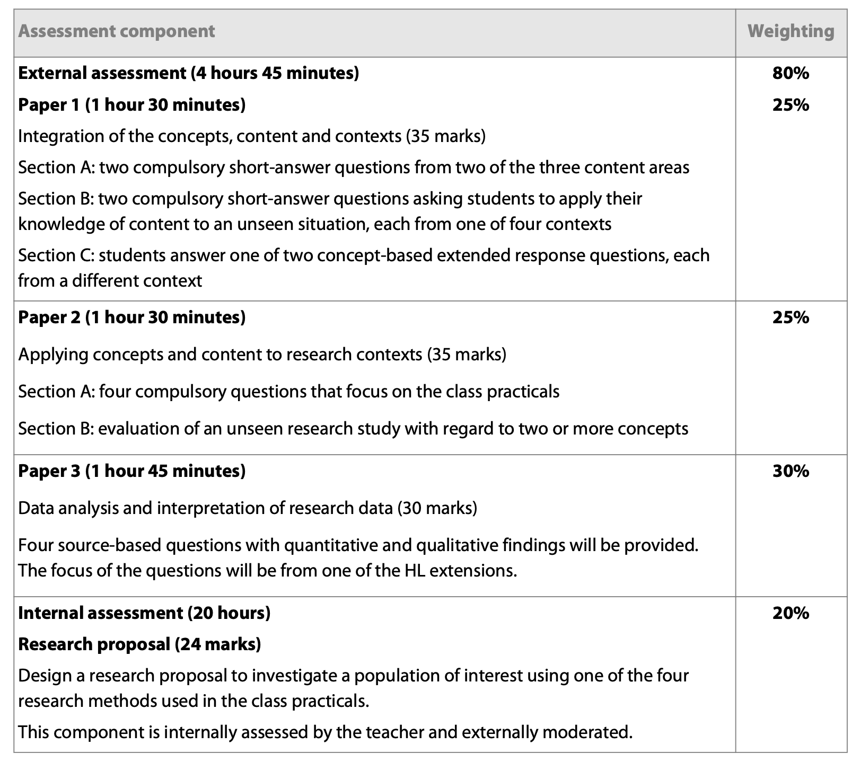
IA in IB Psychology
HL

Slide 3
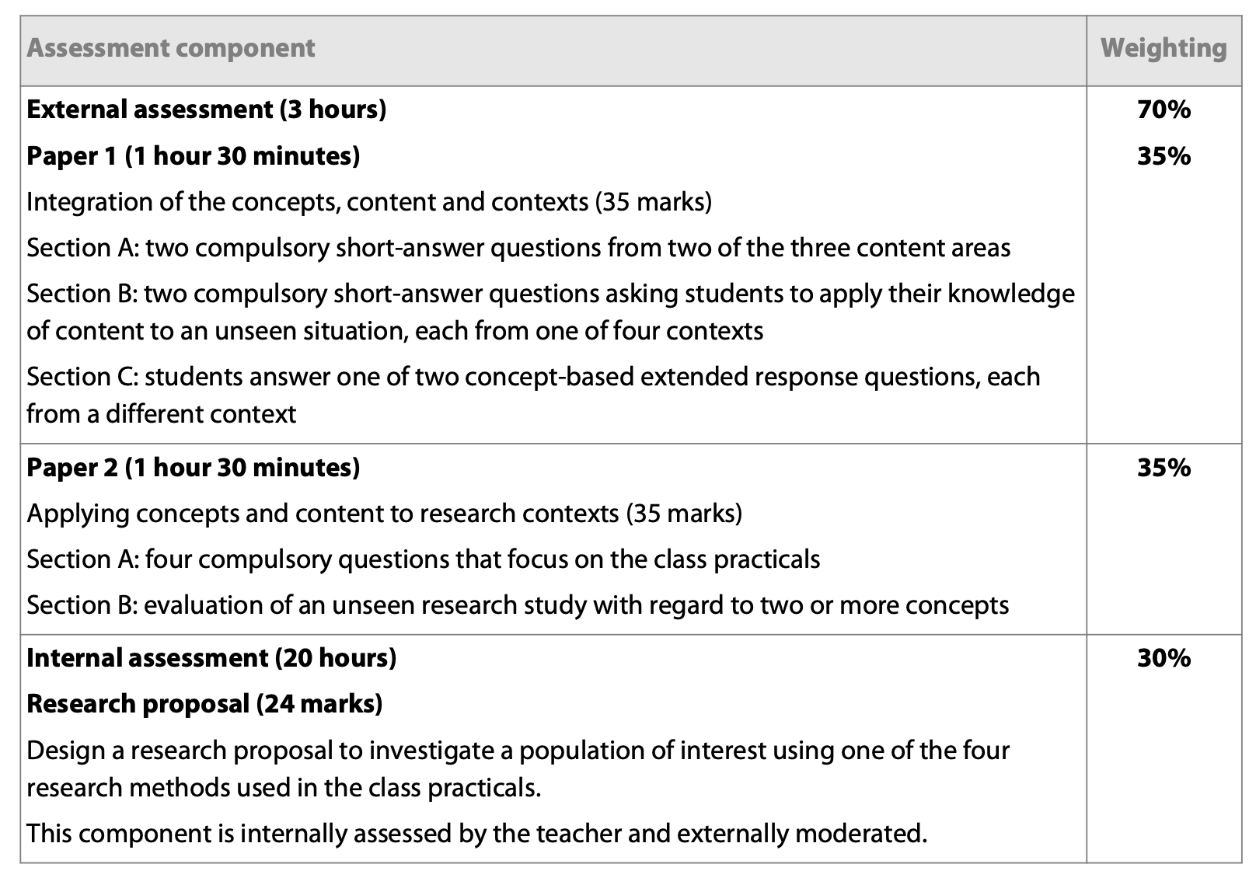
IA in IB Psychology
SL

Slide 4

IA in IB Psychology
In essence, the IB Psychology Internal Assessment task is a research proposal
  You are NOT implementing any research

Slide 5
IA in IB Psychology
IA asks students to consider the power of psychology to lead to real improvement in people’s quality of life
  Real-life problem
  Population of interest
Research proposal should use ONE of the research methods covered in the class practicals
  Experiment
  Observation
  Interview
  Survey/questionnaire

Slide 6
IA in IB Psychology
Real-life
problem
Topic
Population
of interest
Existing
research
Why is my research proposal useful for the population of interest?

Slide 7

IA in IB Psychology
The following topics are NOT allowed
  Any kind of abuse
  Self-harm, including suicide
  Pornography, rape or other sexual acts
  Serial killers or acts of torture
  Any research containing ingestion
  Any use of animals

Slide 8
IA in IB Psychology
Topics covered in the class practicals must NOT be re-examined in the research proposal
Double dipping with psychology EE is also strictly prohibited

Slide 9

IA in IB Psychology
The research proposal should be conducted as if it must be passed by an ethics committee

Slide 10

IA in IB Psychology
Implement the IBO’s ideas and Student IA Proposal Form to plan your psychology IA

Slide 11

IA in IB Psychology
Individual work must be written in APA format
Base document is provided in peda.net
  Download the document to your computer, rename it and start working with your IA

Slide 12
IA in IB Psychology
The research proposal should not exceed 2200 words in length and should consist of the following components:
  Title page
  Introduction
  Research methodology
  Data collection
  Discussion
  Reference list
  Appendices

Slide 13
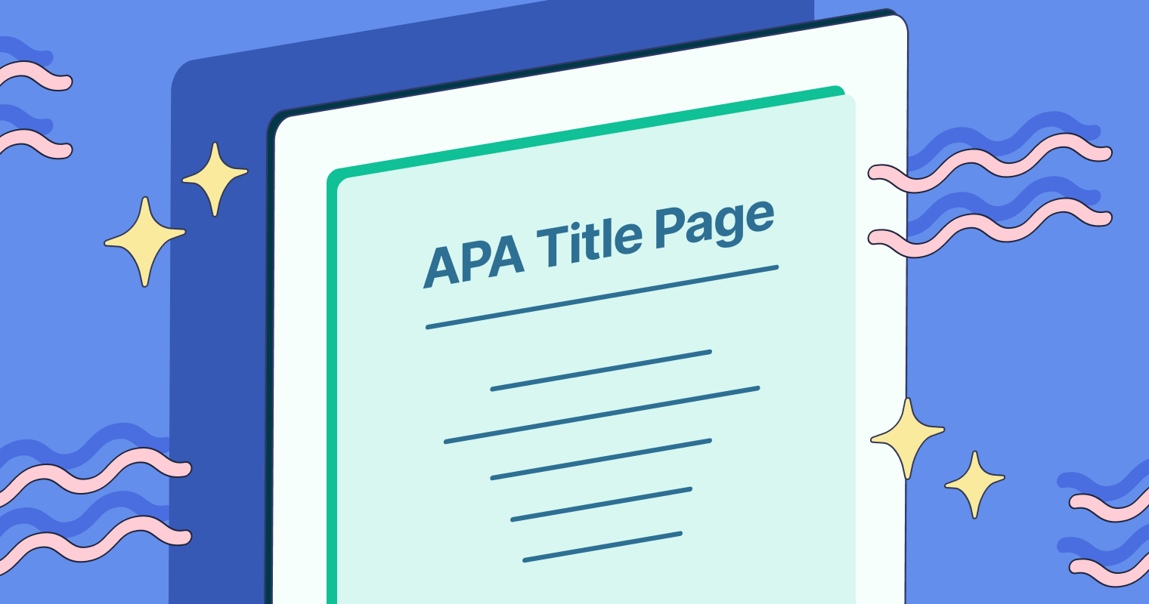
IA in IB Psychology
Title page
  Title of your investigation
  Number of words
  (max 2200)
  No ID info nor dates!

Slide 14

IA in IB Psychology
Introduction
  The aim or research question
  Focus on the impact a certain problem has on a population of interest
  Findings and key conclusions of two relevant pieces of research

Slide 15
IA in IB Psychology
Research methodology
  Justification of your choice of method (choose ONE)
  Explanation of decisions regarding procedure
  Explanation of relevant ethical considerations
Methods:
  Experiment
  (true or quasi-)
  Observation (naturalistic or controlled, overt or covert, participant or non-participant)
  Interview (structured, semi-structured or focus group)
  Survey/questionnaire

Slide 16

IA in IB Psychology
Data collection
  Create ONE data collecting tool (unless you are planning an experiment)
  Explain the decisions made while creating the tool
  Discuss potential challenges of data collection

Slide 17

IA in IB Psychology
Discussion
  How can your findings be used to help your population of interest?
  Personal and epistemological reflexivity
  What additional method could increase your understanding of your topic?

Slide 18

IA in IB Psychology
Reference list
  Should follow APA standards
  In alphabetical order by the last name of the researcher
  No discrepancies between the in-text references and the reference list

Slide 19
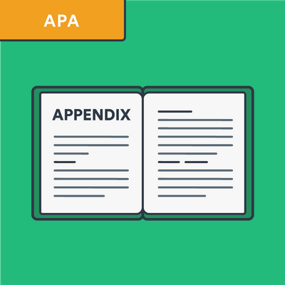
IA in IB Psychology
Appendices
  Copy of the data collection tool
  With experiments, any relevant materials (e.g. standardized instructions, word lists etc.)
  No need for blank consent form

Slide 20
IA in IB Psychology
Deadlines
  Proposals ready before autumn break
  First submission deadline
  in the middle of the 2nd term (IB2 year)
  Final submission deadline at the end of the 2nd term (IB2 year)
  All work is done during the lessons!
According to our present school policies, the only way to get additional time to the IA deadlines is to discuss with the IB coordinator and provide a medical certification

Slide 21

QUESTIONS

Slide 22
Picture sources
Wheel head <http://alexkwee.com/services/psychological-assessments/> Accessed 2nd of January 2018
Banned <https://commons.wikimedia.org/wiki/File:Banned.jpg> Accessed 28th of September 2026.
Got ethics? <https://siliconangle.com/blog/2013/08/10/how-ethical-is-your-big-data/got-ethics/> Accessed 2nd of January 2018.
Idea <http://libguides.butler.edu/c.php?g=578630&p=3992658> Accessed 2nd of January 2018.
APA logo <https://www.ariessys.com/views-press/press-releases/the-american-psychological-association-to-deploy-editorial-manager-for-70-journals/> Accessed 2nd of January 2018.
APA Title Page <https://www.grammarly.com/blog/citations/apa-title-page/> Accessed 28th of September 2026.
Introduction pen <https://www.grammarly.com/blog/academic-writing/research-paper-introduction/> Accessed 28th of September 2026.
Pile of folders <https://www.123rf.com/photo_4406564_stack-of-file-folders.html> Accessed 28th of September 2026.
Scientists with a puzzle head <https://allea.org/allea-publishes-second-discussion-paper-on-loss-of-trust-in-science-and-expertise/> Accessed 28th of September 2026.
APA Reference list <https://www.grammarly.com/blog/citations/works-cited-page/> Accessed 28th of September 2026.
APA Appendix <https://www.bibguru.com/g/apa-appendix-citation/> Accessed 28th of September 2026.
Burning question mark <https://stock.adobe.com/fi/search?k=burning+question+mark> Accessed 14th of September 2025.

