Slide 1
Erasmus+ project: EQUAL ACCESS TO SCIENTIFIC YIELD –DISCOVER THE ELEMENTS AROUND YOU

Slide 2
WORKSHOP 1. - Cosmetics
Pinja Räty, Inka Kannisto, Akseli Jylhä, Roosa Nieminen and Venla Pekkarinen

Slide 3
What are micro-, macro- and nanoplastics?
Macroplastic is the biggest one of these three plastics (over 1cm)
Macroplastic is clearly visible plastics
For example a water bottle
Microplastic is the middle one of these three plastics
Microplastics are tiny plastic particles (particles are 1mm - 1µm) which may end up in the environment
Nanoplastic is the smallest one of these three plastics (particles are 10-100nm)
You can’t see nanoplastics without a microscope

Slide 4
Benefits and harms in cosmetics
Microplastics are used in cosmetics because they scrub skin​
But only a few people realize that quite many products have plastic in them​
Microplastics are a challenge to sewage treatment plants and plastics end up in oceans​
Planktons aren't able to tell plastics and natural nutrition apart, so they eat plastic​
In this way plastic ends up in fish and people's food

Slide 5
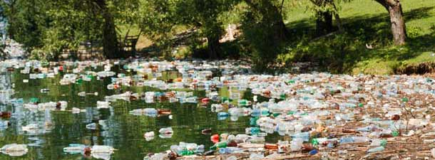
Plastics in nature
According to Greenpeace 10% of our plastics end up in the oceans and most of it sinks to the bottom of the oceans
100 million tons per year and 500 tons per hour​
Road traffic is one of the biggest reasons for oceans' pollution
Car wheels, asphalt ​etc.

Slide 6
Road traffic comes shipping and boats
Plastic waste, such as water bottles, burden the nature with 400 tons
The biggest amount of litter comes from China, Philippines, Vietnam, Indonesia and Thailand
The major reasons why there is so much pollutions in the oceans are landfills near the oceans and rivers, industry, sewage, tourists and the lack of waste management

Slide 7
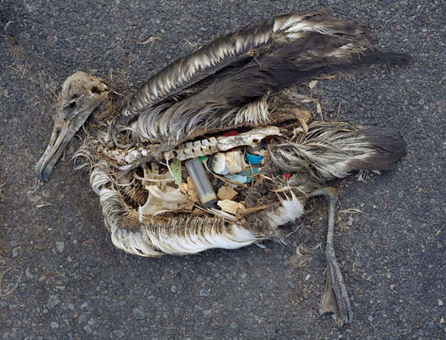
Effects to animals...
Plastics in the oceans end up in the bodies of animals​
Intestines​
Tissues​
Plastics can be found especially in many fish species, waterfowls, marine mammals and invertebrates​

Slide 8
1 million waterfowls and 100 000 marine mammals die because of this plastics​
The plastics are both dangerous themselves and they also gather many poisons into their surface.
That makes them even more dangerous to animals and us (because we eat meat)​.
Fishes etc can suffocate because of the plastics drifting in the ocean​.
Fishnets etc.

Slide 9
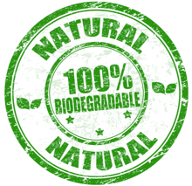
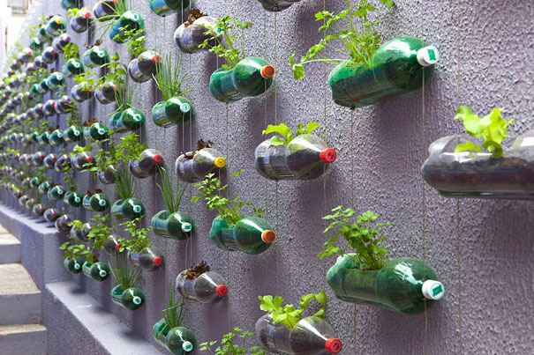
What could we do to these problems?
We can...​
Develop biodegradable plastics​
Reuse more plastic​
Clean the seas from the plastics​
Reduce the use of plastic

Slide 10
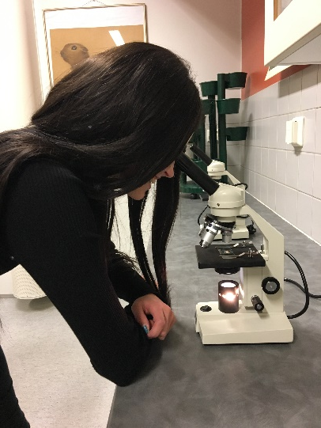
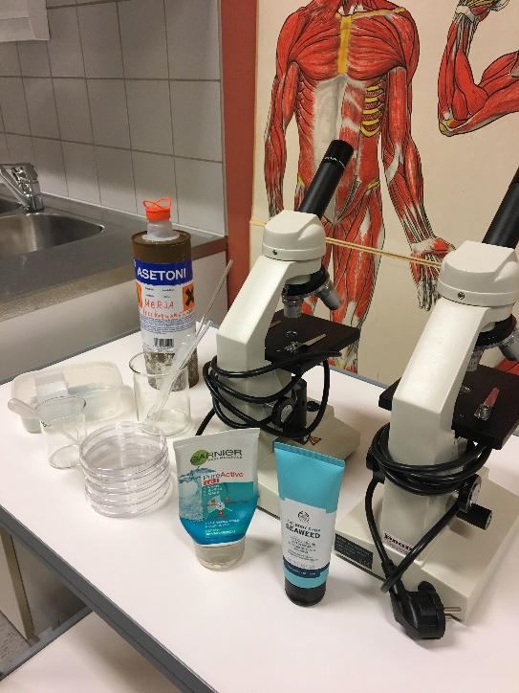
The products that we examined

Slide 11
GARNIER SKIN NATURALS, PURE ACTIVE
Garnier skin natural contains propylene glycol
Propylene gycol is a microplastics which is harmful to the enviroment
In this scrub eucalyptus leaf extract and menthol are cooling materials
Price: 4,55 €

Slide 12
THE BODY SHOP SEAWEED
Contains seaweed which is very nutritious and rich in vitamins
Scrubbing materials are jojoba grain, minced olive seed and luffa
Doesn’t contain any plastic
Price:18,50 €

Slide 14
Which one do we prefer?
The organic one
Why?
Texture was more pleasant than the one with plastic
Fragrance was lovely in the organic one
It protects enviroment with natural choices
Even though the price was higher than the face scrub with plastic we still decided to choose the natural face scrub

Slide 15
THE END
THANK YOU FOR WATCHING

