Slide 1

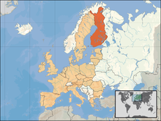
Neighbouring states
- Russia, Norway,
Sweden
Baltic sea coast

Slide 2
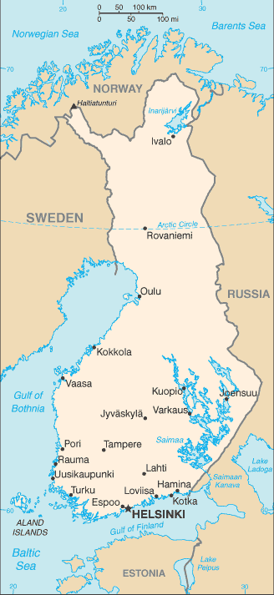
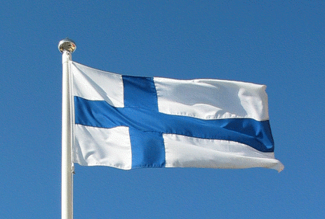
Surface area: 303 891 km²
- Population: 5,4 million
Capital city: Helsinki
President of Finland:
Sauli Niinistö

Slide 3
Population
Nordic-style welfare state
- High standard of living
High quality of life
Good services
High taxation
Notes:
3

Slide 4
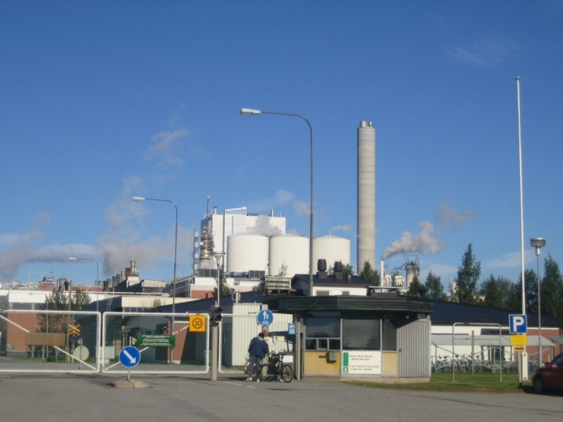
Manufacturing and refining: electronics, machinery
(lifts, paper machines),
vehicles and metal products, forest industry (paper), chemicals.

Slide 5
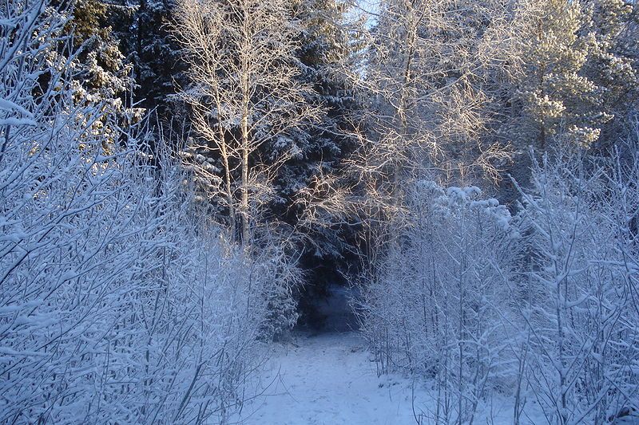
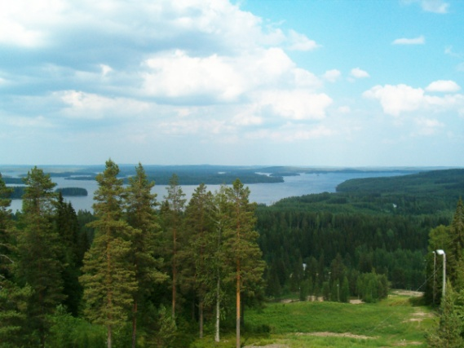
Finland´s nature
In Finland there is over 1000
lakes.
Nature consist of lakes,
forests and swamps.

Slide 6
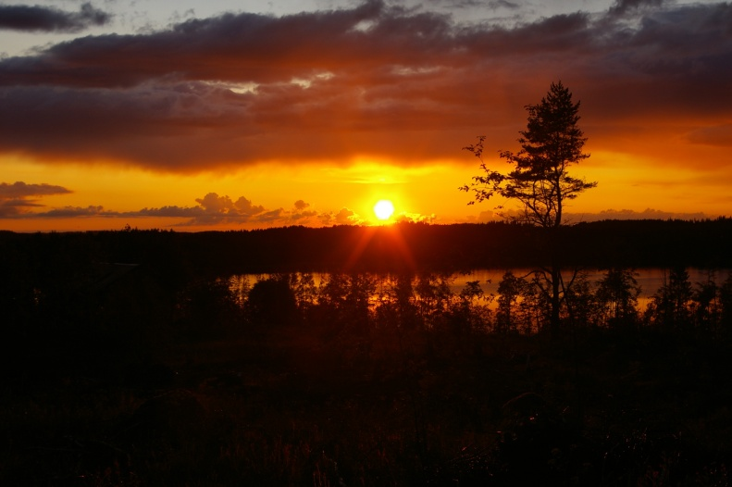
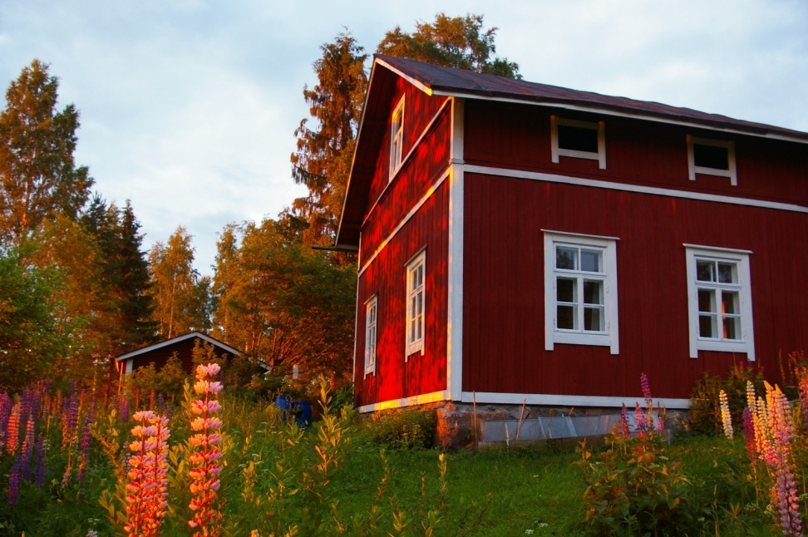
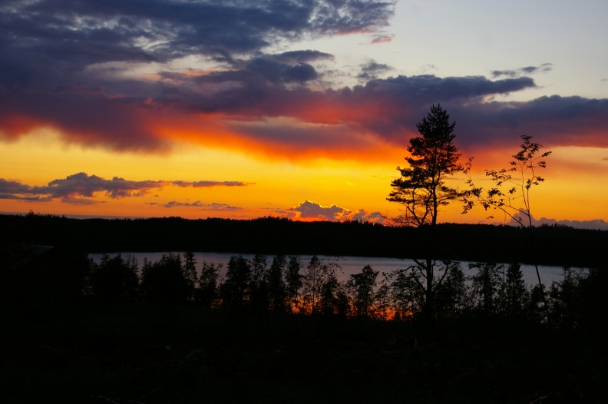
Summer night
21.6.2011 at 22.26 – 22.47 o´clock

Slide 7
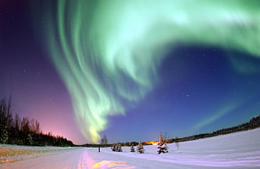
Northern Lights

Slide 8
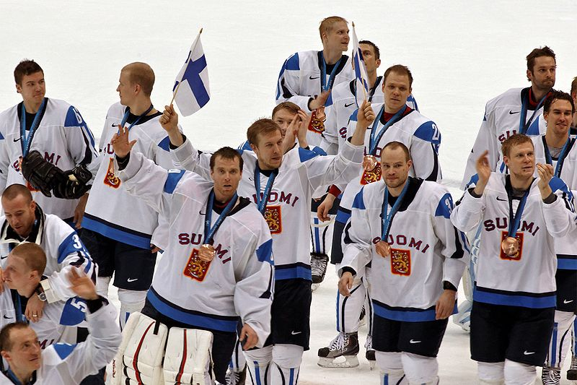
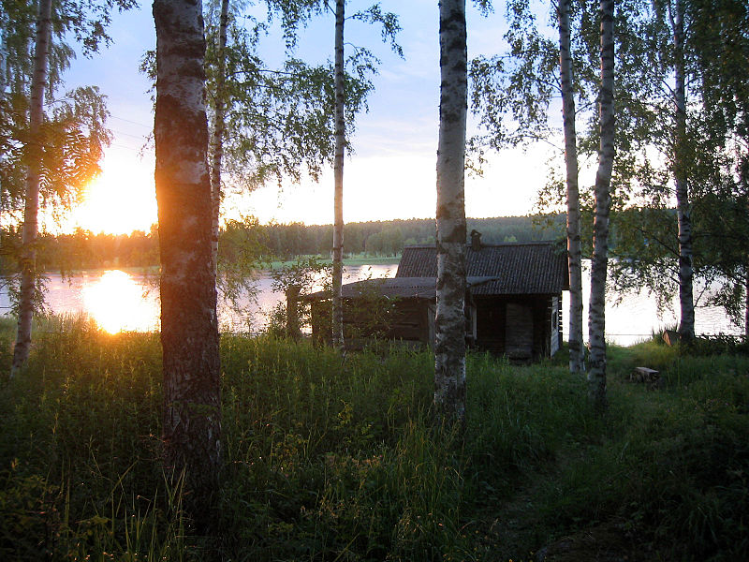
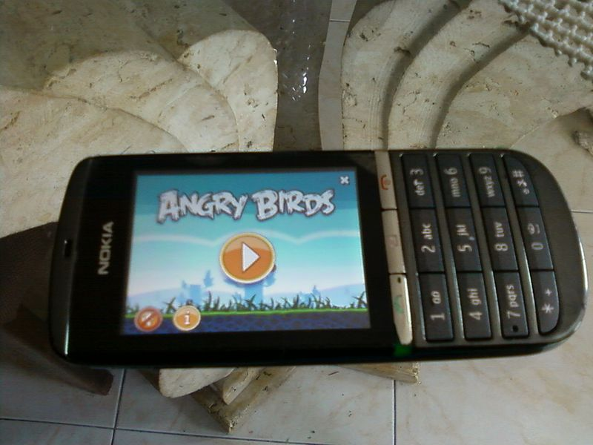
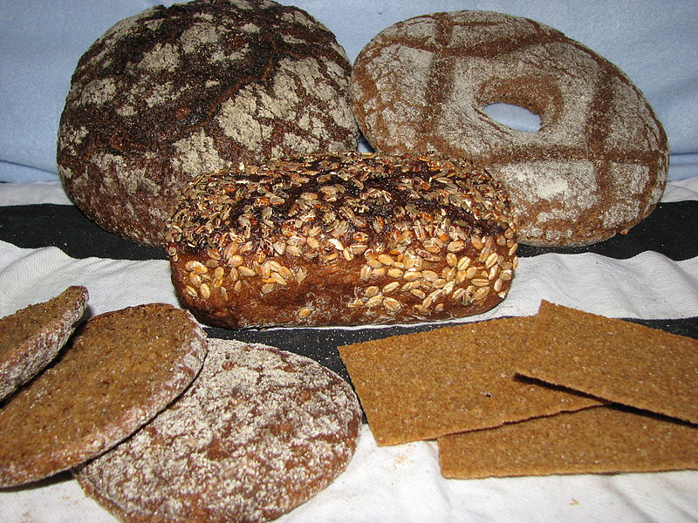
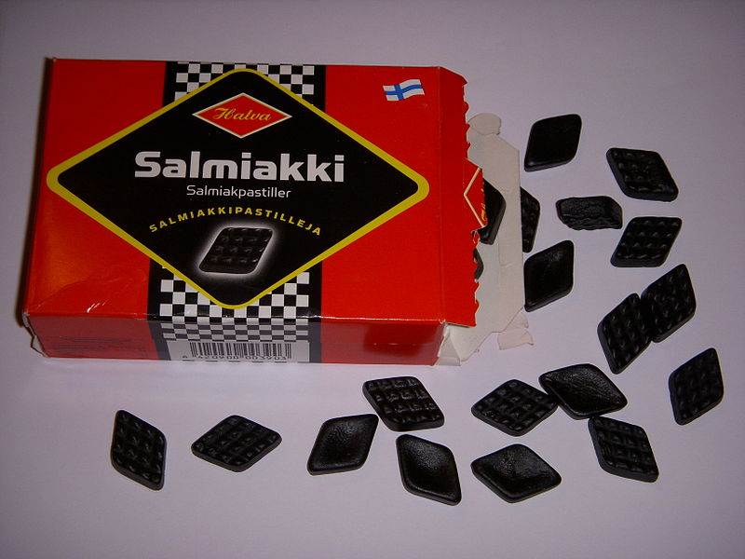
Important to us Finns
Hockey
Sauna
Nokia -> Angry
Birds
Rye bread
Salmiak

