Slide 1
Artikkelit erisnimien kanssa
– Henkilönimet
– More advanced
New Insights
Module 3 Grammar

Slide 2
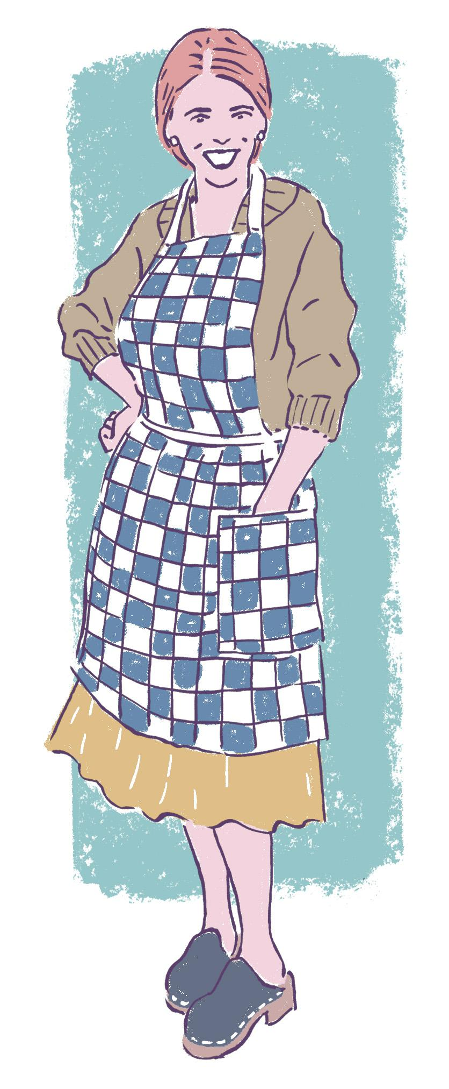
Henkilönimet
Perustapaus:
Ann was known as Ms Cooper at school.
Yleensä henkilönimen kanssa ei artikkelia.
The Hendersons were there with us.
The Rolling Stones rivalled the Beatles in the 1960s.
Monikolliset nimet: the

Slide 3
Henkilönimet
Queen Elizabeth was known as the Maiden Queen in the 1500s.
Has the Pope ever visited Finland?
Arvonimi on nimen yhteydessä: ei artikkelia
Arvonimi on ilman nimeä: the
The physicist Richard Feynman isn’t as well-known as he should be.
Tavallinen ammatti nimen yhteydessä: the

Slide 4
Henkilönimet
I got a personal response from Stephen King!
You mean the Stephen King?
Nimeä painotetaan (juuri se kuuluisa): the
There’s a Mr John Smythe to see you, sir.
Joku, eräs: a/an
A new Rembrandt was found.
Taiteilijan teokseen tai tuotteeseen viitataan tekijän nimellä: a/an

Slide 5
Practise. Add an article if needed.
___ Matilda was ___ former pupil of ___ Ms Muffet.
___ Browns were sure ___ Barry would succeed.
___ lecturer ___ Bob Singh was widely admired.
___ President Johnson did not seek re-election.
___ President gave a rousing speech at the convention.
If I win in the lottery, I’ll buy ___ Bugatti.
The most stylish car is ___ Bugatti.

Slide 6
Practise. Add an article if needed.
_ -_ Matilda was _A_ former pupil of _-_ Ms Muffet.
_ THE_ Browns were sure _-_ Barry would succeed.
_ THE_ lecturer _-_ Bob Singh was widely admired.
_ -_ President Johnson did not seek re-election.
_ THE_ President gave a rousing speech at the convention.
If I win in the lottery, I’ll buy _A_ Bugatti.
The most stylish car is _-_ Bugatti.
___ Matilda was ___ former pupil of ___ Ms Muffet.
___ Browns were sure ___ Barry would succeed.
___ lecturer ___ Bob Singh was widely admired.
___ President Johnson did not seek re-election.
___ President gave a rousing speech at the convention.
If I win in the lottery, I’ll buy ___ Bugatti.
The most stylish car is ___ Bugatti.

