Slide 1


Christmas in the Netherlands.
Together with the children we have discussed how we can show you how we celebrate Christmas in the Netherlands.
We do this by: Pictures of activities at school and at home.

Slide 2

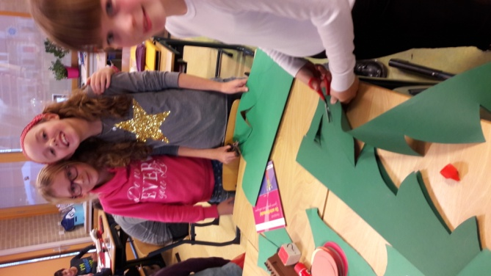
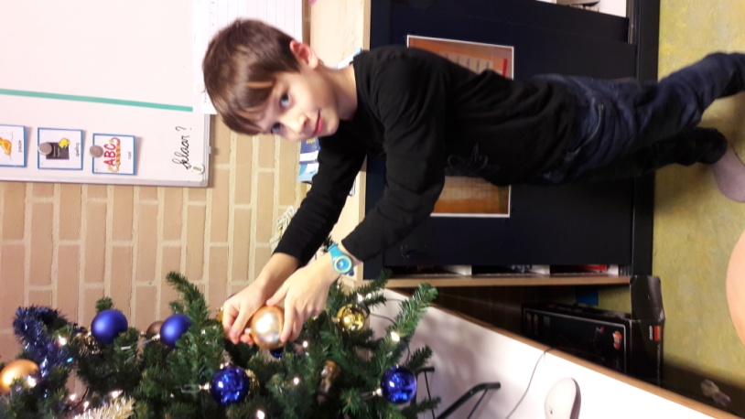
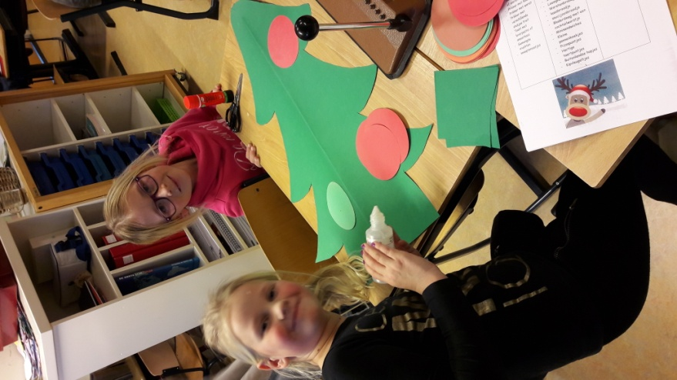

Christmas crafts and decorating school

Slide 3
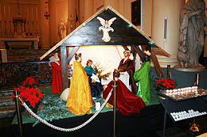
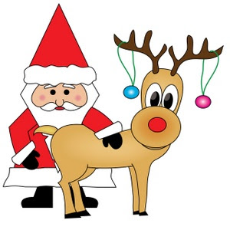
Christmas celebration on school
In the last week before the Christmas holidays we eat with all the kids at school. Everyone does something nice for Christmas dinner. And everyone dressed themselves beautiful.
All children participate in a Christmas play and we will sing carols for the parents.
Jingle bells
Rudolf the red nosed
reindeer

Slide 4

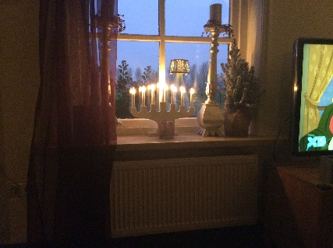
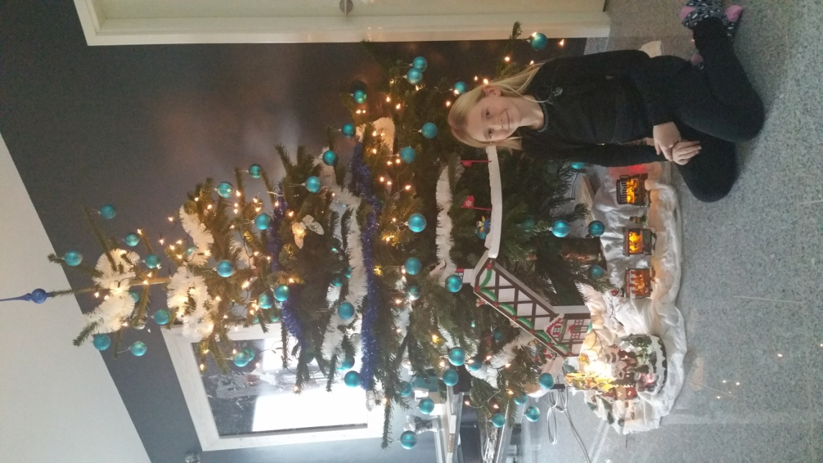
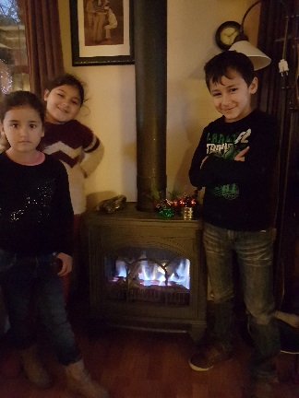
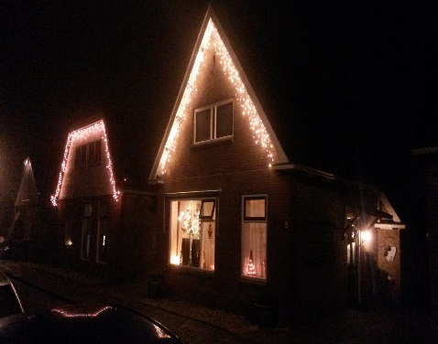
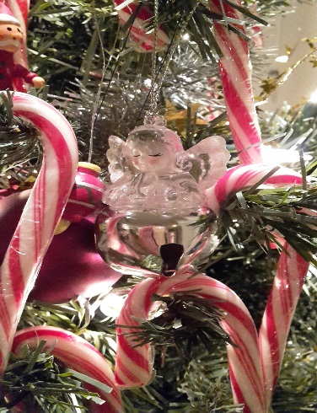
Christmas celebration with the children at home
This is with the kids at home. They decorate the Christmas tree.
Together with family and friends is important during Christmas. We eat together, play games or go to church.

Slide 5
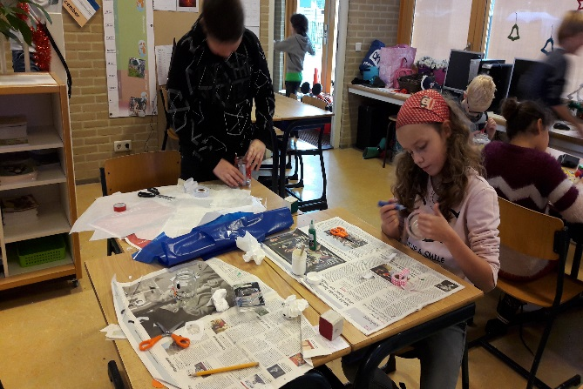
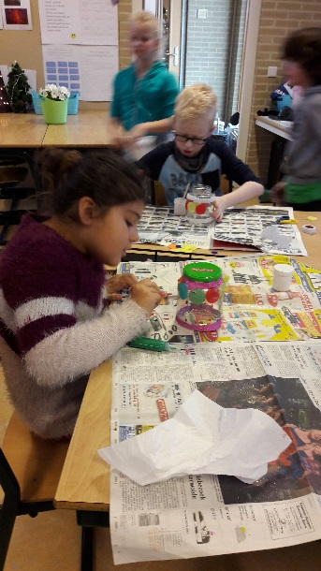
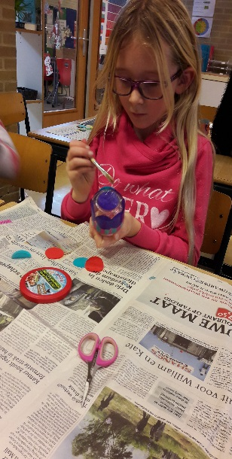
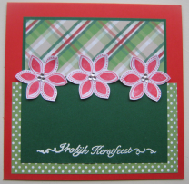
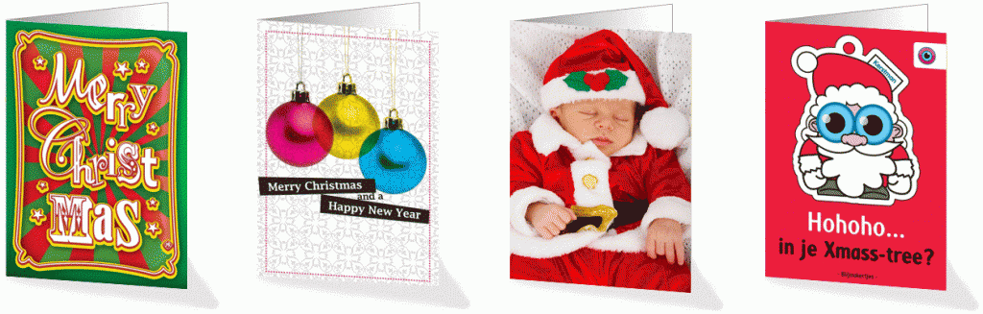
We make our own Christmas lights for Christmas dinner
Create Cards and Send is also tradition in the Netherlands

Slide 6


o.b.s De Oanset wishes everyone a Merry Christmas and a Happy new year

