Slide 1
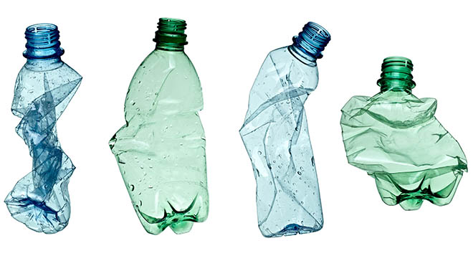
Finnish bottle recycling system

Slide 2
Recycling of plastic bottles and cans in Finland
Recycling of bottles and cans reduces consumption of raw materials and littering.
In Finland, about 40 cans (of aluminum), 13 plastic bottles, 3 glass bottles and 3 refillable glass bottles is returned every second.
Most of beverage packaging materials returns in to use as new packages. Materials used here are glass, polyethyleneterephthalate (plastic) and aluminum alloy. At the moment glass is the only material out of these that can be recycled without its quality being weakened.
In Finland about 97% out of all cans, 92% out of plastic bottles, 89% out of glass bottles and 97% out of refillable glass bottles are recycled.

Slide 3
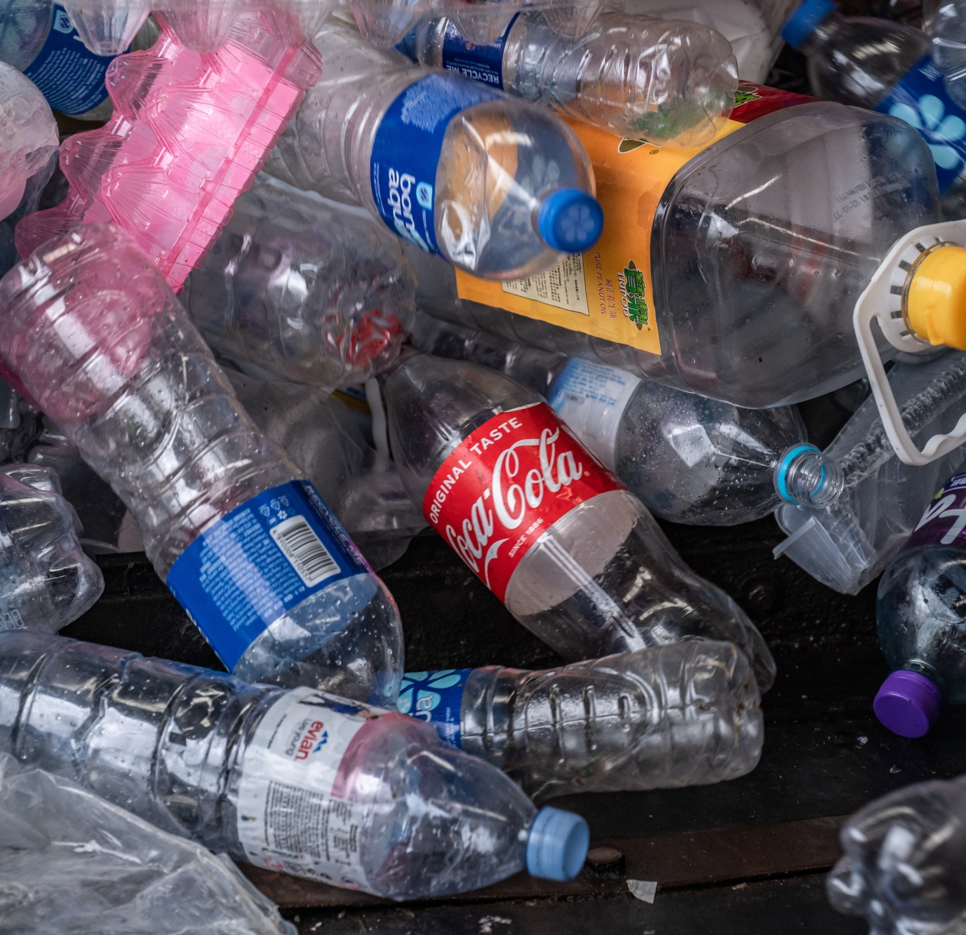
Bottle deposit
There is a container-return machine in almost every grocery store in Finland (almost 5000 container-return machines across Finland)
While returning bottles and cans customer gets a receipt. In the receipt customer can find the amount of money gotten from the deposit.
By showing the receipt to the cashier customer gets the deposit back.
Bottles of different sizes have different deposit amounts.
Usually bottle deposit is 10-40 cents.
With the deposit the customer gets back a small part of the prize they have paid for the product.
Almost all bottles and cans have deposit in Finland.
Palpa maintains the pant system. It is non-profit company.

Slide 4
European Union will possibly be changing the pant system
Even though most of the plastic bottles are recyclable in Europe almost all of them will end up in landfill sites. European union is planning to set a law which purpose is to make 10% of plastic bottles reuseable by 2030.
Eu´s target is also make plastic bottles contain 15% recycled plastic by 2025.
The current plastic bottles in Finland can not be washed. Following the new law would mean that Finnish recycling system needs to change.
The current Finlands plastic bottle recycling is based on the recycling of material, where plastic bottles, aluminium cans and glass bottles are collected and delivered as material for new products. This will maybe be changed in the future: bottles will be washed instead of being recycled. Making this new system work will take a lot of effort and money.

Slide 5
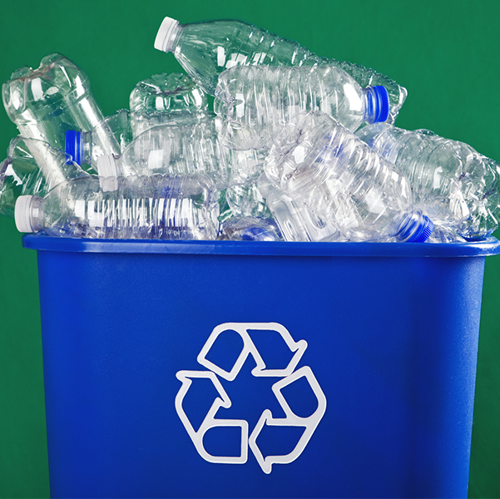
Video
https://youtu.be/dnrxNN0k-Hs

