Slide 1
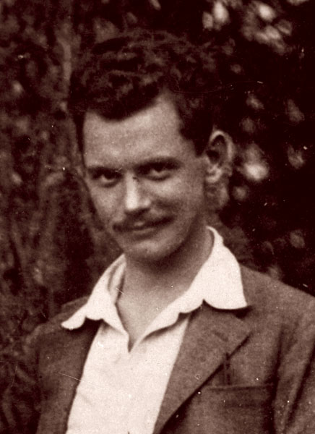
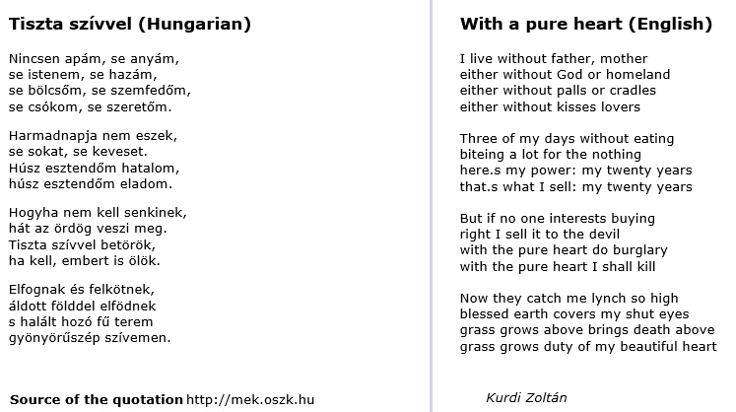
11th of April
Attila József
www.babelmatrix.org

Slide 2
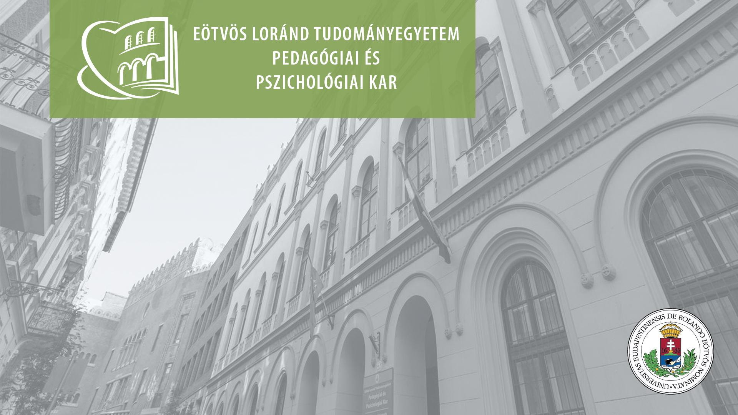



Learning initiatives for different communities – seeking success?
Orsolya Kálmán – Erika Kopp
EÖTVÖS LORÁND UNIVERSITY FACULTY OF EDUCATION AND PSYCHOLOGY

Slide 3
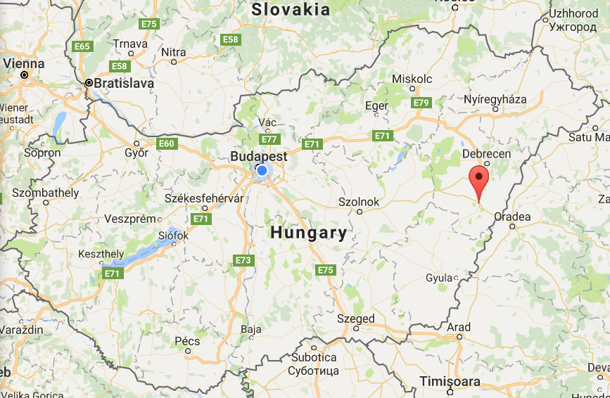
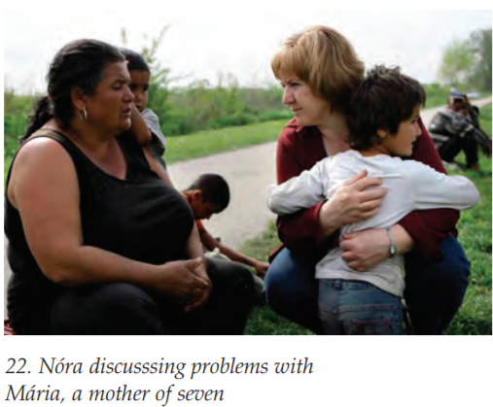
A Hungarian Initiative: Real Pearl Foundation
Established in 1999 by Nóra Ritók
one of the poorest area in Hungary
in the village of Berettyóújfalu and five other locations

Slide 4
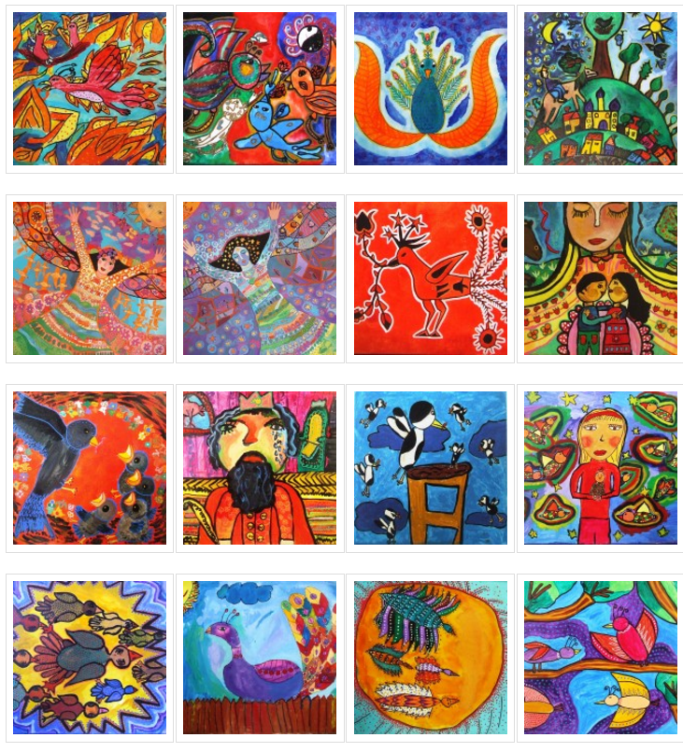
Real Pearl Foundation
Art School
Focusing on visual communication, self-development, social skills
After School Activities Programme (Told)
Mentoring, individual development plans, community events
Some facts
Subsidised by donations and by the state
670 children from 23 villages, 35-40 participants in Told
70% of whom are underprivileged
250 live in deep poverty
Most coming from roma families
Working with children, families, whole community

Slide 5
Teachers’ competences
skills
attitudes
knowledge
As goals for (student) teachers’ development
(Partly) visible
Aspects of self-evaluation and evaluation
Initiating communication, negotiation about teachers’ work
Autonomy and responsibility

Slide 6
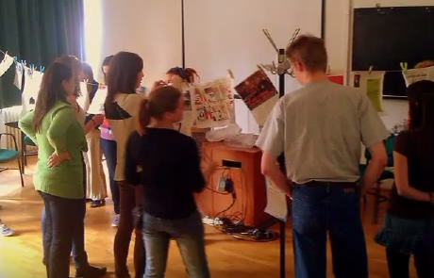
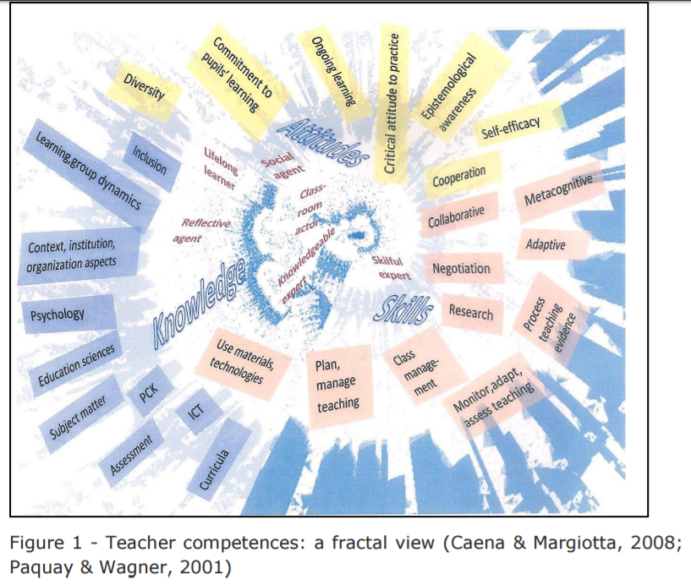
Examples of Teachers’ competences
The teacher is able to elaborate an individual development plan or a learning contract together with the pupil.
The teacher is familiar with the different types of individual plans.
The teacher is committed to build upon pupils’ own learning goals.

Slide 7
Watching the videos and Group task
1. Please watch the two videos about the Real Pearl Foundation!
https://www.youtube.com/watch?v=52MSYbJQMtU&feature=youtu.be
https://www.youtube.com/watch?v=4AmFRlWVeAU
2.a. Please identify those teacher’s competences that you find important for working in a multicultural school setting! Think about your competencies, what are the strong ones and what are those that need to be developed?
Please think also about the different components of teacher’s competences!
2.b. Think about the various ways how you can develop further these competences?
Notes:
https://www.youtube.com/watch?v=52MSYbJQMtU&feature=youtu.be
https://www.youtube.com/watch?v=G-E2PYmtrq0&feature=youtu.be
https://www.youtube.com/watch?v=4AmFRlWVeAU
Ritók, N. L. and Bodoczky, I. (2012), ‘The positive influence of art activities on poor communities’, International Journal of Education through Art 8: 3, pp. 329–336, doi: 10.1386/eta.8.3.329_7

Slide 8
Sources
Ritók, N. L. and Bodoczky, I. (2012), ‘The positive influence of art activities on poor communities’, International Journal of Education through Art 8: 3, pp. 329–336, doi: 10.1386/eta.8.3.329_7
https://www.youtube.com/watch?v=52MSYbJQMtU&feature=youtu.be
https://www.youtube.com/watch?v=G-E2PYmtrq0&feature=youtu.be
https://www.youtube.com/watch?v=4AmFRlWVeAU
European Commission (2013): Supporting teacher competence development for better learning outcomes. Education and Training. http://ec.europa.eu/dgs/education_culture/repository/education/policy/school/doc/teachercomp_en.pdf

Slide 9
Thank you for your attention!
EÖTVÖS LORÁND UNIVERSITY FACULTY OF EDUCATION AND PSYCHOLOGY

