Slide 1
Amerikan korkeakulttuurit
Olmeekit, mayat, inkat ja atsteekit

Slide 2
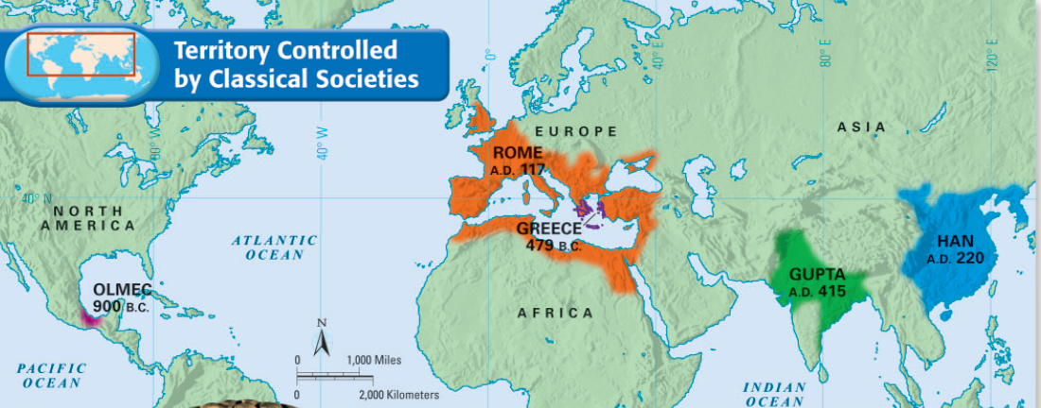
Muinaiset korkeakulttuurit
Näistä eristyksissä kehittyivät Amerikan korkeakulttuurit noin 2000 eaa.
Ensimmäiset korkeakulttuurit kehittyivät Mesopotamiassa ja Aasiassa noin 4000 eaa.

Slide 3
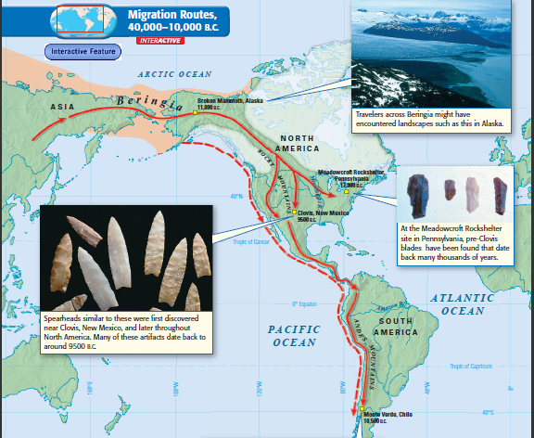
Title
Keräily- ja pyyntiheimot vaelsivat etsien alueita, joissa olisi riistaa ja kasveja. Amerikkaan kehittyi erilaisia kulttuureja.
Text
Ensimmäiset asukkaat tulivat Amerikkaan viimeisen jäkauden aikana.

Slide 4
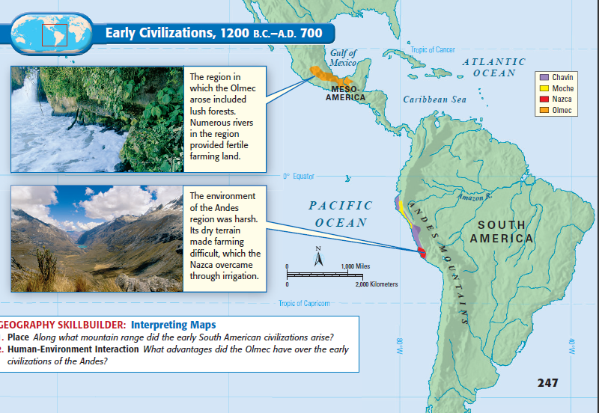
The Olmecs
Olmeekit ovat antaneet runsaasti vaikutteita alueen myöhemmille korkeakulttuureille.
Olmeekit kehittivät Amerikan ensimmäisen korkeakulttuurin
(1200 eaa. – 400 eaa)
Notes:
The Olmec
Mesoamerica’s first known civilization builders were a people known as the Olmec. They began carving out a society around 1200 B.C. in the jungles of southern Mexico. The Olmec influenced neighboring groups, as well as the later civilizations of the region. They often are called Mesoamerica’s “mother culture.”
The Rise of Olmec Civilization
Around 1860, a worker clearing a field in the hot coastal plain of southeastern Mexico uncovered an extraordinary stone sculpture. It stood five feet tall and weighed an estimated eight tons. The sculpture was of an enormous head, wearing a headpiece. (See History Through Art, pages 244–245.) The head was carved in a strikingly realistic style, with thick lips, a flat nose, and large oval eyes. Archaeologists had never seen anything like it in the Americas. This head, along with others that were discovered later, was a remnant of the Olmec civilization. The Olmec emerged about 1200 B.C. and thrived from approximately 800–400 B.C. They lived along the Gulf Coast of Mexico, in the modern-day Mexican states of Veracruz and Tabasco.
Gulf Coast Geography
On the surface, the Gulf Coast seemed an unlikely site for a high culture to take root. The region was hot and humid and covered with swamps and jungle. In some places, giant trees formed a thick cover that prevented most sunlight from reaching the ground. Up to 100 inches of rain fell every year. The rainfall swelled rivers and caused severe flooding. However, the region also had certain advantages. There were abundant deposits of salt and tar, as well as fine clay used in making pottery. There was also wood and rubber from the rain forest. The hills to the north provided hard stone from which the Olmec could make tools and monuments. The rivers that laced the region provided a means of transport. Most important, the flood plains of these rivers provided fertile land for farming. The Olmec used their resources to build thriving communities. The oldest site, San Lorenzo, dates back to around 1150 B.C. Here archaeologists uncovered important clues that offered a glimpse into the Olmec world. Olmec Society At San Lorenzo archaeologists discovered earthen mounds, courtyards, and pyramids. Set among these earthworks were large stone monuments. They included columns, altars, and more colossal, sculpted heads, which may have represented particular Olmec rulers. These giant monuments weigh as much as 44 tons. Some scholars think that Olmec workers may have moved these sculptures over land on rolling logs to the river banks. From there, they may have rafted the monuments along waterways to various sites. To the east of San Lorenzo, another significant Olmec site, La Venta, rose around 900 B.C. Here, researchers discovered a 100-foot-high mound of earth and clay. This structure may have served as the tomb of a great Olmec ruler. Known as the Great Pyramid, the mound also may have been the center of the Olmec religion. Experts believe the Olmec prayed to a variety of nature gods. Most of all, they probably worshiped the jaguar spirit. Numerous Olmec sculptures and carvings depict a half-human, half-jaguar creature. Some scholars believe that the jaguar represented a powerful rain god. Others contend that there were several jaguar gods, representing the earth, fertility, and maize.
Trade and Commerce
Archaeologists once believed that sites such as La Venta were ceremonial centers where important rituals were performed but few people lived. In recent years, however, experts have begun to revise that view. The Olmec appear to have been a prosperous people who directed a large trading network throughout Mesoamerica. Olmec goods traveled as far as Mexico City to the north and Honduras to the south. In addition, raw materials—including iron ore and various stones—reached San Lorenzo from faraway regions. This trade network helped boost the Olmec economy and spread Olmec influence.
Decline of the Olmec
For reasons that are not fully understood, Olmec civilization eventually collapsed. Scholars believe San Lorenzo was destroyed around 900 B.C. La Venta may have fallen sometime around 400 B.C. Some experts speculate that outside invaders caused the destruction. Others believe the Olmec may have destroyed their own monuments upon the death of their rulers.
The Early Mesoamericans’ Legacy Although both the Zapotec and Olmec civilizations eventually collapsed, each culture influenced the Mesoamerican civilizations that followed.
The Olmec Leave Their Mark
The Olmec contributed much to later Mesoamerican civilizations. They influenced the powerful Maya, who will be discussed in Chapter 16. Olmec art styles, especially the use of the jaguar motif, can be seen in the pottery and sculpture of later peoples in the region. In addition, future Mesoamerican societies copied the Olmec pattern of urban design. The Olmec also left behind the notions of planned ceremonial centers, ritual ball games, and an elite ruling class. And while there is no clear evidence that the Olmec used a written language, their descendants or a related people carved out stone symbols that may have influenced later glyph writing.
Zapotec Contributions
The Zapotec left behind their own legacy. It included a hieroglyphic writing system and a calendar system based on the movement of the sun. In addition, the Zapotec are noted as the Americas’ first city builders. Monte Albán combined ceremonial grandeur with residential living space. This style influenced the development of future urban centers and became a hallmark of Mesoamerican civilizations.
As the Zapotec and Olmec flourished and then declined, civilizations were also taking shape in South America. Along the rough and mountainous terrain in what is now Peru, ancient peoples came together. There, they created more advanced and complex societies.
4

Slide 5
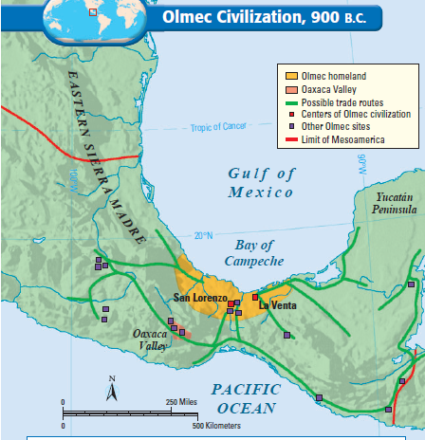
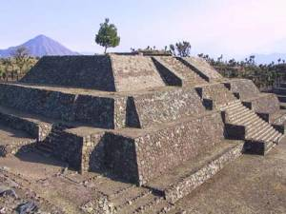
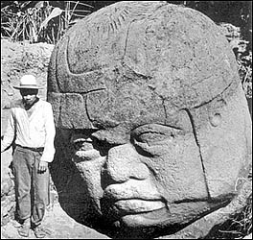
The Olmecs
Olmeekkien sivistynyt kulttuuri poikkesi ympäröivistä yksinkertaisista heimokulttuureista
He hallitsivat ajanlaskun, olivat taitavia kivenkäsittelijöitä ja rakensivat suuria monumentteja.
Olmeekkien kaupankäynti toi vaurautta ja levitti heidän kulttuuriaan laajalle alueelle.
Olmeekkikulttuurin tuhon n. 400 eaa. on arveltu johtuneen jokien uomien luontaisesta vaihtelusta, merenpinnan noususta ja tulivuorenpurkauksista.
Notes:
The Olmec--Mesoamerica’s first known civilization builders were a people known as the Olmec. They began carving out a society around 1200 B.C. in the jungles of southern Mexico. The Olmec influenced neighboring groups, as well as the later civilizations of the region. They often are called Mesoamerica’s “mother culture.”
The Rise of Olmec Civilization--Around 1860, a worker clearing a field in the hot coastal plain of southeastern Mexico uncovered an extraordinary stone sculpture. It stood five feet tall and weighed an estimated eight tons. The sculpture was of an enormous head, wearing a headpiece. (See History Through Art, pages 244–245.) The head was carved in a strikingly realistic style, with thick lips, a flat nose, and large oval eyes. Archaeologists had never seen anything like it in the Americas. This head, along with others that were discovered later, was a remnant of the Olmec civilization. The Olmec emerged about 1200 B.C. and thrived from approximately 800–400 B.C. They lived along the Gulf Coast of Mexico, in the modern-day Mexican states of Veracruz and Tabasco.
Gulf Coast Geography --On the surface, the Gulf Coast seemed an unlikely site for a high culture to take root. The region was hot and humid and covered with swamps and jungle. In some places, giant trees formed a thick cover that prevented most sunlight from reaching the ground. Up to 100 inches of rain fell every year. The rainfall swelled rivers and caused severe flooding. However, the region also had certain advantages. There were abundant deposits of salt and tar, as well as fine clay used in making pottery. There was also wood and rubber from the rain forest. The hills to the north provided hard stone from which the Olmec could make tools and monuments. The rivers that laced the region provided a means of transport. Most important, the flood plains of these rivers provided fertile land for farming. The Olmec used their resources to build thriving communities. The oldest site, San Lorenzo, dates back to around 1150 B.C. Here archaeologists uncovered important clues that offered a glimpse into the Olmec world. At San Lorenzo, archaeologists discovered earthen mounds, courtyards, and pyramids. Set among these earthworks were large stone monuments. They included columns, altars, and more colossal, sculpted heads, which may have represented particular Olmec rulers. These giant monuments weigh as much as 44 tons. Some scholars think that Olmec workers may have moved these sculptures over land on rolling logs to the river banks. From there, they may have rafted the monuments along waterways to various sites. To the east of San Lorenzo, another significant Olmec site, La Venta, rose around 900 B.C. Here, researchers discovered a 100-foot-high mound of earth and clay. This structure may have served as the tomb of a great Olmec ruler. Known as the Great Pyramid, the mound also may have been the center of the Olmec religion. Experts believe the Olmec prayed to a variety of nature gods. Most of all, they probably worshiped the jaguar spirit. Numerous Olmec sculptures and carvings depict a half-human, half-jaguar creature. Some scholars believe that the jaguar represented a powerful rain god. Others contend that there were several jaguar gods, representing the earth, fertility, and maize.
Trade and Commerce
Archaeologists once believed that sites such as La Venta were ceremonial centers where important rituals were performed but few people lived. In recent years, however, experts have begun to revise that view. The Olmec appear to have been a prosperous people who directed a large trading network throughout Mesoamerica. Olmec goods traveled as far as Mexico City to the north and Honduras to the south. In addition, raw materials—including iron ore and various stones—reached San Lorenzo from faraway regions. This trade network helped boost the Olmec economy and spread Olmec influence.
Decline of the Olmec
For reasons that are not fully understood, Olmec civilization eventually collapsed. Scholars believe San Lorenzo was destroyed around 900 B.C. La Venta may have fallen sometime around 400 B.C. Some experts speculate that outside invaders caused the destruction. Others believe the Olmec may have destroyed their own monuments upon the death of their rulers.
The Olmec contributed much to later Mesoamerican civilizations. They influenced the powerful Maya, who will be discussed in Chapter 16. Olmec art styles, especially the use of the jaguar motif, can be seen in the pottery and sculpture of later peoples in the region. In addition, future Mesoamerican societies copied the Olmec pattern of urban design. The Olmec also left behind the notions of planned ceremonial centers, ritual ball games, and an elite ruling class. And while there is no clear evidence that the Olmec used a written language, their descendants or a related people carved out stone symbols that may have influenced later glyph writing.
The Zapotec left behind their own legacy. It included a hieroglyphic writing system and a calendar system based on the movement of the sun. In addition, the Zapotec are noted as the Americas’ first city builders. Monte Albán combined ceremonial grandeur with residential living space. This style influenced the development of future urban centers and became a hallmark of Mesoamerican civilizations. As the Zapotec and Olmec flourished and then declined, civilizations were also taking shape in South America. Along the rough and mountainous terrain in what is now Peru, ancient peoples came together. There, they created more advanced and complex societies.
5

Slide 6
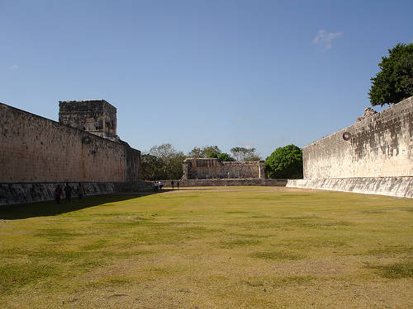
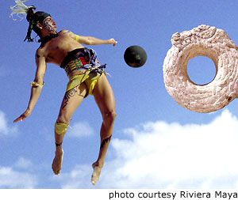

Slide 7
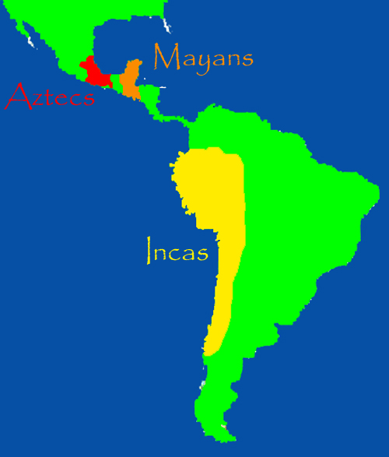
MAYAT
ATSTEEKIT
INKAT

Slide 8
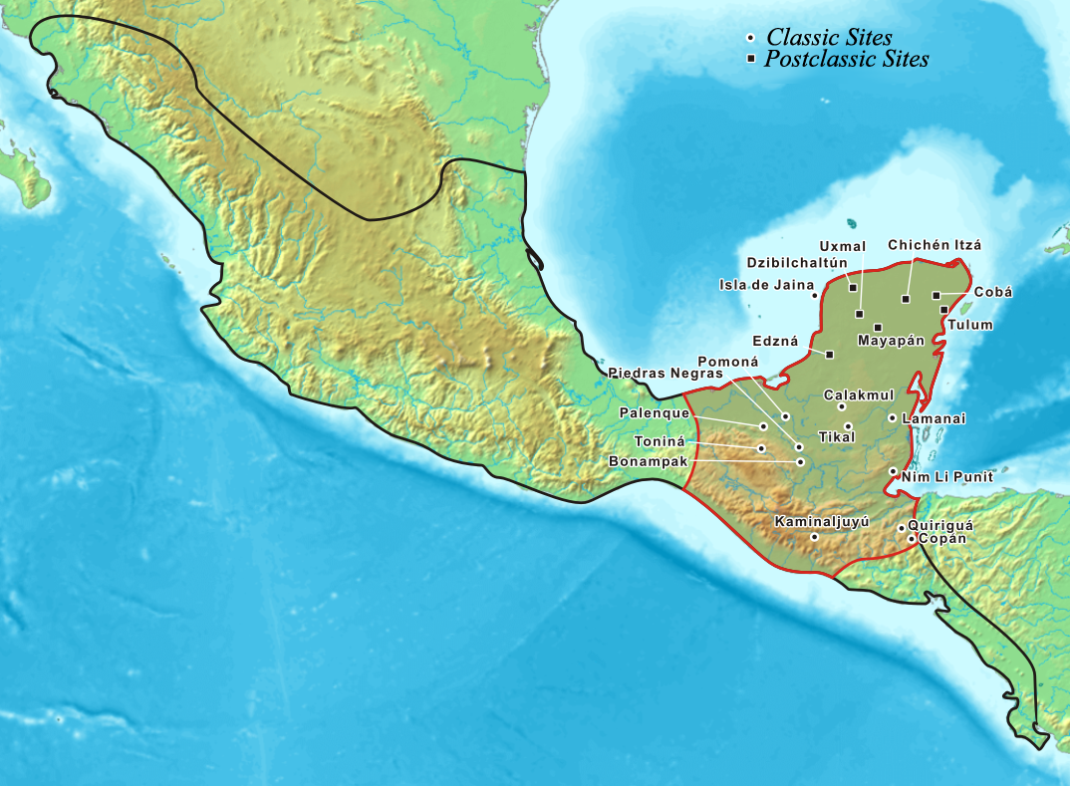
Mayat
Väli-amerikan kehittynein kulttuuri oli mayoilla n. 400 eaa. – 300 jaa.
Mayojen kulttuuri tunnetaan erityisesti mahtavista rauniokaupungeista. Mayojen taide oli korkeatasoista, heillä oli oma kirjoitusjärjestelmänsä ja he laativat tarkkoja kalentereita.

Slide 9
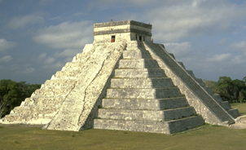
Mayatemppeli
Mayakaupungin keskeisin rakennus oli korkea pyramidimainen mayatemppeli, jonka huipulla suoritettiin uskonnollisia rituaaleja.

Slide 10
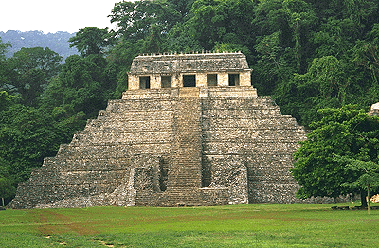

Slide 11
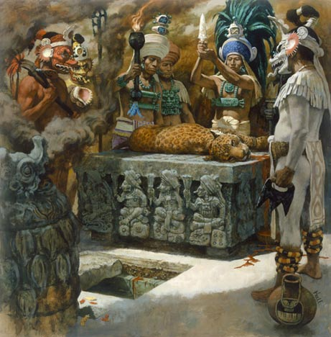
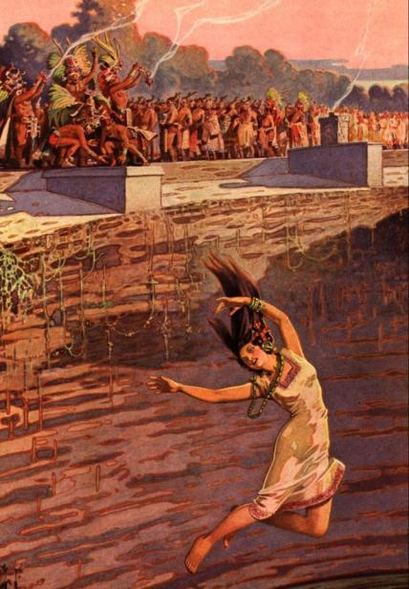
Mayoen uskonnolliset rituaalit
Uskonto: Mayat olivat polyteistisiä. He uhrasivat verta, ruokaa ja ihmisuhreja miellyttääkseen jumaliaan.

Slide 12
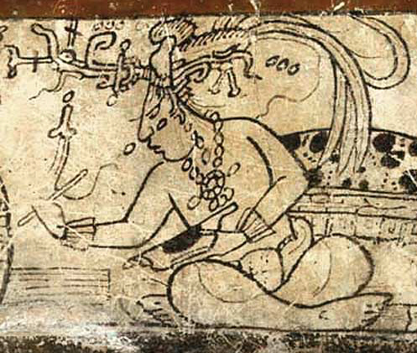

Slide 13
Mayojen saavutuksia
  Olivat erinomaisia matematiikassa ja keksivät nollan käytön ennen muita
  Laskivat tarkasti planeettojen ratoja ja merkitsivät muistiin havaintojaan
  Loivat tarkan kalenterin, jossa oli 365 päivää.
ompelivat haavoja hiuksilla ja ­valmistivat toimivia hammas-, jalka- ja käsiproteeseja.

Slide 14
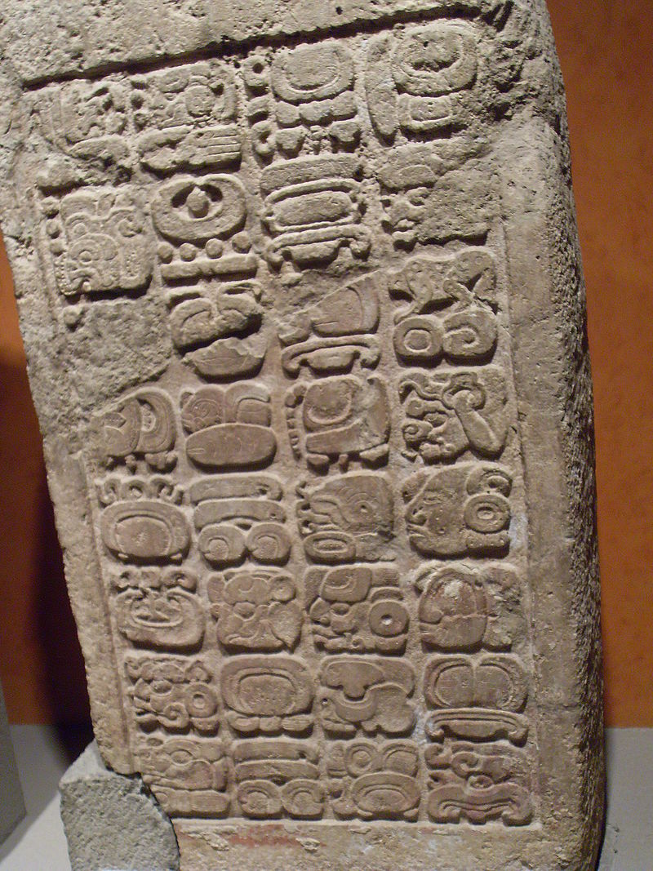
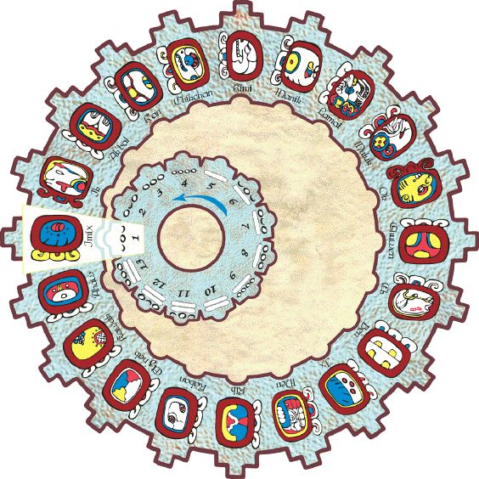

Slide 15
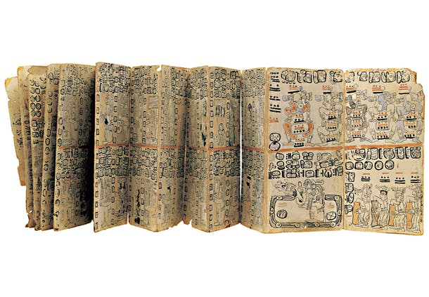

Slide 16
MAYAT
ATSTEEKIT
INKAT

Slide 17
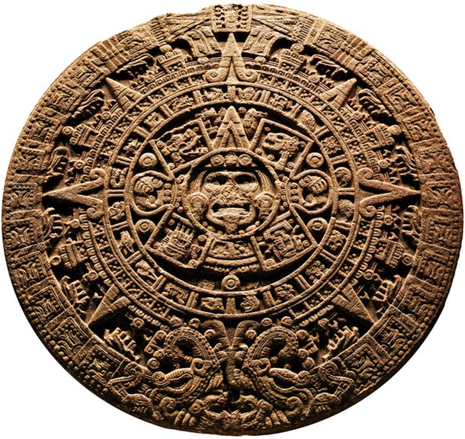

Slide 18
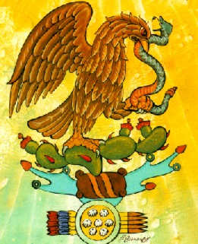

Slide 19
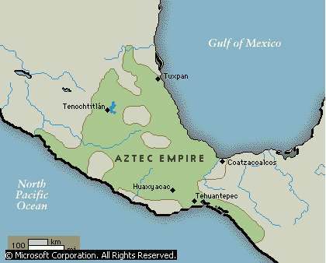
Atsteekkien valtakunta
Atsteekkien korkeakulttuuri vallitsi v.1427 - 1521 (kunnes espanjalaiset valloittajat tuhosivat sen.)
Pääkaupunki Tenochtitlán (Mexico City)

Slide 20
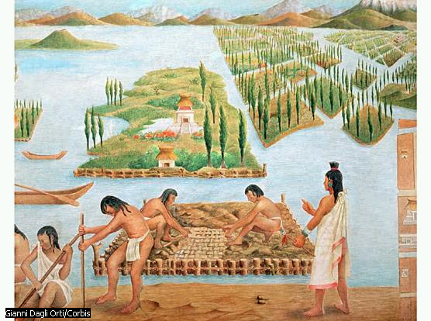
Notes:
Trade—Pottery, tools, jewelry, figurines, baskets, and cloth were produced for the ruler or sold in the local markets.
Prized luxury items (lake salt, gold ornaments, and rich garments) were traded to distant peoples along the Gulf coast and south toward what is now Guatemala. They received: luxury items such as tropical-bird feathers, jaguar skins, cotton, rubber, and cacao beans for chocolate.
The Aztec had no wheeled vehicles or draft animals, so trading goods were carried by canoe or on the backs of porters, who marched in long caravans led by merchants. In dangerous areas, Aztec warriors would protect the caravans. Merchants would often act as spies for the empire when trading in towns that had not been conquered by the Aztec.
"Aztec Empire," Microsoft® Encarta® Encyclopedia 2000. © 1993-1999 Microsoft Corporation. All rights reserved.

Slide 21
Herkkuhetkiä
valmistivat sapotillapuun mahlasta puru­kumia, jolla he puhdistivat hampaansa.
pitivät kaakaopavuista ja ­valmistivat niistä veteen sekoitettua kaakaota
tykkäsivät Popcornista – asteekit rakastivat paukkumaissa, jota he valmistivat avotulella. Paahdettuja maissinjyviä myös uhrattiin jumalille.

Slide 22
Ihmisverta ja temppeleitä
Atsteekit uskoivat, että höyrystetty ihmisveri pitää auringon liikkeessä. Pelottavan auringonpimennyksen torjumiseksi he uhrasivat ihmisiä uhrialttarilla
Sateenjumalalle ihminen uhrattiin heittämällä hänet korkealta jyrkänteeltä veteen
Notes:
As the Mexica grew in number, they established superior military and civil organizations. Gradually, they revolted against the Tepanec and won control of some territory on the mainland. In about 1427 the Mexica of Tenochtitlán formed a triple alliance with the city-states of Texcoco and Tlacopan (now Tacuba). Under the Mexica ruler Itzcoatl, his successor Montezuma I, and the Texcocan ruler Netzahualcóyotl, the three states began a series of conquests. They eventually established an empire that extended from central Mexico to the Guatemalan border and included many different states and ethnic groups, who were forced to pay tribute to the alliance. Tenochtitlán became the dominant power within the alliance.
"Aztec Empire," Microsoft® Encarta® Encyclopedia 2000. © 1993-1999 Microsoft Corporation. All rights reserved.
a highly developed civilization. A fertile basin, the valley was located 2400 m (7800 ft) above sea level. In its center lay five interconnected lakes dotted with marshy islands. From about AD 100 to 650 the valley was dominated by the city of Teotihuacán, center of a powerful religious, economic, and political state.
After the decline of Teotihuacán, the Toltec people migrated into central Mexico from the north and established a conquest state there. The Toltec civilization reached its height in the 10th and 11th centuries. In the 13th century wandering bands of Nahuatl-speaking warriors, often called Chichimec, invaded the valley. They took over Toltec cities, such as Atzcapotzalco, and founded new ones, such as Texcoco de Mora. The Chichimec combined their own culturaltraditions with those of the Toltec to form the early Aztec civilization, whose social structure, economy, and arts would reach their height under the rule of the later empire.
"Aztec Empire," Microsoft® Encarta® Encyclopedia 2000. © 1993-1999 Microsoft Corporation. All rights reserved.

Slide 23
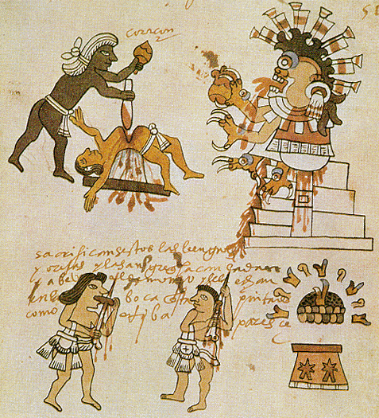

Slide 24
MAYAT
ATSTEEKIT
INKAT

Slide 25
Inkojen valtakunta
Etelä-Amerikan mahtavimmaksi kulttuuriksi nousi inkakulttuuri 1400-luvulla.
Inkat laajensivat valtakuntaa armeijan avulla ja alistivat valloitetut heimot

Slide 26
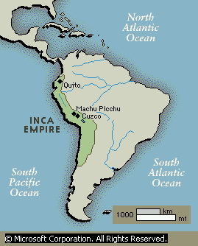
Inkojen valtakunta
Hyvän tieverkoston ansiosta sotilaat voitiin nopeasti siirtää levottomille alueille ja tavaroita saatiin kuljetettua pääkaupunkiin

Slide 27
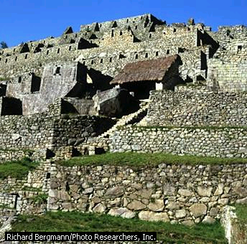
Kuuluisin kaupunki oli Machu Picchu

Slide 28
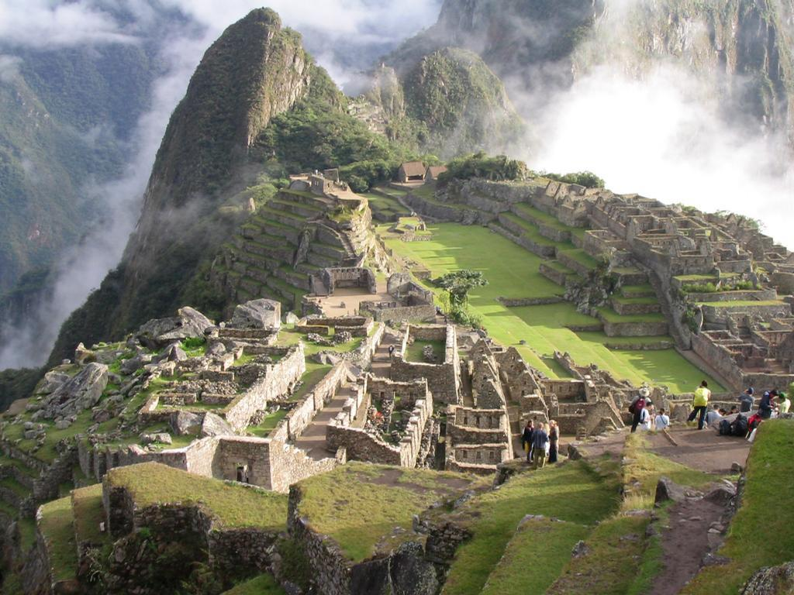

Slide 29
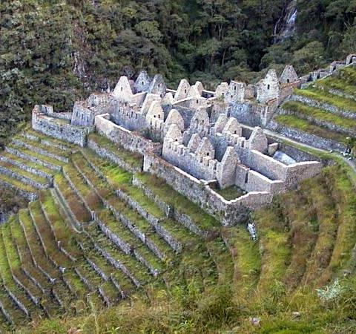
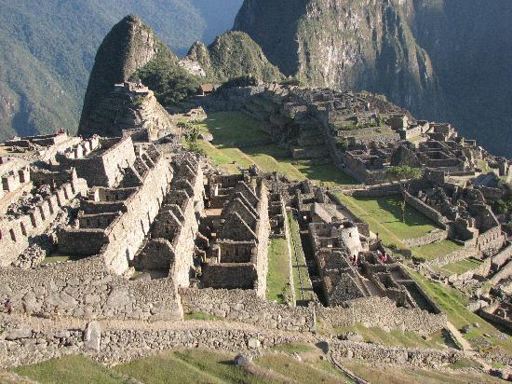
Machu Picchu

Slide 30

Inkojen saavutuksia
Solmunauhat eli khiput olivat inkojen nuorakirjoitusta.
Alkoivat viljellä perunaa.
Inkat rakensivat lähes 40 000 km teitä
Rakensivat kestäviä siltoja
Loistavia kultaseppiä

Slide 31
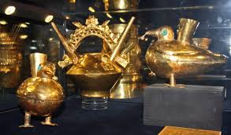

Slide 32
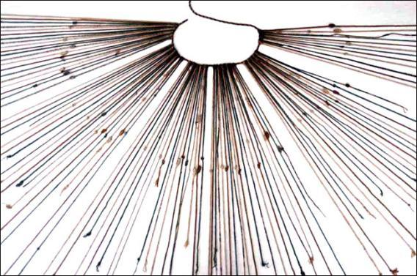
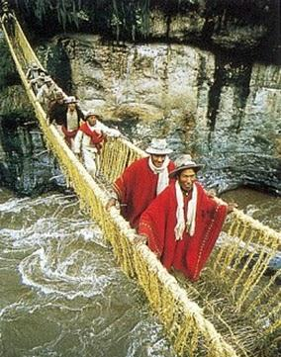
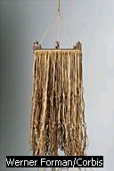

Slide 33

