Slide 1
Pedagogically motivated use of video conferencing in eTwinning
Sari Auramo
eTwinning Ambassador, Finland

Slide 2
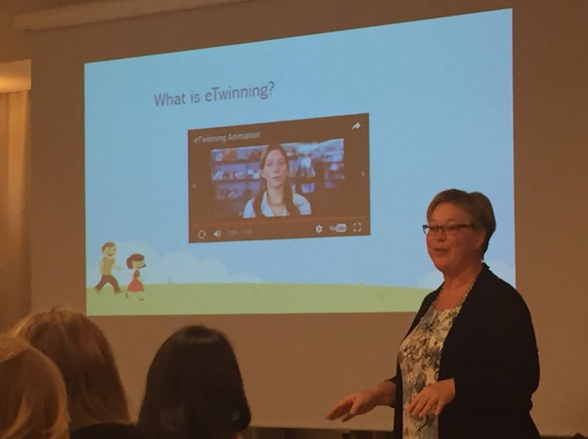
Me?
in eTwinning since 2005
primary school teacher
eTwinning Ambassador since 2007
ICT tutor
over 50 eTwinning projects

Slide 3
My experiences with video conferences
mostly Skype
in many projects
different reasons:
  getting to know each other
  learning languages
  team work in multinational teams
  singing together
  ”party” together

Slide 4
Some examples

Slide 5
Speaking English right away

Slide 6
Speaking English right away!
two classes, Finland and France
children 8-9 years old
just started to study English
a Skype call once a week
everyone talked, taking turns
others listened, doing something quiet
always something interactive

Slide 7
The first call

Slide 8
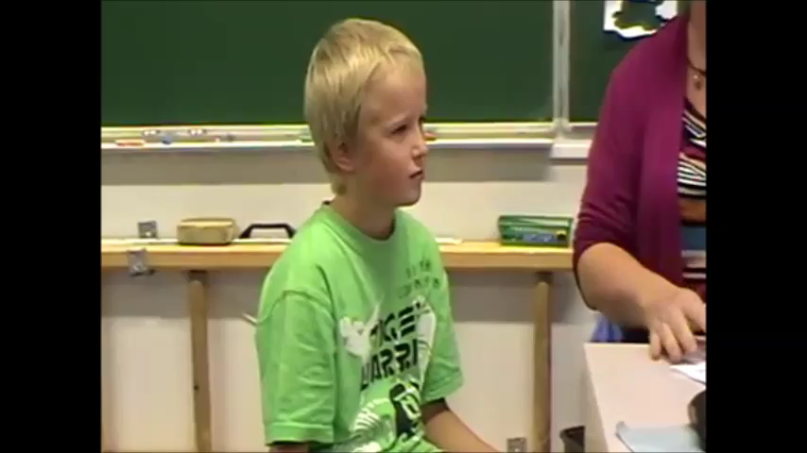
Eetu speaks English… ”How old are you?”

Slide 9
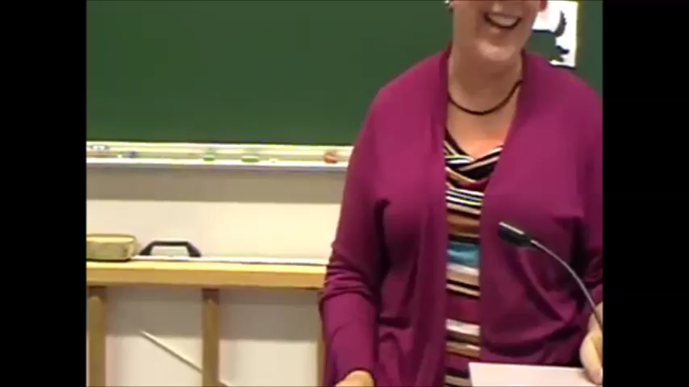
Eemeli’s turn!

Slide 10
The second call

Slide 11
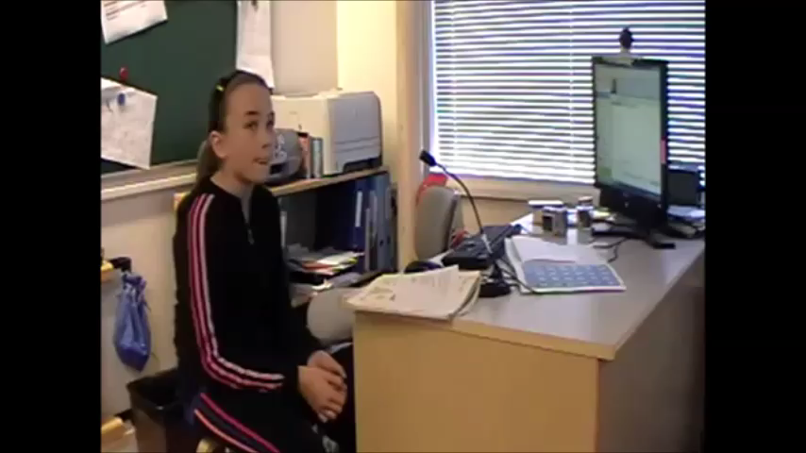
Eve speaks English… ”How many?”

Slide 12
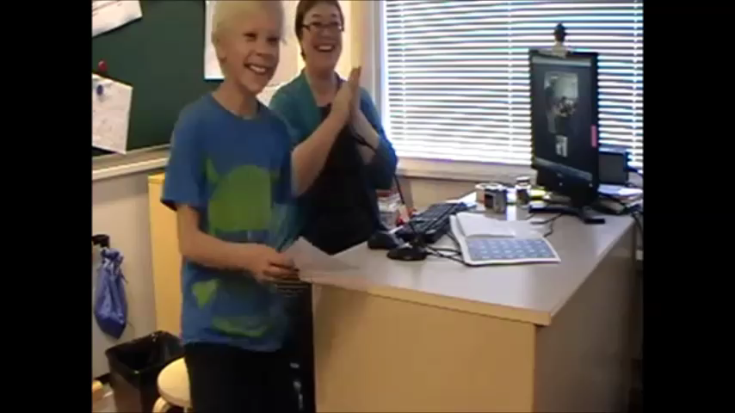
Mikael…

Slide 13
The results
exellent results with learning English
  everyone heard the same sentances many times
real use for a foreign language right away
  you need to speak English to be understood
motivation to learn
  makes more sense to introduce youself to a stranger than you own classmate
courage
  the children are not afraid of using the language in other situations

Slide 14
These videos are in Youtube:
http://bit.ly/TheFirstCall
http://bit.ly/TheSecondCall

Slide 15
Let’s talk and learn English!

Slide 16
Let’s talk and learn English!
Two classes, Finland and Denmark
Children 11-12 years old
2-3 years of English studies
a Skype call twice a week
two pupils from both coutries talked each time
call lasted 15-45 minutes

Slide 17
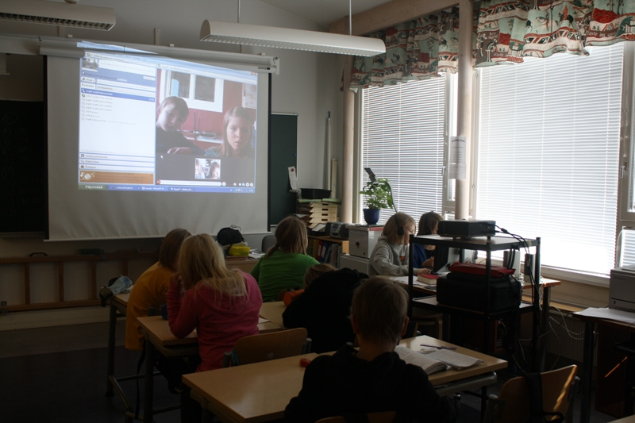

Slide 18
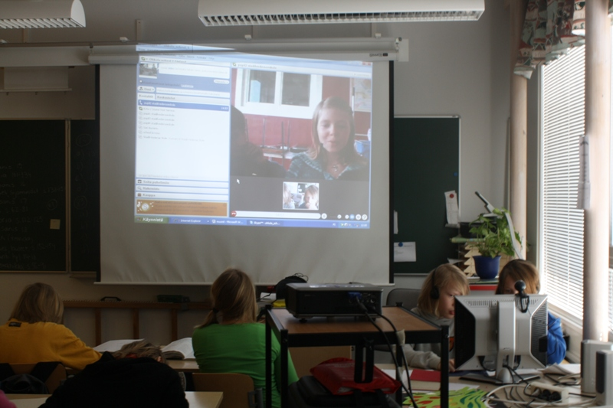

Slide 19
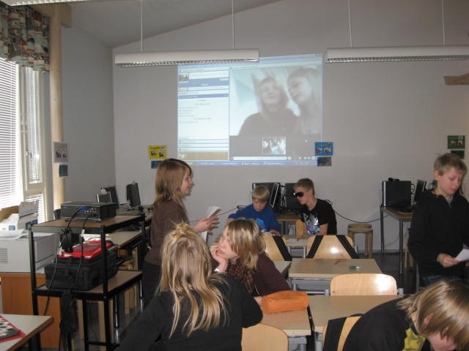

Slide 20
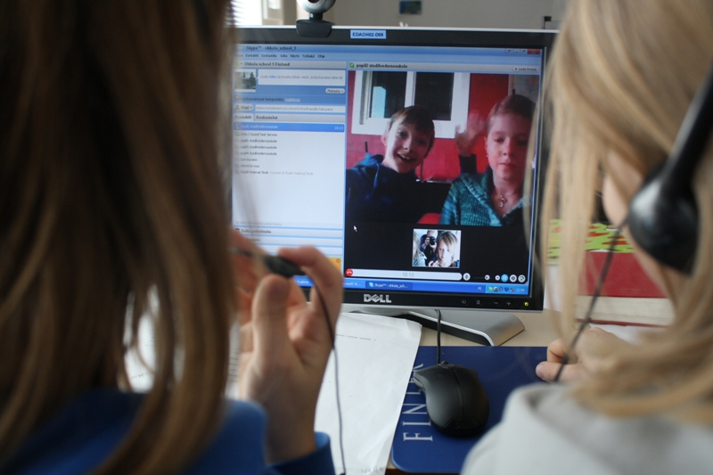

Slide 21
The results
very good results with learning English
motivation to learn
  you spend time learning to say what you want to say
courage to speak English outside the classroom
  ”They understood me! I understood them!”
getting to know kids from another country
  ”They like the same music and sport teams!”

Slide 22
What do I think?
it’s very important to learn to speak the foreign language in real-life situations
it’s often not important if the grammar is absolutely correct
the children get a lot of WOW-moments
  good for their self-esteem
  makes learning fun
  motivates to learn more

Slide 23
Getting closer

Slide 24
Getting closer
two classes, Finland and Spain
children 11-12 years old (5th graders)
multinational teams
5 different Skype accounts (one for each team)
the Finnish and the Spanish half of the team talking and writing to each other about once a month
Skype used also at the beginning and farewell parties

Slide 25
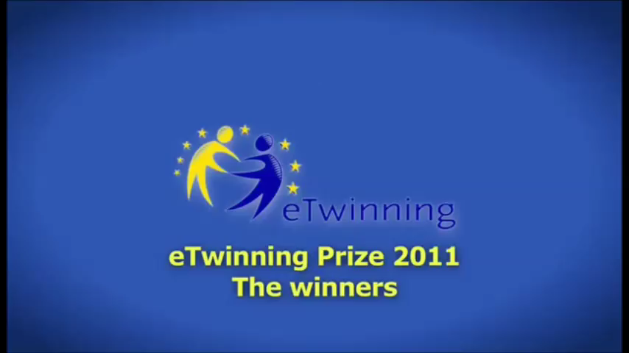

Slide 26
five multinational teams
five different routes between our schools
once a month some task
  first separately at your own school
  then a Skype call between the team members
    ”What is our answer as a team? What is our time combined? etc.”

Slide 27
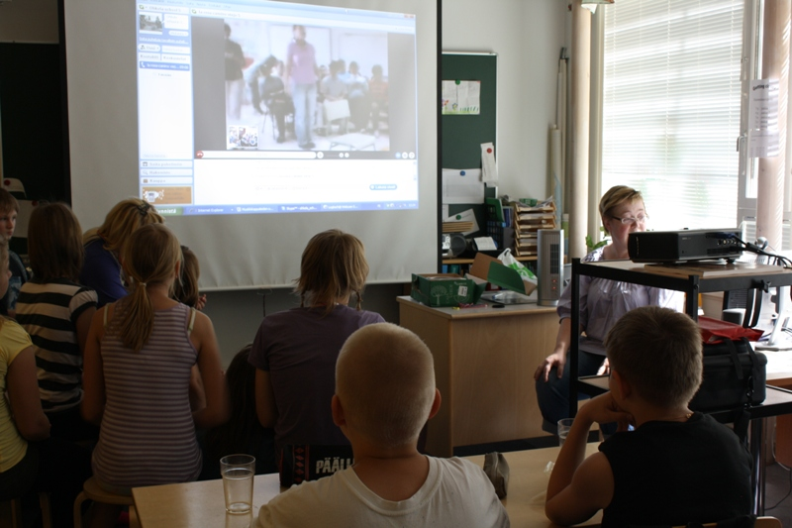

Slide 28
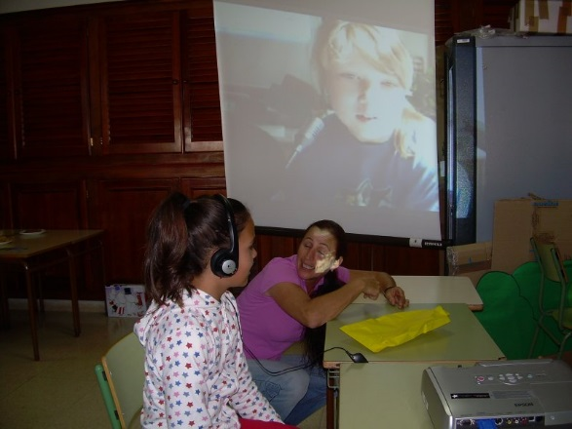

Slide 29
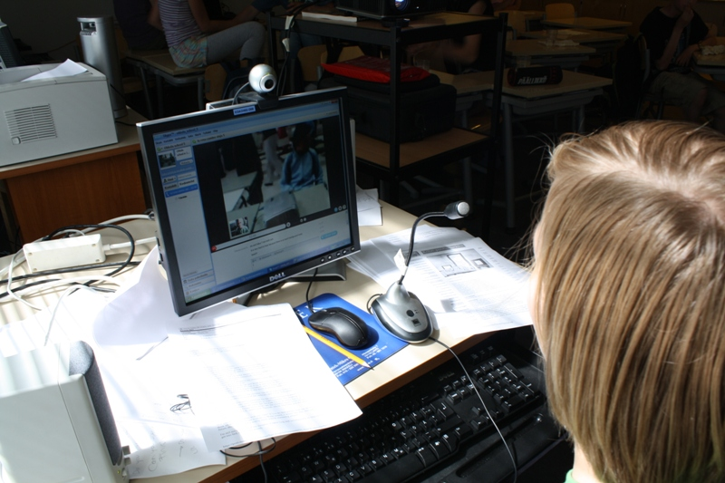

Slide 30
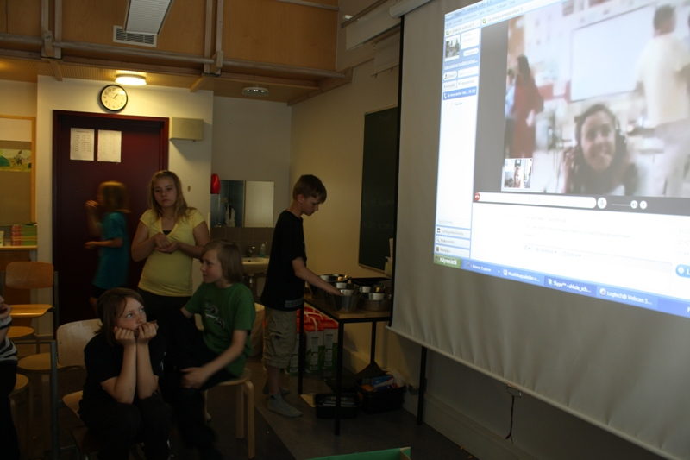

Slide 31
The results
a great project! (Winner in age group 4-11 in 2011!)
very versatile experiences for the pupils
  speaking English (the team meetings with Skype)
  finding information (the games, logbook)
  using Google Earth (following your route, finding where you are)
  new friends (penpals, team members)

Slide 32

And of course… the camp together!

Slide 33
Video conference (VC) within eTwinning
VC is powered by Adobe Connect.
You must pre-book a video conference slot.
The slots are limited – planning ahead recommended!
All times are stated in Central European Time (CET)

Slide 34
Video Conference can be launched in 3 different places:
  Events – max 100 users
  Groups – max 100 users
  Twinspace – max 25 users
Only teachers can access VC
  In the classrooms the VC is facilitated through the teacher’s computer.

Slide 35
Thank you!
Sari Auramo
Mäntsälä, Finland
sari.auramo@mantsala.fi

