Slide 1
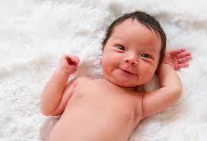
What is your name? Who chose the name? Why?

Slide 2
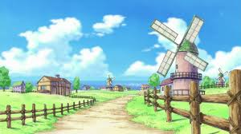
What is your home village like?

Slide 3

How many languages do you speak? Which level?

Slide 4
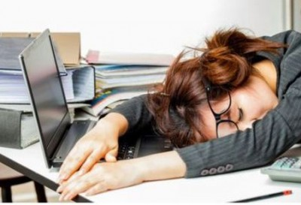
How and where do you study the best?

Slide 5
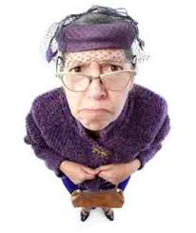
Who is your favourite relative? Why?

Slide 6
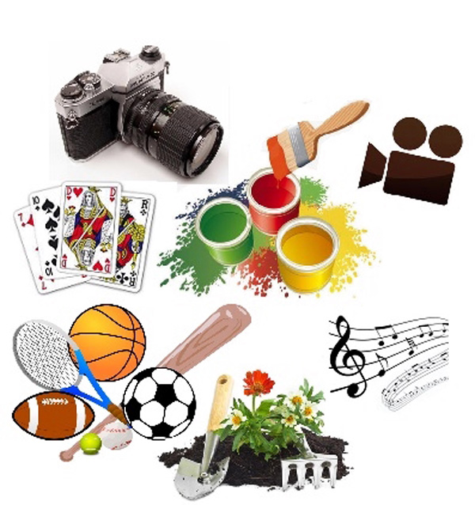
What are you interested in?

Slide 7

Do you like travelling?

Slide 8

What is your favourite colour? Why? How does it show?

Slide 9
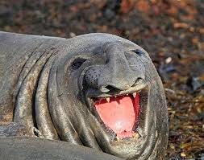
You and animals?

Slide 10
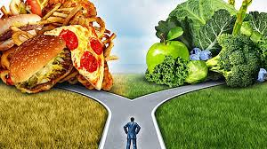
What kind of food do you like?

Slide 11

Are you hungry now? Why?

Slide 12
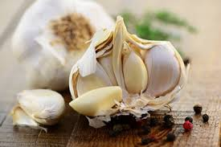
Do you like garlic?

Slide 13
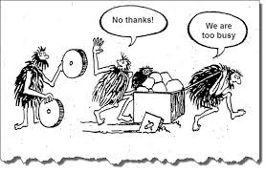
What have you done so far today?

Slide 14
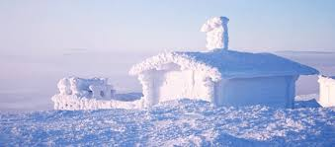
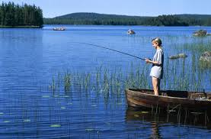
Talk about the Finnish weather!

Slide 15

What makes you happy?

Slide 16
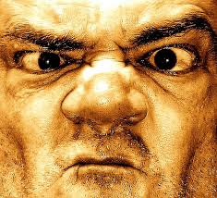
What makes you angry?

Slide 17

What kind of music do you like?

Slide 18
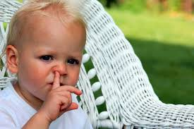
What are your bad habits?

Slide 19
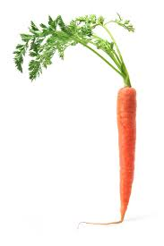
What motivates you?

Slide 20

How do you use the social media?

Slide 21

What have you made for yourself?

Slide 22
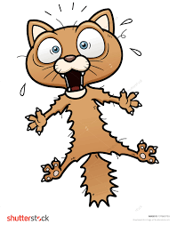
What are you afraid of?

Slide 23
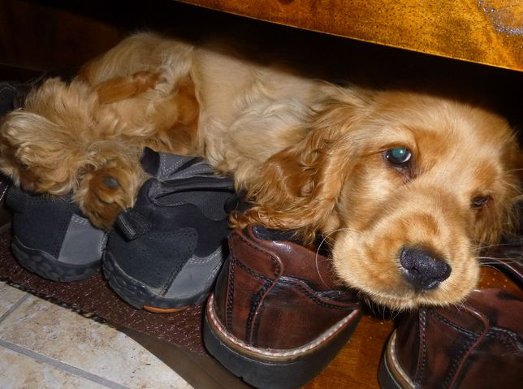
What is your favourite place?

Slide 24

Do you have good manners?

Slide 25

What will you remember most about 2019?

Slide 26

How is your future going to be?

