Slide 1
My Town
Kouvola

Slide 2
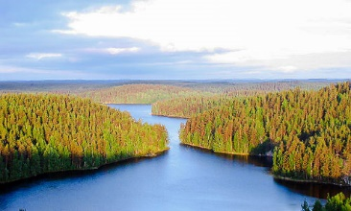
Repovesi National Park
Here in Kouvola there is the national park Repovesi
There are many lakes and great landscapes

Slide 3
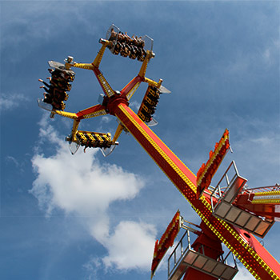
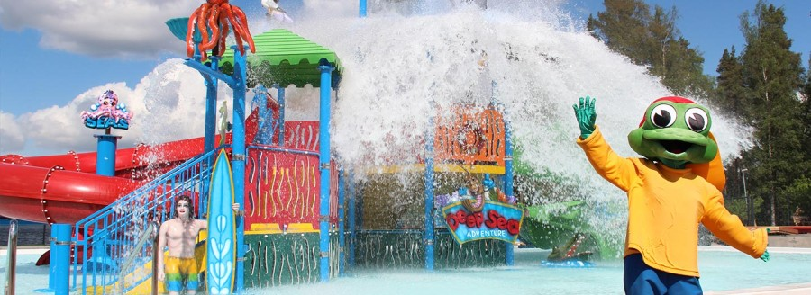
Tykkimäki Amusement Park
In Kouvola we have the amusement park Tykkimäki
Tykkimäki is the third largest amusement park in Finland
There are about thirty different amusement
rides and about ten different games
There is also a campsite
and water park Aquapark
near Tykkimäki

Slide 4
Kouvola sports
There is an ice hall, where our city icehockey team Kookoo plays their home games
Our city sports field is next to the ice hall
Our Finnish baseball field is next to the ice hall and sports field
Our city Finnish baseball team is Kouvolan Pallonlyöjät

Slide 5
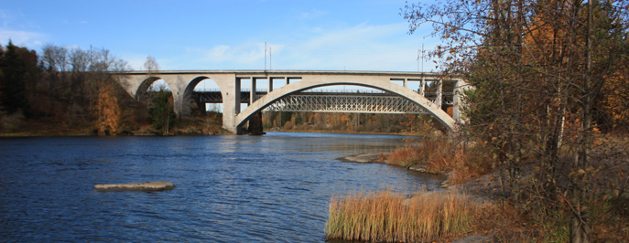
Kymijoki
There is the big river Kymijoki around the city area

