Slide 1
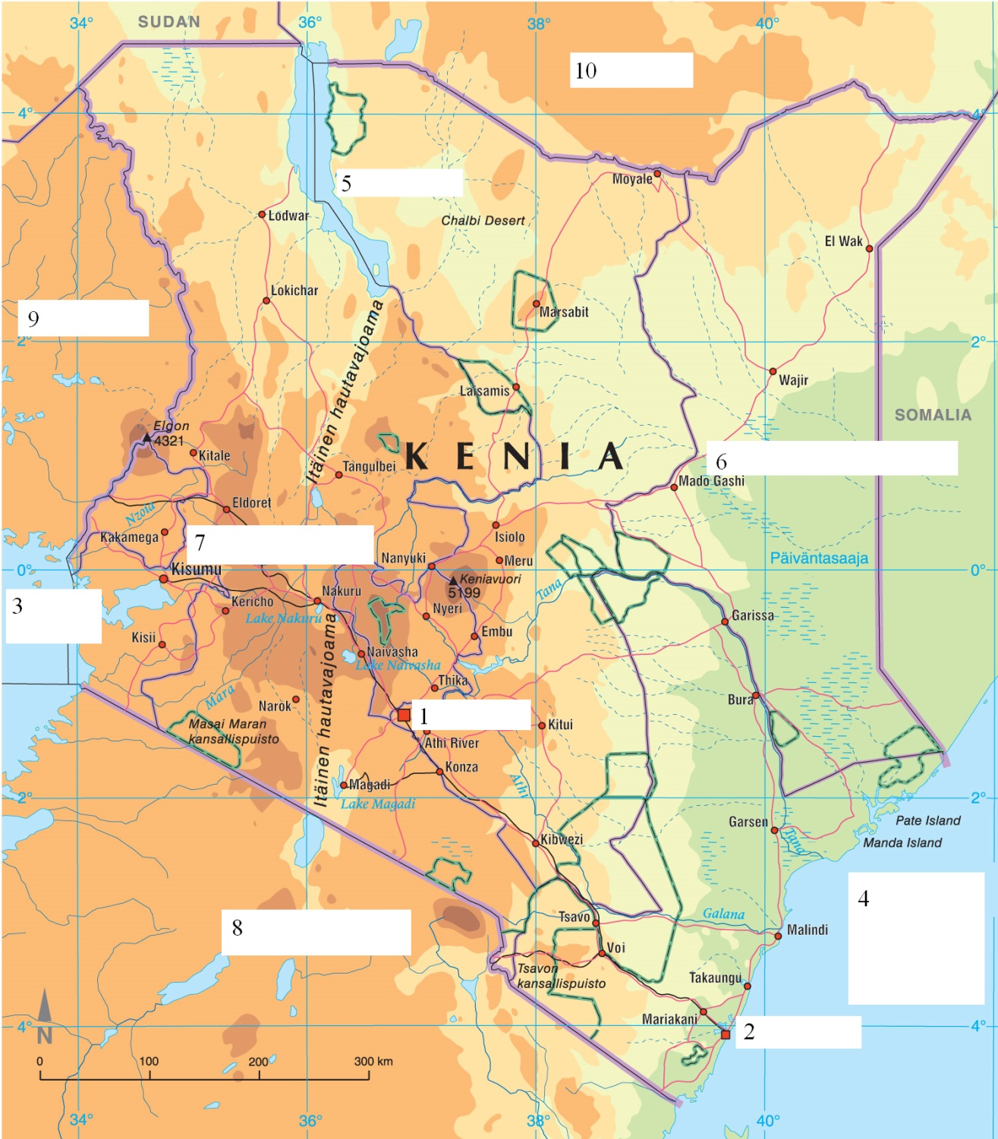
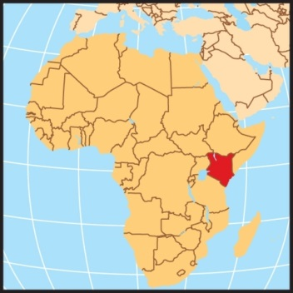

Slide 2
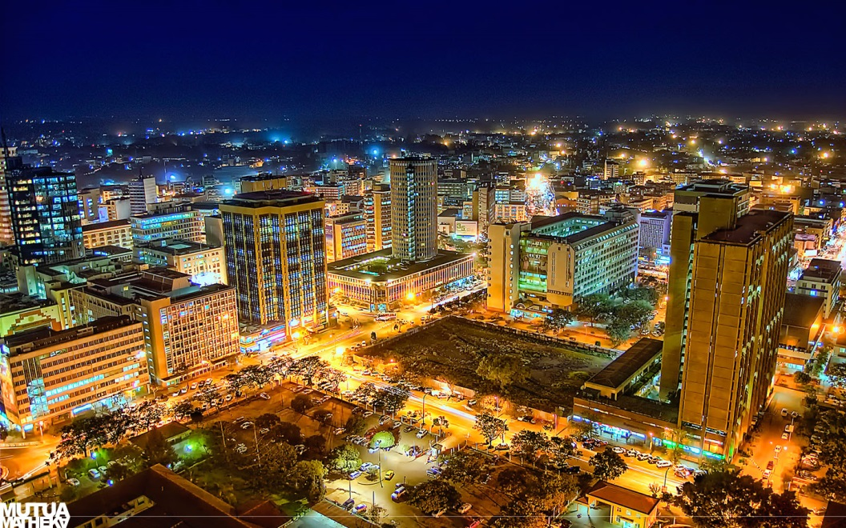

Slide 3
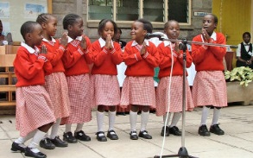

Slide 4
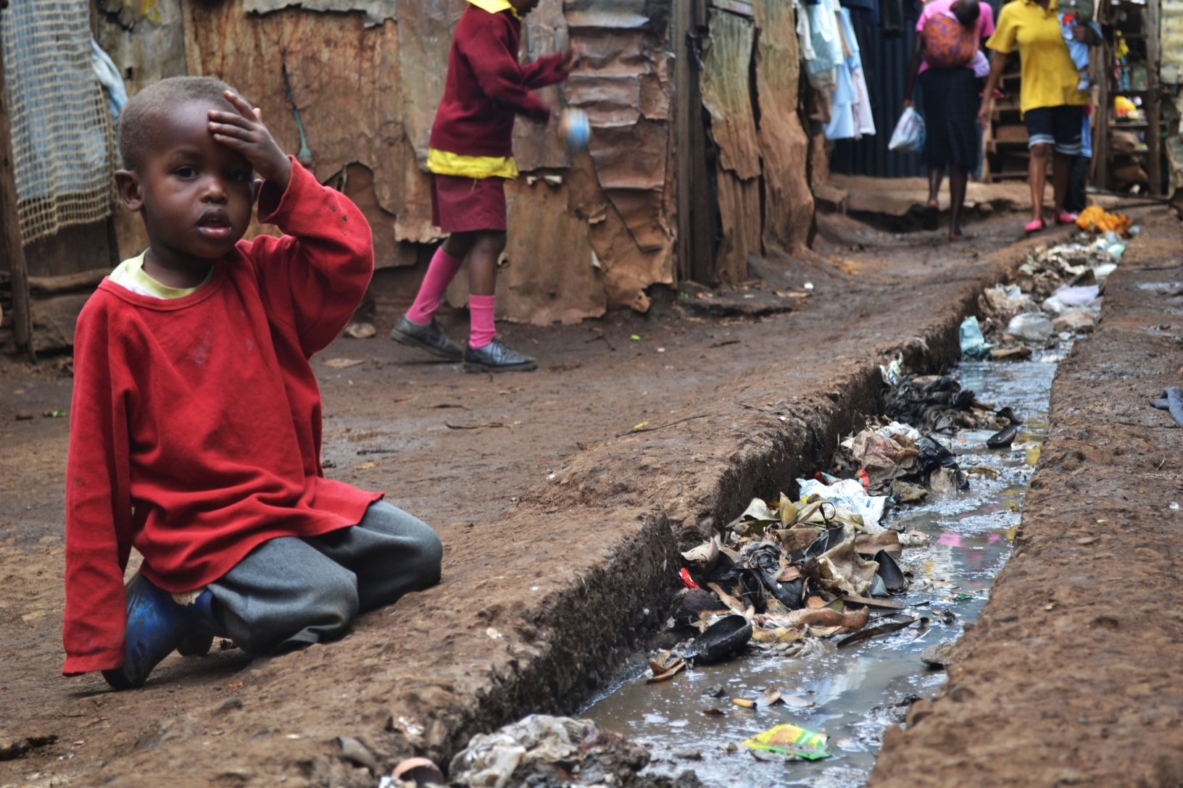

Slide 5
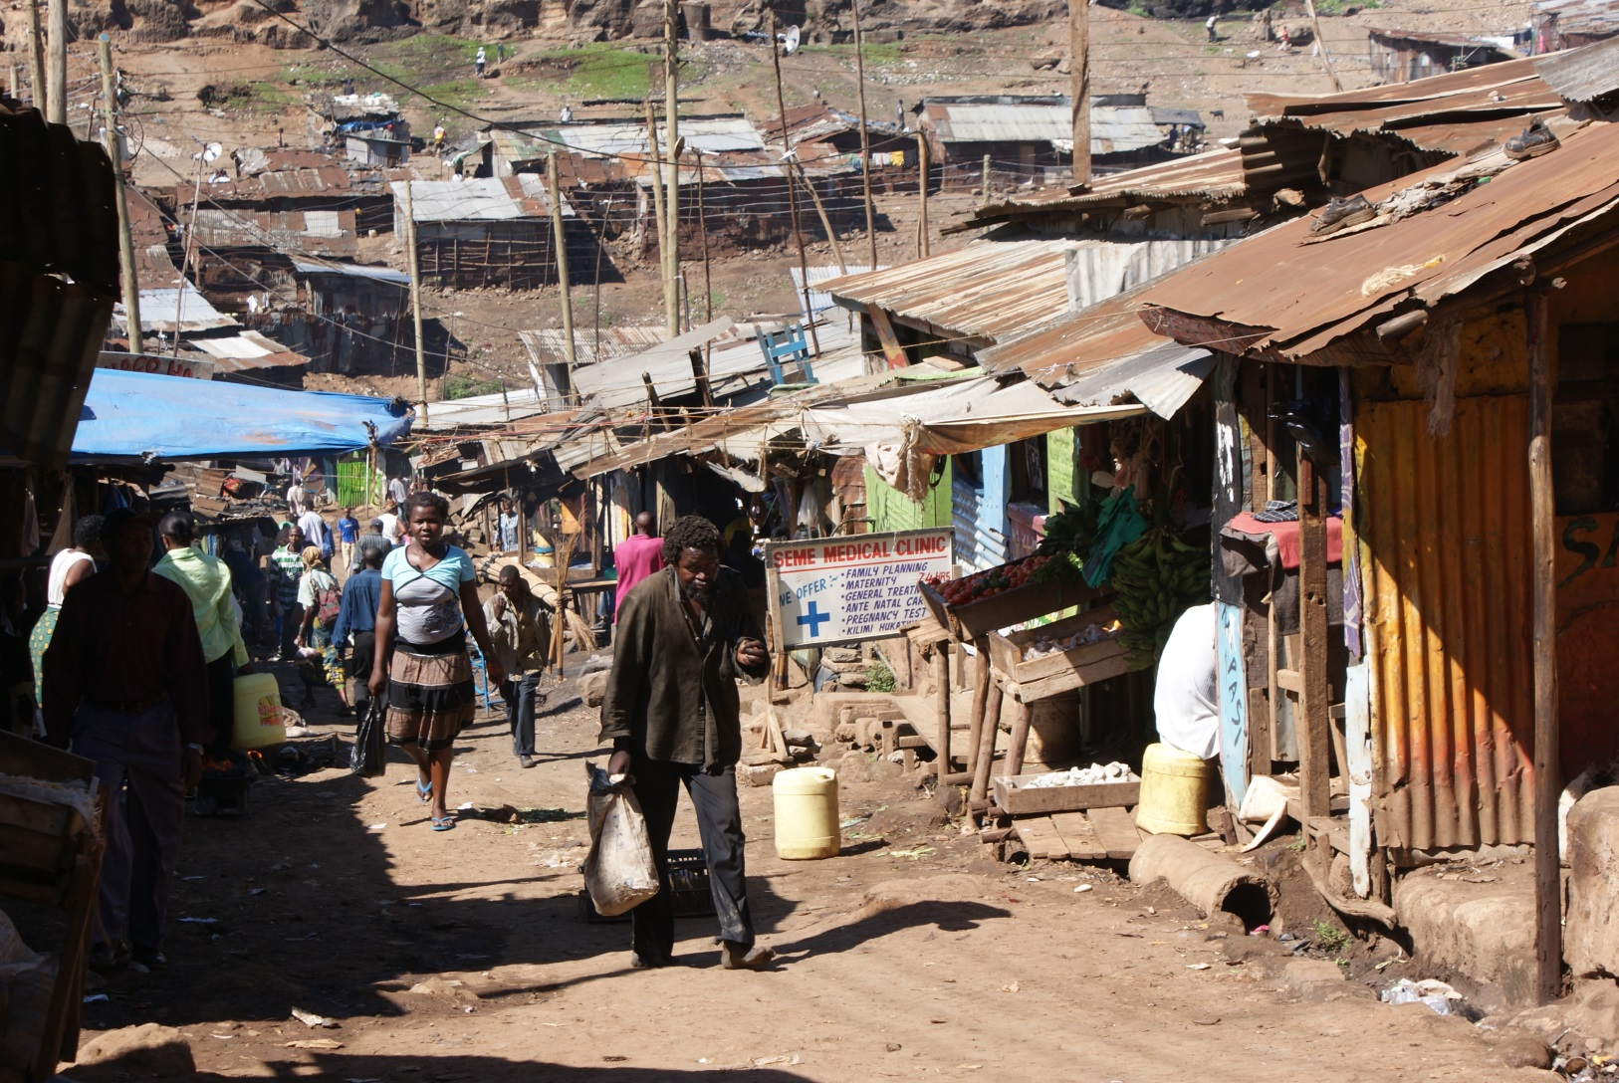

Slide 6
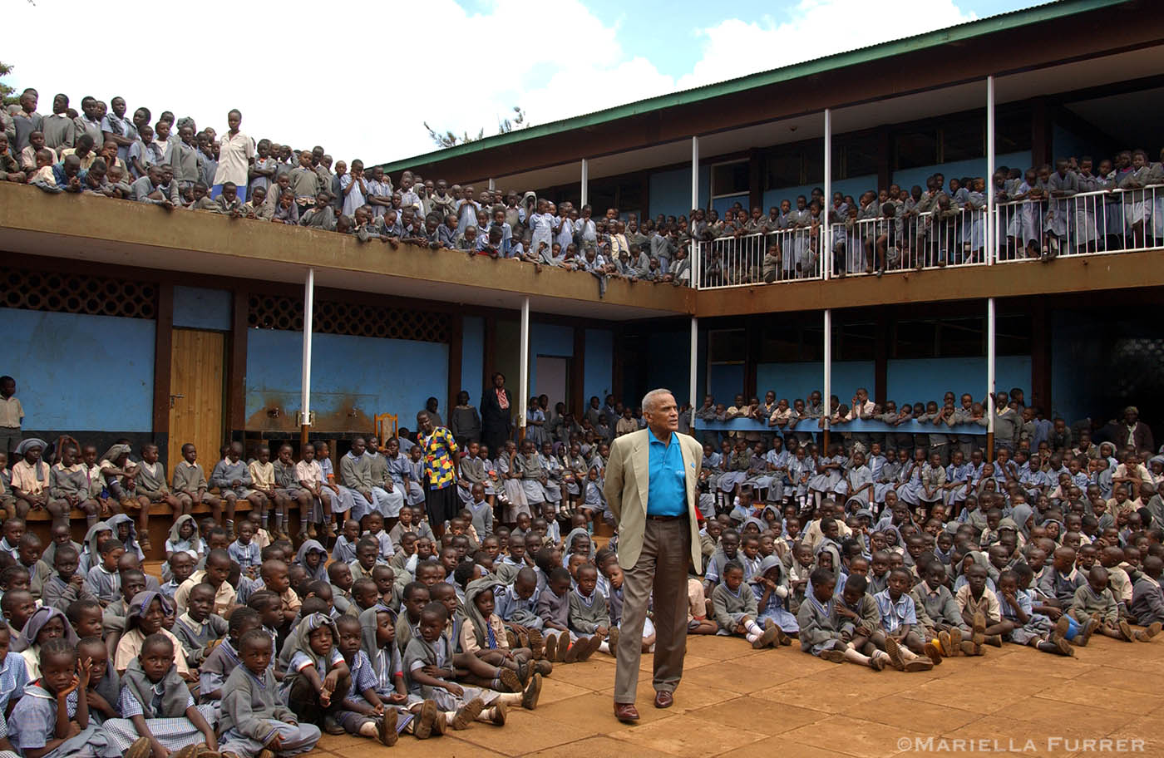

Slide 7
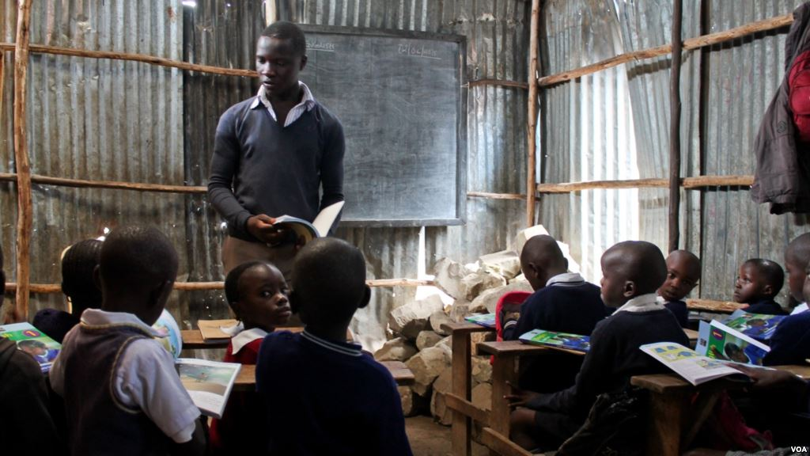

Slide 8
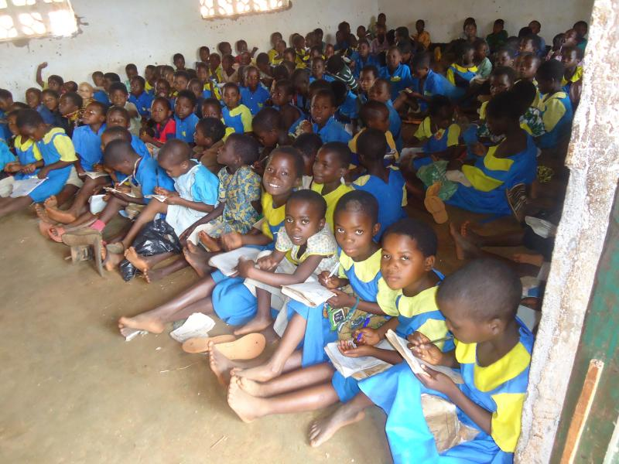

Slide 9
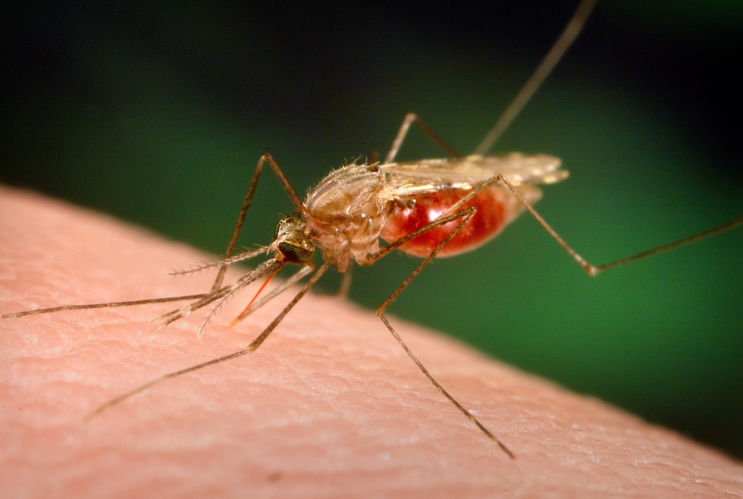
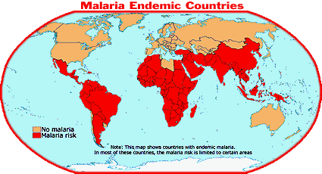

Slide 10
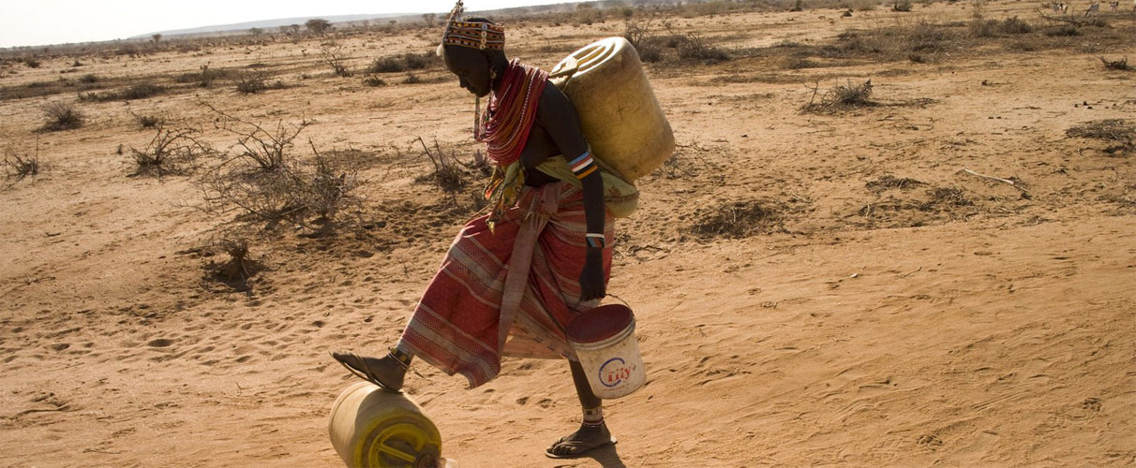

Slide 11
Kikuyu 7.18 million
Kibet 3.96 million
Ekegusii 2.12 million (2006)
Kimîîru 1.74 million
Oluluhyia
Kibet
Kipokomo
Kigiryama 0.62 million (1994)
Kiembu 0.43 million (1994)
Dholuo 4.27 million
Kalenjin > 1.6 million
Maasai 0.59 million
Turkana 0.45 million (2009)
Oromo
Rendille
Somali
Arabic
Hindustani
English

Slide 12
Swahili:
https://www.youtube.com/watch?v=5ya2ip1-mfc

Slide 13
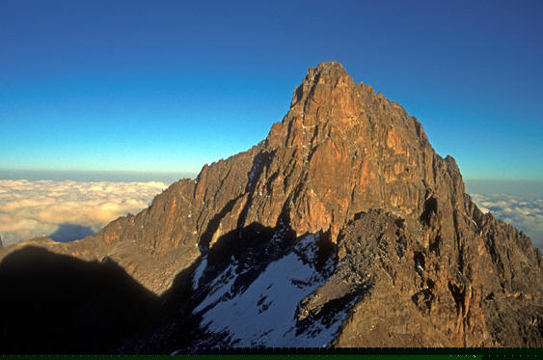

Slide 14
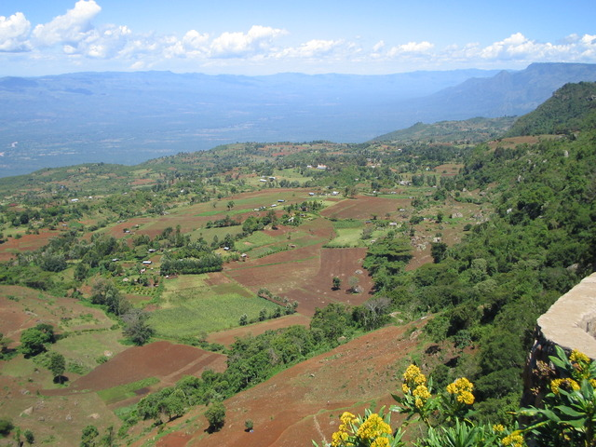

Slide 15
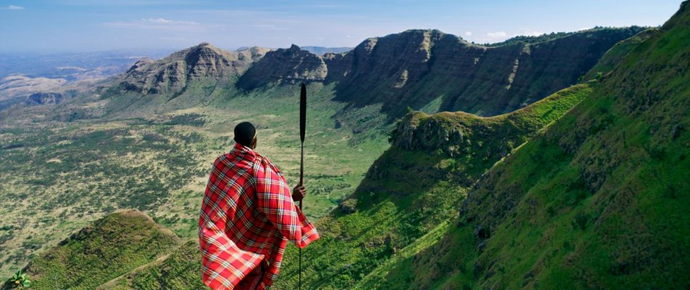

Slide 16
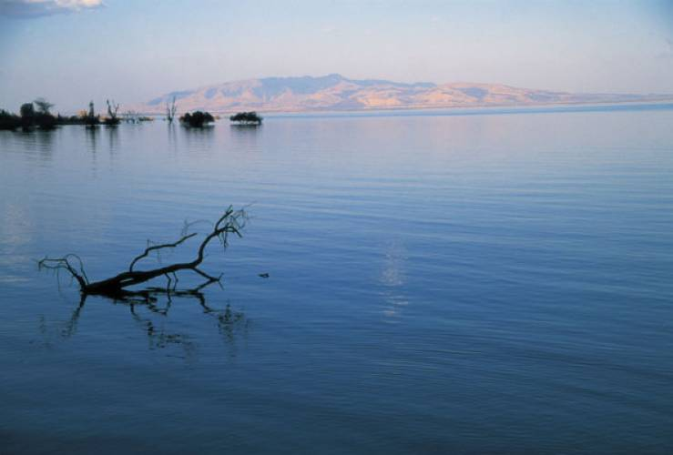

Slide 17
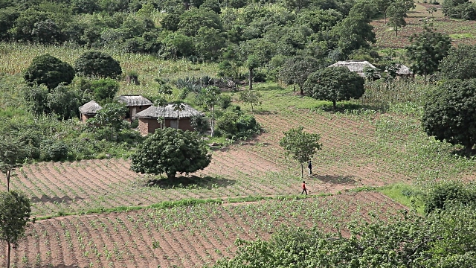

Slide 18
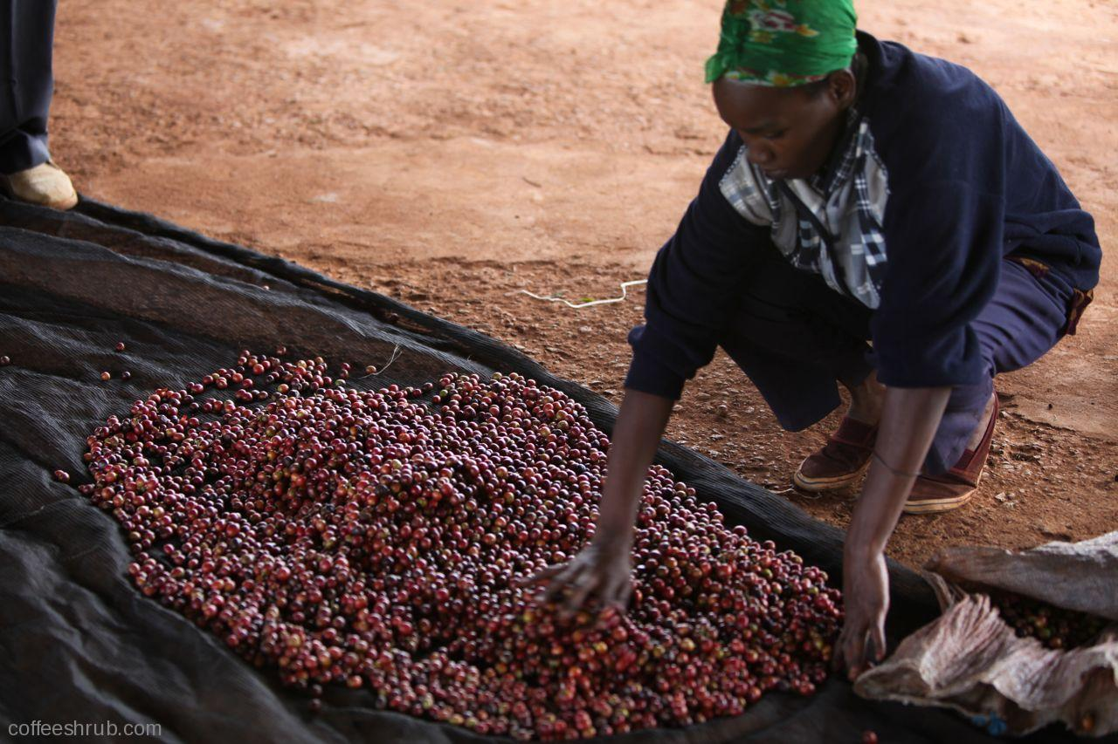

Slide 19
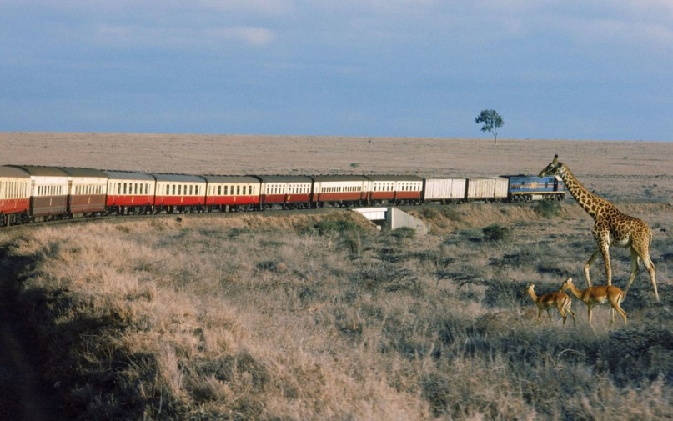

Slide 20
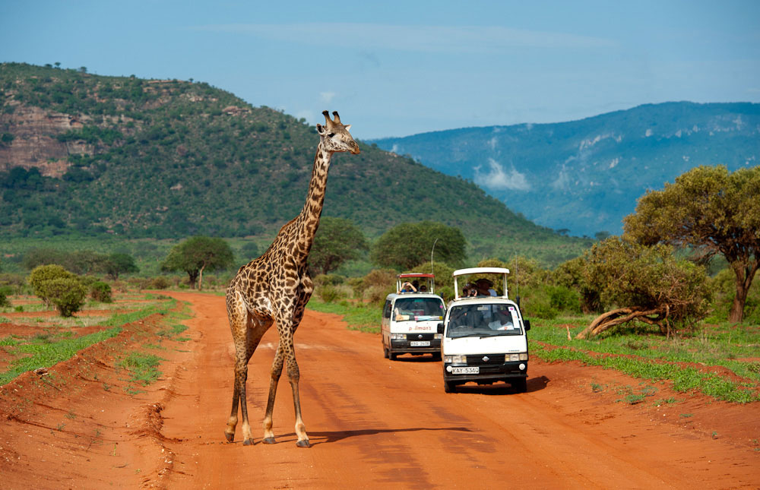

Slide 21
