Slide 1


Financial matters
Guðrún Birna
gudrunbirna@gmail.com

Slide 2
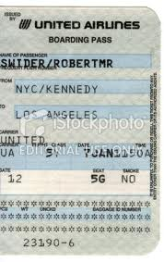
For reimbursement
Please remember when you get home:
1. Hold on to stubs, receipts…

Slide 3
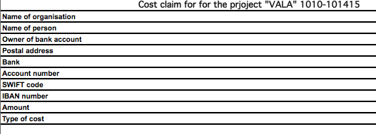
Cost claim
2. Fill out cost claim form (on Vala website- practical matters)
This form is used to make cost claims for travel, flight, bus, trains etc. This can be done after the travel has taken place and all receipts and boarding pass needs to be turned in along with the claim. Scan the form and send as attachemnt to Guðrún Birna at gudrunbirna@gmail.com

Slide 4
Last but not least
3. Send to gudrunbirna@gmail.com
Please contact me if you need more information or assistance ☺
P.s. Hotel will be paid by VALA.

