Slide 1
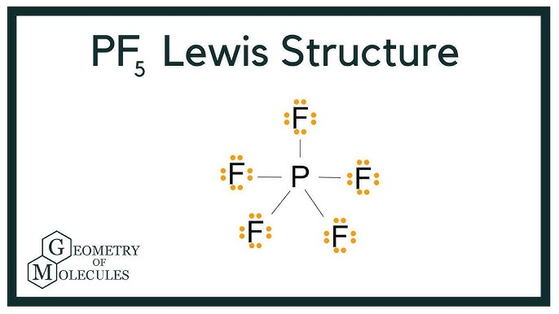
Structure 2.2 (HL)
An expanded octet is when a molecule contains atoms with more than eight valence electrons. The central atom may contain five or six electron pairs.
Along with the expanded octet, one needs to become familiar with the molecular geometries associated (pages 169-171)

Slide 2
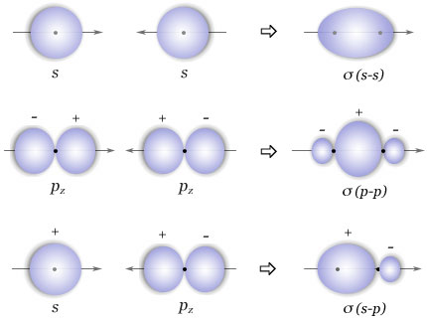
Orbitals in Molecules and Hybridization
Hybridization: The combination of atomic orbitals to form new hybrid orbitals
Representations of sigma bonds (Ơ) formed between two s orbitals overlapping, two p orbitals overlapping and an s and p orbital overlapping

Slide 3

Orbitals in Molecules and Hybridization
Hybridization: The combination of atomic orbitals to form new hybrid orbitals
Representations of pi bonds (╥) showing the overlapping of orbitals occurs above and below the line drawn through nuclei, as opposed to sigma bonds

Slide 4
Formal Charge
A technique used to determine which Lewis structure is correct when several are possible
Formal charge = Number of Valence electrons –Number of non-bonding electrons – (1/2 number of bonding electrons)
FC = V – N- ½ B
The preferred structure is that with the lowest FC!

Slide 5
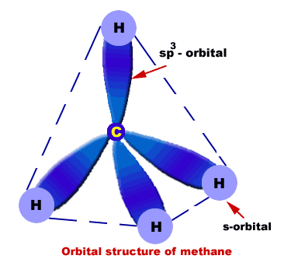
sp³ hybridization
sp³ orbitals of carbon overlap with the s orbital on hydrogen to form four equal sigma bonds
What are sp³ orbitals?
  With carbon’s normal configuration (1s² 2s² 2p²) the perpendicular arrangement of the p orbitals will not allow the 109.5° angle when combined with hydrogen’s s orbitals
  By promoting a 2s electron to the 2p orbital, hybrid orbitals form and become as repulsive as possible (tetrahedrally). Now four equal sigma bonds can be formed with hydrogen

Slide 6
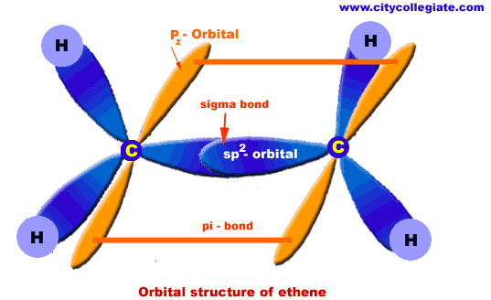
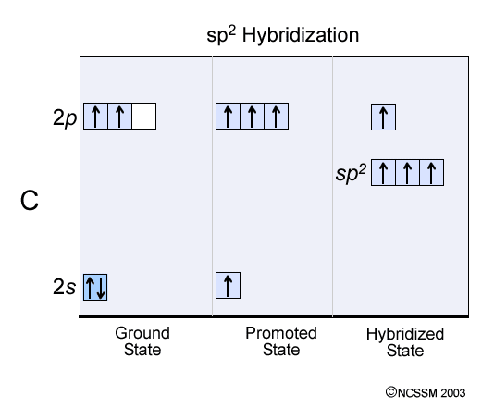
sp² hybridization
When a carbon atom is involved in 3 sigma bonds, it requires 3 hybrid orbitals. A carbon 2s electron is promoted forming three planar hybrid orbitals (at angles of 120°).
These form sigma bonds with hydrogen atoms and a sigma bond with the other carbon atom
Remaining 2p electrons form a pi bond
Sp² hybridization in ethene

Slide 7
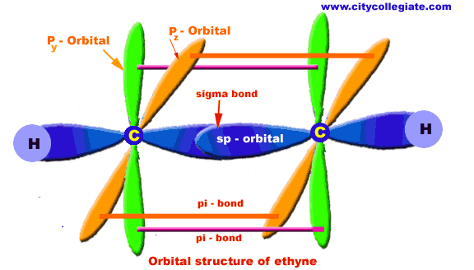
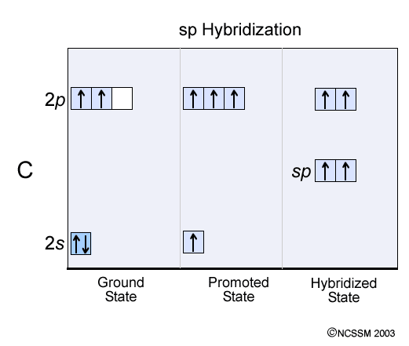
sp hybridization
When a 2s orbital hybridizes with one of the 2p orbtials to form two linear hybrid orbitals.
Remaining two p orbitals on each carbon atom overlap and form two pi bonds
Sp hybridization in ethyne

Slide 8
Hybridization
Hybridization can take place between any s and p orbital in the same energy level (also other types you don’t yet need to know)
Promoting electrons to p orbitals will require energy
Through any sp hybridization, a lack of energy input is explained (this is a theory!)
Hybridization | Bond angle | Examples
sp³ | 109.5° | Methane, ammonia, water, hydrazine
sp² | 120° | Ethane, diazine, formeldahyde
sp | 180° | Ethyne, nitrogen

Slide 9
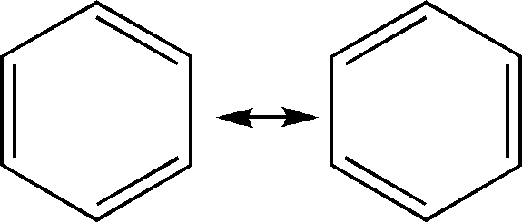
Delocalization of electrons
Benzene rings provide a fine example of delocalization (when a pair of electrons are not fixed but rather free to move between atoms)
The resonance structures (hybrids) shown below represent the extreme forms of bonding.

Slide 10
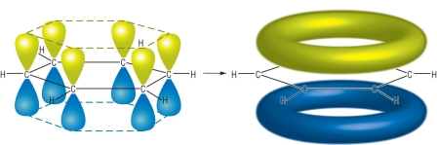
Delocalization of electrons
It is energetically more favorable to delocalize across three atoms then to form a double bond and a single bond (consider the ethanoate ion)
Benzene’s bonds are very stable due to delocalization throughout the ring (unlike e.g. ethene)

