Slide 1
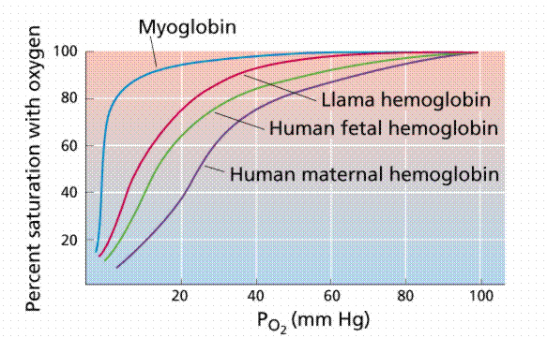
GAS EXCHANGE
Composition of Air
Partial pressure refers to the pressure a certain gas within a mixture applies
When oxygen-rich air is exposed to blood, the oxygen molecules will bind to hemoglobin (4 molecules O₂/ hemoglobin
While hemoglobin travels the blood, myoglobin is the oxygen-binding and storing molecule in muscles
Myoglobin has a higher affinity for oxygen than does hemoglobin
Only when the partial pressure of oxygen is very low does myoglobin release oxygen
This is advantageous during hard, strenuous exercise
Comparative dissociation curves
Online Biology Book

Slide 2
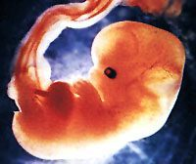
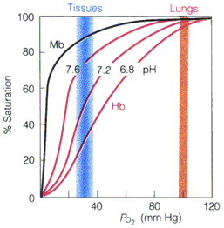
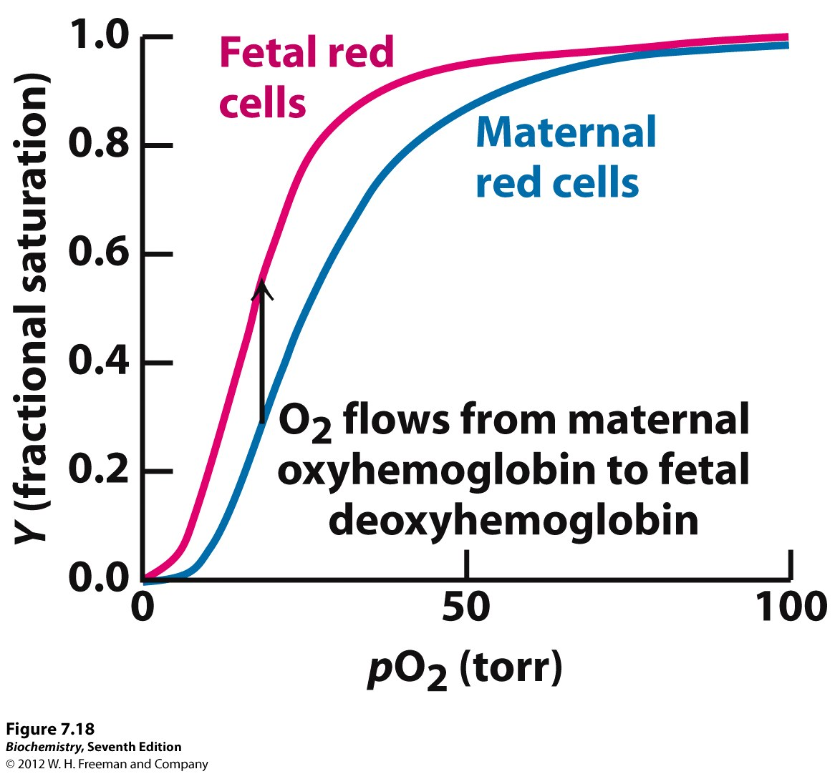
GAS EXCHANGE
Composition of Air
Fetal hemoglobin differs very slightly from adult hemoglobin in structure, and has a greater affinity for oxygen
Thus, maternal hemoglobin will lose oxygen to fetal hemoglobin in the placenta
The Bohr shift
Comparative dissociation curves
Online Biology Book

Slide 3
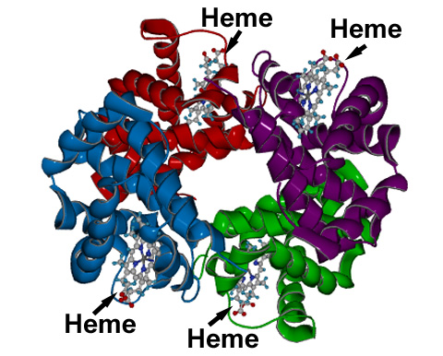

GAS EXCHANGE
Composition of Air
Oxygen tends to dissociate from hemoglobin at high partial pressures of carbon dioxide. Known as the Bohr shift
The Bohr shift explains hemoglobin releasing oxygen to respiring tissues
The lower the oxygen concentration in respiring tissues, the more oxygen hemoglobin will release
Comparative dissociation curves
The Bohr shift

Slide 4
GAS EXCHANGE
Composition of Air
Other factors that increase the release of oxygen by hemoglobin are high temperature and high P_{CO2}: lower pH
Comparative dissociation curves
The Bohr shift

Slide 5
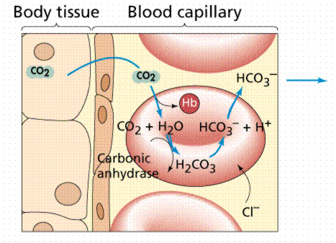
GAS EXCHANGE: CO₂ TRANSPORT
Carbon dioxide doesn’t simply move in blood and diffuse at the alveoli
7% travels in plasma
Some of it (approx. 20-25%) binds to hemoglobin: carbaminohemoglobin
Carbaminohemoglobin dissociates in the lungs
The remainder is converted to hydrogen carbonate in RBCs
The importance of having zinc in small proportions in a diet is because it is a constituent of carbonic anhydrase
CO₂ + H₂O → H₂CO₃ (carbonic acid)
Carbonic acid then dissociates, i.e., the hydrogen ions stay in the RBCs and hydrogen carbonate ions leave
H₂CO₃ → H⁺ + HCO₃
CO₂ + H₂O ←→ H₂CO₃ ←→ H⁺ + HCO₃
WH Freeman

Slide 6
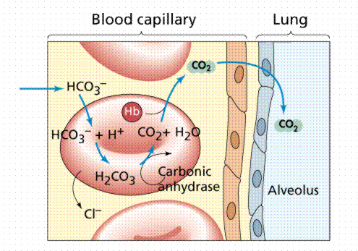
GAS EXCHANGE: CO₂ TRANSPORT
The hydrogen ions left in the RBCs would cause a drop in the pH(increasing acidity) and henceforth acidosis, but hemoglobin buffers this
Chloride ions (Cl⁻) in the blood plasma enter red blood cells and maintain an ionic equilibrium: chloride shift
Where is the CO₂?
It is found in the HCO₃⁻ ions
When these molecules reach the lungs (low PCO₂) CO₂ reforms, diffuses, and is exhaled
WH Freeman
WH Freeman

Slide 7
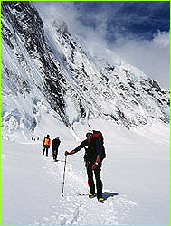


LIFE AT HIGH ALTITUDES
What are the physiological responses to high altitudes?
Why do endurance athletes train in the mountains?
What causes mountain sickness and what are the symptoms?
Adaptations and acclimations:
  Large tidal volume
  Hemoglobin’s affinity for oxygen increased
  More RBCs
  Thicker network of capillaries in muscles
  More myoglobin produced

Slide 8
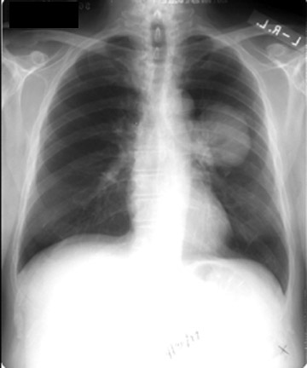
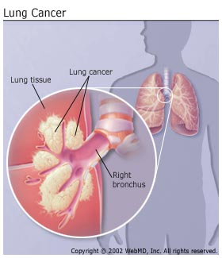
LUNG CANCER
Can be caused e.g. by smoking and air pollution, inhaling radioactive substances
Treatment if detected at an early stage involves removal of infected area
Lung cancer is usually most fatal cancer and usually caused by smoking

Slide 9
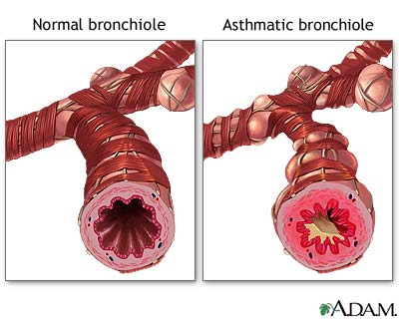
ASTHMA
During an asthma attack, small muscles in the wall of the bronchi contract too much: narrows bronchi, reduces gas exchange, makes ventilation more difficult
Allergic reaction caused by many factors
Clean homes may cause asthma?

