Slide 1
Spring in Armagh
May 2017

Slide 2
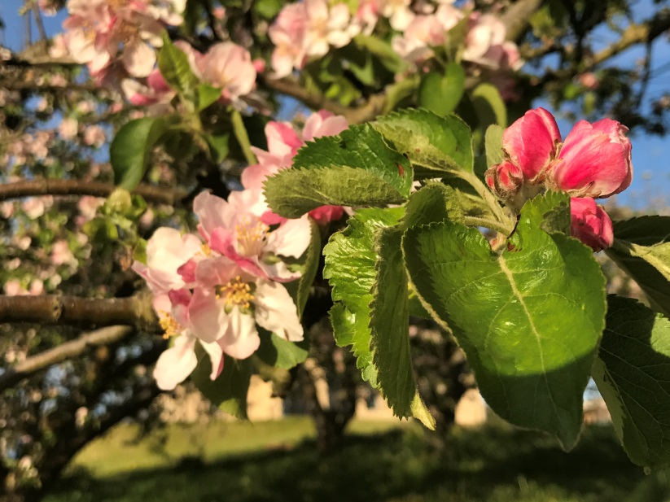
Apple Blossom Festival
Armagh is renowned as the ‘Orchard County’ or the ‘Orchard of Ireland’. The area comes alive with colour as the pink flowers of the apple trees blanket much of the deep green landscape.

Slide 3
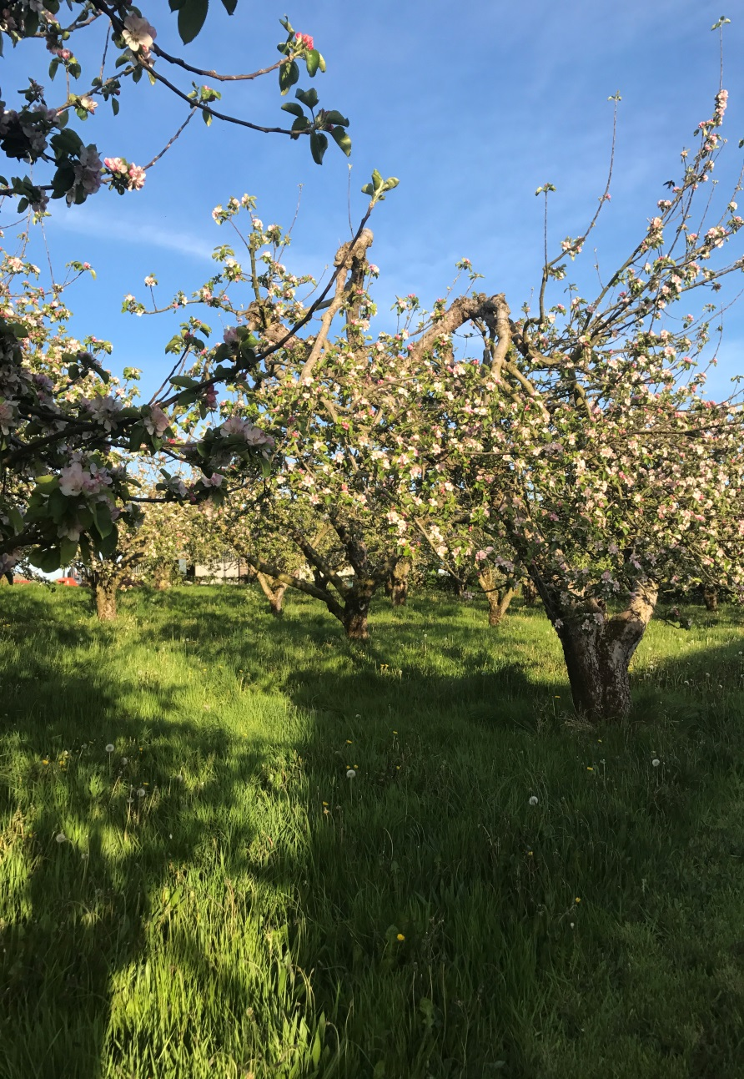
There is a history of apple growing in Armagh dating back 3,000 years. Saint Patrick planted an apple tree at Ceangoba, an ancient settlement east of the City.

Slide 4
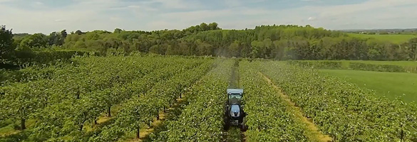
Today more than 4000 acres of Armagh are covered by apple trees. Approximately 90% of the crops are Armgh Bramley Apples which are harvested here in County Armagh. The Armagh Bramley was awarded PGI (Protected Geographical Indication) status in 2012.

Slide 5
Why is Armagh good for growing apples?
The Orchard County enjoys an inland location, protected from the cooling breezes of the sea by the Mourne Mountain. In addition, Armagh’s mild, damp climate is particularly suited to the production of cooking apples. County Armagh gets fewer late frosts than most other areas. Armagh Bramley apple trees flourish in the highly fertile loam soil

Slide 6
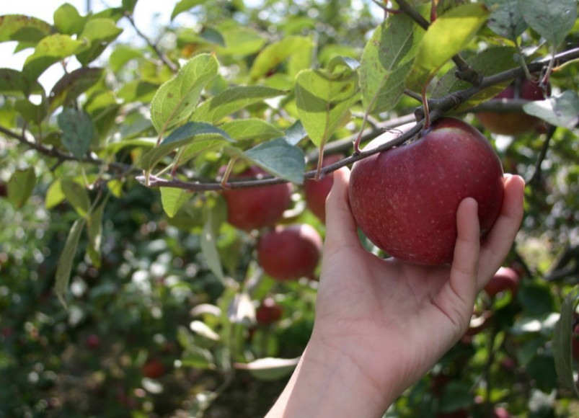
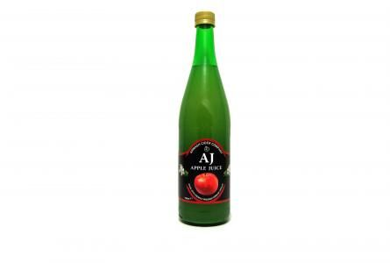
Around 90 percent the crop is processed into produce such as juice, fresh slices, diced, purée and canned apples. The remainder are sold as fresh packed apples to grocers and retailers.

Slide 7
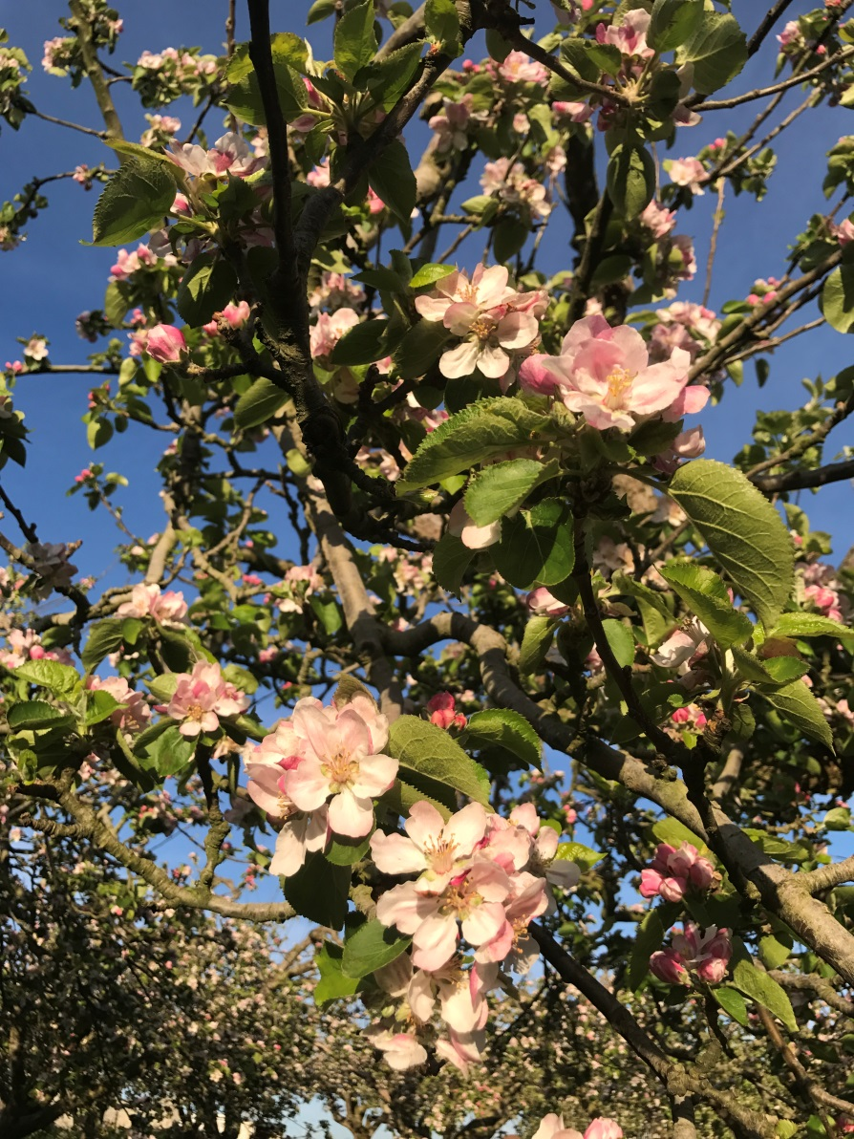
Apple Blossom
In may the apple blossom come s out and the countryside is full of beautiful pink flowers on the apple trees.

Slide 8

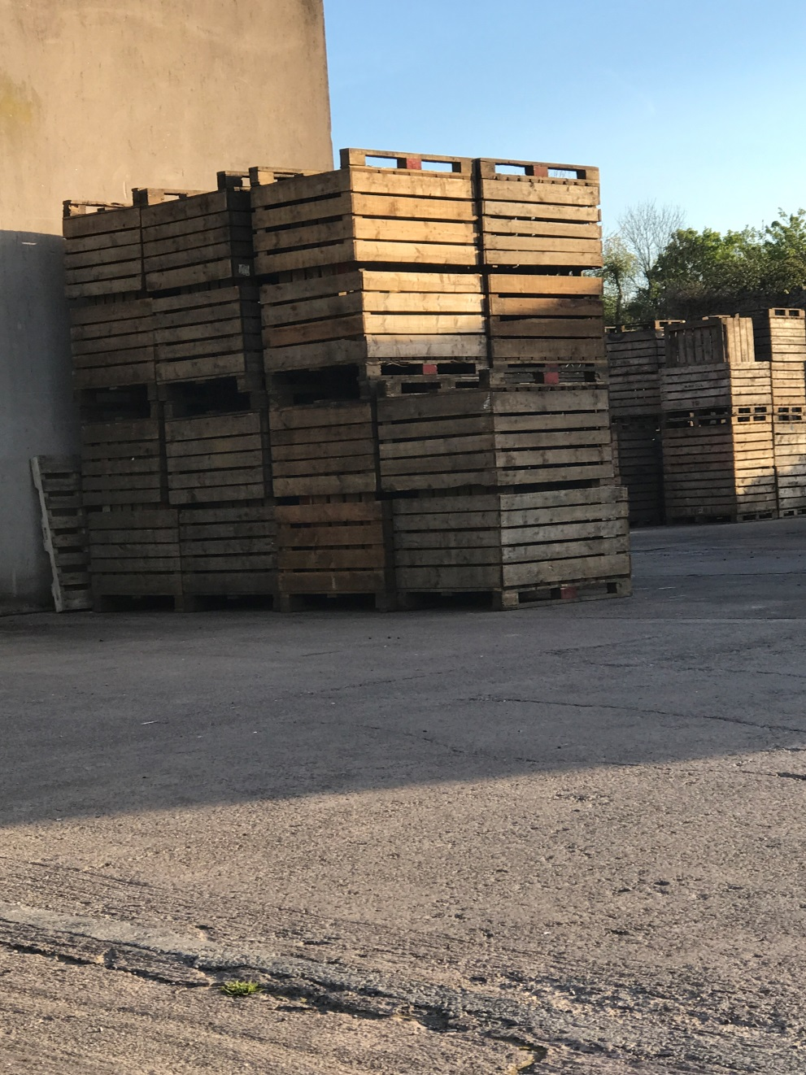
Apple boxes at a local farm waiting for this year’s crop.

Slide 9
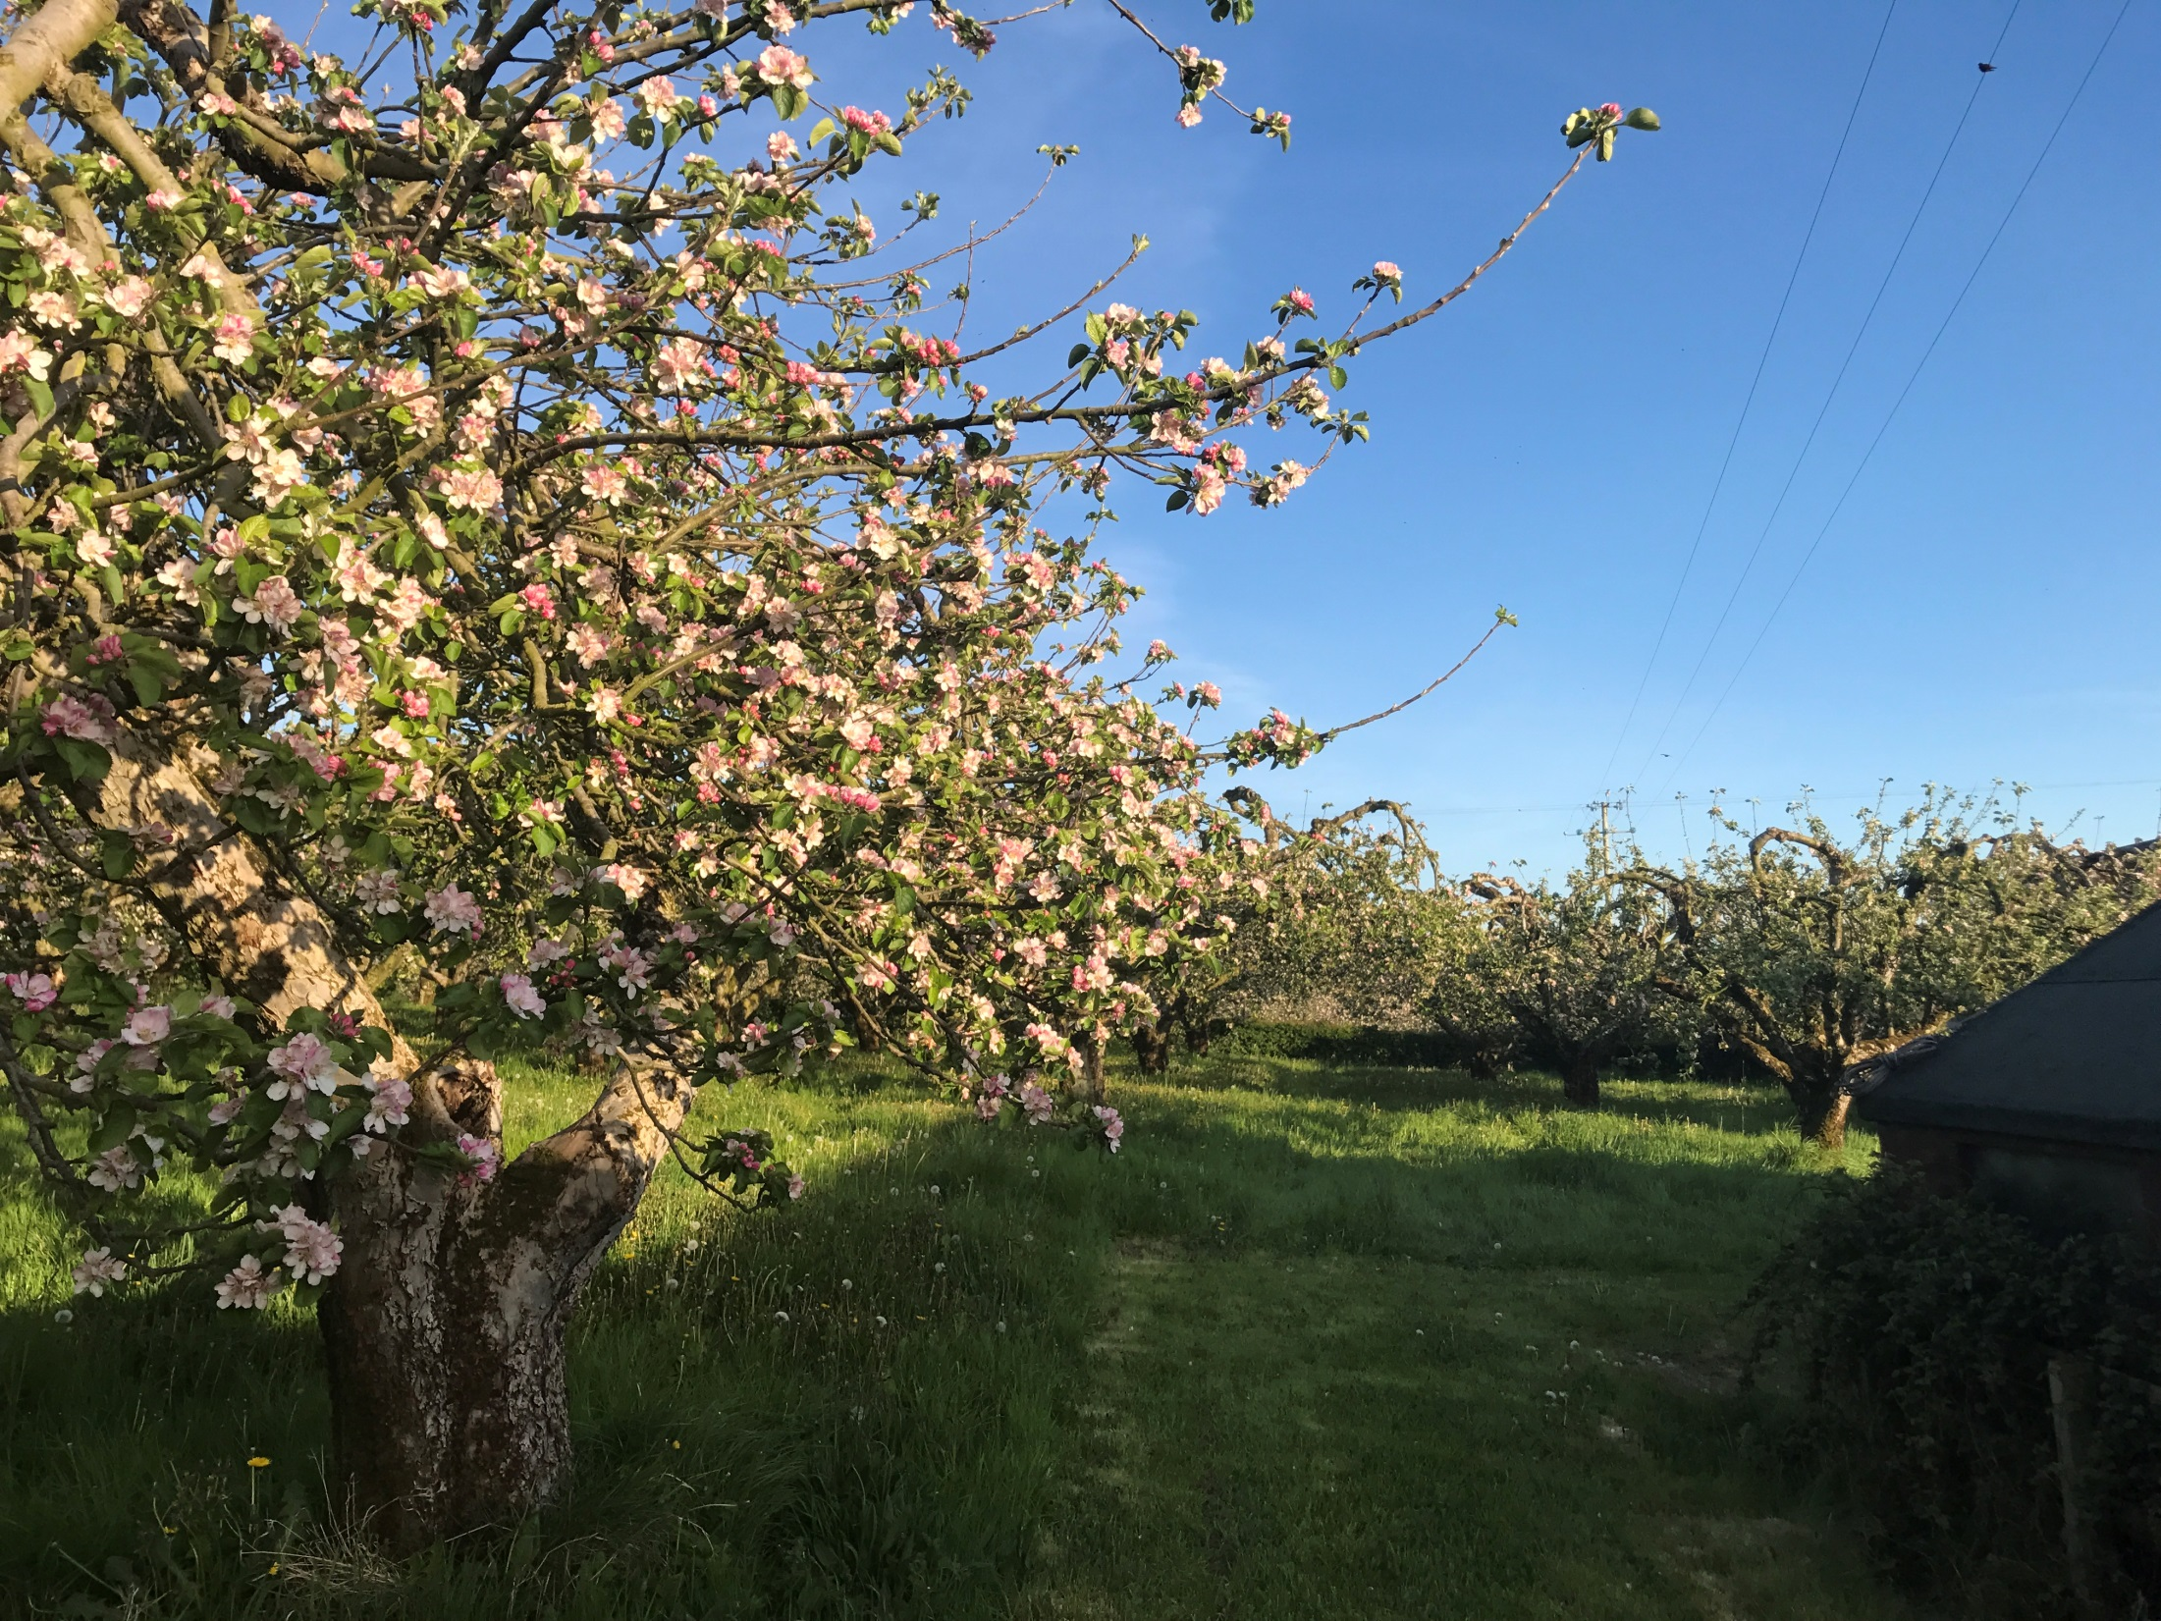
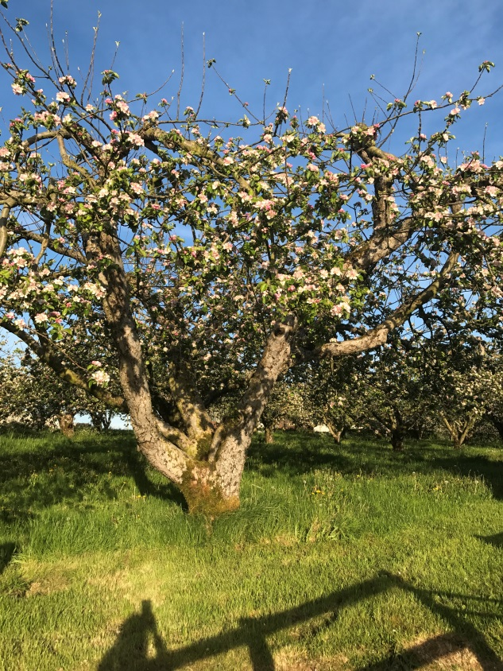

Slide 10
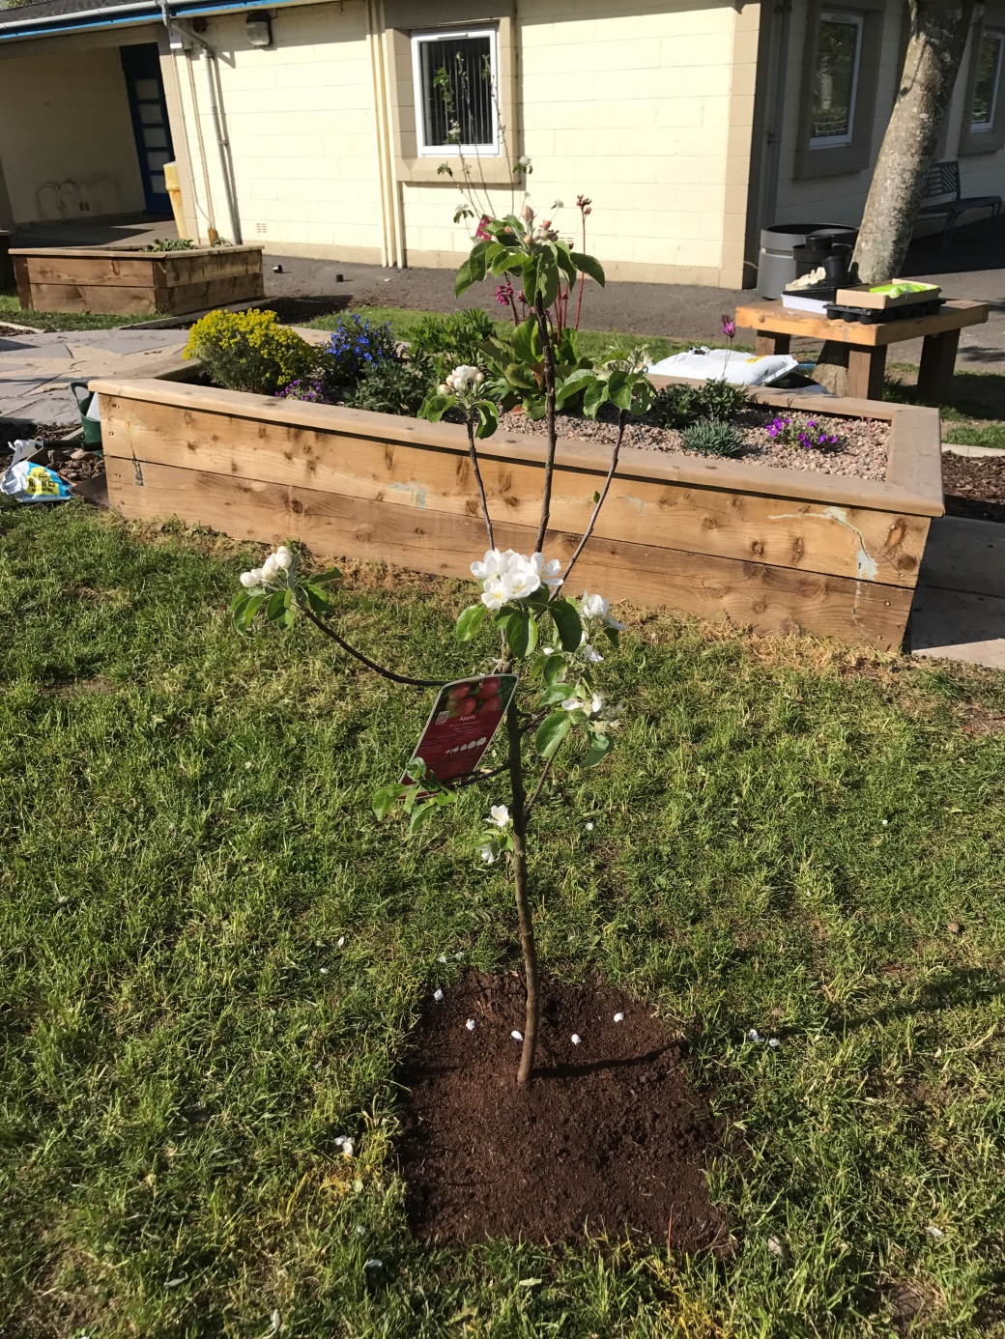
This year we planted apples trees in our school grounds.

