Slide 1

Discussion to start the workshop (note for yourself) Ask for 2 answers from each table: Which food brands or advertisements do you remember? + tell your name, please Hands up: How many of you know what is a subvertisement? Advertisement = advert = ad Subvertisement = subvert

Slide 2

Eeva Kemppainen

Slide 3
Program of the workshop
Examine questions about the production and consumption of food
Analyse the ways advertisements try to affect us and communicate
Get to know and learn subvertising
Make own subvertisements about food
→ subvertisement competition

Slide 4
Let’s talk about advertising
In general, what is the aim of an advertisement? Which things interest or speak to you in food ads?

Slide 5
What kinds of impacts do the production and consumption of food have on the world around us?
#wellbeing of the environment
#everyday life and work of people
#consumer choises #animal rights
#politics #grocery industry #health
#agriculture #impacts of ads

Slide 6
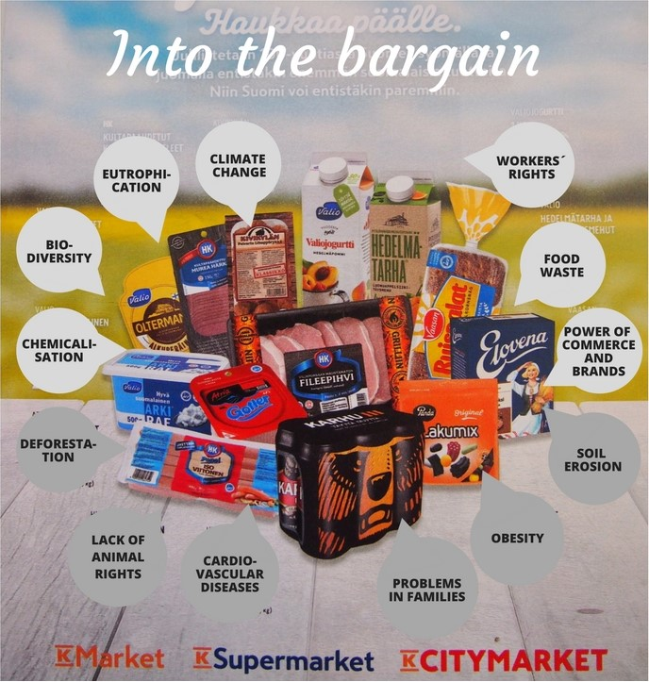

Slide 7

Message and ways of affecting in advertisements
Which product and brand can you see in the ad?
Is there a special effect used in the ad catching your eye?
What kind of image and message is the ad trying to convey to its viewer?
”A crunchy salty novelty…
The best has its colour. Blue.”

Slide 8
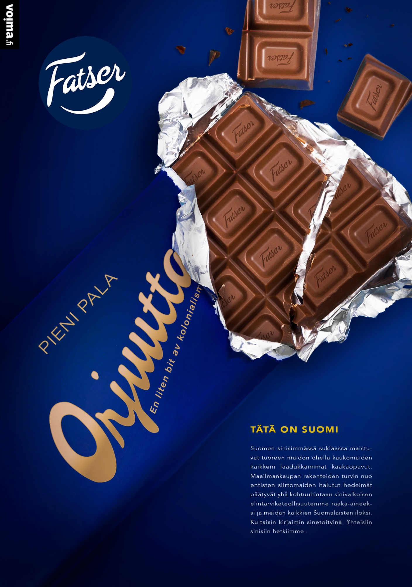
Message and ways of affecting in subvertisements
The maker of a subvert ponders the message and ways of effecting in an ad
modifies the picture, logo or text
→ makes a comment or a question
→ makes you laugh or challenges to think hidden things
”A small piece of slavery…
This is Finland.”

Slide 9
Subvertisement gallery
Which product or brand has been modified in the picture? Is the modification funny or serious?
What is the message of the subvert? What issue does it try to draw attention to or affect?
Has the subvertisement been made in good taste? Which subverts do you like and which ones not? Why?

Slide 10
Make your own subvertisement!
Choose one or more ads that you think have an interesting or provocative message or design. What kind of comment would you like to make about the original product or ad?
Think how the message of the ad could be changed: by modofying the logo, picture or text? By adding or erasing something? How can you make the modifications in style?
Other options:
A parody made on a blank piece of paper, commenting on the language of advertising on a general level
Cut imagery and text from ads and create a collage from them or create new meanings by combining them with your own drawings and sketches

Slide 11
Global Meal – subvertisement competition
If you want to participate in the competition with your work, please write on the back:
Name of your piece of work
Your name(s)
Your age(s)
Your teacher’s name
A note if you want to get your work back via post

Slide 12
What did we learn today?
Besides our health, the production and consumption of food have many kinds of impacts on the environment as well as the people and animals that are part of food production
A consumer can make an impact by making choices between products, participating in societal/critical discussion and affecting the dicisions of companies and politicians
Ads aim at affecting our decisions on what to buy in various ways – let's keep media criticism in mind
Subvertising is one way to participate in discussion and comment on commercial messages

