Slide 1
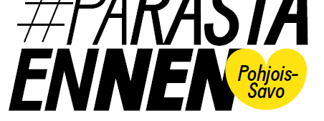
"It's best before" -
Development of school culture and pedagogy towards sense of community in Kuopio region

Slide 2

Finnish National Agency for Education
financed by

Slide 3
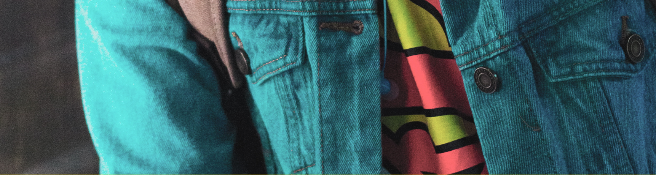
Community culture and pedagogy as general support in school
Equality in learning future skills
- social skills
- learning skills
Preventing school dropouts by encreasing school commitment and motivation

Slide 4
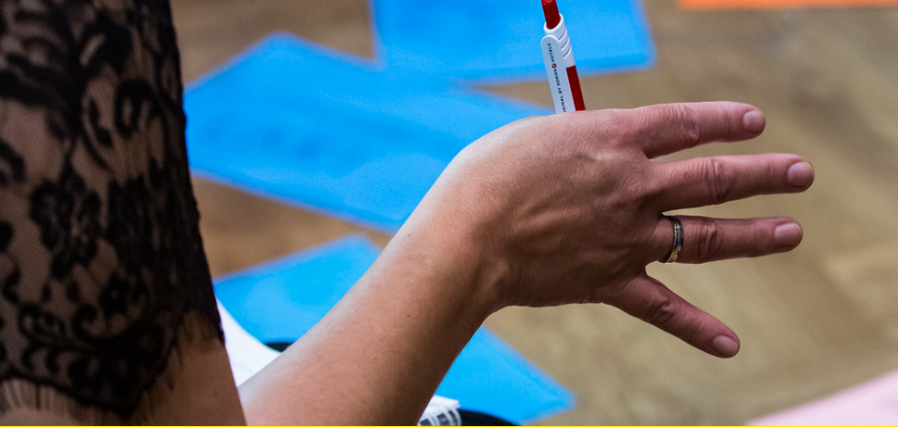
Learning in community
Learning new procedure in community:
1. Experimentation
2. Practising
3. Adopting
4. Knowing

Slide 5
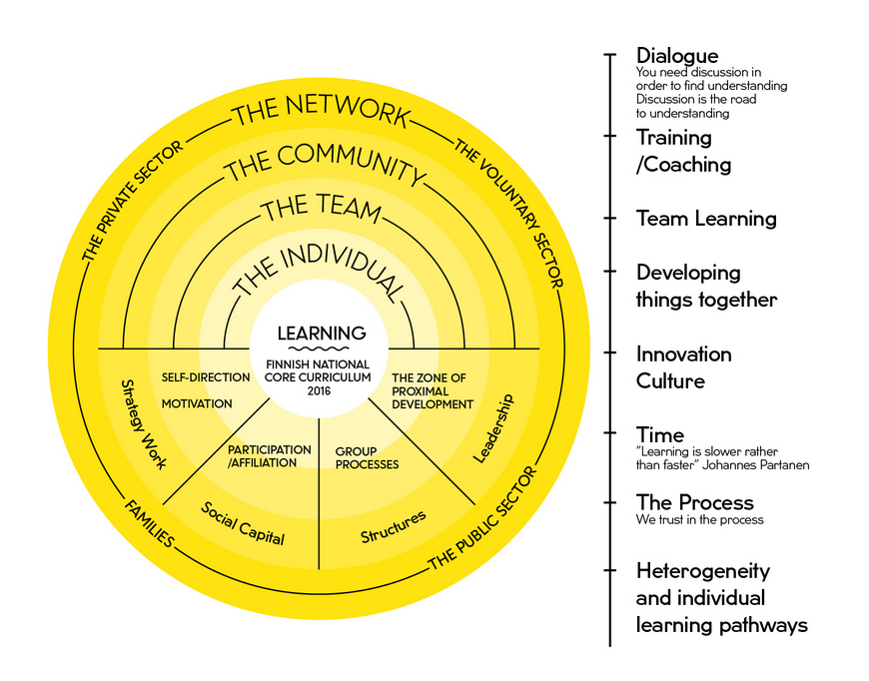
MoMo –model
The MoMo Model is the project’s practical frame of reference. The model describes the operating principles and key concepts. Learning is at the core of the model and radiates to all the other circles.

Slide 6
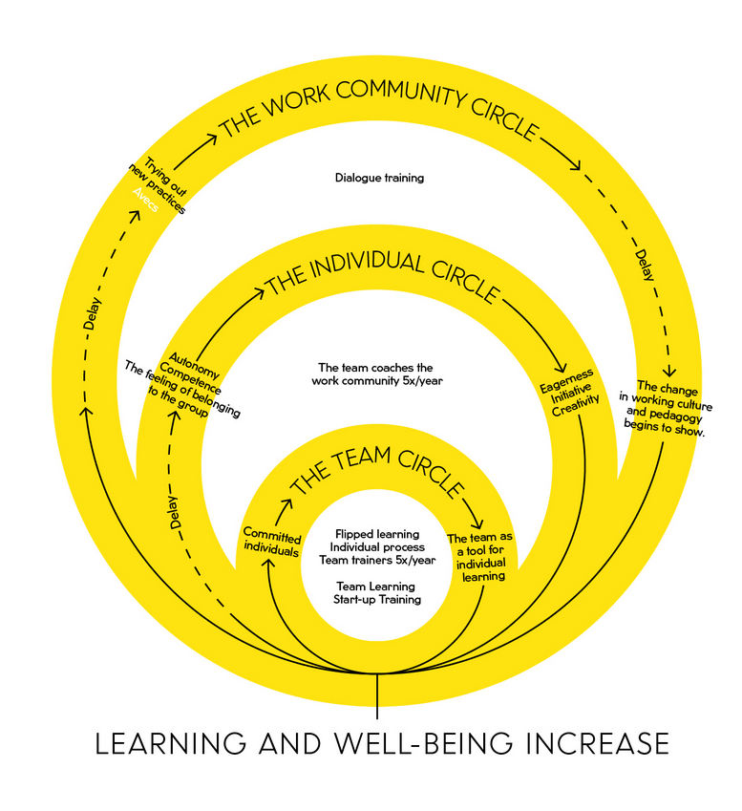
The Mentor Model
The project uses mentoring as a working method. Team coaches and drama educators work with each school’s project team. In turn, the project teams train the work community.

Slide 7
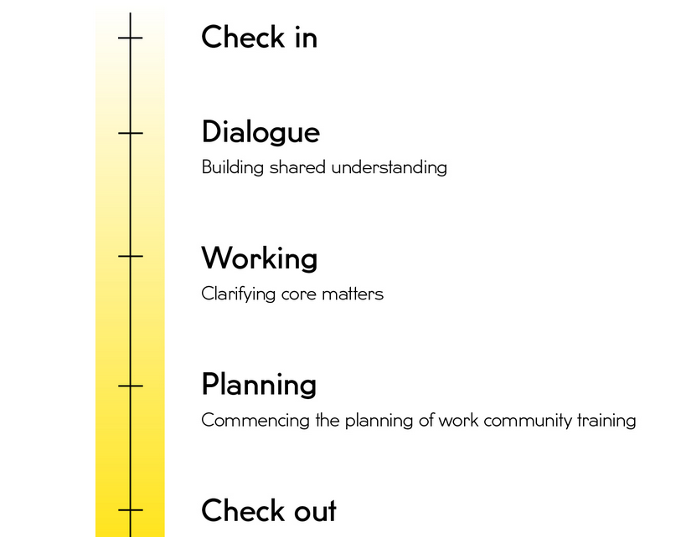
Single Training Session Model
A single training session includes advance preparation, dialogue, working and summarisation. Work community training is also prepared during this time.

Slide 8

More information
Jarno.bruun@kuopio.fi
+3580447184417
https://twitter.com/parastaennenPS
https://www.facebook.com/parastaennenPohjoisSavo/

