Slide 1
PSYCHOLOGY AS A SCIENCE
Pre-IB Psychology LAJM

Slide 2
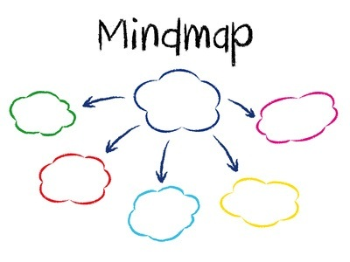
TASK
If psychology is the scientific study of mind and behaviour, what does scientific mean?
Form pairs and/or small groups and compile a mind map on the meaning of scientific
Don’t use any assistive devices!

Slide 3

Common criteria for scientific knowledge
Progressivity
Criticality
Trustworthy methods
Publicity
Generalizability
Objectivity
Ethicality
COMPARE YOUR MIND MAP WITH THESE CRITERIA

Slide 4

TASK
Give examples of scientific theories
What is meant by scientific theory?
Don’t use any assistive devices!

Slide 5
Scientific theory
Systematic body of knowledge
Explanation that explains observations and their relationships
Hypothesis
Prediction that is derived from a theory
Assumption that is being tested

Slide 6

TASK
Give examples of empirical studies
What is meant by empirical study?
Don’t use any assistive devices!

Slide 7
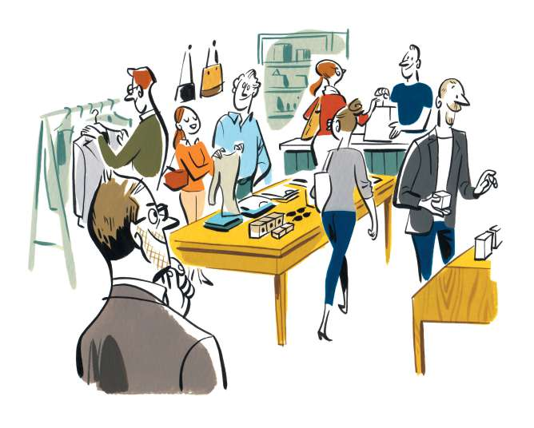
Empirical study
Activity that includes the systematic collection and analysis of empirical data
Information that is based on observations or experience

Slide 8

TASK
Read the teacher’s extra material on psychological theories and empirical studies in psychology

Slide 9
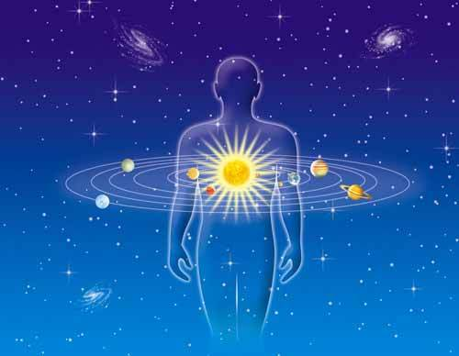
TASK
What kind of non-scientific ways to study the human mind and behaviour do you know?
How do they not meet the criteria for psychological research?

Slide 10
Overview of psychological research process
(1) Research question
Formulating hypothesis (based on theory)
(2) Choice of methods
Who are being studied and by what methods?
(3) Implementing the research
Did the hypothesis get support or was it falsified?
(4) Conclusions
Did the research have an effect on the theory and/or practise?

Slide 11

Research design
The way how the research is conducted
Principles of the psychologist

Slide 12

1. Experimental study
Aims to establish a cause-and-effect relationship between two variables
Manipulation of the independent variable influences the dependant variable

Slide 13
TASK
Which one is independent variable and dependant variable?
Driving a car and being drunk
Rest and success in an examination
Noise and number of words recalled
Success in a task and number of repeats
Amount of light and the level of vitality

Slide 14

1. Experimental study
Variables need to be operationalized into measurable form

Slide 15
TASK
How can these variables be operationalized?
Driving a car and being drunk
Rest and success in an examination
Noise and number of words recalled
Success in a task and number of repeats
Amount of light and the level of vitality

Slide 16
1. Experimental study
Participant
A person who takes part in an experiment
Experimental group
Participants who are exposed to the influence of the independent variable
Control group
Participants who have the same experimental setting, but WITHOUT the influence of the independent variable

Slide 17
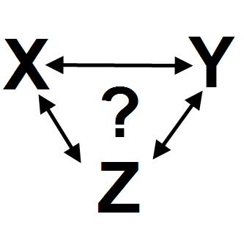
1. Experimental study
Controlling the circumstances and the participants is vital in order to block the effect of undesired confounding variables

Slide 18
TASK
What could be confounding variables in the following research questions?
Does being drunk effect one’s driving ability?
How important is rest for success in examinations?
Does noise effect memory functions?
How important is repetition for learning?
Does the amount of light have an effect on the level of vitality?

Slide 19
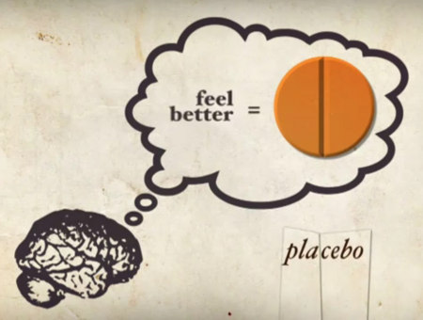
1. Experimental study
Placebo-effect:
An effect based on beliefs and presuppositions, not changes in the independent variable

Slide 20
1. Experimental study
Watch this educational video on placebo-effect
HOW TO AVOID THE
PLACEBO EFFECT IN PSYCHOLOGICAL RESEARCH?

Slide 21
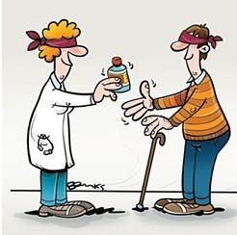
1. Experimental study
Blind test:
Participants don’t know whether they are in the experimental group or in the control group
Double blind test
In addition to participants, the researchers don’t know which group the participants belong

Slide 22
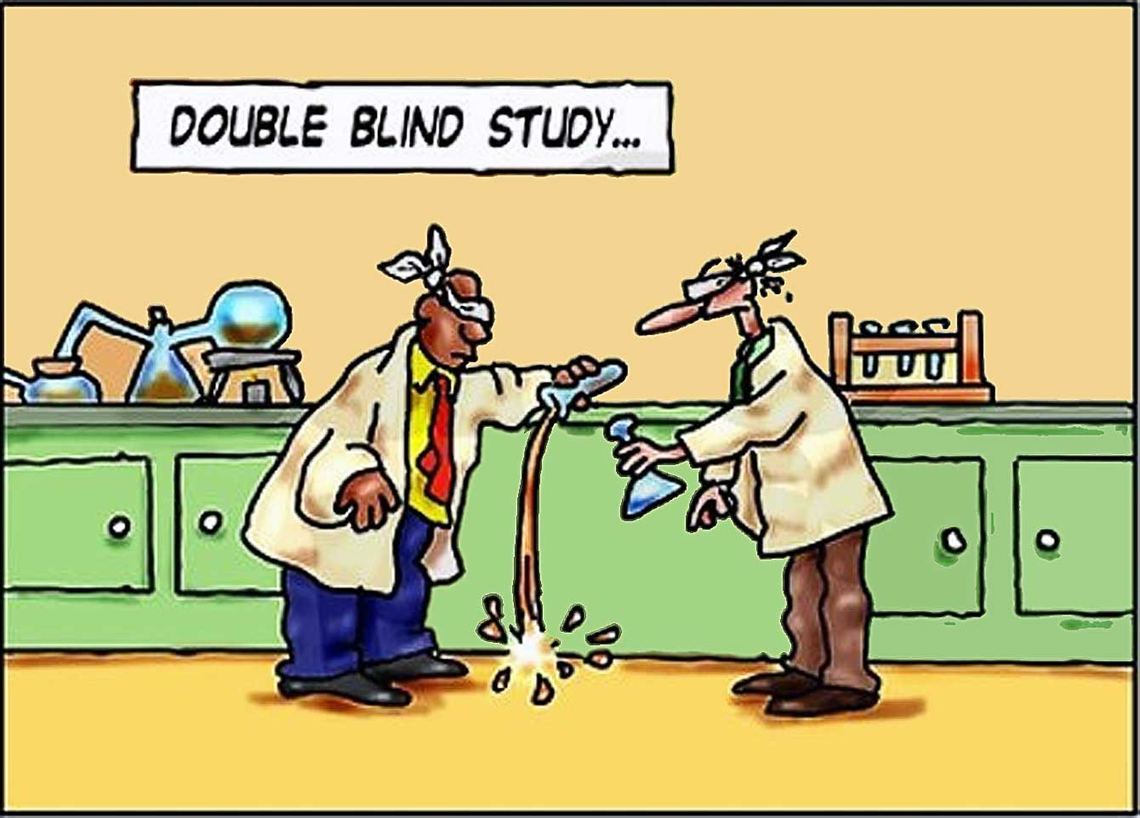
TASK
What kind of problems and limitations might experiments have in psychological research?

Slide 23
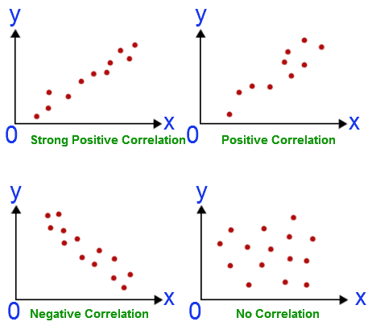
2. Correlational study
Two variables are measured to see how they are related
NO manipulation of variables
CANNOT determine the cause-and-effect relationship

Slide 24
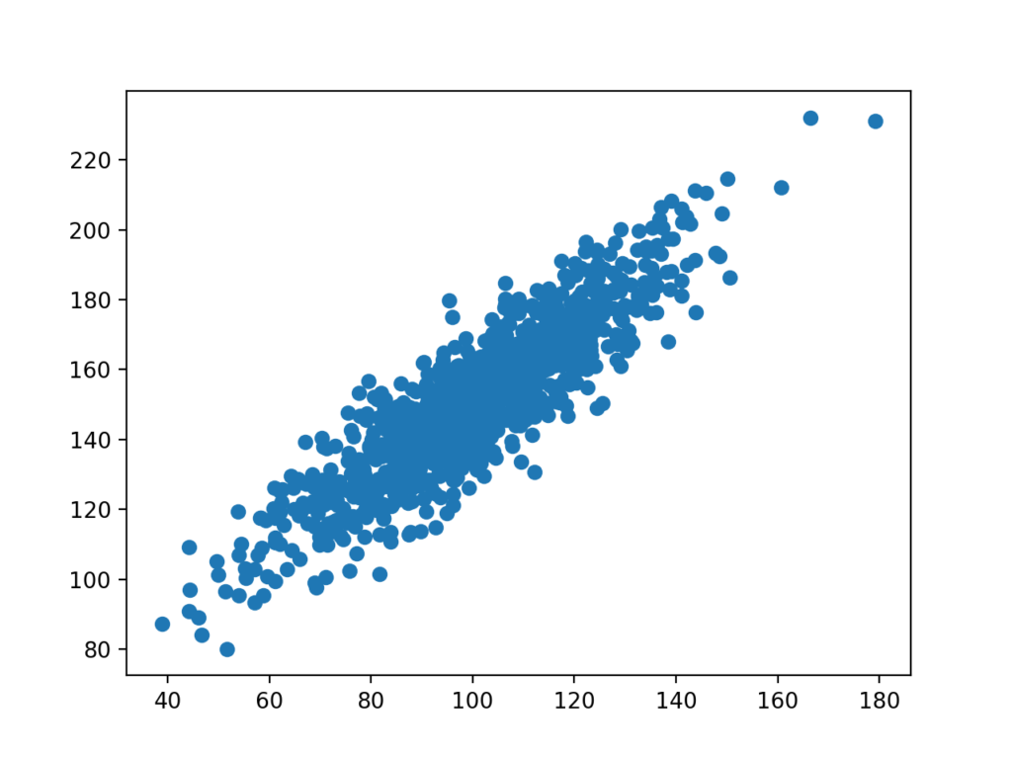
TASK
Play around with Pearson Correlation Coefficient Calculator
You can use random numbers or real sets of data

Slide 25

3. Descriptive study
Aims to describe phenomena without investigating relationships between different variables
Prevalence of a feature within a population
A sample needs to be taken from the population

Slide 26
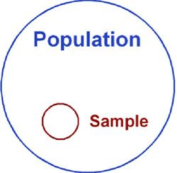
TASK
What makes a good sample?
What needs to be taken into consideration when a sample is taken from the target population?

Slide 27
3. Descriptive study
A good sample:
Represents the target population
Allows reliable generalizations

Slide 28

3. Descriptive study
A phenomenon called WEIRD is a challenge in psychological research
Majority of psychological data is gathered in North America and Europe
HOW DOES THIS EFFECT THE CREDIBILITY OF PSYCHOLOGICAL RESEARCH?

Slide 29
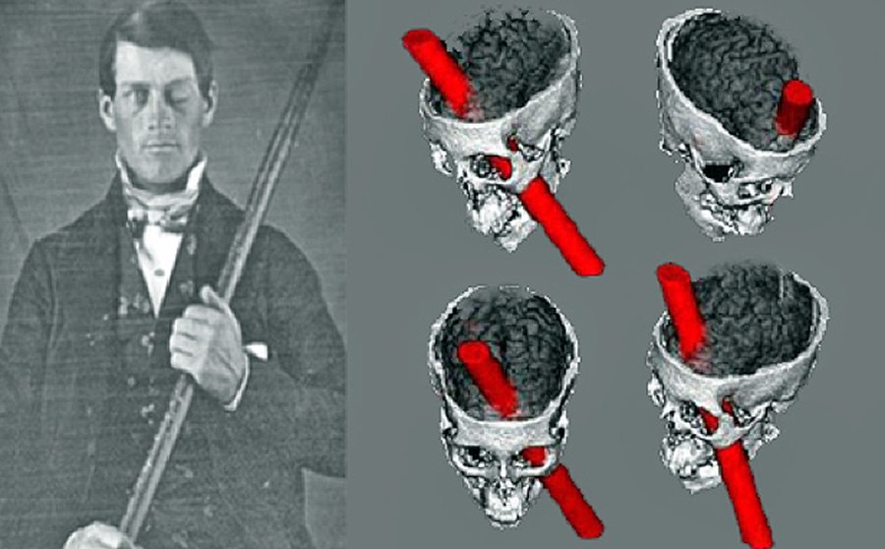
4. Case study
Researches one case
E.g. an individual, a group of people or an event
Common in neuropsychology and abnormal psychology
Aims to understand and help individuals
Results are not generalizable

Slide 30
4. Case study
Watch this educational video on the story of Phineas Gage

Slide 31
EXPERIMENTS
- Cause and effect relationships between phenomena
CORRELATIONAL STUDIES
- Relationships between phenomena
DESCRIPTIVE STUDIES
- Reliable generalizations
CASE STUDIES
- New research ideas and hypothesis

Slide 32
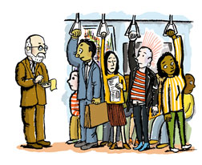
Research setting
Where the research is conducted
Laboratory study
Carefully controlled environment
Field study
Natural environment

Slide 33

Data-collecting methods
How information is gathered
Tools of the psychologist

Slide 34
Data-collecting methods
Quantitative research
Studies relationships, cause-effect and correlation
Uses large samples
Statistical analysis of numerical data
Qualitative research
Examines phenomena as it is, rich in detail
Uses small samples
Narrative description and interpretation

Slide 35
TASK
Pick a phenomenon from the list on the right or choose one of your own
How can you examine this phenomenon from both quantitative and qualitative perspectives?
What kind of data-collecting methods should you use?
Happiness
Love
Aggression
Stress
Addiction
Learning
Memory
COMPILE A MINI RESEARCH PLAN

Slide 36
Data-collecting methods
Quantitative research
Survey / Questionnaire
Quantitative observation
Experiment
Qualitative research
Interview
Qualitative observation
Content analysis
THESE TWO APPROACHES SHOULD NOT BE SEEN AS COMPETING, BUT AS COMPLEMENTARY TO DIFFERENT TYPES OF RESEARCH QUESTIONS

Slide 37

Data-collecting methods
Interview
Structured
Semi-structured
Narrative
Focus group

Slide 38
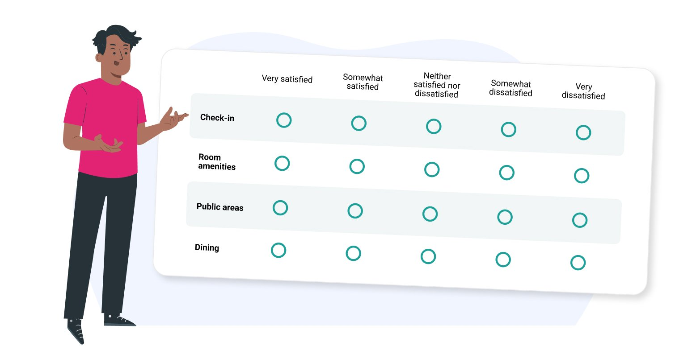
Data-collecting methods
Survey / questionnaire
Standardised set of questions
Fixed scales / narrative responses

Slide 39

Data-collecting methods
Observation
Naturalistic / controlled
Overt / covert
Participant / non-participant

Slide 40

TASK
How participants should be treated in psychological research?
Compile a list of ethical guidelines for treating participants
Skim pages 37–40
How similar were your thoughts compared to the course book?

Slide 41
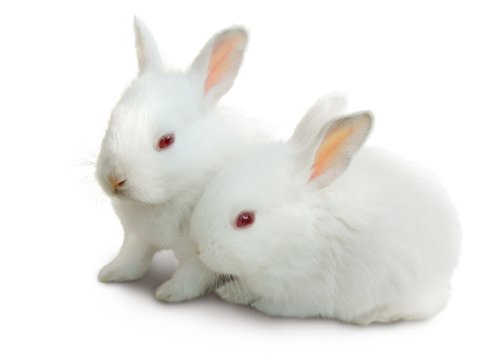
TASK
How should test animals be treated in psychological research?
What kind of arguments can we have for and against the use of test animals in psychology?

Slide 42
Picture sources
Mind map <https://www.fillthefunnel.com/mind-mapping-the-foundation-to-breakout-thinking/> Accessed 25th of September 2017.
Open mind <http://cbtcentre.com.au> Accessed 25th of September 2017.
Science <http://www.brstf.org> Accessed 11th of October 2015.
Sherloc Holmes <https://rubyskyepi.com/features/be-a-detective/pi-observation/> Accessed 8th of May 2018.
Group under observations <https://www.freepik.com/free-vector/qa-tester-developmental-kit-analyzing-binary-code-close-inspection-coding-checking-open-script-website-administration-reaffirming-quality-vector-isolated-concept-metaphor-illustration_11668619.htm#query=observation&position=21&from_view=search&track=sph> Accessed 8th of May 2018.
Kid reading <https://www.freepik.com/premium-vector/cute-kid-reading-book-children-day-illustration-sticker-kid-sitting-ground-read_44955609.htm> Accessed 10th of August 2023.
Astrology <http://netchanting.com> Accessed 25th of September 2017.
Research <http://research.southwales.ac.uk> Accessed 25th of September 2017.
X and Y <http://ieet.org/index.php/IEET/more/goertzel20100207> Accessed 11th of October 2015.
Heart tree <http://www.loveimagesdownload.com> Accessed 11th of October 2015.
Placebo-effect <http://www.theemotionmachine.com/how-to-create-your-own-placebo-pills> Accessed 11th of October 2015.
Double blind test 1 <http://www.chrisasbury.com/?p=373> Accessed 11th of October 2015.
Double blind test 2 <http://www.tychosnose.com/natures-newest-secrets/> Accessed 11th of October 2015.

Slide 43
Picture sources
Correlation 1 <http://math.tutorvista.com/statistics/correlation-and-regression.html> Accessed 16th of August 2015
Correlation 2 <https://machinelearningmastery.com/how-to-use-correlation-to-understand-the-relationship-between-variables/> Accessed 25th of August 2020
Group of people 1 <https://www.cedars-sinai.edu/Patients/Programs-and-Services/Neurology/> Accessed 16th of August 2015
Sample <https://www.simplypsychology.org/sampling.html> Accessed 25th of August 2020.
Phineas Gage <http://onlinestorybank.com/2014/03/the-strange-case-of-mr-phineas-gage/> Accessed 17th of August 2017
People in train <http://www.slate.com/articles/life/transport/2009/11/underground_psychology.html> Accessed 18th of August
Interview <https://blogs.oregonstate.edu/whatsinaninterview/2024/10/31/hello-world/> Accessed 13th of August 2025
Survey <https://yourcx.io/en/blog/2025/01/reasons-why-well-designed-survey-questions-matter-in-feedback-collection/> Accessed 13th of August 2025
Observation <https://westernsydney.pressbooks.pub/customerinsights/chapter/chapter-8-observational-research/> Accessed 13th of August 2025
Participants <https://www.penserv.com/login/> Accessed 26th of September 2017.
Test animals <https://www.crueltyfreeinternational.org/DrugTesting> Accessed 26th of September 2017.

