Slide 1
WHAT IS PSYCHOLOGY?
Pre-IB Psychology LAJM

Slide 2
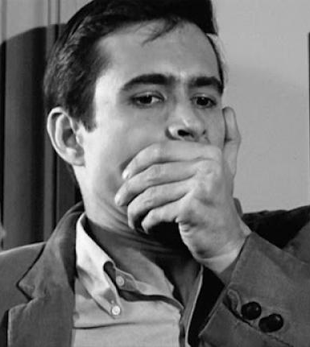
TASK
What kind of psycho related words do you know?
DON’T use any assistive devices!
Volunteers will come to the whiteboard to write their words

Slide 3

TASK
Write down your own definition of psychology
Again, DON’T use any assistive devices
Compare your definition to your neighbours definitions

Slide 4
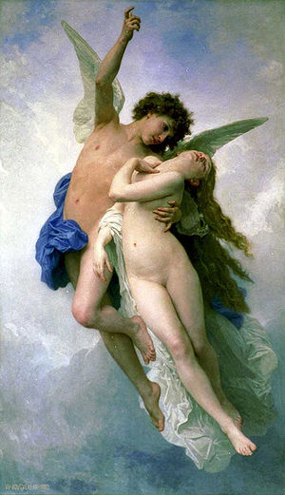
What is psychology?
Etymology
psyche (greek) = mind, soul, spirit
logos (greek) = reason, study, science
”study of the mind”

Slide 5
What is psychology?
Watch this educational video on the myth of Cupid and Psyche

Slide 6
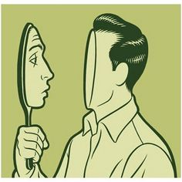
What is psychology?
At first, psychology was just introspection
Observe your mind for one minute and write down your observations

Slide 7

What is psychology?
Then psychology researched only outer behaviour (behaviourism)
Observe your neighbour’s behaviour for one minute and write down your observations

Slide 8

What is psychology?
Nowadays subjective experiences and objective behaviour are both taken into consideration
Psychology is the scientific study of mind and behaviour

Slide 9

TASK
Skim through the syllabus in peda.net and text-book’s contents pages
What topics are you interested in?
Engage in conversation with your neighbours
If possible, try to give reasons why you are interested in certain topics

Slide 10

TASK
What kind of expectations and aims do you have on studying psychology?
Write down your expectations and aims
Engage in conversation with your neighbours

Slide 11

Fields of psychology
Study different aspects of human mind and behaviour
Psychology covers human action from severe mental disorders to peak experiences

Slide 12
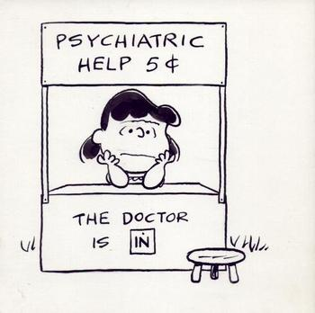
TASK
Read page 24 and familiarize yourself with different career opportunities in psychology
Form groups and build mini plays where a certain kind of psychologist appears
When the plays are presented, other groups must guess what field of psychology the play is about

Slide 13
Important titles
Psychologist
A person who has studied psychology in university as a major
Psychiatrist
A doctor who is specialised in mental disorders
Psychotherapist
A person who has received training in psychotherapy and helps patients to understand themselves better and to deal with their problems

Slide 14
Picture sources
Psycho <http://doubleexposurejournal.com/blog/the-psycho-birds/> Accessed 22nd of September 2015.
Black head <http://directactioneverywhere.com/theliberationist/2015/3/10/what-does-psychology-really-tell-us-about-animal-welfarism> Accessed 22nd of September 2015.
Psyche <https://fi.wikipedia.org/wiki/Psykhe> Accessed 22nd of September 2015.
Mirror mind <https://www.pinterest.com/themirrormind/introspection/> Accessed 22nd of September 2015.
Head in a hand <http://www.spring.org.uk/2015/10/the-emotion-that-does-change-peoples-behaviour-after-all.php> Accessed 21st of September 2017.

Slide 15
Picture sources
Two heads <https://www.quora.com/What-is-the-first-thing-that-comes-to-your-mind-when-you-hear-read-the-word-psychology> Accessed 22nd of September 2015.
Puzzle head <http://crossingzebras.com/the-psychology-of-eve/> Accessed 22nd of September 2015.
Brain in colours <http://www.psychology.uwo.ca/research/index.html> Accessed 22nd of September 2015.
Psychology brain <http://www.advancehealthcare.com.au/psychology/> Accessed 25th of September 2017.
Peanuts psychiatric help <http://www.sodahead.com/living/what-do-you-think-of-when-you-hear-the-word-psychologist-what-is-it-that-you-think-they-do-can-y/question-3154123/> Accessed 22nd of September 2015.

