Slide 1
INDEPENCENDE DAY IN FINLAND

Slide 2
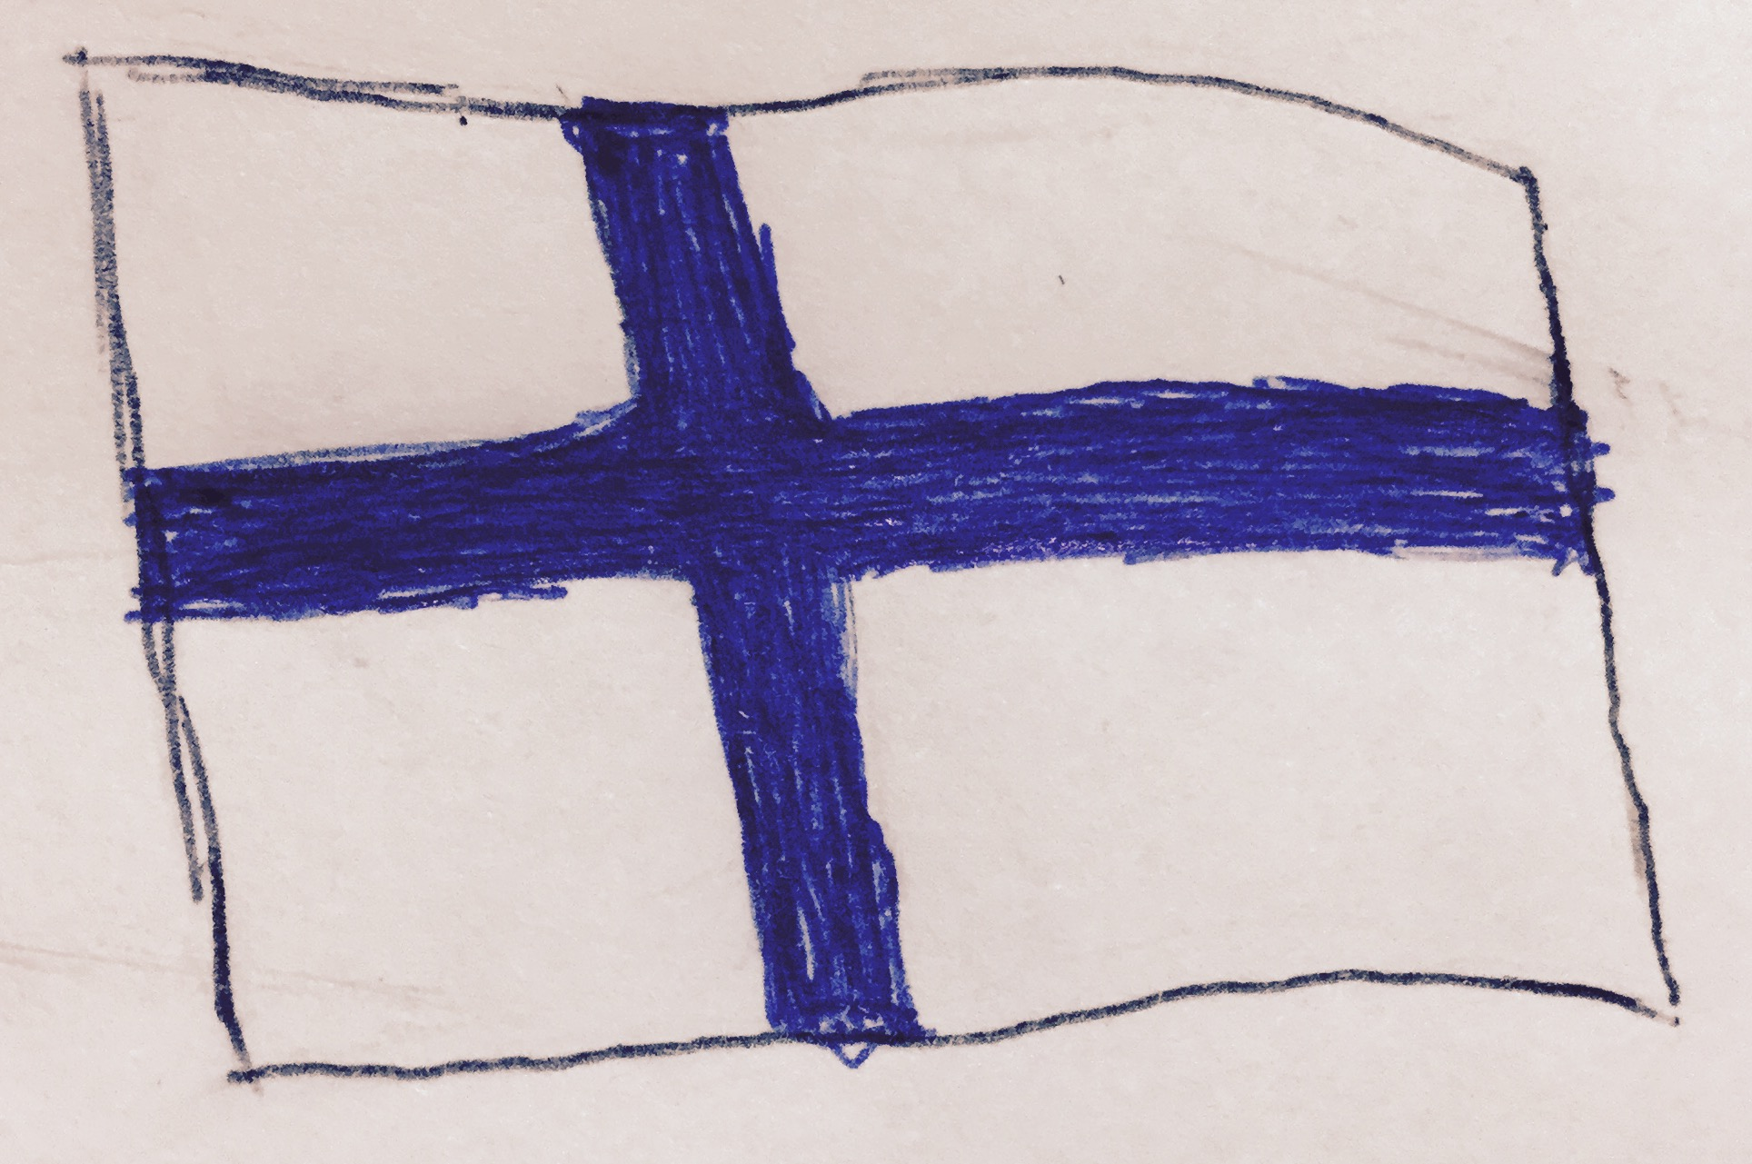
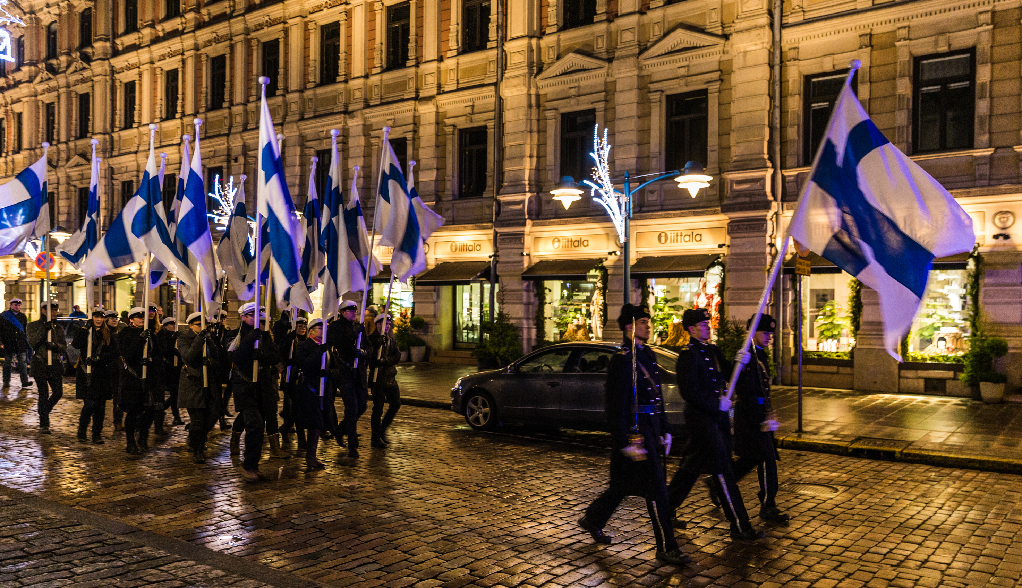
Our country has celebrated its 100th birthday last year .
We celebrate it on 6th of December .

Slide 3
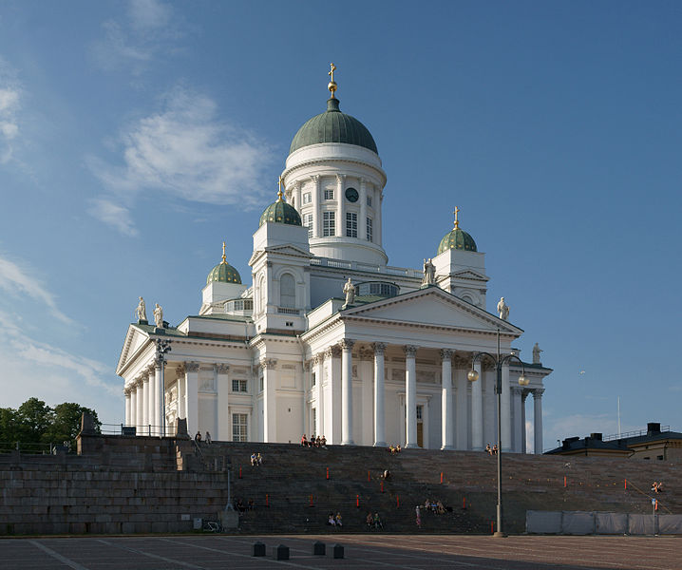
Usually on that day (6th Dec.) we Finns remember the fallen soldiers.
We visit graveyards and bring candles on them.

Slide 4
Finland's President keeps celebration reception in President's castle where the government, congressmen, war veterans and celebrities are invited.
Finns watch the celebration reseption on TV which is called Linnanjuhlat = castle ball.

Slide 5
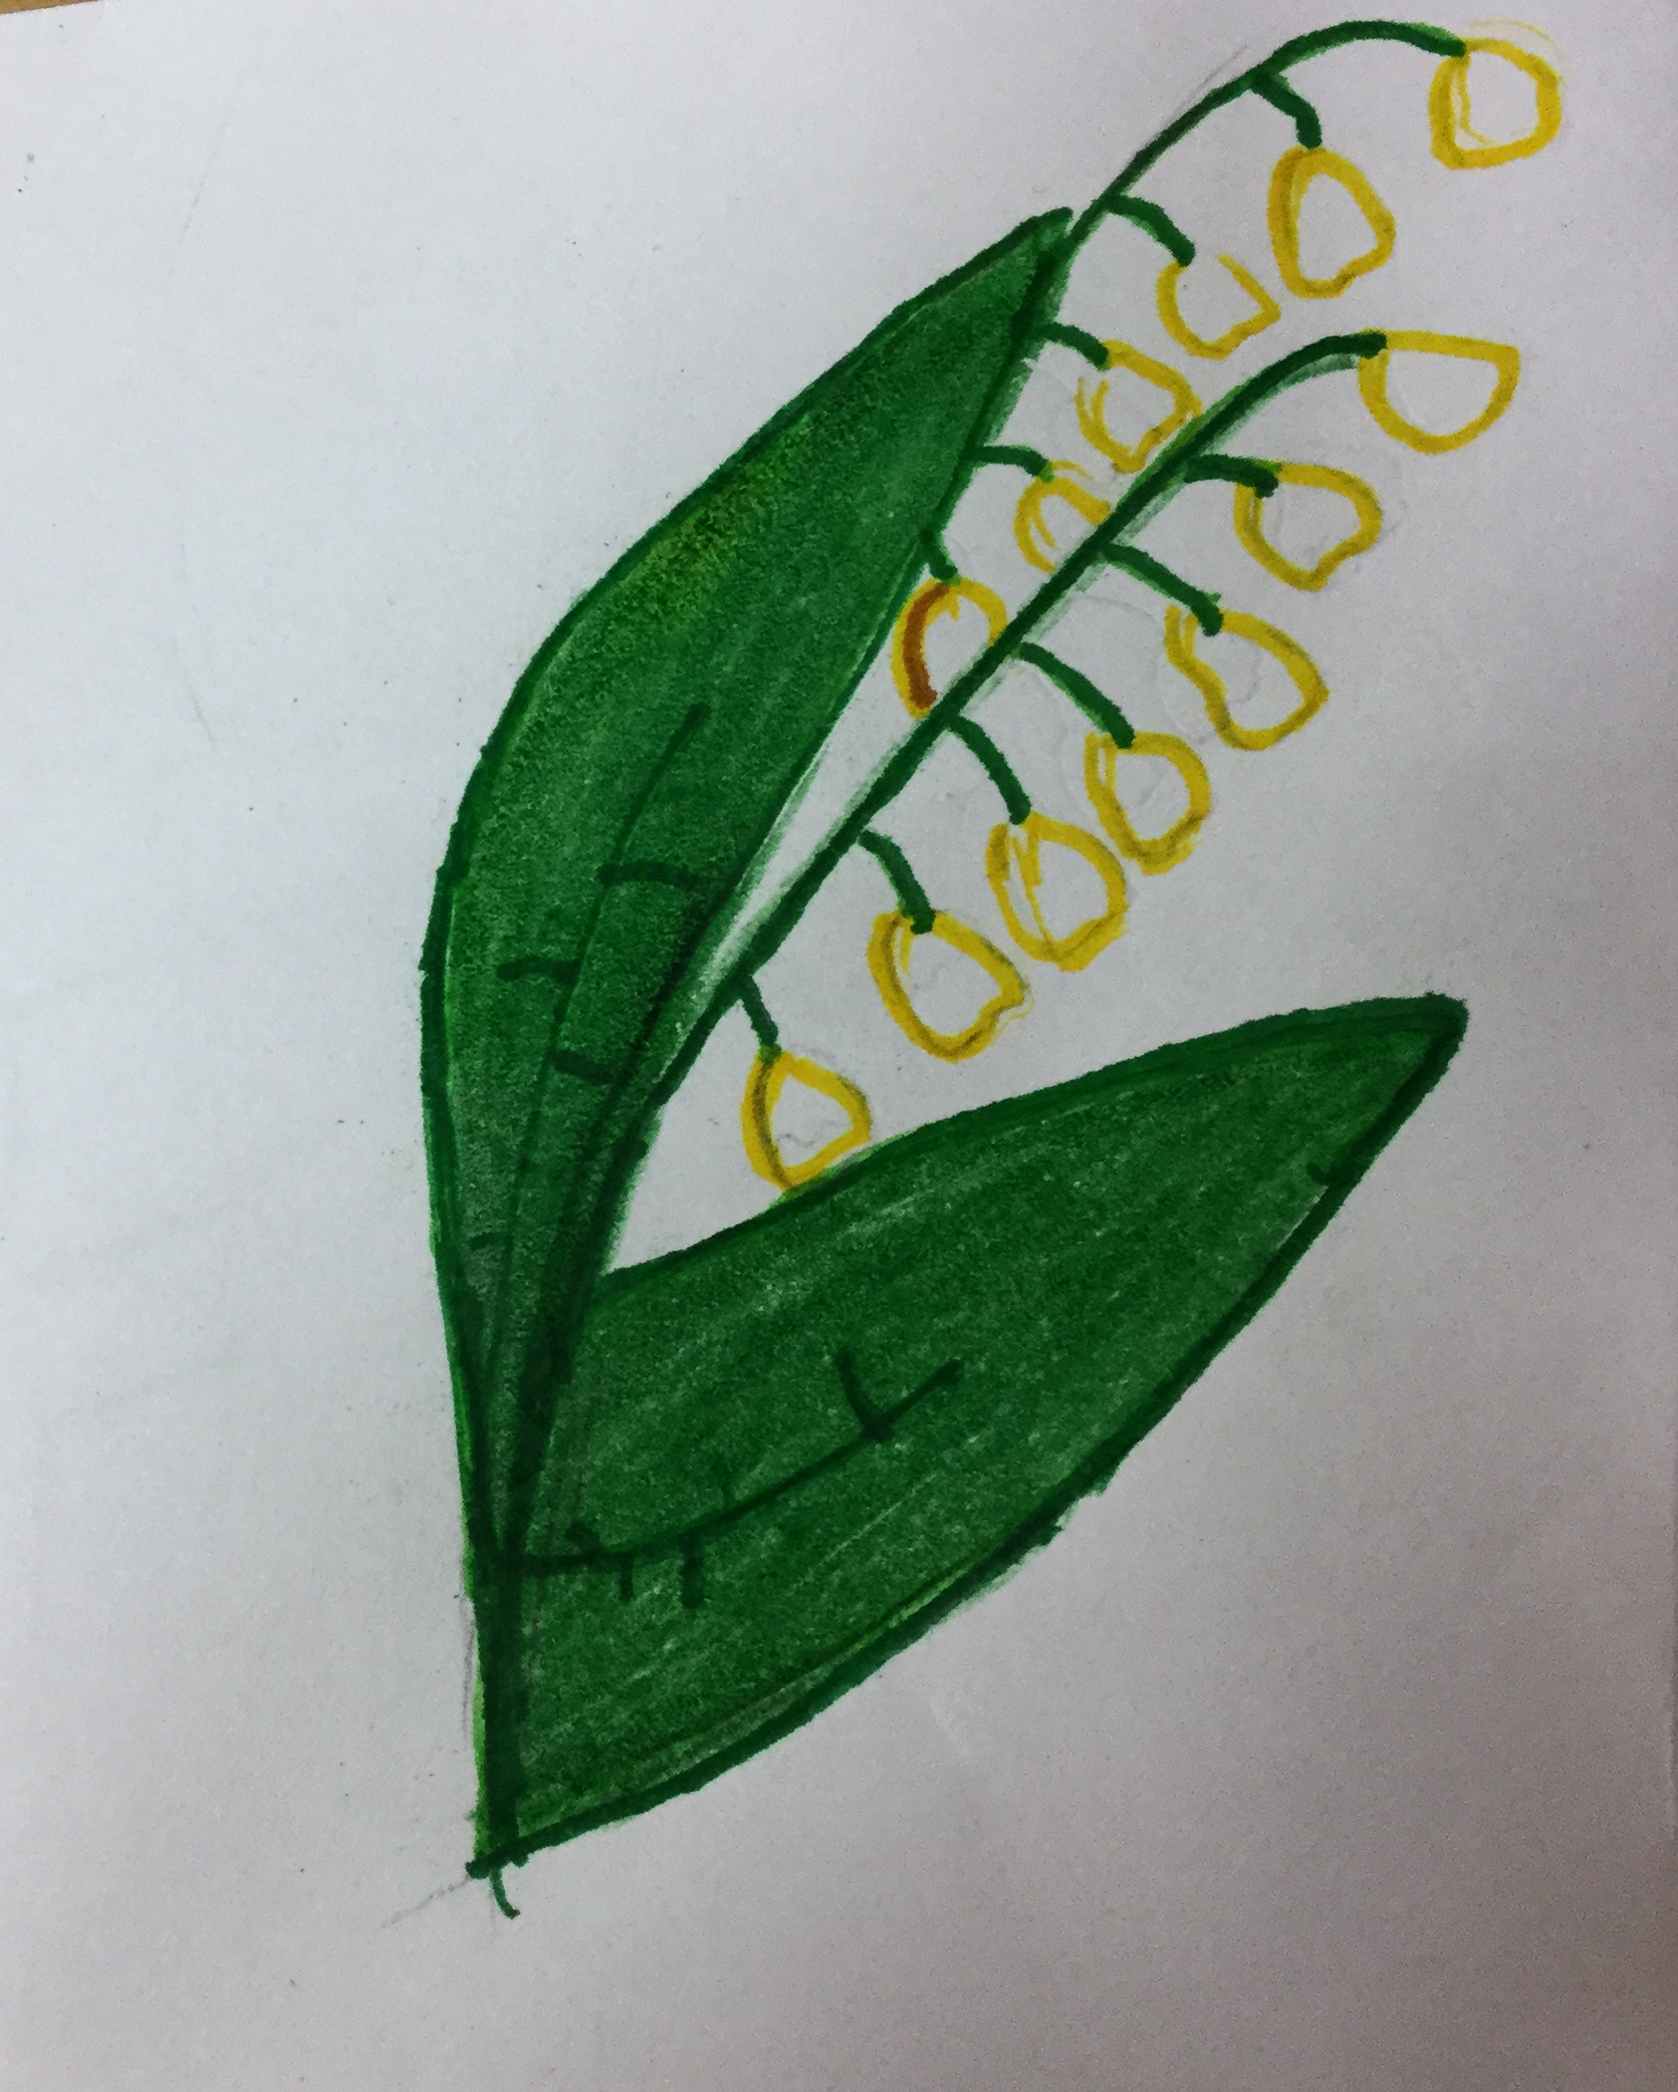
Our national anthem is "Maamme" written by Johan Ludvig Runeberg.

Slide 6
Our traditional food on independence day is called "Karjalanpaisti" .
It contains some kind of meat and vegetables.
We usually drink glogg and champagne.

Slide 7
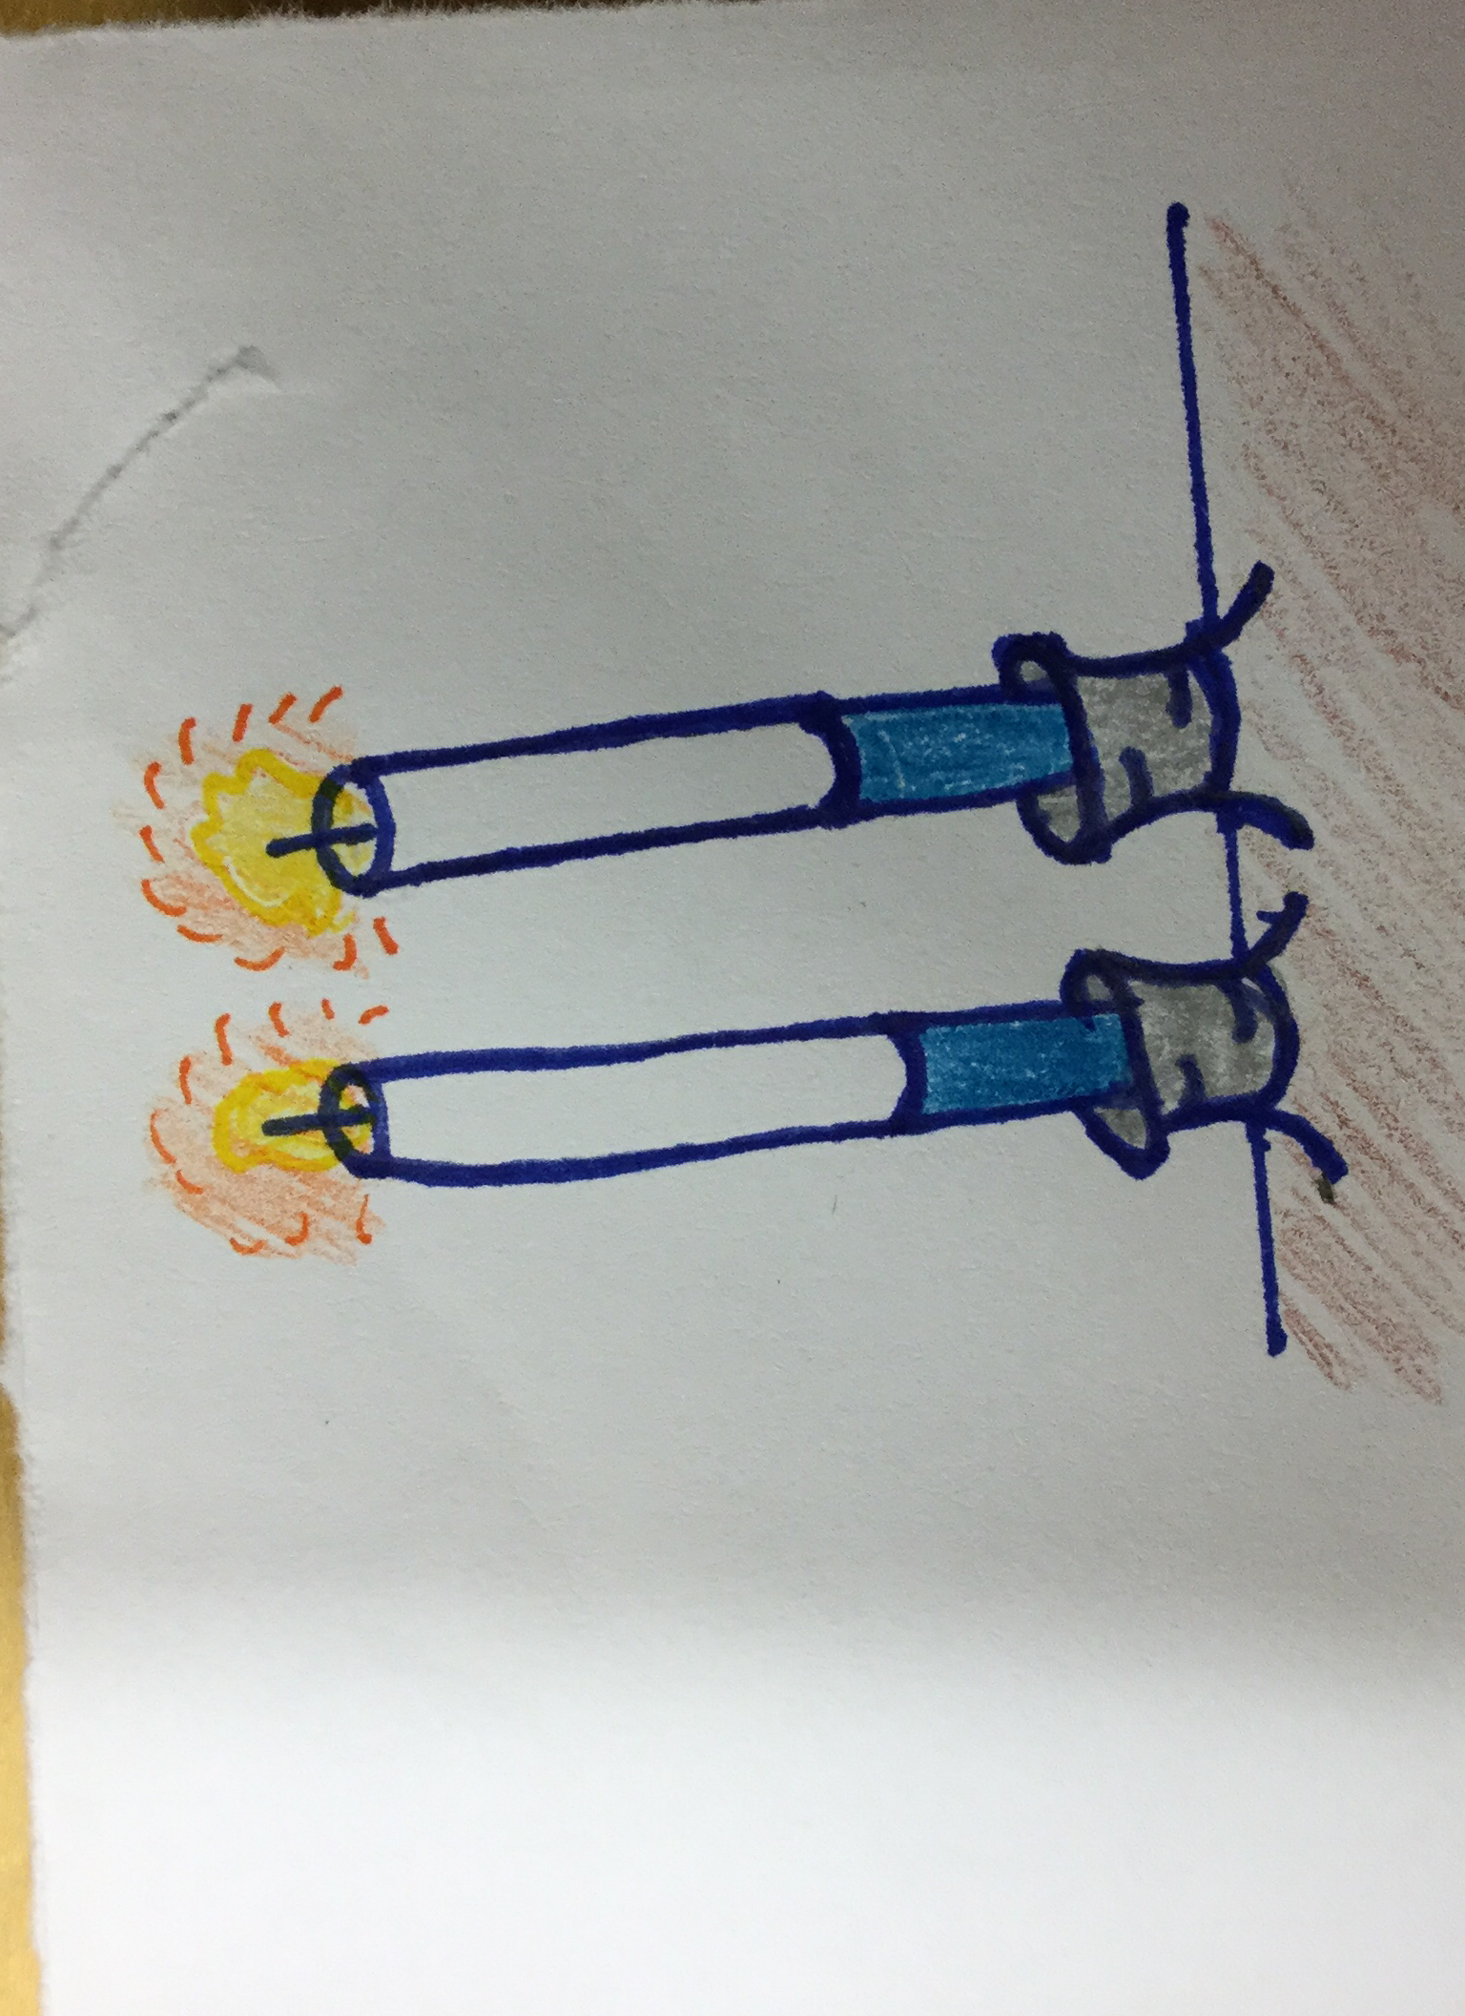
In the evening we light two candles on windowsills.
This tradition started in the 18th century.

