Slide 1
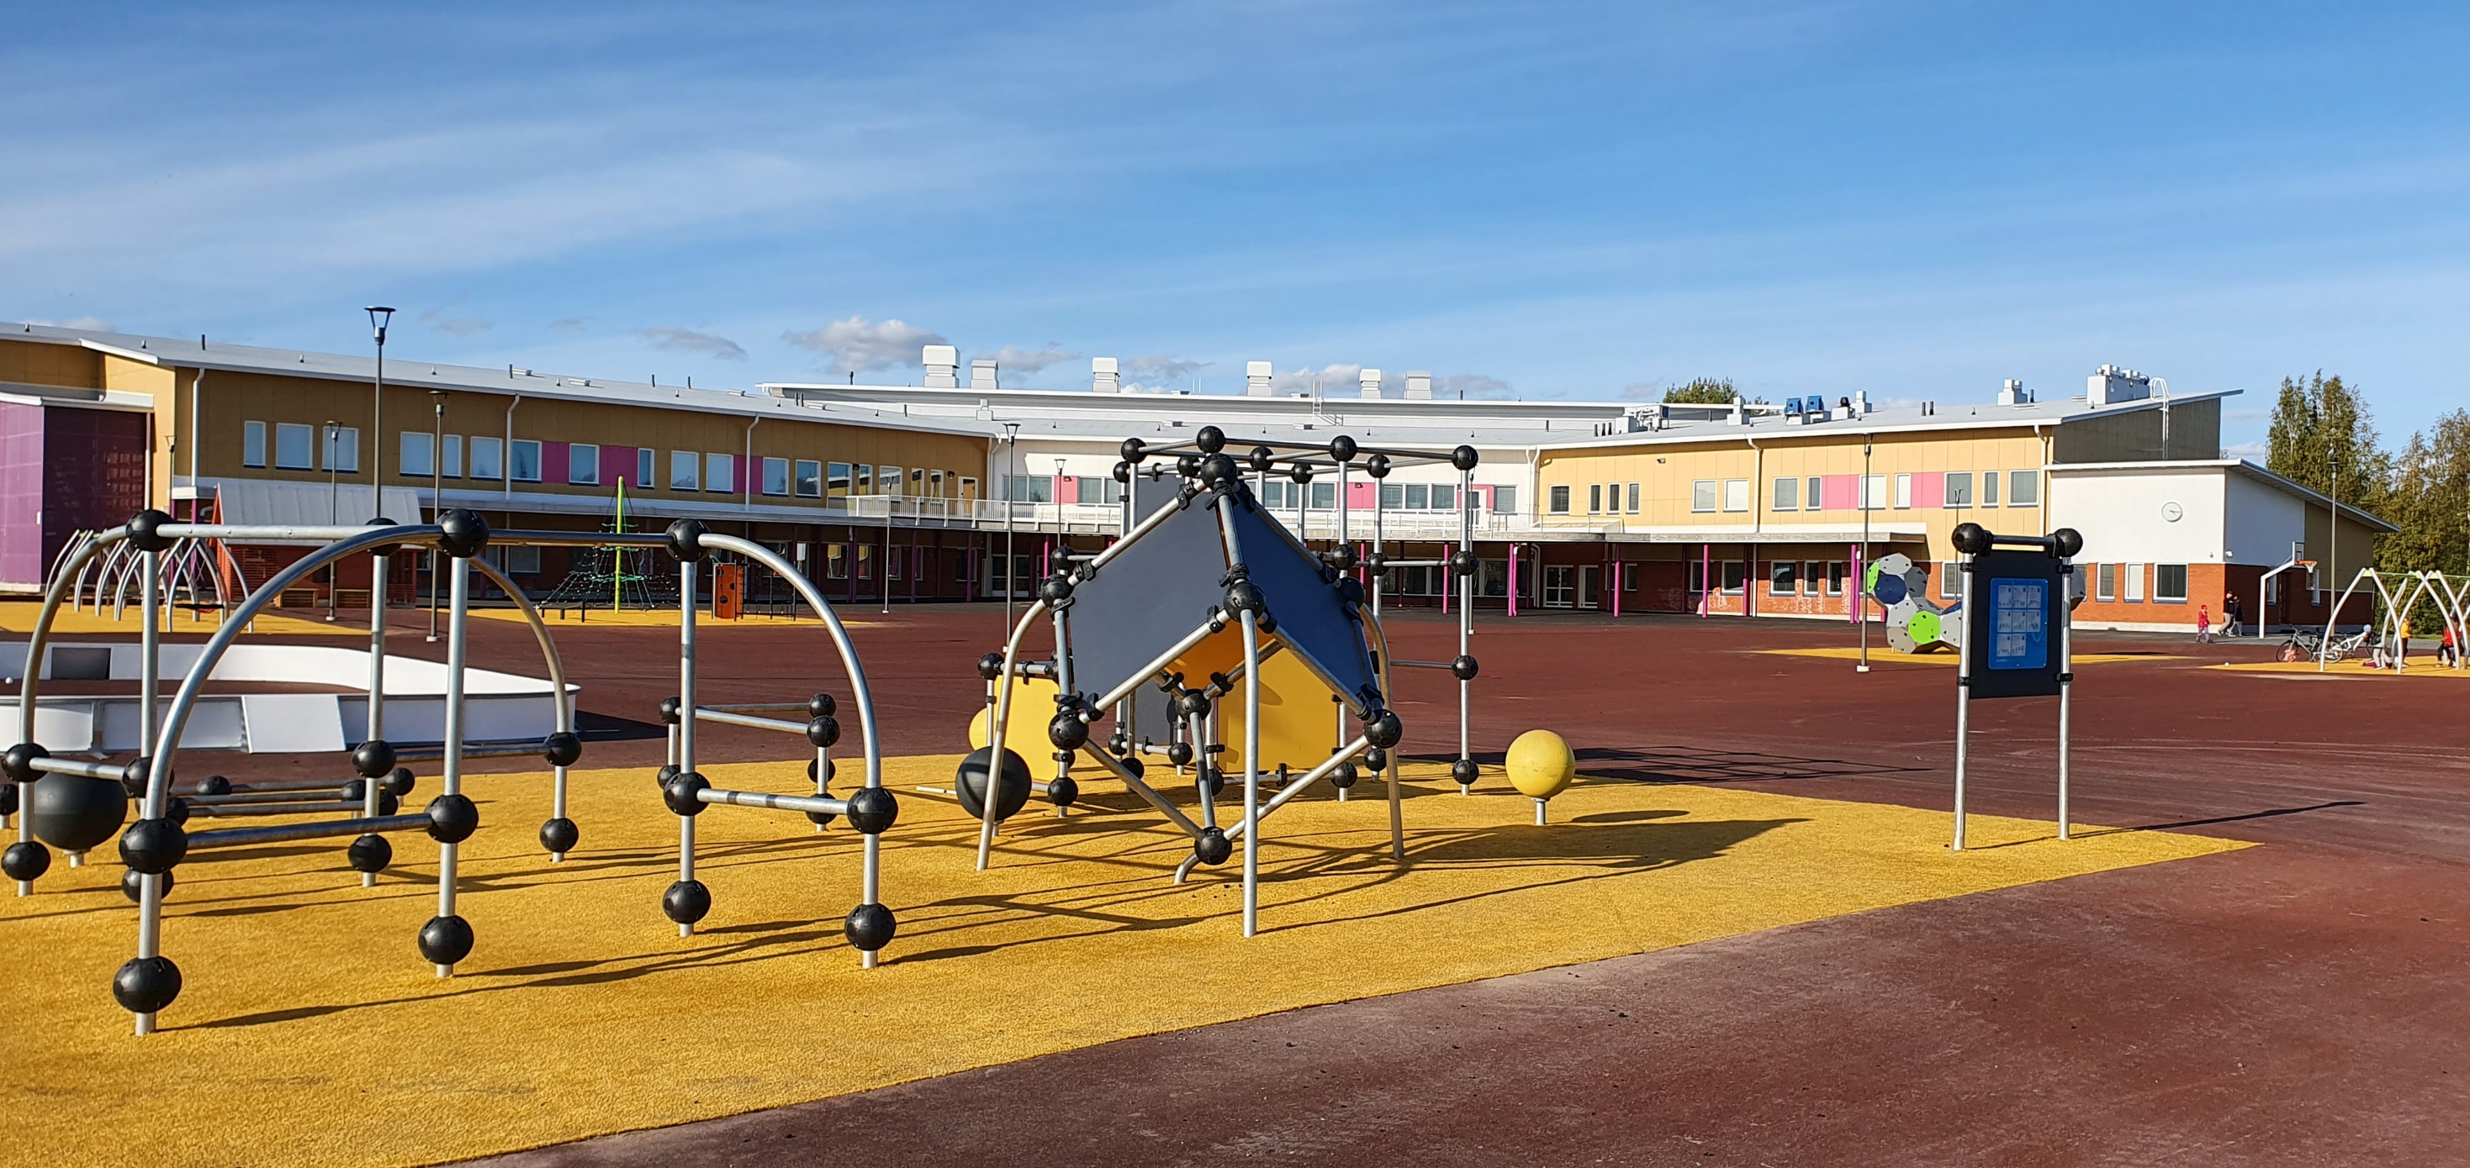
Taanilan koulu Taanila School
Tervetuloa! Welcome!

Slide 2
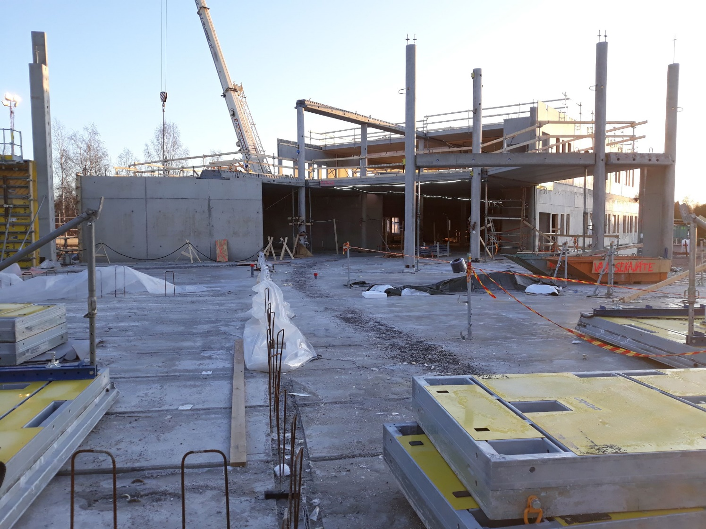
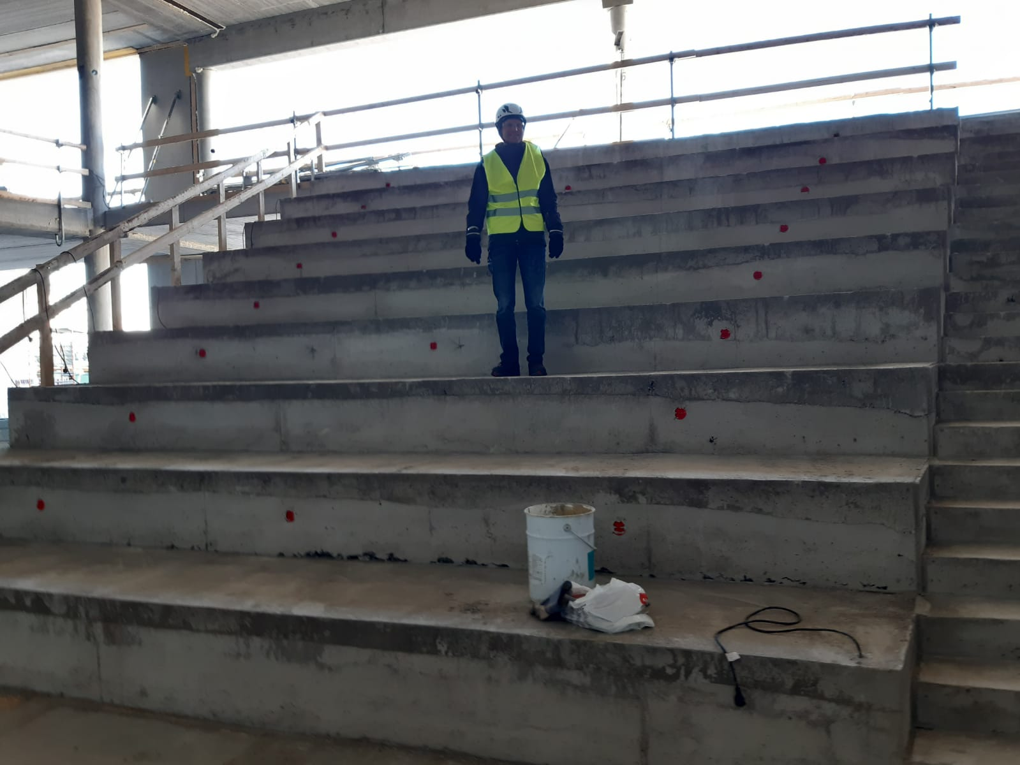
Taanilan koulu
Construction started in the spring of 2019
Kaisaniemi school was build at the same time
School started in August 2021
Total cost of construction of both schools c. 36 million €
Jan. 2020
Apr. 2020

Slide 3
Taanilan koulu
The floor area of the school is 6550 m²
Sports hall is biggest in Ylivieska area:
Surface area 28 m * 44 m -> c. 1200 m²
The hall can accommodate a full-size floorball and futsal courts
Height 8 m, which meets the requirements for national volleyball matches.
The hall can accommodate 1,200 people
250 seated in the side auditorium
400 seated in the chairs on the floor

Slide 4
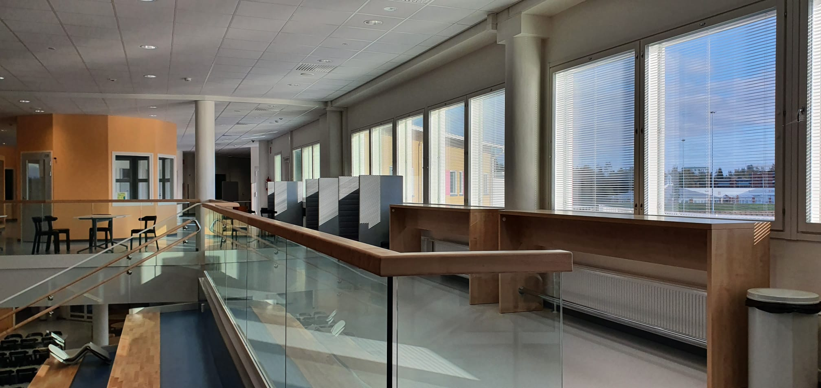
One of the main goals of the design was abundant natural light

Slide 5
Taanilan koulu 2021-2022
Staff about 35
Pupils c. 320, from next year onwards c. 380
Pre-school and grades 1-6: 140 pupils
Grades 7-8: 155 pupils
Next year also c. 80 pupils in 9th grade
High school students c. 25 (only this year)

Slide 6
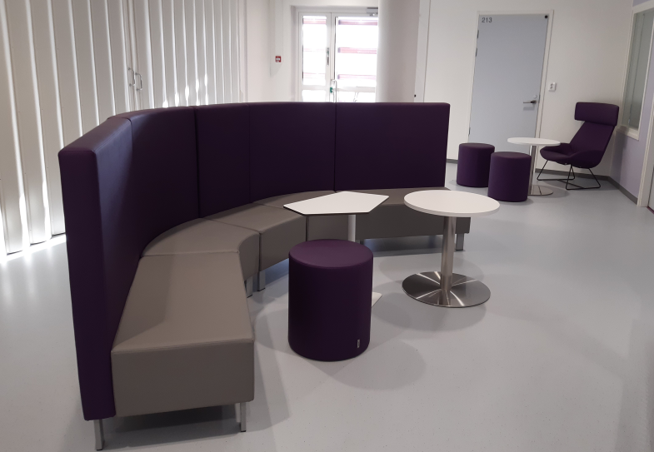
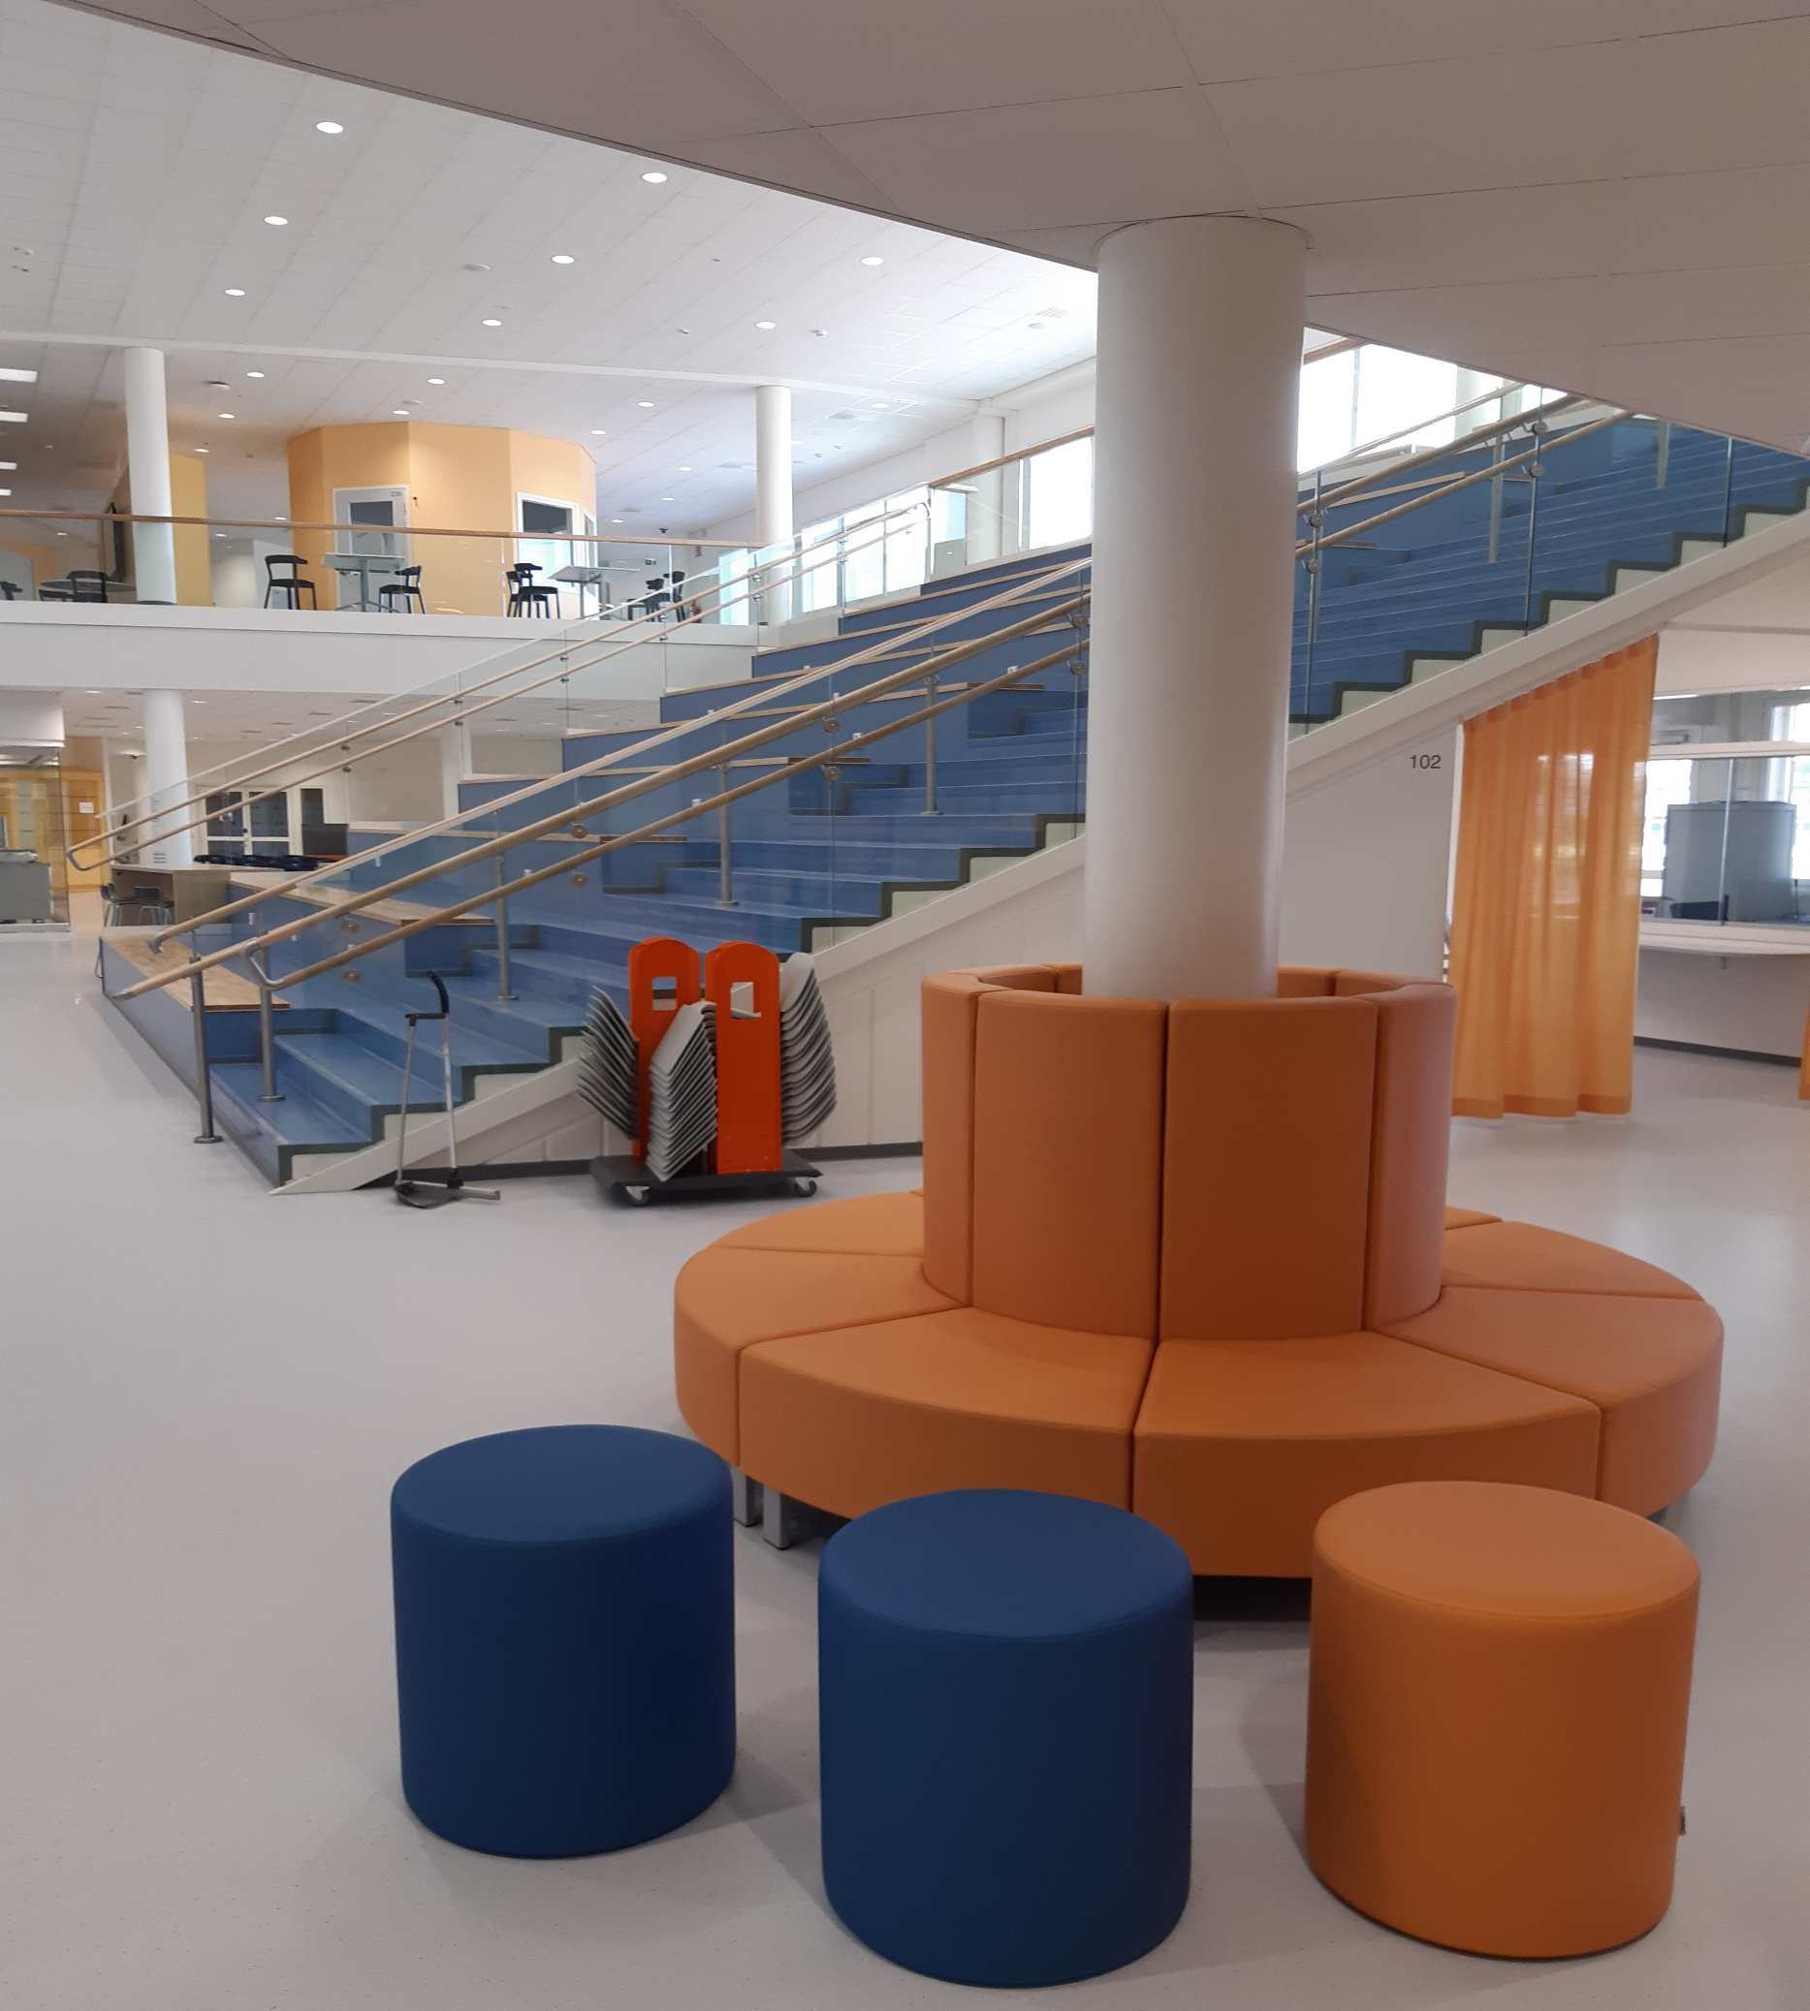
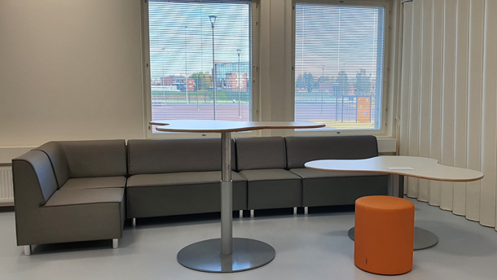
Furniture
by
Lekolar

Slide 7
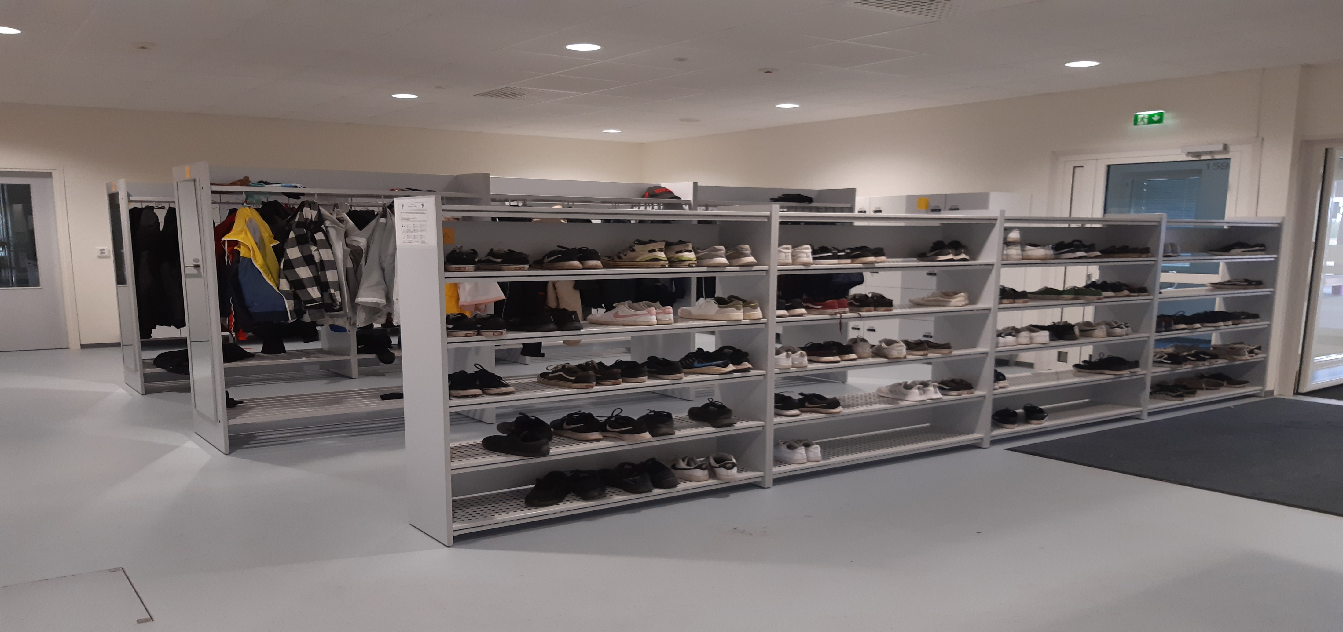

Slide 8
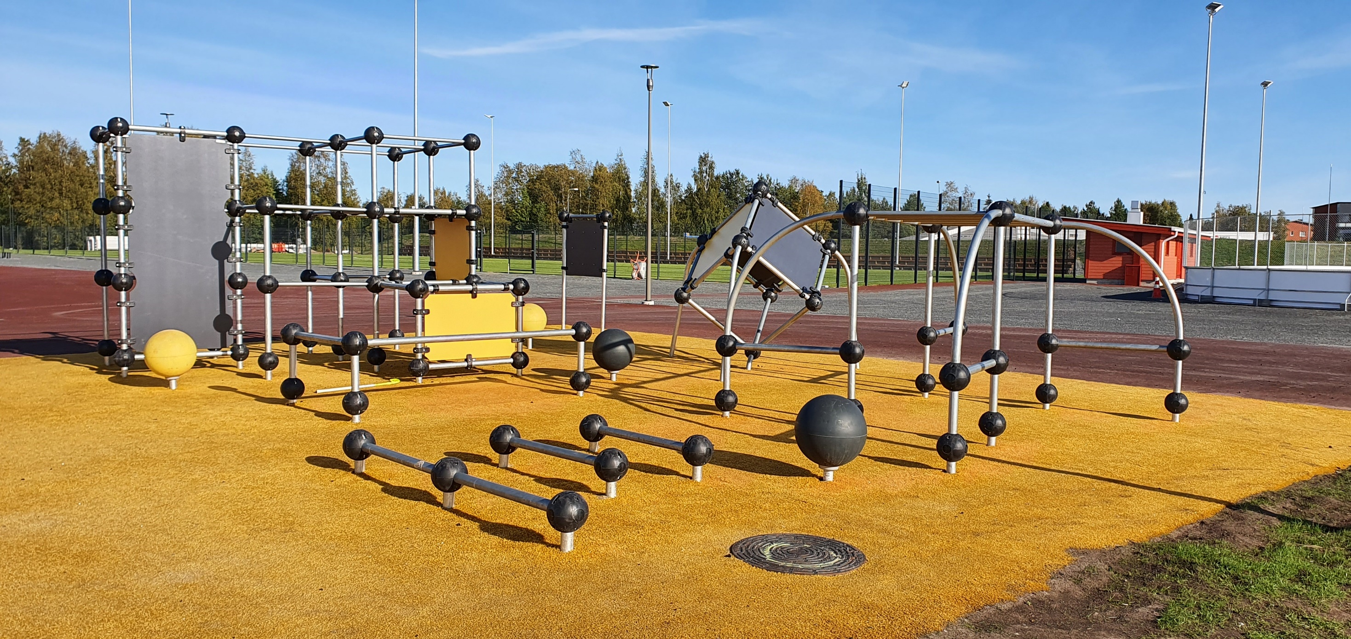
The school yard also serves as a local sports and recreation area.

Slide 9
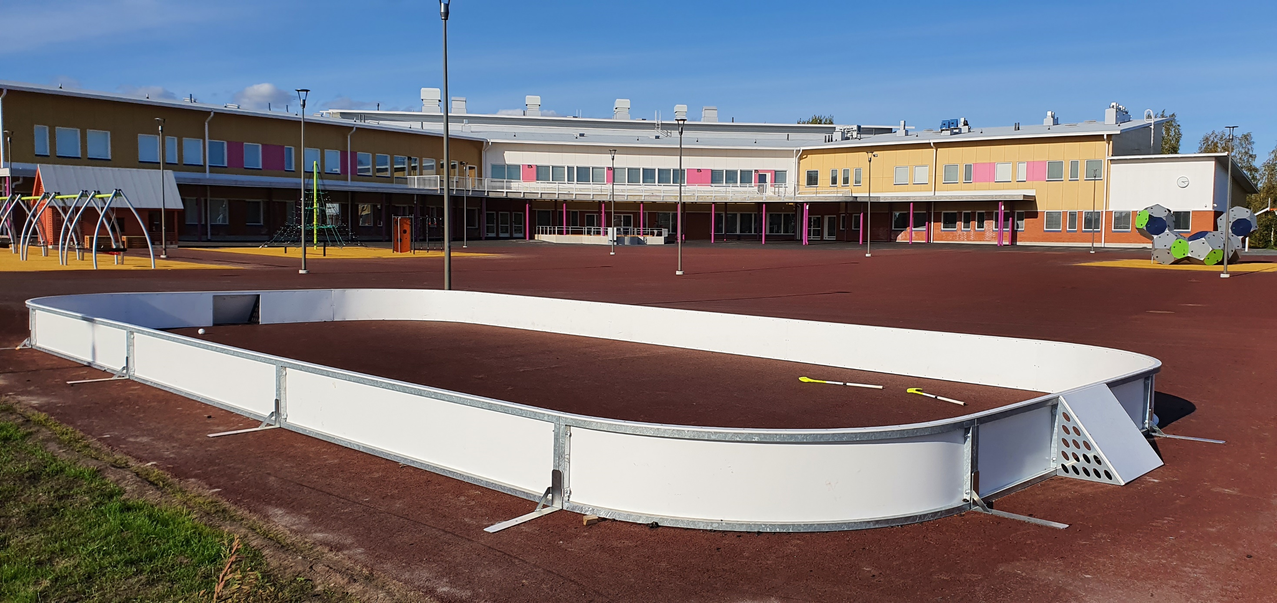

Slide 10
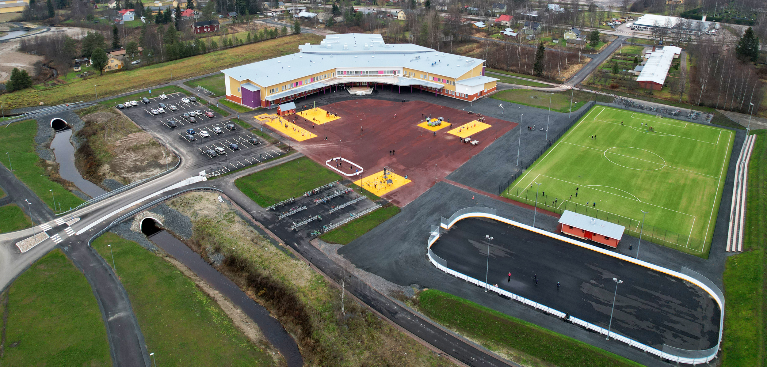
Kuva: Timo Muhonen, Kuvaverkko

Slide 11
Taanilan koulu
Goals and principles of our school:
Encourage collaboration and co-teaching
Boldly experiment with different pedagogical practices
Utilize new learning environments and modern audiovisual technology
Use positive pedagogy in all activities
Take into account the individual needs of pupils
Develop truly unified school model

Slide 12
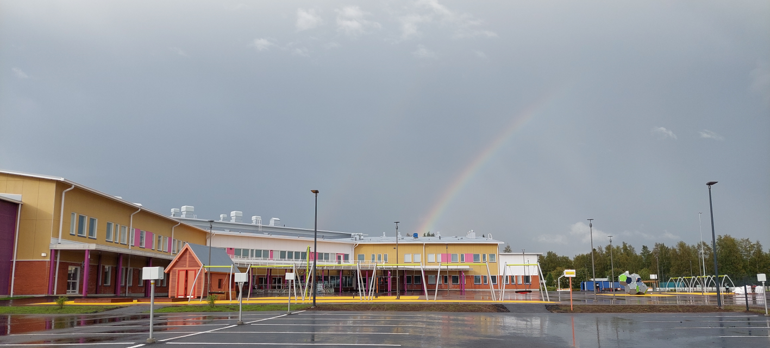
Principal Risto Oja Vice-principal Kari Krook

