Slide 1
Comenius Skills based learning
History, art and career projects
by Anttola Comprehensive School students 2013-2015

Slide 2
A project on cultural inheritance of Anttola village by 9th grade students

Slide 3
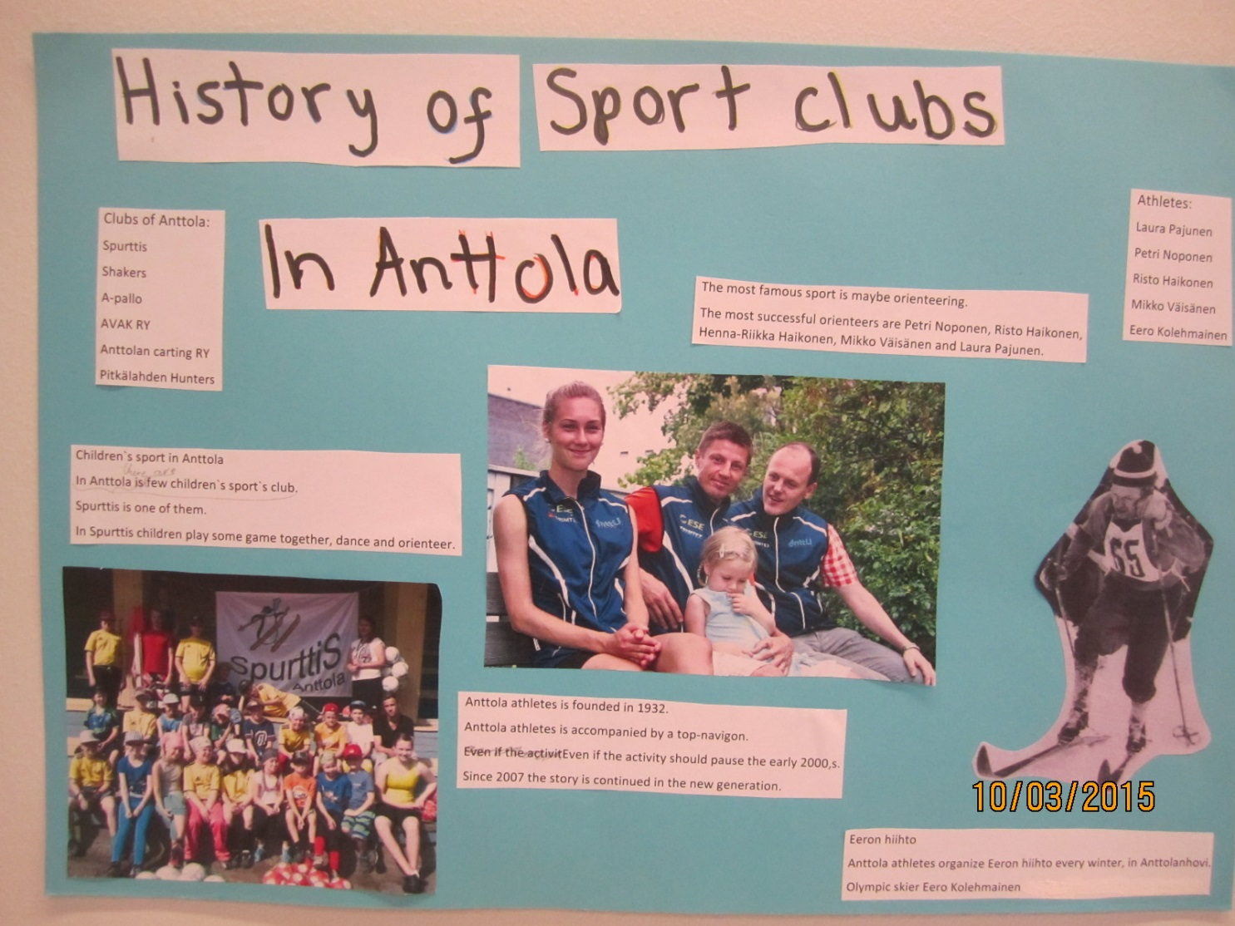
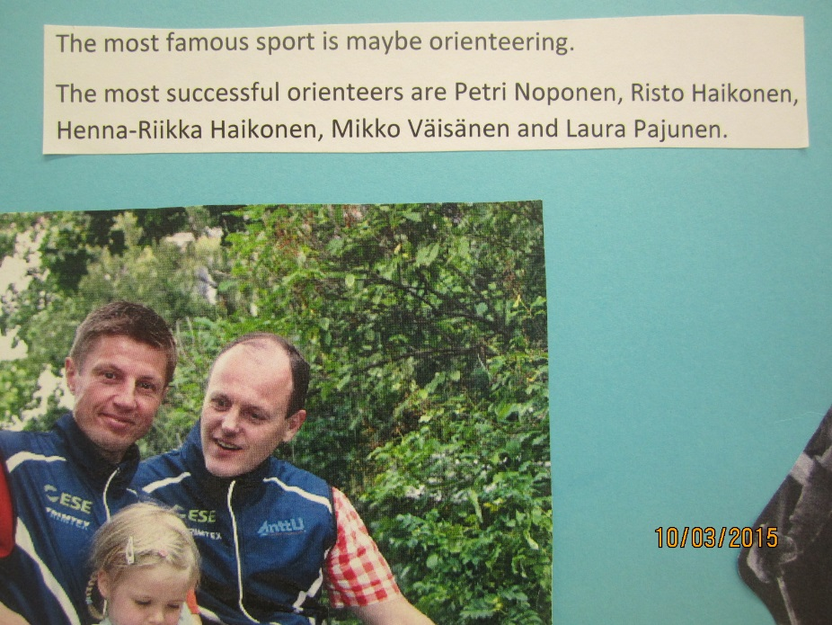
The history of sports clubs in Anttola by Miia, Santra and Riikka

Slide 4
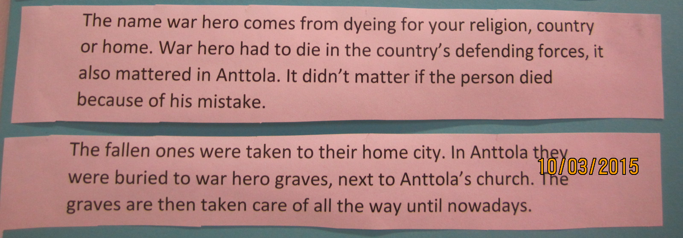
Anttola’s war heroes by Jonttu, Eeli and Oskari

Slide 5
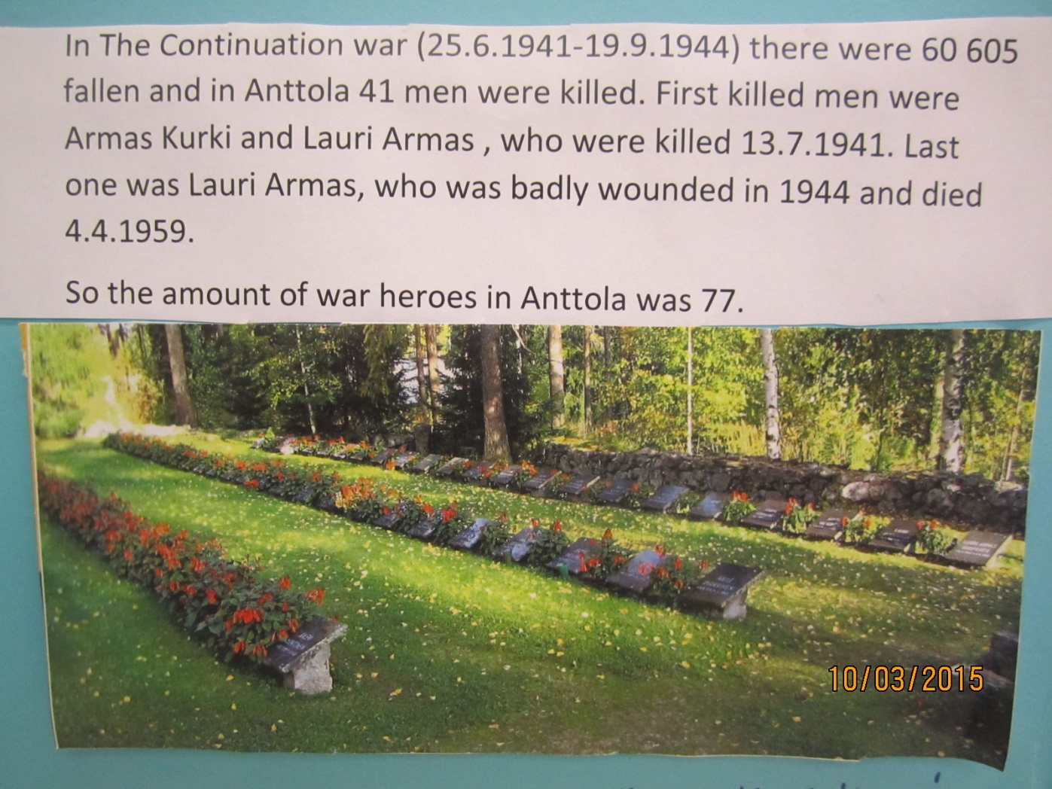
Anttola’s war heroes by Jonttu, Eeli and Oskari

Slide 6
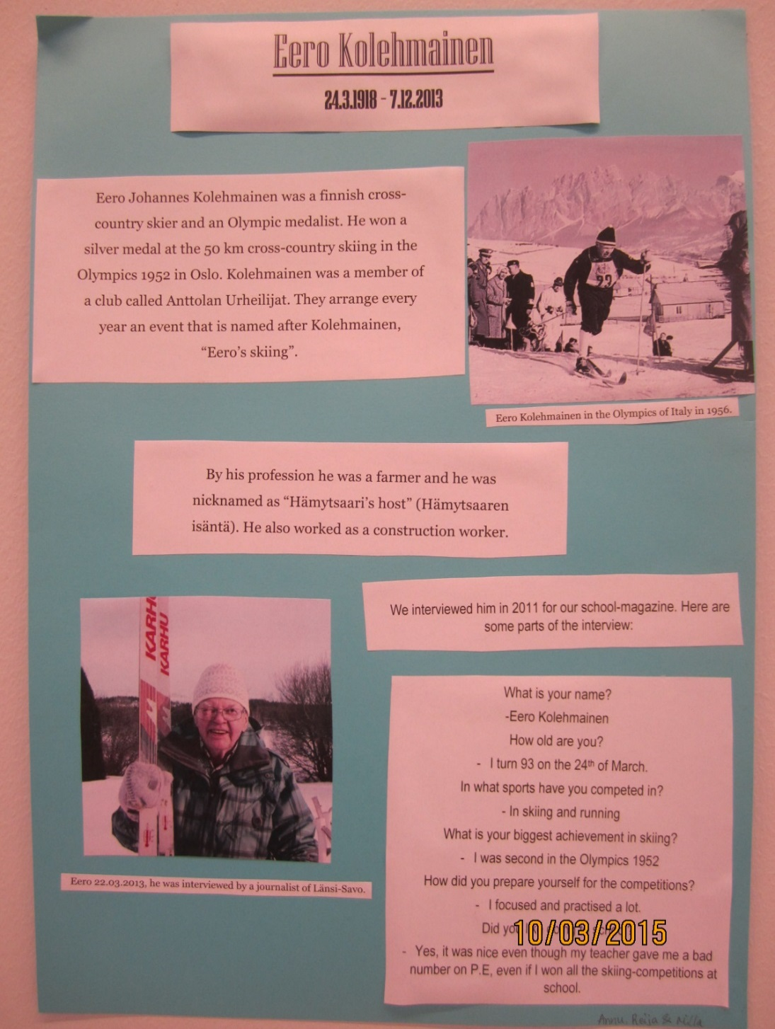
Eero Kolehmainen, a famous Finnish cross-country skier by Annu, Reija and Milla

Slide 7
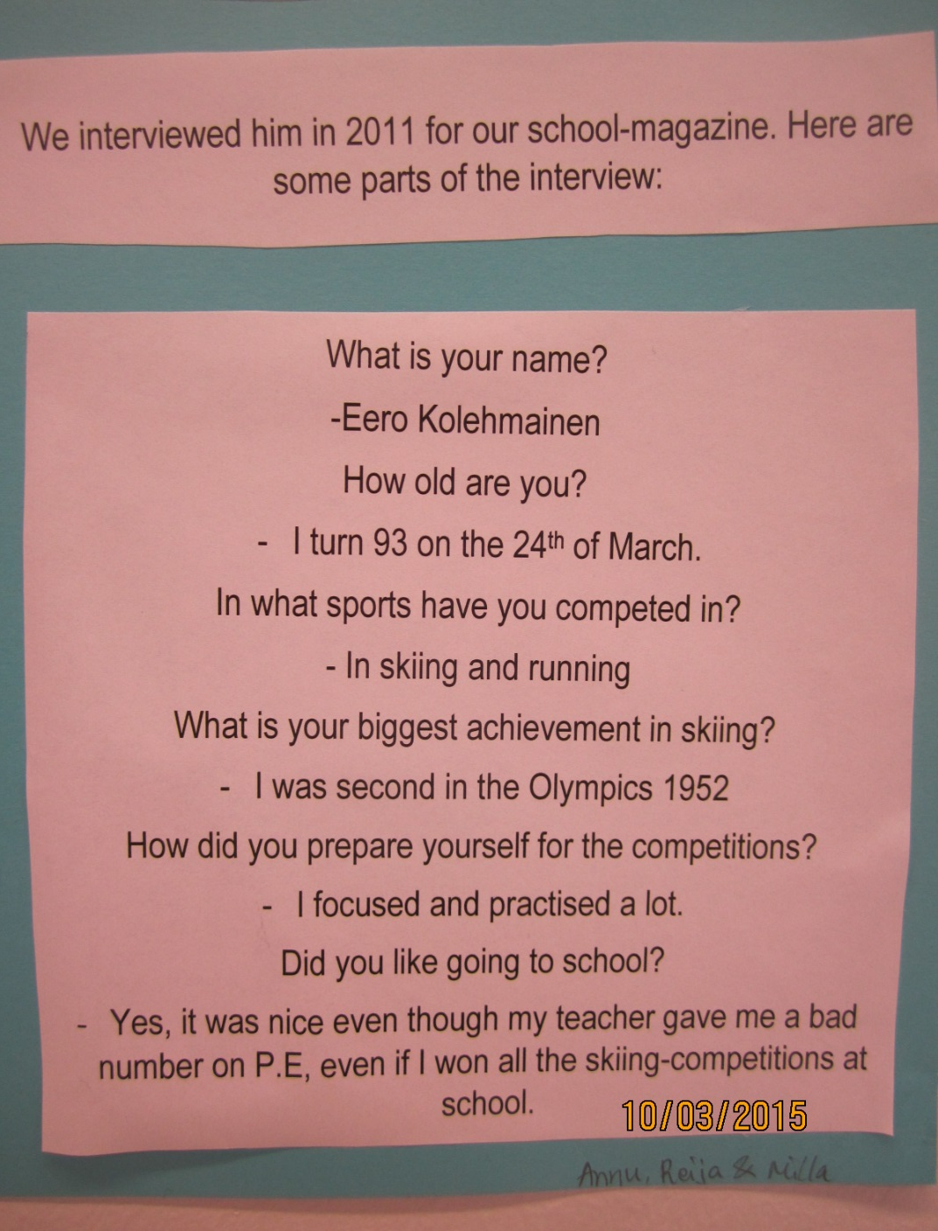
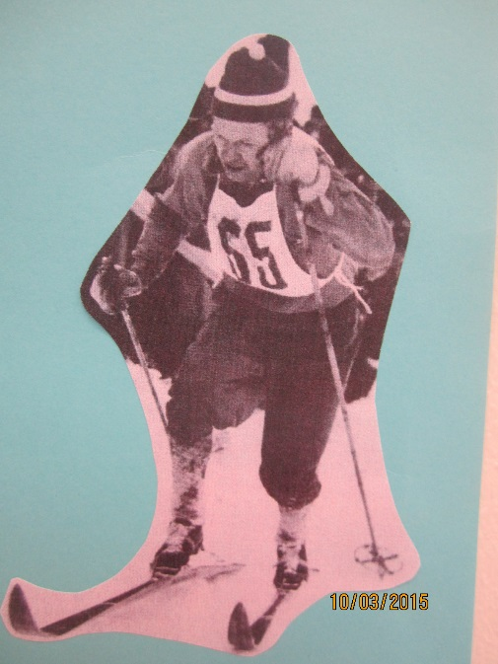
Eero Kolehmainen, a famous Finnish cross-country skier by Annu, Reija and Milla

Slide 8
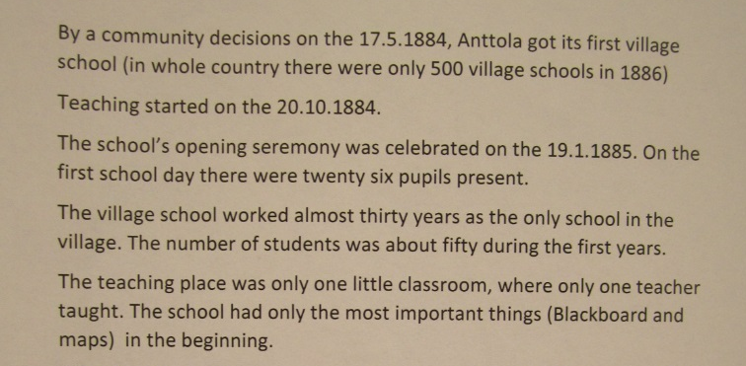
The history of Anttola school by Karri, Jani and Aatu

Slide 9
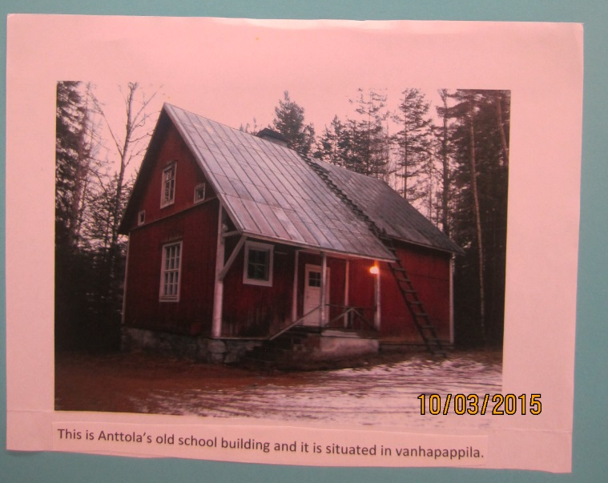
Anttola’s old school building

Slide 10
Important European Cities Art project by 6th grade students
The students learned about important European cities during art lessons. They searched for information about the cities and drew their own versions of buildings, statues and monuments. As technique they used dry pastel colours.

Slide 11
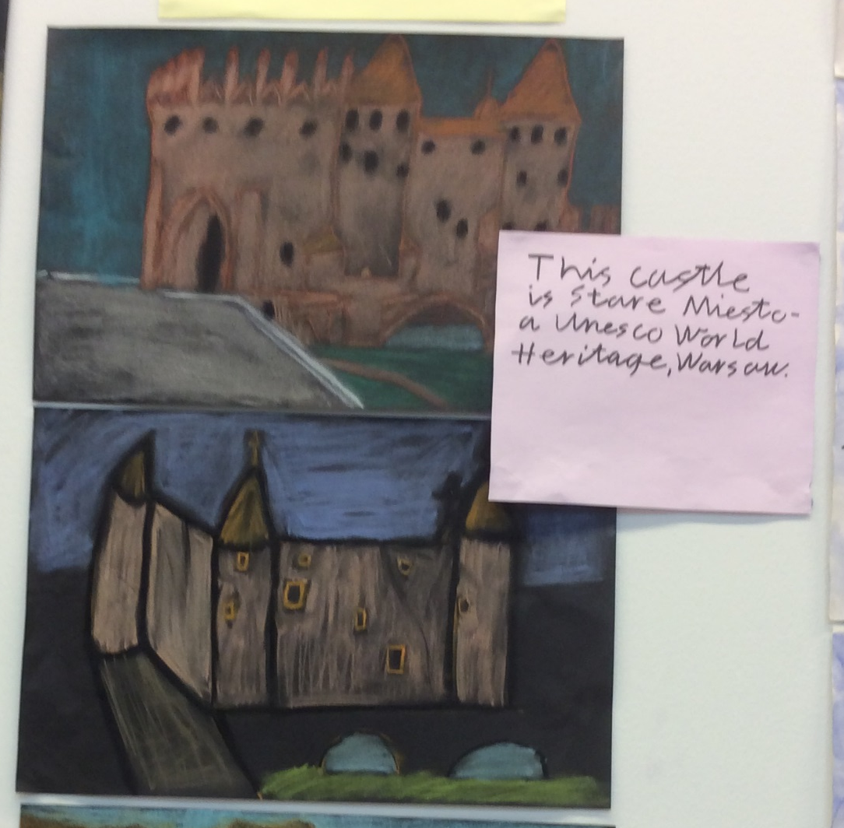
Warsaw

Slide 12
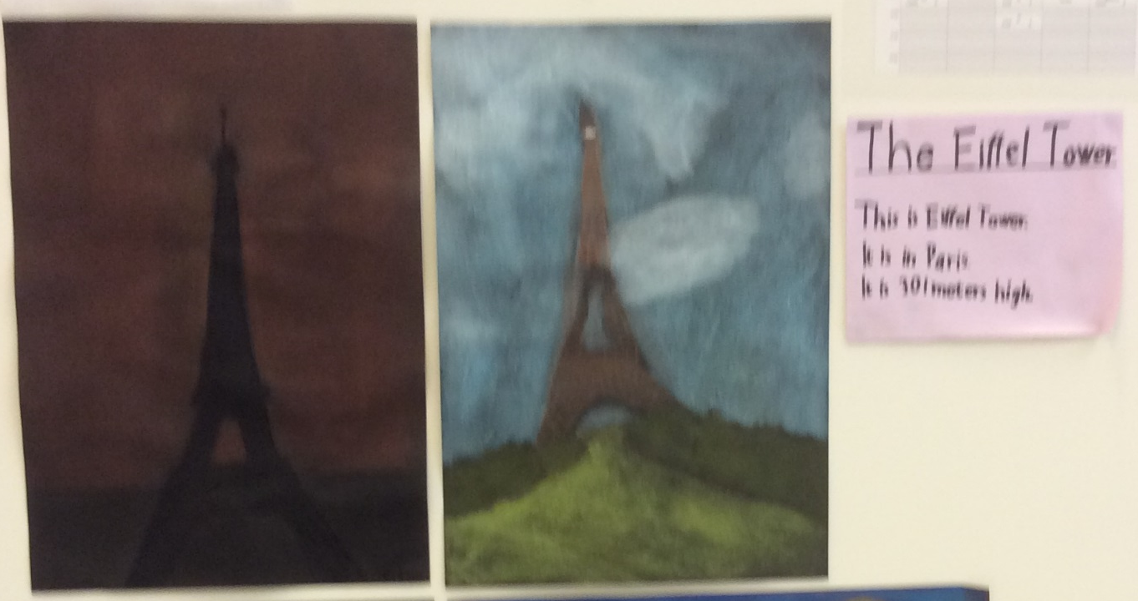

Paris

Slide 13
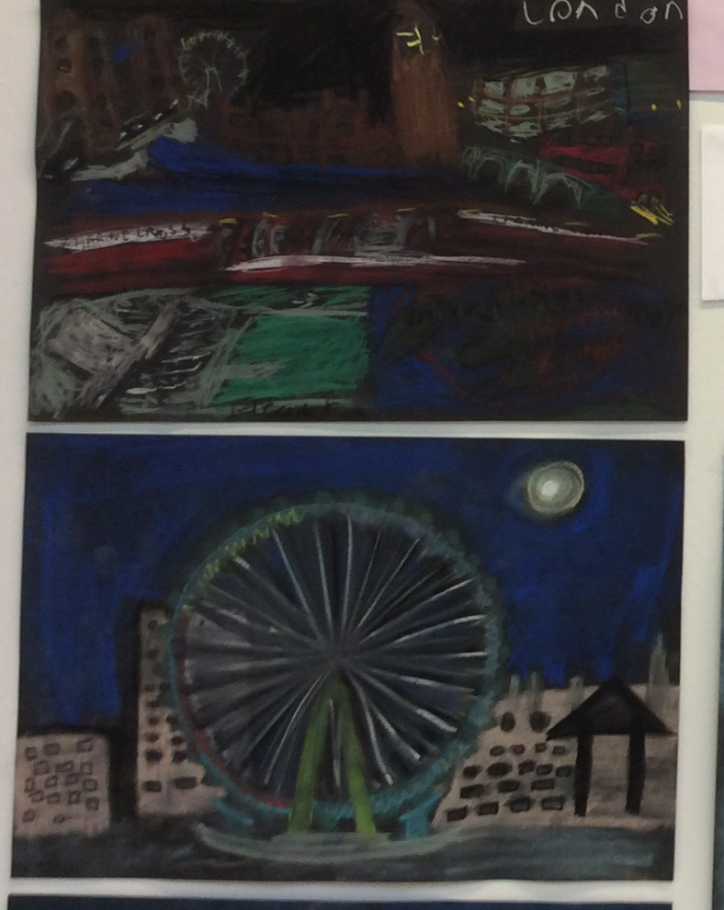

London

Slide 14
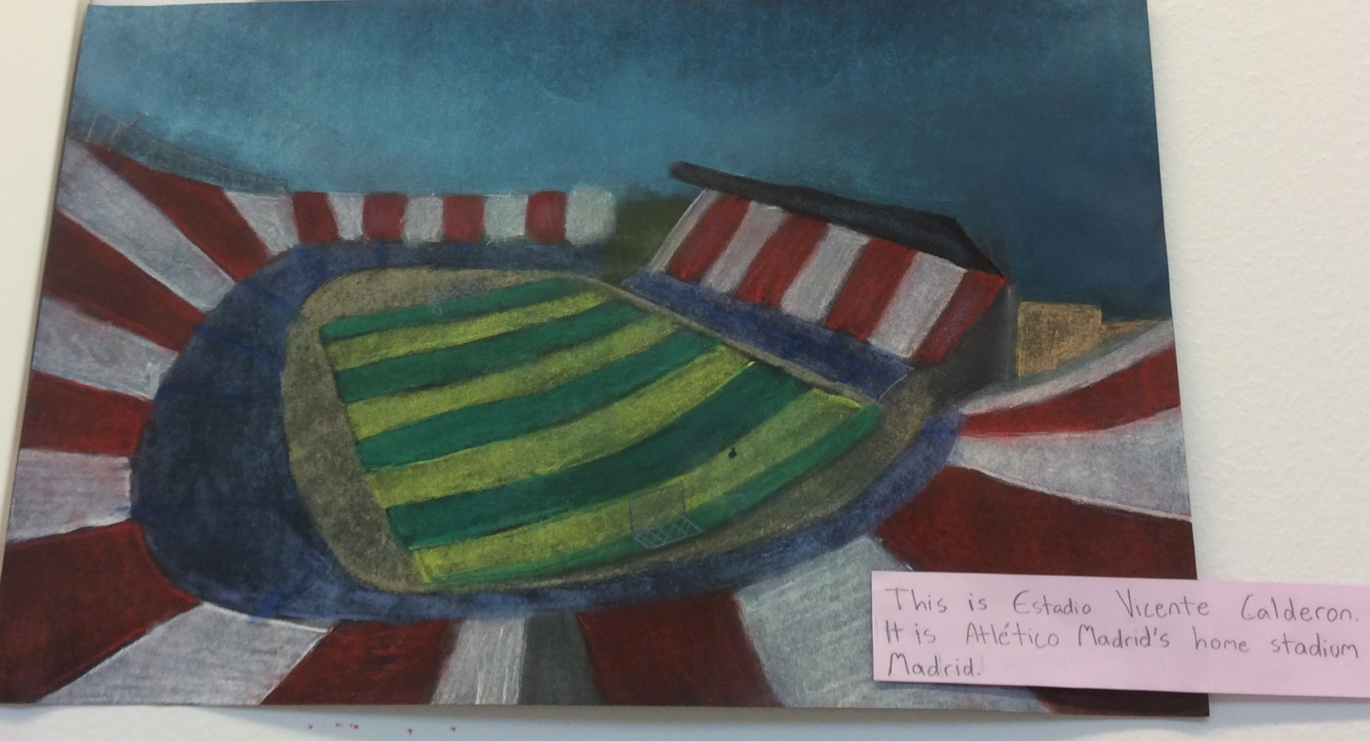
Madrid

Slide 15
Career Plans by 8th graders

Slide 16
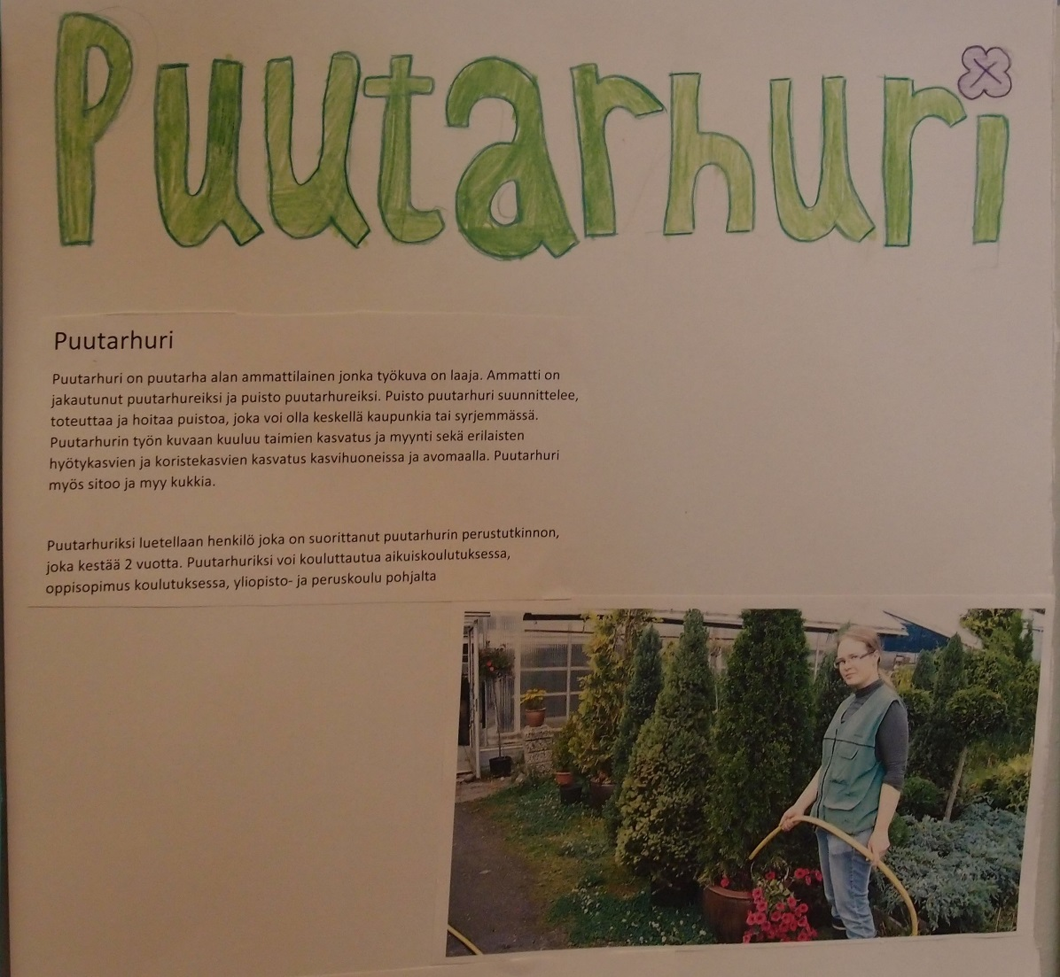
Gardener

Slide 17
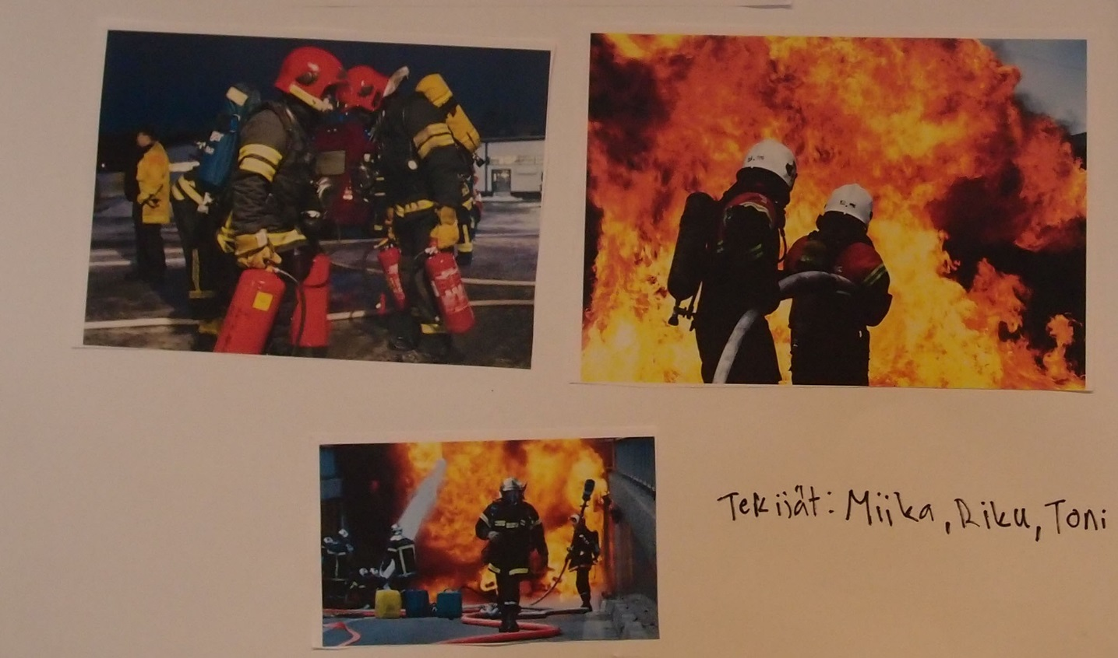
Fire fighter

Slide 18
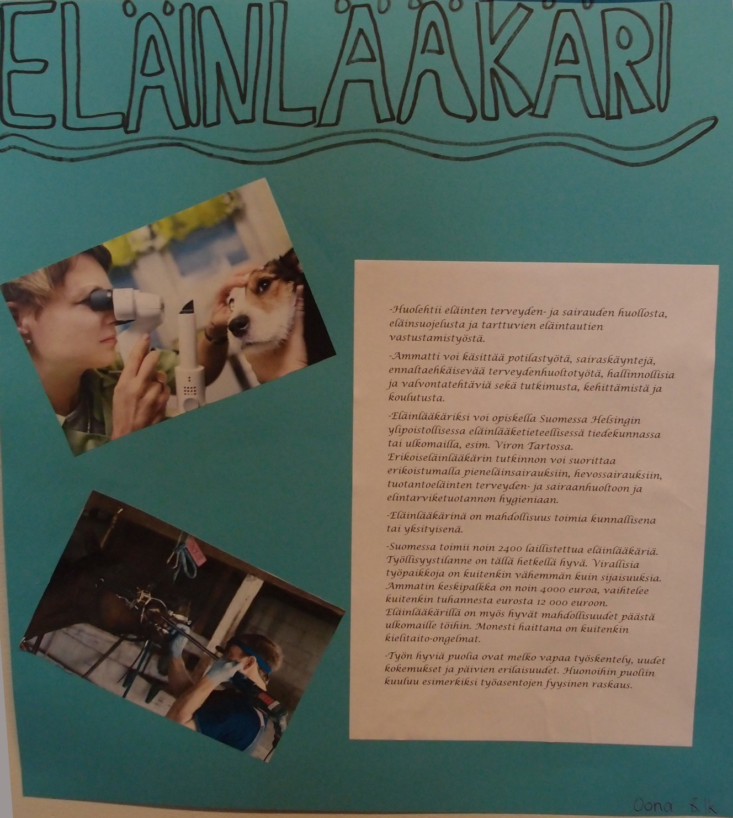
Vet

Slide 19
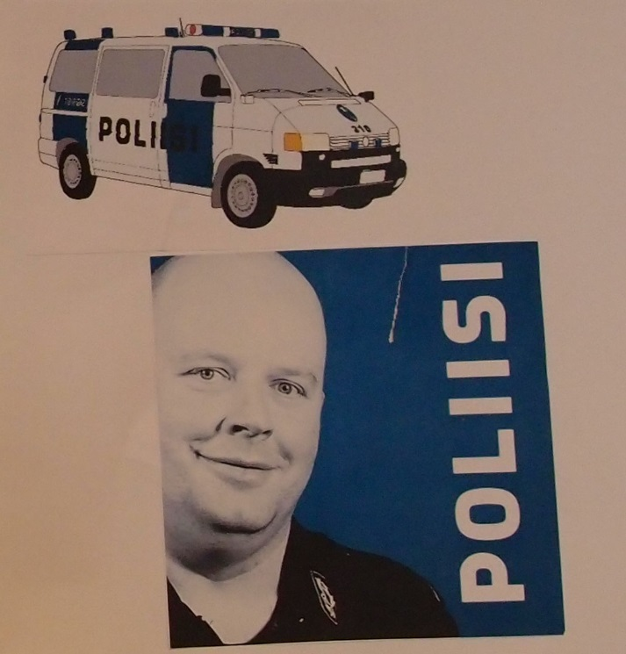
Police

Slide 20
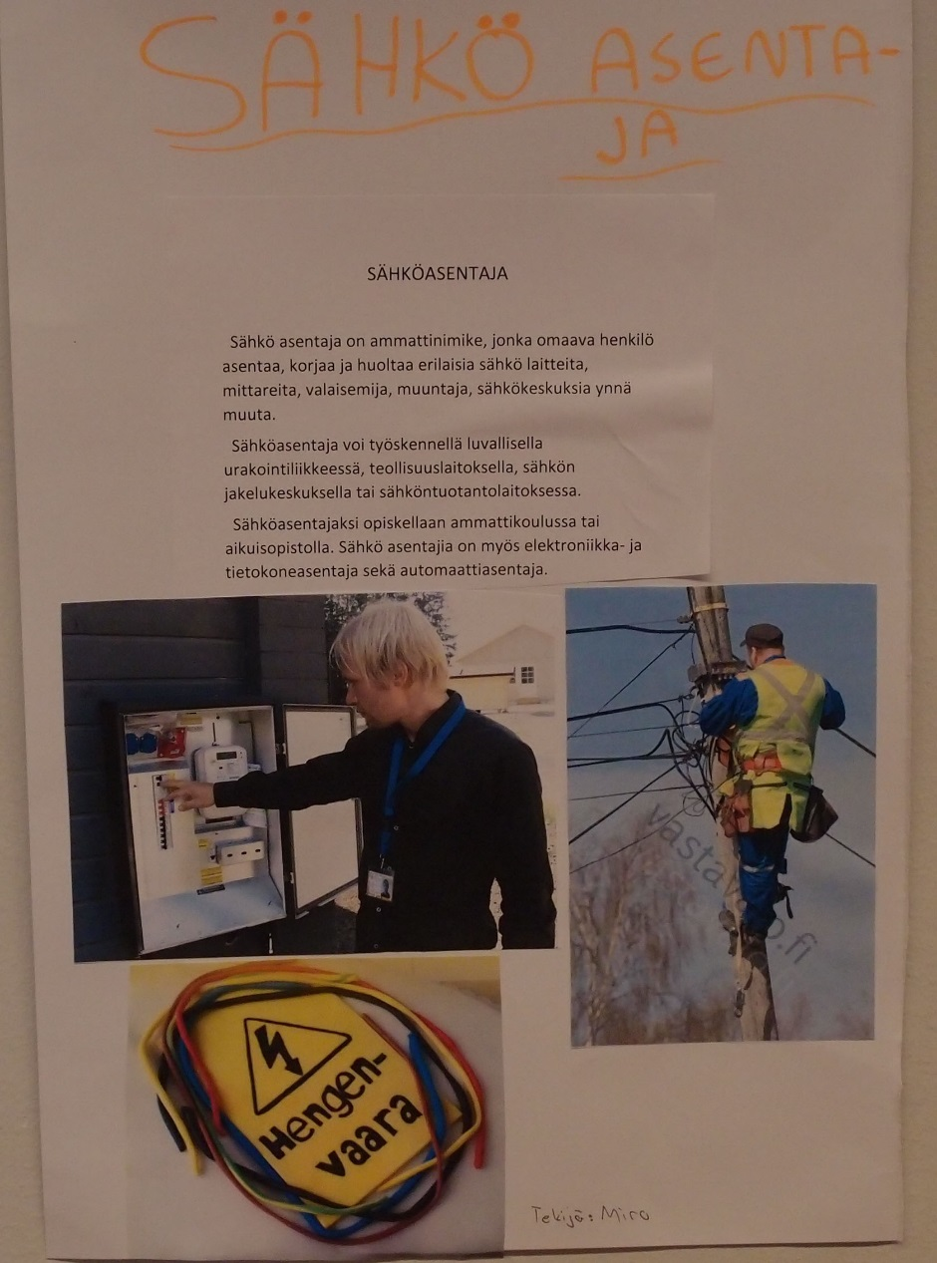
Electrician

Slide 21
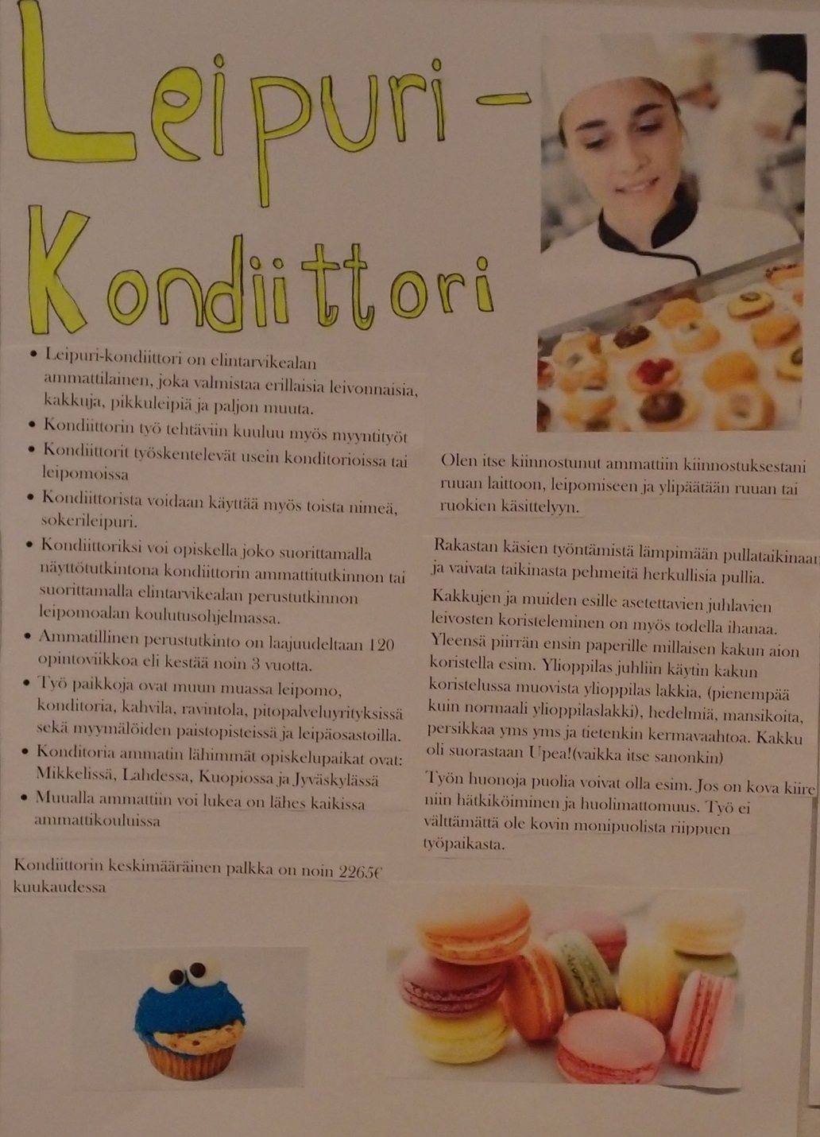
Baker

Slide 22
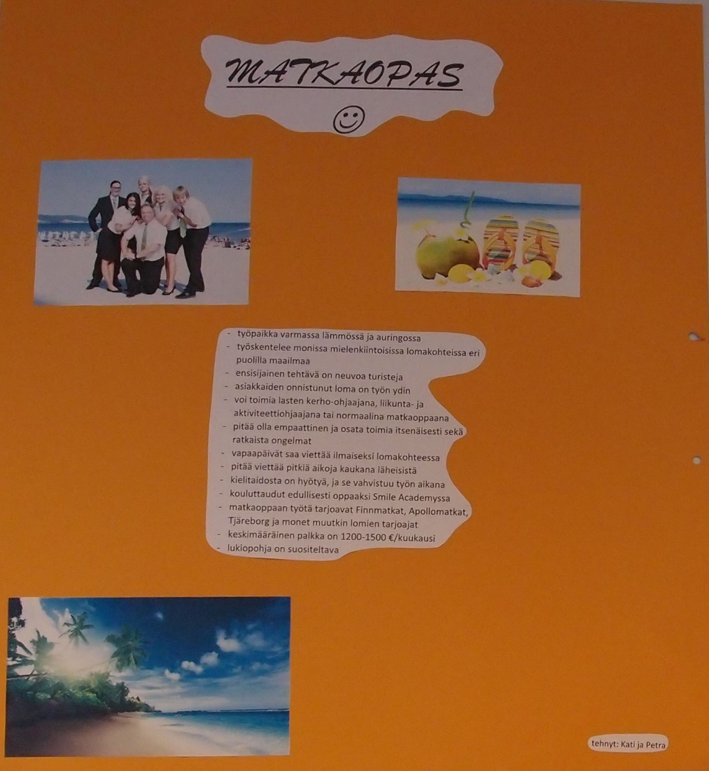
Guide

